Slide 2
XFOCE Website Reference Material
Spreadsheet
Estimation of Shallow-FOCE CO₂ enriched seawater release rate:
Assumptions:
 | 1. Shallow FOCE is smaller than FOCE at MARS by 1/2: 0.5m X 0.5m.
 | 2. Water velocity thru flume set as "on average" a 1 cm/s flow through chamber.
 |  | - residence time for a 1 meter length chamber is 100 secs.
 |  | - internal cyclic flow indiced by a paddle.
 |  | cm/sec | ht (m) | w (m)
 |  | 10 | 0.5 | 0.5 | 25 | L/s
 | 3. Concentration of CO2-ESW: |  |  | 40 | mM | pH: | 4.75
 | 4. FOCE uses different amounts of CO2 depending upon pH offset:
 |  |  |  |  | Vol CO2-ESW |  |  |  | Amt CO2
 |  | pH offset | +TCO2 | Amt CO2 | mL/s | L/min | L/day |  | kg/day | lb/day
 |  |  | μmol/kg | µmole/s
 |  | 0.2 | 74.5 | 1862.5 | 46.563 | 2.794 | 4023 |  | 7.082 | 15.61
 |  | 0.4 | 136.1 | 3402.5 | 85.062 | 5.104 | 7349 |  | 12.938 | 28.52
 |  | 0.8 | 257.3 | 6432.5 | 160.813 | 9.649 | 13894 |  | 24.459 | 53.92
 |  | 1.5 | 767.7 | 19192.5 | 479.813 | 28.789 | 41456 |  | 72.978 | 160.89

Slide 3
XFOCE Website Reference Material
Spreadsheet
 |  | FOCE Delay Section Lengths and Flow(Q)
Assumption for this version - pH delta of - 0.3, 10 deg. C, so 2 Tau ~ 135 seconds |  |  |  |  |  |  |  |  | 4/2/2012
 |  | -Ambient pH ~8.1
 |  | -Mixing Section is Round tubing or pipe
 |  | -Flow thru Test Section is the bulk (average) flow
INPUTS | 47.0 | cm, Height of Test Section |  |  |  | Note: swFOCE dim's Ht, W, L
 |  |  |  |  |  |  | 47cm,49cm, 2m
 | 49.0 | cm, Width of Test Section
 | 2.0 | meters, Length of Test Section
 | 2 | cm/second, Flow velocity in Test Section
 | 30.5 | cm, Diameter of Mixing Section tubing |  |  |  | 12.0 | inches
RESULTS | 2303.0 | cm sqd, Cross Sectional Area of Test Section
 | 730.2 | cm sqd, Cross Sectional Area of Mixing Section
 | 6.3 | cm/sec, Flow vel in mixing section
 | 8.5 | meters, Length of mixing section req'd for 2 Tau
 | 4.6 | Liters/sec, Quantity of S.W. req'd
 | 16582 | Liters/hr
 | 4381 | Gallons/hr
 | 100 | seconds, Residence Time in Test Section

Slide 4
Flow Rate of Stabilized Enriched Seawater Relative to Chamber Cross-Section and Internal Current Speed
XFOCE Website Reference Material
*Liters/minute (Gallons/minute)
Current Speed
Cross Section of Experiment Chamber | 2 cm/sec | 4 cm/sec | 6 cm /sec | 8 cm/sec | 10 cm/sec
.5 m x .5 m | 602 (159) | 1200 (317) | 1802 (476) | 2400 (634) | 3001 (793)
.25 m x .25 m | 299 (79) | 450 (119) | 901 (238) | 1200 (317) | 1503 (397)
.13 m x .13 m | 151 (40) | 299 (79) | 450 (119) | 598 (158) | 749 (198)
*3.785 liters = 1 gallon
NOTE: The relative cross-sectional areas of the time delay mixing section (provides
delivery of stabilized enriched seawater) and the experiment chamber must
be considered when desiring to minimize the time for stabilizing pH in the
chamber.

Slide 5
XFOCE Website Reference Material
Potential Polymer Materials for Large Panels
Polycarbonate-colored or clear
Nearly unbreakable
Scratch resistant
Relatively easy to fabricate
Excellent corrosion resistance
High notch sensitivity (crack propagation)
Difficult to saw
Visible light transmission good ~86%
Yellows when exposed to UV
Acrylic- colored or clear
Fair impact resistance
Excellent corrosion resistance
High notch sensitivity (crack propagation)
Difficult to work with
Requires non-solvent based cutting fluid during fabrication
Visible light transmission is very good, 92%
UV transmission falls off rapidly at ~350 nm
  G UVT formulation available with 275 nm cut-off
Less yellowing from UV
Easily bonded with methyl chloride, or Weld-On #16
PVC – pale blue or clear
Fair impact resistance
Fair notch sensitivity (crack propagation)
Good UV resistance
  Thicker materials retain resistance longer
  Starts to yellow over long term > 20 months
Good chemical resistance
Excellent corrosion resistance

Slide 6
Potential Materials and Components
p.2
XFOCE Website Reference Material
(Cont.)
If using an External Frame to support Panels:
FRP-fiber reinforced plastic (fiberglass)
  Easy to work with
  Available in many structural shapes
  Excellent for long term immersion
  Can dull cutting/boring tools quickly
  Does not hold threads well
  Sheet metal screws can be used in >.25“ thick materials.
6061 Aluminum
  Easy to work with
  Available in many structural shapes
  Corrosion issues when in contact with SS fasteners
    Insulating washers may be used
  Excellent for long term immersion
    Cathodic protection may be used
PVC - polyvinyl chloride
  Easy to work with
    Drilled and tapped easily
    Bonds well with adhesives
  Available in many structural shapes
  Clear version is UV resistant
    Angles used for reinforcing edges allow good passage of light
UHMW- ultra-high molecular weight polyethylene
  Easy to work with
  Common shapes are sheets, bars, rods
  Lower specific gravity than seawater
  Black formulation precludes light but is UV resistant
COMPONENTS
LATCHES
  Must be sturdy
  Corrosion resistant
  Easily operated by diver with gloves on
  Commercially available
    Cabinet type, SS
    Block and pin, plastic or SS
  Custom Design
    Cam lock, single or paired
    Other
HINGES
Must be sturdy, corrosion resistant
-piano type, SS
-solid rubber, 1/8-1/4” thick, screwed in with facing plate
FASTENERS
Use stainless steel
  316 is preferable, 18-8 is acceptable

Slide 7
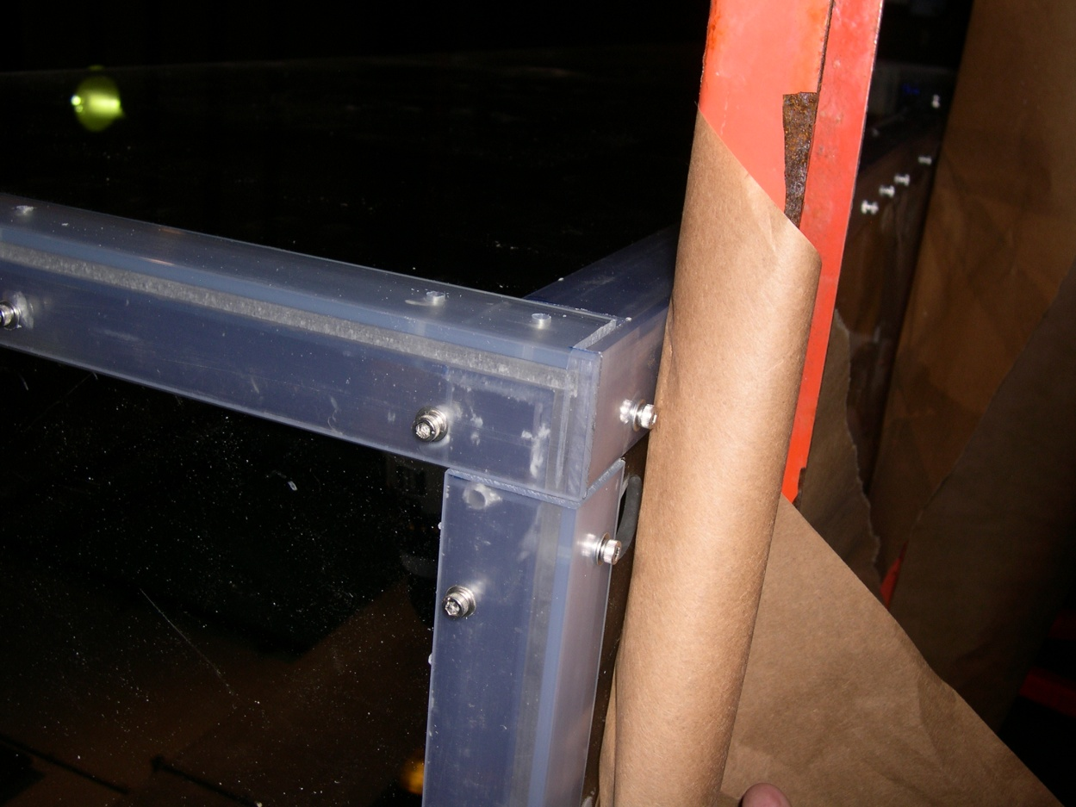
Proven Fabrication Methods
XFOCE Website Reference Material
Outer Angle
Inner Angle
Wall
Clearance
Outer Angle
Wall
Threaded
Inner Angle
Fastening Angles for Stiffness
Use of appropriate materials will maximize light
transmission into the test chamber.
-1/4” Clear Acrylic Panels
-3/16” x 1.5” x 1.5” clear PVC angle used as outside support structure.
-3/16” x1.25” x1.25” clear PVC used inside.
-8-32 x 5/8” screws tapped into inner PVC pieces, 6” Center to Center.
FABRICATION Note: Drilling holes in plastics, polycarbonate and especially acrylic can be difficult because the drill tends to grab and “dig” into the material. Modify the cutting edge of the drill’s flutes by filing or sanding the cutting edge to a more vertical “scraping” edge (i.e. perpendicular to the surface being cut). Keep it sharp and a very nice hole without breakout on the back surface will result.

Slide 8
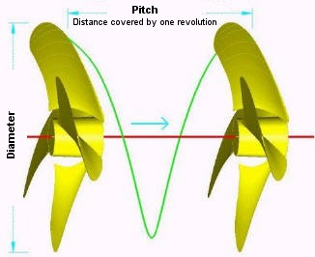
XFOCE Website Reference Material
Custom Thruster using Propellor and Motor
Disk Theory for Moving Water
Ppropellor x RPM x Areapropellor / 100 = Volumewater / minute
Where:
* Ppropellor = Propellor Pitch (cm.)
RPM = Revolutions per minute
Areapropellor = Area of the diameter projected by rotated propellor (cm. sq.)
Volumewater = volume of water moved by propellor (liters)
Equation for motor H.P. Requirement
HP = (psi x GPM) / (1714 x efficiencyMotor)
*NOTE: Pitch is defined as "the distance a propellor would move in one revolution
if it were moving through a soft solid, like a screw through wood." For example,
a 21-pitch propellor would move forward 21 inches (53.3 cm) in one revolution.

Slide 9
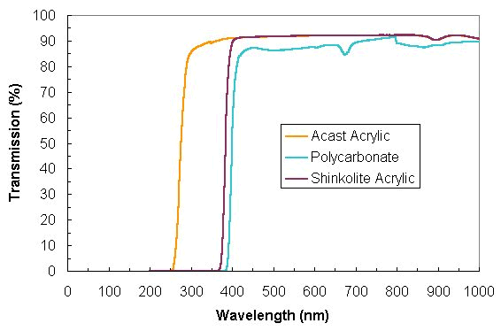
XFOCE Website Reference Material
Light Transmission through
Polycarbonate and Acrylic

Slide 10
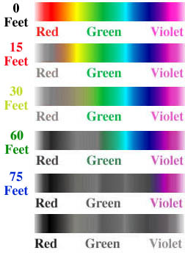
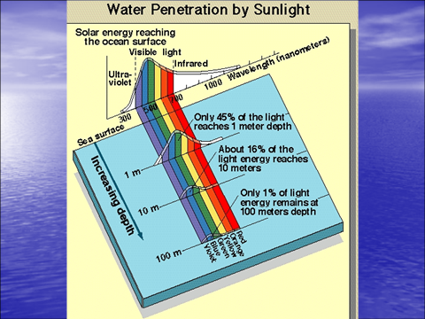
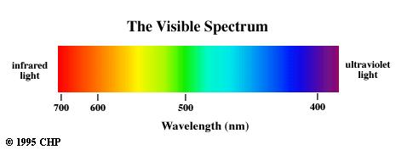
400nm through 700 nm
XFOCE Website Reference Material
Photosynthetically Active Radiation (PAR)
(0 Meters)
(4.6 Meters)
(9.1 Meters)
(18.3 Meters)
(22.9 Meters)

