Slide 1

Permits at Every Level
From earliest meetings with COS & Hopkins, realized permitting was a significant hurdle to overcome.
Brock Woodson initially procured permit from Monterey Bay Sanctuary to install cable
Innovative work, like SW-FOCE, would require the involvement of multiple regulatory agencies
  Monterey Bay National Marine Sanctuary
  California Coastal Commission
  California Department of Fish & Game
  Central Coast Regional Water Quality Control Board
  City of Pacific Grove

Slide 2
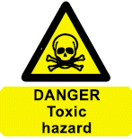
Permitting Issues: cont’d
CO₂ impacts in the ocean poorly understood
  Experimental releases considered “toxic waste”
  Inform agency staff (and public) about FOCE experiments
Notes:
SCUBA equivalents: CO2 release in one SW-FOCE chamber for 1 day would = 4 people breathing (all day)
35 SCUBA man-hours
The CO2 produced by burning 0.42 gallons of gasoline
The CO2 produced by burning 0.38 gallons of diesel fuel
Reduce words
Education about ocean acidification processes occurring today and why research extremely important
Understanding scale: Created comparison examples that could be understood by general public (e.g., SCUBA diver and motor boat equivalents)
Process much easier when agency staff understood the chemistry
Deep FOCE: MBARI was recently granted an increase of CO2 release to 400L per year. The maximum quantities the research team foresees using are far below the CO₂ distributed into Monterey Bay by other methods. To demonstrate just how minor this amount of liquid CO₂ is in the big picture, Jim Barry provided calculations estimating the amount of liquid CO₂ released by one motorized boat operating in the bay. Assuming the boat has an approximately 150-horsepower motor, running at 12 gallons per hour, it will release approximately1800 L of liquid CO₂ per 8-hour-day.

Slide 3
Permitting Issues: cont’d
Inconsistent or lack of permit process
  Every agency has different process
  First research project request in recently established MPA, as well as Area of Special Biological Significance
Notes:
Agency staff didn’t know how to move forward with applications because a process had not been determined even though regulations had gone into effect

Slide 4
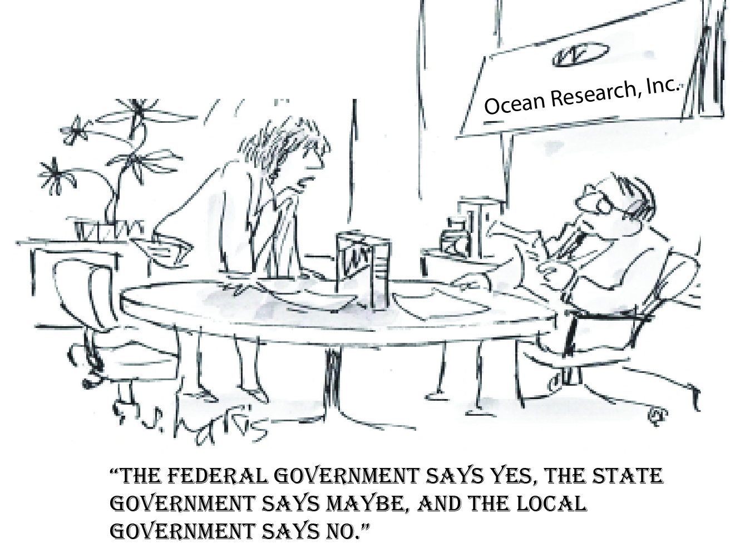
Permitting Issues: cont’d
Inter-Agency Interactions
  Each agency regulating different aspects of project
  Order of response from agencies
  Project exposed shortcomings in permitting process among multiple agencies
  Agency staff understand their respective agency permitting shortcomings due to recent changes in regulations
Notes:
Each agency regulating different aspects of project so there is increased potential for conflicting opinions on project impacts and mitigation measures (e.g., use of local vs. non-local populations for perturbation experiments.
Depending on the project, each agency has a system of waiting for another agency to make a determination first before issuing their own authorization. Staff got creative with how to deal with this, but acknowledged system needed refining.

Slide 5
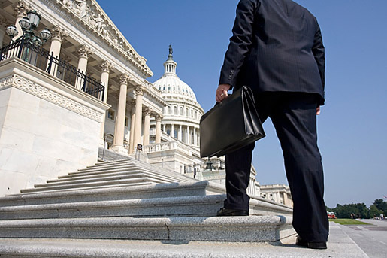
How to Move Forward -
Get an Advocate
Peter Brewer met with Governor Brown
Meg Caldwell helped streamline the process with two key State agencies (CCC & CDFG) through discussions with high level personnel
Notes:
May want to move details of permitting to appendix

