Slide 1
FOCE Review Appendix
Permitting Topics

Slide 2

Permits at Every Level
From earliest meetings with COS & Hopkins, realized permitting was a significant hurdle to overcome.
Brock Woodson initially procured permit from Monterey Bay Sanctuary to install cable
Innovative work, like SW-FOCE, would require the involvement of multiple regulatory agencies
  Monterey Bay National Marine Sanctuary
  California Coastal Commission
  California Department of Fish & Game
  Central Coast Regional Water Quality Control Board
  City of Pacific Grove

Slide 3

Permitting Issues: cont’d
CO₂ impacts in the ocean poorly understood
  Experimental releases considered “toxic waste”
  Inform agency staff (and public) about FOCE experiments
Notes:
SCUBA equivalents: CO2 release in one SW-FOCE chamber for 1 day would = 4 people breathing (all day)
35 SCUBA man-hours
The CO2 produced by burning 0.42 gallons of gasoline
The CO2 produced by burning 0.38 gallons of diesel fuel
Reduce words
Education about ocean acidification processes occurring today and why research extremely important
Understanding scale: Created comparison examples that could be understood by general public (e.g., SCUBA diver and motor boat equivalents)
Process much easier when agency staff understood the chemistry
Deep FOCE: MBARI was recently granted an increase of CO2 release to 400L per year. The maximum quantities the research team foresees using are far below the CO₂ distributed into Monterey Bay by other methods. To demonstrate just how minor this amount of liquid CO₂ is in the big picture, Jim Barry provided calculations estimating the amount of liquid CO₂ released by one motorized boat operating in the bay. Assuming the boat has an approximately 150-horsepower motor, running at 12 gallons per hour, it will release approximately1800 L of liquid CO₂ per 8-hour-day.

Slide 4
Permitting Issues: cont’d
Inconsistent or lack of permit process
  Every agency has different process
  First research project request in recently established MPA, as well as Area of Special Biological Significance
Notes:
Agency staff didn’t know how to move forward with applications because a process had not been determined even though regulations had gone into effect

Slide 5
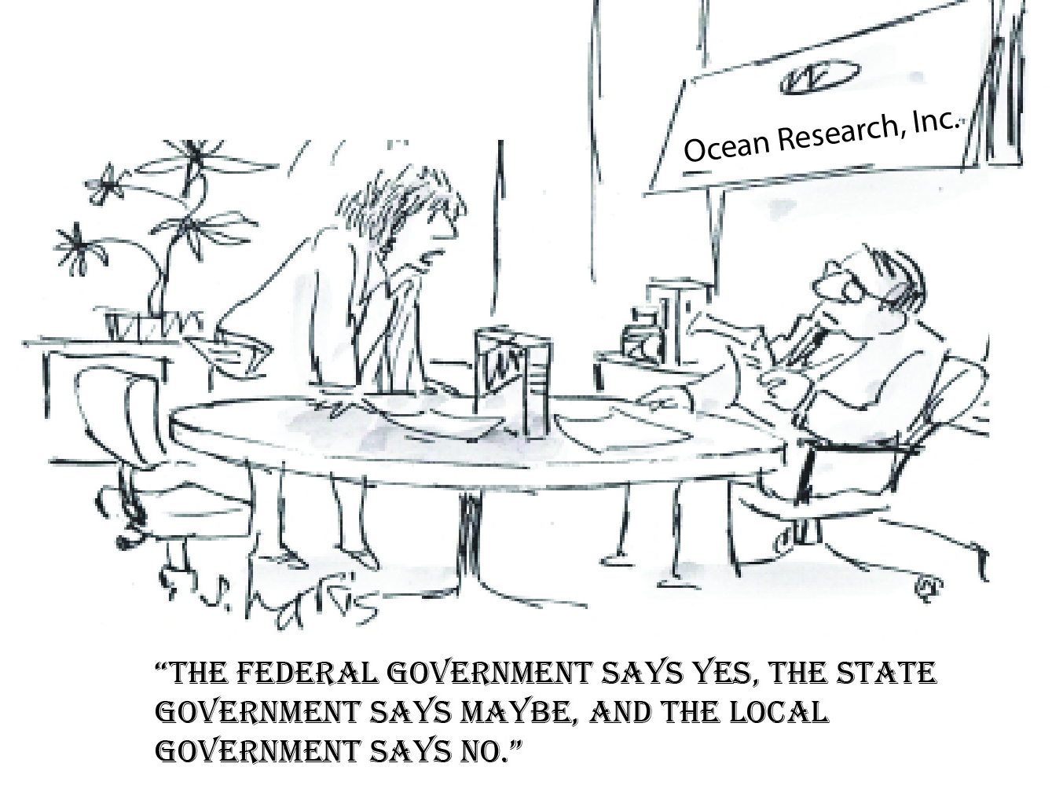
Permitting Issues: cont’d
Inter-Agency Interactions
  Each agency regulating different aspects of project
  Order of response from agencies
  Project exposed shortcomings in permitting process among multiple agencies
  Agency staff understand their respective agency permitting shortcomings due to recent changes in regulations
Notes:
Each agency regulating different aspects of project so there is increased potential for conflicting opinions on project impacts and mitigation measures (e.g., use of local vs. non-local populations for perturbation experiments.
Depending on the project, each agency has a system of waiting for another agency to make a determination first before issuing their own authorization. Staff got creative with how to deal with this, but acknowledged system needed refining.

Slide 6

How to Move Forward -
Get an Advocate
Peter Brewer met with Governor Brown
Meg Caldwell helped streamline the process with two key State agencies (CCC & CDFG) through discussions with high level personnel
Notes:
May want to move details of permitting to appendix

Slide 7
FOCE Review Appendix
Mechanical Topics

Slide 8
XFOCE Website Reference Material
Spreadsheet
Estimation of Shallow-FOCE CO₂ enriched seawater release rate:
Assumptions:
 | 1. Shallow FOCE is smaller than FOCE at MARS by 1/2: 0.5m X 0.5m.
 | 2. Water velocity thru flume set as "on average" a 1 cm/s flow through chamber.
 |  | - residence time for a 1 meter length chamber is 100 secs.
 |  | - internal cyclic flow indiced by a paddle.
 |  | cm/sec | ht (m) | w (m)
 |  | 10 | 0.5 | 0.5 | 25 | L/s
 | 3. Concentration of CO2-ESW: |  |  | 40 | mM | pH: | 4.75
 | 4. FOCE uses different amounts of CO2 depending upon pH offset:
 |  |  |  |  | Vol CO2-ESW |  |  |  | Amt CO2
 |  | pH offset | +TCO2 | Amt CO2 | mL/s | L/min | L/day |  | kg/day | lb/day
 |  |  | μmol/kg | µmole/s
 |  | 0.2 | 74.5 | 1862.5 | 46.563 | 2.794 | 4023 |  | 7.082 | 15.61
 |  | 0.4 | 136.1 | 3402.5 | 85.062 | 5.104 | 7349 |  | 12.938 | 28.52
 |  | 0.8 | 257.3 | 6432.5 | 160.813 | 9.649 | 13894 |  | 24.459 | 53.92
 |  | 1.5 | 767.7 | 19192.5 | 479.813 | 28.789 | 41456 |  | 72.978 | 160.89

Slide 9
XFOCE Website Reference Material
Spreadsheet
 |  | FOCE Delay Section Lengths and Flow(Q)
Assumption for this version - pH delta of - 0.3, 10 deg. C, so 2 Tau ~ 135 seconds |  |  |  |  |  |  |  |  | 4/2/2012
 |  | -Ambient pH ~8.1
 |  | -Mixing Section is Round tubing or pipe
 |  | -Flow thru Test Section is the bulk (average) flow
INPUTS | 47.0 | cm, Height of Test Section |  |  |  | Note: swFOCE dim's Ht, W, L
 |  |  |  |  |  |  | 47cm,49cm, 2m
 | 49.0 | cm, Width of Test Section
 | 2.0 | meters, Length of Test Section
 | 2 | cm/second, Flow velocity in Test Section
 | 30.5 | cm, Diameter of Mixing Section tubing |  |  |  | 12.0 | inches
RESULTS | 2303.0 | cm sqd, Cross Sectional Area of Test Section
 | 730.2 | cm sqd, Cross Sectional Area of Mixing Section
 | 6.3 | cm/sec, Flow vel in mixing section
 | 8.5 | meters, Length of mixing section req'd for 2 Tau
 | 4.6 | Liters/sec, Quantity of S.W. req'd
 | 16582 | Liters/hr
 | 4381 | Gallons/hr
 | 100 | seconds, Residence Time in Test Section

Slide 10
Flow Rate of Stabilized Enriched Seawater Relative to Chamber Cross-Section and Internal Current Speed
XFOCE Website Reference Material
*Liters/minute (Gallons/minute)
Current Speed
Cross Section of Experiment Chamber | 2 cm/sec | 4 cm/sec | 6 cm /sec | 8 cm/sec | 10 cm/sec
.5 m x .5 m | 602 (159) | 1200 (317) | 1802 (476) | 2400 (634) | 3001 (793)
.25 m x .25 m | 299 (79) | 450 (119) | 901 (238) | 1200 (317) | 1503 (397)
.13 m x .13 m | 151 (40) | 299 (79) | 450 (119) | 598 (158) | 749 (198)
*3.785 liters = 1 gallon
NOTE: The relative cross-sectional areas of the time delay mixing section (provides
delivery of stabilized enriched seawater) and the experiment chamber must
be considered when desiring to minimize the time for stabilizing pH in the
chamber.

Slide 11
XFOCE Website Reference Material
Potential Polymer Materials for Large Panels
Polycarbonate-colored or clear
Nearly unbreakable
Scratch resistant
Relatively easy to fabricate
Excellent corrosion resistance
High notch sensitivity (crack propagation)
Difficult to saw
Visible light transmission good ~86%
Yellows when exposed to UV
Acrylic- colored or clear
Fair impact resistance
Excellent corrosion resistance
High notch sensitivity (crack propagation)
Difficult to work with
Requires non-solvent based cutting fluid during fabrication
Visible light transmission is very good, 92%
UV transmission falls off rapidly at ~350 nm
  G UVT formulation available with 275 nm cut-off
Less yellowing from UV
Easily bonded with methyl chloride, or Weld-On #16
PVC – pale blue or clear
Fair impact resistance
Fair notch sensitivity (crack propagation)
Good UV resistance
  Thicker materials retain resistance longer
  Starts to yellow over long term > 20 months
Good chemical resistance
Excellent corrosion resistance

Slide 12
Potential Materials and Components
p.2
XFOCE Website Reference Material
(Cont.)
If using an External Frame to support Panels:
FRP-fiber reinforced plastic (fiberglass)
  Easy to work with
  Available in many structural shapes
  Excellent for long term immersion
  Can dull cutting/boring tools quickly
  Does not hold threads well
  Sheet metal screws can be used in >.25“ thick materials.
6061 Aluminum
  Easy to work with
  Available in many structural shapes
  Corrosion issues when in contact with SS fasteners
    Insulating washers may be used
  Excellent for long term immersion
    Cathodic protection may be used
PVC - polyvinyl chloride
  Easy to work with
    Drilled and tapped easily
    Bonds well with adhesives
  Available in many structural shapes
  Clear version is UV resistant
    Angles used for reinforcing edges allow good passage of light
UHMW- ultra-high molecular weight polyethylene
  Easy to work with
  Common shapes are sheets, bars, rods
  Lower specific gravity than seawater
  Black formulation precludes light but is UV resistant
COMPONENTS
LATCHES
  Must be sturdy
  Corrosion resistant
  Easily operated by diver with gloves on
  Commercially available
    Cabinet type, SS
    Block and pin, plastic or SS
  Custom Design
    Cam lock, single or paired
    Other
HINGES
Must be sturdy, corrosion resistant
-piano type, SS
-solid rubber, 1/8-1/4” thick, screwed in with facing plate
FASTENERS
Use stainless steel
  316 is preferable, 18-8 is acceptable

Slide 13
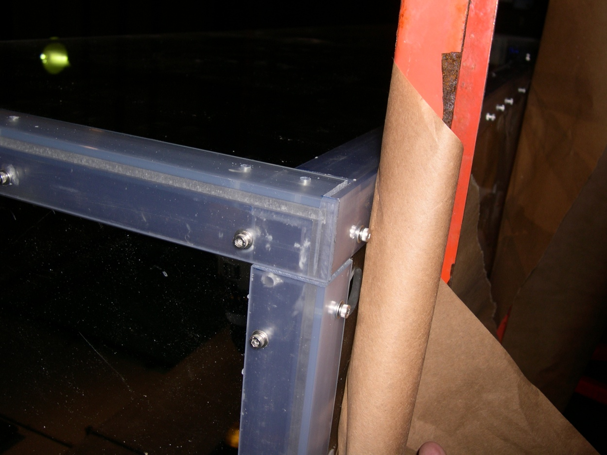
Proven Fabrication Methods
XFOCE Website Reference Material
Outer Angle
Inner Angle
Wall
Clearance
Outer Angle
Wall
Threaded
Inner Angle
Fastening Angles for Stiffness
Use of appropriate materials will maximize light
transmission into the test chamber.
-1/4” Clear Acrylic Panels
-3/16” x 1.5” x 1.5” clear PVC angle used as outside support structure.
-3/16” x1.25” x1.25” clear PVC used inside.
-8-32 x 5/8” screws tapped into inner PVC pieces, 6” Center to Center.
FABRICATION Note: Drilling holes in plastics, polycarbonate and especially acrylic can be difficult because the drill tends to grab and “dig” into the material. Modify the cutting edge of the drill’s flutes by filing or sanding the cutting edge to a more vertical “scraping” edge (i.e. perpendicular to the surface being cut). Keep it sharp and a very nice hole without breakout on the back surface will result.

Slide 14
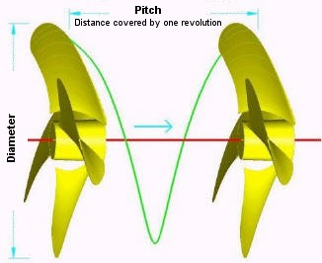
XFOCE Website Reference Material
Custom Thruster using Propellor and Motor
Disk Theory for Moving Water
Ppropellor x RPM x Areapropellor / 100 = Volumewater / minute
Where:
* Ppropellor = Propellor Pitch (cm.)
RPM = Revolutions per minute
Areapropellor = Area of the diameter projected by rotated propellor (cm. sq.)
Volumewater = volume of water moved by propellor (liters)
Equation for motor H.P. Requirement
HP = (psi x GPM) / (1714 x efficiencyMotor)
*NOTE: Pitch is defined as "the distance a propellor would move in one revolution
if it were moving through a soft solid, like a screw through wood." For example,
a 21-pitch propellor would move forward 21 inches (53.3 cm) in one revolution.

Slide 15
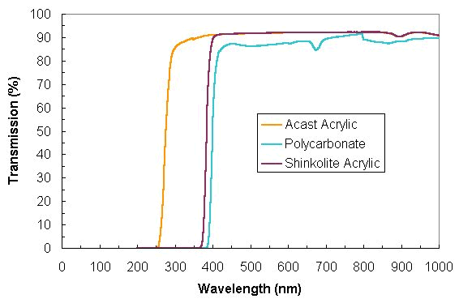
XFOCE Website Reference Material
Light Transmission through
Polycarbonate and Acrylic

Slide 16
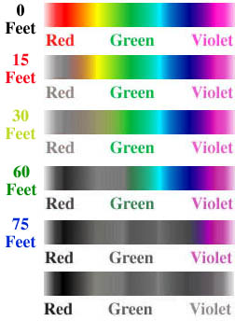
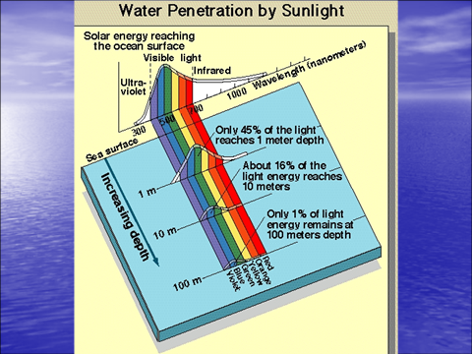
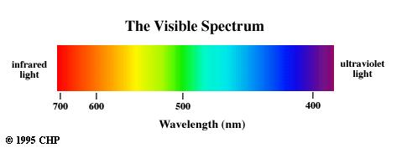
400nm through 700 nm
XFOCE Website Reference Material
Photosynthetically Active Radiation (PAR)
(0 Meters)
(4.6 Meters)
(9.1 Meters)
(18.3 Meters)
(22.9 Meters)

Slide 17
FOCE Review Appendix
Electrical Topics

Slide 18
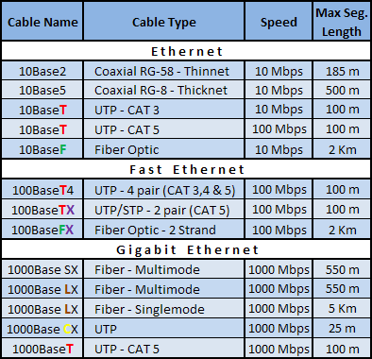
Ethernet Standards
Notes:
x

Slide 19
Serial Standards
Specifications | RS-232 | RS-422 | RS-485
Mode of Operation | Single-Ended | Differential | Differential
Total # of Transmitters and Receivers | 1 Trans 1 Rcvr | 1 Trans 10 Rcvrs | 32 Trans 32 Rcvrs
Maximum Cable Length | 50 ft | 4000 ft | 4000 ft
Maximum Data Rate | 1MBit/s | 10MBit/s | 10MBit/s
Notes:
x

Slide 20
DSL Standards
Technology | Distance | Download Speed | Upload Speed
ADSL | 18,000 ft / 5.4 km | 8 Mbit/s | 1 Mbit/s
SDSL | 18,000 ft / 5.4 km | 1.5 Mbit/s | 1.5 Mbit/s
IDSL | 36,000 ft / 10.8 km | 144 kbit/s | 144 kbit/s
HDSL | 15,000 ft / 4.5 km | 1.5 Mbit/s | 1.5 Mbit/s
VDSL | 4,000 ft / 1.2 km | 50 Mbit/s | 8 Mbit/s
Notes:
x

Slide 21
Instrument Level Power Control
Load Switcher
12V
Load
Switching
Inrush
Limiting
Volt/Curr
Monitoring
Circuit
Breaker
Volt/Curr
Filtering
Over/Under
Volt/Curr
Detection
ADC
Ground Fault Monitor
Amp
Mosfet
ADC
R
Curr Limit
Seawater Ref
ADCP
Notes:
x

Slide 22
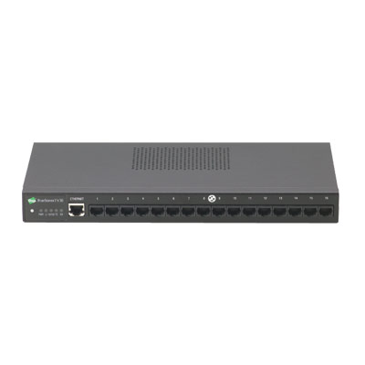
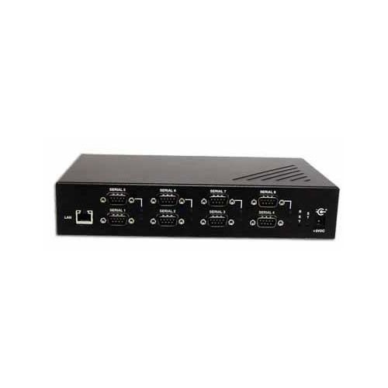
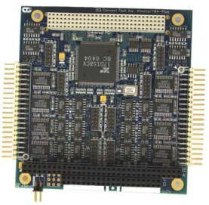
Serial Port Expansion
Large number of serial ports often needed.
DC Powered expanders & servers are plentiful.
Notes:
x

Slide 23
Computer
Can be of almost any variety based upon intended usage in subsea node.
Potential usage:
  Collection and dissemination of data from external instruments and internal subsystems.
  Performing the closed loop operation control of the pH experiments.
  Housing the individual instrument drivers.
Notes:
x

Slide 24
PC/104 Stack
Modules available (multiple manufacturers):
  CPU
  Data storage
  Power Supply
  Digital I/O, Analog I/O (DAQ)
  Relay control
  Serial expansion
  Environmental input (temp, hum, etc…)
  Video Server/Encoder
  Ethernet switch
  Others
Notes:
x

Slide 25
PC/104 Stack
Function | Model # | Manufacturer | Notes | Watts | Cost | Quan | Tot Watts | Tot Cost
Computer | Cool RoadRunner-LX800 | Lippert |  | 6.5 | $500 | 1 | 6.5 | $500
Storage | 500Gb Scorpio Blue | Western Digital |  | 4 | $100 | 1 | 4 | $100
Power Supply | HE104+ DX | Tri-M |  | 10 | $300 | 1 | 10 | $300
Load Switching | DM6956 | RTD Embedded Tech | 16 Channels | 5 | $500 | 2 | 10 | $1000
Circuit Breaker | N/A
Ground Faulting | N/A
Load Power Monitoring | MM-32DX-AT | Diamond Sys | 32 Chan Analog | 3 | $600 | 1 | 3 | $600
Environmental Sensing | Model 518 | SensoRay | Temp/Hum only | 1 | $325 | 1 | 1 | $325
Serial Expansion | Xtreme/104-Plus Port | Connect Tech | 16 Channels | 4 | $350 | 2 | 8 | $700
 |  |  |  |  |  |  | 42.5 | $3525
Notes:
x

Slide 26
Wago I/O System
Modules available:
  Controller
  Power Supply
  Relay Modules
  Digital I/O, Analog I/O (DAQ)
  Thermocouple inputs
  DC Motor Driver
  Others
Notes:
x

Slide 27
Wago I/O System
Function | Model # | Manufacturer | Notes | Watts | Cost | Quan | Tot Watt | Tot Cost
Computer | 750-341 | Wago | Eth-Fieldus Coupler | 12 |  | 1 | 12 | 0
Storage | N/A |  |  |  |  |  | 0 | 0
Power Supply | N/A |  |  |  |  |  | 0 | 0
Load Switching | 857-304 | Wago | Single SPST Relay | 0.5 |  | 20 | 10 | 0
Circuit Breaker | N/A |  |  |  |  |  | 0 | 0
Ground Faulting | N/A |  |  |  |  |  | 0 | 0
Load Voltage Monitoring | 750-483 | Wago | Dual Voltage Analog Inputs | 2 |  | 10 | 20 | 0
Load Current Monitoring | 750-475 | Wago | Dual Current Analog Inputs | 2 |  | 10 | 20 | 0
Envr Sensing - Temp | 750-469 | Wago | Dual Thermocouple input | 1.5 |  | 3 | 4.5 | 0
Envr Sensing - Hum |  |  |  |  |  |  | 0 | 0
 |  |  |  |  |  |  | 0 | 0
Serial Expansion | N/A |  |  |  |  |  | 0 | 0
 |  |  |  |  |  |  | 66.5
Notes:
x

Slide 28
Instrument Chassis
Modules available:
  CPU Board
  Power Supply
  Environmental Monitoring Board
  Low Voltage Load Switcher (8 channels)
  Medium Voltage Load Switcher (4 channels)
  Ground Fault Detection Board (16 channels)
  Others
Notes:
x

Slide 29
Instrument Chassis
Function | Model # | Manuf | Notes | Watts | Cost | # | Tot Watt | Tot Cost
CPU |  | MBARI |  | 0.680 | $253 | 1 | 0.680 | $253
Power Supply |  | MBARI |  | 0.335 | $324 | 1 | 0.335 | $324
Backplane |  | MBARI |  | 0.000 | $193 | 1 | 0.000 | $193
Environmental Board |  | MBARI | 8-hum, 4-temp, pressure, X,Y,Z, H2O Sense | 0.200 | $316 | 1 | 0.200 | $316
Low Voltage Load Switcher |  | MBARI | 8-channels, 0-24V | 0.250 | $550 | 3 | 0.750 | $1650
Medium Voltage Load Switcher |  | MBARI | 4-channels 24V-48V | 0.250 | $425 | 1 | 0.250 | $425
Ground Fault Detection Board |  | MBARI | 16-Channels (with 4 HV) | 0.200 | $325 | 1 | 0.200 | $325
 |  |  |  |  |  | Q | 2.4
 |  |  |  |  |  | Act | 10 | $3,486
Notes:
x

Slide 30
FOCE Review Appendix
SoftwareTopics

Slide 31
Instrument drivers, data and comm links: some guidelines

Slide 32
Instrument data
Always keep “raw” data retrieved from instrument
Save instrument characteristics; make, model, serial #, calibration, etc
  Critical for data interpretation
  Often accessible from instrument itself
Further processing...
  Format conversion, e.g. for MatLab, WWW access, other tools

Slide 33
Acquiring raw data
Self-logging instruments
  Autonomously log and store data internally for later retrieval, often not needed in real-time
Instrument driver: acquires and logs data to external storage
  Runs on shore workstation (cabled) or at-sea computer
  Can also retrieve & log instrument serial number, characteristics
  May provide data/control access to other system components (e.g. CO2 control loop)

Slide 34
Where to get instrument drivers?
Manufacturer usually provides driver for Windows only
  May be usable on cabled system
3rd party drivers (e.g. MBARI SIAM, OASIS, UCSD SensorPod, ...)
  Often suitable for cabled or moored; maybe portable to multiple OSes
  Requires programmer; can customize code, extend to new instruments
Write your own drivers from the ground up
  LabView, Java, C/C++, C#, etc...

Slide 35
Communication links
Cabled or high-speed wireless
  “Transparent” access to serial port; driver/logger can run on shore
  Generally reliable, but consider possible outage
Low-bandwidth/intermittent wireless
  Design system for outages
  Keep raw data on deployed platform
  Summarize raw data for telemetry (e.g. averaging, “snapshots”)

Slide 36
Shore data base
User access to raw and processed data via Web or other interface
  Retrieve/display data based on user criteria
  Long-term data, metadata archive
  Many choices available
MBARI Shore Side Database
  Open source
  Automated data ingest, processing and display

