Slide 1
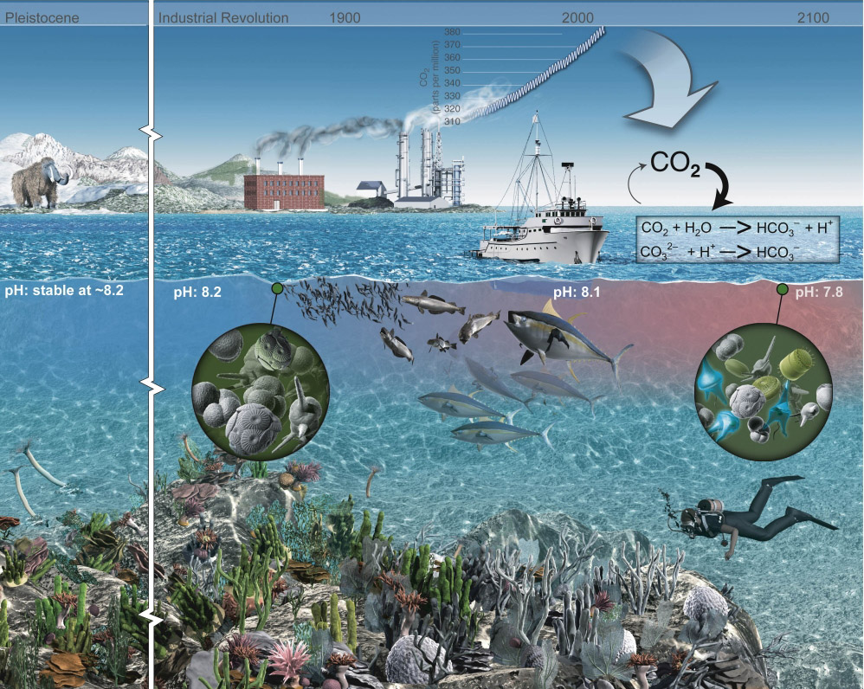
xFOCE/swFOCE Review
An illustration of the atmospheric CO₂ increase and the change in ocean pH

Slide 2
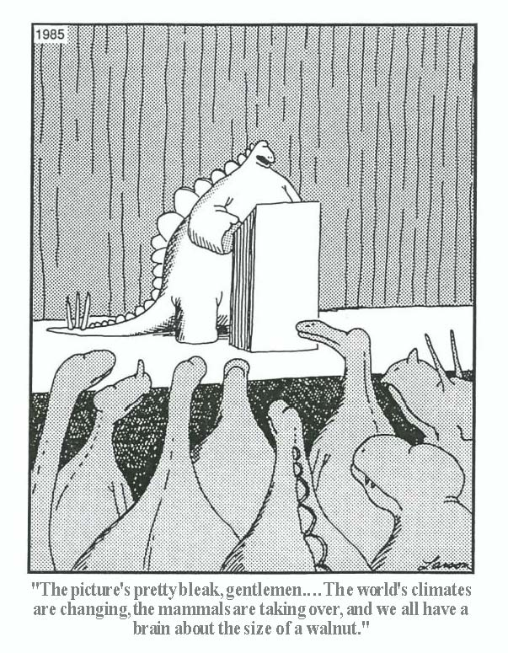
Climate change has consequences

Slide 3
Purpose of CO₂ enrichment experiments
FACE studies on land:
  Greenhouse experiments had shown an enhancement of growth rates with high CO₂ conditions.
  What happens in the “real world?”
FOCE is the marine analog to FACE:
  Avoid the limitations of aquaria experiments.
    Culturable organisms.
    “Axenic ecosystems”.
  Open system vs closed mesocosm.
    Natural cycling of environmental conditions.
    Complete ecosystem interactions.

Slide 4
Chemistry of CO₂ in seawater
Reaction of CO₂ + H₂O is well known:
  Equilibrium constants are well described [ F(S,T,P) ].
  Reaction rates can be predicted:
Kinetic predictions from equations in Appendix C.7 Zeebe & Wolf-Gladrow (2001).

Slide 5
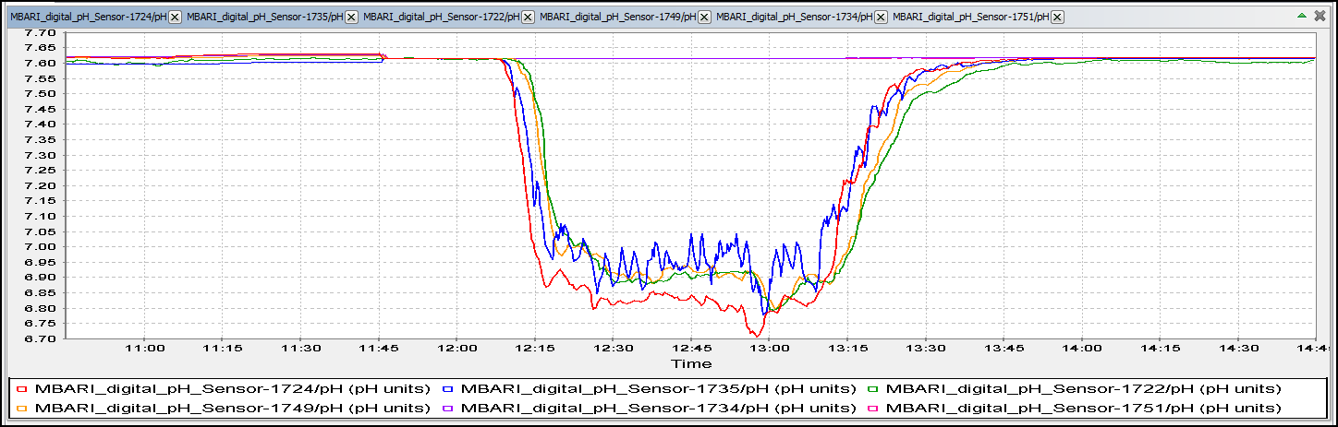
dw-FOCE control of pH / TCO₂
We can control TCO₂ and pH; but these are not the only important variables:
  Dissolved oxygen (Brewer & Peltzer, 2009; Hofmann et al., 2011).
  Flowrate (Hofmann et al., submitted to GBC).

Slide 6
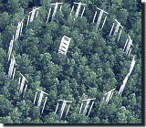

FOCE and OA Research
Free Ocean CO₂ Enrichment experiments are based on an existing base of scientific work that started in the early 1990’s. The Free Air CO₂ Enrichment (FACE) experiments.
Dr. Peter Brewer first proposed this type of experiment to MBARI engineering in 2003 as part of his greenhouse gases research. The drawing to the right is the initial concept from engineering and presented to NOAA’s Dr. Dick Feely later that year.
Concept using the MARS cable in Monterey Bay, later deployed as deep FOCE (dpFOCE)

Slide 7



Why xFOCE?
The problem: Some scientists are misinterpreting our publications and what is required to make a FOCE system work.
MBARI was contacted and we gave feedback about how to use the existing hardware and reconfigure it to become a functional FOCE.
The scientist did some of it but still didn’t grasp what FOCE is an how to properly set up a system to get meaningful science results.
It became apparent that a resource clearly outlining FOCE and how to get started would be useful.

Slide 8


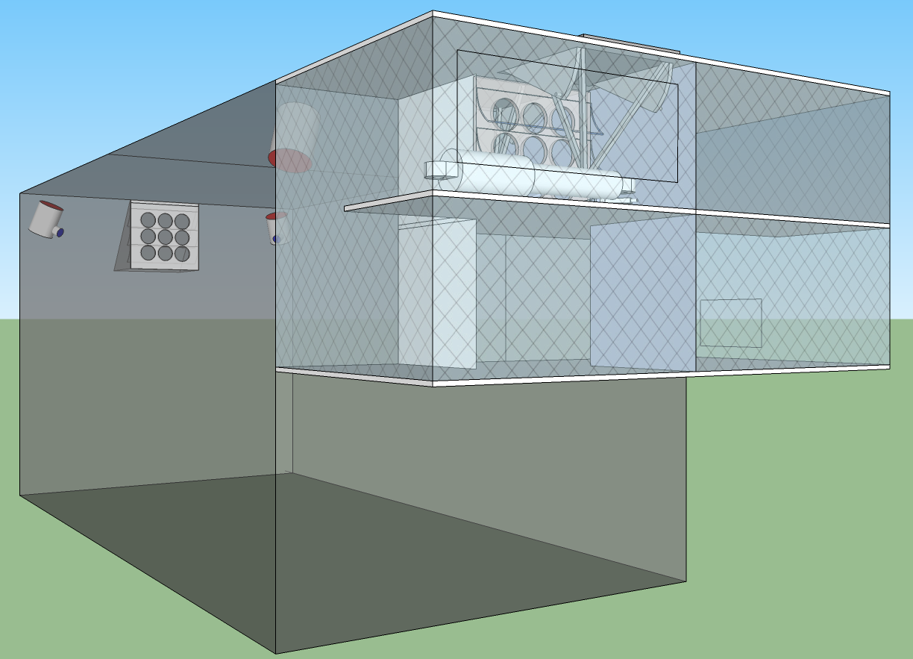





xFOCE
Deep FOCE (dpFOCE) is the original FOCE built for multi-science users on a cabled observatory.
Coral Prototype FOCE (cpFOCE) is the first tech transfer of FOCE built for multi-science users on the Great Barrier Reef. Solar and wind powered except for the creation of the enriched CO₂ water.
European FOCE (eFOCE) is currently under construction and scheduled for deployment in May 2012. This system uses a cable but the CO2 is delivered in bottles to a surface expression.
Antarctic FOCE (antFOCE) proposal submitted and partially funded. Proposal for other 50% of funding submitted April 24th, 2012.

Slide 9
xFOCE
xFOCE shall support 2 test chambers (1 active and 1 control minimum)
xFOCE shall maintain a desired pH offset from ambient within +/- .2 pH
xFOCE shall be capable of pH offsets of between .2 and .8 pH units
xFOCE shall hold a selected pH offset for a minimum of 2 weeks
xFOCE shall be capable of deployments greater than 6 months in duration
xFOCE shall be fully functional in external currents of 50 cm/sec
xFOCE shall mimic surge to the extent possible based on chamber scale
xFOCE shall maximize the allowance of full spectrum natural light
xFOCE shall include pH, CTD, O2, flow rate or calculated flow using velocity

Slide 10
xFOCE
xFOCE shall provide internal environmental data for all instruments on the required list from each active chamber
xFOCE shall provide internal environmental data for
xFOCE shall be diver maintainable
xFOCE shall not use materials that are toxic to the marine environment
xFOCE shall not be dangerous to maintenance divers
xFOCE shall minimize impacts on local marine life
xFOCE shall be capable of being fully recovered and leave no components behind
xFOCE shall be capable of being built, installed and maintained by a typical university oceanographic research lab with a minimum of 1 scientist and 2 graduate students

Slide 11
xFOCE
xFOCE shall maximize use of commercially “off-the-shelf” or readily available technology to the fullest extent possible
xFOCE shall be capable of working in ocean waters where the velocity does not exceed 75 cm/sec.

Slide 12
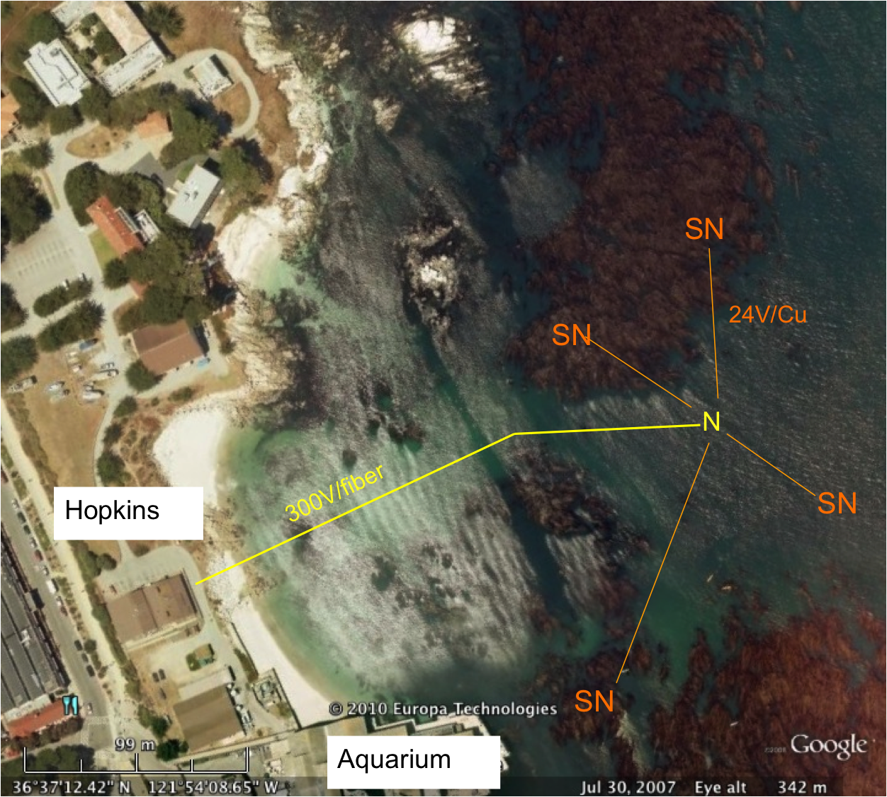
swFOCE
swFOCE shall meet all xFOCE requirements
swFOCE shall not require a support ship greater than 50’ for deployment and recovery
swFOCE shall include a camera system capable of variable time lapse digital data collection suitable for publication, the camera (and light source if included) shall also be adjustable within the swFOCE structure
swFOCE shall use the Stanford Hopkins
Marine Station’s submarine cable
swFOCE shall provide power and communications links separate from the planned Hopkins science use, and will not interfere with other science operations.

Slide 13
xFOCE Concept of Ops cable
Science interface on shore
CO2 and Enriching process on shore
Air / sea interface managed using buried cable
Capable of supporting 1 or more xFOCE units
Depth rating
max – 40m
FOCE chamber
Notes:
----- Meeting Notes (4/30/12 10:09) -----
remove depth rating
change number of units 1-2 xfoce

Slide 14
xFOCE Concept of Ops no cable
Science interface on shore
CO2 and Enriching process off shore
Air / sea interface managed using surface expression
Capable of supporting 1 or more xFOCE units
Buoy or Platform
Wireless link or autonomous
Depth rating
max – 40m
FOCE Chamber

Slide 15
xFOCE Functional Requirements
Max depth:
pH Offset Range:
pH resolution:
Temp range:
Max ext. velocity:
Max int. velocity:
Full spectrum light:
Number of Units:
40m (130 ft)
0.0 to -0.6 continuous based on CO₂ available. Brief excursions to -0.8 or -1.0 offset potentially
0.05 pH units, 0.1 unit may be OK
(prefer best resolution possible)
-2 to 30 degrees C
50 cm/sec
10 cm/sec
Max transmission of sunlight at depth
System support for 1 active and 1 control chamber

Slide 16
swFOCE Additional Requirements
Surge: Imitate surge to extent possible
Number of Units: System support for 3 active and 3 control chamber

Slide 17

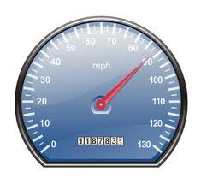
xFOCE/swFOCE Concept of Ops
Flow Vel
Science selected velocity

Slide 18
xFOCE Functional Interfaces
House Power
Internet
Power
Generation
CO2
ESW
Mixer
Comms
Data
Distribution
GUI
Distribution/Protection
SW Pump
Configuration & Control
Data Archive
Control System
Storage
Console
Enriched
Seawater
System
Monitoring/
Health/Status
Data Acquisition
Surface
xFOCE Control
Science / Control System
Subsea
Subsea Electronics
ESW Distributor
ESW injector(s)
Instruments
ESW injector(s)
Flow effector(s)
Camera(s)
Flow effector(s)

Slide 19

xFOCE Systems concept
Blue circles are included for swFOCE
Proposed minimum instrumentation for an active pH controlled chamber. The blue elements are options and controls would only have CTD and pH. Not shown is the other option of a motor and fan to control flow.

Slide 20
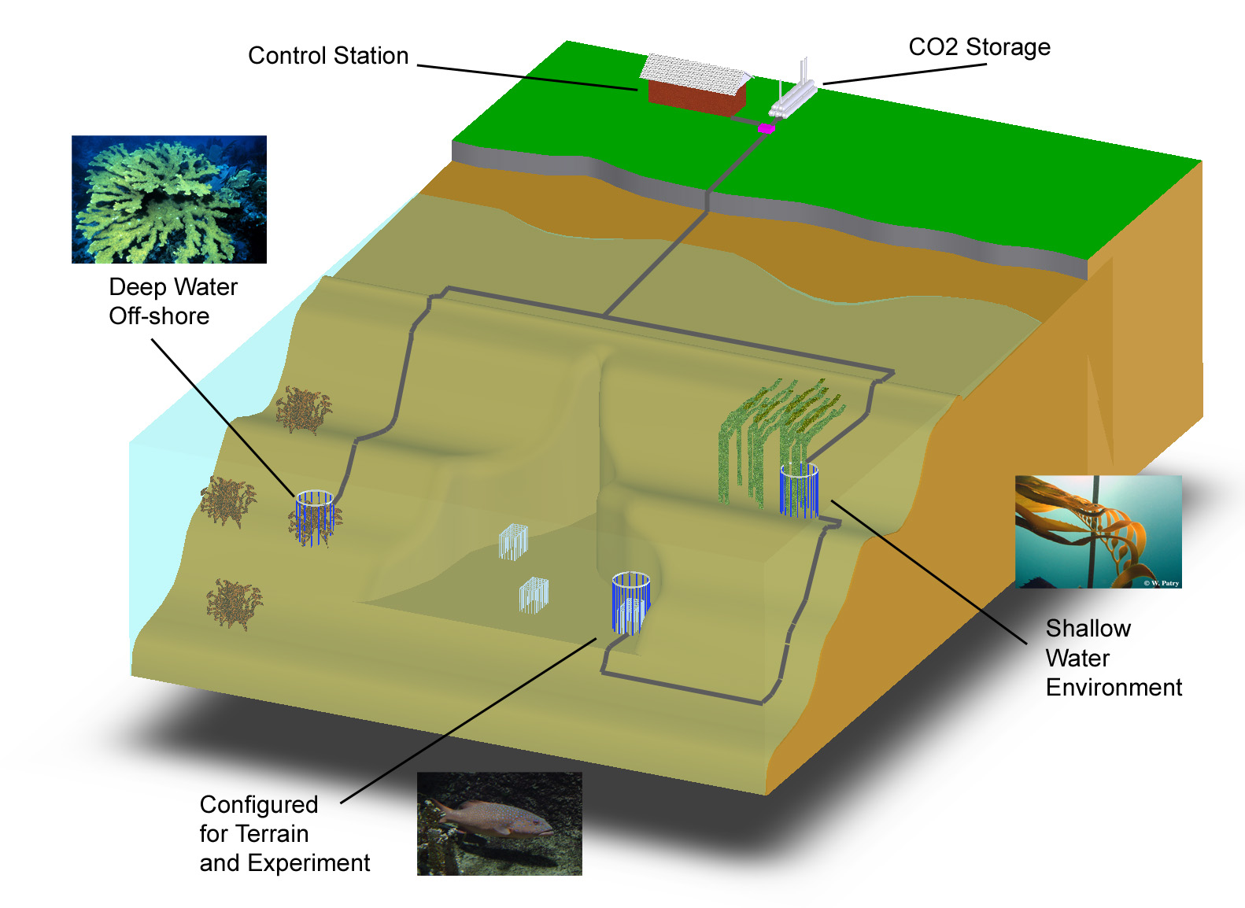
swFOCE Basic Concept
Schematic View of the Hopkins Site
Multi-Site
Multi- Discipline
Multi-Year
Shallow Water
Off-Shore
Shallow Water Corals
Benthic Biology

Slide 21
swFOCE Concept
Bottomside FOCE chamber for swFOCE
pH Sensor
Camera and Light
Ducting
(Time delay)
Flow meter
Mesh screen
CTDO Sensor
Thruster
Anchors
CO₂ Enriched Water
Power and Comm
Cabling
FOCE Controller
Notes:
What is animal restrictor – use mesh

Slide 22
swFOCE Cable Concept
Sea Water
Barrier End Cap
Low pH Sea Water
Power and Comms
Existing Drain at
Hopkins
Sea Level
Intake Filter

Slide 23
xFOCE /swFOCE Data Reqs.
Health and Status: Ability to query system status from web page (data dependent on sensors included)
Timing Accuracy: Internet time stamping to 1 second absolute accuracy
Sample Rates: System will support up to 2 Hz standard operation
Basic Data Format: Comma delimited string, time stamped
swFOCE: Compatible with the current dpFOCE data streams and SSDS (Shore Side Data System*)
Autonomously chapters meta-data for instruments
Near real time ground fault monitoring
*SSDS – Open source from MBARI

Slide 24
swFOCE Permitting

Slide 25
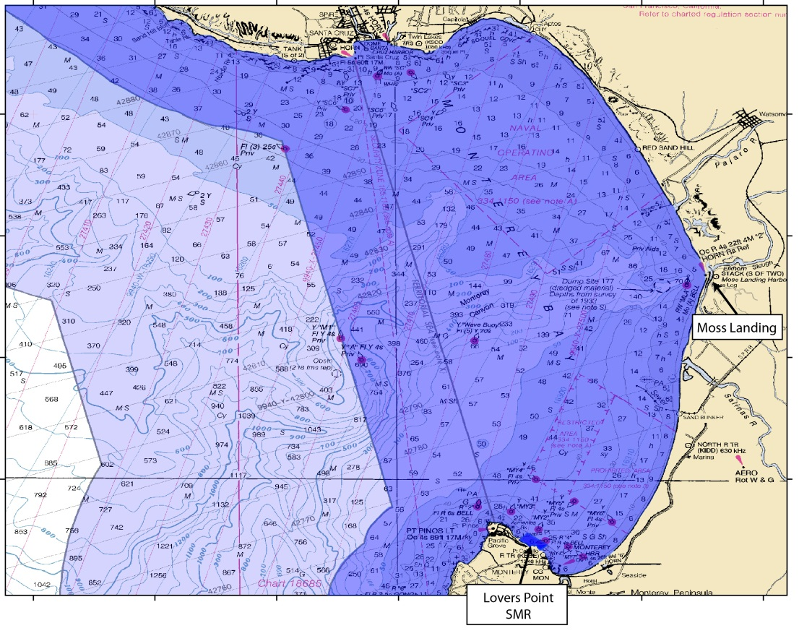
Permitting Issues:
Project Site: Highly Sensitive Location
  Federal: Marine Sanctuary
  State: Coastal Zone & MPAs
Notes:
First issue that triggered all this regulatory oversite was the project site itself.
Project Site – create maps of Sanctuary jurisdiction – zoom to state jurisdiction – zoom to MLPA designations – PG jurisdiction

Slide 26
Permitting Issues: cont’d
Project Site: Highly Sensitive Location
  Federal: Marine Sanctuary
  State: Coastal Zone & MPAs
  Regional: Water Quality
  Local: City of Pacific Grove
Notes:
First issue that triggered all this regulatory oversite was the project site itself.
Project Site – create maps of Sanctuary jurisdiction – zoom to state jurisdiction – zoom to MLPA designations – PG jurisdiction

Slide 27
Permitting: Lessons Learned
Site location can determine how much regulation you will be faced with
Allow plenty of time for permitting
  Process took 2 years to complete
  Coordination of permitting cable & projects
Good rapport with agency personnel key
  Not necessarily trying to make life difficult, but often operating within bureaucratic box
  Future interactions
Advocate(s) who can work with bureaucracy highly valuable
Getting the process streamlined is critical to prevent valuable research from being discouraged due to concerns about permitting.
Notes:
If applying fro permits to install infrastructure, can save time & effort if you recognize that agencies may treat these as associated projects. Can help streamline the process.
Future interactions – probably will end up working with same staff on similar or other projects. Good to keep positive rapport.
This is ver useful slide for main presenti

Slide 28
Computing elements of xFOCE
(Architecture and system trades)

Slide 29
Computing Architectures
User Concerns
Performance: valid scientific approach, data quality
Flexibility: wide range of environments, scenarios
Ease:
  Build
  Test
  Use, maintain
  Extend
Cost
Notes:
Results must produce papers…
Variety of applications in different ocean environments
Must be easy to spec and obtain components, to put them together
Good integration and test is essential to success
Must be safe and robust to deploy, configure and maintain
Finally, must be tech path to extend it (research never calls for decreased capability, fewer sensors, or less data ;o)

Slide 30
xFOCE demographic
Implementer profile | Researchers plus 2-4 post docs, grad students 0-1 engineer
Technical | Access to modest manufacturing facilities Software is harder than hardware, mechanical Strong preference for familiar COTS solutions
Implementation schedule | ~6 months
Experiments | Campaign-style deployments 12 month service life Remote and/or restricted sites
Lifecycle | Prefer to extend capability, rather than re-spin from scratch for successive funding rounds
Notes:
Here are some other key features of who we think our users are…
Subject of much discussion; hope audience identifies with this
Next to understanding requirements, gaining a sense for
Users’ capabilities, resources and workflows needs to be reflected in the design.

Slide 31

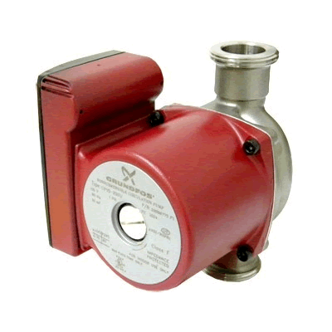

FOCE Essentials
Power
Data
Data, Control
User
IF
User
IF
Power
CO₂
H₂O
Enriched
Seawater
Controller
ESW
pH
CTD
CTD
pH
Flow
Chamber
Flow
DO₂
Flow
DO
External
Notes:
For this part of the program, will use this as reference diagram of essential FOCE elements
Chamber at the bottom where all of the science action happens
Populated with sensors, both internal and external to the chamber
ESW sys delivers ESW
Controller at the center (I’m a software guy ;o)
Must be a source of power (red lines)
nothing is more important than the data (drawn in black)
Which is manipulated through various user and data interfaces

Slide 32
xFOCE helps to simplify the choices
  Experience, Designs, Community
Choices depend on users’ experiment and constraints
  Budget, schedule
  Environment, permitting
  Technical resources
xFOCE community may draw from different approaches
Notes:
Some things must be on the seafloor
Chamber, instruments
Actuators (pumps, fans, etc.)
But location of everything else is flexible…
Power, ESW
Controller
Data storage, user interfaces
And, there are many ways to implement all of it…

Slide 33
Computing Architectures
Shrinking the Universe of Trades
Decisions that have greatest impact on user concerns
  Build vs Buy
  Location matters: Shore vs Surface vs Seafloor
  Topology: how the pieces are connected
Notes:
To diminish the large trade space
We want to focus our attention in the decisions that have the greatest impact on your concerns:
Performance, flexibility, ease and cost
Maybe no decisions you can make are more important than
What you choose to build and what you buy (or better still, get for free)
Where the components are placed
How you choose to connect them, both electromechanically and with data interfaces and protocols

Slide 34

Build vs Buy
General Principles
Buy what you can’t/shouldn’t build
  Processors, (most) instruments, cabling
  Software
Build (or borrow) as needed
  Chambers, housings
  Use COTS components if possible
  Get help on tough key builds
    contract, open source
  You get what you pay for
Beware poor integration
  Patchwork integration of COTS parts
  Power consumption
  Rube Goldberg-ness of mechanical/electrical interfaces
Notes:
Some of these may seem obvious, but they’re important
It’s often tempting to build what is most familiar to us; it’s easy to pour time into whipping something up “simple” that winds up taking a lot more money and time than anticipated – especially software.
Build from scratch only what you really really have to
When you do decide to build, use COTS components and use open source where you can
Stay near the beaten track with 3rd party open source software - Just because it’s free doesn’t mean it isn’t expensive
Use software that has an active developer base (check mail lists) and isn’t too new – you want code with lots of miles and people who have already run into your problems
Temper your use of COTS and open source with an eye towards integration
Make sure the sum isn’t less than the parts
Integration problems manifest in higher power consumption, software workarounds, adapters in elec/mech/software interfaces
These add cost and complexity, and reduce robustness

Slide 35

Location Matters
General Principles
Connected vs Disconnected
  Generally easier to generate and store power, ESW on shore
  Telemetry bandwidth
Trades for off-shore elements
  Accessibility (to you, the elements, others)
  Reliability
Keep what’s offshore/sub-surface as simple and robust as possible
  Basics: Enriched seawater, power
  HW: Cables, connectors, housings
  SW: Applications, protocols, processes
Notes:
The decision to put some part of the system at sea is arguably the most important in terms of its effect on effort required to make things work reliably.
In general, it’s preferable to put as much on shore as possible.
In many cases, there isn’t a choice about that one – geography and permitting often make it for us.
That being the case, the next choice to make is often whether to put things on or below the surface.
Though Easy to say, hard to do: the balance between simplicity and robustness can be hard to get right
Connectors, cables and housings are the #1 point of failure in ocean observing systems.
Even the most expensive options are subject to failure.
Use the right technology for the job – don’t skimp on connectors
Housings can be simple, but not too simple
Options covered later..
Distributed software can be complex to debug: location and distance drive telemetry links, protocols, processor selection and power

Slide 36
The software developer sees…
Power
Data
The user must consider:
CO₂
H₂O
Controller
Enriched
Seawater
What’s inside?
Build or Buy?
Where to put the pieces?
How are pieces connected?
ESW
pH
CTD
CTD
pH
Flow
Chamber
Flow
DO₂
Flow
DO₂
External
Notes:
Here is our reference diagram again, this time as the software developer sees it.
It is this view that the remainder of my slides are about.
The controller and it’s software are a central concern, and object of this concern are
the power and data (includes control signals) that pass through the perimeter
You the users must be concerned with
what is inside the box
How should we arrange the pieces
Which should we built and which bought

Slide 37
3 potential xFOCE architectures
A study of some approaches
  “Centralized Workstation”
  “Industrial Computers”
  “Sensor Node”
3 views to evaluate key features and trades
  Location: shore, surface, seafloor
  Build/buy: hardware, software
  Connections: topology and infrastructure
Notes:
The names for the approaches are just ones we made up
Centralized Workstation: desktop-class PCs packaged for the seafloor (or run on shore)
Industrial computers: building block approach using modular factory automation buses like Wago, NI Compact Rio, etc.
Sensor Node: Low cost, low energy approach using COTS components for modularity and flexibility with a minimum of custom hardware
we’ll look at each in terms of how they’re arranged, technology build/buy choices and interconnections
All are valid approaches with optimizations for a particular application

Slide 38
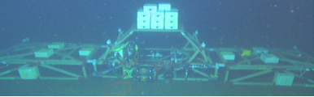
Centralized Workstation
Workstation computing
Similar to dpFOCE implementation (image below)
Mixed Common Off The Shelf (COTS) /custom hardware
Shown here using cabled configuration

Slide 39
Component | Location | Why
Controller HW | Seafloor | Could run on shore Experiment continues if comms fails Simpler, though less accessible
Controller Software | Seafloor | ‘’
UI Software | Shore | Easier maintenance
Power | Seafloor | Need fine-grained power management at site
Data | Seafloor And Shore | Experiment continues if comms fails
Centralized Workstation
Data
Archive
Location View
Power
Source
Surface
Shore
Seafloor
Data
Controller
Power
Distribution
ESW
pH
CTD
CTD
pH
Flow
Chamber
Flow
DO₂
Flow
DO₂
External
Notes:
Here, the entire experiment is situated on the seafloor
Though not shown, ESW could be generated on the seafloor (deep water only), or
surface/shore (depending on depth and distance from shore)
Same generally true for power and communications, though here these originate on shore
The controller is consolidated in a single housing on adjacent to each chamber
(note that an experiment may include multiple chambers; only one is shown here)
Some advantages to putting everything on the seafloor are
As long as the unit gets power, the experiment may run autonomously
Having the user interface on shore (with hooks in the controller) makes maintenance easier
- It is simpler w/o a surface expression, at the expense of some accessibility

Slide 40
Centralized Workstation
Build/Buy
View
Component | Build/Buy | Implementation
Controller HW | Buy | PC104 Pentium Serial port cards (16 total)
Controller Software | Build Open Source | Linux, Java Custom: SIAM Data Acquisition software Open Source: DataTurbine, e.g.
Archive, UI | Build | PC Workstation MacOS, Windows, Linux, Java Custom: SSDS, FOCE GUI
Power | Build | Custom: load switching and monitoring chassis
ESW | Build | Custom: electronics, software, chassis COTS: pumps, controllers
SIAM: Software Infrastructure and Applications for MOOS
SSDS: Shore Side Data System
Notes:
There are many variations what you may choose to build or buy, but in this scenario, as for dpFOCE, a lot of custom components were used for various reasons:
We did use an OTS PC104 controller computer
One potential drawback to this approach is that it requires a large serial expansion; not hard, since you can buy serial UART cards, but it ties you to a larger, more power hungry workstation class computer
The controller software was custom almost entirely throughout (though with substantial open source components like Linux, Java, OSDT), in our case to reuse software we had a large investment in.
The power system was semi custom as well, though it made use of available voltage converters and off the shelf data acq for environmental monitoring

Slide 41
Centralized Workstation
Ethernet
Connection
View
Data
Power
Source
Surface
100 MBps
Ethernet
Shore
Fiber Optic
Power and Data Cable
Seafloor
Data
Controller
1 kW
Ethernet-Serial
Power
Distribution
Serial
ESW
pH
CTD
CTD
pH
Flow
Chamber
Flow
DO₂
Flow
DO₂
External
Notes:
Here is a look at the communications and power infrastructure – the connections between the boxes
A cable to shore offers substantial power and communications bandwidth,
though it it is typically requires some technical and financial investment, and may be challenging to permit.
The upsides are easy to see: it is easy to access and maintain from shore, and supports features like live real-time video feeds, which have both scientific and social/strategic value.
The large amount of available energy makes it easy to support the larger workstation computers and larger chamber size (bigger water movers, etc.)
From the controller, connections to the instruments are mostly serial, though ethernet-serial connections are also used
To the ESW system (to show another possibility – we did it to make the ESW system more modular and ROV compatible)

Slide 42
Summary
Centralized Workstation
Pros
  One software platform
  COTS computers
  COTS serial I/O solutions
Cons
  Extensibility in packaging and housings…have to put a lot of holes in housings
    Can use junction boxes
  Need lots of serial ports
    Custom serial IO
  Power consumption
  Less modular
  Custom HW/SW
Notes:
So the centralized workstation essentially trades the convenience of using off the shelf PCs and serial expansion capability over power consumption and modularity.
It means fewer housings, but larger ones (which are more difficult to seal). Fewer housing may be an up-side just because there is less to build and maintain, but it may be difficult or expensive to spare and the whole thing must be replaced at once.
Though you could exercise different SW choices, custom software takes time to develop,
though with only one hardware platform, there is only one software development environment needed.

Slide 43
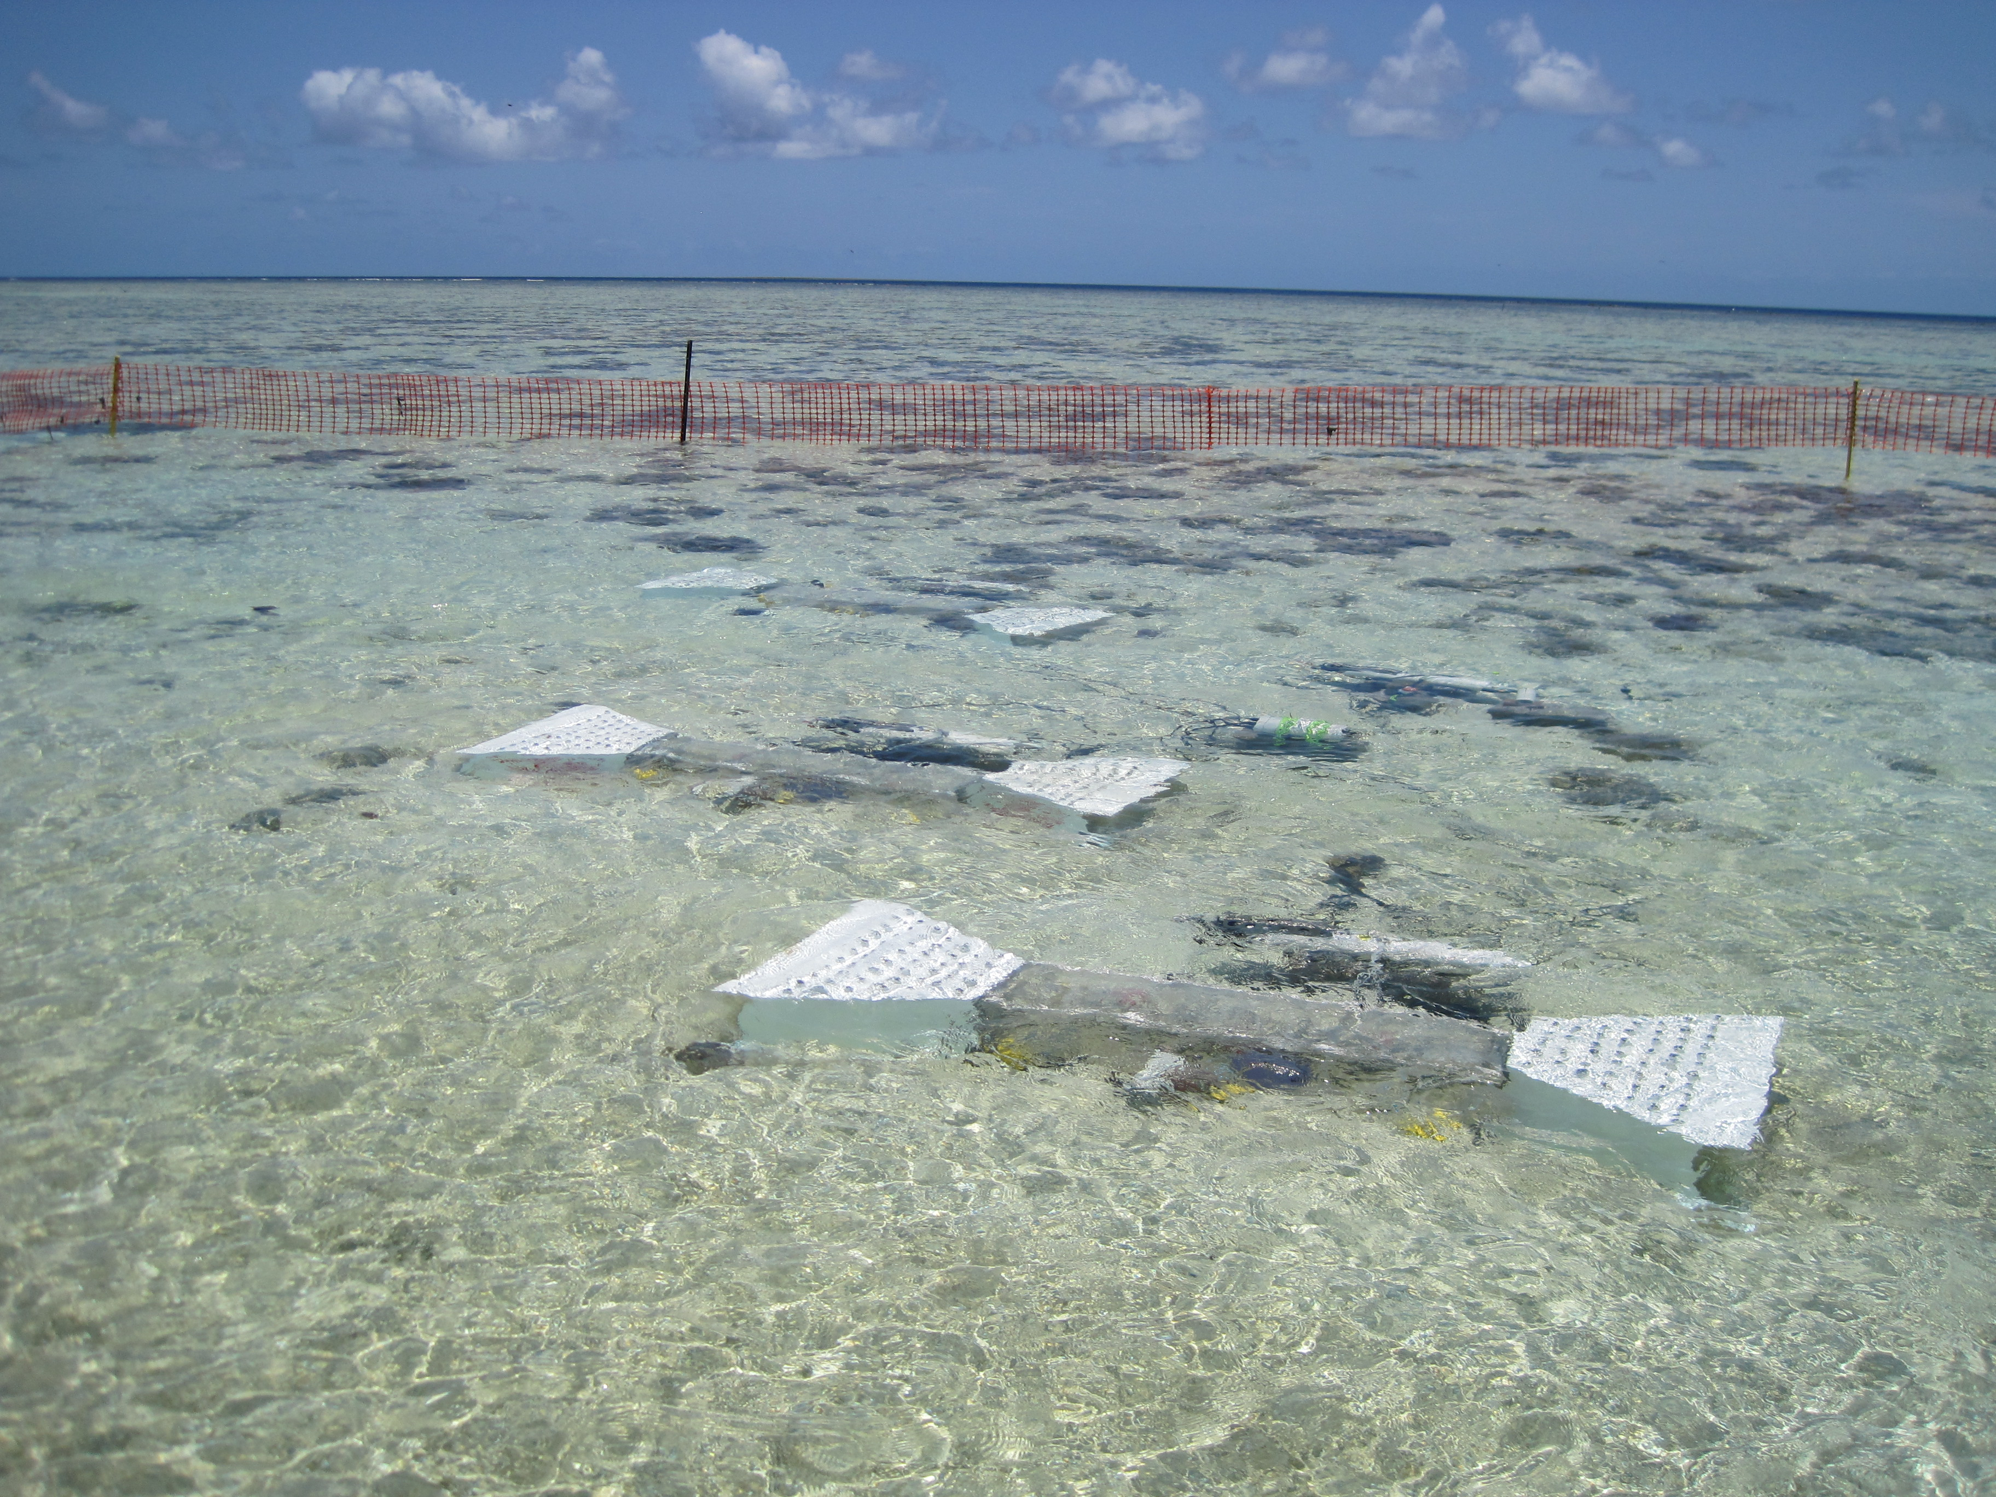
Industrial Computers
Industrial automation computers (WAGO, Compact Rio, e.g.)
Similar to CP-FOCE implementation
Uses primarily COTS hardware and software
Shown here using moored configuration

Slide 44
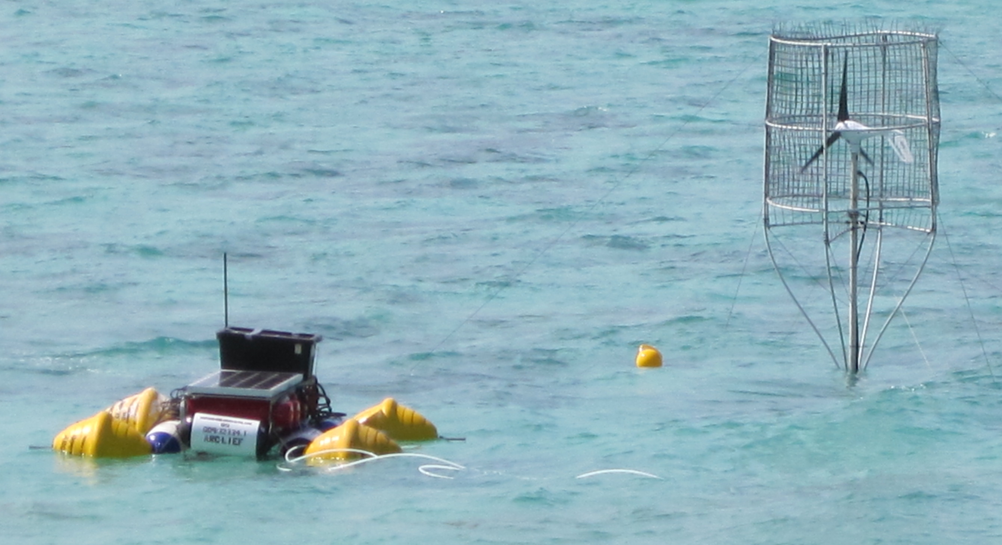
Component | Location | Why
Controller HW | Surface and/or Shore | Easier access Large housings
Controller Software | Surface And Shore | Co-located w/ HW
UI Software | Shore | Easier maintenance
Power | Surface or Shore | Easier access
Data | Surface and/or Shore | Co-located w/ control
ESW | Shore Or Surface | Permitting, depth, distance from shore
Industrial Computers
Location View
Data
Data
Power
Controller
Controller
Wireless
Controller
UI
Controller
Surface
Shore
Seafloor
Junction
ESW
pH
CTD
CTD
pH
Flow
Chamber
Flow
DO₂
Flow
DO₂
External
Notes:
Starting again with the geographic distribution of components
In this configuration, all of the electronics are situated on the surface.
Several controller housings, power generation and distribution
ESW distribution manifold
Though not explicitly shown, the ESW was generated on shore (using bottled CO2) and delivered to the site
Via gravity and pumps.
In the case of cpFOCE, this arrangement was motivated by permitting issues: it was OK to run an ESW hose, but not power lines, across the beach to the site.
A subsurface 1-atm jbox distributed power and comms to the chambers (there were 3 for cpFOCE).
A graphical user interface is implemented on shore
The reason for putting the electronics on the surface is for easier access, and could place fewer demands on the housings (at least at this shallow and relatively benign coral site).
To do this in deeper water would require some engineering to develop a robust surface expression and connect it to the seafloor.

Slide 45
Industrial Computers
Component | Build/Buy | Implementation
Controller HW | Buy | COTS: WAGO, National Instruments Compact-Rio (NI-CRIO), Serial MUX, Video MUX
Controller Software | Buy | COTS: LabView (custom drivers) Open Source: DataTurbine
Archive, UI | Buy | PC Workstation MacOS, Windows, Linux Open Source: DataTurbine, RDV, Pachube... COTS: LabView (custom archive), MATLAB
Power | Build/Buy | COTS: WAGO, NI-CRIO Custom: Ground fault detection, isolation
ESW | Build/Buy | Custom: pump and valve drivers COTS: WAGO, NI-CRIO, LabView, pumps, motor controllers
Build/Buy
View
COTS: Common Off The Shelf
OSDT: Open Source Data Turbine
RDV: Real-time Data Viewer OSDT client
WAGO, CRIO: Industrial computer implementations
MUX: multiplexer
Notes:
One of the distinguishing features of this approach is the use of COTS hardware and software.
The controller hardware takes advantage of flexible modular industrial computers like NI C-Rio and Wago.
These feature real time operating systems and a wide variety of control modules, layered with excellent software on top, which really speeds up development time.
These are expensive, but this approach may be one to consider when the funding is there, but the schedule and staffing are more lean.
These computers tend to consume more power – the processors are typically workstation class, and they are geared towards industrial applications.
The software stacks provide rich libraries that provide GUI components, control loop elements and functions that greatly reduce development time and are usually very robust.
They generally integrate well with some selected 3rd party packages like MATLAB.
One cost of this approach is flexibility – you are somewhat tied to the software tools (which, for example may use a graphical programming model), and the set of available hardware modules.
Though there is plenty of capability inside the boundaries (enough for basic FOCE),and even though there are some customization paths,
it may be difficult to go outside the box if the piece you need isn’t there or isn’t up to the required spec (e.g. serial IO – 9600 bps max)

Slide 46
Industrial Computers
ConnectionView
Data
Data
Power
Controller
Controller
UI
Controller
Controller
Surface
RF Wireless
WiFi
Cell
Satellite
Shore
Seafloor
Serial
Ethernet
Serial
Ethernet
Junction
ESW
pH
CTD
CTD
pH
Flow
Chamber
Flow
DO₂
Flow
DO₂
External
Notes:
With the power sub-system and controllers (and ESW distribution – e.g. manifold) on the surface,
A link for distributing power and communications needs to extend from the surface expression to the seafloor.
A junction box could be implemented as a 1 atm housing or oil-filled box would make the cabling simpler than directly running so many cables
Directly to the surface.
Though not specific to this approach, a few thoughts on connection options:
Serial is a likely choice if the deployment depth is approximately in the range of diver depth. For longer runs, it may be necessary to consider
Ethernet from surface to seafloor, either over copper using DSL or via fiber, though such designs can be somewhat technical to implement robustly, particularly in dynamic environments.
If no physical connection to shore is possible, then any telemetry could be done wirelessly. There are many options to choose from, and the trades are between
Cost, power, bandwidth and distance. RF and WiFi are very simple to use, with many great COTS options.
Fairly high bandwidths are achievable, though these are generally suitable over Line-of-sight distances and consume moderate to high amounts of power.
Depending on where they are used, you may encounter interference; you can use licensed frequencies, though there is some overhead cost associated with this path.
If you are within range of a cell phone network, there are a few good cellular modem options. Satellite is available almost anywhere in the world; Iridium is very popular and robust.
Cell and satellite connections can be costly and have limited bandwidth compared to RF options. Globalstar satellite is somewhat lower availability, but can be less expensive than other satellite options.

Slide 47
Summary
Industrial Computers
Pros
  Mostly COTS components
  Vendor and user community support
  Easier to build
  COTS software provides much infrastructure
Cons
  High cost of software and hardware
  High power consumption
  Large electronics form factors require larger housings
Notes:
The basic trades for Industrial computers are summarized here.
The hardware and software is expensive (I estimated $20k for a FOCE chamber; some software (about 30% of the cost) could be spread over multiple units.
It’s relatively high power – keep that in mind when using it in remote applications powered by solar and/ors wind.
The form factors tend to be large – completely practical, but it does require larger housings (which are harder to keep the water out of).
On the plus side, these systems can go together quickly, and the hardware and software available is generally robust.
Great support is available from vendors and user communities.

Slide 48
Sensor Node
Small COTS embedded PCs and microprocessors (Arduino, Beagle Board, etc.)
Modularize and aggregate power switching and/or data acquisition
Similar to eFOCE implementation
Reduce power consumption
Shown here using moored configuration
eFOCE image
Notes:
The approach we call Sensor Node takes advantage of the wide spectrum of small processors currently available off the shelf at very low cost.
The central ideas are to keep the hardware and software as simple as possible, and keep power consumption down to support remote configurations.
There is a little more integration work to do, but we aim to use COTS and open source as much as possible, and make any custom hardware and software
Easy to work with.

Slide 49
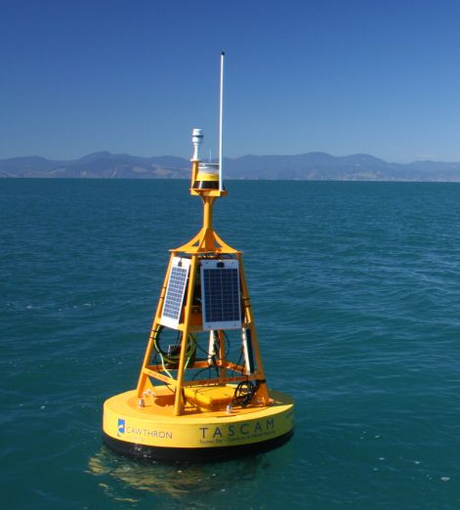
Component | Location | Why
Controller HW | Surface/Seafloor | Surface: telemetry, UI Seafloor: experiment control
Controller Software | Seafloor | Gateway: control, telemetry Node: data acquisition
UI Software | Shore/Surface | Easier maintenance
Power | Surface | Probably use generator, solar, wind on surface
Data | Seafloor And Shore | Local data needed for control Central archive for redundancy, easier access
Sensor Node
Data
Location View
Power
Data
Gateway
Wireless
Surface
Shore
Seafloor
Gateway
(Controller)
Data
Experiment Control for 1 chamber
Load switching,
Data Acquisition for
1-4 Devices
Node
Node
Node
Node
ESW
pH
CTD
CTD
pH
Flow
Chamber
Flow
DO₂
Flow
DO₂
External
Notes:
In each chamber, the system functions are split between a Gateway and several Sensor Nodes.
The Sensor Nodes are responsible for data acquisition from 1-3 devices, which includes switching power, as well as requesting and buffering data.
The controller gateway hosts periodically collects the data from the various sensor nodes, and hosts the control process that controls pH.
The Gateways also archive data for each FOCE chamber.
Another gateway on the surface (or shore) aggregates and archives data from each chamber controller gateway, and is a relay point for configuration and telemetry.
The hardware used for the Sensor Nodes can be simpler OS-less platforms like Arduino or PIC24.
These are fairly low power and have enough capability to get data from instruments and do simple control functions.
The Gateways need a little more capability, for example an ARM based solution that can run Linux.
The aim is to keep the system as simple as possible and the cost down.
Having the controller gateways and sensor nodes together on the seafloor makes each node modular and independent.
The types of hardware used typically have 3-5 hardware serial ports, so that using the readily available level of aggregation avoids the use of custom serial IO expansion hardware.
This arrangement also has a fine granularity (and low cost) of field replaceable units – when something breaks, it is less disruptive to replace it.

Slide 50
Sensor Node
Build/Buy View
Component | Build/Buy | Implementation
Controller HW | Buy | Gateway: BeagleBoard, Android, Gumstix Node: Arduino, MSP430, SmartSensor
Controller Software | Build | Gateway: Linux, C++/Java Node: C/C++, Wiring, e.g. Instrument drivers
Archive, UI | Build/Buy | Custom: back end interface Open Source: web server on gateway
Power | Build | Custom: load switch, ground fault detection, isolation
ESW | Build/Buy | Custom: pump and valve drivers COTS: pumps, motor controllers
Notes:
This Sensor Node approach balances build and buy, trying to keep the custom hardware and software focused on items on can’t be readily purchased.
Again, we want to take advantage of the wide selection of COTS processor boards with peripheral support for the things we need.
One of the tightest hardware requirements to satisfy is the number of serial ports.
Almost all have one or two, but finding more than three narrows the field pretty quickly.
Starting from scratch, this approach requires some software development – all things that are hard to find off the shelf or open source, though good building blocks are available.
For example, we find peripheral drivers (like SD cards), add on hardware and file systems even on small embedded platforms, but we will need to develop our own instrument drivers, data archive and transport formats.
In some cases, we may need to integrate our own real time clock, or find
On embedded linux systems, we can build our own protocols on top of existing network standards like TCP and HTTP, and will need to implement our own configuration and control libraries.
To simplify things, we’ll want to minimize the number of development languages and development tool chains we use. We can use existing standards and protocols where sensible; but we do want to keep the software minimal and accessible to users without a lot of software development experience.
There is some custom hardware to develop as well. The functions are ones that generally can’t be readily purchased, like voltage regulation, load switching, GF monitoring and galvanic isolation.
Some users may opt out of some of these features; they can be developed in a modular way using COTS components, and the designs made available for reuse by the community (perhaps through outlets like SparkFun).
If enough of a community grows around FOCE, there is potential for a lot of sharing of code and hardware designs.

Slide 51
Sensor Node
Data
Connection
View
Power
Data
Gateway
RF Wireless
Cell
Satellite
WiFi
Ethernet
(Serial?)
Surface
Shore
Seafloor
Gateway
(controller)
Data
Serial
Node
Node
Node
Node
Serial
ESW
pH
CTD
CTD
pH
Flow
Chamber
Flow
DO₂
Flow
DO₂
External
Notes:
As with all the approaches, it’s possible to connect them in different ways;
Here, the sensor node approach is shown in a moored configuration (as it is with eFOCE).
The important things to note are that the connection between the controller and surface gateways are connected by ethernet
While the sensor node to controller gateway connections are serial, as are the connections between sensor nodes and instruments/effectors.
This is done mainly to conserve power and keep the connectors and cabling simple - ethernet requires somewhat more specialized connectors, and the cabling may be
Trickier over long distances.
Each Gateway has an archive, duplicated on the surface as well for easy access and fault tolerance – another reason for providing a high bandwidth connection to the surface/shore gateway.
The connection to shore is flexible – here a wireless link is shown, though the whole spectrum is possible, from sneaker-net to high speed cable.

Slide 52
Summary
Sensor Node
Pros
  Reduce power
  No custom serial IO expansion
  Modularizes data acquisition
  Many variations possible
    COTS processors, languages
    Topologies
    Connection backbone (cost: power)
    Component upgrades
    Drivers on Gateway
Cons
  Two software development platforms
  More custom hardware to build, configure, maintain
  More cables, connectors, housings
  Video expansion path unclear
  Multiple system clocks
Notes:
To summarize the Sensor Node approach:
It’s aimed at reducing power by delegating data acquisition to small low power processors
and modularizing data acquisition functions according to the “naturally available” number of serial ports on COTS hardware, eliminating the need for custom serial expansion solutions or big workstation solutions
It’s flexible pattern that others can use, reuse and adapt to use components of preference or opportunity
The system cost can be quite low, with processors costing ~$50-300.
Possible down sides are that there are more that is custom, and even if you pick up someone else’s design, it is just more hardward to build, configure and manage.
There may be more cables and connectors, though some of these could be simpler than other options, for example if the Sensor nodes are potted and considered disposable since the cost is so low.

Slide 53
Approach Tradeoffs
Approach | Performance | Flexibility | Ease |  |  | Cost
 |  |  | Build | Use | Extend
“Centralized Workstation” |  | ■ |  | ■ | ■ | 
“Industrial Computer” | ■ | ■ | ■ |  | ■ | 
“Sensor Node” | ■ |  | ■ | ■ | ■ | ■
Recommendation: Prefer sensor node approach for xFOCE, though all are viable
Con

Pro
Notes:
The Bottom Line
Sensor Node is a good design pattern, with balance of build/buy
flexible, extensible, moderate cost
Variants trade complexity, power, modularity
In balance, we prefer the Sensor Node approach; we favor it for xFOCE and plan to use a variant of this for swFOCE

Slide 54
swFOCE Hardware Specs
Features | Sensor Node | Gateway
Serial | 4 | 5
Flash | 256 KB | ■
RAM | 8 KB | 256 MB
EEPROM | ■ | ■
SD Card | ■ | ■
SPI | ■ | ■
I2C | ■ | ■
Features | Sensor Node | Gateway
GPIO | ■ | ■
PWM | 2 @ ?Hz | ■
ADC | 12 bit | ■
Ext INT
Linux | ■ | ■
Optional

Required
Notes:
With an eye towards hardware selection for swFOCE,
these tables summarize some of the key hardware requirements.
The requirements are largely about program storage, serial ports and peripherals.
There are quite a few choices available that could probably to the jobs at hand.
One of the big drivers becomes the software development environments – we want to choose hardware so that the software tools and programming language support are accessible.
We imagine that C/C++, and Java are most familiar, as are things like the Arduino programming environment

Slide 55
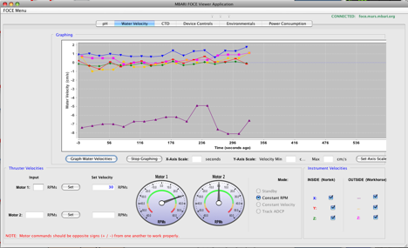
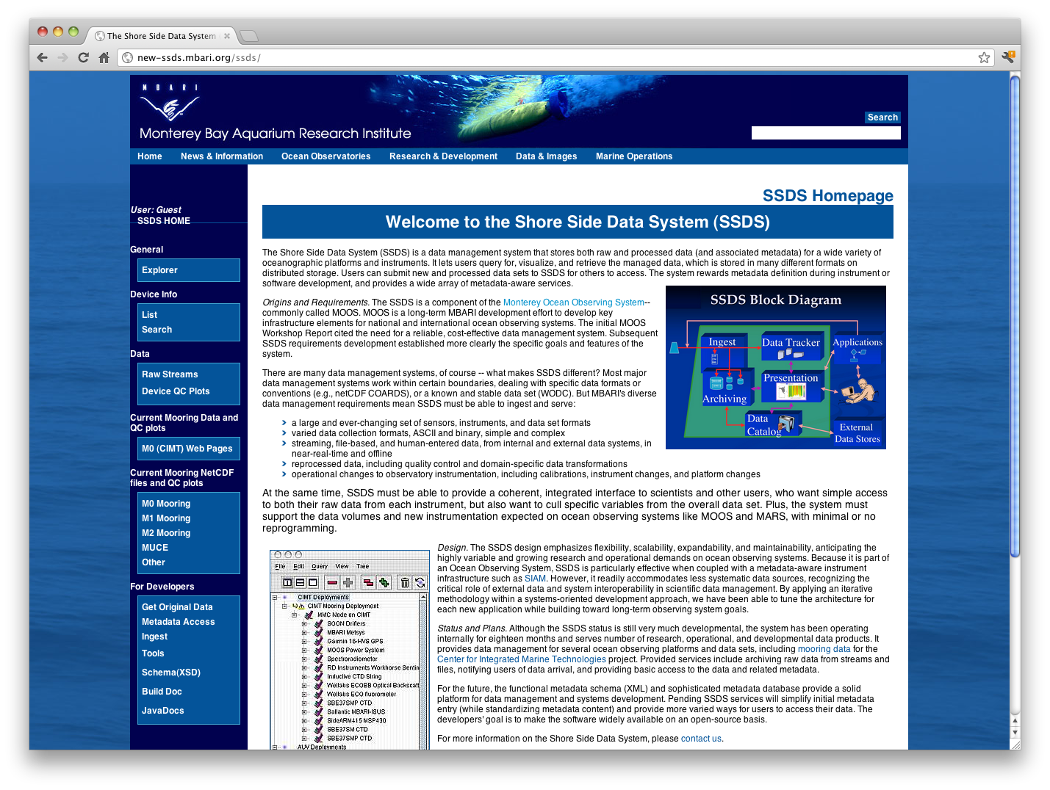
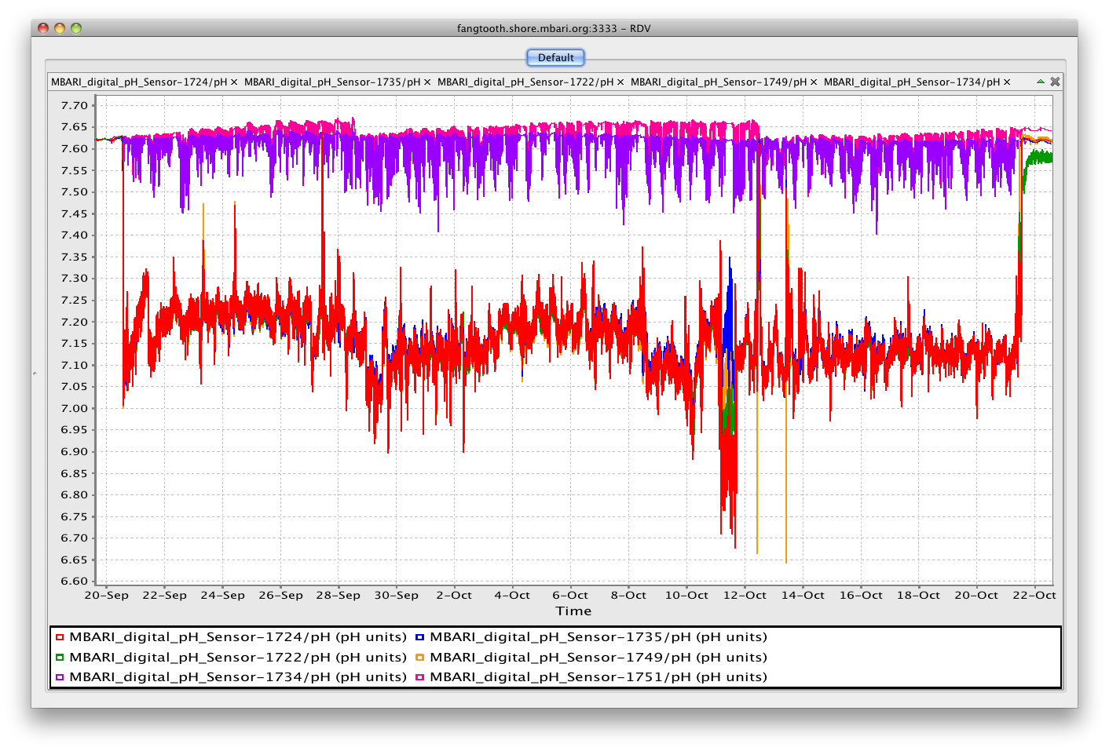

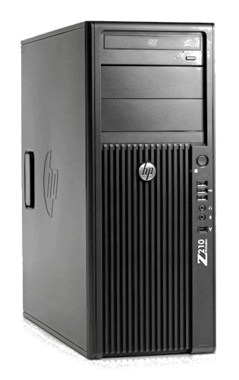
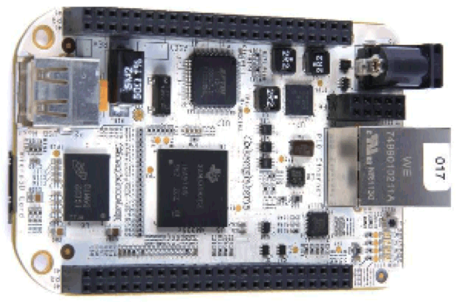
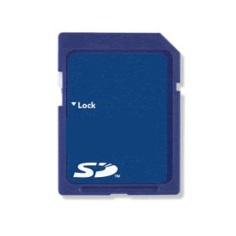



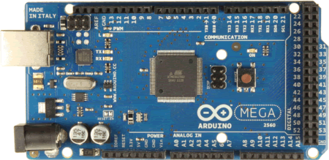
swFOCE Sensor Node Technology
FOCE GUI
Control
Configuration
Data Distribution
SSDS
RDV
Controller
Gateway
TCPIP
HTTP
100 Mbps
Shore Gateway
Network
Junction
Beagle
Bone
Power
Switch
MV
Converter
2 kW
KFA Cable
Serial
Data
Node
12, 24…V
ATMega
PIC24…
SSDS
Data Acq
Node
Node
Node
Motor
Drive
Power SW, ISO, GF
custom
1-3 Instruments Per Node
power
data
tbd
Flow
ESW
CTD
pH
DO
Flow
CTD
pH
DO
Flow
Notes:
With software factors in mind, here is our proposed configuration for swFOCE:
- Controller gateway using BeagleBone (open, ARM based embedded linux)
Arduino, PIC24 or similar for Sensor Nodes
Shore Gateway is a workstation
Custom hardware includes Power conversion (300-MV), power switching (w/ optional GF/iso) , sub-surface network switching
motor drives may be available off the shelf
We’ll do our own instrument drivers, control system, and protocols for distributing and archiving data at the low levels
Open Source Data Turbine - data distribution and streaming middleware - is an example of a great open source component that is robust and provides capability that would hard to develop well from the ground up.
We would likely use OSDT on the shore side to playback data in real-time or post-experiment, and possibly on the controller gateways to facilitate closed loop control as we have done in dpFOCE.
We’ll use our SSDS as the primary archive, along with a custom GUI for configuration and control.

Slide 56
Mechanical Components
Comprising
xFOCE / swFOCE
Farley F. Shane

Slide 57
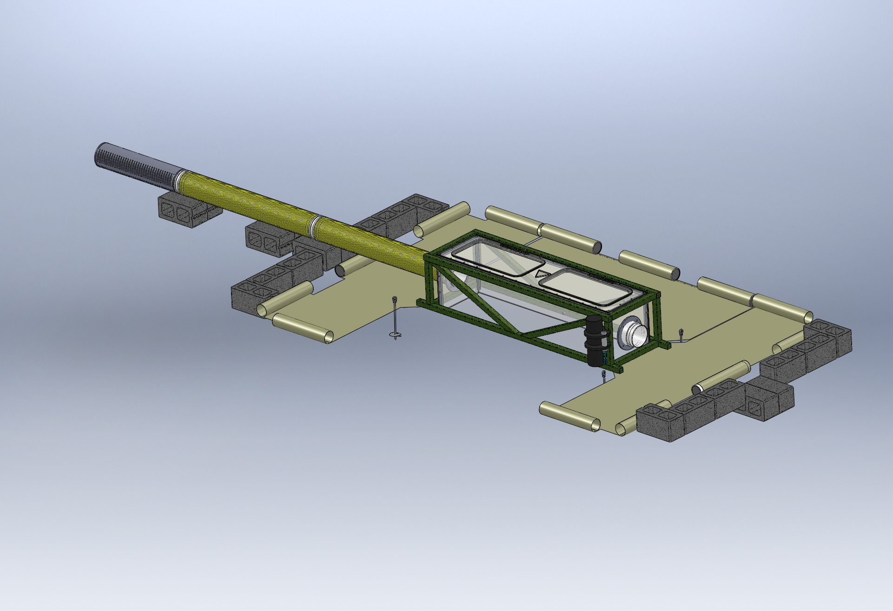
Typical Seafloor System Comprising an xFOCE
As needed
Enriched Seawater Delivery
From Surface
Enriched Seawater
Experiment Chamber
(Both Ends)
Perimeter Weights
Seawater Inlet
Valve Manifold
(Both Ends)
Fan Module
Location
(Both Ends)
Delay Path Section
(Both Ends)
(Conformal Sealing Mat
Removed for Clarity)
Conformal Sealing Mat(s)
Chamber Anchors (at corners)
Shear Skirt
(Bottom Perimeter
Scour Protection Elements
Notes:
Bricks optional

Slide 58

Sample Experiment Chambers
Fans to
Control Current
Buoyancy Blocks
Access Hatches
Control System in
Pressure Housing
Exo-Frame
Fitting for Time
Delay Section
Delay Path
Experiment Chamber
Conformal Seal
Subsea CO2 Reservoir
Enriched SW
Delay Path
Anchors
MBARI Deep FOCE
swFOCE Prototype
Surge Translation Paddle
Surface Available for Instrumentation
Fan
Fan
Handle
Side Access Opening
(Hatch Not Shown)
Modular Fan Section
Perimeter Shear Skirt
Hemi- Cylindrical
Trapezoidal

Slide 59
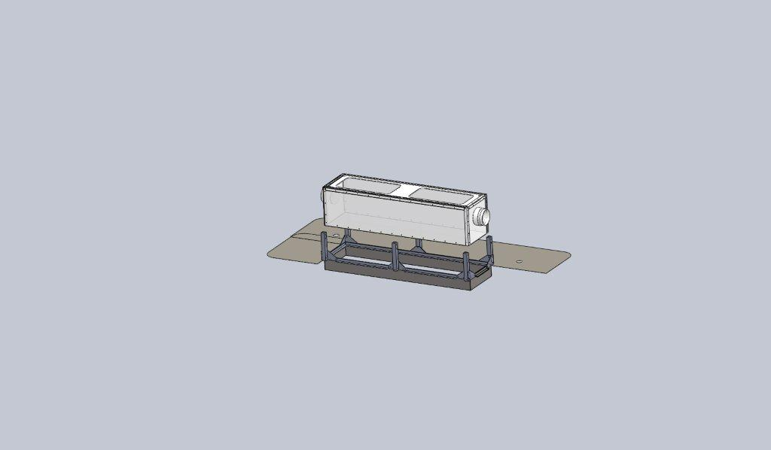
swFOCE Assembly w/Shear Skirt and Interface Seal
Experiment Chamber
Chamber Dock
Interface Seal
Rigid Perimeter Shear Skirt
Notes:
Make image bigger
Add “concept” notation
Add real picture of test unit (in situ)

Slide 60
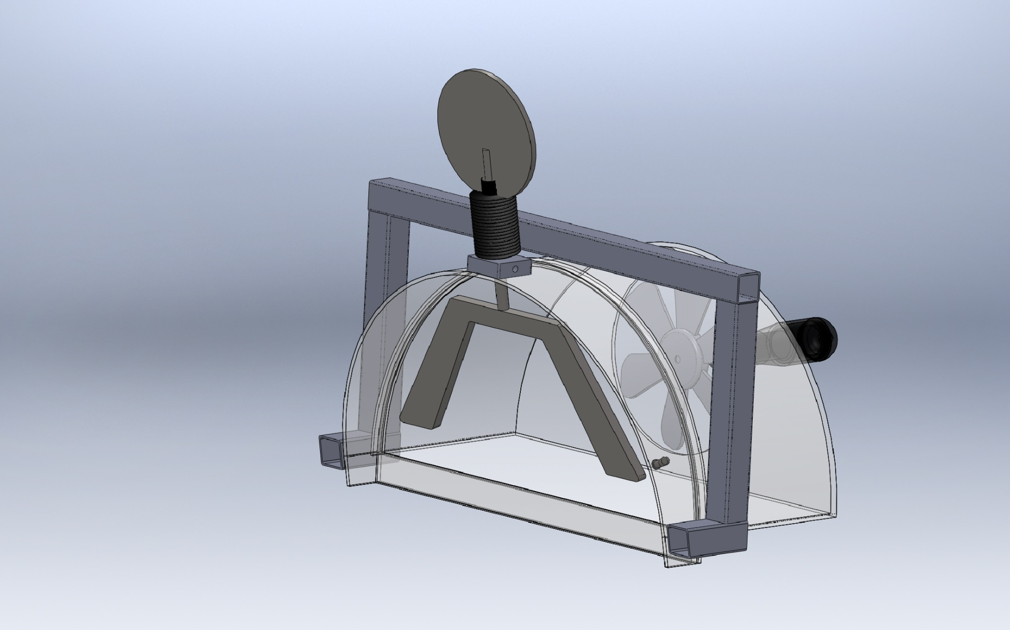
Surge Translation Mechanism
Pivot
Paddles
Section View

Slide 61


Time Delay Mixing Section
Offset pH = -0.7
Bkgrd pH ~ 8.1
Offset pH = -0.5
Offset pH = -0.3
(34.9 deg. F)
Flexible Duct
(39.2 deg. F)
(50 deg. F)
Length
  Calculated using 2 Tau time delay and desired maximum current speed.
  Provides the time necessary for the CO2 and seawater to chemically react and establish stabilized pH.
Cross-sectional area and current speed
(volume/time) will approximate the rate of change
of the enriched seawater in the Experiment Chamber.
(77 deg. F)
Tau = 67.8 secs
*
*
Tau = 51.3 secs
*
Tau = 31.1 secs
*
Curves from the Zeebe-Wolf Gladrow CO2 kinetic model
showing e-folding time at various temperatures as a function
of pH.
Notes:
Add time delay comments at front of talk

Slide 62



Simulating Current
Type
Pro
Con
  Compatible with shallow depths
  Easy maintenance/replacement
  Compatible with available power (AC/DC, etc.)
  Controllable according to requirements
  Capable of reasonable volume/rate delivery
  Low Cost --$50-$200
Requires modification to fit shroud
Not designed for long term running
Requires close monitoring of shaft seals
Trolling Motor
Technadyne Model 520 Brushless DC
  Multiple voltages
  Analog or digital control
  Magnetically coupled prop
CrustCrawler 400 HFL
  0-50VDC 400watts
  300 ft Depth
  Low Cost --$600
High Cost --$3700
Lip seals
Commercial Thruster
  Compatible with shallow depths
  Large range of flow rates
  Large range of DC voltages
  Readily available/replaceable
  Very inexpensive-- $20-$50
  Not designed to run continuously
  May need replacing more often
Submersible Bilge Pump
Brand Names: Rule, Attwood, Lovett, Johnson, Jabsco,…

Slide 63











Examples of Anchors
CQR
Epoxied Anchor Pins in Coral
Installation of
Anchor Pins
Claw or Bruce
Danforth
Drag Embedment Anchors for Mooring Buoy
Powder Actuated Stud Gun
Self Embedment Anchors
Deadweight Block
Single or
Multiple Helix
Dor-Mor
Helix Anchor

Slide 64
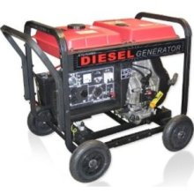


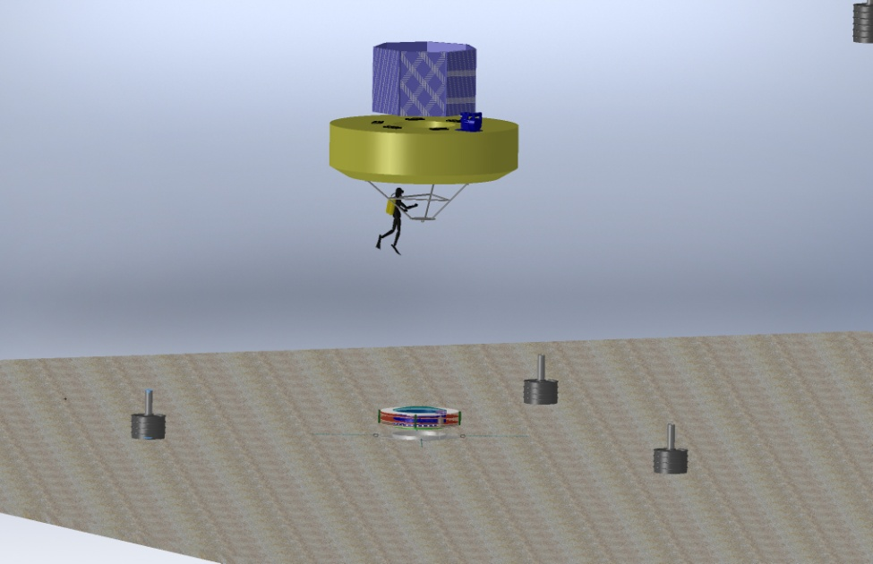
Power Options for xFOCE
Diesel Generator
3500 Watt Output
0.3 Gallon per Hr.
Onshore Power
  Power supply Unit
  UPS
Remote Location Power
Onshore or Offshore
  Diesel Generator
    Batteries
    Bonus of CO2 generation
  Wind Powered Generator
    Batteries
  Solar Cells
    Batteries
Offshore
  Moored Buoy
Wind Generator
400 Watt Output
240 Watt Panel
Buoy
xFOCE
Anchor
  Moored Buoy
Notes:
Check power consumption for half power (2 kW for 0.3 Gal/h)

Slide 65





Supporting Information
Exhaust used for CO₂
Diesel Fuel
Option for Extracting CO₂
from Exhaust
CO₂ Mix Electronics
Particle Scrubber
Supplemental
System Control Electronics
Carbon Dioxide Emissions from 1 gallon of fuel
Source: U.S. Environmental Protection Agency, "Emission Facts: Average Carbon Dioxide Emissions Resulting from Gasoline and Diesel Fuel," February 2009.
Notes:
Option for xFOCE (should be explicit for

Slide 66
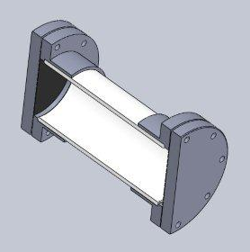
Low-cost Shallow Water Pressure Housing
PVC - Polyvinyl Chloride
strong and rigid
resistant to a variety of acids and bases
maximum usable temperature 140ºF (60ºC)
PVC Pipe
Nominal Pipe Size (inches) | Schedule 40 | Schedule 80
1/2 | 358 | 509
3/4 | 289 | 413
1 | 270 | 378
1 1/4 | 221 | 312
1 1/2 | 198 | 282
2 | 166 | 243
2 1/2 | 182 | 255
3 | 158 | 225
4 |  | 194
5 |  | 173
6 |  | 167
8 |  | 148
(psi)
(psi)
Operating Temp (°F) | De-Rating Factor
73 | 1.00
80 | 0.88
90 | 0.75
100 | 0.62
110 | 0.51
120 | 0.40
130 | 0.31
140 | 0.22
Design Parameters
Operating Depth = 40 Meters (~131 ft.)
Maximum Pressure = .444 x Depth (ft.) +14.7 psi → 73 psi
Factor of Safety = 2 Therefore 2 x 73 psi = ~146 psi max.
Notes:
This is a generic Sch80 PVC, COTS pressure housing good to diver depths.
Flanges glued on with PVC cement, Butyl or Neoprene 1/8" rubber discs for
seals, caps bolted on.

Slide 67


xFOCE Engineering Trades
Color Frequency Wavelength
violet 668–789 THz 380–450 nm
blue 631–668 THz 450–475 nm
cyan 606–630 THz 476–495 nm
green 526–606 THz 495–570 nm
yellow 508–526 THz 570–590 nm
orange 484–508 THz 590–620 nm
red 400–484 THz 620–750 nm
infrared longer than 750 nm
Since these wavelengths penetrate water easier but most plastic materials respond poorly to high freq light the materials selections will focus on this end of the spectrum
The selection of materials will likely transmit this end of the spectrum fairly well but in selection, if required, we would trade attenuation here to maximize shorter frequencies.
Acrylic (vs Polycarbonate) has less attenuation overall and carries much further into the ultraviolet when comparing the blue lines.

Slide 68
xFOCE Electrical Design
Chad Kecy
Electrical Engineer

Slide 69
Preliminary Considerations for any FOCE system
Cabled vs Non-Cabled
Power
  Generation
  Distribution
  Heat Dissipation
Communications
  Shore to subsea
  Subsea to instruments
  Type / amount of data
Reliability
  Environmental condition monitoring
  Electrical protection of instruments/subsystems
  Ground fault protection

Slide 70
Non-Cabled System
(general for xFOCE)
Wireless
Communication
Buoy or Platform
Local Power
Generation

Slide 71
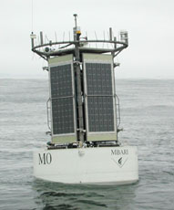
Mooring
Power Generation
  Solar, Wind, Diesel
  Battery Storage
Shore Communication
  Wireless Telemetry
Tether to Subsea Component
  Power
  Communication

Slide 72
Cabled System
(swFOCE configuration)
Shore Side
Station
Tether
Underwater
Connection

Slide 73
Shore Side Station
Physical Requirements
  Location
  Type of Installation
  Weather / Environmental Conditions
  Cable path (buried, exposed)
  Permitting
Electrical Requirements
  Power Source
  Communication Equipment
  Ground Fault Detection / Safety
Notes:
Trawling
Anchoring
How to deploy

Slide 74
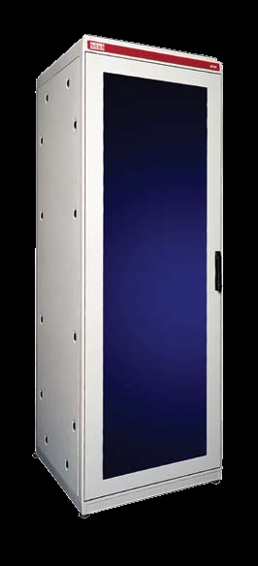
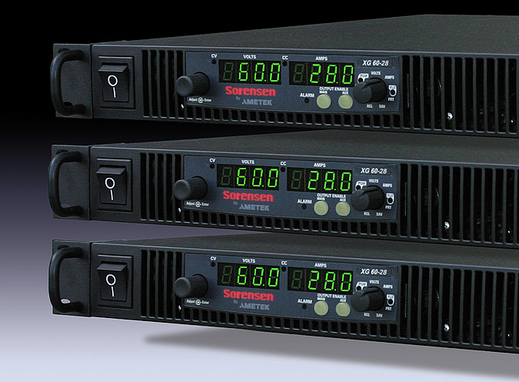
swFOCE Shore Side Electronics
Rack mountable components
  Power Supplies
  Isolation Transformer
  Router
  CO₂ generation control
  Data Acquisition

Slide 75
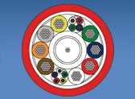
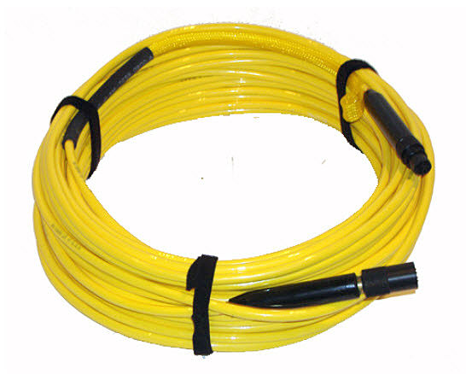
swFOCE Cabled Tether
Electrical Requirements
  Power rating
  Communication speed / bandwidth
  Number of conductors (twisted pairs)
  Fiber optics?
  Connector selection
Mechanical Requirements
  Length
  Strength
  Anchoring
  Trawl Resistant
  Deployment Method

Slide 76
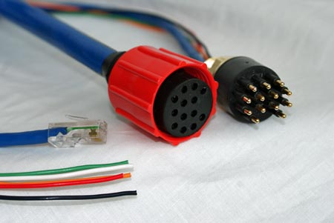
Underwater Connectors
Types
  Wet-mateable
  Dry-mateable
Considerations
  Deployment
  Servicing
Ratings
  Power conductors: voltage/current
  Communication conductors: speed/bandwidth
Notes:
#1 failure point
Speed/power issues

Slide 77
System Level Functions
Distribution of DC power to external instruments and internal subsystems
Bidirectional communication to external instruments and internal subsystems
Health monitoring for entire the subsea node
Computer
  Collection and dissemination of data
  Closed loop control of the experiment

Slide 78
DC Power Example
48V to 24V
Conditioning
Patch Panel
Inrush
Limiting
48V to 12V
Conditioning
12V
Ethernet
Switch
12V
Load Switching
24V
24V
Computer
pH Probe
CTD
ADCP
Camera
Thruster

Slide 79
DC Power
DC-DC Converters
  Converts input DC voltage to all necessary lower DC bus voltages.
Conditioning and monitoring
  Provides filtering and power monitoring.
Patch panel
  Distributes lower DC bus voltages to internal subsystems.
Load switching to individual instruments
  Provides galvanic isolation, over/under current/voltage protection, power monitoring, and ground fault detection to each instrument.

Slide 80
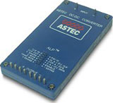
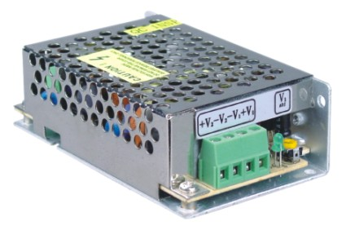
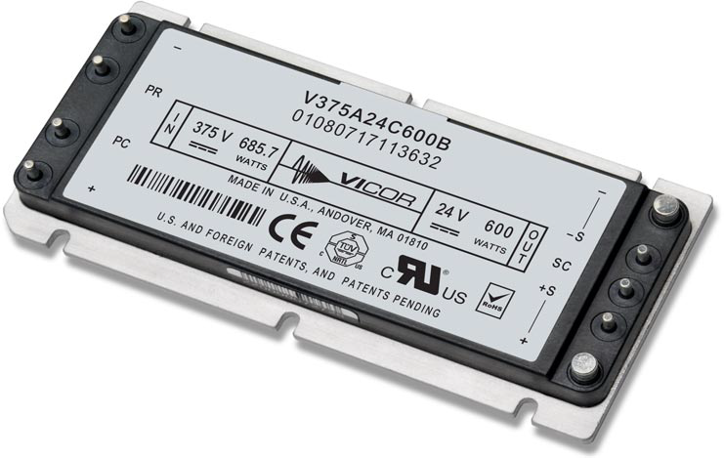
DC-DC Converters
Multitude of form factors
COTS vs Custom
Standard package for wiring consideration
Choice of bus voltage
Built-in Conditioning?

Slide 81
Communication
Communication from shore to subsea node
  Factors:
    Is your FOCE tethered or standalone?
    Distance
    Bandwidth requirements
    Shore based infrastructure
  Potential choices:
    Tethered: Ethernet, RS-422, DSL
    Standalone: Wireless ethernet
Communication from subsea node to individual external instruments
  Most instruments utilize serial comms
    RS-232 and RS-485 most common

Slide 82
Communications Example
Ethernet
Switch
Computer
Video
Server
Serial
Expander/Server
Serial
UARTs +
Transceivers
Optional Paths
pH Probe
CTD
ADCP
Camera
Thruster

Slide 83
System Health Monitoring
Provides top side users with status of environmental conditions in the subsea node.
Can be used to automatically power down instruments in the event of a failure.
Conditions measured:
  Temperature
  Humidity
  Water presence
  Housing pressure
  Orientation

Slide 84
Health Monitoring Example
Ethernet
Switch
Computer
Ambient Temp
48V to 24V
Ambient Humidity
Health
Monitor
Ambient Pressure
Thermocouples
48V to 12V
Cooling Fan
H2O Sensor

Slide 85
Four Potential Backbone Systems
1. PC/104 Stack
2. Wago I/O System
3. Instrument Chassis
4. Sensor Node

Slide 86



PC/104 Stack
What is PC/104?

Slide 87
PC/104 Stack
Advantages
Disadvantages
Rapid prototype/design
Expandable/reconfigurable
Extensive functionality
Relatively inexpensive
Industry standard
Often software drivers included
Can incorporate custom boards
Power consumption
Maintenance
  Need to disassemble the stack to get to middle boards.
Limit on # of boards in stack
Sometimes, no software drivers….

Slide 88

Wago I/O System
What is a Wago I/O System?

Slide 89
Wago I/O System
Advantages
Disadvantages
Rapid prototype/design
Expandable/reconfigurable
Industry Standard
Generic software interface
Can incorporate custom boards
Limited functionality for our requirements
  More custom designs
Power consumption

Slide 90




Instrument Chassis
What is the Instrument Chassis?

Slide 91
Instrument Chassis
Advantages
Disadvantages
Was designed specifically for use in the shallow water FOCE system
Modular; new boards can be designed.
Low Power design
Simple software interface
Design complexity
Expensive to produce
Custom firmware needed
Currently, no serial expansion included

Slide 92
Sensor Node Board
What is the Sensor Node Board?
DC Power from Bus
DC Power to Instrument
Pluggable
CPU
Module
BeagleBone?
Arduino?
Microchip PIC?
SmartSensor?
Load Switching
Inrush
Limiting
Circuit
Breaker
Over/Under
Curr/Volt
Det / Mon
Ground Fault Detection
UART
Serial Transceiver
Comms
Serial comms to Instrument

Slide 93
Sensor Node Board
Modules available?
  None, it is a fully functional standalone unit
  1-3 instruments per Sensor Node board
Functions available:
  CPU, storage
    Device driver could be active locally
  Serial interface (uart + transceiver)
  Load switching
    Over/under curr/voltage detection
    Ground fault monitoring
    Current/Voltage monitoring

Slide 94
Sensor Node Board
Advantages
Disadvantages
All functions on one board
CPU simple to program
Single board design can handle a large variety of instruments
Open source HW and SW
Custom design
Cost?
Distribution

Slide 95
Electrical System Comparison
 | PC/104 | Wago | Instrument Chassis | Sensor Node Board
Central CPU | Yes | No | No | No
Local CPU | No | Yes | Yes | Yes
Local Storage | Hard Drive | No | SD Card | ?
Ethernet Interface | Yes | Yes | Yes | ?
Serial Expansion | Yes | No | No | One per
Load Control Relays | Yes | Yes | Yes | Yes
Circuit Breaker Protection | No | No | Yes | Yes
Inrush Limiting | No | No | Yes | Yes
Ground Fault Detection | No | No | Yes | Yes
Thermal Inputs | Yes | Yes | Yes | Yes
Humidity Inputs | Yes | No | Yes | Yes
H2O Sensor Inputs | Yes | Yes | Yes | Yes
Pressure Sensor Input | Yes | Yes | Yes | Yes
3-Axis Orientation | No | No | Yes | ?
Power Usage (Watts) | 45 | 70 | 10 | ?
Cost per System ($) | $3500 |  | $ 3486 | ?

Slide 96
Proposed swFOCE Electrical System
Cabled System
  Tether carries 375Vdc and fiber optics for ethernet
Down-converting to 48Vdc in a central node
Copper Gigabit ethernet to swFOCE node
Utilizing star topology architecture with Sensor Node boards
Sensor Node boards with configuration options
Time-lapse camera + video option
Notes:
Camera/time-lapse, video option
Sensor node configuration options?

Slide 97
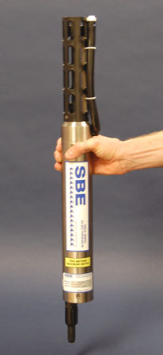
xFOCE Core Instrument Suite
Sensor | Specification
pH | +/- .01 pH unit or better and suitable for control loop applications
CTD, DO₂ | Comparable to current units at MBARI, unit is SBE37 (oxygen can be included)
Flow Sensor | TBD, likely electromagnetic to get smooth flow numbers and volumetric data. From dpFOCE acoustic velocity sensors are not suitable.
Suggested architecture allows for expansion of additional instrumentation

Slide 98
swFOCE Core Instrument Suite
Sensor | Specification
pH | +/- .01 pH unit or better and suitable for control loop applications
CTD, DO₂ | Comparable to current units at MBARI, baseline unit is SBE37 (oxygen can be included)
Flow Sensor | TBD, likely electromagnetic to get smooth flow numbers and volumetric data. From dpFOCE, acoustic velocity sensors are not suitable.
PAR* Sensor | 400 – 700 nm / calibrated to 0 – 5000 μmol photons•m ⁻²•s ⁻¹
Camera/Lights | 1080p - 16:9 ratio format – light source either natural and/or color balanced LED
Suggested architecture allows for expansion of additional instrumentation
PAR* - Photosynthetically Active Radiation
Notes:
Reformat slide

Slide 99
xFOCE/swFOCE Data System

Slide 100
xFOCE Data
Clients
Archive
Configuration
& Control
Basic requirements
  Sample rates, Timestamp accuracy (1 s)
  Time-stamped archive of experiment data
  Flexible data archive format (time-stamped CSV)
  Health and status monitoring
Users will prefer different ways to access data
  MATLAB, Excel, LabView, custom utilities…
Well defined (and standard) interfaces are key
  Configuration and control interfaces
  Data access interfaces:
    Services, clients, applications
    Simple, efficient, support low-bandwidth links
  Data archive formats
Metadata
  Science and system contextual data
    Changes to instruments, sampling, calibrations
    Ground faults, leaks and other system faults
  Enables understanding of what is (or did) happen
  Provides insight into anomalies, troubleshooting
Transformation
Presentation
Query
Links
Archive
Distribution
Distribution
Distribution
Controller
Controller
Controller
Driver
Driver
Device
Device

Slide 101
swFOCE Data
Added requirements
  Remote access
    Multi-user
    Separate administrative access
  Metadata management
  Compatibility w/ dpFOCE data
  Ground fault monitoring
  Still/video image data

Slide 102

swFOCE Data
Seafloor
Hopkins
Remote
Shore Side Data System (SSDS)
Primary data archive
MBARI internal standard
SSDS Server
Controller
TCP, UDP
HTTPS
Java RMI
Controller
SSDS Data
Archive
Controller
User
Tools
Instrument Data
Archive
HTTPS
Instrument Data
Archive
Local Data
Archive
SSDS
Controller Software
Access
Server
Control Service
Access
Service
Data ACQ
Services
FOCE GUI
Control, monitor
Data ACQ
Services
OSDT?
Data ACQ
Services
OSDT Server
TCP, UDP
OSDT Data
Archive
Data
ACQ
•••
Data
ACQ
Real-time Data Viewer (RDV) OSDT client
Live, post-experiment
data playback
Open Source
DataTurbine
Flow
ESW
CTD
pH
DO
Flow

Slide 103
UI System Requirements
Network Connectivity (Ethernet, Serial, Wireless)
Health and Status (heartbeat on connection)
Control Application Programming Interfaces (APIs) – System and Instruments
Data Collection APIs
Security:
  User Authentication / Authorization
  Enforce Maintenance or Lockout of System (unless mechanical)
Node / Instrument List (registry)
Metadata access / management
Data Format and Parsing (or pick data format)
System Change Notification (push notification for low bandwidth)
Scaling and Extensibility (all the above for additional instruments)
Data repository for historical data

Slide 104
REQUIREMENTS | xFOCE | SWFOCE
1. Network Connectivity | ■ | ■
2. Health and Status | ■ | ■
3. Control APIs for both System & Instruments | ■ | ■
4. Data Collection APIs | ■ | ■
5. Security | ■ | ■
6. Node / Instrument List (Registry) | ■ | ■
7. Metadata Access Management | ■ | ■
8. Data format and parsing | ■ | ■
9. System Change Notification | ■ | ■
10. Scaling and Extensibility | ■ | ■
11. Data repository | ■ | ■
■ = Required
■ = Maybe, It Depends…

Slide 105
UI Functions

Slide 106
One end of the spectrum

Slide 107
The other end (swFOCE)

Slide 108
The other end (swFOCE)
Telemetry
Important Considerations:
Telemetry / Communications

Slide 109
The other end (swFOCE)
Transport
Important Considerations:
Telemetry / Communications
Transport

Slide 110
The other end (swFOCE)
Security
Important Considerations:
Telemetry / Communications
Transport
Security

Slide 111
The other end (swFOCE)
APIs
Important Considerations:
Telemetry / Communications
Transport
Security
APIs

Slide 112
The take home
Co-develop / design GUI in-concert with system hardware and software
Define options for telemetry / communications
Design transport for system concerns and telemetry
  RPC / Messaging / ?
Design security / safety
Take a disciplined, layered approach to architecture
  Explicit, well documented, and controlled interfaces / APIs
These core system APIs can be used by any type of client
  Command line
  Direct client application
  Remote Client

Slide 113
Schedule and Resources

Slide 114
swFOCE 2012 Resources

Slide 115
swFOCE schedule

Slide 116
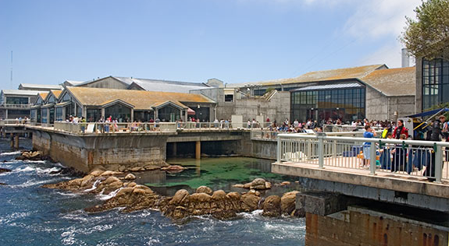
FOCE: A tool to understand local impacts of Ocean Acidification
Funding Provided by The David and Lucile Packard Foundation

