Slide 1
xFOCE / swFOCE
Review

Slide 2
xFOCE
Bill
Quick Background – talk about the current activities
eFOCE, cpFOCE, dpFOCE and how these led to the xFOCE

Slide 3
xFOCE Science Reqs
Bill / Ed
Shall
Broad spectrum light transmissibility approp. to test
Anchoring and sealing to ocean floor approp. to test, the more uneven the bottom, the more difficult this aspect becomes
May

Slide 4
swFOCE Science Reqs
Bill / Ed
Shall be Built on xFOCE

Slide 5
xFOCE Technical Requirements
-OTS components where possible
-Easy to obtain and fabricate materials, typical shop tool construction, E.G.- Band saw, power hand drill, etc.

Slide 6
swFOCE Technical Requirements
-Max Light Transmissibility- Biologist Requirement
-Wave Zone-Protection from Wave generated forces and scouring
-Mechanism to generate internal oscillating flow-similar to wave surges
-Photic zone-clean as necessary
-Controlled flow thru system.
-Diver access to instrumentation , cameras, etc. for cleaning, orientation, etc.
-Use of underwater matable or non-contact connections wherever poss.

Slide 7
xFOCE Concept of Ops cable
Science interface on shore
CO2 and Enriching process on shore
Air / sea interface managed using buried cable
Capable of supporting 6 to 8 xFOCE units
(4 active pH chg and 4 control or
A regression series incl. a control)
Depth rating
min - XX
max - XX
Anchored to bottom
Uses ??? to prevent erosion
Length of cable is limited by req. of power, comm’s and noise

Slide 8
xFOCE Concept of Ops no cable
Science interface on shore
CO2 and Enriching process off shore
Air / sea interface managed using surface expression (buoy ?)
Capable of supporting 6 xFOCE units (?? Maybe less)
(3 active pH chg and 3 control)
Comms by telemetry
Depth rating
min - XX
max - XX
Anchored to bottom
Uses ??? to prevent erosion
Largest trade-off is power supply . Wind + solar + Batteries might supply
10-20 W continuously.

Slide 9

xFOCE Concept of Ops

Slide 10
xFOCE Tech Specifications
Several pages maybe???
Divide shalls from nice to have
These are specific and measureable… testable

Slide 11
swFOCE Tech Specifications
Starting with xFOCE… does not conflict
Divide shalls from nice to have
These are specific and measureable… testable
- assembled with shop tools
-enhSW distribution block for multiple units
-mixing section of flexible ducting on each end– Dia. and Length TBD

Slide 12
xFOCE Systems concept
Divide sub-systems out, major blocks and define what will traded.
Define system / sub-system interfaces
Assign each trade to a
Provide user/designer with tools and info sufficient to make an informed choices
from trade-offs. Excel- ETP3 CO2 Calculator and JTS xFOCE Mixing Section Length and Q’s
See xFOCE Mechanical Design Trade-off.doc – also in this file.

Slide 13
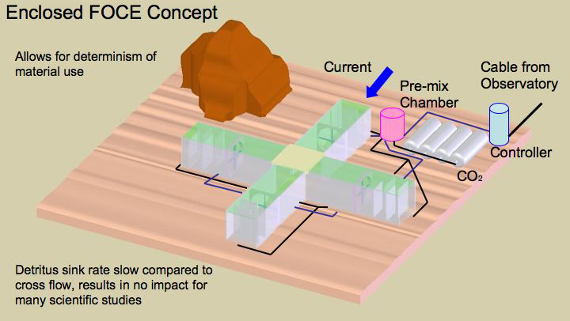
xFOCE Systems concept

Slide 14
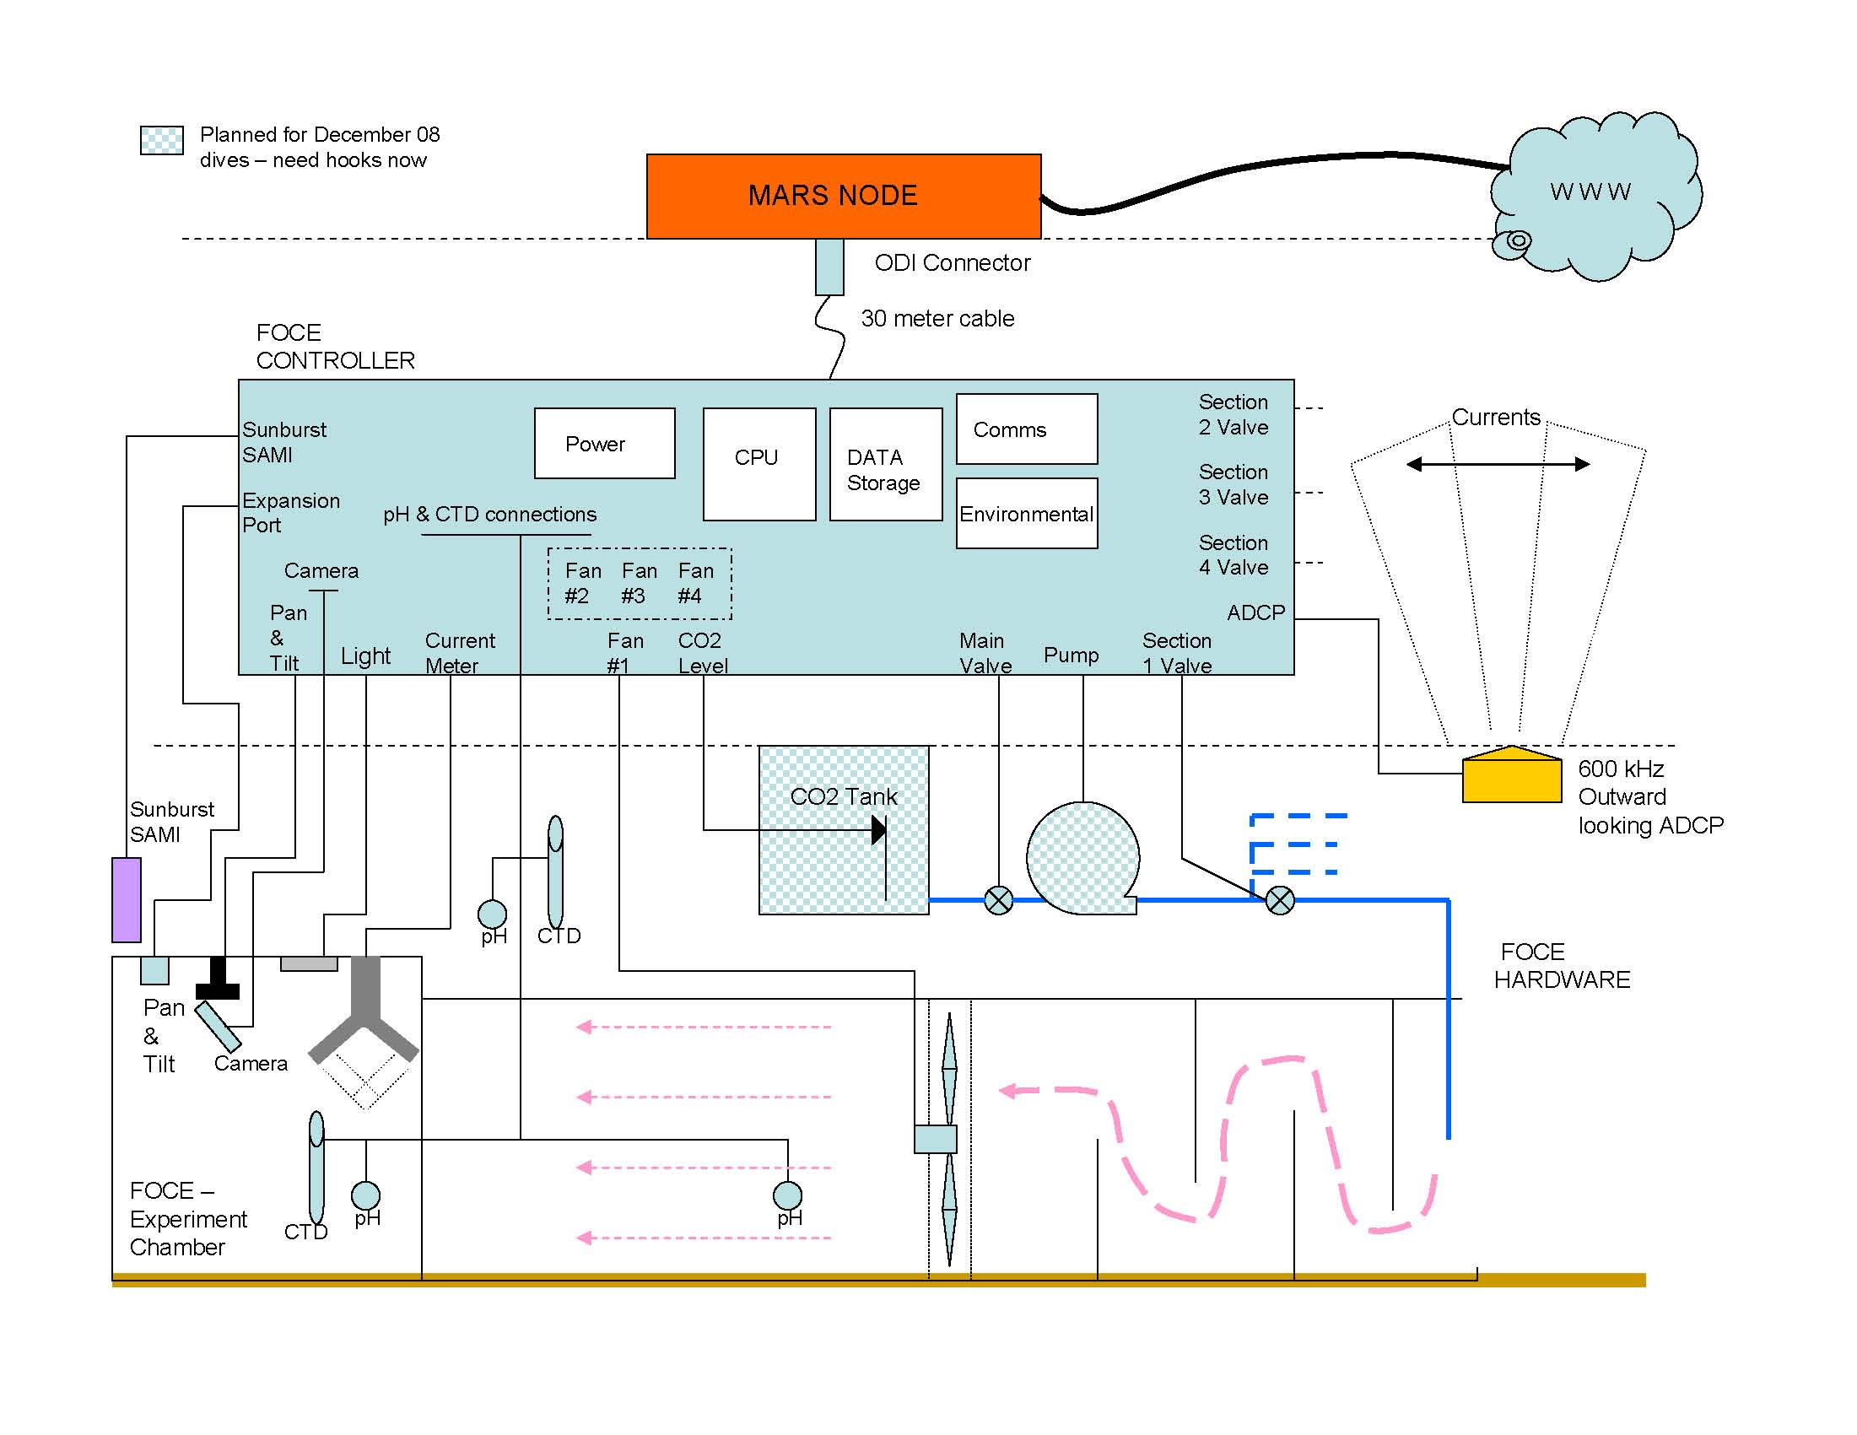
xFOCE Systems concept
What is the minimum requirement of elements for xFOCE?

Slide 15
swFOCE Systems concept
Divide sub-systems out, major blocks and define what will traded starting with xFOCE base.
Define system / sub-system interfaces
Assign each trade to a

Slide 16
swFOCE Systems concept

Slide 17
swFOCE Systems concept
What is required to make an swFOCE?

Slide 18
Mechanical
Basic xFOCE Structure
swFOCE if anything is modified
Anchoring (environmental data)
Flow control
Thruster/Pumps TBD, test section flow 0-4 cm/sec
Light management
-Acrylic sheets with translucent corners-next slide
Bio-fouling
0.5m x 0.5 m x 2 meters
4 helical sand anchors + weighted scour skirts

Slide 19
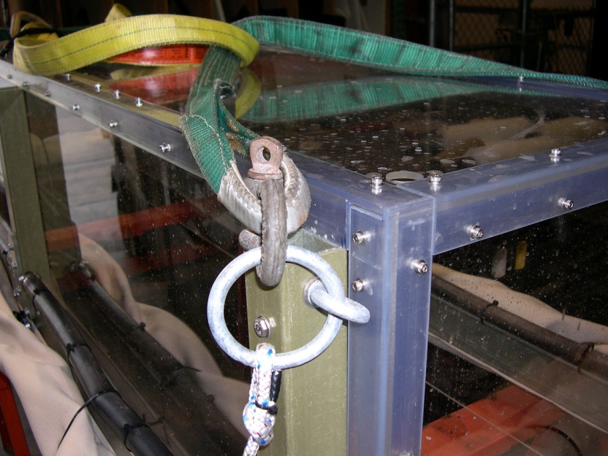
Acrylic sheets with PVC corners

Slide 20
Electrical
Power
Budgets
Management
Communications
Ground Fault ??
Control Circuits

Slide 21
Software
Basic Architectural Structure
xFOCE (minimum needs)
swFOCE (extensible elements as needed)
Open Source
Controller / algorithm development
Science/User interfaces
most basic
options
Realtime vs. ??

Slide 22
Data
Collection
Storage
Processing (??)
Quality
How does design handle modularity of xFOCE

