Slide 1
Mechanical Components
Comprising
xFOCE / swFOCE
Farley F. Shane

Slide 2
xFOCE Mechanical
Sub-Systems
              Seafloor Array
              Onshore Array

Slide 3
Typical Components Comprising a Seafloor Array
Optional
Enriched Seawater Delivery Line
From Onshore Array
Scour Protection Elements
Experiment Chamber
Seawater Inlet
Scour Protection Elements
Scour Protection Elements
Time Delay Mixing Section
Chamber Anchors (at 4 corners)
Conformal Sealing Mat(s)
Time Delay Mixing Section
Seawater Inlet

Slide 4
Experiment Chamber Requirements
  Appropriately sized to meet requirements dictated by the site and the specific
  dimensional area of experimentation.
  The height of the vertical cross-sectional area shall be capable of accommodating all
  biology and other items of interest , plus all required instrumentation and ancillary
  equipment.
  There shall be at least one entrance and one exit to permit active or passive simulation of
  any local current.
  A method shall be used for incorporating a 2 Tau time delay path, volumetrically sized
  relative to the chamber and desired current velocity.
  Tidal effects may be simulated mechanically or by another method as desired.
  A method shall be used for sealing the interface between the chamber and the specific
  site to mitigate enriched seawater leakage or seawater intrusion, and to inhibit local
  critter incursion.
  A method shall be used as necessary to mitigate scour or erosion at the experiment site.
  An appropriate method of securing the chamber to the site shall be used.
  Hatch requirements
    Several smaller rather than one larger
    Secured by latches
  Diver Depth
    40 meters

Slide 5
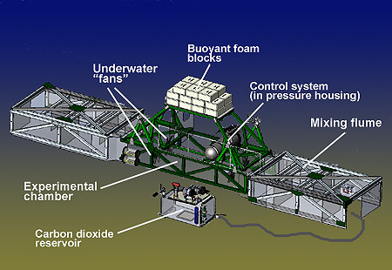

Sample Experiment Chamber Configurations
Access Hatches
Fitting for Time
Delay Section
Conformal Seal
Anchors
MBARI Deep FOCE
SWFOCE Prototype
Surge Translation Paddle
Surface for Possible Instrumentation
Handle
Modular Fan Section
Side Access Hatch
Perimeter Shear Skirt
Hemi- Cylindrical
Trapezoidal

Slide 6
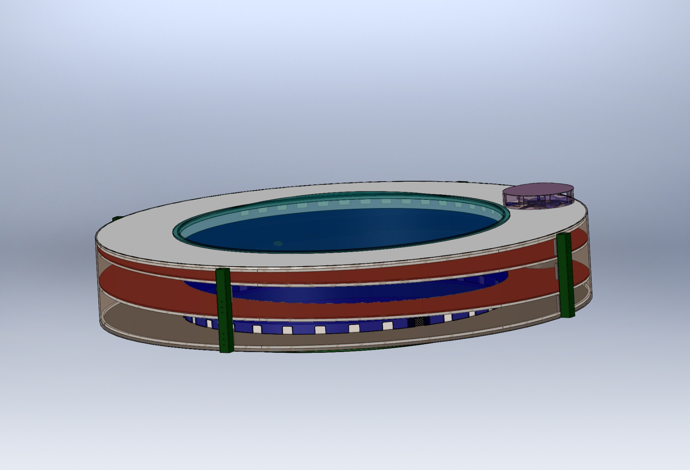
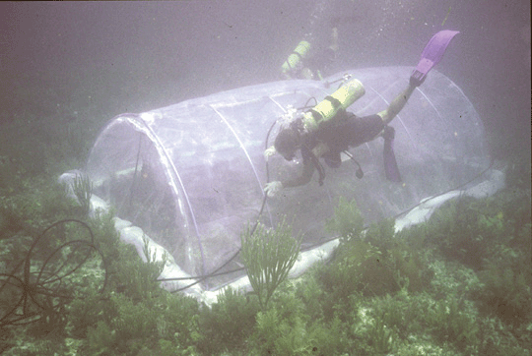
Sample Experiment Chamber Configurations
(Cont.)
Experiment Chamber
Volume
Transparent Cover
Exhaust Vents
Fan
Integral 2 Tau Path
Inlet vents
Guggenheim/Stadium Concept
Compliant Chamber
(Not a FOCE as shown)
Submersible Habitat for Analyzing Reef Quality (SHARQ)
Polyethylene film
Frame made of plastic or metal tubing.
Requires a fairly benign environment.
Translates surge.
Current configuration does not incorporate delay
path.
Requires creative instrument attachment.

Slide 7
Time Delay Mixing Section
The Enriched Seawater Time Delay “mixing” Section provides the necessary time for the CO2 and the seawater to chemically react and establish a stabilized pH.
The 2 Tau time delay is determined by water temperature and the desired pH.
The Zeebe-Wolf Gladrow CO2 Kinetic Model is used to determine Tau.
The length of the mixing section is relative to the desired current speed.

Slide 8

XFOCE Chamber Requirements
Offset pH = -0.7
Bkgrd pH ~ 8.1
Offset pH = -0.5
Offset pH = -0.3
Tau = 67.8 secs
*
*
Tau = 51.3 secs
*
Tau = 31.1 secs
*
Curves from the Zeebe-Wolf Gladrow CO2 kinetic model
showing e-folding time at various temperatures as a function of pH.

Slide 9
Excel Spreadsheet
Estimation of Shallow-FOCE CO₂ enriched seawater release rate:
Assumptions:
 | 1. Shallow FOCE is smaller than FOCE at MARS by 1/2: 0.5m X 0.5m.
 | 2. Water velocity thru flume set as "on average" a 1 cm/s flow through chamber.
 |  | - residence time for a 1 meter length chamber is 100 secs.
 |  | - internal cyclic flow indiced by a paddle.
 |  | cm/sec | ht (m) | w (m)
 |  | 10 | 0.5 | 0.5 | 25 | L/s
 | 3. Concentration of CO2-ESW: |  |  | 40 | mM | pH: | 4.75
 | 4. FOCE uses different amounts of CO2 depending upon pH offset:
 |  |  |  |  | Vol CO2-ESW |  |  |  | Amt CO2
 |  | pH offset | +TCO2 | Amt CO2 | mL/s | L/min | L/day |  | kg/day | lb/day
 |  |  | μmol/kg | µmole/s
 |  | 0.2 | 74.5 | 1862.5 | 46.563 | 2.794 | 4023 |  | 7.082 | 15.61
 |  | 0.4 | 136.1 | 3402.5 | 85.062 | 5.104 | 7349 |  | 12.938 | 28.52
 |  | 0.8 | 257.3 | 6432.5 | 160.813 | 9.649 | 13894 |  | 24.459 | 53.92
 |  | 1.5 | 767.7 | 19192.5 | 479.813 | 28.789 | 41456 |  | 72.978 | 160.89

Slide 10
Spreadsheet
 |  | FOCE Mixing Section Lengths and Q's
Assumption for this version - pH delta of - 0.3, 10 deg. C, so 2 Tau ~ 135 seconds |  |  |  |  |  |  |  |  | 4/2/2012
 |  | -Ambient pH ~8.1 |  |  |  | Note, Ed insert Tau calculator here.
 |  | -Mixing Section is Round tubing or pipe
 |  | -Flow thru Test Section is the bulk (average) flow
INPUTS | 47.0 | cm, Height of Test Section |  |  |  | Note: swFOCE dim's Ht, W, L
 |  |  |  |  |  |  | 47cm,49cm, 2m
 | 49.0 | cm, Width of Test Section
 | 2.0 | meters, Length of Test Section
 | 2 | cm/second, Flow velocity in Test Section
 | 30.5 | cm, Diameter of Mixing Section tubing |  |  |  | 12.0 | inches
RESULTS | 2303.0 | cm sqd, Cross Sectional Area of Test Section
 | 730.2 | cm sqd, Cross Sectional Area of Mixing Section
 | 6.3 | cm/sec, Flow vel in mixing section
 | 8.5 | meters, Length of mixing section req'd for 2 Tau
 | 4.6 | Liters/sec, Quantity of S.W. req'd
 | 16582 | Liters/hr
 | 4381 | Gallons/hr
 | 100 | seconds, Residence Time in Test Section

Slide 11
Flow Rate of Stabilized Enriched Seawater Relative to Chamber Cross-Section and Internal Current Speed
*Liters/minute (Gallons/minute)
Cross Section of Experiment Chamber | 2 cm/sec | 4 cm/sec | 6 cm /sec | 8 cm/sec | 10 cm/sec
.5 m x .5 m | 602 (159) | 1200 (317) | 1802 (476) | 2400 (634) | 3001 (793)
.25 m x .25 m | 299 (79) | 450 (119) | 901 (238) | 1200 (317) | 1503 (397)
.13 m x .13 m | 151 (40) | 299 (79) | 450 (119) | 598 (158) | 749 (198)
*3.785 liters = 1 gallon
NOTE: The relative cross-sectional areas of the time delay mixing section (provides
delivery of stabilized enriched seawater) and the experiment chamber must
be considered when desiring to minimize the time for stabilizing pH in the
chamber.

Slide 12
Potential Materials and Fabrication Guidelines
Polycarbonate-colored or clear
Nearly unbreakable
Relatively easy to fabricate
- Difficult to Saw
Visible light transmission good ~86
-Yellows when exposed to UV.
Acrylic- colored or clear
-Impact is tougher than glass but will break easily at stress points.
-Hard to fabricate
-Cutting, drilling needs to be done carefully with a non-solvent based cutting fluid paying special attention to heat generation.
-Holes should be >0.5” from edges to avoid breakout.
- Overall perpendicular visible light transmission is very good, 92%
-UV transmission of general purpose Acrylic falls off rapidly at ~350 nm however a version is available( G UVT), which has a 275 nm cut-off when this aspect is important, especially in shallow deployments.
-Less yellowing effect when exposed to daylight UV.
-Can be bonded with methyl chloride, or easily obtainable Weld-On #16
NOTE ON FABRICATION- Drilling holes in plastics, polycarbonate and especially acrylic can be difficult because the drill tends to grab and “dig” into the material. Modify the cutting edge of the drill’s flutes by filing or sanding the cutting edge to a more vertical “scraping” edge (i.e. perpendicular to the surface being cut). Keep it sharp and a very nice hole without breakout on the back surface will result. See image at right.
O
Drill bit mod for plastics

Slide 13
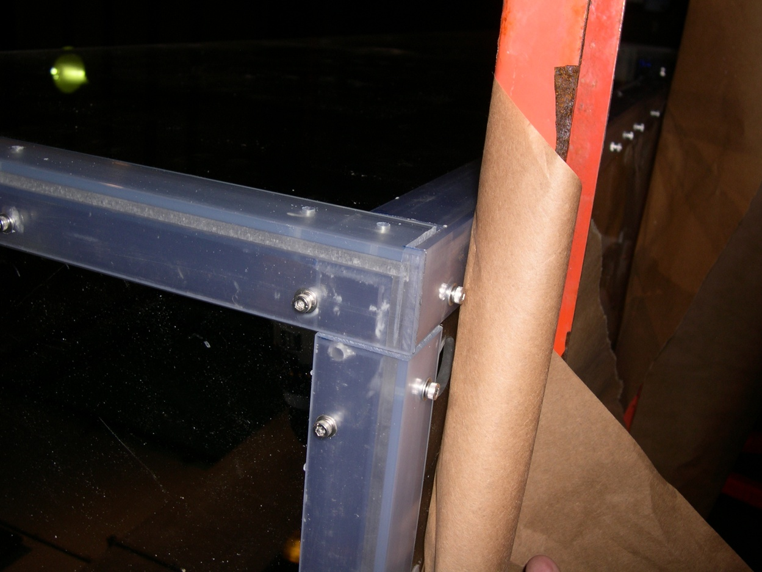
Proven Fabrication Methods
Outer Angle
Outer Angle
Wall
Wall
Inner Angle
Inner Angle
Fastening Angles for Stiffness
Use of these materials maximizes light transmission into the test chamber.
-1/4” Clear Acrylic Panels
-3/16” x 1.5” x 1.5” clear PVC angle used as outside support structure.
-3/16” x1.25” x1.25” clear PVC used inside.
-8-32 x 5/8” screws tapped into inner PVC pieces, 6”C/C.

Slide 14
Potential Materials and Fabrication Guidelines
p.2
(Cont.)
If using an Exo-Frame
FRP-fiber reinforced plastic (fiberglass) – easily worked material that is available in structural shapes like angles, sheets and round or square tubes.
Almost impervious to SW.
NOTE-FRP is destructive to tooling so cutting/boring tools need to be replaced often as they become dull. Does not hold threads well,
sheet metal screws can be used in >.25 “ thick materials.
6061 Aluminum- Corrosion issues when in contact with SS fasteners, insulating washers help.
PVC – Common shapes are sheets, bars, tubes, some sizes of angles. Can be found in a clear version so when angles used for reinforcing edges, there is
less blockage of light.
-Easily fabricated and can be drilled/tapped easily. Can also be bonded. Not as strong as FRP.
UHMW-nearly inert in SW, easy to fabricate, common shapes are sheets, bars, rods. Lighter than SW.
Many of the plastics can be obtained in black to preclude light transmission and improve resistance to UV degradation when at or very near the surface .
LATCHES
- Must be sturdy, corrosion resistant, easy for diver to manipulate with gloves on.
-Cabinet type, SS.
-Block and pin, plastic SS
fabricated custom design-cam lock, single or paired
HINGES
- Must be sturdy, corrosion resistant
-piano type, SS
-solid rubber, 1/8-1/4” thick, screwed in with facing plate

Slide 15
Potential Materials and Fabrication Guidelines
(Cont.)
Ducting (for 2 tau delay section)
- Most often used for air handling. Has integrated coil to maintain openness.
-Try to use all plastics. Also comes with copper, steel wire or urethane reinforcement. 2 “ - 12” diameter, various pressure/vac ratings, durability, flexibility, costs.
THRUSTERS – high reliability, select appropriate thrust/GPM rating, convenient power req. (AC/DC, Watts?), easy to control, cost
-Small Boat Submersible Bilge Pumps, At shallow depth most any of the big names should work. (Rule, Attwood, Lovett, Johnson, Jobsco...) They are very inexpensive, get the non-auto on/off. They may, however, have to be changed out every few months. They are not designed for constant use. Available in 12,24,36 VDC. Largest flows available are 3500-4000 GPH for ~$200. (Flow ratings are with 0 head or backpressure).
CrustCrawler 400 HFL - $600, 0-50 VDC, 400 watts, lip seals, 300 ft
Technadyne Model 520 DC Brushless - $3700, 520 Watts, various voltages available, analog or digital control, magnetically coupled prop
Equation for motor H.P. Requirement
HP = (psi x GPM) / 1714 efficiencyMotor

Slide 16
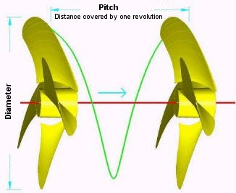
Disk Theory for moving Water
Ppropellor x RPM x Areapropeller = Volumewater / minute
Where:
* Ppropeller = Propellor Pitch (in.)
RPM = Revolutions per minute
Areapropeller = Area of the diameter projected by rotated propeller (sq. in.)
Volumewater = volume of water moved by propeller (cu. In.)
Gallon = 231 sq. in.
*NOTE: Pitch is defined as "the distance a propeller would move in one revolution if it were moving through a soft solid, like a screw through wood." For example, a 21-pitch propeller would move forward 21 inches in one revolution.

Slide 17
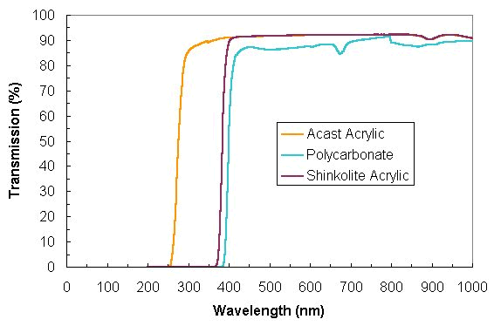
Light Transmission through
Polycarbonate and Acrylic

Slide 18
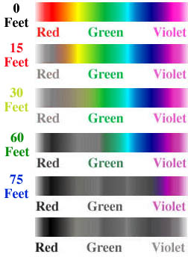
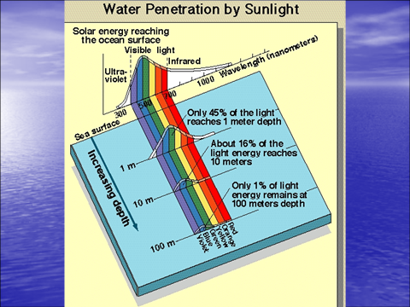
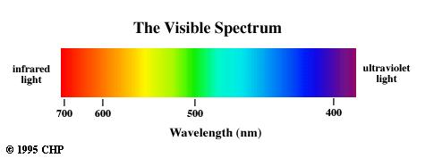
PAR 400nm through 700 nm
Photosynthetically Active Radiation (PAR)
(0 Meters)
(4.6 Meters)
(9.1 Meters)
(18.3 Meters)
(22.9 Meters)

Slide 19
XFOCE Platform Components
(Cont.)
Internal Current Control Method
  Fan/Screw
  Pump
  Other
Enriched Seawater Distribution
Chamber to Seafloor Interface Seal
  Shear Skirt (skirt should extend into the soil
    at least 20 cm.)
  Canvas
  Reinforced Plastic Sheet
  Rubber/Nitrile/ sheet
  Grout Bags
(Cont.)

Slide 20
Anchoring
Anchors
  Related to type of seafloor, longevity, access, etc.
    Semi, Consolidated, and Unconsolidated Sand, Silt, and Clay
      Deadweight
        Concrete Block
        Other
      Direct Embedment
        Helix
        Keyed Plate
      Drag Embedment (Difficult without additional equipment assistance)
        Danforth, CQR, Delta, Bruce, etc.
      Self –Burying (Better for loose sand, silt)
        Dor-Mor
        Mushroom
    Rock and Coral
      Deadweight
        Concrete Block
        Other
      Direct Embedment
        Powder Actuated Stud Gun (down to 46 meter (150’) depth)
        Epoxied Stud (Drilled hole)
        Expansion Bolt (Drilled hole)

Slide 21











Examples of Anchors
CRQ
Anchor Pins in Coral
Installation of
Anchor Pins
Claw or Bruce
Danforth
Drag Embedment Anchors
Powder Actuated Stud Gun
Self Embedment Anchors
Deadweight Block
Single or
Multiple Helix
Dor-Mor

Slide 22
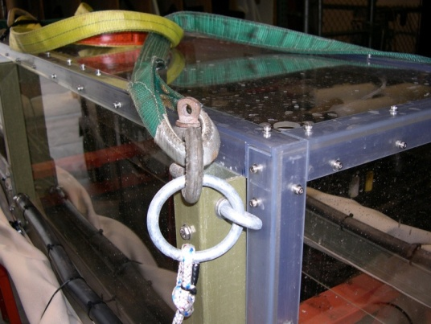
Anchor Notes
– auger types easiest, Plate type “earth anchors” need to be dug out to retrieve.
-Screw-It Beach anchor, removable handle, Corrosion resistant - $70, RoxyMarineMart
-Ironwood Pacific – 21”, 4” helix, powder coated steel, $40 each
-Helix – set of 4 for $23. MilSpec Anchors
-Triangular earth Anchors with Galvanized cables, set of 4. ~$40
Method of Anchoring to Frame

Slide 23
Enriched Seawater Delivery System
  This system mixes CO2 with seawater and delivers the enriched seawater to each Seafloor Experiment System.
  The Delivery System is comprised of at least the following components:
    Mixing Tank
      Shall contain CO2 and seawater at 2 atmospheres.
      Shall be partitioned and designed to allow for the creation and buffered storage of
      enriched seawater.
      Shall have adequate volume to supply the requirements for all Experiment System
      enclosures at their maximum anticipated current speeds while maintaining
      production of additional enriched seawater.
      Shall have at least one Vaporizing Nozzle to create enriched seawater.
      Shall have proper equipment and instrumentation to assure adequate monitoring,
      mixing, and storage of enriched seawater.

Slide 24
SWFOCE

Slide 25
Alternatives for producing power for XFOCE
Chamber Maintenance Issues

Slide 26
Low Cost Shallow Water Pressure Housing Case Fabrication
PVC - Polyvinyl Chloride
strong and rigid
resistant to a variety of acids and bases
maximum usable temperature 140ºF (60ºC)
PVC
Nominal Pipe Size (inches) | Schedule 40 | Schedule 80
1/2 | 358 | 509
3/4 | 289 | 413
1 | 270 | 378
1 1/4 | 221 | 312
1 1/2 | 198 | 282
2 | 166 | 243
2 1/2 | 182 | 255
3 | 158 | 225
4 | 133 | 194
5 | 117 | 173
6 | 106 | 167
8 | 93 | 148
10 | 84 | 140
12 | 79 | 137
Operating Temp (°F) | De-Rating Factor
73 | 1.00
80 | 0.88
90 | 0.75
100 | 0.62
110 | 0.51
120 | 0.40
130 | 0.31
140 | 0.22
Operating Depth = 40 Meters (~131 ft.)
Maximum Pressure = .444 x Depth (ft.) +14.7 psi → 73 psi
Factor of Safety = 2 Therefore 2 x 73 psi = ~146 psi

Slide 27
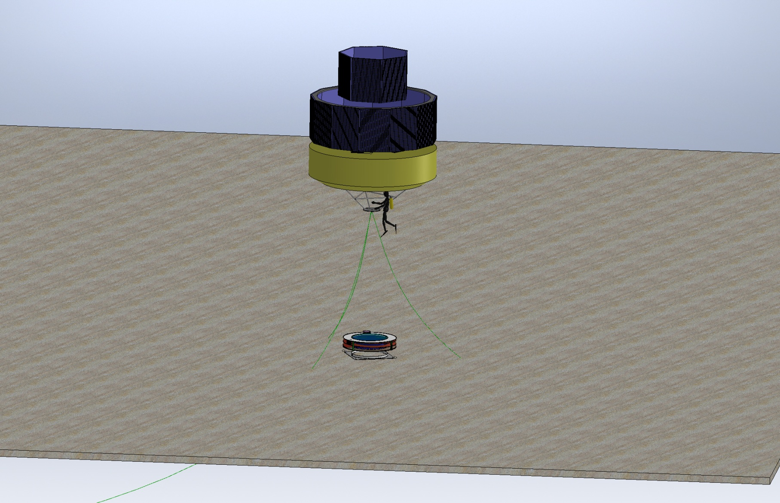
Power from Solar Cells on Buoy

Slide 28
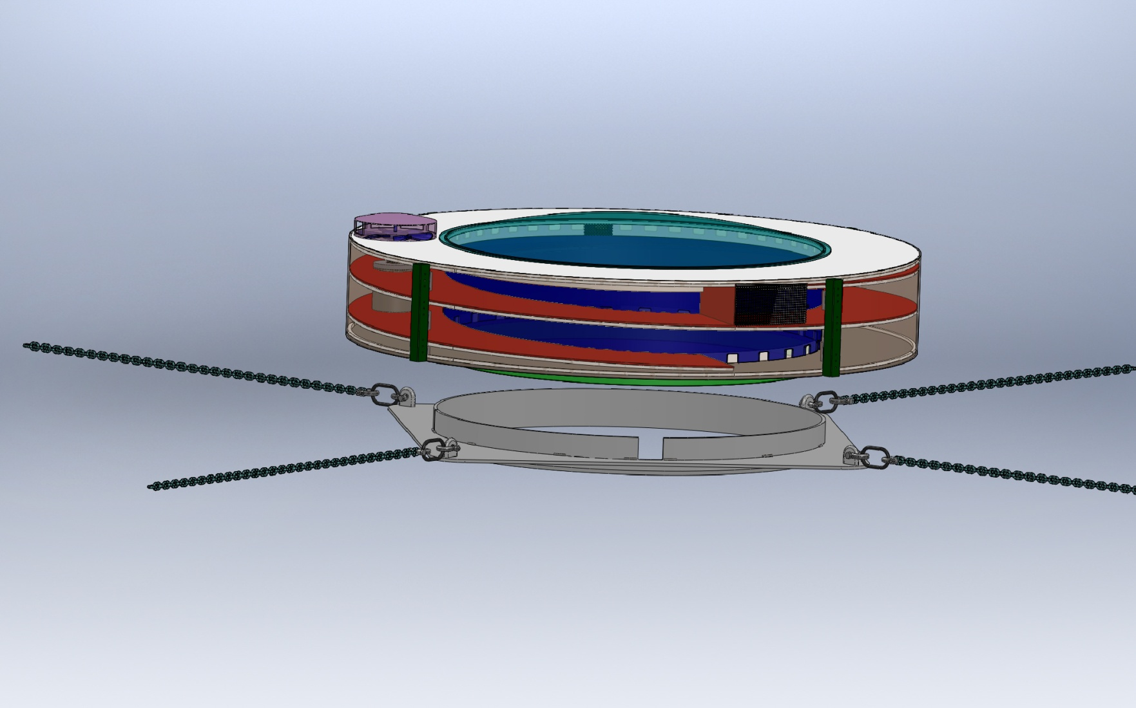
Possible Anchoring Template for Experiment Maintenance/Replacement

