Slide 1
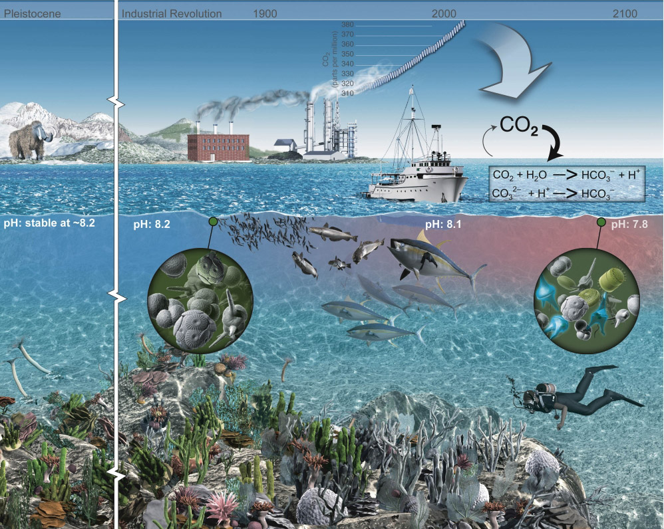
xFOCE/swFOCE Review
An illustration of the atmospheric CO₂ increase and the change in ocean pH

Slide 2
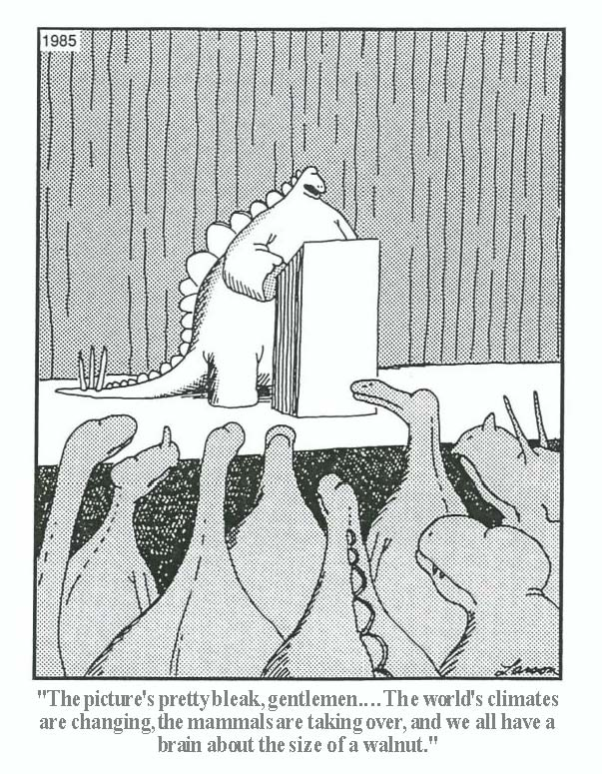
Climate change has consequences

Slide 3
Purpose of CO₂ enrichment experiments
FACE studies on land:
  Greenhouse experiments had shown an enhancement of growth rates with high CO₂ conditions.
  What happens in the “real world?”
FOCE is the marine analog to FACE:
  Avoid the limitations of aquaria experiments.
    Culturable organisms.
    “Axenic ecosystems”.
  Open system vs closed mesocosm.
    Natural cycling of environmental conditions.
    Complete ecosystem interactions.

Slide 4
Chemistry of CO₂ in seawater
Reaction of CO₂ + H₂O is well known:
  Equilibrium constants are well described [ F(S,T,P) ].
  Reaction rates can be predicted:
Kinetic predictions from equations in Appendix C.7 Zeebe & Wolf-Gladrow (2001).

Slide 5
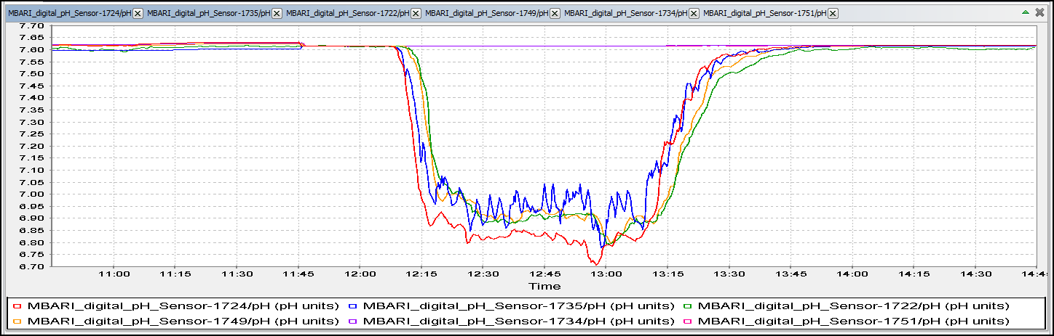
dw-FOCE control of pH / TCO₂
We can control TCO₂ and pH; but these are not the only important variables:
  Dissolved oxygen (Brewer & Peltzer, 2009; Hofmann et al., 2011).
  Flowrate (Hofmann et al., submitted to GBC).

Slide 6
xFOCE and swFOCE

Slide 7
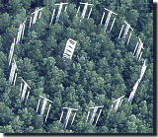

FOCE and OA Research
Free Ocean CO₂ Enrichment experiments are based on an existing base of scientific work that started in the early 1990’s. The Free Air CO₂ Enrichment (FACE) experiments.
Dr. Peter Brewer first proposed this type of experiment to MBARI engineering in 2003 as part of his greenhouse gases research. The drawing to the right is the initial concept from engineering and presented to NOAA’s Dr. Dick Feely later that year.
Concept using the MARS cable in Monterey Bay, later deployed as deep FOCE (dpFOCE)

Slide 8



Why xFOCE?
The problem: Some scientists are misinterpreting our publications and what is required to make a FOCE system work.
MBARI was contacted and we gave feedback about how to use the existing hardware and reconfigure it to become a functional FOCE.
The scientist did some of it but still didn’t grasp what FOCE is an how to properly set up a system to get meaningful science results.
It became apparent that a resource clearly outlining FOCE and how to get started would be useful.

Slide 9


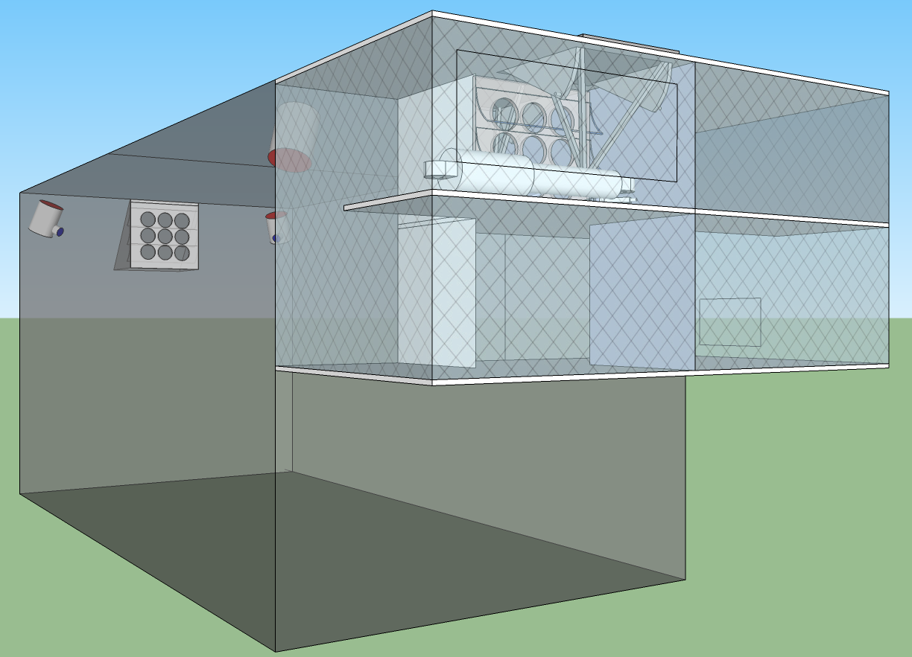





xFOCE
Deep FOCE (dpFOCE) is the original FOCE built for multi-science users on a cabled observatory.
Coral Prototype FOCE (cpFOCE) is the first tech transfer of FOCE built for multi-science users on the Great Barrier Reef. Solar and wind powered except for the creation of the enriched CO₂ water.
European FOCE (eFOCE) is currently under construction and scheduled for deployment in May 2012. This system uses a cable but the CO2 is delivered in bottles to a surface expression.
Antarctic FOCE (antFOCE) proposal submitted and partially funded. Proposal for other 50% of funding submitted April 24th, 2012.

Slide 10
xFOCE
xFOCE shall support 2 test chambers (1 active and 1 control minimum)
xFOCE shall maintain a desired pH offset from ambient within +/- .2 pH
xFOCE shall be capable of pH offsets of between .2 and .8 pH units
xFOCE shall hold a selected pH offset for a minimum of 2 weeks
xFOCE shall be capable of deployments greater than 6 months in duration
xFOCE shall be fully functional in external currents of 50 cm/sec
xFOCE shall mimic surge to the extent possible based on chamber scale
xFOCE shall maximize the allowance of full spectrum natural light
xFOCE shall include pH, CTD, O2, flow rate or calculated flow using velocity

Slide 11
xFOCE
xFOCE shall provide internal environmental data for all instruments on the required list from each active chamber
xFOCE shall provide internal environmental data for
xFOCE shall be diver maintainable
xFOCE shall not use materials that are toxic to the marine environment
xFOCE shall not be dangerous to maintenance divers
xFOCE shall minimize impacts on local marine life
xFOCE shall be capable of being fully recovered and leave no components behind
xFOCE shall be capable of being built, installed and maintained by a typical university oceanographic research lab with a minimum of 1 scientist and 2 graduate students

Slide 12
xFOCE
xFOCE shall maximize use of commercially “off-the-shelf” or readily available technology to the fullest extent possible
xFOCE shall be capable of working in ocean waters where the velocity does not exceed 75 cm/sec.

Slide 13
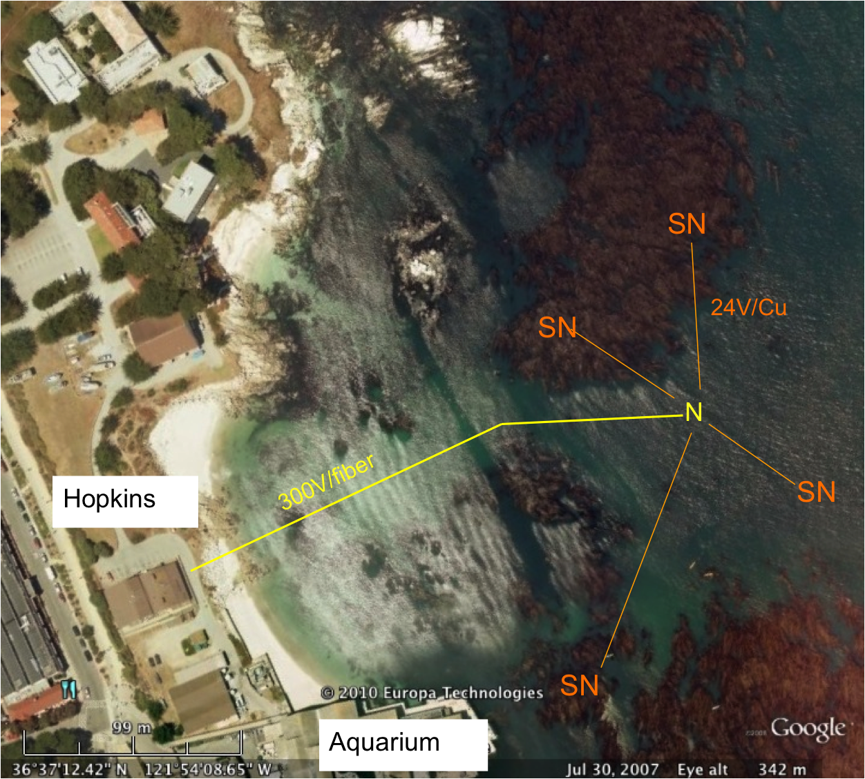
swFOCE
swFOCE shall meet all xFOCE requirements
swFOCE shall not require a support ship greater than 50’ for deployment and recovery
swFOCE shall include a camera system capable of variable time lapse digital data collection suitable for publication, the camera (and light source if included) shall also be adjustable within the swFOCE structure
swFOCE shall use the Stanford Hopkins
Marine Station’s submarine cable
swFOCE shall provide power and communications links separate from the planned Hopkins science use, and will not interfere with other science operations.

Slide 14
xFOCE Concept of Ops cable
Science interface on shore
CO2 and Enriching process on shore
Air / sea interface managed using buried cable
Capable of supporting 1 or more xFOCE units
Depth rating
max – 40m
FOCE chamber
Notes:
----- Meeting Notes (4/30/12 10:09) -----
remove depth rating
change number of units 1-2 xfoce

Slide 15
xFOCE Concept of Ops no cable
Science interface on shore
CO2 and Enriching process off shore
Air / sea interface managed using surface expression
Capable of supporting 1 or more xFOCE units
Buoy or Platform
Wireless link or autonomous
Depth rating
max – 40m
FOCE Chamber

Slide 16
xFOCE Functional Requirements
Max depth:
pH Offset Range:
pH resolution:
Temp range:
Max ext. velocity:
Max int. velocity:
Full spectrum light:
Number of Units:
40m (130 ft)
0.0 to -0.6 continuous based on CO₂ available. Brief excursions to -0.8 or -1.0 offset potentially
0.05 pH units, 0.1 unit may be OK
(prefer best resolution possible)
-2 to 30 degrees C
50 cm/sec
10 cm/sec
Max transmission of sunlight at depth
System support for 1 active and 1 control chamber

Slide 17
swFOCE Additional Requirements
Surge: Imitate surge to extent possible
Number of Units: System support for 3 active and 3 control chamber

Slide 18

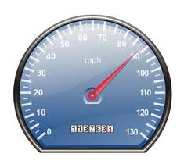
xFOCE/swFOCE Concept of Ops
Flow Vel
Science selected velocity

Slide 19
xFOCE Functional Interfaces
House Power
Internet
Power
Generation
CO2
ESW
Mixer
Comms
Data
Distribution
GUI
Distribution/Protection
SW Pump
Configuration & Control
Data Archive
Control System
Storage
Console
Enriched
Seawater
System
Monitoring/
Health/Status
Data Acquisition
Surface
xFOCE Control
Science / Control System
Subsea
Subsea Electronics
ESW Distributor
ESW injector(s)
Instruments
ESW injector(s)
Flow effector(s)
Camera(s)
Flow effector(s)

Slide 20

xFOCE Systems concept
Blue circles are included for swFOCE
Proposed minimum instrumentation for an active pH controlled chamber. The blue elements are options and controls would only have CTD and pH. Not shown is the other option of a motor and fan to control flow.

Slide 21
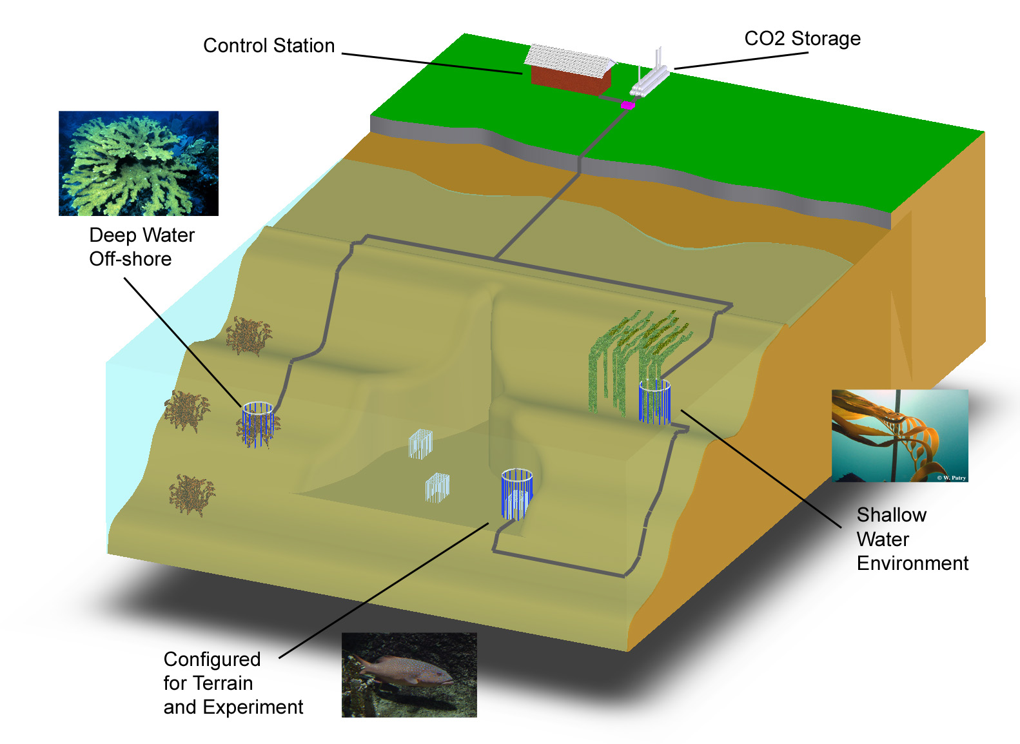
swFOCE Basic Concept
Schematic View of the Hopkins Site
Multi-Site
Multi- Discipline
Multi-Year
Shallow Water
Off-Shore
Shallow Water Corals
Benthic Biology

Slide 22
swFOCE Concept
Bottomside FOCE chamber for swFOCE
pH Sensor
Camera and Light
Ducting
(Time delay)
Flow meter
Mesh screen
CTDO Sensor
Thruster
Anchors
CO₂ Enriched Water
Power and Comm
Cabling
FOCE Controller
Notes:
What is animal restrictor – use mesh

Slide 23
swFOCE Cable Concept
Sea Water
Barrier End Cap
Low pH Sea Water
Power and Comms
Existing Drain at
Hopkins
Sea Level
Intake Filter

Slide 24
xFOCE /swFOCE Data Reqs.
Health and Status: Ability to query system status from web page (data dependent on sensors included)
Timing Accuracy: Internet time stamping to 1 second absolute accuracy
Sample Rates: System will support up to 2 Hz standard operation
Basic Data Format: Comma delimited string, time stamped
swFOCE: Compatible with the current dpFOCE data streams and SSDS (Shore Side Data System*)
Autonomously chapters meta-data for instruments
Near real time ground fault monitoring
*SSDS – Open source from MBARI

Slide 25
swFOCE Permitting

Slide 26
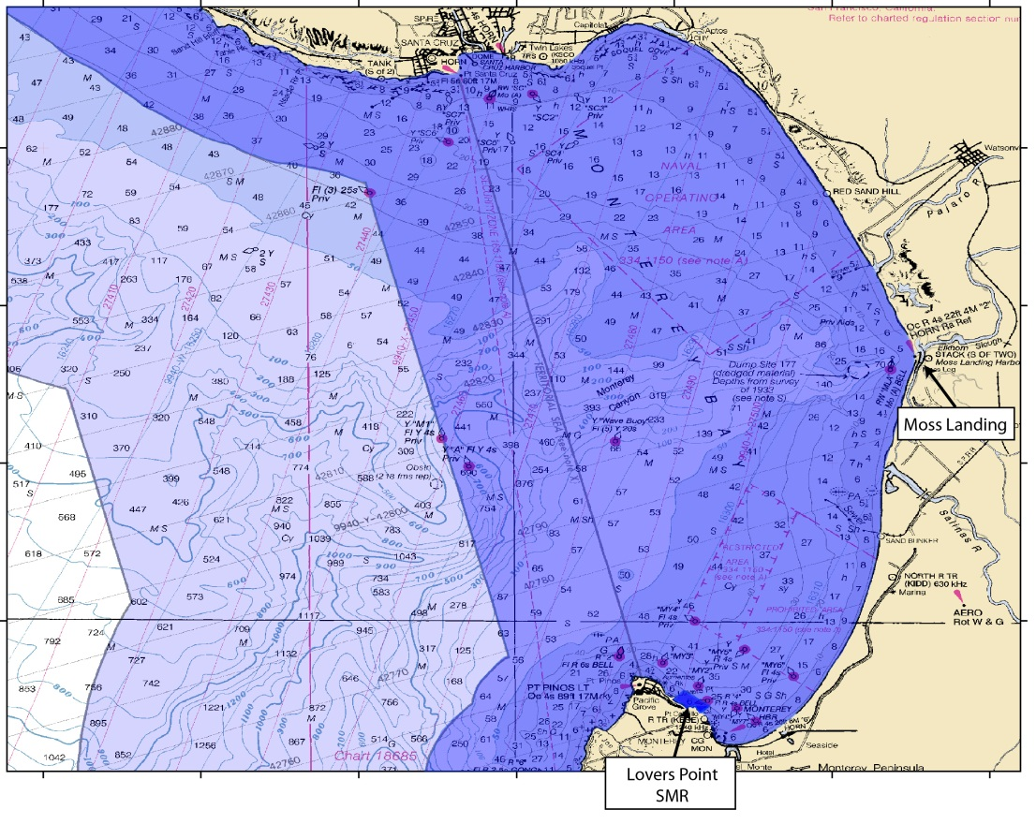
Permitting Issues:
Project Site: Highly Sensitive Location
  Federal: Marine Sanctuary
  State: Coastal Zone & MPAs
Notes:
First issue that triggered all this regulatory oversite was the project site itself.
Project Site – create maps of Sanctuary jurisdiction – zoom to state jurisdiction – zoom to MLPA designations – PG jurisdiction

Slide 27
Permitting Issues: cont’d
Project Site: Highly Sensitive Location
  Federal: Marine Sanctuary
  State: Coastal Zone & MPAs
  Regional: Water Quality
  Local: City of Pacific Grove
Notes:
First issue that triggered all this regulatory oversite was the project site itself.
Project Site – create maps of Sanctuary jurisdiction – zoom to state jurisdiction – zoom to MLPA designations – PG jurisdiction

Slide 28
Permitting: Lessons Learned
Site location can determine how much regulation you will be faced with
Allow plenty of time for permitting
  Process took 2 years to complete
  Coordination of permitting cable & projects
Good rapport with agency personnel key
  Not necessarily trying to make life difficult, but often operating within bureaucratic box
  Future interactions
Advocate(s) who can work with bureaucracy highly valuable
Getting the process streamlined is critical to prevent valuable research from being discouraged due to concerns about permitting.
Notes:
If applying fro permits to install infrastructure, can save time & effort if you recognize that agencies may treat these as associated projects. Can help streamline the process.
Future interactions – probably will end up working with same staff on similar or other projects. Good to keep positive rapport.
This is ver useful slide for main presenti

Slide 29
Computing elements of xFOCE
(Architecture and system trades)
Notes:
In this part of the presentation, I’ll be talking about xFOCE architecture – what the pieces are and how they’re best arranged in the application space
At MBARI, it isn’t often that we get an opportunity to take something we’ve done and start from a clean sheet of paper.
That’s exactly what we got for xFOCE – a chance to completely re-think our experience with dpFOCE.
To a bunch of engineers, a clean sheet of paper can be both exciting and daunting. The wrinkle with xFOCE is that
Our new take on FOCE is optimized for cost and performance:
The metric for success is how easy it is for someone outside MBARI to build it and do real science with it.
This is a new game for MBARI, and a challenging one; we’ve always built things that complement our unique deep water capabilities, and built them for decades of service in the harsh marine environment.
The xFOCE challenge has been to push the extremes of simplicity while still providing value as a serious tool for ocean scientists.
So as we get into the details of xFOCE, the questions are about whether or not we’ve got that balance right, and we look to the reviewers to help us know if we’ve gone far enough to make
The technology accessible, and whether the we’ve gone too far (or in the right direction) in generating a robust and cost-effective technology.

Slide 30
Computing Architectures
User Concerns
Performance: valid scientific approach, data quality
Flexibility: wide range of environments, scenarios
Ease:
  Build
  Test
  Use, maintain
  Extend
Cost
Notes:
With that in mind, these are some things that matter most to potential users, and are metrics
Against which we should measure our concepts.
The bottom line is that experimental results need to produce papers.
So the tools need to use a valid scientific approach and produce good data.
They need to support applications that span several different science disciplines, and in different ocean environments
Must be easy to specify and obtain components, to manufacture the system
It’s essential to be able to test and validate the operation of the system
Must be safe and robust to deploy, configure and maintain
Since research never calls for decreased capability, fewer sensors, or less data ;o)
There ought to be a technology path to extend it to add sensors and modify algorithms
So that users can start using FOCE techniques simply, but have the ability to do increasingly sophisticated experiments.

Slide 31
xFOCE demographic
Implementer profile | Researchers plus 2-4 post docs, grad students 0-1 engineer
Technical | Access to modest manufacturing facilities Software is harder than hardware, mechanical Strong preference for familiar COTS solutions
Implementation schedule | ~6 months
Experiments | Campaign-style deployments 12 month service life Remote and/or restricted sites
Lifecycle | Prefer to extend capability, rather than re-spin from scratch for successive funding rounds
Notes:
Next to understanding requirements, gaining a sense for
Users’ capabilities, resources and workflows needs to be reflected in the concepts and design.
Here are some other key features of who we think our users are…
These were the subject of much discussion as we developed concepts and requirements
[go thru list]
Hopefully they resonate well with our external audience

Slide 32

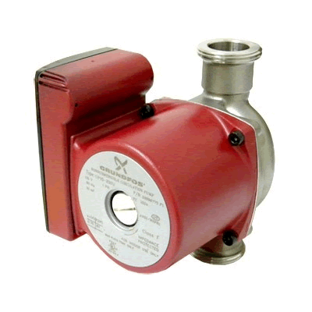

FOCE Essentials
Power
Data
Data, Control
User
IF
User
IF
Power
CO₂
H₂O
Enriched
Seawater
Controller
ESW
pH
CTD
CTD
pH
Flow
Chamber
Flow
DO₂
Flow
DO
External
Notes:
For the purpose of discussing basic FOCE design concepts, here is reference diagram showing essential FOCE elements-
About the simplest system we can still think of as FOCE, which at it’s core is about controlling pH in a box.
Chamber at the bottom where all of the science action happens – the fundamental idea of FOCE is to create a pH controlled environment inside this box.
Populated with sensors and actuators, both internal and external to the chamber – these comprise a basic science suite and most participate in the pH control algorithm
There is a system for enriching seawater with CO2 and delivering it to the chamber
Controller at the center (I’m a software guy ;o) that reads sensors and manages the flow through the chamber and delivery of ESW
Must be a source of power (red lines)
nothing is more important than the data (drawn in black)
Which is manipulated through various user and data interfaces to configure and monitor the experiment

Slide 33
xFOCE helps to simplify the choices
  Experience, Designs, Community
Choices depend on users’ experiment and constraints
  Budget, schedule
  Environment, permitting
  Technical resources
xFOCE community may draw from different approaches
Notes:
Some components must be on the seafloor
Chamber, instruments
Arguably Actuators (pumps, fans, etc.)
But location of everything else is flexible…
Power, ESW
Controller
Data storage, user interfaces
And, there are many ways to implement each of those functional blocks…

Slide 34
Computing Architectures
Shrinking the Universe of Trades
Decisions that have greatest impact on user concerns
  Build vs Buy
  Location matters: Shore vs Surface vs Seafloor
  Topology: how the pieces are connected
Notes:
If you are starting from first principles, that’s a large trade space,
That includes lots of technical decisions – like buying a bike or camera or car –
And to diminish it
It’s helpful to focus on the decisions that have the greatest impact on your concerns of
Performance, flexibility, ease of use and cost
Maybe no decisions you can make are more important than
What parts of it you choose to build yourself and what you buy (or better still, get for free)
Where the components are placed
How you choose to connect them, both electromechanically and topologically with data interfaces and protocols

Slide 35

Build vs Buy
General Principles
Buy what you can’t/shouldn’t build
  Processors, (most) instruments, cabling
  Software
Build (or borrow) as needed
  Chambers, housings
  Use COTS components if possible
  Get help on tough key builds
    contract, open source
  You get what you pay for
Beware poor integration
  Patchwork integration of COTS parts
  Power consumption
  Kludgy mechanical/electrical interfaces
Notes:
Some of these may seem obvious, but they’re important
It’s often tempting to build what is most familiar to us; it’s easy to pour time into whipping something up “simple” that winds up taking a lot more money and time than anticipated – especially software.
Build from scratch only what you really really have to
When you do decide to build, use COTS components and use open source where you can
Stay near the beaten track with 3rd party open source software - Just because it’s free doesn’t mean it isn’t expensive
Use software that has an active developer base (check mail lists) and isn’t too new – you want code with lots of miles and people who have already run into your problems
Temper your use of COTS and open source with an eye towards integration
Make sure the sum isn’t less than the parts
Integration problems manifest in higher power consumption, software workarounds, adapters in elec/mech/software interfaces
These add cost and complexity, and reduce robustness

Slide 36

Location Matters
General Principles
Connected vs Disconnected
  Generally easier to generate and store power, ESW on shore
  Telemetry bandwidth
Trades for off-shore elements
  Accessibility (to you, the elements, others)
  Reliability
Keep what’s offshore/sub-surface as simple and robust as possible
  Basics: Enriched seawater, power
  HW: Cables, connectors, housings
  SW: Applications, protocols, processes
Notes:
The decision to put some part of the system at sea is arguably the most important in terms of its effect on effort required to make things work reliably.
In general, it’s preferable to put as much on shore as possible.
In many cases, there isn’t a choice about that one – the science question, geography and permitting often make this decision for us.
That being the case, the next choice to make is often whether to put things on or below the surface.
Making that choice is easy to say, hard to do: the balance between simplicity and robustness can be hard to get right
Connectors, cables and housings tend to be the #1 point of failure in ocean observing systems.
While even the most expensive options are subject to failure, you generally get what you pay for.
Use the right technology for the job – don’t skimp on connectors
Housings can be simple, but not too simple
Some Options for these are covered later..
Distributed software can be complex to debug: location and distance drive telemetry links, protocols, processor selection and power

Slide 37
The software developer sees…
Power
Data
The user must consider:
CO₂
H₂O
Controller
Enriched
Seawater
What’s inside?
Build or Buy?
Where to put the pieces?
How are pieces connected?
ESW
pH
CTD
CTD
pH
Flow
Chamber
Flow
DO₂
Flow
DO₂
External
Notes:
Here is a twist on our reference diagram again, as the software developer sees it.
And it’s a convenient way of guiding a trade study to sift through all the options there are in implementing a FOCE system.
The controller and it’s software are a central concern, and object of this concern are
the power and data (includes control signals) that pass through the perimeter, in and out of the controller.
You the users will be concerned with
What is inside the box – there are lots of ways to do these functions
How should we arrange the pieces physically and logically
Which we should build ourselves and which we should purchase and integrate

Slide 38
3 potential xFOCE architectures
A study of some approaches
  “Centralized Workstation”
  “Industrial Computers”
  “Sensor Node”
3 views to evaluate key features and trades
  Location: shore, surface, seafloor
  Build/buy: hardware, software
  Connections: topology and infrastructure
Notes:
What we’ll do is walk through several architectures, all of which contain elements that have been used in FOCE implementations
Inside and outside MBARI.
The names for the approaches are just ones we made up
Centralized Workstation: desktop-class PCs packaged for the seafloor (or run on shore)
Industrial computers: building block approach using modular factory automation buses like Wago, NI Compact Rio, etc.
Sensor Node: Low cost, low energy approach using COTS components for modularity and flexibility with a minimum of custom hardware
These approaches are really distinguished mostly by the choice of pieces – the build/buy choices.
But we also need to examine the options you (and we) might consider for how to arrange and connect them.
For each approach, we’ll look at it from three perspectives: Location, Build/buy and Connections
Location view shows one way of arranging system pieces, though the choice of where to put things is somewhat independent of what pieces you choose.
The idea behind location view is is to highlight the pros and cons of where things are placed.
Build Buy View – again, the distinguishing feature of each approach – is about why you may choose to build or by various components
Connection view, similar to Location view, shows one way you might connect the parts of a FOCE system.
All are valid approaches with optimizations for a particular application
We’ll end up by discussing the approach we’d recommend for xFOCE and our own swFOCE

Slide 39
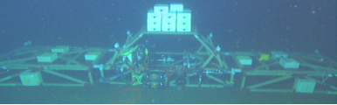
Centralized Workstation
Workstation computing
Similar to dpFOCE implementation (image below)
Mixed Common Off The Shelf (COTS) /custom hardware
Shown here using cabled configuration
Notes:
The first approach we’ll look at is the one we call Centralized Workstation
The main concept of this approach is to use one workstation/PC class computer to perform all of the data acquisition and control functions using desktop-class applications, standards and tools.
We used something like this for our deep FOCE, which includes a mixture of hardware that is fairly rich in custom designs.

Slide 40
Component | Location | Why
Controller HW | Seafloor | Could run on shore Experiment continues if comms fails Simpler, though less accessible
Controller Software | Seafloor | ‘’
UI Software | Shore | Easier maintenance
Power | Seafloor | Need fine-grained power management at site
Data | Seafloor And Shore | Experiment continues if comms fails
Centralized Workstation
Data
Archive
Location View
Power
Source
Surface
Shore
Seafloor
Data
Controller
Power
Distribution
ESW
pH
CTD
CTD
pH
Flow
Chamber
Flow
DO₂
Flow
DO₂
External
Notes:
Here we look at Centralized Workstation pieces, arranged with the entire experiment located on the seafloor
Though not shown, ESW could be generated on the seafloor (deep water only), or
surface/shore (depending on depth and distance from shore)
Same generally true for power and communications, though here these originate on shore (as we did for dpFOCE on MARS and will do again for swFOCE on the KFA cable)
Some advantages to putting everything on the seafloor are
As long as the unit gets power, the experiment may run autonomously
Having the user interface on shore (with hooks in the controller) makes maintenance easier
It is simpler w/o a surface expression, at the expense of some accessibility
What distinguishes this approach from others is that the controller is a workstation class computer, consolidated in a single housing, one per chamber.
All of the instrument and actuator connections terminate at this single housing.
(note that an experiment may include multiple chambers; only one is shown here)

Slide 41
Centralized Workstation
Build/Buy
View
Component | Build/Buy | Implementation
Controller HW | Buy | PC104 Pentium Serial port cards (16 total)
Controller Software | Build Open Source | Linux, Java Custom: SIAM Data Acquisition software Open Source: DataTurbine, e.g.
Archive, UI | Build | PC Workstation MacOS, Windows, Linux, Java Custom: SSDS, FOCE GUI
Power | Build | Custom: load switching and monitoring chassis
ESW | Build | Custom: electronics, software, chassis COTS: pumps, controllers
SIAM: Software Infrastructure and Applications for MOOS
SSDS: Shore Side Data System
Notes:
There are many variations what you may choose to build or buy, but in this scenario, as for dpFOCE, a lot of custom components were used for various reasons:
We did use a COTS PC104 controller computer
One potential drawback to this approach is that it requires a large serial expansion because a single computer is used to collect data from all of the instruments and control the experiment
Serial expansion isn’t hard, since you can buy serial port peripheral cards, but it ties you to a larger, more power hungry workstation class computer
It makes sense to use open source components like Linux, Java, OSDT (data distribution and archiving software),
but the controller software was custom almost entirely throughout, in our case to reuse software we had a large investment in. (also, I’m not sure if any 100% turnkey solutions exist that will work for FOCE)
We specifically wanted to use SIAM (distributed data acquisition software developed for use on MOOS and MARS)
And also SSDS (shore side data system), which is an institutional data repository for many different platforms including moorings, auvs and experiments on MARS
FOCE GUI is a graphical user interface optimized for for controlling and monitoring the deep FOCE experiment
The power system hardware was semi-custom as well, though it made use of available voltage converters and takes advantage of available peripheral cards available off the shelf
For example data acq cards for environmental monitoring

Slide 42
Centralized Workstation
Ethernet
Connection
View
Data
Power
Source
Surface
100 MBps
Ethernet
Shore
Fiber Optic
Power and Data Cable
Seafloor
Data
Controller
1 kW
Ethernet-Serial
Power
Distribution
Serial
ESW
pH
CTD
CTD
pH
Flow
Chamber
Flow
DO₂
Flow
DO₂
External
Notes:
Here is a look at communications and power infrastructure – one possible way of connecting the boxes.
On the right there is a data and power cable to shore that can provide kWatts of power and Mbps (or Gbps) communications bandwidth.
A potential drawback of cables is that it typically requires greater technical and financial investment, and may be challenging to permit.
The high power and bandwidth make it a good fit for the work station class computer and distributed software chosen in this Centralized Workstation concept.
The upsides are easy to see: it is easy to access and maintain from shore, and supports features like live real-time video feeds, which have both scientific and social/strategic value.
The large amount of available energy makes it easy to support a larger chamber size (larger experiments, requiring larger water movers, etc.)
Reaching out from the controller, connections to the instruments are predominantly serial, though ethernet-serial connections are also used
To the ESW system ( we did it to make the ESW system ROV compatible)
But also it shows another option that we might think twice about if we didn’t have a cable to shore, because of the power needed by Ethernet

Slide 43
Summary
Centralized Workstation
Pros
  One software platform
  COTS computers
  COTS serial I/O solutions
Cons
  Extensibility in packaging and housings…have to put a lot of holes in housings
    Can use junction boxes
  Need lots of serial ports
    Custom serial IO
  Power consumption
  Less modular
  Custom HW/SW
Notes:
So the centralized workstation essentially trades the convenience of using off the shelf PCs and serial expansion capability over power consumption and modularity.
It means fewer housings, but larger ones (which are more difficult to seal).
Fewer housing may be an up-side just because there is less to build and maintain,
but it may be difficult or expensive to spare since the whole thing must be replaced at once.
Though you could exercise different SW choices, custom software takes time to develop,
though with only one hardware platform, there is only one software development environment needed.
One of the big drivers for any of the approaches is how to handle many serial instruments, and how to distribute power to them.
These are capabilities that are fairly easy to buy and integrate (as peripherals) into larger computers for which available power isn’t a concern.
Once you get into the realm of smaller processors that use less than a few Watts, the selection of serial expansion and power switching options
becomes narrow, and designing them from scratch may be something our users may not want to get into.

Slide 44
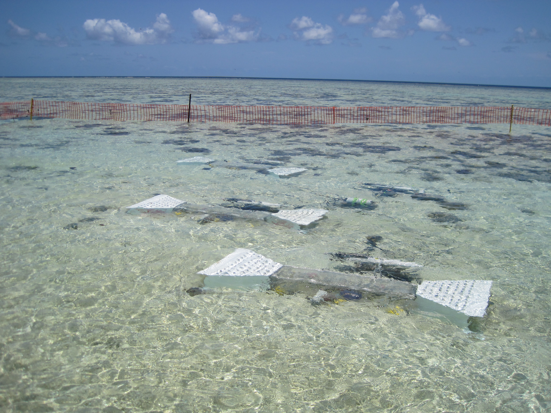
Industrial Computers
Industrial automation computers (WAGO, Compact Rio, e.g.)
Similar to CP-FOCE implementation
Uses primarily COTS hardware and software
Shown here using moored configuration
Notes:
The approach we’ll call Industrial Computers is distinct in that it seeks to minimize custom hardware and software development
By using readily available and robust industrial automation computers.
The CP-FOCE implementation applied an approach like this very effectively in an un-cabled near-shore application at Heron Island.
We’ll start again in a Location view that arranges the Industrial computer pieces in a configuration with a moored surface expression

Slide 45
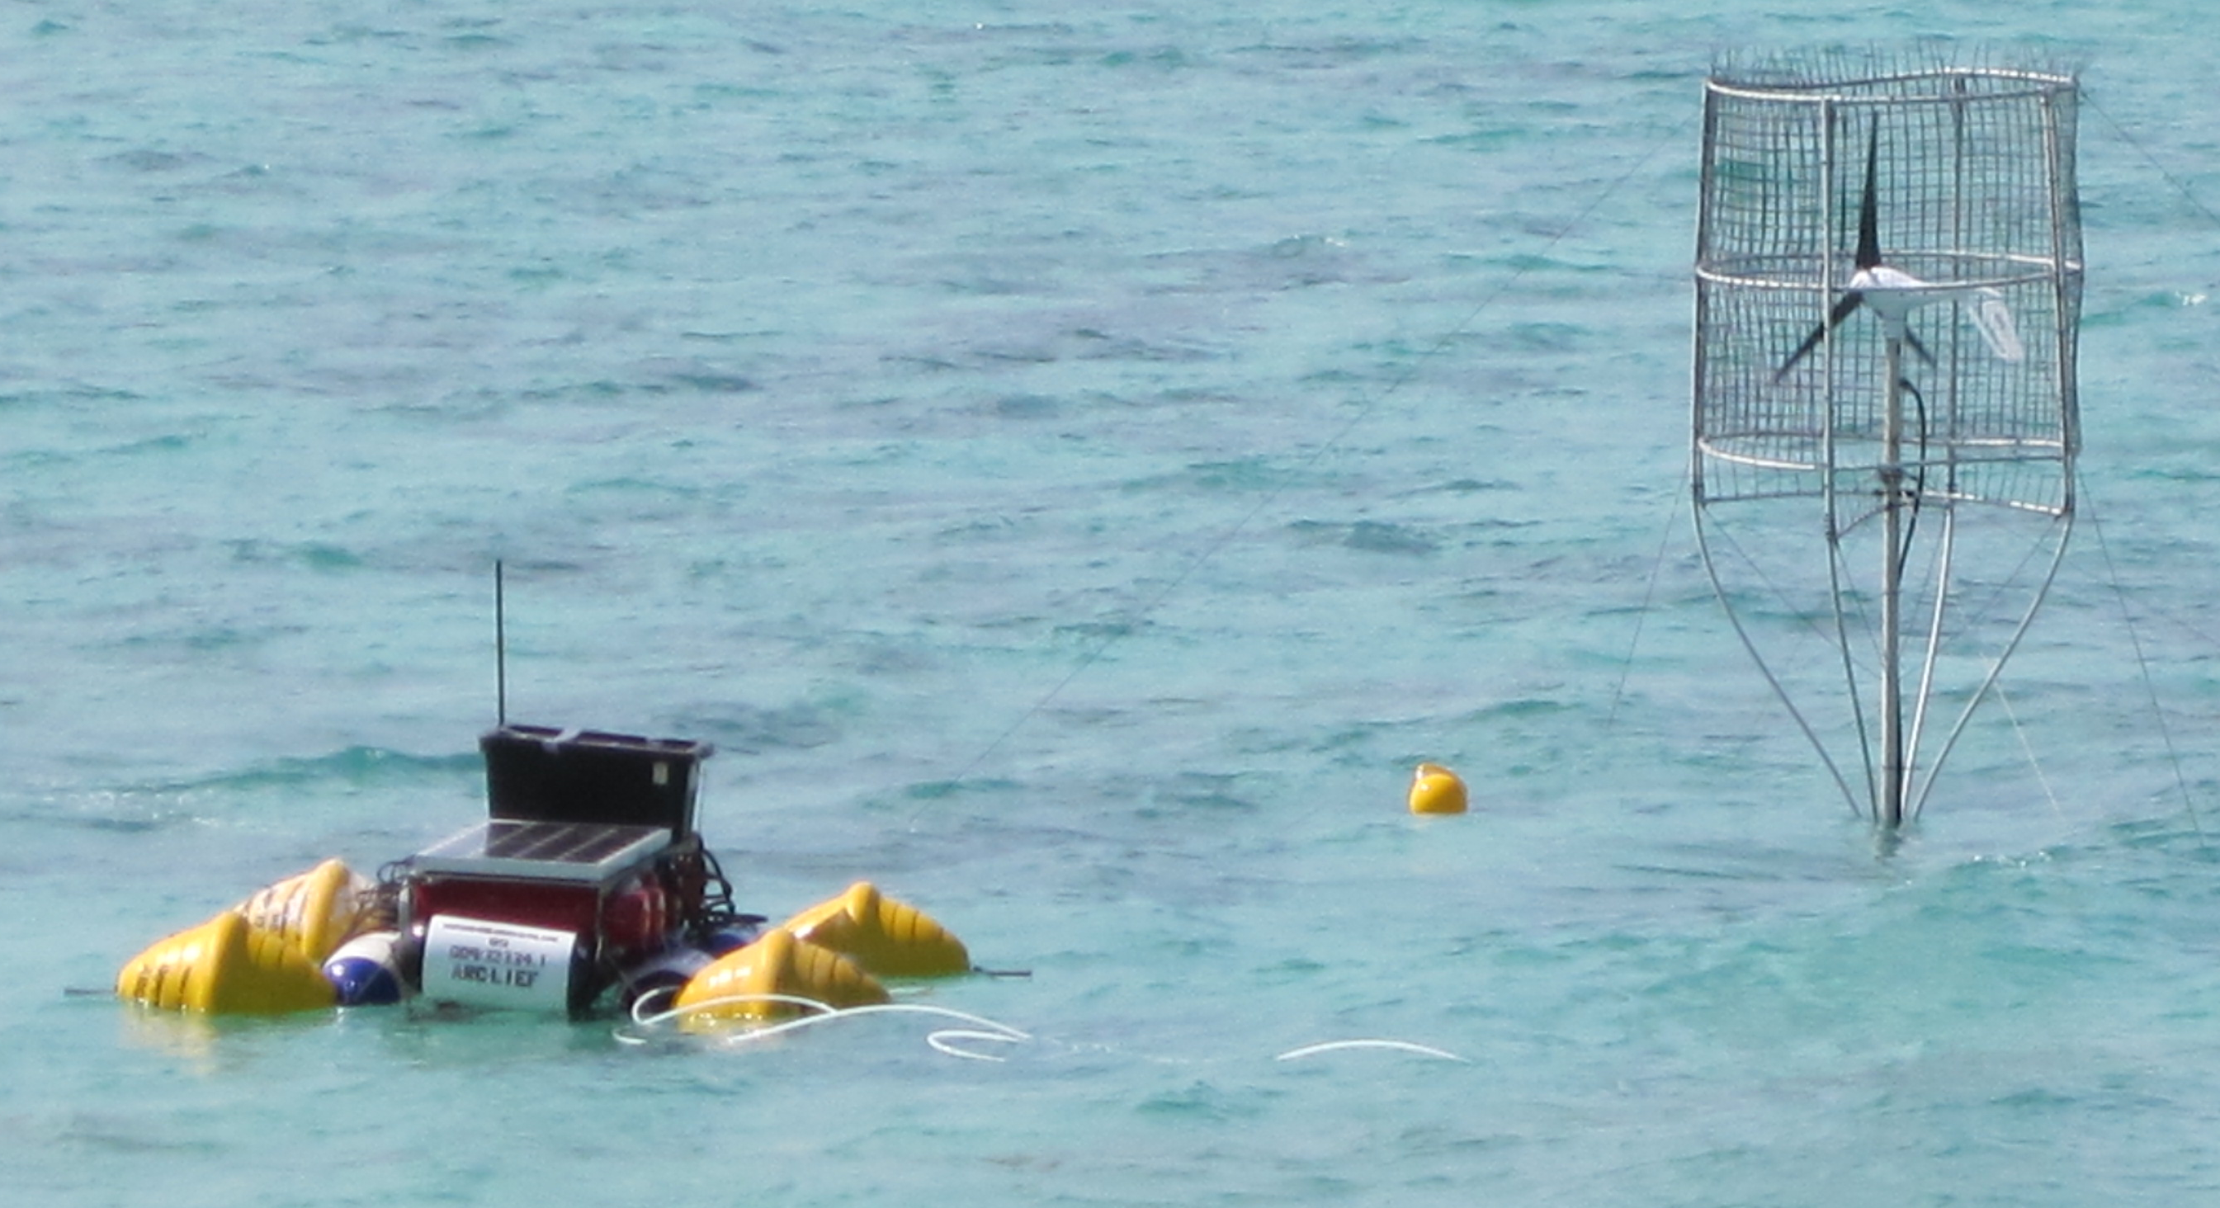
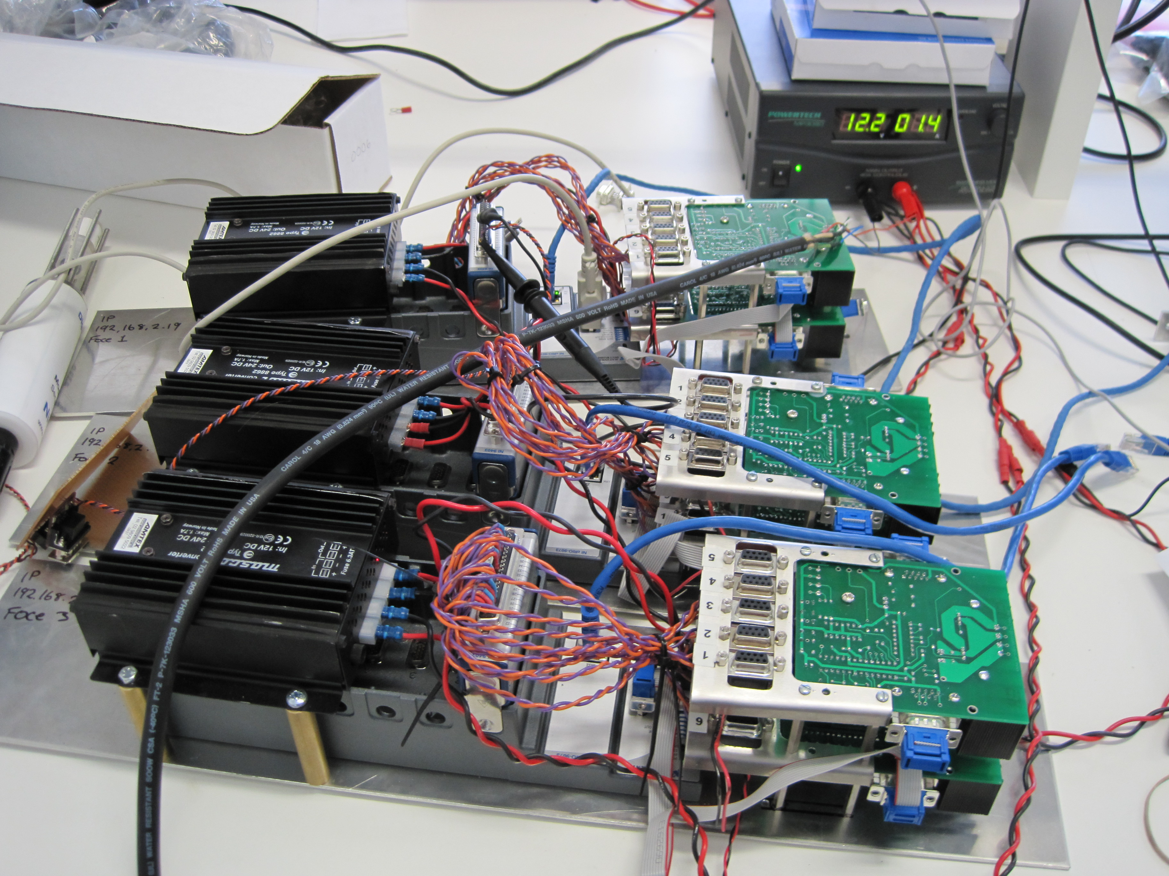
Component | Location | Why
Controller HW | Surface and/or Shore | Easier access Large housings
Controller Software | Surface And Shore | Co-located w/ HW
UI Software | Shore | Easier maintenance
Power | Surface or Shore | Easier access
Data | Surface and/or Shore | Co-located w/ control
ESW | Shore Or Surface | Permitting, depth, distance from shore
Industrial Computers
Location View
Data
Data
Power
Controller
Controller
Wireless
Controller
UI
Controller
Surface
Shore
Seafloor
Junction
ESW
pH
CTD
CTD
pH
Flow
Chamber
Flow
DO₂
Flow
DO₂
External
Notes:
In this configuration, all of the control and power distribution electronics are situated on the surface.
Several controller housings, power generation and distribution
ESW distribution manifold
Though not explicitly shown, the ESW was generated on shore (using bottled CO2) and delivered to the site
Via gravity and pumps.
In the case of cpFOCE, this arrangement was motivated in part by permitting issues: it was OK to run an ESW hose, but not power lines, across the beach to the site.
So here is a case in which the physical partitioning of the system is dictated somewhat by environmental issues –
The key choice here is whether to put the electronics on the surface or under water.
That in some way was driven by the use of industrial computers: they have a large form factor, requiring larger housings. Multiple experimental chambers were needed, each
with a corresponding number of cables, connectors and seals. In a relatively shallow and benign site, it made sense to opt to most things on a surface float for the sake of
Accessibility and reliability.
A subsurface 1-atm jbox distributed power and comms to the chambers (there were 3 for cpFOCE).
The proximity to shore and local facilities made it convenient to locate a graphical user interface on shore
To do this in deeper water would require some engineering to develop a robust surface expression and connect it to the seafloor.

Slide 46
Industrial Computers
Component | Build/Buy | Implementation
Controller HW | Buy | COTS: WAGO, National Instruments Compact-Rio (NI-CRIO), Serial MUX, Video MUX
Controller Software | Buy | COTS: LabView (custom drivers) Open Source: DataTurbine
Archive, UI | Buy | PC Workstation MacOS, Windows, Linux Open Source: DataTurbine, RDV, Pachube... COTS: LabView (custom archive), MATLAB
Power | Build/Buy | COTS: WAGO, NI-CRIO Custom: Ground fault detection, isolation
ESW | Build/Buy | Custom: pump and valve drivers COTS: WAGO, NI-CRIO, LabView, pumps, motor controllers
Build/Buy
View
COTS: Common Off The Shelf
OSDT: Open Source Data Turbine
RDV: Real-time Data Viewer OSDT client
WAGO, CRIO: Industrial computer implementations
MUX: multiplexer
Notes:
One of the distinguishing features of this approach is a greater use of COTS hardware and software.
The controller hardware takes advantage of flexible modular industrial computers like National Instruments C-Rio and Wago.
These feature real time operating systems and a wide variety of control modules, layered with excellent software on top, which really speeds up development time.
These are expensive, but this approach may be one to consider when the funding is there, but the schedule and staffing are more lean.
These computers tend to consume more power – the processors are typically workstation class, and they are geared towards industrial applications,
And so not optimized for low power consumption.
The software stacks provide rich libraries that include GUI components, control loop elements and functions that greatly reduce development time and are usually very robust.
They generally integrate well with some selected 3rd party packages like MATLAB, and are flexible enough to bridge into custom software components too.
This approach ties you to the software tools (which, for example may use a graphical programming model), and the set of available hardware modules.
Though there is plenty of capability inside the boundaries (enough for basic FOCE),and even though there are some customization paths,
it may be difficult to go outside the box if the piece you need isn’t there or isn’t up to the required spec (e.g. serial IO – 9600 bps max)

Slide 47
Industrial Computers
ConnectionView
Data
Data
Power
Controller
Controller
UI
Controller
Controller
Surface
RF Wireless
WiFi
Cell
Satellite
Shore
Seafloor
Serial
Ethernet
Serial
Ethernet
Junction
ESW
pH
CTD
CTD
pH
Flow
Chamber
Flow
DO₂
Flow
DO₂
External
Notes:
As you’d expect, the interconnections relate to where you choose to locate the pieces.
With the power sub-system and controllers (and ESW distribution – e.g. manifold) on the surface,
Some link for distributing power and communications needs to extend from the surface expression to the seafloor.
A junction box could be implemented as a 1 atm housing or oil-filled box would make the cabling simpler than directly running multiple cables
Directly to the surface. Like the Centralized Workstation approach, there are still many serial connections that must go to each controller.
Though not specific to this approach, a few thoughts on connection options:
Serial is a likely choice if the deployment depth is approximately in the range of diver depth. For longer runs, it may be necessary to consider
Ethernet from surface to seafloor, either over copper using DSL or via fiber, though such designs can be somewhat technical to implement robustly, particularly in dynamic environments.
If no physical connection to shore is possible, then any telemetry could be done wirelessly. There are many options to choose from, and the trades are between
Cost, power, bandwidth and distance. RF and WiFi are very simple to use, with many great COTS options.
Fairly high bandwidths are achievable, though these are generally suitable over Line-of-sight distances and consume moderate to high amounts of power.
Depending on where they are used, you may encounter interference; you can use licensed frequencies, though there is some overhead cost associated with this path.
If you are within range of a cell phone network, there are a few good cellular modem options. Satellite is available almost anywhere in the world; Iridium is very popular and robust.
Cell and satellite connections can be costly and have limited bandwidth compared to RF options.
Globalstar satellite is somewhat lower availability, but can be less expensive than other satellite options.

Slide 48
Summary
Industrial Computers
Pros
  Mostly COTS components
  Vendor and user community support
  Easier to build
  COTS software provides much infrastructure
Cons
  High cost of software and hardware
  High power consumption
  Large electronics form factors require larger housings
Notes:
The basic trades for Industrial computers are summarized here.
The hardware and software is expensive (I estimated $10-20k for each FOCE chamber; some of that is software cost that could be spread over multiple units.
It’s relatively high power – keep that in mind when using it in remote applications powered by solar and/ors wind.
The form factors tend to be large – completely practical, but it does require larger housings (which are harder to keep the water out of).
On the plus side, these systems can go together quickly, and the hardware and software available is generally robust.
The instrument drivers for the CTD, pH sensors, velocimeters went together in a matter of days, along with a very nice graphical user interface.
With COTS and open source products, there is great support is available from vendors and user communities.

Slide 49
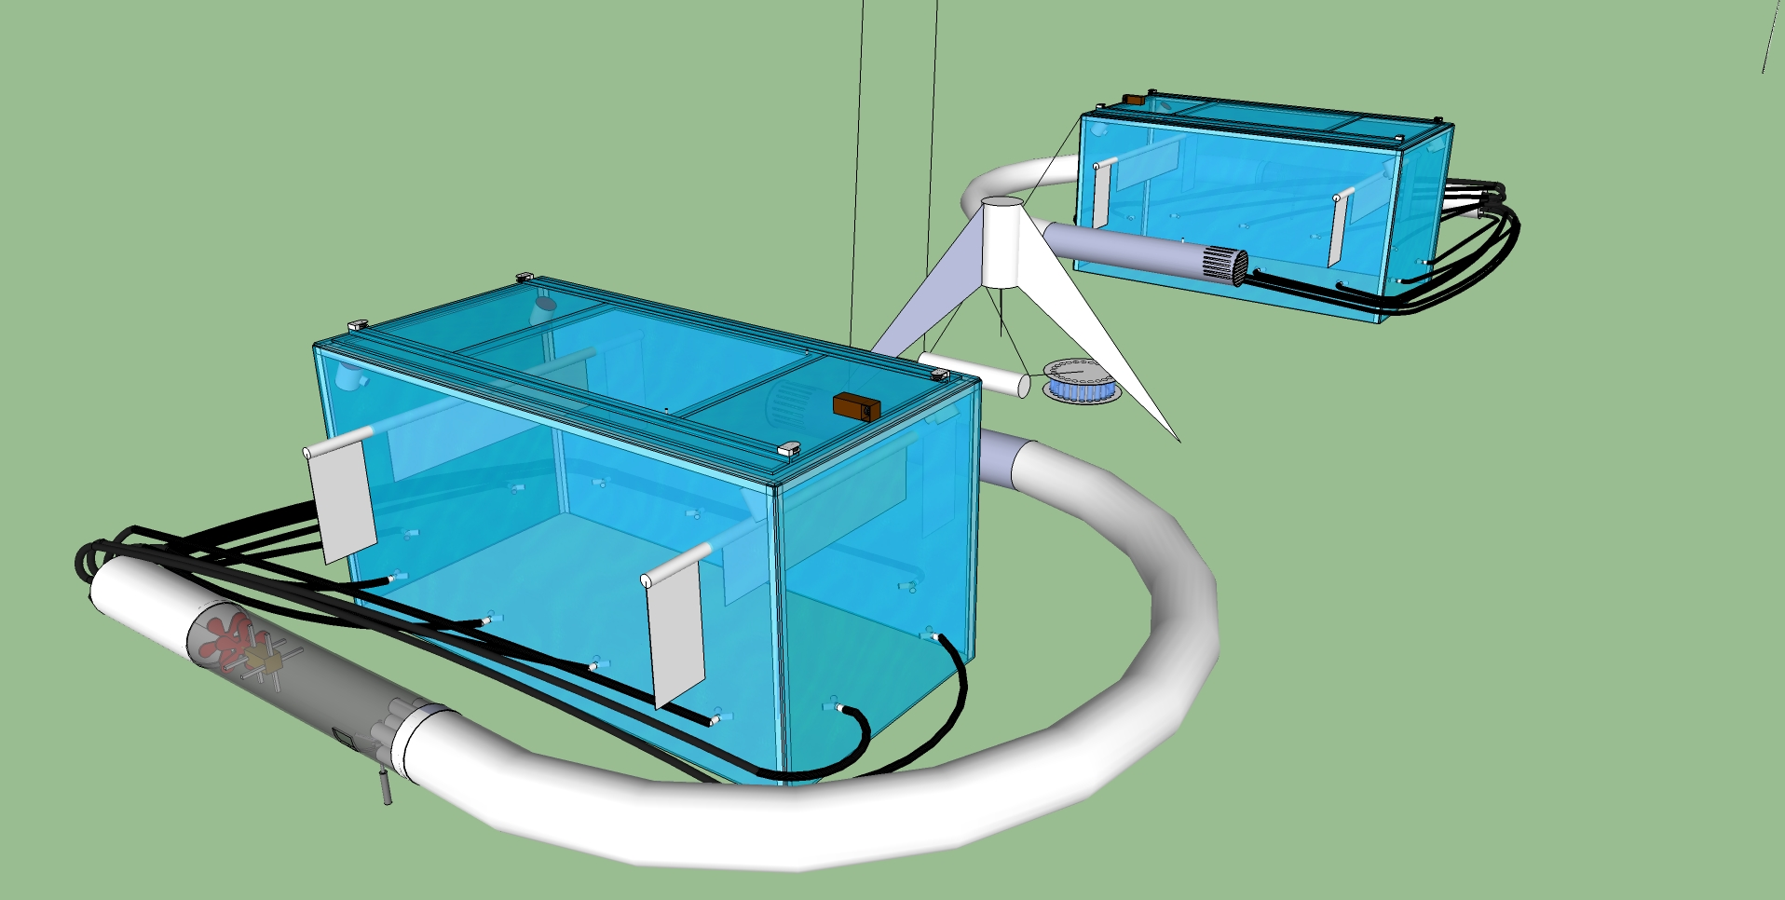
Sensor Node
Small COTS embedded PCs and microprocessors (Arduino, Beagle Board, etc.)
Modularize and aggregate power switching and/or data acquisition
Similar to eFOCE implementation
Reduce power consumption
Shown here using moored configuration
Notes:
The approach we call Sensor Node is looking like our preference for xFOCE and swFOCE, and bears
Resemblance to the approach being used by Ville Franche with eFOCE.
Though again, in practice, users may draw from a number of methods.
The central idea behind Sensor Node is to take advantage of the wide spectrum of small processors
currently available off the shelf at very low cost and aimed at a DIY market.
We’ll propose that dividing some of the system functions between different types of processors, it will
serve to
keep the hardware and software as simple as possible,
keep power consumption down to support remote configurations
Designing minimal custom hardware (and avoiding the need for some designs like serial port expansion)
With a little custom hardware, there is a little more integration work to do, but we aim to use COTS and open source
as much as possible, and make any custom hardware and software we do to be easy for end users to adopt.

Slide 50
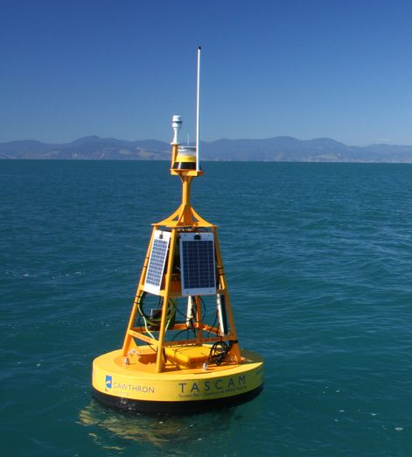
Component | Location | Why
Controller HW | Surface Seafloor | Surface: telemetry, UI Seafloor: experiment control
Controller Software | Seafloor | Gateway: control, telemetry Node: data acquisition
UI Software | Shore Surface | Easier maintenance
Power | Surface | Probably use generator, solar, wind on surface
Data | Seafloor And Shore | Local data needed for control Central archive for redundancy, easier access
Sensor Node
Data
Location View
Power
Data
Gateway
Wireless
Surface
Shore
Seafloor
Gateway
(Controller)
Data
Experiment Control for 1 chamber
Load switching,
Data Acquisition for
1-4 Devices
Node
Node
Node
Node
ESW
pH
CTD
CTD
pH
Flow
Chamber
Flow
DO₂
Flow
DO₂
External
Notes:
The picture here isn’t actually a FOCE implementation, but I chose it because it suggests a moored application somewhat further from shore
And in deeper water, which is the gist of this Location View.
In each experiment chamber, the system functions are split between a Gateway and several Sensor Nodes.
The Sensor Nodes are responsible for data acquisition from 1-3 devices, which includes switching power, as well as requesting and buffering data.
The controller gateway periodically collects the data from the various sensor nodes, and runs the software process that controls pH.
The Gateways also archive data for each FOCE chamber.
Another gateway on the surface (or shore) aggregates and archives data from each chamber controller gateway, and is a relay point for configuration and telemetry.
The hardware used for the Sensor Nodes can be simpler platforms with no operating system, like Arduino or PIC24.
These are fairly low power and have enough capability to get data from instruments and do simple control functions.
The Gateways need a little more capability, for example an ARM based solution that can run Linux.
The aim is to keep the system as simple as possible to build and the cost low.
Having the controller gateways and sensor nodes together on the seafloor makes each node modular and independent.
The types of hardware used typically have 3-5 hardware serial ports, so that using the readily available level of aggregation avoids the use of custom serial IO expansion hardware.
This arrangement also has a fine granularity (and low cost) of field replaceable units – when something breaks, it is less disruptive to replace it.

Slide 51
Sensor Node
Build/Buy View
Component | Build/Buy | Implementation
Controller HW | Buy | Gateway: BeagleBoard, Android, Gumstix Node: Arduino, MSP430, SmartSensor
Controller Software | Build | Gateway: Linux, C++/Java Node: C/C++, Wiring, e.g. Instrument drivers
Archive, UI | Build/Buy | Custom: back end interface Open Source: web server on gateway
Power | Build | Custom: load switch, ground fault detection, isolation
ESW | Build/Buy | Custom: pump and valve drivers COTS: pumps, motor controllers
Notes:
The Sensor Node approach balances build and buy, trying to keep the custom hardware and software minimal and focused on items that can’t be readily purchased.
Again, we want to take advantage of the wide selection of COTS processor boards with peripheral support for the things we need.
One of the tightest hardware requirements to satisfy is the number of serial ports.
Almost all have one or two, but finding more than three narrows the field pretty quickly.
Starting from scratch, this approach requires some software development – all things that are hard to find off the shelf or open source, though good building blocks are available.
For example, we find peripheral drivers (like SD cards), add on hardware and file systems even on small embedded platforms, but we will need to develop our own instrument drivers, data archive and transport formats.
In some cases, we may need to integrate our own real time clock, or find
On embedded linux systems, we can build our own protocols on top of existing network standards like TCP and HTTP, and will need to implement our own configuration and control libraries.
To simplify things, we’ll want to minimize the number of development languages and development tool chains we use. We can use existing standards and protocols where sensible; but we do want to keep the software minimal and accessible to users without a lot of software development experience.
There is some custom hardware to develop as well. The functions are ones that generally can’t be readily purchased, like voltage regulation, load switching, GF monitoring and galvanic isolation.
Some users may opt out of some of these features; they can be developed in a modular way using COTS components, and the designs made available for reuse by the community (perhaps through outlets like SparkFun).
As a community grows around FOCE, there is potential for greater sharing and reuse of code and hardware designs.

Slide 52
Sensor Node
Data
Connection
View
Power
Data
Gateway
RF Wireless
Cell
Satellite
WiFi
Ethernet
(Serial?)
Surface
Shore
Seafloor
Gateway
(controller)
Data
Serial
Node
Node
Node
Node
Serial
ESW
pH
CTD
CTD
pH
Flow
Chamber
Flow
DO₂
Flow
DO₂
External
Notes:
As with all the approaches discussed, it’s possible to connect them in different ways;
Here, the sensor node approach is shown in a moored configuration (as it is with eFOCE).
The important things to note are that the connection between the controller and surface gateways are connected by ethernet, while the sensor node to controller gateway connections are serial, as are the connections between sensor nodes and instruments/effectors.
This is done mainly to conserve power and keep the connectors and cabling simple - ethernet requires somewhat more specialized connectors, and the cabling may be
Trickier over long distances and more sensitive to temperature gradients in the water column.
Each Gateway has an archive, duplicated on the surface as well for easy access and fault tolerance – another reason for providing a high bandwidth connection to the surface/shore gateway.
The connection to shore is flexible – here a wireless link is shown, though the whole spectrum is possible, from sneaker-net to high speed cable.

Slide 53
Summary
Sensor Node
Pros
  Reduce power
  No custom serial IO expansion
  Modularizes data acquisition
  Many variations possible
    COTS processors, languages
    Topologies
    Connection backbone (cost: power)
    Component upgrades
    Drivers on Gateway
Cons
  Two software development platforms
  More custom hardware to build, configure, maintain
  More cables, connectors, housings
  Video expansion path unclear
  Multiple system clocks
Notes:
To summarize the Sensor Node approach:
It’s aimed at reducing power by delegating data acquisition to small low power processors
and modularizing data acquisition functions according to the “naturally available” number of serial ports on COTS hardware, eliminating the need for custom serial expansion solutions or big workstation solutions
It’s flexible pattern that others can use, reuse and adapt to use components of preference or opportunity
The system cost can be low, with processors costing ~$50-300.
Possible down sides are that there is some custom hardware, and even if you adopt someone else’s design, there is more hardware to build, configure and manage.
There may be more cables and connectors, though some of these could be simpler than other options, for example if the Sensor nodes are potted and considered disposable since the cost is so low.

Slide 54
Approach Tradeoffs
Approach | Performance | Flexibility | Ease |  |  | Cost
 |  |  | Build | Use | Extend
“Centralized Workstation” |  | ■ |  | ■ | ■ | 
“Industrial Computer” | ■ | ■ | ■ |  | ■ | 
“Sensor Node” | ■ |  | ■ | ■ | ■ | ■
Recommendation: Prefer sensor node approach for xFOCE, though all are viable
Con

Pro
Notes:
The Bottom Line
Sensor Node is a good design pattern, with balance of build/buy
flexible, extensible, moderate cost
Variants trade complexity, power, modularity
Here we boil down the trades to a simple matrix in terms of the basic criteria we started with, though elements of all the approaches are valid under different conditions
In balance, we prefer the Sensor Node as the recommended approach for xFOCE and plan to use a variant of this for swFOCE

Slide 55
swFOCE Hardware Specs
Features | Sensor Node | Gateway
Serial | 4 | 5
Flash | 256 KB | ■
RAM | 8 KB | 256 MB
EEPROM | ■ | ■
SD Card | ■ | ■
SPI | ■ | ■
I2C | ■ | ■
Features | Sensor Node | Gateway
GPIO | ■ | ■
PWM | 2 @ ?Hz | ■
ADC | 12 bit | ■
Ext INT
Linux | ■ | ■
Optional

Required
Notes:
With an eye towards hardware selection for swFOCE,
these tables summarize some of the key hardware requirements.
The requirements are largely about program storage, serial ports and peripherals.
There are quite a few choices available that could easily do the SensorNode and Gateway tasks.
One of the big drivers becomes the software development environments – we want to choose hardware so that the software tools and programming language support are low cost and easy to use.
We imagine that C/C++, and Java are most familiar to users, as are things like the Arduino programming environment

Slide 56
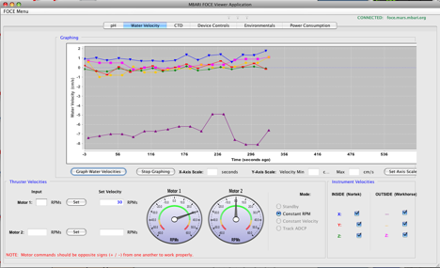
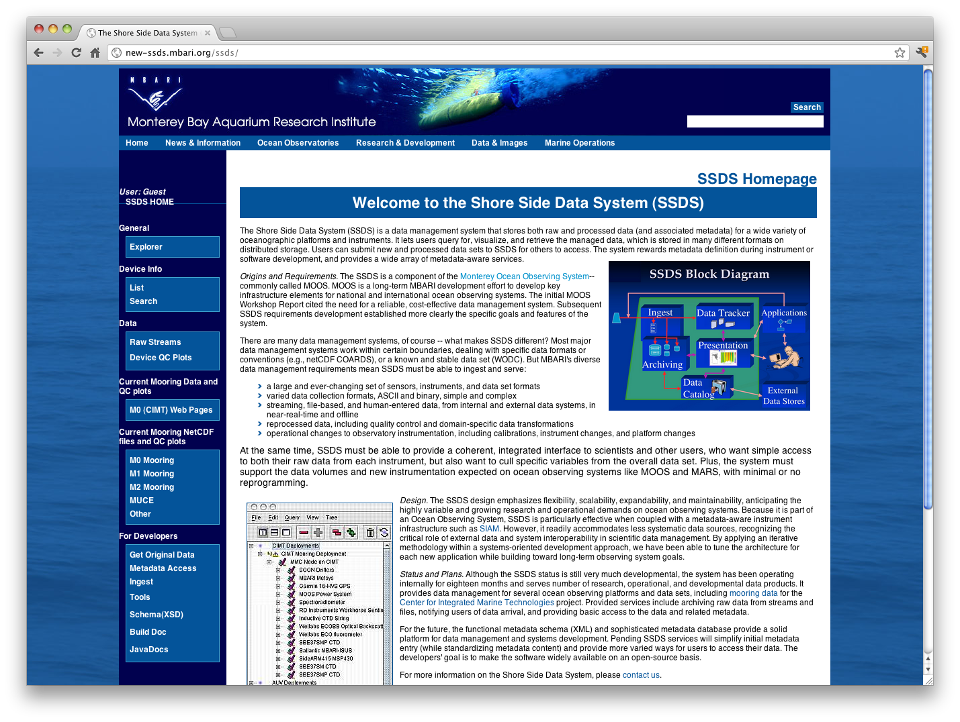
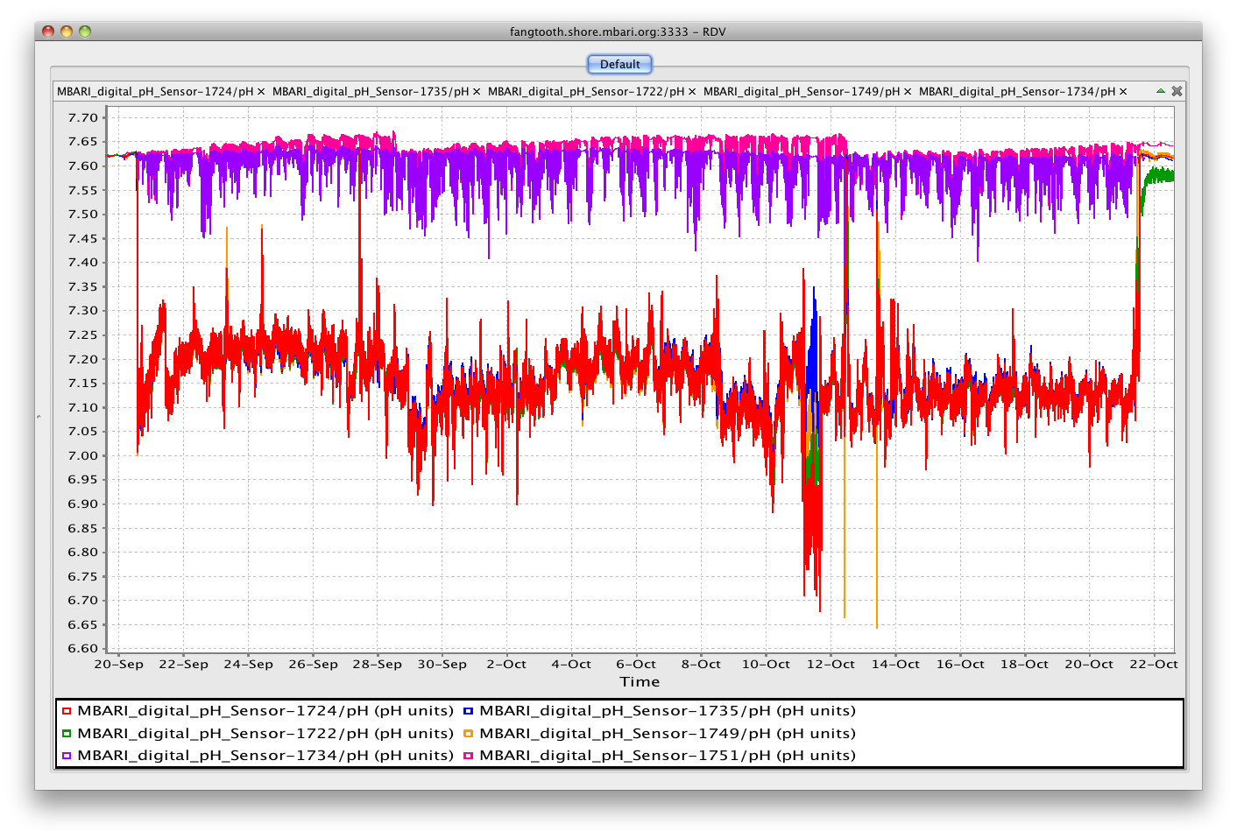

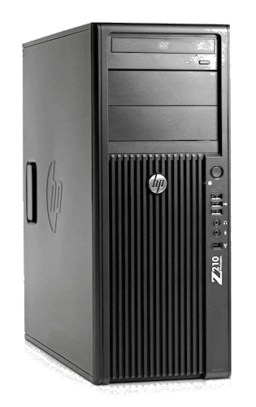
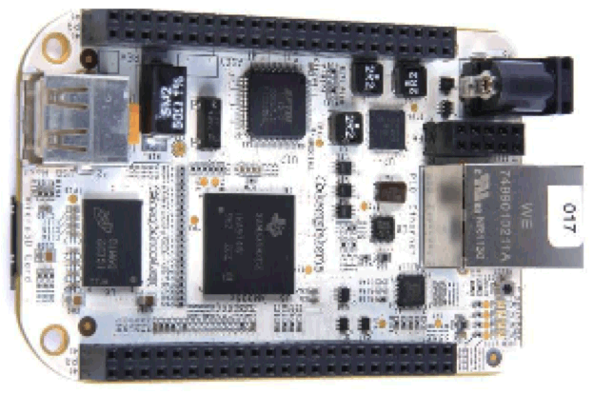
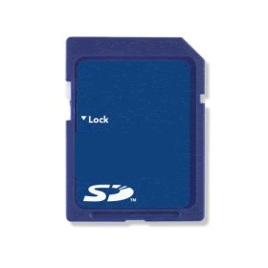



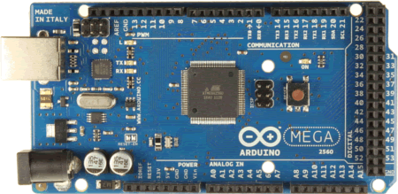
swFOCE Sensor Node Technology
FOCE GUI
Control
Configuration
Data Distribution
SSDS
RDV
Controller
Gateway
TCPIP
HTTP
100 Mbps
Shore Gateway
Network
Junction
Beagle
Bone
Power
Switch
MV
Converter
2 kW
KFA Cable
Serial
Data
Node
12, 24…V
ATMega
PIC24…
SSDS
Data Acq
Node
Node
Node
Motor
Drive
Power SW, ISO, GF
custom
1-3 Instruments Per Node
power
data
tbd
Flow
ESW
CTD
pH
DO
Flow
CTD
pH
DO
Flow
Notes:
With software factors in mind, here is our proposed configuration for swFOCE:
- Controller gateway using BeagleBone (open, ARM based embedded linux)
Arduino, PIC24 or similar for Sensor Nodes
Shore Gateway is a workstation
Custom hardware includes Power conversion (300-MV), power switching (w/ optional GF/iso) , sub-surface network switching
motor drives may be available off the shelf (or we can develop and open source a custom solution
We’ll do our own instrument drivers, control system, and protocols for distributing and archiving data at the low levels
We’d then open source any custom hardware and software to the xFOCE community
Open Source Data Turbine - data distribution and streaming middleware - is an example of a great open source component that is robust and provides capability that would hard to develop well from the ground up.
We would likely use OSDT on the shore side to playback data in real-time or post-experiment, and possibly on the controller gateways to facilitate closed loop control as we have done in dpFOCE.
We’ll use our SSDS as the primary archive, along with a custom GUI for configuration and control.

Slide 57
Architecture Summary
Many valid approaches and choices of
  Build vs Buy
  Location/Partioning of system
  Topology/Interconnections
For xFOCE (and swFOCE) we like Sensor Node
  Best balance or
    performance
    cost
    ease of construction/use
    extensibility

Slide 58
Mechanical Components
Comprising
xFOCE / swFOCE
Farley F. Shane

Slide 59
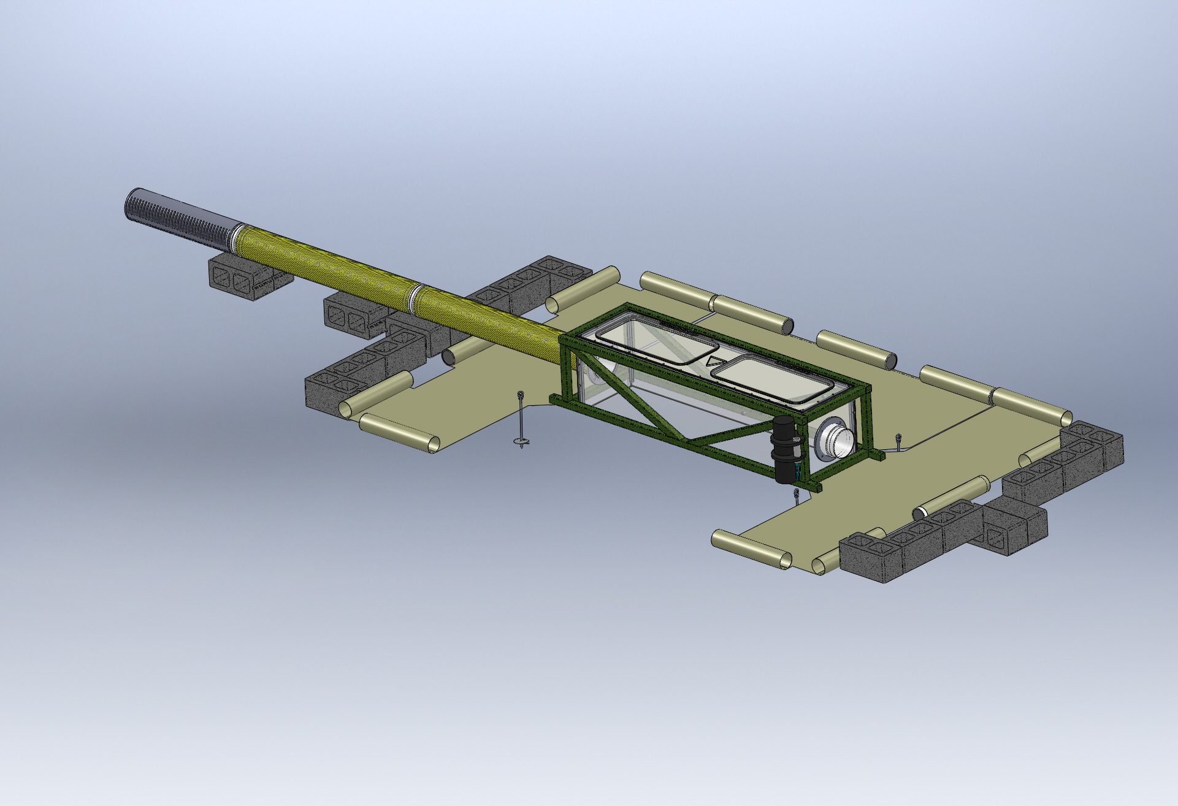
Typical Seafloor System Comprising an xFOCE
As needed
Enriched Seawater Delivery
From Surface
Enriched Seawater
Experiment Chamber
(Both Ends)
Perimeter Weights
Seawater Inlet
Valve Manifold
(Both Ends)
Fan Module
Location
(Both Ends)
Delay Path Section
(Both Ends)
(Conformal Sealing Mat
Removed for Clarity)
Conformal Sealing Mat(s)
Chamber Anchors (at corners)
Shear Skirt
(Bottom Perimeter
Scour Protection Elements
Notes:
Bricks optional

Slide 60

Sample Experiment Chambers
Fans to
Control Current
Buoyancy Blocks
Access Hatches
Control System in
Pressure Housing
Exo-Frame
Fitting for Time
Delay Section
Delay Path
Experiment Chamber
Conformal Seal
Subsea CO2 Reservoir
Enriched SW
Delay Path
Anchors
MBARI Deep FOCE
swFOCE Prototype
Surge Translation Paddle
Surface Available for Instrumentation
Fan
Fan
Handle
Side Access Opening
(Hatch Not Shown)
Modular Fan Section
Perimeter Shear Skirt
Hemi- Cylindrical
Trapezoidal

Slide 61
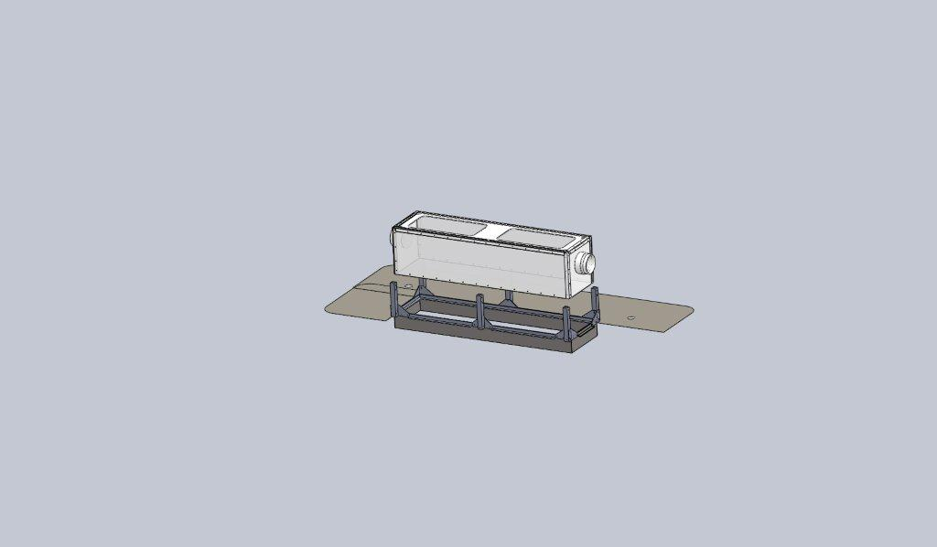
swFOCE Assembly w/Shear Skirt and Interface Seal
Experiment Chamber
Chamber Dock
Interface Seal
Rigid Perimeter Shear Skirt
Notes:
Make image bigger
Add “concept” notation
Add real picture of test unit (in situ)

Slide 62
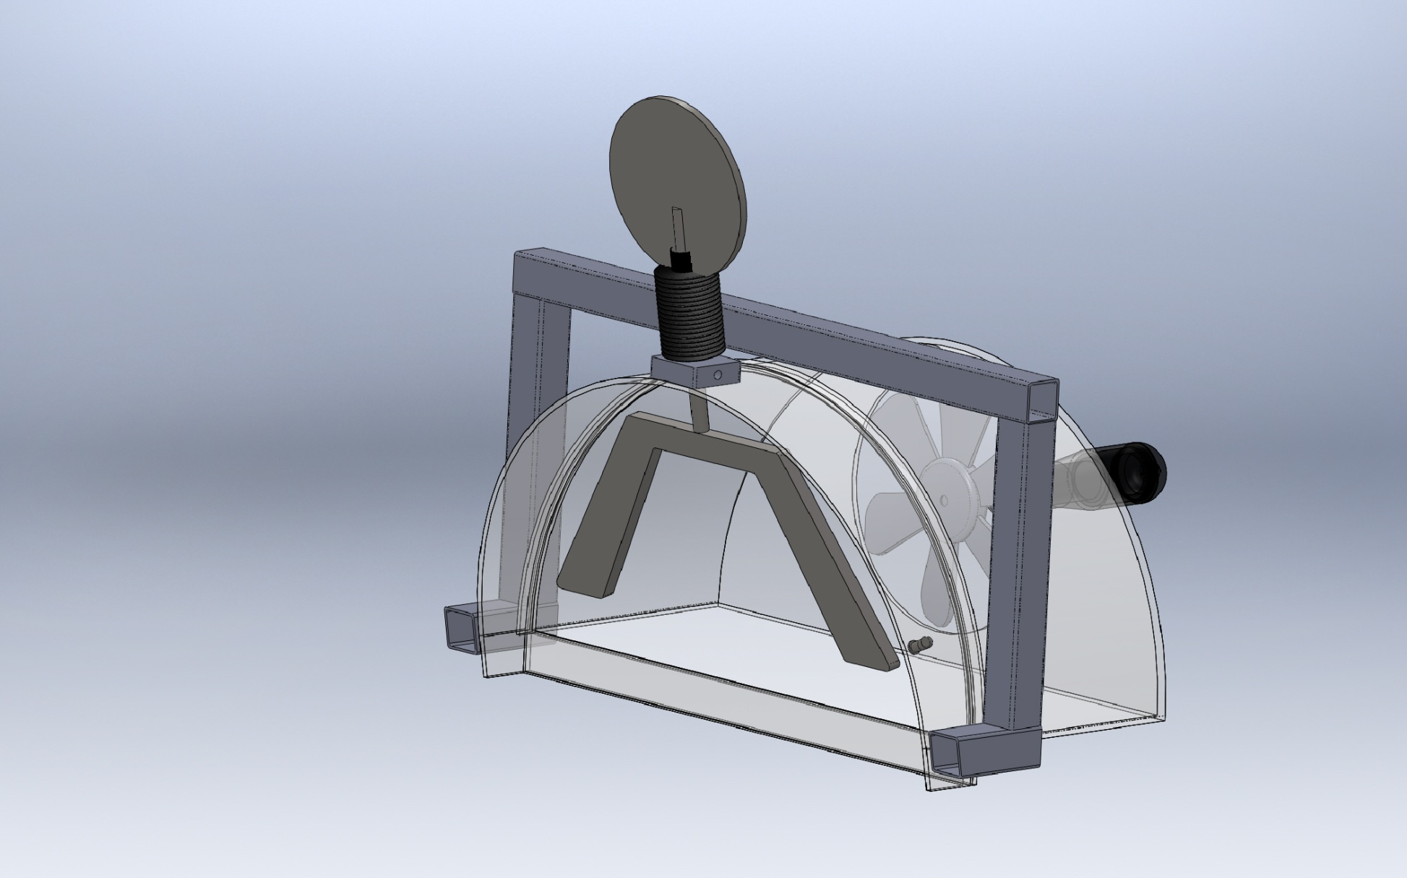
Surge Translation Mechanism
Pivot
Paddles
Section View

Slide 63


Time Delay Mixing Section
Offset pH = -0.7
Bkgrd pH ~ 8.1
Offset pH = -0.5
Offset pH = -0.3
(34.9 deg. F)
Flexible Duct
(39.2 deg. F)
(50 deg. F)
Length
  Calculated using 2 Tau time delay and desired maximum current speed.
  Provides the time necessary for the CO2 and seawater to chemically react and establish stabilized pH.
Cross-sectional area and current speed
(volume/time) will approximate the rate of change
of the enriched seawater in the Experiment Chamber.
(77 deg. F)
Tau = 67.8 secs
*
*
Tau = 51.3 secs
*
Tau = 31.1 secs
*
Curves from the Zeebe-Wolf Gladrow CO2 kinetic model
showing e-folding time at various temperatures as a function
of pH.
Notes:
Add time delay comments at front of talk

Slide 64



Simulating Current
Type
Pro
Con
  Compatible with shallow depths
  Easy maintenance/replacement
  Compatible with available power (AC/DC, etc.)
  Controllable according to requirements
  Capable of reasonable volume/rate delivery
  Low Cost --$50-$200
Requires modification to fit shroud
Not designed for long term running
Requires close monitoring of shaft seals
Trolling Motor
Technadyne Model 520 Brushless DC
  Multiple voltages
  Analog or digital control
  Magnetically coupled prop
CrustCrawler 400 HFL
  0-50VDC 400watts
  300 ft Depth
  Low Cost --$600
High Cost --$3700
Lip seals
Commercial Thruster
  Compatible with shallow depths
  Large range of flow rates
  Large range of DC voltages
  Readily available/replaceable
  Very inexpensive-- $20-$50
  Not designed to run continuously
  May need replacing more often
Submersible Bilge Pump
Brand Names: Rule, Attwood, Lovett, Johnson, Jabsco,…

Slide 65











Examples of Anchors
CQR
Epoxied Anchor Pins in Coral
Installation of
Anchor Pins
Claw or Bruce
Danforth
Drag Embedment Anchors for Mooring Buoy
Powder Actuated Stud Gun
Self Embedment Anchors
Deadweight Block
Single or
Multiple Helix
Dor-Mor
Helix Anchor

Slide 66
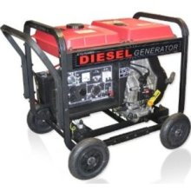


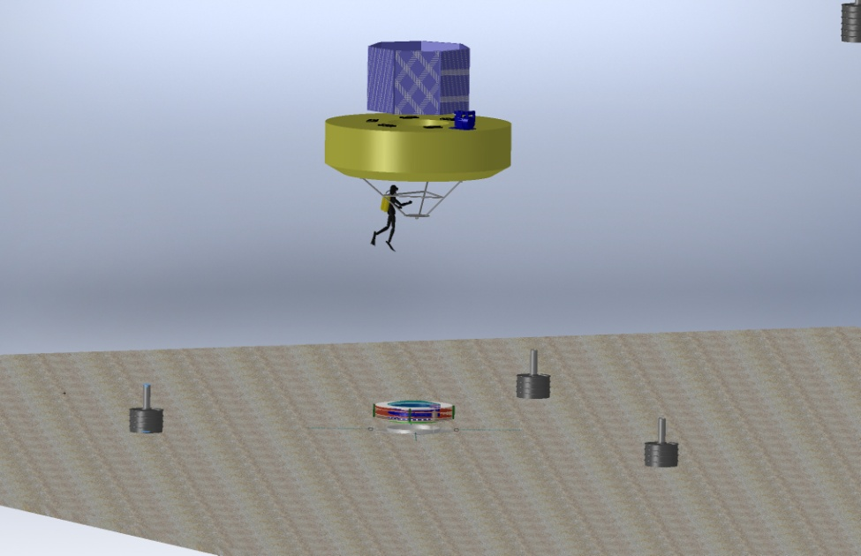
Power Options for xFOCE
Diesel Generator
3500 Watt Output
0.3 Gallon per Hr.
Onshore Power
  Power supply Unit
  UPS
Remote Location Power
Onshore or Offshore
  Diesel Generator
    Batteries
    Bonus of CO2 generation
  Wind Powered Generator
    Batteries
  Solar Cells
    Batteries
Offshore
  Moored Buoy
Wind Generator
400 Watt Output
240 Watt Panel
Buoy
xFOCE
Anchor
  Moored Buoy
Notes:
Check power consumption for half power (2 kW for 0.3 Gal/h)

Slide 67





Supporting Information
Exhaust used for CO₂
Diesel Fuel
Option for Extracting CO₂
from Exhaust
CO₂ Mix Electronics
Particle Scrubber
Supplemental
System Control Electronics
Carbon Dioxide Emissions from 1 gallon of fuel
Source: U.S. Environmental Protection Agency, "Emission Facts: Average Carbon Dioxide Emissions Resulting from Gasoline and Diesel Fuel," February 2009.
Notes:
Option for xFOCE (should be explicit for

Slide 68
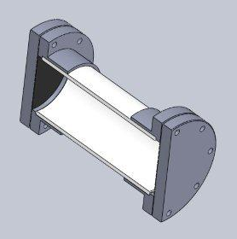
Low-cost Shallow Water Pressure Housing
Van-Stone / Socket Flange
PVC - Polyvinyl Chloride
strong and rigid
resistant to a variety of acids and bases
maximum usable temperature 140ºF (60ºC)
Cap
PVC Pipe
Nominal Pipe Size (inches) | Schedule 40 | Schedule 80
1/2 | 358 | 509
3/4 | 289 | 413
1 | 270 | 378
1 1/4 | 221 | 312
1 1/2 | 198 | 282
2 | 166 | 243
2 1/2 | 182 | 255
3 | 158 | 225
4 |  | 194
5 |  | 173
6 |  | 167
8 |  | 148
(psi)
(psi)
Operating Temp (°F) | De-Rating Factor
73 | 1.00
80 | 0.88
90 | 0.75
100 | 0.62
110 | 0.51
120 | 0.40
130 | 0.31
140 | 0.22
PVC Pipe
Gasket
Design Parameters
Operating Depth = 40 Meters (~131 ft.)
Maximum Pressure = .444 x Depth (ft.) +14.7 psi → 73 psi
Factor of Safety = 2 Therefore 2 x 73 psi = ~146 psi max.
Notes:
This is a generic Sch80 PVC, COTS pressure housing good to diver depths.
Flanges glued on with PVC cement, Butyl or Neoprene 1/8" rubber discs for
seals, caps bolted on.

Slide 69


xFOCE Engineering Trades
Color Frequency Wavelength
violet 668–789 THz 380–450 nm
blue 631–668 THz 450–475 nm
cyan 606–630 THz 476–495 nm
green 526–606 THz 495–570 nm
yellow 508–526 THz 570–590 nm
orange 484–508 THz 590–620 nm
red 400–484 THz 620–750 nm
infrared longer than 750 nm
Since these wavelengths penetrate water easier but most plastic materials respond poorly to high freq light the materials selections will focus on this end of the spectrum
The selection of materials will likely transmit this end of the spectrum fairly well but in selection, if required, we would trade attenuation here to maximize shorter frequencies.
Acrylic (vs Polycarbonate) has less attenuation overall and carries much further into the ultraviolet when comparing the blue lines.

Slide 70
xFOCE Electrical Design
Chad Kecy
Electrical Engineer

Slide 71
Preliminary Considerations for any FOCE system
Cabled vs Non-Cabled
Power
  Generation
  Distribution
  Heat Dissipation
Communications
  Shore to subsea
  Subsea to instruments
  Type / amount of data
Reliability
  Environmental condition monitoring
  Electrical protection of instruments/subsystems
  Ground fault protection

Slide 72
Non-Cabled System
(general for xFOCE)
Wireless
Communication
Buoy or Platform
Local Power
Generation

Slide 73
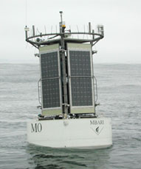
Mooring
Power Generation
  Solar, Wind, Diesel
  Battery Storage
Shore Communication
  Wireless Telemetry
Tether to Subsea Component
  Power
  Communication

Slide 74
Cabled System
(swFOCE configuration)
Shore Side
Station
Tether
Underwater
Connection

Slide 75
Shore Side Station
Physical Requirements
  Location
  Type of Installation
  Weather / Environmental Conditions
  Cable path (buried, exposed)
  Permitting
Electrical Requirements
  Power Source
  Communication Equipment
  Ground Fault Detection / Safety
Notes:
Trawling
Anchoring
How to deploy

Slide 76
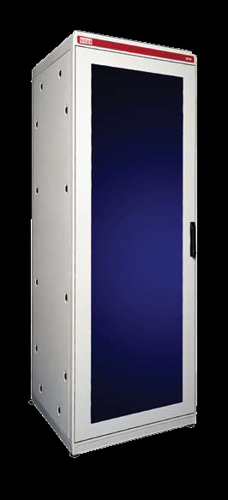
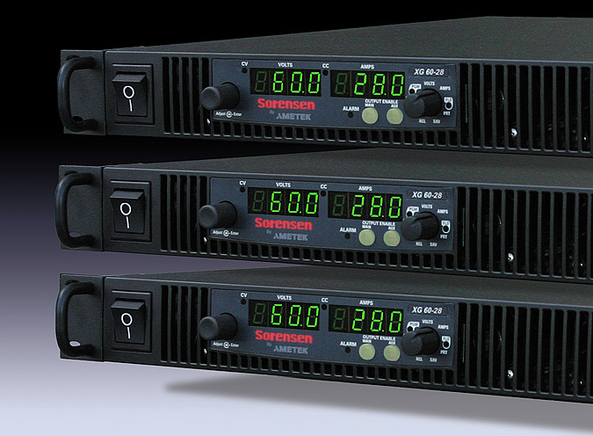
swFOCE Shore Side Electronics
Rack mountable components
  Power Supplies
  Isolation Transformer
  Router
  CO₂ generation control
  Data Acquisition

Slide 77
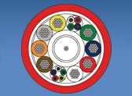
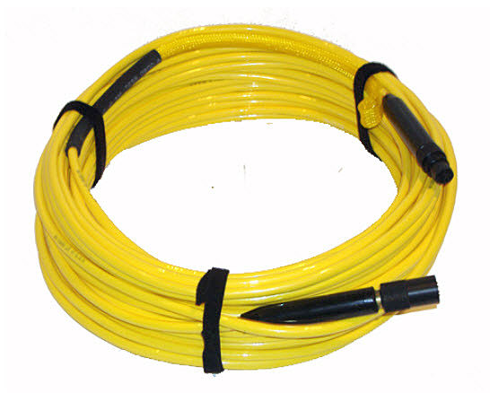
swFOCE Cabled Tether
Electrical Requirements
  Power rating
  Communication speed / bandwidth
  Number of conductors (twisted pairs)
  Fiber optics?
  Connector selection
Mechanical Requirements
  Length
  Strength
  Anchoring
  Trawl Resistant
  Deployment Method

Slide 78
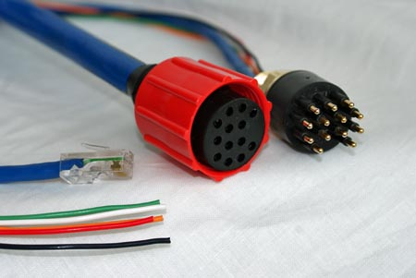
Underwater Connectors
Types
  Wet-mateable
  Dry-mateable
Considerations
  Deployment
  Servicing
Ratings
  Power conductors: voltage/current
  Communication conductors: speed/bandwidth
Notes:
#1 failure point
Speed/power issues

Slide 79
System Level Functions
Distribution of DC power to external instruments and internal subsystems
Bidirectional communication to external instruments and internal subsystems
Health monitoring for entire the subsea node
Computer
  Collection and dissemination of data
  Closed loop control of the experiment

Slide 80
DC Power Example
48V to 24V
Conditioning
Patch Panel
Inrush
Limiting
48V to 12V
Conditioning
12V
Ethernet
Switch
12V
Load Switching
24V
24V
Computer
pH Probe
CTD
ADCP
Camera
Thruster

Slide 81
DC Power
DC-DC Converters
  Converts input DC voltage to all necessary lower DC bus voltages.
Conditioning and monitoring
  Provides filtering and power monitoring.
Patch panel
  Distributes lower DC bus voltages to internal subsystems.
Load switching to individual instruments
  Provides galvanic isolation, over/under current/voltage protection, power monitoring, and ground fault detection to each instrument.

Slide 82
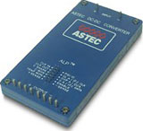
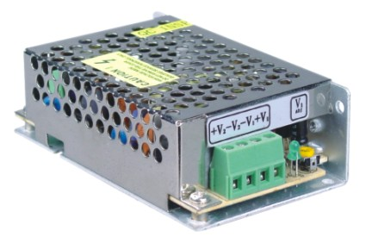
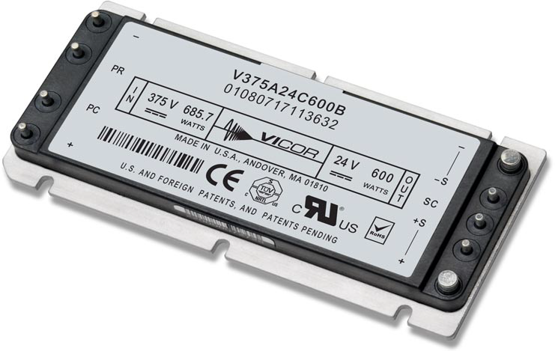
DC-DC Converters
Multitude of form factors
COTS vs Custom
Standard package for wiring consideration
Choice of bus voltage
Built-in Conditioning?

Slide 83
Communication
Communication from shore to subsea node
  Factors:
    Is your FOCE tethered or standalone?
    Distance
    Bandwidth requirements
    Shore based infrastructure
  Potential choices:
    Tethered: Ethernet, RS-422, DSL
    Standalone: Wireless ethernet
Communication from subsea node to individual external instruments
  Most instruments utilize serial comms
    RS-232 and RS-485 most common

Slide 84
Communications Example
Ethernet
Switch
Computer
Video
Server
Serial
Expander/Server
Serial
UARTs +
Transceivers
Optional Paths
pH Probe
CTD
ADCP
Camera
Thruster

Slide 85
System Health Monitoring
Provides top side users with status of environmental conditions in the subsea node.
Can be used to automatically power down instruments in the event of a failure.
Conditions measured:
  Temperature
  Humidity
  Water presence
  Housing pressure
  Orientation

Slide 86
Health Monitoring Example
Ethernet
Switch
Computer
Ambient Temp
48V to 24V
Ambient Humidity
Health
Monitor
Ambient Pressure
Thermocouples
48V to 12V
Cooling Fan
H2O Sensor

Slide 87
Four Potential Backbone Systems
1. PC/104 Stack
2. Wago I/O System
3. Instrument Chassis
4. Sensor Node

Slide 88



PC/104 Stack
What is PC/104?

Slide 89
PC/104 Stack
Advantages
Disadvantages
Rapid prototype/design
Expandable/reconfigurable
Extensive functionality
Relatively inexpensive
Industry standard
Often software drivers included
Can incorporate custom boards
Power consumption
Maintenance
  Need to disassemble the stack to get to middle boards.
Limit on # of boards in stack
Sometimes, no software drivers….

Slide 90

Wago I/O System
What is a Wago I/O System?

Slide 91
Wago I/O System
Advantages
Disadvantages
Rapid prototype/design
Expandable/reconfigurable
Industry Standard
Generic software interface
Can incorporate custom boards
Limited functionality for our requirements
  More custom designs
Power consumption

Slide 92




Instrument Chassis
What is the Instrument Chassis?

Slide 93
Instrument Chassis
Advantages
Disadvantages
Was designed specifically for use in the shallow water FOCE system
Modular; new boards can be designed.
Low Power design
Simple software interface
Design complexity
Expensive to produce
Custom firmware needed
Currently, no serial expansion included

Slide 94
Sensor Node Board
What is the Sensor Node Board?
DC Power from Bus
DC Power to Instrument
Pluggable
CPU
Module
BeagleBone?
Arduino?
Microchip PIC?
SmartSensor?
Load Switching
Inrush
Limiting
Circuit
Breaker
Over/Under
Curr/Volt
Det / Mon
Ground Fault Detection
UART
Serial Transceiver
Comms
Serial comms to Instrument

Slide 95
Sensor Node Board
Modules available?
  None, it is a fully functional standalone unit
  1-3 instruments per Sensor Node board
Functions available:
  CPU, storage
    Device driver could be active locally
  Serial interface (uart + transceiver)
  Load switching
    Over/under curr/voltage detection
    Ground fault monitoring
    Current/Voltage monitoring

Slide 96
Sensor Node Board
Advantages
Disadvantages
All functions on one board
CPU simple to program
Single board design can handle a large variety of instruments
Open source HW and SW
Custom design
Cost?
Distribution

Slide 97
Electrical System Comparison
 | PC/104 | Wago | Instrument Chassis | Sensor Node Board
Central CPU | Yes | No | No | No
Local CPU | No | Yes | Yes | Yes
Local Storage | Hard Drive | No | SD Card | ?
Ethernet Interface | Yes | Yes | Yes | ?
Serial Expansion | Yes | No | No | One per
Load Control Relays | Yes | Yes | Yes | Yes
Circuit Breaker Protection | No | No | Yes | Yes
Inrush Limiting | No | No | Yes | Yes
Ground Fault Detection | No | No | Yes | Yes
Thermal Inputs | Yes | Yes | Yes | Yes
Humidity Inputs | Yes | No | Yes | Yes
H2O Sensor Inputs | Yes | Yes | Yes | Yes
Pressure Sensor Input | Yes | Yes | Yes | Yes
3-Axis Orientation | No | No | Yes | ?
Power Usage (Watts) | 45 | 70 | 10 | ?
Cost per System ($) | $3500 |  | $ 3486 | ?

Slide 98
Proposed swFOCE Electrical System
Cabled System
  Tether carries 375Vdc and fiber optics for ethernet
Down-converting to 48Vdc in a central node
Copper Gigabit ethernet to swFOCE node
Utilizing star topology architecture with Sensor Node boards
Sensor Node boards with configuration options
Time-lapse camera + video option
Notes:
Camera/time-lapse, video option
Sensor node configuration options?

Slide 99
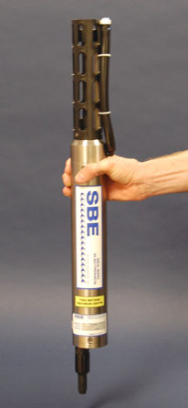
xFOCE Core Instrument Suite
Sensor | Specification
pH | +/- .01 pH unit or better and suitable for control loop applications
CTD, DO₂ | Comparable to current units at MBARI, unit is SBE37 (oxygen can be included)
Flow Sensor | TBD, likely electromagnetic to get smooth flow numbers and volumetric data. From dpFOCE acoustic velocity sensors are not suitable.
Suggested architecture allows for expansion of additional instrumentation

Slide 100
swFOCE Core Instrument Suite
Sensor | Specification
pH | +/- .01 pH unit or better and suitable for control loop applications
CTD, DO₂ | Comparable to current units at MBARI, baseline unit is SBE37 (oxygen can be included)
Flow Sensor | TBD, likely electromagnetic to get smooth flow numbers and volumetric data. From dpFOCE, acoustic velocity sensors are not suitable.
PAR* Sensor | 400 – 700 nm / calibrated to 0 – 5000 μmol photons•m ⁻²•s ⁻¹
Camera/Lights | 1080p - 16:9 ratio format – light source either natural and/or color balanced LED
Suggested architecture allows for expansion of additional instrumentation
PAR* - Photosynthetically Active Radiation
Notes:
Reformat slide

Slide 101
xFOCE/swFOCE Data System

Slide 102
xFOCE Data
Clients
Archive
Configuration
& Control
Basic requirements
  Sample rates, Timestamp accuracy (1 s)
  Time-stamped archive of experiment data
  Flexible data archive format (time-stamped CSV)
  Health and status monitoring
Users will prefer different ways to access data
  MATLAB, Excel, LabView, custom utilities…
Well defined (and standard) interfaces are key
  Configuration and control interfaces
  Data access interfaces:
    Services, clients, applications
    Simple, efficient, support low-bandwidth links
  Data archive formats
Metadata
  Science and system contextual data
    Changes to instruments, sampling, calibrations
    Ground faults, leaks and other system faults
  Enables understanding of what is (or did) happen
  Provides insight into anomalies, troubleshooting
Transformation
Presentation
Query
Links
Archive
Distribution
Distribution
Distribution
Controller
Controller
Controller
Driver
Driver
Device
Device
Notes:
Data is, of course, a central focus of any experiment. It is among the primary interests of potential FOCE users.
This picture schematically shows the path data takes as it is produced and consumed for xFOCE.
Data originates from devices (which may be science instruments, actuators (pumps and fans) or diagnostic sensors.
Driver software collects data from the system and passes it to components that use the data to control the experiment.
The controllers use some kind of distribution component that can usher the data into archives, and to various clients that consume the data: archives, configuration and monitoring interfaces, as well as query and visualization tools.
-----------
BASIC REQUIREMENTS
So for xFOCE, one could say that the fundamental data requirement is to provide a robust primary archive of the experimental data in a format that is flexible and extensible.
To this end, the basic data requirements of xFOCE are that:
Adjustable sample rates
We have data time stamp accuracy (1-second)
The data format needs to also be flexible (e.g., time stamped CSV files (comma separated values) would be okay to use by scientists)
The system also needs to provide health and status of the system and instruments (i.e., quality of data).
ACCESS CLIENTS
2. We envision that users will have different ways to access data. The clients haven’t all been defined, and may vary from implementer to implementer – everyone has their favorite way to look at data.
However, common examples of these are:
MATLAB
Excel
LabView
Or their own in-house custom built utilities
INTERFACES
3. To attain the needed flexibility, well-defined (and hopefully somewhat standard) interfaces (point to diagram) are the key.
The interfaces that matter most are:
Configuration and control interfaces – Setting up/Accessing the system while deployed to deliver data in the form they need.
Data access interface
- You need to consider links to the data (e.g., specific services, clients and applications to view the data).
- Other important considerations include using interfaces that are simple, efficient, (standard) and can support low bandwidth links (should there not be high-bandwidth capabilities). As a result, the specific amount of
bandwidth and electrical connections for the system NEED to be well defined.
3. Data archival formats
- Users need to be able to use data archive formats.
**Due to their importance, these interfaces should be defined EARLY in the xFOCE design process.
METADATA
4. It’s easy to lose the importance of metadata in the system when you’re struggling with technical issues like wiring and housings, but Metadata also needs to also be architected in early.
Knowing - what sensors were in place, when and how they were calibrated, and whether the system was working nominally - can be the difference between understanding the experimental outcome or not.
There are a lot of valid ways to manage metadata. Currently, xFOCE doesn’t place any specific requirements what metadata to manage or how to manage it.
1. However, it is a best practice to have metadata “hooks” for automating this designed in at the very least because it is both science contextual data as well as system data.
- Important data for science users would be Changes to instruments, sampling changes or calibrations, while
- Data about the system would include system ground faults, water leaks or other system faults.
2. Metadata enables the user to understand what is or what did happen.
- You might not know why an experiment is happening / or has happened the way it has.
3. It provides insight into strange data anomalies and can aid in troubleshooting a system problem.
- It can “forensically” help to reconstruct what happened.
As a result it is a good idea to keep track of a systems/experiment’s metadata

Slide 103
swFOCE Data
Added requirements
  Remote access
    Multi-user
    Separate administrative access
  Metadata management
  Compatibility w/ dpFOCE data
  Ground fault monitoring
  Still/video image data
Notes:
Built on top of the xFOCE data requirements, swFOCE will need added data requirements including:
REMOTE ACCESS
1. Remote Access - – More than one institution needs to use swFOCE and are physically distant from the experiment site.
- From multi-users
System needs to have the capability to grant different levels of access to the system – for example, accessing data vs configuring and controlling the system.
- A separate administrative access for configuration of the system or manipulating hardware versus just looking or observing data. “Active versus passive role”.
Concurrency and safety also fall into this domain – we have to make sure that we handle people accessing the system at the same time, and operators on-site are safe.
METADATA MANAGEMENT
2. As we just mentioned, there is no strict requirement on metadata for xFOCE but for shallow water FOCE it is an important requirement.
- We need to automatically keep and access data including: voltage, ground faults, instrument manifest, etc., similarly to how it was done with dpFOCE.
COMPATIBILITY WITH dpFOCE DATA
3. We also require that swFOCE data be compatible with the previous dpFOCE experiment data and our shore side data system.
GROUND FAULT MONITORING
4. While ground fault monitoring for xFOCE isn’t a strict requirement, we have found it very useful (e.g., in monitoring electrical engineering systems and devices), and would like to add this to our monitoring capability.
STILL / VIDEO IMAGE DATA
5. Finally, our science user has expressed a need for time-lapse video and still image data for swFOCE.

Slide 104


swFOCE Data
Seafloor
Hopkins
Remote
Shore Side Data System (SSDS)
Primary data archive
MBARI internal standard
SSDS Server
Controller
TCP, UDP
HTTPS
Other…
Controller
SSDS Data
Archive
Controller
User
Tools
Instrument Data
Archive
HTTPS
Instrument Data
Archive
Local Data
Archive
SSDS
Controller Software
Access
Server
Control Service
Access
Service
Data ACQ
Services
FOCE GUI
Control, monitor
Data ACQ
Services
OSDT?
Data ACQ
Services
OSDT Server
TCP, UDP
OSDT Data
Archive
Data
ACQ
•••
Data
ACQ
?
Real-time Data Viewer (RDV) OSDT client
Live, post-experiment
data playback
Open Source
DataTurbine
Flow
ESW
CTD
pH
DO
Flow
image
Notes:
This diagram shows how these data requirements overlay onto the Sensor Node architecture that we’ll use for the swFOCE.
1. Controller Gateway nodes collect data from the sensor nodes (Data ACQ) and store the original data.
These primary archives will likely use a simple file format (CSV, for example).
2. The nodes need to present an interface [Access Service] to components on shore to configure and monitor the system (e.g. with the FOCE GUI from a remote location) and to access data.
3. The Shore Side Data System (SSDS) (which will reside at the Hopkins site) will be used as the primary repository for the swFOCE data (supports queries via HTTP using browser or client software).
4. We also include an Open Source Data Turbine (OSDT) instance that is another archive that can be used with clients like Real-Time Date Viewer (RDV) to visualize and playback data time series in real time or post-deployment.
5. The component labeled Access Server represents software components that manage user access to the system.
6. For swFOCE, which is a cabled system, the link between shore and the experiment is Ethernet providing high bandwidth. As a result, we’ll design interfaces around TCP/UDP protocols, though we’ll need to keep these lightweight and scalable to support lower bandwidth options that may be used in other xFOCE applications.
7. The video/image data path is somewhat TBD. By trying to keep the processing infrastructure simple (and serial), it may not be possible to integrate live video feeds via sensor nodes (or even gateway nodes), It may turn out to be more practical to simply hang TCP based cameras on the network and provide additional tools (or third party) to collect and archive image data

Slide 105
UI System Requirements
Network Connectivity (Ethernet, Serial, Wireless)
Health and Status (heartbeat on connection)
Control Application Programming Interfaces (APIs) – System and Instruments
Data Collection APIs
Security:
  User Authentication / Authorization
  Enforce Maintenance or Lockout of System (unless mechanical)
Node / Instrument List (registry)
Metadata access / management
Data Format and Parsing (or pick data format)
System Change Notification (push notification for low bandwidth)
Scaling and Extensibility (all the above for additional instruments)
Data repository for historical data
Notes:
When considering the UI requirements for either the xFOCE or swFOCE system, we took a step back and looked at the existing dpFOCE GUI and what it required. These requirements include:
Network Connectivity (Ethernet, Serial, Wireless)
Health and Status (heartbeat on connection)
Control Application Programming Interfaces (APIs) – System and Instruments
Data Collection APIs
Security:
User Authentication / Authorization
Enforce Maintenance or Lockout of System (unless mechanical)
Node / Instrument List (registry)
Metadata access / management
Data Format and Parsing (or pick data format)
System Change Notification (push notification for low bandwidth)
Scaling and Extensibility (all the above for additional instruments)
Data repository for historical data

Slide 106
REQUIREMENTS | xFOCE | SWFOCE
1. Network Connectivity | ■ | ■
2. Health and Status | ■ | ■
3. Control APIs for both System & Instruments | ■ | ■
4. Data Collection APIs | ■ | ■
5. Security | ■ | ■
6. Node / Instrument List (Registry) | ■ | ■
7. Metadata Access Management | ■ | ■
8. Data format and parsing | ■ | ■
9. System Change Notification | ■ | ■
10. Scaling and Extensibility | ■ | ■
11. Data repository | ■ | ■
■ = Required
■ = Maybe, It Depends…
Notes:
This slide show these same requirements for both the xFOCE and the swFOCE UIs and how they might be represented for the two systems.
The xFOCE, which does not have many strict data requirements, only a few items would be required for the system including:
Network Connectivity
Health and Status displays
Control APIs for both the System and the Instruments
So much of the xFOCE falls into the “It Depends, Maybe” classification as each system and their requirements will be on a a system-to-system basis. What
Is needed by one group may not be needed by another.
However, for the swFOCE, which is much more complex and well-defined in its design, would have a larger list of requirements in addition to the first three.
4. Data Collection APIs
5. Security
6. Node / Instrument List (Registry)
7. Metadata Access Management
8. Data format and parsing
9. System Change Notificiation
10. Scaling and Extensibility
11. Data Repository

Slide 107
UI Functions
Notes:
This is a simple diagram showing the before mentioned UI Functions.
In order for the GUI to meet the stated requirements (we are assuming swFOCE here), it will need certain things from the deployed FOCEsystem.
These functions are defined in the blocks to the left.
It is important to note that the GUI does not necessarily care where these functions are in the deployed FOCE, they just need to be available to the GUI.
The separation of the contextual data and metadata is done to emphasize that while this information does not necessarily need to be kept on the deployed
system, it needs to be kept somewhere for the GUI to utilize.

Slide 108
One end of the spectrum
Notes:
This slide is to emphasize that this can all be done in the xFOCE scenario without having all of the capability baked in to the system itself.
All the functions still need to be available if you are going to do a "UI" of any kind.
Maybe in this case you use MATLAB or LabVIEW as your GUI. That is not a problem but you still need to have all the functionality of the
previous diagram supported to enable even the MATLABUI. <Then you give some examples from the diagram>.
Data standard format is CSV files scraped from terminal sessions and the metadata is kept in a notebook so the MATLAB user knows how
to deal with the data.

Slide 109
The other end (swFOCE)
Notes:
This slide is to emphasize that this can all be done in the xFOCE scenario without having all of the capability baked in to the system itself.
All the functions still need to be available if you are going to do a "UI" of any kind.
Maybe in this case you use MATLAB or LabVIEW as your GUI. That is not a problem but you still need to have all the functionality of the
previous diagram supported to enable even the MATLABUI. <Then you give some examples from the diagram>.
Data standard format is CSV files scraped from terminal sessions and the metadata is kept in a notebook so the MATLAB user knows how
to deal with the data.

Slide 110
The other end (swFOCE)
Telemetry
Important Considerations:
Telemetry / Communications
Notes:
This is just a step through of the things that are crucial for UI development.
Telemetry and comms
Again, this could be a terminal session, satellite or high-bandwidth cabled connectivity at the other. For there to be an effective UI, connectivity is key.
<Don't need to spend too much time here, but we just want to make sure that the specification of what that connection (or options of that connection are)
before doing the UI development.>
Need to know all operating connectivity modes that the UI(s) will have to deal with.

Slide 111
The other end (swFOCE)
Transport
Important Considerations:
Telemetry / Communications
Transport
Notes:
This is the various means by which the information will travel.
These are heavily linked to the APIs, but are different.
The APIs are the functions that need to be provided, while the transport indicates how the UIs interact with those APIs.
It is a layer above the connection, but is critically important for the UI choice. The choice of the transport will heavily
influence how the GUI is architected and the choice of technologies to use.

Slide 112
The other end (swFOCE)
Security
Important Considerations:
Telemetry / Communications
Transport
Security
Notes:
As with the other parts of the system, this can be done in many ways and will depend on the architecture choices made in the telemetry and transport options.
The level of complexity here can be none (i.e. your security is a firewall), to having logins with roles and access policies to both controls and data.
Again, will depend on requirements and architecture.

Slide 113
The other end (swFOCE)
APIs
Important Considerations:
Telemetry / Communications
Transport
Security
APIs
Notes:
Again these will depend on the previous choices and on the requirements of the UI.
The APIs are the core of the functionality that will be provided to the user through the UIs,
but will have to be subject to the connectivity, the transport and the security before they can
be utilized.

Slide 114
The take home
Co-develop / design GUI in-concert with system hardware and software
Define options for telemetry / communications
Design transport for system concerns and telemetry
  RPC / Messaging / ?
Design security / safety
Take a disciplined, layered approach to architecture
  Explicit, well documented, and controlled interfaces / APIs
These core system APIs can be used by any type of client
  Command line
  Direct client application
  Remote Client
Notes:
These are the take home messages from the UI side of the house.
These can largely be read and are just to summarize the preceding slides.
It is also to emphasize that the UIs need to be co-developed along with the system and will be part of the system architecture and design.
That is really all there is to it.
We are largely waiting for the architecture and requirements to be defined before we can move ahead with UI design and choices of
technologies and architectures.

Slide 115
Schedule and Resources

Slide 116
swFOCE 2012 Resources

Slide 117
swFOCE schedule

Slide 118
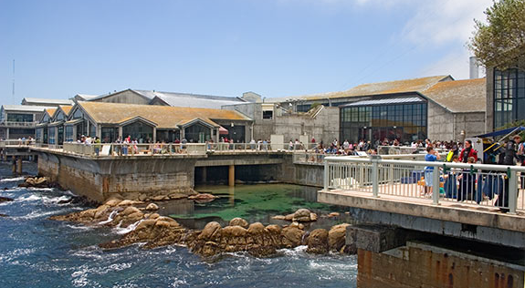
FOCE: A tool to understand local impacts of Ocean Acidification
Funding Provided by The David and Lucile Packard Foundation

