Slide 1
xFOCE/swFOCE Data System

Slide 2
xFOCE Data
Clients
Archive
Configuration
& Control
Basic requirements
  Sample rates, Timestamp accuracy (1 s)
  Time-stamped archive of experiment data
  Flexible data archive format (time-stamped CSV)
  Health and status monitoring
Users will prefer different ways to access data
  MATLAB, Excel, LabView, custom utilities…
Well defined (and standard) interfaces are key
  Configuration and control interfaces
  Data access interfaces:
    Services, clients, applications
    Simple, efficient, support low-bandwidth links
  Data archive formats
Metadata
  Science and system contextual data
    Changes to instruments, sampling, calibrations
    Ground faults, leaks and other system faults
  Enables understanding of what is (or did) happen
  Provides insight into anomalies, troubleshooting
Transformation
Presentation
Query
Links
Archive
Distribution
Distribution
Distribution
Controller
Controller
Controller
Driver
Driver
Device
Device
Notes:
Data is, of course, a central focus of any experiment. It is among the primary interests of potential FOCE users.
This picture schematically shows the path data takes as it is produced and consumed for xFOCE.
Data originates from devices (which may be science instruments, actuators (pumps and fans) or diagnostic sensors.
Driver software collects data from the system and passes it to components that use the data to control the experiment.
The controllers use some kind of distribution component that can usher the data into archives, and to various clients that consume the data: archives, configuration and monitoring interfaces, as well as query and visualization tools.
-----------
BASIC REQUIREMENTS
So for xFOCE, one could say that the fundamental data requirement is to provide a robust primary archive of the experimental data in a format that is flexible and extensible.
To this end, the basic data requirements of xFOCE are that:
Adjustable sample rates
We have data time stamp accuracy (1-second)
The data format needs to also be flexible (e.g., time stamped CSV files (comma separated values) would be okay to use by scientists)
The system also needs to provide health and status of the system and instruments (i.e., quality of data).
ACCESS CLIENTS
2. We envision that users will have different ways to access data. The clients haven’t all been defined, and may vary from implementer to implementer – everyone has their favorite way to look at data.
However, common examples of these are:
MATLAB
Excel
LabView
Or their own in-house custom built utilities
INTERFACES
3. To attain the needed flexibility, well-defined (and hopefully somewhat standard) interfaces (point to diagram) are the key.
The interfaces that matter most are:
Configuration and control interfaces – Setting up/Accessing the system while deployed to deliver data in the form they need.
Data access interface
- You need to consider links to the data (e.g., specific services, clients and applications to view the data).
- Other important considerations include using interfaces that are simple, efficient, (standard) and can support low bandwidth links (should there not be high-bandwidth capabilities). As a result, the specific amount of
bandwidth and electrical connections for the system NEED to be well defined.
3. Data archival formats
- Users need to be able to use data archive formats.
**Due to their importance, these interfaces should be defined EARLY in the xFOCE design process.
METADATA
4. It’s easy to lose the importance of metadata in the system when you’re struggling with technical issues like wiring and housings, but Metadata also needs to also be architected in early.
Knowing - what sensors were in place, when and how they were calibrated, and whether the system was working nominally - can be the difference between understanding the experimental outcome or not.
There are a lot of valid ways to manage metadata. Currently, xFOCE doesn’t place any specific requirements what metadata to manage or how to manage it.
1. However, it is a best practice to have metadata “hooks” for automating this designed in at the very least because it is both science contextual data as well as system data.
- Important data for science users would be Changes to instruments, sampling changes or calibrations, while
- Data about the system would include system ground faults, water leaks or other system faults.
2. Metadata enables the user to understand what is or what did happen.
- You might not know why an experiment is happening / or has happened the way it has.
3. It provides insight into strange data anomalies and can aid in troubleshooting a system problem.
- It can “forensically” help to reconstruct what happened.
As a result it is a good idea to keep track of a systems/experiment’s metadata

Slide 3
swFOCE Data
Added requirements
  Remote access
    Multi-user
    Separate administrative access
  Metadata management
  Compatibility w/ dpFOCE data
  Ground fault monitoring
  Still/video image data
Notes:
Built on top of the xFOCE data requirements, swFOCE will need added data requirements including:
REMOTE ACCESS
1. Remote Access - – More than one institution needs to use swFOCE and are physically distant from the experiment site.
- From multi-users
System needs to have the capability to grant different levels of access to the system – for example, accessing data vs configuring and controlling the system.
- A separate administrative access for configuration of the system or manipulating hardware versus just looking or observing data. “Active versus passive role”.
Concurrency and safety also fall into this domain – we have to make sure that we handle people accessing the system at the same time, and operators on-site are safe.
METADATA MANAGEMENT
2. As we just mentioned, there is no strict requirement on metadata for xFOCE but for shallow water FOCE it is an important requirement.
- We need to automatically keep and access data including: voltage, ground faults, instrument manifest, etc., similarly to how it was done with dpFOCE.
COMPATIBILITY WITH dpFOCE DATA
3. We also require that swFOCE data be compatible with the previous dpFOCE experiment data and our shore side data system.
GROUND FAULT MONITORING
4. While ground fault monitoring for xFOCE isn’t a strict requirement, we have found it very useful (e.g., in monitoring electrical engineering systems and devices), and would like to add this to our monitoring capability.
STILL / VIDEO IMAGE DATA
5. Finally, our science user has expressed a need for time-lapse video and still image data for swFOCE.

Slide 4

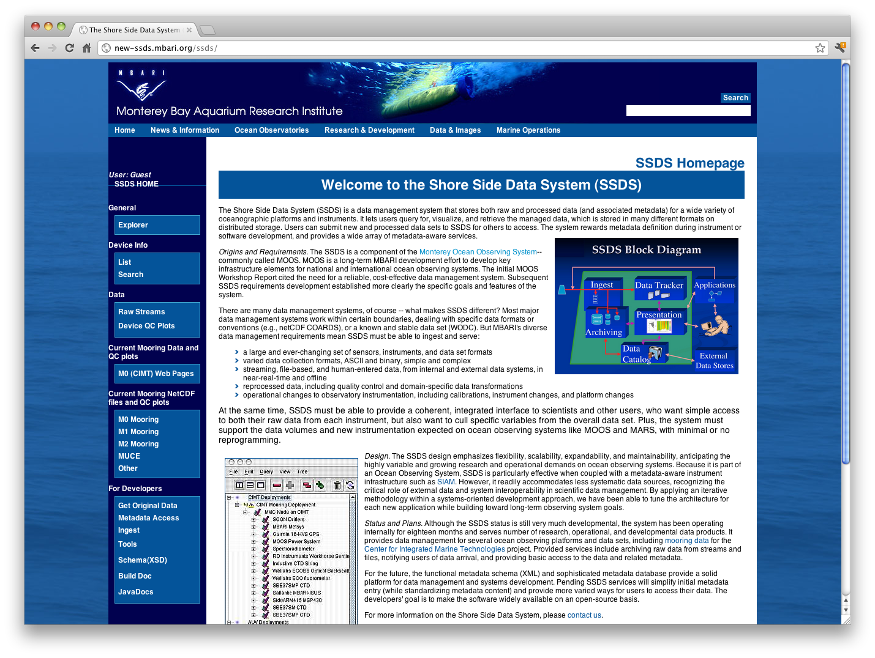

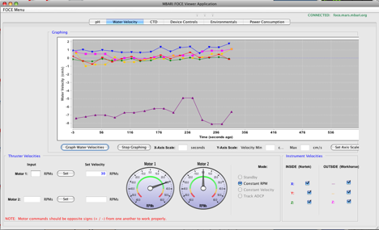
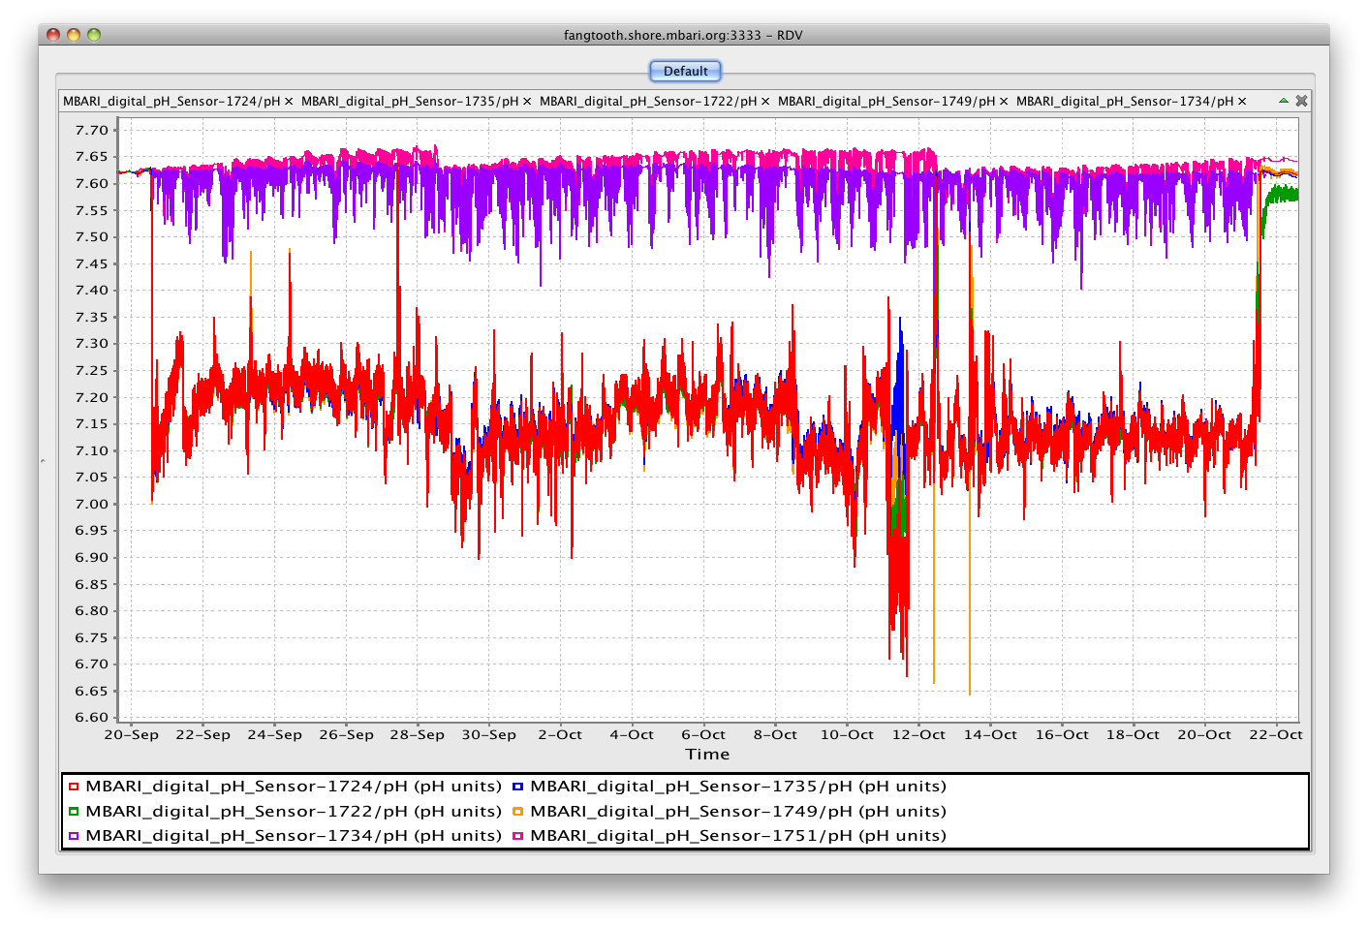

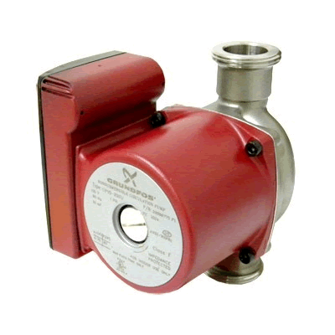
swFOCE Data
Seafloor
Hopkins
Remote
Shore Side Data System (SSDS)
Primary data archive
MBARI internal standard
SSDS Server
Controller
TCP, UDP
HTTPS
Java RMI
Controller
SSDS Data
Archive
Controller
User
Tools
Instrument Data
Archive
HTTPS
Instrument Data
Archive
Local Data
Archive
SSDS
Controller Software
Access
Server
Control Service
Access
Service
Data ACQ
Services
FOCE GUI
Control, monitor
Data ACQ
Services
OSDT?
Data ACQ
Services
OSDT Server
TCP, UDP
OSDT Data
Archive
Data
ACQ
•••
Data
ACQ
Real-time Data Viewer (RDV) OSDT client
Live, post-experiment
data playback
Open Source
DataTurbine
Flow
ESW
CTD
pH
DO
Flow
Notes:
This diagram shows how these data requirements overlay onto the Sensor Node architecture that we’ll use for the swFOCE.
1. Controller Gateway nodes collect data from the sensor nodes (Data ACQ) and store the original data.
These primary archives will likely use a simple file format (CSV, for example).
2. The nodes need to present an interface [Access Service] to components on shore to configure and monitor the system (e.g. with the FOCE GUI from a remote location) and to access data.
3. The Shore Side Data System (SSDS) (which will reside at the Hopkins site) will be used as the primary repository for the swFOCE data (supports queries via HTTP using browser or client software).
4. We also include an Open Source Data Turbine (OSDT) instance that is another archive that can be used with clients like Real-Time Date Viewer (RDV) to visualize and playback data time series in real time or post-deployment.
5. The component labeled Access Server represents software components that manage user access to the system.
6. For swFOCE, which is a cabled system, the link between shore and the experiment is Ethernet providing high bandwidth. As a result, we’ll design interfaces around TCP/UDP protocols, though we’ll need to keep these lightweight and scalable to support lower bandwidth options that may be used in other xFOCE applications.
7. The video/image data path is somewhat TBD. By trying to keep the processing infrastructure simple (and serial), it may not be possible to integrate live video feeds via sensor nodes (or even gateway nodes), It may turn out to be more practical to simply hang TCP based cameras on the network and provide additional tools (or third party) to collect and archive image data

Slide 5
UI System Requirements
Network Connectivity (Ethernet, Serial, Wireless)
Health and Status (heartbeat on connection)
Control Application Programming Interfaces (APIs) – System and Instruments
Data Collection APIs
Security:
  User Authentication / Authorization
  Enforce Maintenance or Lockout of System (unless mechanical)
Node / Instrument List (registry)
Metadata access / management
Data Format and Parsing (or pick data format)
System Change Notification (push notification for low bandwidth)
Scaling and Extensibility (all the above for additional instruments)
Data repository for historical data
Notes:
When considering the UI requirements for either the xFOCE or swFOCE system, we took a step back and looked at the existing dpFOCE GUI and what it required. These requirements include:
Network Connectivity (Ethernet, Serial, Wireless)
Health and Status (heartbeat on connection)
Control Application Programming Interfaces (APIs) – System and Instruments
Data Collection APIs
Security:
User Authentication / Authorization
Enforce Maintenance or Lockout of System (unless mechanical)
Node / Instrument List (registry)
Metadata access / management
Data Format and Parsing (or pick data format)
System Change Notification (push notification for low bandwidth)
Scaling and Extensibility (all the above for additional instruments)
Data repository for historical data

Slide 6
REQUIREMENTS | xFOCE | SWFOCE
1. Network Connectivity | ■ | ■
2. Health and Status | ■ | ■
3. Control APIs for both System & Instruments | ■ | ■
4. Data Collection APIs | ■ | ■
5. Security | ■ | ■
6. Node / Instrument List (Registry) | ■ | ■
7. Metadata Access Management | ■ | ■
8. Data format and parsing | ■ | ■
9. System Change Notification | ■ | ■
10. Scaling and Extensibility | ■ | ■
11. Data repository | ■ | ■
■ = Required
■ = Maybe, It Depends…
Notes:
This slide show these same requirements for both the xFOCE and the swFOCE UIs and how they might be represented for the two systems.
The xFOCE, which does not have many strict data requirements, only a few items would be required for the system including:
Network Connectivity
Health and Status displays
Control APIs for both the System and the Instruments
So much of the xFOCE falls into the “It Depends, Maybe” classification as each system and their requirements will be on a a system-to-system basis. What
Is needed by one group may not be needed by another.
However, for the swFOCE, which is much more complex and well-defined in its design, would have a larger list of requirements in addition to the first three.
4. Data Collection APIs
5. Security
6. Node / Instrument List (Registry)
7. Metadata Access Management
8. Data format and parsing
9. System Change Notificiation
10. Scaling and Extensibility
11. Data Repository

Slide 7
UI Functions
Notes:
This is a simple diagram showing the before mentioned UI Functions.
In order for the GUI to meet the stated requirements (we are assuming swFOCE here), it will need certain things from the deployed FOCEsystem.
These functions are defined in the blocks to the left.
It is important to note that the GUI does not necessarily care where these functions are in the deployed FOCE, they just need to be available to the GUI.
The separation of the contextual data and metadata is done to emphasize that while this information does not necessarily need to be kept on the deployed
system, it needs to be kept somewhere for the GUI to utilize.

Slide 8
One end of the spectrum
Notes:
This slide is to emphasize that this can all be done in the xFOCE scenario without having all of the capability baked in to the system itself.
All the functions still need to be available if you are going to do a "UI" of any kind.
Maybe in this case you use MATLAB or LabVIEW as your GUI. That is not a problem but you still need to have all the functionality of the
previous diagram supported to enable even the MATLABUI. <Then you give some examples from the diagram>.
Data standard format is CSV files scraped from terminal sessions and the metadata is kept in a notebook so the MATLAB user knows how
to deal with the data.

Slide 9
The other end (swFOCE)
Notes:
This example is where you build a great deal of that functionality into the system itself.
You may have multiple node support, with each node having multiple instruments to monitor and control.
You may have many layers of UI components (command line to a rich GUI).
<It is also a slide to get people to think about the options at the different layers. You can just point to several of the ideas we throw out at the various layers (web, RMI, messaging, etc.).>
At the time of the review there was not enough concrete architecture and requirements to determine what this might look like for the GUI, but we have options as long as we co-develop
with the system designers and the UIs are first class citizens.

Slide 10
The other end (swFOCE)
Telemetry
Important Considerations:
Telemetry / Communications
Notes:
This is just a step through of the things that are crucial for UI development.
Telemetry and comms
Again, this could be a terminal session, satellite or high-bandwidth cabled connectivity at the other. For there to be an effective UI, connectivity is key.
<Don't need to spend too much time here, but we just want to make sure that the specification of what that connection (or options of that connection are)
before doing the UI development.>
Need to know all operating connectivity modes that the UI(s) will have to deal with.

Slide 11
The other end (swFOCE)
Transport
Important Considerations:
Telemetry / Communications
Transport
Notes:
This is the various means by which the information will travel.
These are heavily linked to the APIs, but are different.
The APIs are the functions that need to be provided, while the transport indicates how the UIs interact with those APIs.
It is a layer above the connection, but is critically important for the UI choice. The choice of the transport will heavily
influence how the GUI is architected and the choice of technologies to use.

Slide 12
The other end (swFOCE)
Security
Important Considerations:
Telemetry / Communications
Transport
Security
Notes:
As with the other parts of the system, this can be done in many ways and will depend on the architecture choices made in the telemetry and transport options.
The level of complexity here can be none (i.e. your security is a firewall), to having logins with roles and access policies to both controls and data.
Again, will depend on requirements and architecture.

Slide 13
The other end (swFOCE)
APIs
Important Considerations:
Telemetry / Communications
Transport
Security
APIs
Notes:
Again these will depend on the previous choices and on the requirements of the UI.
The APIs are the core of the functionality that will be provided to the user through the UIs,
but will have to be subject to the connectivity, the transport and the security before they can
be utilized.

Slide 14
The take home
Co-develop / design GUI in-concert with system hardware and software
Define options for telemetry / communications
Design transport for system concerns and telemetry
  RPC / Messaging / ?
Design security / safety
Take a disciplined, layered approach to architecture
  Explicit, well documented, and controlled interfaces / APIs
These core system APIs can be used by any type of client
  Command line
  Direct client application
  Remote Client
Notes:
These are the take home messages from the UI side of the house.
These can largely be read and are just to summarize the preceding slides.
It is also to emphasize that the UIs need to be co-developed along with the system and will be part of the system architecture and design.
That is really all there is to it.
We are largely waiting for the architecture and requirements to be defined before we can move ahead with UI design and choices of
technologies and architectures.

