Slide 1
xFOCE / swFOCE
Review

Slide 2
xFOCE
Bill
Quick Background – talk about the current activities
eFOCE, cpFOCE, dpFOCE and how these led to the xFOCE

Slide 3
xFOCE Science Reqs
Bill / Ed
Shall
May

Slide 4
swFOCE Science Reqs
Bill / Ed
Shall be Built on xFOCE

Slide 5
xFOCE Concept of Ops cable
Science interface on shore
CO2 and Enriching process on shore
Air / sea interface managed using buried cable
Capable of supporting 6 to 8 xFOCE units
(4 active pH chg and 4 control)
Depth rating
min - XX
max - XX
Anchored to bottom
Uses ??? to prevent erosion

Slide 6
xFOCE Concept of Ops no cable
Science interface on shore
CO2 and Enriching process off shore
Air / sea interface managed using surface expression (buoy ?)
Capable of supporting 6 xFOCE units (?? Maybe less)
(3 active pH chg and 3 control)
Comms by telemetry
Depth rating
min - XX
max - XX
Anchored to bottom
Uses ??? to prevent erosion

Slide 7

xFOCE Concept of Ops

Slide 8
xFOCE Tech Specifications
Several pages maybe???
Divide shalls from nice to have
These are specific and measureable… testable

Slide 9
swFOCE Tech Specifications
Starting with xFOCE… does not conflict
Divide shalls from nice to have
These are specific and measureable… testable

Slide 10
xFOCE Systems concept
Divide sub-systems out, major blocks and define what will traded.
Define system / sub-system interfaces
Assign each trade to a

Slide 11
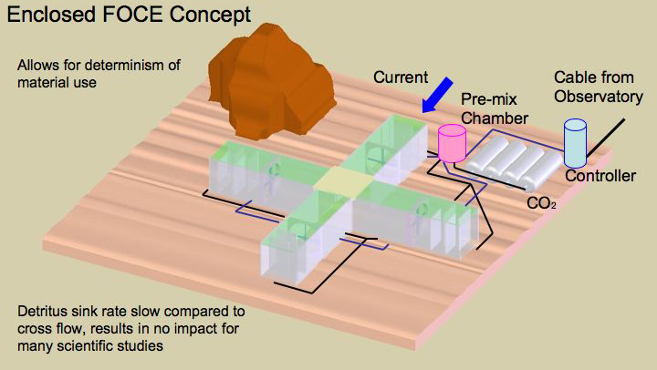
xFOCE Systems concept

Slide 12
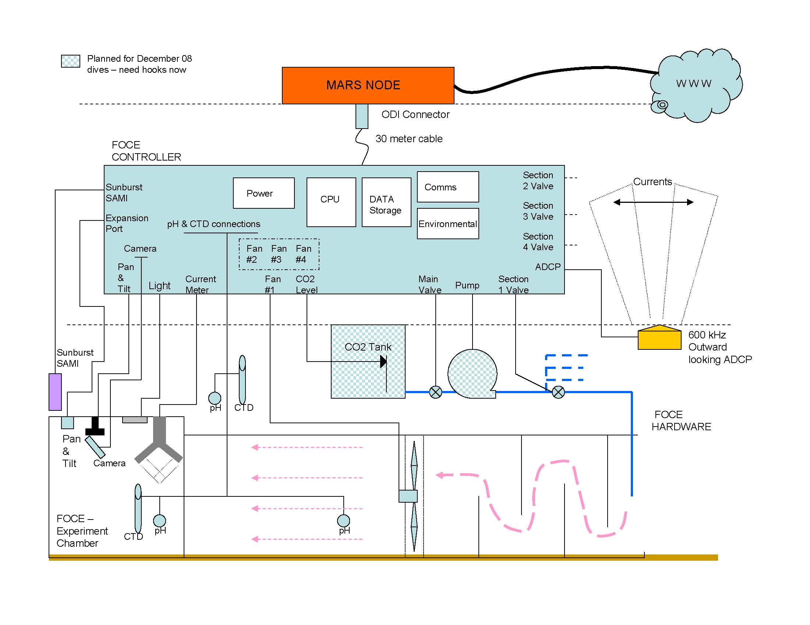
xFOCE Systems concept
What is the minimum requirement of elements for xFOCE?

Slide 13
swFOCE Systems concept
Divide sub-systems out, major blocks and define what will traded starting with xFOCE base.
Define system / sub-system interfaces
Assign each trade to a

Slide 14
swFOCE Systems concept

Slide 15
swFOCE Systems concept
What is required to make an swFOCE?

Slide 16
Mechanical
Basic xFOCE Structure
swFOCE if anything is modified
Anchoring (environmental data)
Flow control
Light management
Bio-fouling

Slide 17
Electrical
Power
Budgets
Management
Communications
Ground Fault ??
Control Circuits

Slide 18
Software
Basic Architectural Structure
xFOCE (minimum needs)
swFOCE (extensible elements as needed)
Open Source
Controller / algorithm development
Science/User interfaces
most basic
options
Realtime vs. ??

Slide 19
Data
Collection
Storage
Processing (??)
Quality
How does design handle modularity of xFOCE

