Slide 1
xFOCE Power/Comms
Chad Kecy
Electrical Engineer

Slide 2
Intro Slide
Say something smart, dummy!

Slide 3
Cabled System

Slide 4
Cabled System
Shore Side
Tether
Underwater Connection

Slide 5
Shore Side
Physical Location
Type of Installation
Weather / Environmental Conditions
Power Source
Communication Equipment
Ground Fault Detection / Safety
Permitting?

Slide 6
Cabled Tether
Power Requirements
Communication Speed/Bandwidth
Length
Strength (Stiffening Rod?)
Number of Conductors
Type of Underwater Connectors
Use of Fiber Optics?

Slide 8
High Voltage Source
Advantages
Disadvantages
Minimizes i²r losses in cable.
Allows for less copper in cable (less $$)
Need to down convert to lower DC voltages downstream.
Safety isses

Slide 9
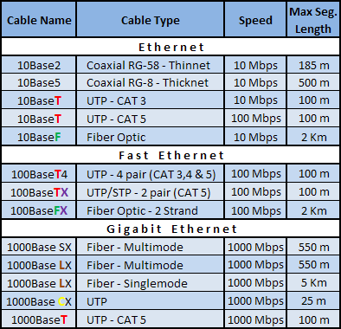
Ethernet Standards

Slide 10
Serial Standards
Specifications | RS-232 | RS-422 | RS-485
Mode of Operation | Single-Ended | Differential | Differential
Total # of Transmitters and Receivers | 1 Trans 1 Rcvr | 1 Trans 10 Rcvrs | 32 Trans 32 Rcvrs
Maximum Cable Length | 50 ft | 4000 ft | 4000 ft
Maximum Data Rate | 1MBit/s | 10MBit/s | 10MBit/s

Slide 11
Underwater Connections
Types
  Wet-mateable
  Dry-mateable
Considerations
  Deployment
  Servicing

Slide 12
Non-Cabled System
Comms by telemetry
Buoy or Platform

