Slide 1
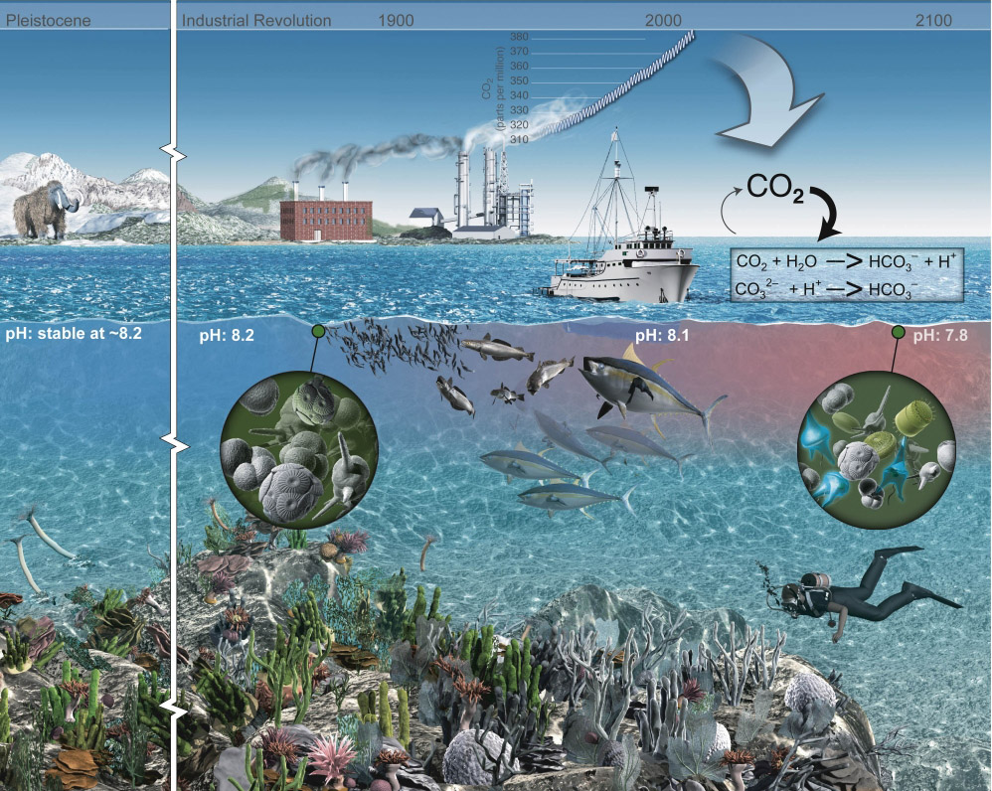
Free Ocean CO₂ Enrichment
An illustration of the atmospheric CO₂ increase and the change in ocean pH

Slide 2
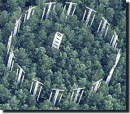

FOCE and OA Research
Free Ocean CO₂ Enrichment experiments are based on an existing base of scientific work that started in the early 1990’s. The Free Air CO₂ Enrichment (FACE) experiments.
Dr. Peter Brewer first proposed this type of experiment to MBARI engineering in 2003 as part of his greenhouse gases research. The drawing to the right is the initial concept from engineering and presented to NOAA’s Dr. Dick Feely later that year.
Concept using the MARS cable in Monterey Bay, later deployed as deep FOCE (dpFOCE)

Slide 3



Why xFOCE?
The problem: Some scientists are misinterpreting our publications and what is required to make a FOCE system work.
MBARI was contacted and we gave feedback about how to use the existing hardware and reconfigure it to become a functional FOCE.
The scientist did some of it but still didn’t grasp what FOCE is an how to properly set up a system to get meaningful science results.
It became apparent that a resource clearly outlining FOCE and how to get started would be useful.

Slide 4


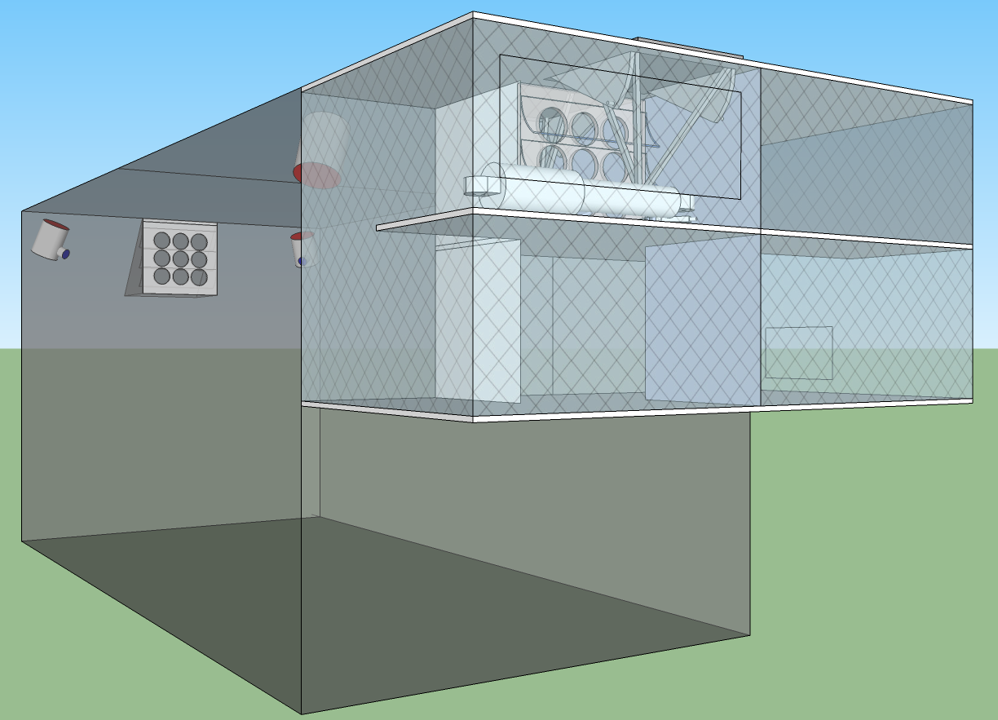





xFOCE
Deep FOCE (dpFOCE) is the original FOCE built for multi-science users on a cabled observatory.
Coral Prototype FOCE (cpFOCE) is the first tech transfer of FOCE built for multi-science users on the Great Barrier Reef. Solar and wind powered except for the creation of the enriched CO₂ water.
European FOCE (eFOCE) is currently under construction and scheduled for deployment in May 2012. This system uses a cable but the CO2 is delivered in bottles to a surface expression.
Antarctic FOCE (antFOCE) proposal submitted and partially funded. Proposal for other 50% of funding underway.

Slide 5
xFOCE
xFOCE shall support 2 test chambers (1 active and 1 control)
xFOCE shall maintain a desired pH offset from ambient within +/- .2 pH
xFOCE shall be capable of pH offsets of between .2 and .8 pH units
xFOCE shall hold a selected pH offset for a minimum of 2 weeks
xFOCE shall be capable of deployments greater than 6 months in duration
xFOCE shall be fully functional in external currents of 50 cm/sec
xFOCE shall mimic surge to the extent possible based on chamber scale
xFOCE shall maximize the allowance of full spectrum natural light
xFOCE shall include pH, CTD, O2, flow rate or calculated flow using velocity

Slide 6
xFOCE
xFOCE shall provide internal environmental data for all instruments on the required list from each active chamber
xFOCE shall provide internal environmental data for
xFOCE shall be diver maintainable
xFOCE shall not use materials that are toxic to the marine environment
xFOCE shall not be dangerous to maintenance divers
xFOCE shall minimized impacts on local marine life
xFOCE shall be capable of being fully recovered and leave no components behind
xFOCE shall be capable of being built, installed and maintained by a typical university oceanographic research lab with a minimum of 1 scientist and 2 graduate students

Slide 7
xFOCE
xFOCE shall maximize use of commercially “off-the-shelf” or readily available technology to the fullest extent possible
xFOCE shall be capable of working in ocean waters where the velocity does not exceed 75 cm/sec.

Slide 8
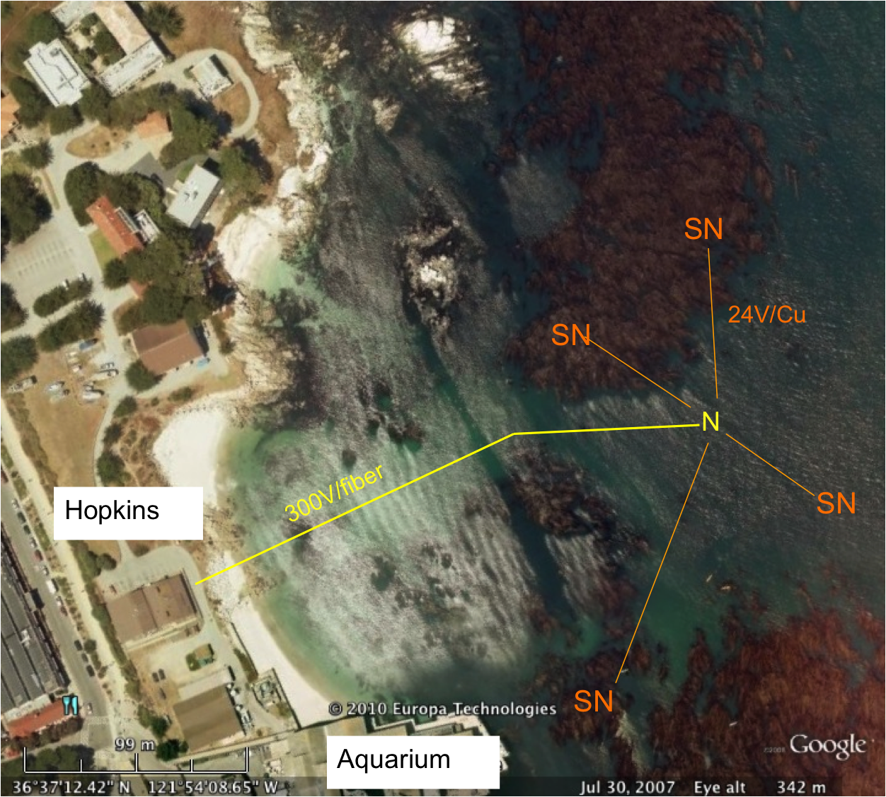
swFOCE
swFOCE shall meet all xFOCE requirements
swFOCE shall not require a support ship greater than 50’ for deployment and recovery
swFOCE shall include a camera system capable of variable time lapse digital data collection suitable for publication, the camera (and light source if included) shall also be adjustable within the swFOCE structure
swFOCE shall use the Stanford Hopkins
Marine Station’s submarine cable
swFOCE shall provide a separate power and communications links form the planned Hopkins science use and will not interfere with other science operations.

Slide 9
xFOCE Concept of Ops cable
Science interface on shore
CO2 and Enriching process on shore
Air / sea interface managed using buried cable
Capable of supporting 6 to 8 xFOCE units
(4 active pH chg and 4 control)
Depth rating
min - XX
max - XX
Anchored to bottom
Uses ??? to prevent erosion

Slide 10
xFOCE Concept of Ops no cable
Science interface on shore
CO2 and Enriching process off shore
Air / sea interface managed using surface expression
Capable of supporting 2 xFOCE units minimum
1 active pH chg and 1 control, 3 active and 3 control desired
Buoy or Platform
Comms by telemetry
Depth rating
max – 40m
Anchored to bottom

Slide 11
xFOCE Functional Requirements
Max depth: 40m (130 ft)
pH Range: 0.0 to -0.6 continuous based on CO₂ available. Brief excursions to -0.8 or -1.0 offset potentially
pH resolution: resolution: 0.05 pH units, 0.1 unit may be OK (prefer best resolution possible)
Temp range: -2 to 30 degrees C
Max ext. velocity: 50 cm/sec
Max int. velocity: 10 cm/sec
Full spectrum light: Max transmission of sunlight at depth
Number of Units: System support for 1 active and 1 control chamber

Slide 12
swFOCE Additional Requirements
Surge: Imitate surge to extent possible
Temp range: -2 to 30 degrees C
Number of Units: System support for 3 active and 3 control chamber

Slide 13

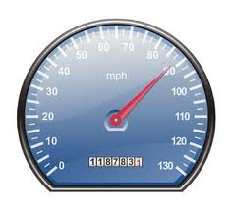
xFOCE/swFOCE Concept of Ops
Flow Vel
Science selected velocity

Slide 14
xFOCE Functional Interfaces
House Power
Internet
Power
Generation
CO2
ESW
Mixer
Comms
Data
Distribution
GUI
Distribution/Protection
SW Pump
Configuration & Control
Data Archive
Control System
Storage
Console
Enriched
Seawater
System
Monitoring/
Health/Status
Data Acquisition
Surface
xFOCE Control
Science / Control System
Subsea
Subsea Electronics
ESW Distributor
ESW injector(s)
Instruments
ESW injector(s)
Flow effector(s)
Camera(s)
Flow effector(s)

Slide 15



xFOCE Mooring Concept
Exhaust used for CO₂
Diesel Fuel
Particle Scrubber
CO₂ Mix Electronics
System Control Electronics

Slide 16

xFOCE Systems concept
Blue circles are included for swFOCE
Proposed minimum instrumentation for an active pH controlled chamber. The blue elements are options and controls would only have CTD and pH. Not shown is the other option of a motor and fan to control flow.

Slide 17
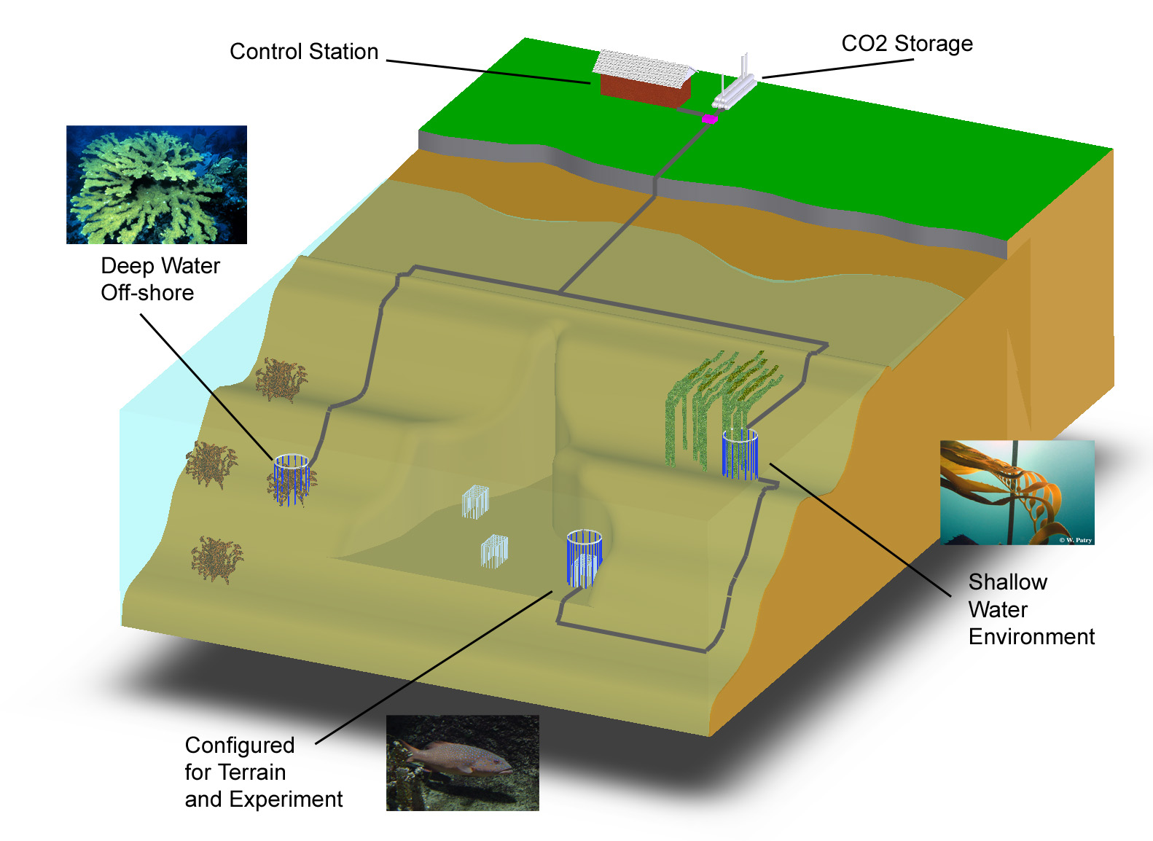
swFOCE Basic Concept
Schematic View of the Hopkins Site
Multi-Site
Multi- Discipline
Multi-Year
Shallow Water
Off-Shore
Shallow Water Corals
Benthic Biology

Slide 18
swFOCE Concept
Bottomside FOCE chamber for swFOCE
pH Sensor
Camera and Light
Ducting
(Time delay)
Flow meter
Animal
Restrictor
CTDO Sensor
Thruster
Anchors
CO₂ Enriched Water
Power and Comm
Cabling
FOCE Controller
Notes:
----- Meeting Notes (4/26/12 09:45) -----
more contrast

Slide 19
swFOCE Cable Concept
Sea Water
Barrier End Cap
Low pH Sea Water
Power and Comms
Existing Drain at
Hopkins
Sea Level
Intake Filter

Slide 20
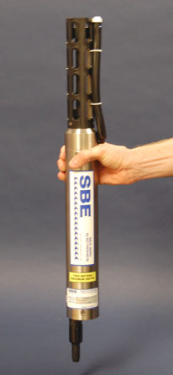
xFOCE Core Instrument Suite
pH : +/- .01 pH unit or better and suitable for
control loop applications
CTD: Comparable to current units at MBARI, unit is
FastCAT SBE49 (oxygen can be included)
Flow sensor: TBD, likely electromagnetic to get smooth
flow numbers and volumetric data. From dpFOCE acoustic velocity sensors are not suitable.
Suggested architecture allows for expansion of additional instrumentation
PAR* - Photosynthetically Active Radiation
Notes:
----- Meeting Notes (4/26/12 09:45) -----
PAR not mentioned on this slide

Slide 21
swFOCE Core Instrument Suite
pH : +/- .01 pH unit or better and suitable for control loop applications
CTD: Comparable to current units at MBARI, baseline unit is FastCAT SBE49 (oxygen can be included)
Flow sensor: TBD, likely electromagnetic to get smooth
flow numbers and volumetric data. From dpFOCE acoustic velocity sensors are not suitable.
PAR* Sensor: 400 – 700 nm / calibrated t0 0 – 5000 μmol photons•m ⁻² •s ⁻¹
Camera/Lights: 1080p - 16:9 ratio format – light source either natural and/or color balanced LED
PAR* - Photosynthetically Active Radiation
Notes:
----- Meeting Notes (4/26/12 09:45) -----
aspect ratio

Slide 22
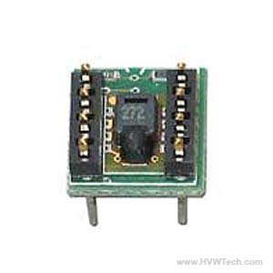
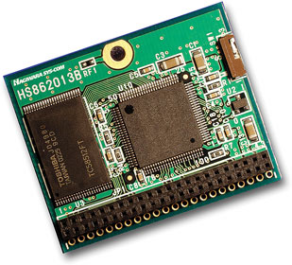
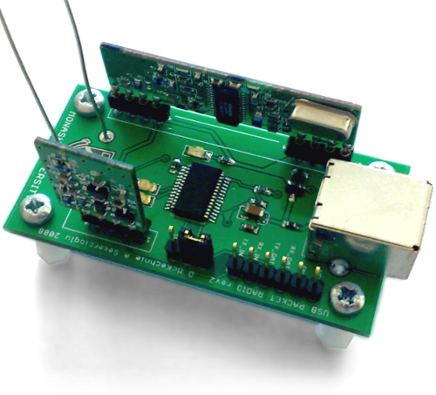
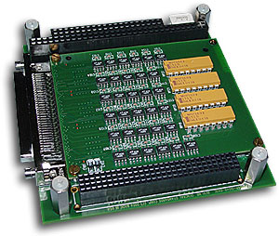
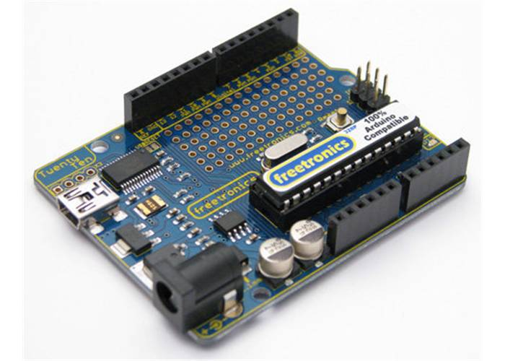
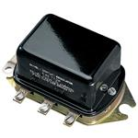
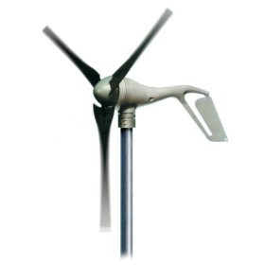
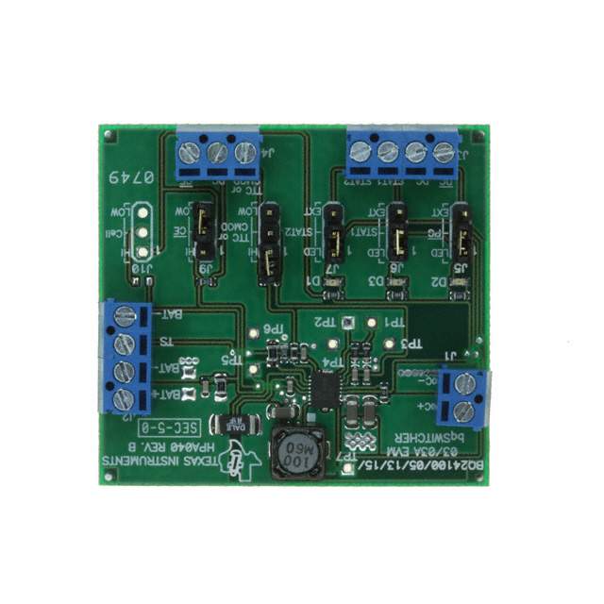
xFOCE /swFOCE Components
Humidity Sensor
Flash Storage
Wireless Comm
Instrument Interface
CPU
Voltage Regulator
Wind ??
Battery Charger
Deep Cycle Batteries

Slide 23
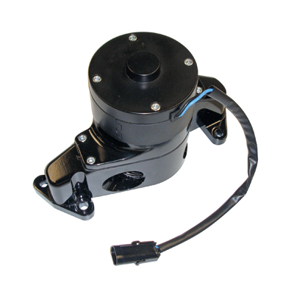
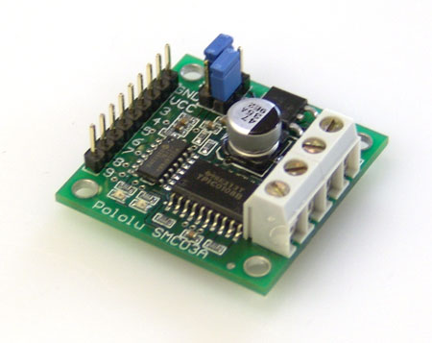
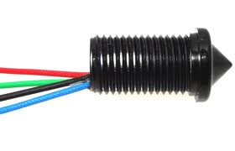
xFOCE /swFOCE Components
Motor Controller
Small Water Pump
Voltage Regulator
Level Sensor
CPU
Deep Cycle Batteries

Slide 24
xFOCE /swFOCE Data Reqs.
Health and Status: Ability to query system status from web page (data dependent on sensors included)
Timing Accuracy: Network Time Protocol (NTP) protocol for synchronizing computers
Sample Rates: System will support 10 Hz standard operation
Basic Data Format: Comma delimited string, time stamped
swFOCE: Compatible with the current dpFOCE data streams and SSDS (Shore Side Data System*)
Near real time ground fault monitoring
*SSDS – Open source from MBARI
Notes:
----- Meeting Notes (4/26/12 09:45) -----
move to elec section, w/ component picture slides
requirements? "data needs?" should have number
NTP is implementation name a number - better than 1 sec required?
specify as abs timing accuracy
specify as
*up to* 10 hz - up to 2 Hz - what is standard operation?
MBARI SSDS
metadata capture - add for swfoce

Slide 25


xFOCE Engineering Trades
Color Frequency Wavelength
violet 668–789 THz 380–450 nm
blue 631–668 THz 450–475 nm
cyan 606–630 THz 476–495 nm
green 526–606 THz 495–570 nm
yellow 508–526 THz 570–590 nm
orange 484–508 THz 590–620 nm
red 400–484 THz 620–750 nm
infrared longer than 750 nm
Since these wavelengths penetrate water easier but most plastic materials respond poorly to high freq light the materials selections will focus on this end of the spectrum
The selection of materials will likely transmit this end of the spectrum fairly well but in selection, if required, we would trade attenuation here to maximize shorter frequencies.
Acrylic (vs Polycarbonate) has less attenuation overall and carries much further into the ultraviolet when comparing the blue lines.
Notes:
----- Meeting Notes (4/26/12 09:45) -----
move to mechanical (Farley also has version)

Slide 26
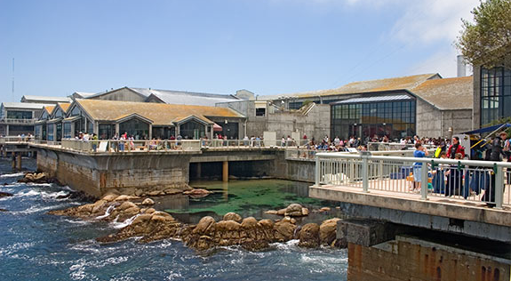
FOCE: A tool to understand local impacts of Ocean Acidification
Funding Provided by The David and Lucile Packard Foundation

Slide 27
An Idea Takes Shape
Build a consortium of researchers and engineers to tackle large, real-world issue of increasing relevance
Center for Ocean Solutions: Ideal fit to highlight ocean acidification
Hopkins: Cable infrastucture and numerous potential research opportunities
Notes:
----- Meeting Notes (4/26/12 11:22) -----
title: swFOCE takes shape

Slide 28
Pushing the Limits of Permitting
Brock Woodson initially procured permit from Sanctuary to install cable.
Innovative work, like SW-FOCE, would require the involvement of multiple regulatory agencies
First research project request in recently established MPA, as well as Area of Special Biological Significance
Exposed several shortcomings in permitting process among multiple agencies

Slide 29

Permits at Every Level
Monterey Bay National Marine Sanctuary
California Coastal Commission
California Department of Fish & Game
Central Coast Regional Water Quality Control Board
City of Pacific Grove
Notes:
----- Meeting Notes (4/26/12 11:22) -----
re-order
time to permit )

Slide 30
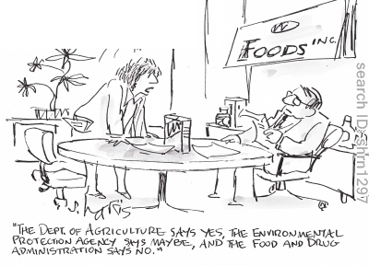
How to Move Forward -
Go to the Top
Agencies had no procedures to move forward or interact
Peter Brewer met with Governor Brown
Meg Caldwell helped streamline the process with two key State agencies (CCC & CDFG) through discussions with high level personnel
Notes:
----- Meeting Notes (4/26/12 11:22) -----
enlarge cartoons
stacked jurisdiction overlaps

Slide 31
Lessons Learned
Allow plenty of time for permitting
  Process took 2 years to complete
Good rapport with agency personnel key
  Not necessarily trying to make life difficult, but often operating within bureaucratic box
Well-placed connections are valuable
Getting the process streamlined is critical to prevent valuable research from being discouraged due to concerns about permitting.
Notes:
----- Meeting Notes (4/26/12 11:22) -----
enlist an advocate who can work w/ beaurocracy
put in terms that agencies can understand: divers, cans of coke
site location can make a difference (map of govt jurisdictions)
early slide - the problem: many agencies, co2 viewed as toxic waste

Slide 32
Computing elements of xFOCE
(Architecture and system trades)

Slide 33
Computing Architectures
User Concerns
Performance: valid scientific approach, data quality
Flexibility: wide range of environments, scenarios
Ease:
  Build
  Test
  Use, maintain
  Extend
Cost
Notes:
----- Meeting Notes (4/19/12 09:27) -----
power constrained slide 2

Slide 34
A few assumptions
Implementer profile | Researchers plus 2-4 post docs, grad students 0-1 engineer
Technical | Access to modest manufacturing facilities Software is harder than hardware, mechanical Strong preference for familiar COTS solutions
Implementation schedule | ~6 months
Experiments | Campaign-style deployments 12 month service life Remote and/or restricted sites
Lifecycle | Prefer to extend capability, rather than re-spin from scratch for successive funding rounds

Slide 35

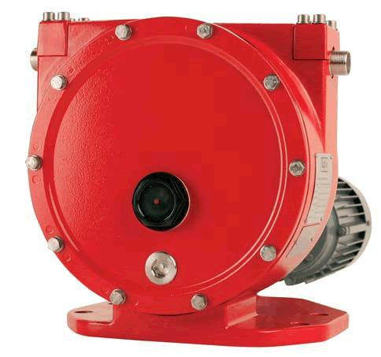

Power
Data
CO₂
H₂O
Enriched
Seawater
Controller
FOCE Essentials
ESW
pH
CTD
CTD
pH
Flow
Chamber
Flow
DO₂
Flow
DO
External
Notes:
----- Meeting Notes (4/19/12 09:27) -----
pump hard to recognize
workstation graphic
remo
----- Meeting Notes (4/19/12 09:36) -----
expand DO2?

Slide 36

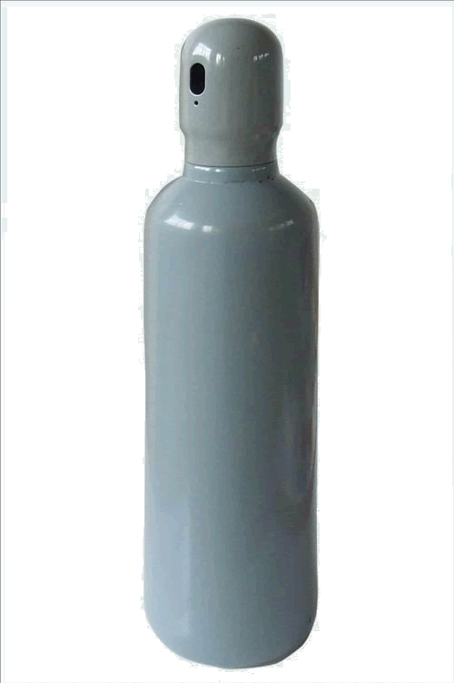
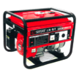


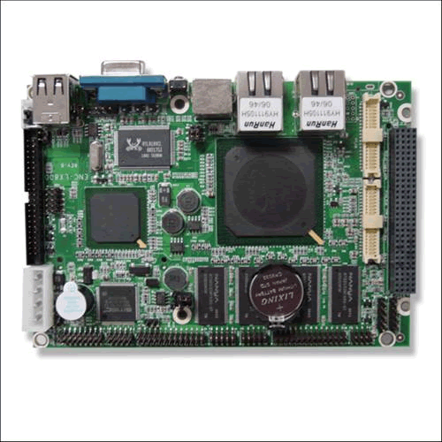



Computing Architectures
Elements
Instruments
Electronics
Housings
Cabling
Software
Computers
Many ways to arrange them
In a FOCE experiment
For each, many options
Notes:
----- Meeting Notes (4/19/12 09:36) -----
computer heads in periodic table
----- Meeting Notes (4/26/12 11:22) -----
graphics aliasing

Slide 37
Computing Architectures
Shrinking the Universe of Trades
Look at decisions that have greatest impact on user concerns
  Build vs Buy
  Location matters: Shore vs Surface vs Seafloor
  Topology: how the pieces are connected

Slide 38

Build vs Buy
General Principles
Buy what you can’t/shouldn’t build
  Processors, instruments, cabling
  Software
Build (or borrow) as needed
  Chambers, housings
  Use COTS components if possible
  Get help on tough key builds
    contract, open source
Beware Frankensystem
  Patchwork integration of COTS parts
  Power consumption
  Rube Goldberg-ness of mechanical/electrical interfaces

Slide 39

Location Matters
General Principles
Connected vs Disconnected
  Generally easier to generate and store power, ESW on shore
  Telemetry bandwidth
Trades for off-shore elements
  Accessibility (to you, the elements, others)
  Reliability
Keep what’s offshore/sub-surface as simple and robust as possible
  Basics: Enriched seawater, power
  HW: Cables, connectors, housings
  SW: Applications, protocols, processes
Play to your application, tech strengths and budget
  Permits, environment
  Experiment duration, depth
  Data access requirements
  Maintenance schedule, spares
  Available design/fabrication resources

Slide 40
Power
Data
The software developer sees…
The user needs to consider
CO₂
H₂O
Controller
Enriched
Seawater
What’s inside?
Build or Buy?
Where to put the pieces?
How are pieces connected?
ESW
pH
CTD
CTD
pH
DO2
Flow
Chamber
Flow
DO₂
Flow
DO₂
External
Notes:
----- Meeting Notes (4/19/12 09:45) -----
not clear about thought bubbles

Slide 41
Some things must be on the seafloor
  Chamber, instruments
  Actuators (pumps, fans, etc.)
But location of everything else is flexible…
  Power, ESW
  Controller
  Data storage, user interfaces
And, there are many ways to implement all of it…

Slide 42
Our goal is to simplify the choices
Choices depend on experiment and constraints
  Budget, schedule
  Environment
  Technical resources
xFOCE community may draw from different approaches

Slide 43
A study of some approaches
  Centralized Workstation
  Industrial Computers
  Sensor Node
3 views to evaluate key features and trades
  Build/buy what and why: hardware, software
  Location: shore, surface, seafloor
  Connections: topology and infrastructure

Slide 44
Next up: Centralized Workstation…
  Workstation computing
  Mixed Common Off The Shelf (COTS) /custom hardware
  Shown here using cabled configuration

Slide 45
Grand Centralized Workstation
Component | Location | Why
Controller HW | Seafloor | Experiment continues if comms fails
Controller Software | Seafloor | ‘’
UI Software | Shore | Easier maintenance
Power | Seafloor | Need fine-grained power management at site
Data | Seafloor And Shore | Experiment continues if comms fails
Data
Location View
Surface
Shore
Seafloor
Data
Controller
Power
ESW
pH
CTD
CTD
pH
Flow
Chamber
Flow
DO₂
Flow
DO₂
External
Notes:
----- Meeting Notes (4/19/12 09:50) -----
purpose of flow
----- Meeting Notes (4/26/12 11:22) -----
power dist on seafloor,
power source on shore
views grand

Slide 46
Grand Centralized Workstation
Data
Build/Buy
View
Component | Build/Buy | Implementation
Controller HW | Buy | PC104 Serial port cards (16 total)
Controller Software | Build Open Source | Linux, Java Custom: SIAM Data Acquisition software Open Source: DataTurbine, e.g.
Archive, UI | Build | PC Workstation MacOS, Windows, Linux, Java Custom: Shore Side Data System (SSDS), FOCE GUI
Power | Build | Custom: chassis
ESW | Build | Custom: electronics, software, chassis COTS: pumps, controllers
Surface
Shore
Seafloor
Data
Controller
Power
ESW
pH
CTD
CTD
pH
Flow
Chamber
Flow
DO₂
Flow
DO₂
External
Notes:
----- Meeting Notes (4/26/12 11:22) -----
power distribution
define SIAM
label dpFOCE variant
animate to make one slide

Slide 47
Grand Centralized Workstation
Ethernet
Connection
View
Data
100 MBps
Ethernet
1 kW Cable
Surface
Shore
Seafloor
Data
Controller
Ethernet-Serial
Power
Serial
ESW
pH
CTD
CTD
pH
Flow
Chamber
Flow
DO₂
Flow
DO₂
External
Notes:
----- Meeting Notes (4/26/12 11:22) -----
combine connection and location views
animate into one slide

Slide 48
Summary
Centralized Workstation
Pros
  One software platform
  COTS computers
  COTS serial I/O solutions
Cons
  Extensibility in packaging and housings…have to put a lot of holes in housings
    Can use junction boxes
  Power consumption
  Less modular
  Need lots of serial ports
    Custom serial IO
  Custom HW/SW

Slide 49
Next up: Industrial Computers…
  Industrial automation computers (WAGO, Compact Rio, e.g.)
  Heavy use of COTS hardware and software
  Shown here using moored configuration

Slide 50
Component | Location | Why
Controller HW | Surface and/or Shore | Easier access Large housings
Controller Software | Surface And Shore | Co-located w/ HW
UI Software | Shore | Easier maintenance
Power | Surface or Shore | Easier access
Data | Surface and/or Shore | Co-located w/ control
ESW | Shore Or Surface | Permitting, depth, distance from shore
Industrial Computers
Mooring pic
Location View
Data
Data
Power
Controller
Controller
UI
Controller
Controller
Wireless
Surface
Shore
Seafloor
Junction
ESW
pH
CTD
CTD
pH
Flow
Chamber
Flow
DO₂
Flow
DO₂
External
Notes:
----- Meeting Notes (4/26/12 11:22) -----
say like cpFOCE
move pump to surface

Slide 51
Industrial Computers
Build/Buy
View
Component | Build/Buy | Implementation
Controller HW | Build/Buy | COTS: WAGO, National Instruments Compact-Rio (NI-CRIO), Serial Multiplexer (MUX), Video MUX
Controller Software | Build/Buy COTS Open Source | COTS/Custom: LabView Open Source: DataTurbine
Archive, UI | Build/Buy COTS Open Source | PC Workstation MacOS, Windows, Linux Open Source: DataTurbine, RDV, Pachube... COTS/Custom: LabView
Power | Buy Build | COTS: WAGO, NI-CRIO Custom: GF, isolation
ESW | Build/Buy | COTS: WAGO, NI-CRIO, LabView, pumps, motor controllers
Data
Data
Power
Controller
Controller
UI
Controller
Controller
Wireless
Surface
Shore
Seafloor
Junction
ESW
pH
CTD
CTD
pH
Flow
Chamber
Flow
DO₂
Flow
DO₂
External

Slide 52
Industrial Computers
ConnectionView
Data
Data
Power
Controller
Controller
UI
Controller
Controller
Surface
RF Wireless
WiFi
Cell
Satellite
Shore
Seafloor
Serial
Ethernet
Junction
ESW
pH
CTD
CTD
pH
Flow
Chamber
Flow
DO₂
Flow
DO₂
External

Slide 53
Summary
Industrial Computers
Pros
  Mostly COTS components
  Vendor and user community support
  Easier to build
  COTS software provides much infrastructure
Cons
  High cost of software and hardware
  High power consumption
  Cable may be somewhat technical, especially from surface expression in active environment
  Large electronics form factors require larger housings

Slide 54
Next up: Sensor Node…
  Focus on small COTS embedded PCs and microprocessors
  Modularize and aggregate power switching and/or data acquisition
  Reduce power consumption
  Shown here using moored configuration

Slide 55
Component | Location | Why
Controller HW | Surface/Seafloor | Surface: telemetry, UI Seafloor: experiment control
Controller Software | Seafloor | Gateway: control, telemetry Node: data acquisition
UI Software | Shore/Surface | Easier maintenance
Power | Surface | Probably use generator, solar, wind on surface
Data | Seafloor And Shore | Local data needed for control Central archive for redundancy, easier access
Sensor Node
Data
Location View
Power
Data
Controller/
Gateway
Wireless
Surface
Shore
Seafloor
Load switching,
Data Acquisition for
1-4 Devices
Controller
/Gateway
Data
Experiment Control for 1 chamber
Node
Node
Node
Node
ESW
pH
CTD
CTD
pH
Flow
Chamber
Flow
DO₂
Flow
DO₂
External
Notes:
----- Meeting Notes (4/19/12 09:50) -----
purpose of flow
----- Meeting Notes (4/26/12 11:22) -----
say: similar to eFOCE...
ESW pump on surface
bilge pump?

Slide 56
Sensor Node
Data
Build/Buy View
Power
Data
Open source:
options./examples vs required
Controller
Gateway
Component | Build/Buy | Implementation
Controller HW | Buy | Gateway: BeagleBoard, Android Node: Arduino, MSP430
Controller Software | Build | Gateway: Linux, Java, C++/Java Node: C/C++, Wiring, e.g.
Archive, UI | Build/Buy | Custom: back end interface Open Source: web server on gateway
Power | Build | Custom: load switch, GF/iso
ESW | Build/Buy
Wireless
Surface
Shore
Seafloor
Controller
Gateway
Data
Node
Node
Node
Node
ESW
pH
CTD
CTD
pH
Flow
Chamber
Flow
DO₂
Flow
DO₂
External
Notes:
----- Meeting Notes (4/19/12 09:50) -----
purpose of flow
----- Meeting Notes (4/26/12 11:22) -----
mention sensor node

Slide 57
Sensor Node
Data
Connection
View
Power
Data
Controller
Gateway
RF Wireless
Cell
Satellite
WiFi
Ethernet
(Serial?)
Surface
Shore
Seafloor
Controller
Gateway
Data
Serial
Node
Node
Node
Node
Serial
ESW
pH
CTD
CTD
pH
Flow
Chamber
Flow
DO₂
Flow
DO₂
External
Notes:
----- Meeting Notes (4/19/12 09:50) -----
purpose of flow

Slide 58
Summary
Sensor Node
Pros
  Reduce power
  No custom serial IO expansion
  Modularizes data acquisition
  Many variations possible
    COTS processors, languages
    Topologies
    Connection backbone (cost: power)
    Component upgrades
    Drivers on Gateway
Cons
  Two software development platforms
  More custom hardware to build, configure, maintain
  More cables, connectors, housings
  Video expansion path unclear
  Multiple system clocks
Notes:
The Bottom Line
It’s a good design pattern, with balance of build/buy
flexible, extensible, moderate cost
Variants trade complexity, power, modularity

Slide 59
Approach Tradeoffs
Approach | Performance | Flexibility | Ease |  |  | Cost
 |  |  | Build | Use | Extend
Centralized Workstation |  | ■ |  | ■ | ■ | 
Industrial Computer | ■ | ■ | ■ |  | ■ | 
Sensor Node | ■ |  | ■ | ■ | ■ | ■
Con

Pro

Slide 60
UI
Help users to understand and simplify key choices
What UI choices will the user make related to UI
  Network, interfaces, security
How do those choices affect concerns (performance, flexibility, ease, cost)
What are pros/cons of various choices
  Cost, power, bandwidth, software skill, processing capability, software/system dependencies
Modularity
  Interfaces that support flexibility in UI choices
  Expansion path: what’s needed up front to start simply and build capability
Sketch out a couple of concepts at either end of the spectrum
Specific choice/detail more important for SWFOCE
Notes:
----- Meeting Notes (4/26/12 11:22) -----
move UI to end SW FOCE
most users won't have GUI, security

Slide 61
Tethers?

Slide 62
Questions?

Slide 63
xFOCE Power/Comms
Chad Kecy
Electrical Engineer

Slide 64
Intro Slide
Say something smart, dummy!

Slide 65
Cabled System

Slide 66
Cabled System
Shore Side
Tether
Underwater Connection
Notes:
----- Meeting Notes (4/26/12 11:22) -----
put on picture before

Slide 67
Shore Side
Physical Location
Type of Installation
Weather / Environmental Conditions
Power Source
Communication Equipment
Ground Fault Detection / Safety
Permitting?

Slide 68
Cabled Tether
Power Requirements
Communication Speed/Bandwidth
Length
Strength (Stiffening Rod?)
Number of Conductors
Type of Underwater Connectors
Use of Fiber Optics?
Notes:
----- Meeting Notes (4/26/12 11:22) -----
not use stiffening rod
interface at ocean
trawl protection
anchoring
FO could be subbullet of comms

Slide 70
High Voltage Source
Advantages
Disadvantages
Minimizes i²r losses in cable.
Allows for less copper in cable (less $$)
Need to down convert to lower DC voltages downstream.
Safety isses
Notes:
----- Meeting Notes (4/26/12 11:22) -----
water blocking
insulation resistance
isses -> issues

Slide 71
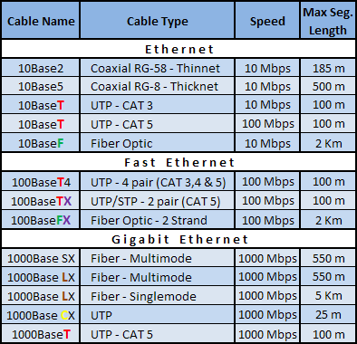
Ethernet Standards
Notes:
----- Meeting Notes (4/26/12 11:22) -----
make sure cable, connectors support speed, length
bends, temp issues
deployment of cable

Slide 72
Serial Standards
Specifications | RS-232 | RS-422 | RS-485
Mode of Operation | Single-Ended | Differential | Differential
Total # of Transmitters and Receivers | 1 Trans 1 Rcvr | 1 Trans 10 Rcvrs | 32 Trans 32 Rcvrs
Maximum Cable Length | 50 ft | 4000 ft | 4000 ft
Maximum Data Rate | 1MBit/s | 10MBit/s | 10MBit/s
Notes:
----- Meeting Notes (4/26/12 11:22) -----
how about DSL?

Slide 73
Underwater Connections
Types
  Wet-mateable
  Dry-mateable
Considerations
  Deployment
  Servicing
Notes:
----- Meeting Notes (4/26/12 11:22) -----
ethernet
note: number one failure point
pictures

Slide 74
Non-Cabled System
Comms by telemetry
Buoy or Platform
Notes:
----- Meeting Notes (4/26/12 11:22) -----
put mechanical in front of electrical
add me slide w/ mooring options: dive platforms, regular moorings,
2+ anchor points, cable, strength member
subsurface moorings

Slide 75
SW-FOCE Electrical Architecture
(Subsea Node)
Chad Kecy
Electrical Engineer

Slide 76
System Level Functions
Distribution of DC power to external instruments and internal subsystems
Bidirectional communication to external instruments and internal subsystems
Health monitoring for entire the subsea node
Computer
  Collection and dissemination of data
  Closed loop control of the experiment

Slide 77
DC Power
DC-DC Converters
  Converts input DC voltage to all necessary lower DC bus voltages.
Conditioning and monitoring
  Provides filtering and power monitoring.
Patch Panel
  Distributes lower DC bus voltages to internal subsystems.
Load Switching to individual instruments
  Provides galvanic isolation, over/under current/voltage protection, power monitoring, and ground fault detection to each instrument.

Slide 78
DC Power Example
Subsea Node
48V to 24V
Conditioning
Patch Panel
Inrush
Limiting
48V to 12V
Conditioning
12V
Ethernet
Switch
12V
Load Switching
24V
24V
Computer
pH Probe
CTD
ADCP
Camera
Thruster

Slide 79
Instrument Level Power Control
Load Switcher
12V
Load
Switching
Inrush
Limiting
Volt/Curr
Monitoring
Circuit
Breaker
Volt/Curr
Filtering
Over/Under
Volt/Curr
Detection
ADC
Ground Fault Monitor
Amp
Mosfet
ADC
R
Curr Limit
Seawater Ref
ADCP

Slide 80
Communication
Communication from shore to subsea node
  Factors:
    Is your FOCE tethered or standalone?
    Distance
    Bandwidth requirements
    Shore based infrastructure
  Potential choices:
    Tethered: Ethernet, RS-422, DSL
    Standalone: Wireless ethernet
Communication from subsea node to individual external instruments
  Most instruments utilize serial comms
    RS-232 and RS-485 most common

Slide 81
Communications Example
Subsea Node
Ethernet
Switch
Computer
Video
Server
Serial
Expander/Server
Serial
UARTs +
Transceivers
pH Probe
CTD
ADCP
Camera
Thruster
Notes:
----- Meeting Notes (4/26/12 11:22) -----
solid and dotted lines - label

Slide 82
System Health Monitoring
Provides top side users with status of environmental conditions in the subsea node.
Can be used to automatically power down instruments in the event of a failure.
Conditions measured:
  Temperature
  Humidity
  Water presence
  Housing pressure
  Orientation
Notes:
----- Meeting Notes (4/26/12 11:22) -----
make sure we separate xFOCE from swFOCE

Slide 83
Health Monitoring Example
Subsea Node
Thermocouple
Ethernet
Switch
Computer
Ambient Temp
48V to 24V
Ambient Humidity
Health
Monitor
Ambient Pressure
Thermocouples
48V to 12V
Cooling Fan
H2O Sensor
Notes:
----- Meeting Notes (4/26/12 11:22) -----
for sensor nodes, where is it env monitoring needed

Slide 84
Central Computer
Can be of almost any variety based upon intended usage in subsea node.
Potential usage:
  Collection and dissemination of data from external instruments and internal subsystems.
  Performing the closed loop operation control of the pH experiments.
  Housing the individual instrument drivers.
Notes:
----- Meeting Notes (4/26/12 11:22) -----
Control

Slide 85
Four Potential Architectures
1. PC/104 Stack
2. Wago I/O System
3. Instrument Chassis
4. Device Appliance Controller
Notes:
----- Meeting Notes (4/26/12 11:22) -----
Sensor Node
Instrument Chassis
This is only for

Slide 86



PC/104 Stack
What is PC/104?

Slide 87
PC/104 Stack
Modules available (multiple manufacturers):
  CPU
  Data storage
  Power Supply
  Digital I/O, Analog I/O (DAQ)
  Relay control
  Serial expansion
  Environmental input (temp, hum, etc…)
  Video Server/Encoder
  Ethernet switch
  Others

Slide 88
PC/104 Stack
Advantages
Disadvantages
Rapid prototype/design
Expandable/reconfigurable
Extensive functionality
Relatively inexpensive
Industry standard
Often software drivers included
Can incorporate custom boards
Power consumption
Maintenance
  Need to disassemble the stack to get to middle boards.
Limit on # of boards in stack
Sometimes, no software drivers….

Slide 89
PC/104 Stack
Function | Model # | Manufacturer | Notes | Watts | Cost | Quan | Tot Watts | Tot Cost
Computer | Cool RoadRunner-LX800 | Lippert |  | 6.5 | 500 | 1 | 6.5 | 500
Storage | 500Gb Scorpio Blue | Western Digital |  | 4 | 100 | 1 | 4 | 100
Power Supply | HE104+ DX | Tri-M |  | 10 | 300 | 1 | 10 | 300
Load Switching | DM6956 | RTD Embedded Tech | 16 Channels | 5 | 500 | 2 | 10 | 1000
Circuit Breaker | N/A
Ground Faulting | N/A
Load Power Monitoring | MM-32DX-AT | Diamond Sys | 32 Chan Analog | 3 | 600 | 1 | 3 | 600
Environmental Sensing | Model 518 | SensoRay | Temp/Hum only | 1 | 325 | 1 | 1 | 325
Serial Expansion | Xtreme/104-Plus Port | Connect Tech | 16 Channels | 4 | 350 | 2 | 8 | 700
 |  |  |  |  |  |  | 42.5 | 3525

Slide 90

Wago I/O System
What is a Wago I/O System?
Notes:
----- Meeting Notes (4/26/12 11:22) -----
Industrial Computer

Slide 91
Wago I/O System
Modules available:
  Controller
  Power Supply
  Relay Modules
  Digital I/O, Analog I/O (DAQ)
  Thermocouple inputs
  DC Motor Driver
  Others

Slide 92
Wago I/O System
Advantages
Disadvantages
Rapid prototype/design
Expandable/reconfigurable
Industry Standard
Generic software interface
Can incorporate custom boards
Limited functionality for our requirements
  More custom designs
Power consumption

Slide 93
Wago I/O System
Function | Model # | Manufacturer | Notes | Watts | Cost | Quan | Tot Watt | Tot Cost
Computer | 750-341 | Wago | Eth-Fieldus Coupler | 12 |  | 1 | 12 | 0
Storage | N/A |  |  |  |  |  | 0 | 0
Power Supply | N/A |  |  |  |  |  | 0 | 0
Load Switching | 857-304 | Wago | Single SPST Relay | 0.5 |  | 20 | 10 | 0
Circuit Breaker | N/A |  |  |  |  |  | 0 | 0
Ground Faulting | N/A |  |  |  |  |  | 0 | 0
Load Voltage Monitoring | 750-483 | Wago | Dual Voltage Analog Inputs | 2 |  | 10 | 20 | 0
Load Current Monitoring | 750-475 | Wago | Dual Current Analog Inputs | 2 |  | 10 | 20 | 0
Envr Sensing - Temp | 750-469 | Wago | Dual Thermocouple input | 1.5 |  | 3 | 4.5 | 0
Envr Sensing - Hum |  |  |  |  |  |  | 0 | 0
 |  |  |  |  |  |  | 0 | 0
Serial Expansion | N/A |  |  |  |  |  | 0 | 0
 |  |  |  |  |  |  | 66.5

Slide 94




Instrument Chassis
What is the Instrument Chassis?

Slide 95
Instrument Chassis
Modules available:
  CPU Board
  Power Supply
  Environmental Monitoring Board
  Low Voltage Load Switcher (8 channels)
  Medium Voltage Load Switcher (4 channels)
  Ground Fault Detection Board (16 channels)
  Others

Slide 96
Instrument Chassis
Advantages
Disadvantages
Was designed specifically for use in the shallow water FOCE system
Modular; new boards can be designed.
Low Power design
Simple software interface
Design complexity
Expensive to produce
Custom firmware needed
Currently, no serial expansion included

Slide 97
Instrument Chassis
Function | Model # | Manuf | Notes | Watts | Cost | # | Tot Watt | Tot Cost
CPU |  | MBARI |  | 0.680 | 253 | 1 | 0.680 | 253
Power Supply |  | MBARI |  | 0.335 | 324 | 1 | 0.335 | 324
Backplane |  | MBARI |  | 0.000 | 193 | 1 | 0.000 | 193
Environmental Board |  | MBARI | 8-hum, 4-temp, pressure, X,Y,Z, H2O Sense | 0.200 | 316 | 1 | 0.200 | 316
Low Voltage Load Switcher |  | MBARI | 8-channels, 0-24V | 0.250 | 550 | 3 | 0.750 | 1650
Medium Voltage Load Switcher |  | MBARI | 4-channels 24V-48V | 0.250 | 425 | 1 | 0.250 | 425
Ground Fault Detection Board |  | MBARI | 16-Channels (with 4 HV) | 0.200 | 325 | 1 | 0.200 | 325
 |  |  |  |  |  | Q | 2.4
 |  |  |  |  |  | Act | 10 | $3,486

Slide 98
Device Appliance Controller
What is the Device Appliance Controller?
DC Power from Bus
DC Power to Instrument
Pluggable
CPU
Module
BeagleBone?
Arduino?
Microchip PIC?
Load Switching
Inrush
Limiting
Circuit
Breaker
Over/Under
Curr/Volt
Det / Mon
Ground Fault Detection
UART
Serial Transceiver
Ethernet Comms from Switch
Serial comms to Instrument
Notes:
----- Meeting Notes (4/26/12 11:22) -----
smart sensor, android

Slide 99
Device Appliance Controller
Modules available?
  None, it is a fully functional standalone unit
  One instrument per DAC card
Functions available:
  CPU, storage
    Device driver could be stored locally
  Serial interface (uart + transceiver)
  Load switching
    Over/under curr/voltage detection
    Ground fault monitoring
    Current/Voltage monitoring
Notes:
----- Meeting Notes (4/26/12 11:22) -----
one per sensor node? limited number
device driver could run locally

Slide 100
Device Appliance Controller
Advantages
Disadvantages
All functions on one board
CPU simple to program
Single board design can handle a large variety of instruments
Open source HW and SW
Custom design
Cost?
Distribution

Slide 101
Architecture Comparison
 | PC/104 | Wago | Instrument Chassis | Appliance Controller
Central CPU | Yes | No | No | No
Local CPU | No | Yes | Yes | Yes
Local Storage | Hard Drive | No | SD Card | ?
Ethernet Interface | Yes | Yes | Yes | ?
Serial Expansion | Yes | No | No | One per
Load Control Relays | Yes | Yes | Yes | Yes
Circuit Breaker Protection | No | No | Yes | Yes
Inrush Limiting | No | No | Yes | Yes
Ground Fault Detection | No | No | Yes | Yes
Thermal Inputs | Yes | Yes | Yes | Yes
Humidity Inputs | Yes | No | Yes | Yes
H2O Sensor Inputs | Yes | Yes | Yes | Yes
Pressure Sensor Input | Yes | Yes | Yes | Yes
3-Axis Orientation | No | No | Yes | ?
Power Usage (Watts) | 45 | 70 | 10
Cost per System ($) | 3500 |  | 3486

Slide 102
Mechanical Components
Comprising
xFOCE / swFOCE
Farley F. Shane

Slide 103
xFOCE Mechanical
Sub-Systems
        Seafloor System
          Experiment Chamber
          Ancillary Support Equipment
        Surface Support Systems
          Seawater Enrichment System
            Generation
            Delivery
          Power
Notes:
----- Meeting Notes (4/26/12 11:22) -----
move before chad
order:
architecture, me, sw (ui,data), ee?
architecture, me, ee, sw (ui,data)?
put surface above seafloor

Slide 104
Typical Seafloor System Comprising an xFOCE
Enriched Seawater Delivery Line
As needed
From Surface
Scour Protection Elements
Experiment Chamber
Perimeter Weights
Seawater Inlet
Delay Path Section
Scour Protection Elements
Fan
Chamber Anchors (at 4 corners)
Seawater Inlet
Fan
Conformal Sealing Mat(s)
Delay Path Section
Notes:
----- Meeting Notes (4/26/12 11:22) -----
larger, brighter
hard to make out what's there
elim one hose?

Slide 105
Experiment Chamber
Requirements
  Diver Accessible
    40 meters or less
  Design focus on modularity
    Addition, Removal, or maintenance of equipment and instrumentation
  Sized for desired site and area of experimentation.
  Capable of accommodating all required instrumentation and ancillary equipment.
  At least one seawater entrance and one exit.
    Permits local current access.
    Permits active simulation of local current.
      Fan or Pump
  Access Hatch(es)
    Internal observation subject access.
    Access for maintenance of chamber, internal instrumentation, and ancillary equipment.
  Delay Path Connections
    Inlet to the Chamber for the mixed Enriched Seawater.
    Permits attachment of the duct
    Inlet for nutrients
  Anchoring points
  Site Interface Seal
    Mitigate enriched seawater leakage/ intrusion.
    Inhibit undesired local critter incursion.
  Optional
    Local surge internally translated by mechanical or other method.
    Detachable baseplate for securing to the site for ease of replacing/cleaning chamber.
Notes:
----- Meeting Notes (4/26/12 11:22) -----
elim slide, use pictures on next slide
[
reduce text
elim diver stuff, design focus...,
highlight size number
Permits local...
many sub bullets
]

Slide 106

Sample Experiment Chambers
Fans to
Control Current
Buoyancy Blocks
Access Hatches
Control System in
Pressure Housing
Exo-Frame
Fitting for Time
Delay Section
Delay Path
Experiment Chamber
Conformal Seal
Subsea CO2 Reservoir
Enriched SW
Delay Path
Anchors
MBARI Deep FOCE
SWFOCE Prototype
Surge Translation Paddle
Surface Available for Instrumentation
Fan
Fan
Handle
Side Access Opening
(Hatch Not Shown)
Modular Fan Section
Perimeter Shear Skirt
Hemi- Cylindrical
Trapezoidal
Notes:
----- Meeting Notes (4/26/12 11:22) -----
make this section (me) earlier in order
use swfoce test chamber upgrades
talk modularity, shape choices

Slide 107
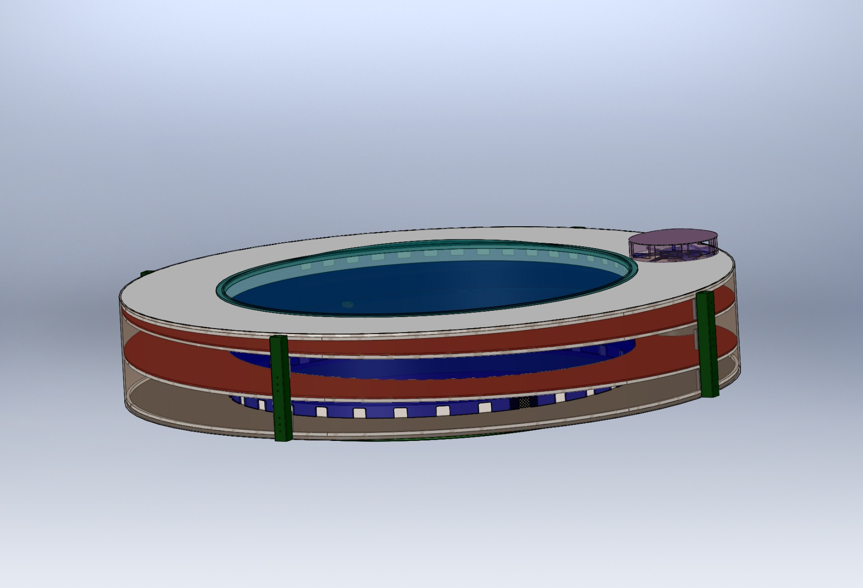
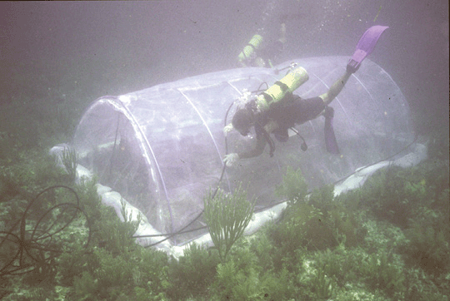
Sample Experiment Chambers
(Cont.)
Experiment Chamber
Transparent Cover
Exhaust Vents
Exhaust
Fan
Enriched SW
Inlet
Integral Delay Path
Inlet vents
Guggenheim Museum/Stadium Concept
Compliant Chamber
(Not a FOCE as shown)
Submersible Habitat for Analyzing Reef Quality (SHARQ)
Polyethylene film
Frame made of plastic or metal tubing.
Requires a fairly benign environment.
Translates surge.
Isolates waterborne nutrients.
Requires creative instrument attachment.
Notes:
----- Meeting Notes (4/26/12 11:22) -----
eliminate

Slide 108
Chamber Shear Skirt and Interface Seal
Chamber Shear Skirt
  Extend into the seafloor 8-10 cm.
    Resists lateral movement
    Seals perimeter of chamber at seafloor
    Assists in preventing critter intrusion
Chamber Interface Seal
  Extend 30 – 40 cm on seafloor surface from perimeter of Chamber
  Assists in sealing chamber at uneven seafloor surface
  Can assist in scour prevention and erosion from currents
  Variety of applicable materials
    Canvas
    Reinforced Plastic Sheet
    Rubber/Nitrile/ sheet
  Should be weighted
    Lead
    Concrete blocks
    Grout Bags
Notes:
----- Meeting Notes (4/26/12 11:22) -----
use pictures of real unit w/ arrows, main bullets

Slide 109


Time Delay Mixing Section
Duct that provides the necessary time for the CO2
and seawater to chemically react and establish
a stabilized pH.
Reference the Zeebe-Wolf Gladrow CO2 Kinetic
Model to determine Tau (shown previously and
here).
Duct length is determined by using a 2 Tau time delay and the desired maximum current speed.
The cross-sectional area and the current speed
(volume/time) will approximate the rate of change
of the enriched seawater in the Experiment Chamber.
Offset pH = -0.7
Bkgrd pH ~ 8.1
Offset pH = -0.5
Offset pH = -0.3
Tau = 67.8 secs
*
*
Flexible Duct
Tau = 51.3 secs
*
Tau = 31.1 secs
*
Commonly used for air handling
Integrated coil to maintain flow (use plastic instead of metals)
Use all plastic.
2 “ - 12” diameter commonly available
Low cost
Curves from the Zeebe-Wolf Gladrow CO2 kinetic model
showing e-folding time at various temperatures as a function of pH.
Notes:
----- Meeting Notes (4/26/12 11:22) -----
reduce text
use pictures
elim Referenct to Zeeb....
combine bullets on Ducts

Slide 110



Components to Simulate Current
Trolling Motors
  Compatible with shallow depths
  Reasonably predictable reliability (MTBF)
  Easy maintenance/replacement
  Compatible with available power (AC/DC, etc.)
  Controllable according to requirements
  Capable of reasonable volume/rate delivery
Commercial Thrusters
  Technadyne Model 520 DC Brushless - $3700, 520 Watts, various voltages available, analog or digital control, magnetically coupled prop
  CrustCrawler 400 HFL - $600, 0-50 VDC, 400 watts, lip seals, 300 ft
Submersible Bilge Pumps
  Compatible with shallow depths
  Large range of flow rates
  Large range of DC voltages
  Readily available/replaceable
  Very inexpensive
  Brand Names: Rule, Attwood, Lovett, Johnson, Jabsco,…
  May need replacing more often
  Not designed to run continuously
Trolling Motor
Commercial Thruster
Submersible Bilge Pump
Notes:
----- Meeting Notes (4/26/12 11:22) -----
use trade table
keep pictures

Slide 111
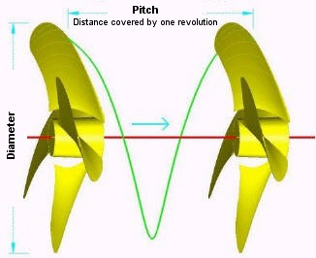
Components to Simulate Current
(Cont.)
Custom Thruster using Propellor and Motor
Disk Theory for Moving Water
Ppropellor x RPM x Areapropellor / 100 = Volumewater / minute
Where:
* Ppropellor = Propellor Pitch (cm.)
RPM = Revolutions per minute
Areapropellor = Area of the diameter projected by rotated propellor (cm. sq.)
Volumewater = volume of water moved by propellor (liters)
Equation for motor H.P. Requirement
HP = (psi x GPM) / (1714 x efficiencyMotor)
*NOTE: Pitch is defined as "the distance a propellor would move in one revolution
if it were moving through a soft solid, like a screw through wood." For example,
a 21-pitch propellor would move forward 21 inches (53.3 cm) in one revolution.
Notes:
----- Meeting Notes (4/26/12 11:22) -----
use for reference material (elim slide)

Slide 112
Anchoring
Anchors
  Related to type of seafloor, longevity, access, etc.
    Semi, Consolidated, and Unconsolidated Sand, Silt, and Clay
      Deadweight
        Concrete Block
        Other
      Direct Embedment
        Helix
        Keyed Plate
      Drag Embedment (Primarily for buoy moorings)
        Danforth, CQR, Delta, Bruce, etc.
      Self –Burying (Better for loose sand, silt)
        Dor-Mor
        Mushroom
    Rock and Coral
      Deadweight
        Concrete Block
        Other
      Direct Embedment
        Powder Actuated Stud Gun (down to 46 meter (150’) depth)
        Epoxied Stud (Drilled hole)
        Expansion Bolt (Drilled hole)
Notes:
----- Meeting Notes (4/26/12 11:22) -----
use picture slide, trade table

Slide 113











Examples of Anchors
CQR
Epoxied Anchor Pins in Coral
Installation of
Anchor Pins
Claw or Bruce
Danforth
Drag Embedment Anchors for Mooring Buoy
Powder Actuated Stud Gun
Self Embedment Anchors
Deadweight Block
Single or
Multiple Helix
Dor-Mor
Helix Anchor

Slide 114
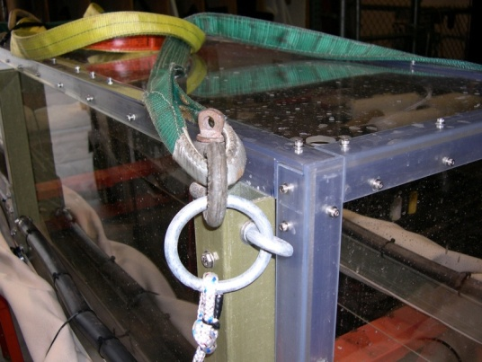
Anchor Notes
Helix type easy to install by diver
  Screw-It Beach anchor, removable handle, Corrosion resistant - $70
  Ironwood Pacific – 21”, 4” helix, powder coated steel, $40 each
  MilSpec Anchors -- set of 4 for $23
Keyed Plate type requires digging out for retrieval
  Triangular earth anchors with galvanized cables, set of 4. ~$40
Drag embedment anchors require setting by boat.
Installation of anchor pins require drilling holes in coral or rock.
SWFOCE method of securing anchor to frame
Notes:
----- Meeting Notes (4/26/12 11:22) -----
matl for trade table

Slide 115
Enriched Seawater Generation and Delivery
  This system mixes CO2 with seawater and delivers the enriched seawater to each Seafloor Experiment System.
  The Delivery System is comprised of at least the following components:
    Mixing Tank
      Contains CO2 and seawater at 2 atmospheres.
      Designed for the creation and buffered storage of
      enriched seawater.
      Adequate volume to supply the requirements for all Experiment Systems
      Vaporizing Nozzle(s) to create enriched seawater
      Instrumentation to assure adequate monitoring and mixing of enriched seawater.
    Pump and Motor
      Provides recirculating seawater to mixing tank
      Provides enriched seawater to experiment systems
    Seawater Delivery Source
    CO2 Delivery Source
    Ancillary equipment and instrumentation
      Valves
      Gauges
      Filters
      Sensors
Notes:
----- Meeting Notes (4/26/12 11:22) -----
use simple picture slide

Slide 116
Enriched Seawater Generation and Delivery
(Cont.)
(SWFOCE shown)
Notes:
----- Meeting Notes (4/26/12 11:22) -----
do cartoon style
explain why we rain down instead of bubble up, etc.
partial pressures (2 atm)

Slide 117


Supporting Information
Optional CO2 Use from Exhaust
Carbon Dioxide Emissions from 1 gallon of fuel
Source: U.S. Environmental Protection Agency, "Emission Facts: Average Carbon Dioxide Emissions Resulting from Gasoline and Diesel Fuel," February 2009.
Notes:
----- Meeting Notes (4/26/12 11:22) -----
shrink epa , enlarge others

Slide 118



Power for XFOCE
Onshore Power
  Power supply Unit
  UPS
Diesel Generator
3500 Watt Output
0.3 Gallon per Hr.
Remote Location Power
Onshore or Offshore
  Diesel Generator
    Bonus of CO2 generation
  Wind Powered Generator
    Batteries
  Solar Cells
    Batteries
Wind Generator
400 Watt Output
240 Watt Panel
Notes:
----- Meeting Notes (4/26/12 11:22) -----
mention fuel cell (cost, mostly mil backup, made to run at one power, hard to regulate)
wind, solar inconsistent,
even diesel needs batteries
we can produce 50 W continuous solar wind
put this before diesel picture: advantage: combine CO2 and energy

Slide 119
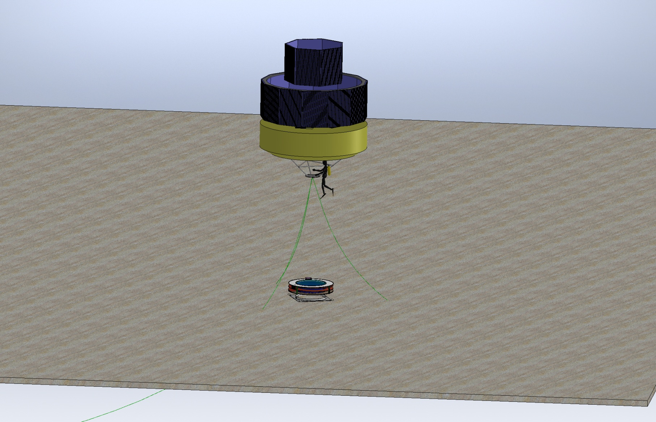
Option for Power to Remote xFoce
Power from Solar Cells on Buoy
Notes:
----- Meeting Notes (4/26/12 11:22) -----
shrink and combine

Slide 120
XFOCE Website Reference Material
Spreadsheet
Estimation of Shallow-FOCE CO₂ enriched seawater release rate:
Assumptions:
 | 1. Shallow FOCE is smaller than FOCE at MARS by 1/2: 0.5m X 0.5m.
 | 2. Water velocity thru flume set as "on average" a 1 cm/s flow through chamber.
 |  | - residence time for a 1 meter length chamber is 100 secs.
 |  | - internal cyclic flow indiced by a paddle.
 |  | cm/sec | ht (m) | w (m)
 |  | 10 | 0.5 | 0.5 | 25 | L/s
 | 3. Concentration of CO2-ESW: |  |  | 40 | mM | pH: | 4.75
 | 4. FOCE uses different amounts of CO2 depending upon pH offset:
 |  |  |  |  | Vol CO2-ESW |  |  |  | Amt CO2
 |  | pH offset | +TCO2 | Amt CO2 | mL/s | L/min | L/day |  | kg/day | lb/day
 |  |  | μmol/kg | µmole/s
 |  | 0.2 | 74.5 | 1862.5 | 46.563 | 2.794 | 4023 |  | 7.082 | 15.61
 |  | 0.4 | 136.1 | 3402.5 | 85.062 | 5.104 | 7349 |  | 12.938 | 28.52
 |  | 0.8 | 257.3 | 6432.5 | 160.813 | 9.649 | 13894 |  | 24.459 | 53.92
 |  | 1.5 | 767.7 | 19192.5 | 479.813 | 28.789 | 41456 |  | 72.978 | 160.89
Notes:
----- Meeting Notes (4/26/12 11:22) -----
reference matl

Slide 121
XFOCE Website Reference Material
Spreadsheet
 |  | FOCE Delay Section Lengths and Flow(Q)
Assumption for this version - pH delta of - 0.3, 10 deg. C, so 2 Tau ~ 135 seconds |  |  |  |  |  |  |  |  | 4/2/2012
 |  | -Ambient pH ~8.1
 |  | -Mixing Section is Round tubing or pipe
 |  | -Flow thru Test Section is the bulk (average) flow
INPUTS | 47.0 | cm, Height of Test Section |  |  |  | Note: swFOCE dim's Ht, W, L
 |  |  |  |  |  |  | 47cm,49cm, 2m
 | 49.0 | cm, Width of Test Section
 | 2.0 | meters, Length of Test Section
 | 2 | cm/second, Flow velocity in Test Section
 | 30.5 | cm, Diameter of Mixing Section tubing |  |  |  | 12.0 | inches
RESULTS | 2303.0 | cm sqd, Cross Sectional Area of Test Section
 | 730.2 | cm sqd, Cross Sectional Area of Mixing Section
 | 6.3 | cm/sec, Flow vel in mixing section
 | 8.5 | meters, Length of mixing section req'd for 2 Tau
 | 4.6 | Liters/sec, Quantity of S.W. req'd
 | 16582 | Liters/hr
 | 4381 | Gallons/hr
 | 100 | seconds, Residence Time in Test Section
Notes:
----- Meeting Notes (4/26/12 11:22) -----
reference

Slide 122
Flow Rate of Stabilized Enriched Seawater Relative to Chamber Cross-Section and Internal Current Speed
XFOCE Website Reference Material
*Liters/minute (Gallons/minute)
Current Speed
Cross Section of Experiment Chamber | 2 cm/sec | 4 cm/sec | 6 cm /sec | 8 cm/sec | 10 cm/sec
.5 m x .5 m | 602 (159) | 1200 (317) | 1802 (476) | 2400 (634) | 3001 (793)
.25 m x .25 m | 299 (79) | 450 (119) | 901 (238) | 1200 (317) | 1503 (397)
.13 m x .13 m | 151 (40) | 299 (79) | 450 (119) | 598 (158) | 749 (198)
*3.785 liters = 1 gallon
NOTE: The relative cross-sectional areas of the time delay mixing section (provides
delivery of stabilized enriched seawater) and the experiment chamber must
be considered when desiring to minimize the time for stabilizing pH in the
chamber.
Notes:
----- Meeting Notes (4/26/12 11:22) -----
reference matl not in talk

Slide 123
XFOCE Website Reference Material
Potential Polymer Materials for Large Panels
Polycarbonate-colored or clear
Nearly unbreakable
Scratch resistant
Relatively easy to fabricate
Excellent corrosion resistance
High notch sensitivity (crack propagation)
Difficult to saw
Visible light transmission good ~86%
Yellows when exposed to UV
Acrylic- colored or clear
Fair impact resistance
Excellent corrosion resistance
High notch sensitivity (crack propagation)
Difficult to work with
Requires non-solvent based cutting fluid during fabrication
Visible light transmission is very good, 92%
UV transmission falls off rapidly at ~350 nm
  G UVT formulation available with 275 nm cut-off
Less yellowing from UV
Easily bonded with methyl chloride, or Weld-On #16
PVC – pale blue or clear
Fair impact resistance
Fair notch sensitivity (crack propagation)
Good UV resistance
  Thicker materials retain resistance longer
  Starts to yellow over long term > 20 months
Good chemical resistance
Excellent corrosion resistance

Slide 124
Potential Materials and Components
p.2
XFOCE Website Reference Material
(Cont.)
If using an External Frame to support Panels:
FRP-fiber reinforced plastic (fiberglass)
  Easy to work with
  Available in many structural shapes
  Excellent for long term immersion
  Can dull cutting/boring tools quickly
  Does not hold threads well
  Sheet metal screws can be used in >.25“ thick materials.
6061 Aluminum
  Easy to work with
  Available in many structural shapes
  Corrosion issues when in contact with SS fasteners
    Insulating washers may be used
  Excellent for long term immersion
    Cathodic protection may be used
PVC - polyvinyl chloride
  Easy to work with
    Drilled and tapped easily
    Bonds well with adhesives
  Available in many structural shapes
  Clear version is UV resistant
    Angles used for reinforcing edges allow good passage of light
UHMW- ultra-high molecular weight polyethylene
  Easy to work with
  Common shapes are sheets, bars, rods
  Lower specific gravity than seawater
  Black formulation precludes light but is UV resistant
COMPONENTS
LATCHES
  Must be sturdy
  Corrosion resistant
  Easily operated by diver with gloves on
  Commercially available
    Cabinet type, SS
    Block and pin, plastic or SS
  Custom Design
    Cam lock, single or paired
    Other
HINGES
Must be sturdy, corrosion resistant
-piano type, SS
-solid rubber, 1/8-1/4” thick, screwed in with facing plate
FASTENERS
Use stainless steel
  316 is preferable, 18-8 is acceptable

Slide 125
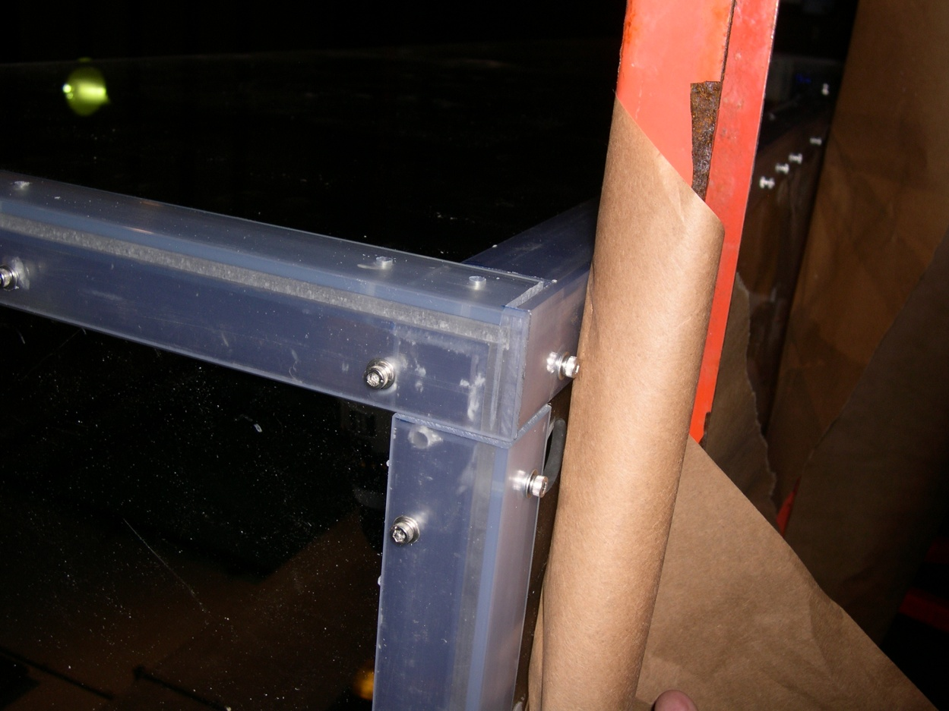
Proven Fabrication Methods
XFOCE Website Reference Material
Outer Angle
Inner Angle
Wall
Clearance
Outer Angle
Wall
Threaded
Inner Angle
Fastening Angles for Stiffness
Use of appropriate materials will maximize light
transmission into the test chamber.
-1/4” Clear Acrylic Panels
-3/16” x 1.5” x 1.5” clear PVC angle used as outside support structure.
-3/16” x1.25” x1.25” clear PVC used inside.
-8-32 x 5/8” screws tapped into inner PVC pieces, 6” Center to Center.
FABRICATION Note: Drilling holes in plastics, polycarbonate and especially acrylic can be difficult because the drill tends to grab and “dig” into the material. Modify the cutting edge of the drill’s flutes by filing or sanding the cutting edge to a more vertical “scraping” edge (i.e. perpendicular to the surface being cut). Keep it sharp and a very nice hole without breakout on the back surface will result.

Slide 126
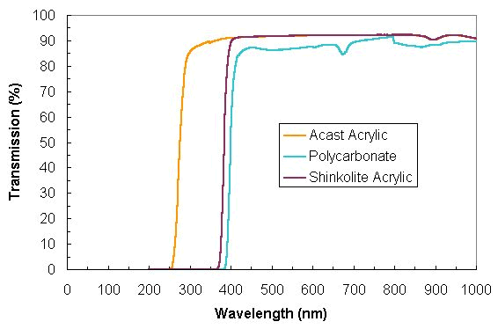
XFOCE Website Reference Material
Light Transmission through
Polycarbonate and Acrylic

Slide 127
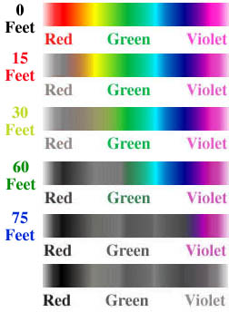
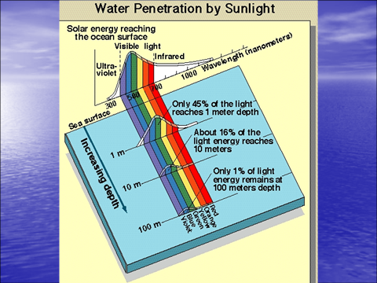
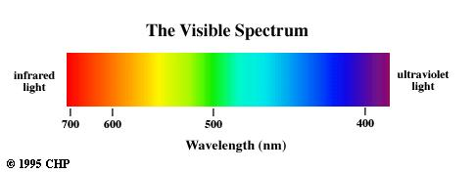
400nm through 700 nm
XFOCE Website Reference Material
Photosynthetically Active Radiation (PAR)
(0 Meters)
(4.6 Meters)
(9.1 Meters)
(18.3 Meters)
(22.9 Meters)

Slide 128
XFOCE Website Reference Material
Low Cost Shallow Water Pressure Housing Case Fabrication
PVC - Polyvinyl Chloride
strong and rigid
resistant to a variety of acids and bases
maximum usable temperature 140ºF (60ºC)
PVC
Nominal Pipe Size (inches) | Schedule 40 | Schedule 80
1/2 | 358 | 509
3/4 | 289 | 413
1 | 270 | 378
1 1/4 | 221 | 312
1 1/2 | 198 | 282
2 | 166 | 243
2 1/2 | 182 | 255
3 | 158 | 225
4 | 133 | 194
5 | 117 | 173
6 | 106 | 167
8 | 93 | 148
10 | 84 | 140
12 | 79 | 137
Operating Temp (°F) | De-Rating Factor
73 | 1.00
80 | 0.88
90 | 0.75
100 | 0.62
110 | 0.51
120 | 0.40
130 | 0.31
140 | 0.22
Operating Depth = 40 Meters (~131 ft.)
Maximum Pressure = .444 x Depth (ft.) +14.7 psi → 73 psi
Factor of Safety = 2 Therefore 2 x 73 psi = ~146 psi
Notes:
----- Meeting Notes (4/26/12 11:22) -----
need version in talk for xFOCE: can use PVC
how can scientists make low cost housings
length limits (otherwise get help), depth limits, what machining required, thermal issues
torpedo locks
what other seal options: flanged bolts
consistent units in meters, deg C
safety factor
handling safety (vents): if you're unsure, don't do it

