Slide 1
An Idea Takes Shape
Build a consortium of researchers and engineers to tackle large, real-world issue of increasing relevance
Center for Ocean Solutions: Ideal fit to highlight ocean acidification
Hopkins: Cable infrastucture and numerous potential research opportunities

Slide 2
Pushing the Limits of Permitting
Brock Woodson initially procured permit from Sanctuary to install cable.
Innovative work, like SW-FOCE, would require the involvement of multiple regulatory agencies
First research project request in recently established MPA, as well as Area of Special Biological Significance
Exposed several shortcomings in permitting process among multiple agencies

Slide 3

Permits at Every Level
Monterey Bay National Marine Sanctuary
California Coastal Commission
California Department of Fish & Game
Central Coast Regional Water Quality Control Board
City of Pacific Grove

Slide 4
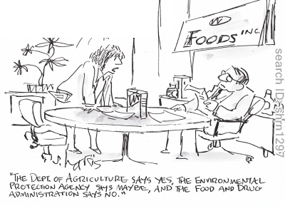
How to Move Forward -
Go to the Top
Agencies had no procedures to move forward or interact
Peter Brewer met with Governor Brown
Meg Caldwell helped streamline the process with two key State agencies (CCC & CDFG) through discussions with high level personnel

Slide 5
Lessons Learned
Allow plenty of time for permitting
  Process took 2 years to complete
Good rapport with agency personnel key
  Not necessarily trying to make life difficult, but often operating within bureaucratic box
Well-placed connections are valuable
Getting the process streamlined is critical to prevent valuable research from being discouraged due to concerns about permitting.

