Slide 1
xFOCE Computing Architecture Trade Analysis
(In 20 slides or less)

Slide 2
Computing Architectures
User Concerns
Performance: data quality and access
Flexibility: wide range of applications
Ease: manufacturing and technical capability required
  Build
  Use, maintain
  Extend
Cost

Slide 3
A few assumptions
Implementer profile | Researchers plus 2-4 post docs, grad students 0-1 engineer (ME/EE/EM)
Technical | Access to modest manufacturing facilities Software is harder than software, mechanical Strong preference for familiar COTS solutions
Implementation schedule | 6-9 months to build
Budget | $200k
Experiments | 1 – 3 mo campaign 12 mo service life Remote and/or restricted sites
Lifecycle | Prefer to extend capability, rather than re-spin from scratch

Slide 4
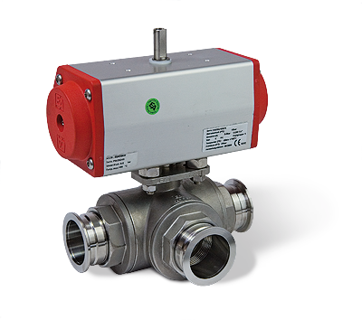
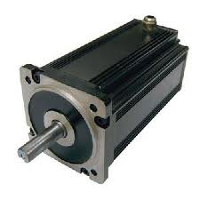
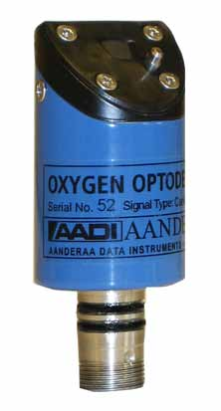
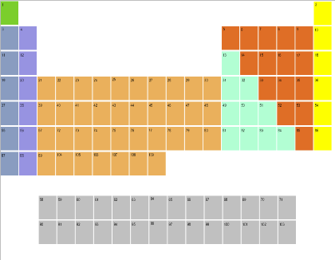
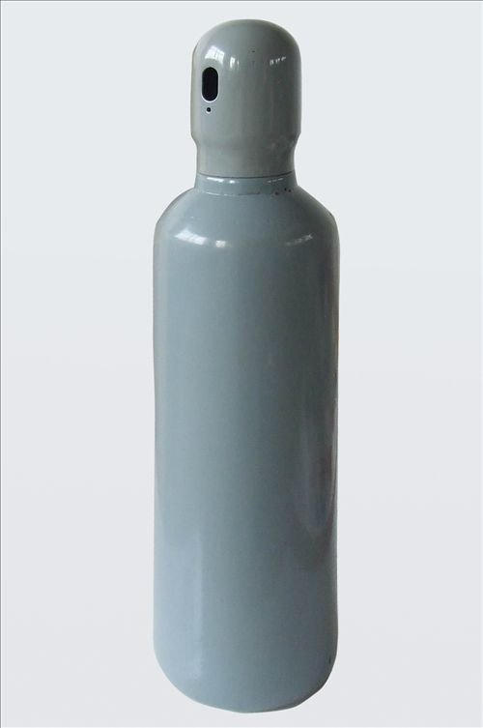
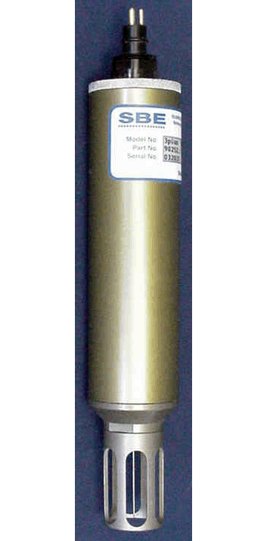
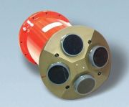
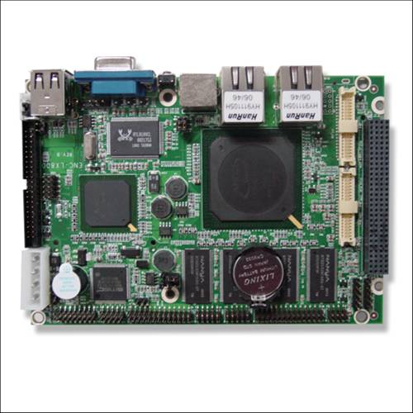
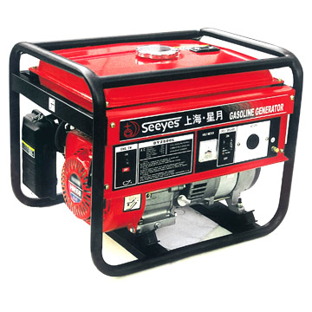
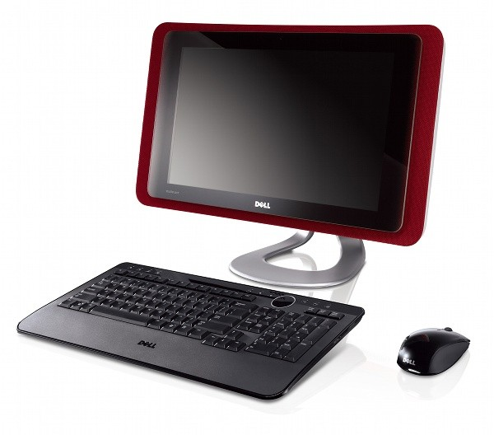
Computing Architectures
Elements
Instruments
Electronics
Housings
Cabling
Software
Computers
Many ways to arrange them
In a FOCE experiment
For each, many options

Slide 5
Computing Architectures
Shrinking the Universe of Trades
Look at decisions that have greatest impact on user concerns
  Build vs Buy
  Location matters: Shore vs Surface vs Seafloor
  Topology: how the pieces are connected

Slide 6

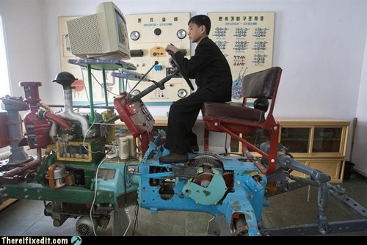
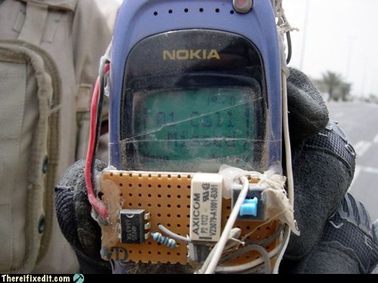
Build vs Buy
General Principles
Buy what you can’t/shouldn’t build
  Processors, instruments, cabling
Build (or borrow) as needed
  Chambers, housings
  Use COTS components if possible
  Get help on tough key builds
    contract, open source
Beware Frankensystem
  Patchwork integration of COTS parts
  Power consumption
  Rube Goldberg-ness of mechanical/electrical interfaces

Slide 7

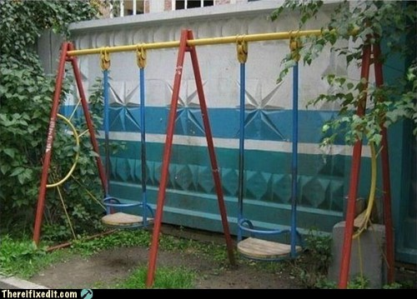
Location Matters
General Principles
Connected vs Disconnected
  Generally easier to generate and store power, ESW on shore
Trades for off-shore elements
  Accessibility (to you, the elements, others)
  Reliability
Keep what’s offshore/sub-surface as simple and robust as possible
  Basics: Enriched seawater, power
  HW: Cables, connectors, housings
  SW: Applications, protocols, processes
Play your application, tech strengths and budget
  Permits, environment
  Experiment duration, depth
  Data access requirements
  Maintenance schedule, spares
  Available design/fabrication resources

Slide 8
Computing Architectures
Considered Approaches
Location Matters ➔ Build vs Buy ⬇ | Connected | Semi-Connected | Stand-alone
Custom
Consumer COTS
High grade COTS
Deep FOCE
eFOCE
SW FOCE
Sensor Node
CP FOCE
IPC
SIAM+Digi
?
SensorPod
xFOCE

Slide 9

The Options
What to look for:
Location Matters:
More stuff @...
Shore 
Surface 
Seafloor 
Build vs Buy:
by subsystem, color
custom
mixed
cots/os
Topology, Resources:
Power, Bandwidth
Backbone
Topology
10 kW
1000 MBps
Eth, Serial
Star
Remember to breathe :o)

Slide 10
Computing Architectures
Deep Cabled Approach
custom
mixed
cots/os
Description
  1 year experiment
  1000m Operation
  High Power, Bandwidth cable
Features
  Custom electronics & housings
  Custom/open software
  Ethernet, serial
  In situ ESW gen
  ROV CO2 handling
  Video
Examples
  Deep FOCE
Power
CO2
Shore
Sci/Control
DFOCE GUI
Power
Dist
SIAM
SSDS
10 kW
1000 MBps
Eth, Serial
Star
FOCE Control
RDV
ESW
mixer
OSDT
SIAM
Browser
(video)
PC104
ESW dist
terminal
Flow
instruments
Mac/Win/Lin
video

Slide 11
Summary
Deep Cabled Approach
Why consider this
  Long term, deep operation required
  Large experimental chamber
The Rub
  Expensive to build, maintain
  High power
  Specialized for cabled observatory
    Ship, ROV service
  Custom HW/SW
  Custom Ti housings
  Large physical size
The Bottom Line
  High performance variation of sensor node (minus sensor nodes)
  Expensive, specialized precision application

Slide 12
Computing Architectures
WAGO Lego Approach
custom
mixed
cots/os
Description
  1 year experiment
  40-? m Operation
  Med Power, Bandwidth cable
  Not stand-alone (power)
Features
  Custom electronics & housings
  COTS/custom software
  Ethernet, serial, modbus
  On shore ESW gen
  Video
Examples
  Deep FOCE
ESW
mixer
CO2
Power
Dist
Shore
Power
Sci/Control
WAGO
LV GUI
GF ISO
0.2 kW
2-10 MBps
Eth, RS422
Star/Bus
LabView
FOCE Control
National
Inst
WAGO
ESW dist
Serial MUX
Browser
(video)
terminal
flow
instruments
Mac/Win/Lin
video
video
MUX
Serial MUX

Slide 13
Summary
WAGO Lego Approach
Why consider this
  Mostly COTS
  Easier to build
  Potentially long cable runs
The Rub
  High cost
  High power consumption
  Cable may be very technical, especially from surface expression in active environment
The Bottom Line
  Expensive, more straightforward design pattern
  min custom HW/SW
  Best suited to cabled system

Slide 14
Computing Architectures
Sensor Node Approach
custom
mixed
cots/os
Description
  0.5-1 year experiment
  40 m Operation
  stand-alone (shown) or cable
Features
  Custom electronics & housings
  COTS/custom software
  Mixed topology
  Ethernet, serial, modbus
  Off shore ESW gen
Examples
  eFOCe
CO2
Power
FOCE Control
Telem
Electronics
Cell
RF
WiFi
GF ISO
Custom SW
ESW
mixer
Diesel Gen
Beagle
Power Dist
2 kW
0.1-2 MBps
Eth/DSL?
RS422
Star
FOCE Control
Sci/Control
Custom SW
GUI
Beagle e.g. Gateway
Browser
ESW dist
FOCE Control
terminal
Sensor Node
Mac/Win/Lin
instruments
Flow
Custom SW
Serial MUX
Arduino, e.g.

Slide 15
Summary
Sensor Node Approach
Why consider this
  Reduce power*
  Avoid custom serial IO expansion
  Modularizes data acquisition
  Many variations possible
    COTS processors, languages
    Topologies
    *Connection backbone (cost: power)
    Component upgrades
    Drivers on Gateway
The Rub
  Two software development platforms
  More custom hardware to build, configure, maintain
  More cables, connectors, housings
  Video expansion path unclear
  Multiple system clocks
The Bottom Line
  It’s a good design pattern, with balance of build/buy
  flexible, extensible, moderate cost
  Variants trade complexity, power, modularity

Slide 16
Approach Scorecard
Approach | Performance | Flexibility | Ease |  |  | Cost
 |  |  | Build | Use | Extend
Deep Cabled |  | ■ |  | ■ |  | 
WAGO Lego | ■ | ■ | ■ |  | ■ | 
Sensor Node | ■ |  | ■ | … |  | ■
Not so much

I want that!

Slide 17
Other technologies and approaches
Options | Why not here
CAN bus
Inductive cables
OASIS, BRS
Pachube
MatLab
Acoustic comms

Slide 18
What was tough for us
(but may be easier for you)
Understanding range or users’ resources and capabilities
Understanding user requirements
Likeliest application configurations, constraints
  Stand- alone vs connected
What will users re-use, re-invent (and why)
Trading processors, programming languages
Exporting custom hardware

