Slide 1
Software side of xFOCE
(Computing system trades)
FIXIT

Slide 2
Computing Architectures
User Concerns
Performance: proven science approach, data quality
Flexibility: wide range of environments, scenarios
Ease:
  Build
  Test
  Use, maintain
  Extend
Cost

Slide 3
A few assumptions
Implementer profile | Researchers plus 2-4 post docs, grad students 0-1 engineer
Technical | Access to modest manufacturing facilities Software is harder than hardware, mechanical Strong preference for familiar COTS solutions
Implementation schedule | A few months to build
Experiments | Campaign-style deployments 12 month service life Remote and/or restricted sites
Lifecycle | Prefer to extend capability, rather than re-spin from scratch for successive funding rounds

Slide 4
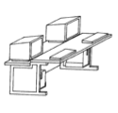


Power
Data
CO₂
H₂O
Enriched
Seawater
Controller
FOCE Essentials
pH
CTD
CTD
pH
Flow
DO
Flow
DO

Slide 5
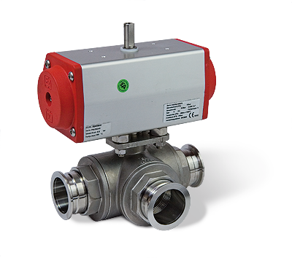
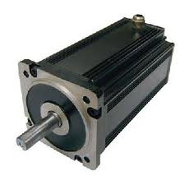
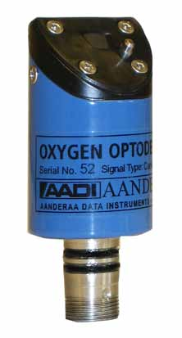
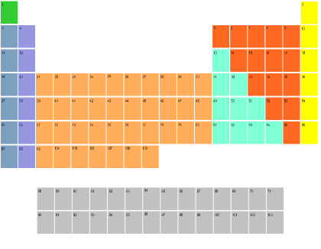
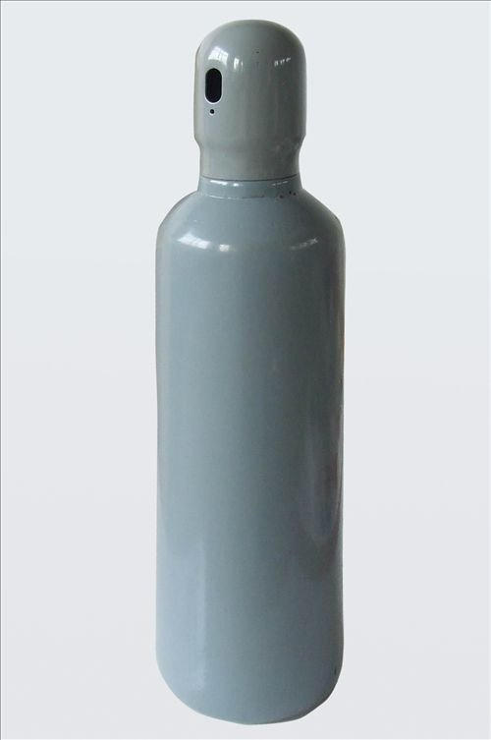
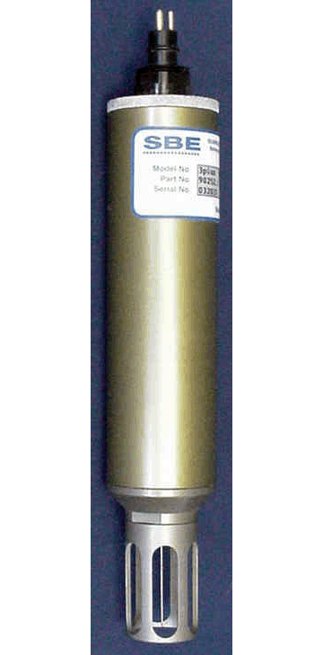
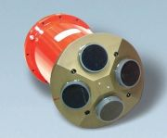
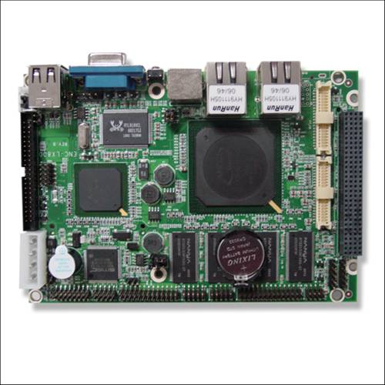
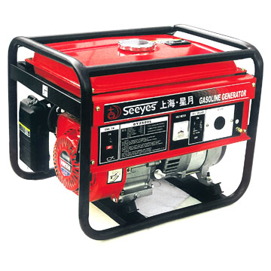
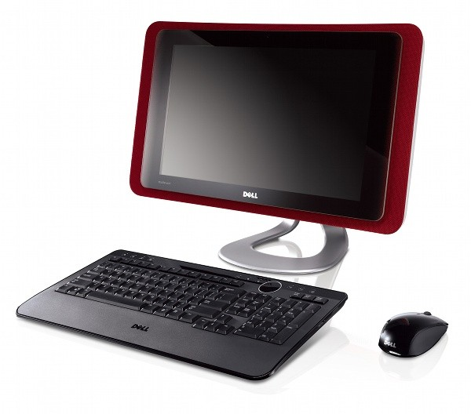
Computing Architectures
Elements
Instruments
Electronics
Housings
Cabling
Software
Computers
Many ways to arrange them
In a FOCE experiment
For each, many options

Slide 6
Computing Architectures
Shrinking the Universe of Trades
Look at decisions that have greatest impact on user concerns
  Build vs Buy
  Location matters: Shore vs Surface vs Seafloor
  Topology: how the pieces are connected

Slide 7

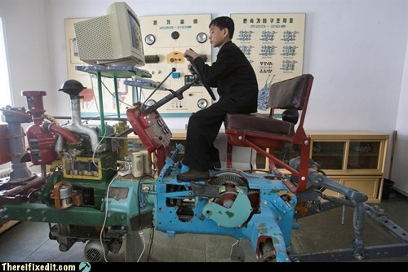
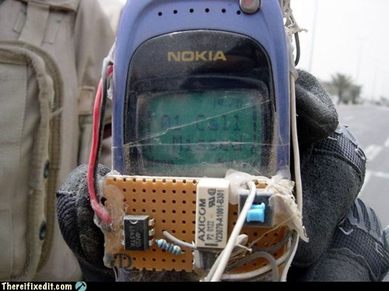
Build vs Buy
General Principles
Buy what you can’t/shouldn’t build
  Processors, instruments, cabling
  Software
Build (or borrow) as needed
  Chambers, housings
  Use COTS components if possible
  Get help on tough key builds
    contract, open source
Beware Frankensystem
  Patchwork integration of COTS parts
  Power consumption
  Rube Goldberg-ness of mechanical/electrical interfaces

Slide 8

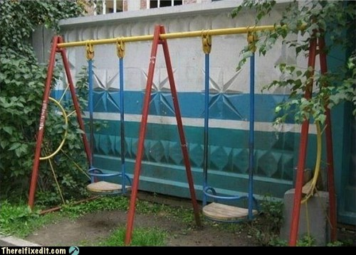
Location Matters
General Principles
Connected vs Disconnected
  Generally easier to generate and store power, ESW on shore
  Telemetry bandwidth
Trades for off-shore elements
  Accessibility (to you, the elements, others)
  Reliability
Keep what’s offshore/sub-surface as simple and robust as possible
  Basics: Enriched seawater, power
  HW: Cables, connectors, housings
  SW: Applications, protocols, processes
Play your application, tech strengths and budget
  Permits, environment
  Experiment duration, depth
  Data access requirements
  Maintenance schedule, spares
  Available design/fabrication resources

Slide 9
What the software developer sees…
Power
Data
What pieces inside?
Build or Buy?
Where to put the pieces?
How are pieces connected?
CO₂
H₂O
Controller
Enriched
Seawater
…What the user needs to consider
pH
CTD
CTD
pH
Flow
DO
Flow
DO

Slide 10

Some things must be on the seafloor
  Chamber, instruments
  Actuators (pumps, fans, etc.)
But location of everything else is flexible…
  Power, ESW
  Controller
  Data storage, user interfaces
And, there are many ways to implement all of it…

Slide 11
Our goal is to narrow the choices
Choices depend on experiment and constraints
  Budget, schedule
  Environment
  Technical resources
xFOCE community may draw from different approaches

Slide 12
A study of some approaches
  Grand Centralized Workstation
  Industrial Computers
  Sensor Node
Zoom in, evaluate key features and trades
  Build/buy what and why: hardware, software
  Location: shore, surface, seafloor
  Connections: topology and infrastructure
Next stop: Grand Centralized Workstation…

Slide 13
Grand Centralized Workstation
Location View
Data
Component | Location | Why
Controller HW | Seafloor | Experiment continues if comms fails
Controller Software | Seafloor | ‘’
UI Software | Shore | Easier maintenance
Power | Seafloor/Shore | Need fine-grained power management at site
Data | Seafloor/Shore | Experiment continues if comms fails
ESW | Seafloor | Depth, distance from shore
Data
Controller
Power
pH
CTD
CTD
pH
Flow
DO
Flow
DO

Slide 14
Component
Build/Buy View
Grand Centralized Workstation
Data
Component | Build/Buy | Implementation
Controller HW | Buy | PC104 16 serial ports
Controller Software | Build Open Source | Linux/Java SIAM Open Source Dataturbine
Archive, UI | Build | PC Workstation MacOS, Windows, Linux, Java SSDS Custom FOCE GUI
Power | Build | Custom chassis
Data | Build | SIAM SSDS Open Source
ESW | Build | Custom electronics, Software, chassis COTS pumps, controllers
Data
Controller
Power
pH
CTD
CTD
pH
Flow
DO
Flow
DO

Slide 15
Grand Centralized Workstation
Connections View
Ethernet
Data
1000 MBps
Ethernet
10 kW Cable
Data
Controller
Ethernet-Serial
Power
RS232
pH
CTD
CTD
pH
Flow
DO
Flow
DO

Slide 16
Summary
Grand Centralized Workstation
Benefits
  Long term, deep operation required
  High bandwith comms supports video
  Large experimental chamber
  One software platform
  Software reuse
  COTS computers, IO solutions
Costs
  Expensive to build, maintain
  Power consumption
  Specialized for cabled observatory
    Ship, ROV service
  Custom HW/SW
  Custom Ti housings
  Large physical size
Bottom Line for xFOCE
  Central computing w/ workstation computing environment
  Much custom hardware and software
  Expensive and technical to build and use

Slide 17
Next up: Industrial Computers…

Slide 18
Summary
Industrial Computer Approach
Benefits
  Mostly COTS
  Easier to build
  Potentially long cable runs
Costs
  High cost
  High power consumption
  Cable may be very technical, especially from surface expression in active environment
The Bottom Line
  Expensive, more straightforward design pattern
  min custom HW/SW
  Best suited to cabled system

Slide 19
Summary
Sensor Node Approach
Why consider this
  Reduce power*
  Avoid custom serial IO expansion
  Modularizes data acquisition
  Many variations possible
    COTS processors, languages
    Topologies
    *Connection backbone (cost: power)
    Component upgrades
    Drivers on Gateway
The Rub
  Two software development platforms
  More custom hardware to build, configure, maintain
  More cables, connectors, housings
  Video expansion path unclear
  Multiple system clocks
The Bottom Line
  It’s a good design pattern, with balance of build/buy
  flexible, extensible, moderate cost
  Variants trade complexity, power, modularity

Slide 20
Approach Scorecard
Approach | Performance | Flexibility | Ease |  |  | Cost
 |  |  | Build | Use | Extend
Deep Cabled |  | ■ |  | ■ |  | 
WAGO Lego | ■ | ■ | ■ |  | ■ | 
Sensor Node | ■ |  | ■ | … |  | ■
Not so much

I want that!

Slide 21
Other technologies and approaches
Options | Why not here
CAN bus
Inductive cables
OASIS, BRS
Pachube
MatLab
Acoustic comms

Slide 23
Computing Architectures
Considered Approaches
Slide order? later?
What are Sensor Node etc?
Location Matters ➔ Build vs Buy ⬇ | Connected | Semi-Connected | Stand-alone
Custom
Consumer COTS
High grade COTS
Deep FOCE
eFOCE
SW FOCE
Sensor Node
CP FOCE
IPC
SIAM+Digi
?
SensorPod
xFOCE

Slide 24

The Options
What to look for:
Location Matters:
More stuff @...
Shore 
Surface 
Seafloor 
Build vs Buy:
by subsystem, color
custom
mixed
cots/os
Topology, Resources:
Power, Bandwidth
Backbone
Topology
10 kW
1000 MBps
Eth, Serial
Star
Remember to breathe :o)

Slide 25
Computing Architectures
Deep Cabled Approach
custom
mixed
cots/os
Description
  1 year experiment
  1000m Operation
  High Power, Bandwidth cable
Features
  Central computing w/ many serial ports
  Custom electronics & housings
  Custom/open software
  Ethernet, serial
  In situ ESW gen
  ROV CO2 handling
  Video
Examples
  Deep FOCE
Power
CO2
Shore
Sci/Control
DFOCE GUI
Power
Dist
SIAM
SSDS
10 kW
1000 MBps
Eth, Serial
Star
FOCE Control
RDV
ESW
mixer
OSDT
SIAM
Browser
(video)
PC104
ESW dist
terminal
Flow
instruments
Mac/Win/Lin
video

Slide 26
Computing Architectures
WAGO Lego Approach
custom
mixed
cots/os
Description
  1 year experiment
  40-? m Operation
  Med Power, Bandwidth cable
  Not stand-alone (power)
Features
  Custom electronics & housings
  COTS/custom software
  Ethernet, serial, modbus
  On shore ESW gen
  Video
Examples
  Deep FOCE
ESW
mixer
CO2
Power
Dist
Shore
Power
Sci/Control
WAGO
LV GUI
GF ISO
0.2 kW
2-10 MBps
Eth, RS422
Star/Bus
LabView
FOCE Control
National
Inst
WAGO
ESW dist
Serial MUX
Browser
(video)
terminal
flow
instruments
Mac/Win/Lin
video
video
MUX
Serial MUX

Slide 27
Computing Architectures
Sensor Node Approach
custom
mixed
cots/os
Description
  0.5-1 year experiment
  40 m Operation
  stand-alone (shown) or cable
Features
  Custom electronics & housings
  COTS/custom software
  Mixed topology
  Ethernet, serial, modbus
  Off shore ESW gen
Examples
  eFOCe
CO2
Power
FOCE Control
Telem
Electronics
Cell
RF
WiFi
GF ISO
Custom SW
ESW
mixer
Diesel Gen
Beagle
Android
Power Dist
2 kW
0.1-2 MBps
Eth/DSL?
RS422
Star
FOCE Control
Sci/Control
Custom SW
GUI
Beagle e.g. Gateway
Browser
ESW dist
FOCE Control
terminal
Sensor Node
Mac/Win/Lin
instruments
Flow
Custom SW
Serial MUX
Arduino, e.g.

Slide 28
What was tough for us
(but may be easier for you)
Understanding range or users’ resources and capabilities
Understanding user requirements
Likeliest application configurations, constraints
  Stand- alone vs connected
What will users re-use, re-invent (and why)
Trading processors, programming languages
Exporting custom hardware

