Slide 1
Computing side of xFOCE
(Computing system trades)
FIXIT

Slide 2
Computing Architectures
User Concerns
Performance: valid scientific approach, data quality
Flexibility: wide range of environments, scenarios
Ease:
  Build
  Test
  Use, maintain
  Extend
Cost
Notes:
----- Meeting Notes (4/19/12 09:27) -----
power constrained slide 2

Slide 3
A few assumptions
Implementer profile | Researchers plus 2-4 post docs, grad students 0-1 engineer
Technical | Access to modest manufacturing facilities Software is harder than hardware, mechanical Strong preference for familiar COTS solutions
Implementation schedule | A few months to build
Experiments | Campaign-style deployments 12 month service life Remote and/or restricted sites
Lifecycle | Prefer to extend capability, rather than re-spin from scratch for successive funding rounds

Slide 4

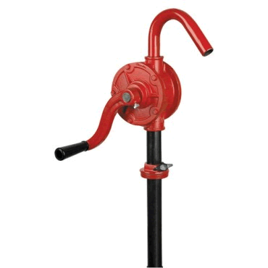

Power
Data
CO₂
H₂O
Enriched
Seawater
Controller
FOCE Essentials
ESW
pH
CTD
CTD
pH
Flow
Flow
DO₂
Flow
DO
Notes:
----- Meeting Notes (4/19/12 09:27) -----
pump hard to recognize
workstation graphic
remo
----- Meeting Notes (4/19/12 09:36) -----
expand DO2?

Slide 5



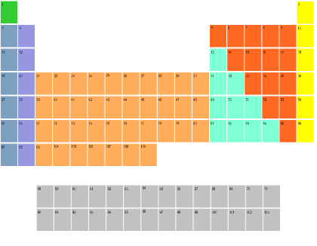
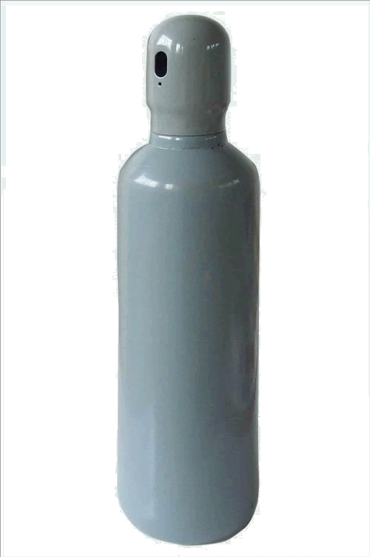


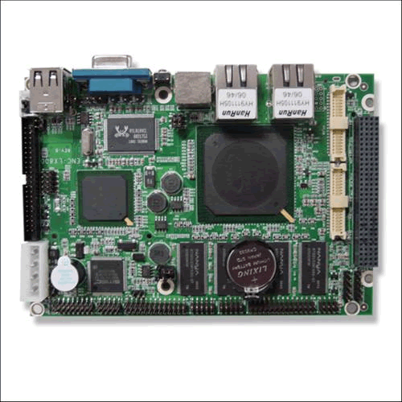
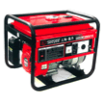

Computing Architectures
Elements
Instruments
Electronics
Housings
Cabling
Software
Computers
Many ways to arrange them
In a FOCE experiment
For each, many options
Notes:
----- Meeting Notes (4/19/12 09:36) -----
computer heads in periodic table

Slide 6
Computing Architectures
Shrinking the Universe of Trades
Look at decisions that have greatest impact on user concerns
  Build vs Buy
  Location matters: Shore vs Surface vs Seafloor
  Topology: how the pieces are connected

Slide 7

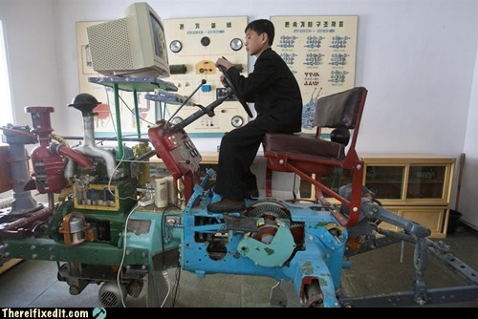
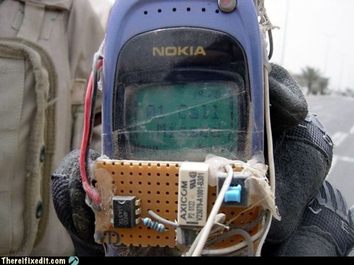
Build vs Buy
General Principles
Buy what you can’t/shouldn’t build
  Processors, instruments, cabling
  Software
Build (or borrow) as needed
  Chambers, housings
  Use COTS components if possible
  Get help on tough key builds
    contract, open source
Beware Frankensystem
  Patchwork integration of COTS parts
  Power consumption
  Rube Goldberg-ness of mechanical/electrical interfaces

Slide 8

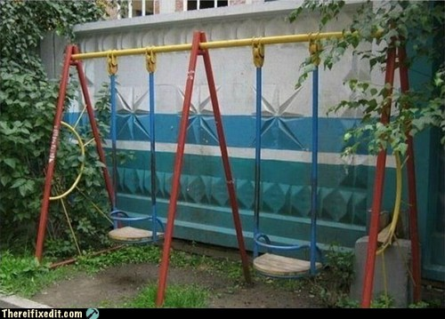
Location Matters
General Principles
Connected vs Disconnected
  Generally easier to generate and store power, ESW on shore
  Telemetry bandwidth
Trades for off-shore elements
  Accessibility (to you, the elements, others)
  Reliability
Keep what’s offshore/sub-surface as simple and robust as possible
  Basics: Enriched seawater, power
  HW: Cables, connectors, housings
  SW: Applications, protocols, processes
Play to your application, tech strengths and budget
  Permits, environment
  Experiment duration, depth
  Data access requirements
  Maintenance schedule, spares
  Available design/fabrication resources

Slide 9
Power
Data
The software developer sees…
The user needs to consider
CO₂
H₂O
Controller
Enriched
Seawater
What’s inside?
Build or Buy?
Where to put the pieces?
How are pieces connected?
ESW
pH
CTD
CTD
pH
Flow
Flow
DO
Flow
DO₂
Notes:
----- Meeting Notes (4/19/12 09:45) -----
not clear about thought bubbles

Slide 10

Some things must be on the seafloor
  Chamber, instruments
  Actuators (pumps, fans, etc.)
But location of everything else is flexible…
  Power, ESW
  Controller
  Data storage, user interfaces
And, there are many ways to implement all of it…

Slide 11
Our goal is to narrow the choices
Choices depend on experiment and constraints
  Budget, schedule
  Environment
  Technical resources
xFOCE community may draw from different approaches

Slide 12
A study of some approaches
  Grand Centralized Workstation
  Industrial Computers
  Sensor Node
3 views to evaluate key features and trades
  Build/buy what and why: hardware, software
  Location: shore, surface, seafloor
  Connections: topology and infrastructure

Slide 13
Next stop: Grand Centralized Workstation…
  Workstation computing
  Mixed COTS/custom hardware
  Shown using cabled configuration (it’s not the only way)

Slide 14
Grand Centralized Workstation
Component | Location | Why
Controller HW | Seafloor | Experiment continues if comms fails
Controller Software | Seafloor | ‘’
UI Software | Shore | Easier maintenance
Power | Seafloor | Need fine-grained power management at site
Data | Seafloor And Shore | Experiment continues if comms fails
Data
Location View
Surface
Shore
Seafloor
Data
Controller
Power
ESW
pH
CTD
CTD
pH
Flow
Flow
DO
Flow
DO₂
Notes:
----- Meeting Notes (4/19/12 09:50) -----
purpose of flow

Slide 15
Grand Centralized Workstation
Data
Build/Buy
View
Component | Build/Buy | Implementation
Controller HW | Buy | PC104 16 serial ports
Controller Software | Build Open Source | Linux/Java SIAM Open Source Dataturbine
Archive, UI | Build | PC Workstation MacOS, Windows, Linux, Java SSDS Custom FOCE GUI
Power | Build | Custom chassis
Data | Build | SIAM SSDS Open Source
ESW | Build | Custom electronics, Software, chassis COTS pumps, controllers
Surface
Shore
Seafloor
Data
Controller
Power
ESW
pH
CTD
CTD
pH
Flow
Flow
DO
Flow
DO₂

Slide 16
Grand Centralized Workstation
Ethernet
Connection
View
Data
100 MBps
Ethernet
1 kW Cable
Surface
Shore
Seafloor
Data
Controller
Ethernet-Serial
Power
RS232
ESW
pH
CTD
CTD
pH
Flow
Flow
DO
Flow
DO₂

Slide 17
Summary
Grand Centralized Workstation
Benefits
  One software platform
  COTS computers
  COTS serial I/O solutions
Costs
  Extensibility in packaging and housings…have to put a lot of holes in housings
    Can use junction boxes
  Less modular, extensible
  Need lots of serial ports
    Custom serial IO
  Power consumption
  Specialized for cabled observatory
    Ship, ROV service
  Custom HW/SW
Bottom Line for xFOCE
  Central computing w/ workstation computing environment

Slide 18
Next up: Industrial Computers…
  COTS Industrial automation computers
  Heavy use of COTS hardware and software
  Shown using stand-alone configuration (it’s not the only way)

Slide 19
Component | Location | Why
Controller HW | Surface and/or Shore | Easier access Large housings
Controller Software | Surface And Shore | Co-located w/ HW
UI Software | Shore | Easier maintenance
Power | Surface or Shore | Lots Needed! Easier access
Data | Surface and/or Shore | Co-located w/ control
ESW | Shore Or Surface | Permitting, depth, distance from shore
Industrial Computers
Location View
Data
Data
Power
Controller
Controller
UI
Surface
Shore
Seafloor
Junction
ESW
pH
CTD
CTD
pH
Flow
Flow
DO₂
Flow
DO

Slide 20
Industrial Computers
Component | Build/Buy | Implementation
Controller HW | Build/Buy | WAGO, National Instruments C-Rio Serial Mux, Video Mux Custom serial expansion
Controller Software | Build/Buy COTS Open Source | LabView Open Source Dataturbine?...
Archive, UI | Build/Buy COTS | PC Workstation MacOS, Windows, Linux LabView
Power | Buy Build | WAGO, National Instruments C-Rio Custom GF monitoring
Data | Build/Buy | Matlab SIAM, SSDS Open Source
ESW | Build/Buy | WAGO, National Instruments C-Rio LabView COTS pumps, controllers
Location View
Data
Data
Power
Controller
Controller
UI
Surface
Shore
Seafloor
Junction
ESW
pH
CTD
CTD
pH
Flow
Flow
DO₂
Flow
DO

Slide 21
Industrial Computers
Location View
Data
Data
Power
Controller
Controller
Controller
UI
Surface
RF Wireless
WiFi
Wired Ethernet
Shore
Seafloor
RS422
Junction
ESW
pH
CTD
CTD
pH
Flow
Flow
DO₂
Flow
DO

Slide 22
Summary
Industrial Computers
Benefits
  Mostly COTS components
  Vendor and user community support
  Easier to build
  COTS software provides much infrastructure
Costs
  High cost of software and hardware
  High power consumption
  Cable may be very technical, especially from surface expression in active environment
  Large form factors mean larger housings
The Bottom Line
  Expensive, more straightforward design pattern
  min custom HW/SW
  Best suited to cabled system

Slide 23
Next up: Sensor Node…
  Focus on small COTS embedded PCs and microprocessors
  Modularize and aggregate instrument drivers/data acquisition
  Reduce power consumption
  Shown using stand-alone configuration (it’s not the only way)

Slide 24
Component | Location | Why
Controller HW | Surface/Seafloor | Surface: telemetry, UI Seafloor: experiment control
Controller Software | Seafloor | Gateway: control, telemetry Node: data acquisition
UI Software | Shore/Surface | Easier maintenance
Power | Surface | Stand-alone option
Data | Seafloor And Shore | Local data needed for control Central archive for redundancy, easier access
Sensor Node
Data
Location View
Power
Data
Controller
Gateway
Surface
Shore
Seafloor
Controller
Gateway
Data
Node
Node
Node
Node
ESW
pH
CTD
CTD
pH
Flow
Flow
DO
Flow
DO₂
Notes:
----- Meeting Notes (4/19/12 09:50) -----
purpose of flow

Slide 25
Sensor Node
Data
Component | Build/Buy | Implementation
Controller HW | Buy | Gateway: BeagleBoard, Android Node: Arduino, MSP430
Controller Software | Build | Gateway: Linux, Java, C++/Java Node: C/C++, Wiring, e.g.
Archive, UI | Build/Buy | Custom backend Front end options TBD
Power | Build | Custom load switch, GF/iso
Data | Build | Mix of open source, custom Open source data turbine, C++/Java (OSDataTurbine+custom)
ESW | Build/Buy
Location View
Power
Data
Controller
Gateway
Surface
Shore
Seafloor
Controller
Gateway
Data
Node
Node
Node
Node
ESW
pH
CTD
CTD
pH
Flow
Flow
DO
Flow
DO₂
Notes:
----- Meeting Notes (4/19/12 09:50) -----
purpose of flow

Slide 26
Sensor Node
Data
Location View
Power
Data
Controller
Gateway
RF Wireless
Cell/Sat
WiFi
Wired Ethernet
RS422
Surface
Shore
Seafloor
Controller
Gateway
Data
RS422
Node
Node
Node
Node
RS232
ESW
pH
CTD
CTD
pH
Flow
Flow
DO
Flow
DO₂
Notes:
----- Meeting Notes (4/19/12 09:50) -----
purpose of flow

Slide 27
Summary
Sensor Node
Benefits
  Reduce power
  No custom serial IO expansion
  Modularizes data acquisition
  Many variations possible
    COTS processors, languages
    Topologies
    Connection backbone (cost: power)
    Component upgrades
    Drivers on Gateway
Costs
  Two software development platforms
  More custom hardware to build, configure, maintain
  More cables, connectors, housings
  Video expansion path unclear
  Multiple system clocks
The Bottom Line
  It’s a good design pattern, with balance of build/buy
  flexible, extensible, moderate cost
  Variants trade complexity, power, modularity

Slide 28
Approach Tradeoffs
Approach | Performance | Flexibility | Ease |  |  | Cost
 |  |  | Build | Use | Extend
Deep Cabled |  | ■ |  | ■ |  | 
WAGO Lego | ■ | ■ | ■ |  | ■ | 
Sensor Node | ■ |  | ■ | … |  | ■
Cost

Benefit

Slide 29
Other technologies and approaches
Options | Why not here
CAN bus
Inductive cables
OASIS, BRS
Pachube
MatLab
Acoustic comms

Slide 30
We’d like to hear from you
Requirements and priorities
Range of resources and capabilities
Likeliest application configurations, constraints
  Stand- alone vs connected
What you’d re-use, re-invent (and why)
When you have to open the hood: processors and programming languages

Slide 32
UI
Could organize technology options by connection bandwidth, power, platform capability
  Serial
  Satellite
  WiFi
  Ethernet
  Embedded, Industrial PC, Workstation
Sketch out a couple of concepts at either end of the spectrum

Slide 33
Computing Architectures
Considered Approaches
Slide order? later?
What are Sensor Node etc?
Location Matters ➔ Build vs Buy ⬇ | Connected | Semi-Connected | Stand-alone
Custom
Consumer COTS
High grade COTS
Deep FOCE
eFOCE
SW FOCE
Sensor Node
CP FOCE
IPC
SIAM+Digi
?
SensorPod
xFOCE

Slide 34

The Options
What to look for:
Location Matters:
More stuff @...
Shore 
Surface 
Seafloor 
Build vs Buy:
by subsystem, color
custom
mixed
cots/os
Topology, Resources:
Power, Bandwidth
Backbone
Topology
10 kW
1000 MBps
Eth, Serial
Star
Remember to breathe :o)

Slide 35
Computing Architectures
Deep Cabled Approach
custom
mixed
cots/os
Description
  1 year experiment
  1000m Operation
  High Power, Bandwidth cable
Features
  Central computing w/ many serial ports
  Custom electronics & housings
  Custom/open software
  Ethernet, serial
  In situ ESW gen
  ROV CO2 handling
  Video
Examples
  Deep FOCE
Power
CO2
Shore
Sci/Control
DFOCE GUI
Power
Dist
SIAM
SSDS
10 kW
1000 MBps
Eth, Serial
Star
FOCE Control
RDV
ESW
mixer
OSDT
SIAM
Browser
(video)
PC104
ESW dist
terminal
Flow
instruments
Mac/Win/Lin
video

Slide 36
Computing Architectures
WAGO Lego Approach
custom
mixed
cots/os
Description
  1 year experiment
  40-? m Operation
  Med Power, Bandwidth cable
  Not stand-alone (power)
Features
  Custom electronics & housings
  COTS/custom software
  Ethernet, serial, modbus
  On shore ESW gen
  Video
Examples
  Deep FOCE
ESW
mixer
CO2
Power
Dist
Shore
Power
Sci/Control
WAGO
LV GUI
GF ISO
0.2 kW
2-10 MBps
Eth, RS422
Star/Bus
LabView
FOCE Control
National
Inst
WAGO
ESW dist
Serial MUX
Browser
(video)
terminal
flow
instruments
Mac/Win/Lin
video
video
MUX
Serial MUX

Slide 37
Computing Architectures
Sensor Node Approach
custom
mixed
cots/os
Description
  0.5-1 year experiment
  40 m Operation
  stand-alone (shown) or cable
Features
  Custom electronics & housings
  COTS/custom software
  Mixed topology
  Ethernet, serial, modbus
  Off shore ESW gen
Examples
  eFOCe
CO2
Power
FOCE Control
Telem
Electronics
Cell
RF
WiFi
GF ISO
Custom SW
ESW
mixer
Diesel Gen
Beagle
Android
Power Dist
2 kW
0.1-2 MBps
Eth/DSL?
RS422
Star
FOCE Control
Sci/Control
Custom SW
GUI
Beagle e.g. Gateway
Browser
ESW dist
FOCE Control
terminal
Sensor Node
Mac/Win/Lin
instruments
Flow
Custom SW
Serial MUX
Arduino, e.g.

