Slide 1
Computing elements of xFOCE
(Architecture and system trades)

Slide 2
Computing Architectures
User Concerns
Performance: valid scientific approach, data quality
Flexibility: wide range of environments, scenarios
Ease:
  Build
  Test
  Use, maintain
  Extend
Cost
Notes:
----- Meeting Notes (4/19/12 09:27) -----
power constrained slide 2

Slide 3
A few assumptions
Implementer profile | Researchers plus 2-4 post docs, grad students 0-1 engineer
Technical | Access to modest manufacturing facilities Software is harder than hardware, mechanical Strong preference for familiar COTS solutions
Implementation schedule | ~6 months
Experiments | Campaign-style deployments 12 month service life Remote and/or restricted sites
Lifecycle | Prefer to extend capability, rather than re-spin from scratch for successive funding rounds

Slide 4

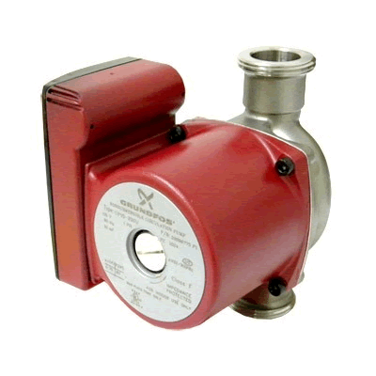

Power
Data
Data, Control
Power
CO₂
H₂O
Enriched
Seawater
Controller
FOCE Essentials
ESW
pH
CTD
CTD
pH
Flow
Chamber
Flow
DO₂
Flow
DO
External
Notes:
----- Meeting Notes (4/19/12 09:27) -----
pump hard to recognize
workstation graphic
remo
----- Meeting Notes (4/19/12 09:36) -----
expand DO2?

Slide 5
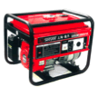

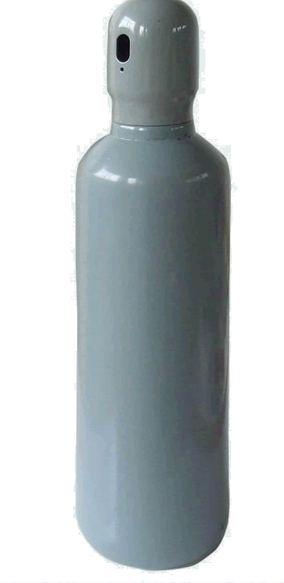


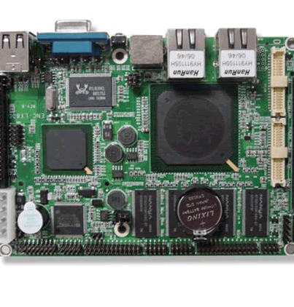



Computing Architectures
Elements
Instruments
Electronics
Housings
Cabling
Software
Computers
Many ways to arrange them
In a FOCE experiment
For each, many options
Notes:
----- Meeting Notes (4/19/12 09:36) -----
computer heads in periodic table

Slide 6
Computing Architectures
Shrinking the Universe of Trades
Look at decisions that have greatest impact on user concerns
  Build vs Buy
  Location matters: Shore vs Surface vs Seafloor
  Topology: how the pieces are connected

Slide 7

Build vs Buy
General Principles
Buy what you can’t/shouldn’t build
  Processors, instruments, cabling
  Software
Build (or borrow) as needed
  Chambers, housings
  Use COTS components if possible
  Get help on tough key builds
    contract, open source
Beware Frankensystem
  Patchwork integration of COTS parts
  Power consumption
  Rube Goldberg-ness of mechanical/electrical interfaces

Slide 8

Location Matters
General Principles
Connected vs Disconnected
  Generally easier to generate and store power, ESW on shore
  Telemetry bandwidth
Trades for off-shore elements
  Accessibility (to you, the elements, others)
  Reliability
Keep what’s offshore/sub-surface as simple and robust as possible
  Basics: Enriched seawater, power
  HW: Cables, connectors, housings
  SW: Applications, protocols, processes
Play to your application, tech strengths and budget
  Permits, environment
  Experiment duration, depth
  Data access requirements
  Maintenance schedule, spares
  Available design/fabrication resources

Slide 9
Power
Data
The software developer sees…
The user needs to consider
CO₂
H₂O
Controller
Enriched
Seawater
What’s inside?
Build or Buy?
Where to put the pieces?
How are pieces connected?
ESW
pH
CTD
CTD
pH
Flow
Chamber
Flow
DO₂
Flow
DO₂
External
Notes:
----- Meeting Notes (4/19/12 09:45) -----
not clear about thought bubbles

Slide 10
Some things must be on the seafloor
  Chamber, instruments
  Actuators (pumps, fans, etc.)
But location of everything else is flexible…
  Power, ESW
  Controller
  Data storage, user interfaces
And, there are many ways to implement all of it…

Slide 11
xFOCE helps to simplify the choices
  Experience, Designs, Community
Choices depend on experiment and constraints
  Budget, schedule
  Environment
  Technical resources
xFOCE community may draw from different approaches

Slide 12
A study of some approaches
  Centralized Workstation
  Industrial Computers
  Sensor Node
3 views to evaluate key features and trades
  Location: shore, surface, seafloor
  Build/buy: hardware, software
  Connections: topology and infrastructure

Slide 13
Next up: Centralized Workstation…
  Workstation computing
  Similar to dpFOCE implementation
  Mixed Common Off The Shelf (COTS) /custom hardware
  Shown here using cabled configuration

Slide 14
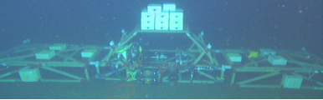
Component | Location | Why
Controller HW | Seafloor | Could run on shore Experiment continues if comms fails
Controller Software | Seafloor | ‘’
UI Software | Shore | Easier maintenance
Power | Seafloor | Need fine-grained power management at site
Data | Seafloor And Shore | Experiment continues if comms fails
Centralized Workstation
Data
Archive
Location View
Power
Source
Surface
Shore
Seafloor
Data
Controller
Power
Distribution
ESW
pH
CTD
CTD
pH
Flow
Chamber
Flow
DO₂
Flow
DO₂
External
Notes:
----- Meeting Notes (4/19/12 09:50) -----
purpose of flow

Slide 15
Centralized Workstation
Build/Buy
View
Component | Build/Buy | Implementation
Controller HW | Buy | PC104 Pentium Serial port cards (16 total)
Controller Software | Build Open Source | Linux, Java Custom: SIAM Data Acquisition software Open Source: DataTurbine, e.g.
Archive, UI | Build | PC Workstation MacOS, Windows, Linux, Java Custom: SSDS, FOCE GUI
Power | Build | Custom: load switching and monitoring chassis
ESW | Build | Custom: electronics, software, chassis COTS: pumps, controllers
SIAM: Software Infrastructure and Applications for MOOS
SSDS: Shore Side Data System

Slide 16
Centralized Workstation
Ethernet
Connection
View
Data
Power
Source
Surface
100 MBps
Ethernet
Shore
Fiber Optic
Power and Data Cable
Seafloor
Data
Controller
1 kW
Ethernet-Serial
Power
Distribution
Serial
ESW
pH
CTD
CTD
pH
Flow
Chamber
Flow
DO₂
Flow
DO₂
External

Slide 17
Summary
Centralized Workstation
Pros
  One software platform
  COTS computers
  COTS serial I/O solutions
Cons
  Extensibility in packaging and housings…have to put a lot of holes in housings
    Can use junction boxes
  Need lots of serial ports
    Custom serial IO Power consumption
  Less modular
  Custom HW/SW

Slide 18
Next up: Industrial Computers…
  Industrial automation computers (WAGO, Compact Rio, e.g.)
  Similar to CP-FOCE implementation
  Uses primarily COTS hardware and software
  Shown here using moored configuration

Slide 19
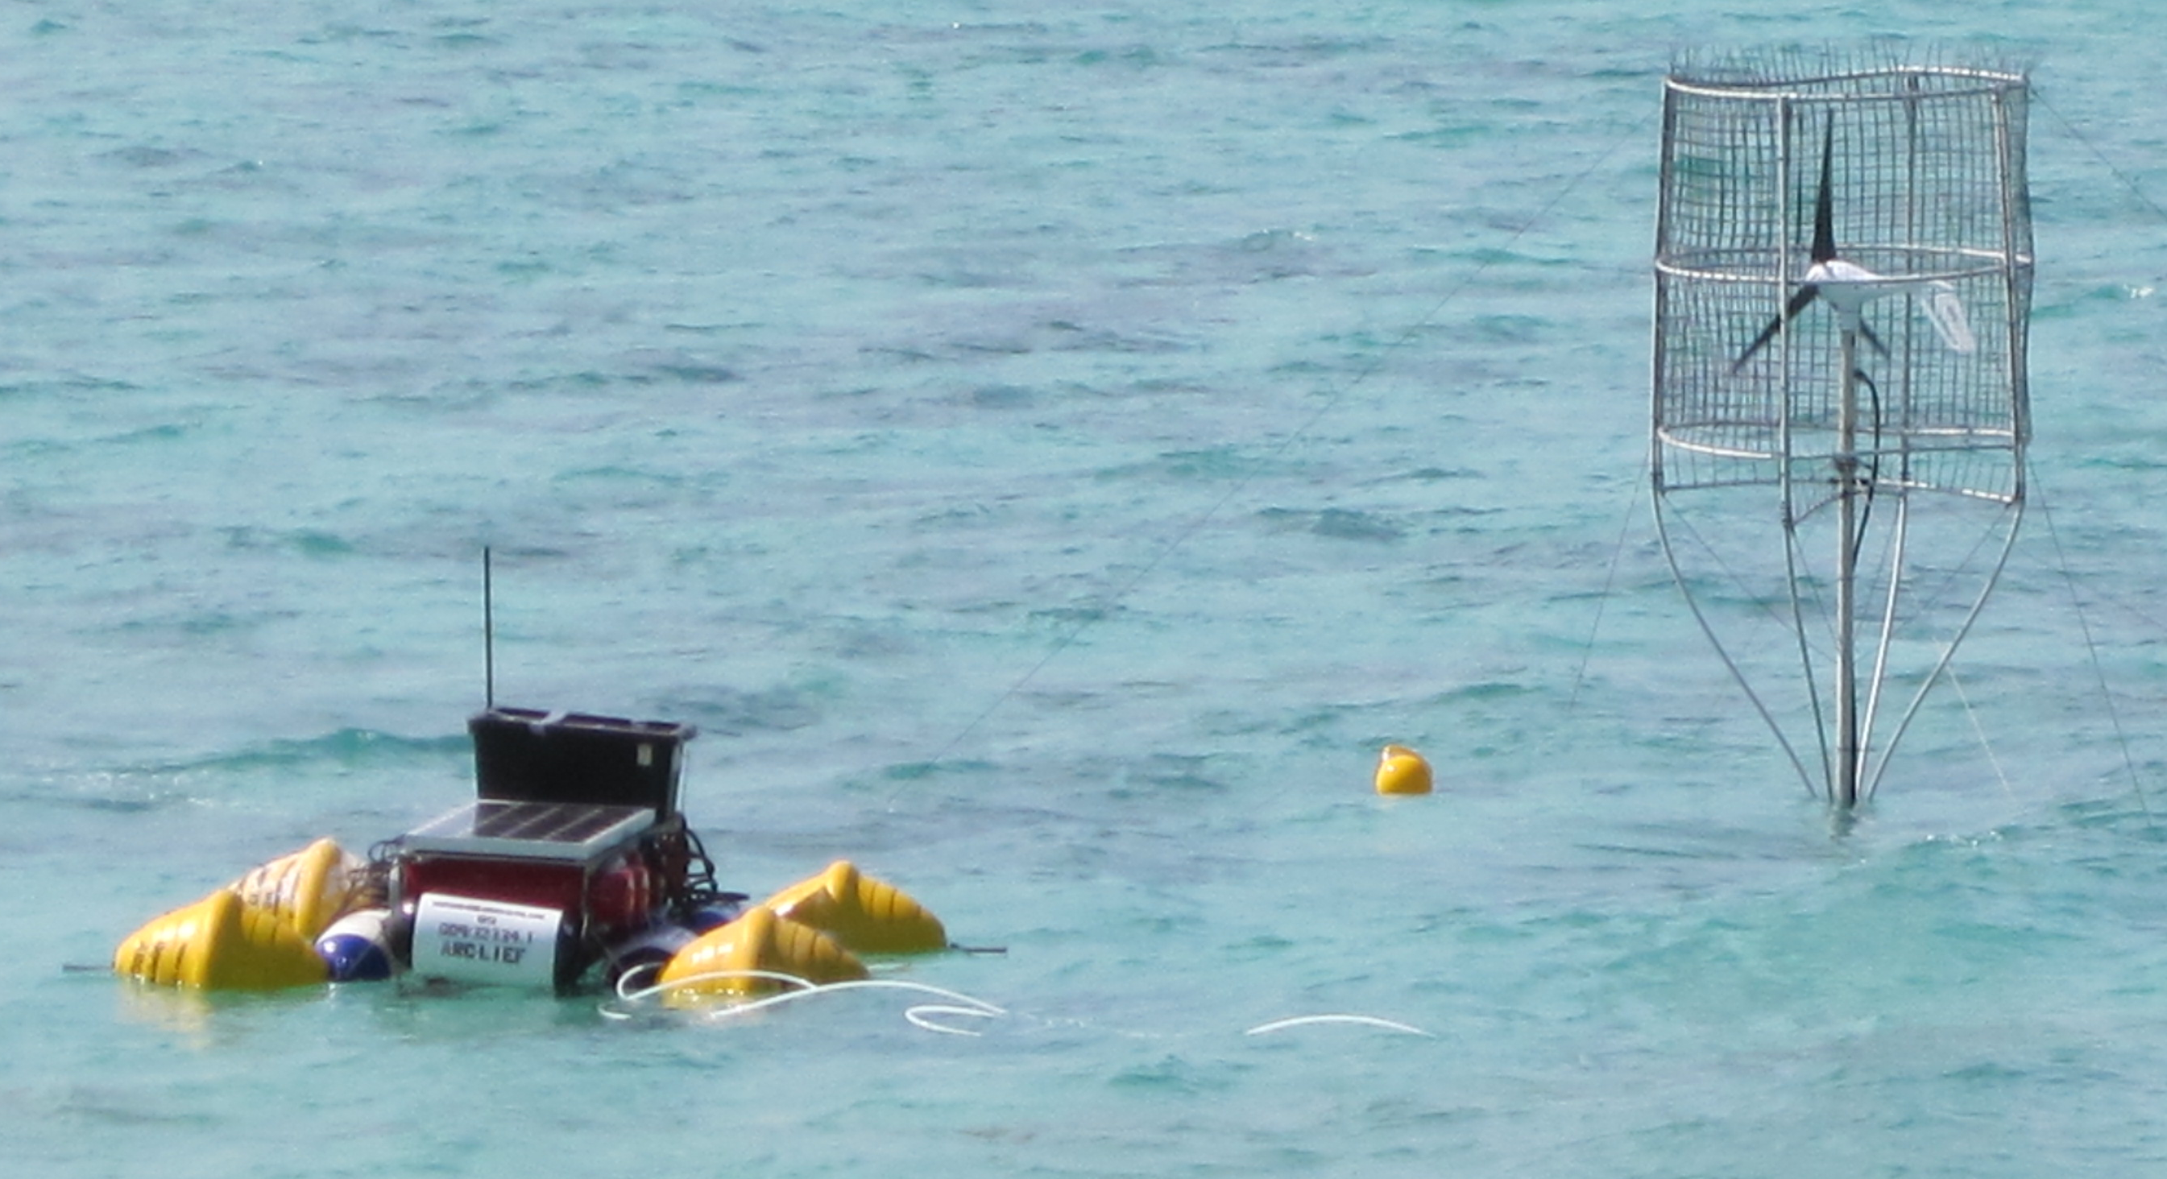
Component | Location | Why
Controller HW | Surface and/or Shore | Easier access Large housings
Controller Software | Surface And Shore | Co-located w/ HW
UI Software | Shore | Easier maintenance
Power | Surface or Shore | Easier access
Data | Surface and/or Shore | Co-located w/ control
ESW | Shore Or Surface | Permitting, depth, distance from shore
Industrial Computers
Location View
Data
Data
Power
Controller
Controller
Wireless
Controller
UI
Controller
Surface
Shore
Seafloor
Junction
ESW
pH
CTD
CTD
pH
Flow
Chamber
Flow
DO₂
Flow
DO₂
External

Slide 20
Industrial Computers
Component | Build/Buy | Implementation
Controller HW | Buy | COTS: WAGO, National Instruments Compact-Rio (NI-CRIO), Serial MUX, Video MUX
Controller Software | Buy | COTS: LabView (custom drivers) Open Source: DataTurbine
Archive, UI | Buy | PC Workstation MacOS, Windows, Linux Open Source: DataTurbine, RDV, Pachube... COTS: LabView (custom archive), MATLAB
Power | Build/Buy | COTS: WAGO, NI-CRIO Custom: Ground fault detection, isolation
ESW | Build/Buy | Custom: pump and valve drivers COTS: WAGO, NI-CRIO, LabView, pumps, motor controllers
Build/Buy
View
COTS: Common Off The Shelf
OSDT: Open Source Data Turbine
RDV: Real-time Data Viewer OSDT client
WAGO, CRIO: Industrial computer implementations
MUX: multiplexer

Slide 21
Industrial Computers
ConnectionView
Data
Data
Power
Controller
Controller
UI
Controller
Controller
Surface
RF Wireless
WiFi
Cell
Satellite
Shore
Seafloor
Serial
Ethernet
Serial
Ethernet
Junction
ESW
pH
CTD
CTD
pH
Flow
Chamber
Flow
DO₂
Flow
DO₂
External

Slide 22
Summary
Industrial Computers
Pros
  Mostly COTS components
  Vendor and user community support
  Easier to build
  COTS software provides much infrastructure
Cons
  High cost of software and hardware
  High power consumption
  Large electronics form factors require larger housings

Slide 23
Next up: Sensor Node…
  Small COTS embedded PCs and microprocessors
  Modularize and aggregate power switching and/or data acquisition
  Similar to eFOCE implementation
  Reduce power consumption
  Shown here using moored configuration

Slide 24
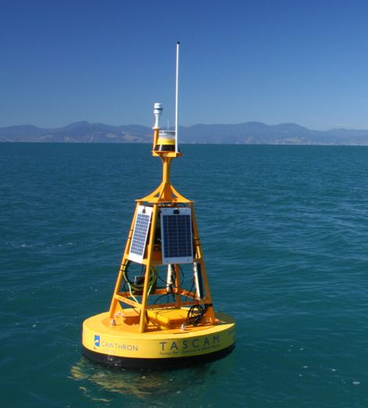
Component | Location | Why
Controller HW | Surface/Seafloor | Surface: telemetry, UI Seafloor: experiment control
Controller Software | Seafloor | Gateway: control, telemetry Node: data acquisition
UI Software | Shore/Surface | Easier maintenance
Power | Surface | Probably use generator, solar, wind on surface
Data | Seafloor And Shore | Local data needed for control Central archive for redundancy, easier access
Sensor Node
Data
Location View
Power
Data
Controller/
Gateway
Wireless
Surface
Shore
Seafloor
Controller
/Gateway
Data
Experiment Control for 1 chamber
Load switching,
Data Acquisition for
1-4 Devices
Node
Node
Node
Node
ESW
pH
CTD
CTD
pH
Flow
Chamber
Flow
DO₂
Flow
DO₂
External
Notes:
----- Meeting Notes (4/19/12 09:50) -----
purpose of flow

Slide 25
Sensor Node
Build/Buy View
Component | Build/Buy | Implementation
Controller HW | Buy | Gateway: BeagleBoard, Android, Gumstix Node: Arduino, MSP430, SmartSensor
Controller Software | Build | Gateway: Linux, Java, C++/Java Node: C/C++, Wiring, e.g. Instrument drivers
Archive, UI | Build/Buy | Custom: back end interface Open Source: web server on gateway
Power | Build | Custom: load switch, ground fault detection, isolation
ESW | Build/Buy | Custom: pump and valve drivers COTS: pumps, motor controllers
Notes:
----- Meeting Notes (4/19/12 09:50) -----
purpose of flow

Slide 26
Sensor Node
Data
Connection
View
Power
Data
Controller
Gateway
RF Wireless
Cell
Satellite
WiFi
Ethernet
(Serial?)
Surface
Shore
Seafloor
Controller
Gateway
Data
Serial
Node
Node
Node
Node
Serial
ESW
pH
CTD
CTD
pH
Flow
Chamber
Flow
DO₂
Flow
DO₂
External
Notes:
----- Meeting Notes (4/19/12 09:50) -----
purpose of flow

Slide 27
Summary
Sensor Node
Pros
  Reduce power
  No custom serial IO expansion
  Modularizes data acquisition
  Many variations possible
    COTS processors, languages
    Topologies
    Connection backbone (cost: power)
    Component upgrades
    Drivers on Gateway
Cons
  Two software development platforms
  More custom hardware to build, configure, maintain
  More cables, connectors, housings
  Video expansion path unclear
  Multiple system clocks
Notes:
The Bottom Line
It’s a good design pattern, with balance of build/buy
flexible, extensible, moderate cost
Variants trade complexity, power, modularity

Slide 28
Approach Tradeoffs
Approach | Performance | Flexibility | Ease |  |  | Cost
 |  |  | Build | Use | Extend
Centralized Workstation |  | ■ |  | ■ | ■ | 
Industrial Computer | ■ | ■ | ■ |  | ■ | 
Sensor Node | ■ |  | ■ | ■ | ■ | ■
Con

Pro

Slide 29
Questions?

Slide 30
UI
Help users to understand and simplify key choices
What UI choices will the user make related to UI
  Network, interfaces, security
How do those choices affect concerns (performance, flexibility, ease, cost)
What are pros/cons of various choices
  Cost, power, bandwidth, software skill, processing capability, software/system dependencies
Modularity
  Interfaces that support flexibility in UI choices
  Expansion path: what’s needed up front to start simply and build capability
Sketch out a couple of concepts at either end of the spectrum
Specific choice/detail more important for SWFOCE

