Slide 1
xFOCE / swFOCE
Review

Slide 2
xFOCE
Bill
Quick Background – talk about the current activities
eFOCE, cpFOCE, dpFOCE and how these led to the xFOCE

Slide 3
xFOCE Science Reqs
Bill / Ed
Required
Preferred
Optional

Slide 4
xFOCE Functional Requirements
Performance
number of experimental units | required | 3 control units (w/ CO2) 3 experimental units (w/o CO2) 400L CO2/year (MBARI permit) CO2 generator and deliver systems must be appropriately scalable to meet experimental requirements
maintain a pH offset relative to a reference value | required | min: -0.2 typ: -0.4 to -0.8 max: -1.5 pH range: resolution: 0.05 pH units, 0.1 unit may be OK higher resolution (0.003-0.01) required for chemistry experiments Vint:₌ 5 cm/sec
maintain a specified constant pH value | required | 7.0 < pH < 8.2 independent of ambient pH internal <= 5 cm/sec
maintain a specified Vint | required | 2-5 cm/sec resolution?

Slide 5
xFOCE Functional Requirements
Environmental
Max depth | required | 40m (130 ft) Note diver-servicable requirement Not suitable for active surf, river mouth
Water temperature range | required | -2 to 30 degrees C
Bio-fouling protection/prevention | required | Hard to spec, Can document recommendations Environmental requirements trades (e.g. toxicity) Ties to reliability and maintenance (is a maintenance schedule issue) e.g. passive, Cu…
Min external V_{H20} | required | 0 cm/sec
Max external V_{H20} | required | 50 cm/sec
Min internal V_{H20} | required | 2 cm/sec
Max internal V_{H20} | required | 0 cm/sec 50 cm/sec 2 cm/sec
Min/max surge | required | Must maintain pH in some surge conditions. Surge is mostly moving water back and forth in chamber – should not affect control (?)
surge replication | preferred | To the extent possible, the system should replicate natural surge as needed. The mechanism for this may not be needed for all experiments, but is critical in some (e.g. for filter feeders); this should be a modular feature
Light transmission | required | chamber should enable maximum natural light to be transmitted into the chamber for greatest replication of ambient conditions
Water flow | required | chamber should enable maximum natural water flow to be transmitted into the chamber for greatest replication of ambient conditions

Slide 6
xFOCE Functional Requirements
Core Instrument Suite
pH | required | 1xn experiment, 1 control, 1 environment
CTD | required | T required for pH measurement 1xn experiment, 1 control, 1 environment
DO₂ | required | not required for pH control required for biology experiment not required for deep/chemistry experiment 1xn experiment, 1 control, 1 environment
PAR | preferred | 1xn experiment, 1 control, 1 environment
H₂O flow (velocity) | required | 1xn experiment, 1 control, 1 environment Nice to have as sci context data, required for control Range, precision, rate?
H₂O flow (volume) | required | Either volume or velocity Not both

Slide 7
xFOCE Functional Requirements
Core Instrument Suite
Camera (time lapse video) | required | xFOCE must support camera expansion Required for swFOCE How will video be used? Frame rate 1/min max 1/30-60min to 1/day typ previously estimated at 10 frames/min) Resolution: publication quality (e.g. HD, Coolpix…5-12 MP) Supplement to measurement data
Camera (video) | unspecified | TBD
Light panel | required | Required for camera Output, angle, power…
Flow effector(s) | required | Quantity: 1 min, app-specific, number and type may change Spec Depends: VH20 range pH offset range
ESW effector(s) | required | Quantity 1 min; depends number of thrusters, use of valves Spec Depends: pH offset range deployment duration
ESW valve(s) | required | Depends on injection design
ESW pH | preferred | Useful when at end of ESW supply to modify feed algorithm
ESW CTD | optional | Should, but not core Number, type?

Slide 8
xFOCE Functional Requirements
Operation & Maintenance
accessibility | required | easy diver access to chamber
accessibility | required | sensors positioned to enable access to experiment
accessibility | preferred | it must be possible to reposition cameras for maintenance and observation
Small-boat deployable | required | Zodiac/whaler
Diver serviceable | required | Installation, cleaning, instrument replacement, recovery
In-situ replaceable instruments | preferred | Must for pH (cal) Others should? Maintenance schedule
sealable chamber | required | Remotely operated is requirement?
In-situ pH calibration | optional | Depends on cost trade Nice to have
Deployment/experiment duration | required | Design for 6 month deployment | Objective is to run realistic long- term, in-situ community /multi species experiments months to years variety of environments (lakes, estuaries, oceans) Something that could work from a Lobo-class mooring would be great. LTER sites (yrs-decade records) would benefit from FOCE. Typical experiments would run < 6 months' a couple car batteries for a few weeks at a time would be OK
Operate continuously | required | Runs overnight w/o monitoring min
Operate autonomously | preferred | Set it up and run it, but person in loop to correct anomalies …requirements for event detection and/or data visualization
Maintenance schedule | unspecified | Will depend on application, ranging from every day or two (e.g. at start of shallow experiment) to every few days, with periodic system checks. | Checks may be infrequent, need to be able to tell whether system is working (need more information on appropriate granularity of diagnostics and repair - red/green light, console with report(s) and utils, etc. ) What faults is the user capable of addressing? What components should be field-replaceable?

Slide 9
xFOCE Functional Requirements
Data Management
Data logging (remote side) | required | Requirement is that all data must be recorded (independent of telemetry function) and available at end of experiment. Full-resolution science and system data (for forensic reconstruction of events/anomalies) Must be independent of telemetry
Adjustable device sample rates | preferred | Must be able to set sample rates to provide best resolution for diagnostics, and lower sample rates for logging and performance. See data logging rates below
Data logging rates (core instruments) | required | TBD… CTD, pH, velocity/flow Rates up to 2 Hz (10 Hz?) Must support system and science data stream rates Depends on environmental conditions, velocity sampling strategies
Data archive (shore side) | unspecified | Split opinions – must vs should Single point of failure/enabler Vs Not strictly required to do FOCE Part of system to get data to shore Maybe not automatic Maybe very low tech (scp) Cost vs value
Data log format | optional | Timestamped data Any format OK as long as complete, robust. If not human readable, need tools to access records. Segmented logs? Must be able to request specific records using specified time range(s) or number of records | Simple timestamped comma delimited flat files are OK Need mechanism to decimate/filter data (too much data is hard to work with)
Data log capacity | required | Must record all science and system data for 6 month deployment. Depends: data rates, number of streams, sample rates, data log format

Slide 10
xFOCE Functional Requirements
Data Management
Near real-time telemetry | required | Full data resolution if possible, but all data must be recorded even w/o telemetry link. Must provide data required to assess health and status of experiment. Rate: best effort to reflect full-resolution logged data.
Telemetry data summarization | preferred | Data telemetry must support system health and status reporting. Should make best effort to reflect full-resolution logged telemetry, but this is not required. Alarm is summary Some form probably needed
Near real-time data visualization | preferred | Must be able to see from shore whether the system is working. What does it mean to be working? How do we tell? What streams? How often updated? Should, but not must? What is cost?
Event detection and notification | preferred | Should do if telemetry Data telemetry must support system health and status reporting. Other event detection and reporting would be great, but not required. What events? Sci or Sys-only?

Slide 11
xFOCE Functional Requirements
Data Management
Timestamp data | required | Need to correlate data streams in memory Accuracy? Resolution?
Time distribution | unspecified | Timestamp data Time distribution Timing determinism
Timing determinism | required | ~0.5 max sample rate – Nyquist freq.
Metadata Management | unspecified | The instrument data stream shall (automatically) include metadata describing the identity and state of the instrument and its driver. New metadata shall be (automatically) added to the stream when the state of the instrument or driver changes in a way that affects data interpretation. User shall be able to associate any instrument data record with the instrument and driver metadata in effect at the time the data was acquired. | klh not sure this a strict requirement - it is possible to control pH in the box w/o doing this. I see the value, but the users need to weigh in, and we need to understand how it drives other requirements (e.g. choice of processor, language, etc.). The costs of meeting this proposed requirement need to be determined; alternative implemtations need to be proposed and traded.

Slide 12
swFOCE Science Reqs
Bill / Ed
Shall be Built on xFOCE

Slide 13
xFOCE Concept of Ops cable
Science interface on shore
CO2 and Enriching process on shore
Air / sea interface managed using buried cable
Capable of supporting 6 to 8 xFOCE units
(4 active pH chg and 4 control)
Depth rating
min - XX
max - XX
Anchored to bottom
Uses ??? to prevent erosion

Slide 14
xFOCE Concept of Ops no cable
Science interface on shore
CO2 and Enriching process off shore
Air / sea interface managed using surface expression (buoy ?)
Capable of supporting 6 xFOCE units (?? Maybe less)
(3 active pH chg and 3 control)
Comms by telemetry
Depth rating
min - XX
max - XX
Anchored to bottom
Uses ??? to prevent erosion

Slide 15

xFOCE Concept of Ops

Slide 16
xFOCE Tech Specifications
Several pages maybe???
Divide shalls from nice to have
These are specific and measureable… testable

Slide 17
swFOCE Tech Specifications
Starting with xFOCE… does not conflict
Divide shalls from nice to have
These are specific and measureable… testable
Tie directly to science requirement(s)

Slide 18
xFOCE Systems concept
Divide sub-systems out, major blocks and define what will traded.
Define system / sub-system interfaces
Assign each trade to a

Slide 19
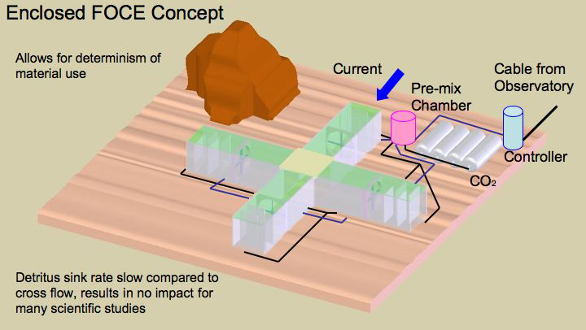
xFOCE Systems concept

Slide 20
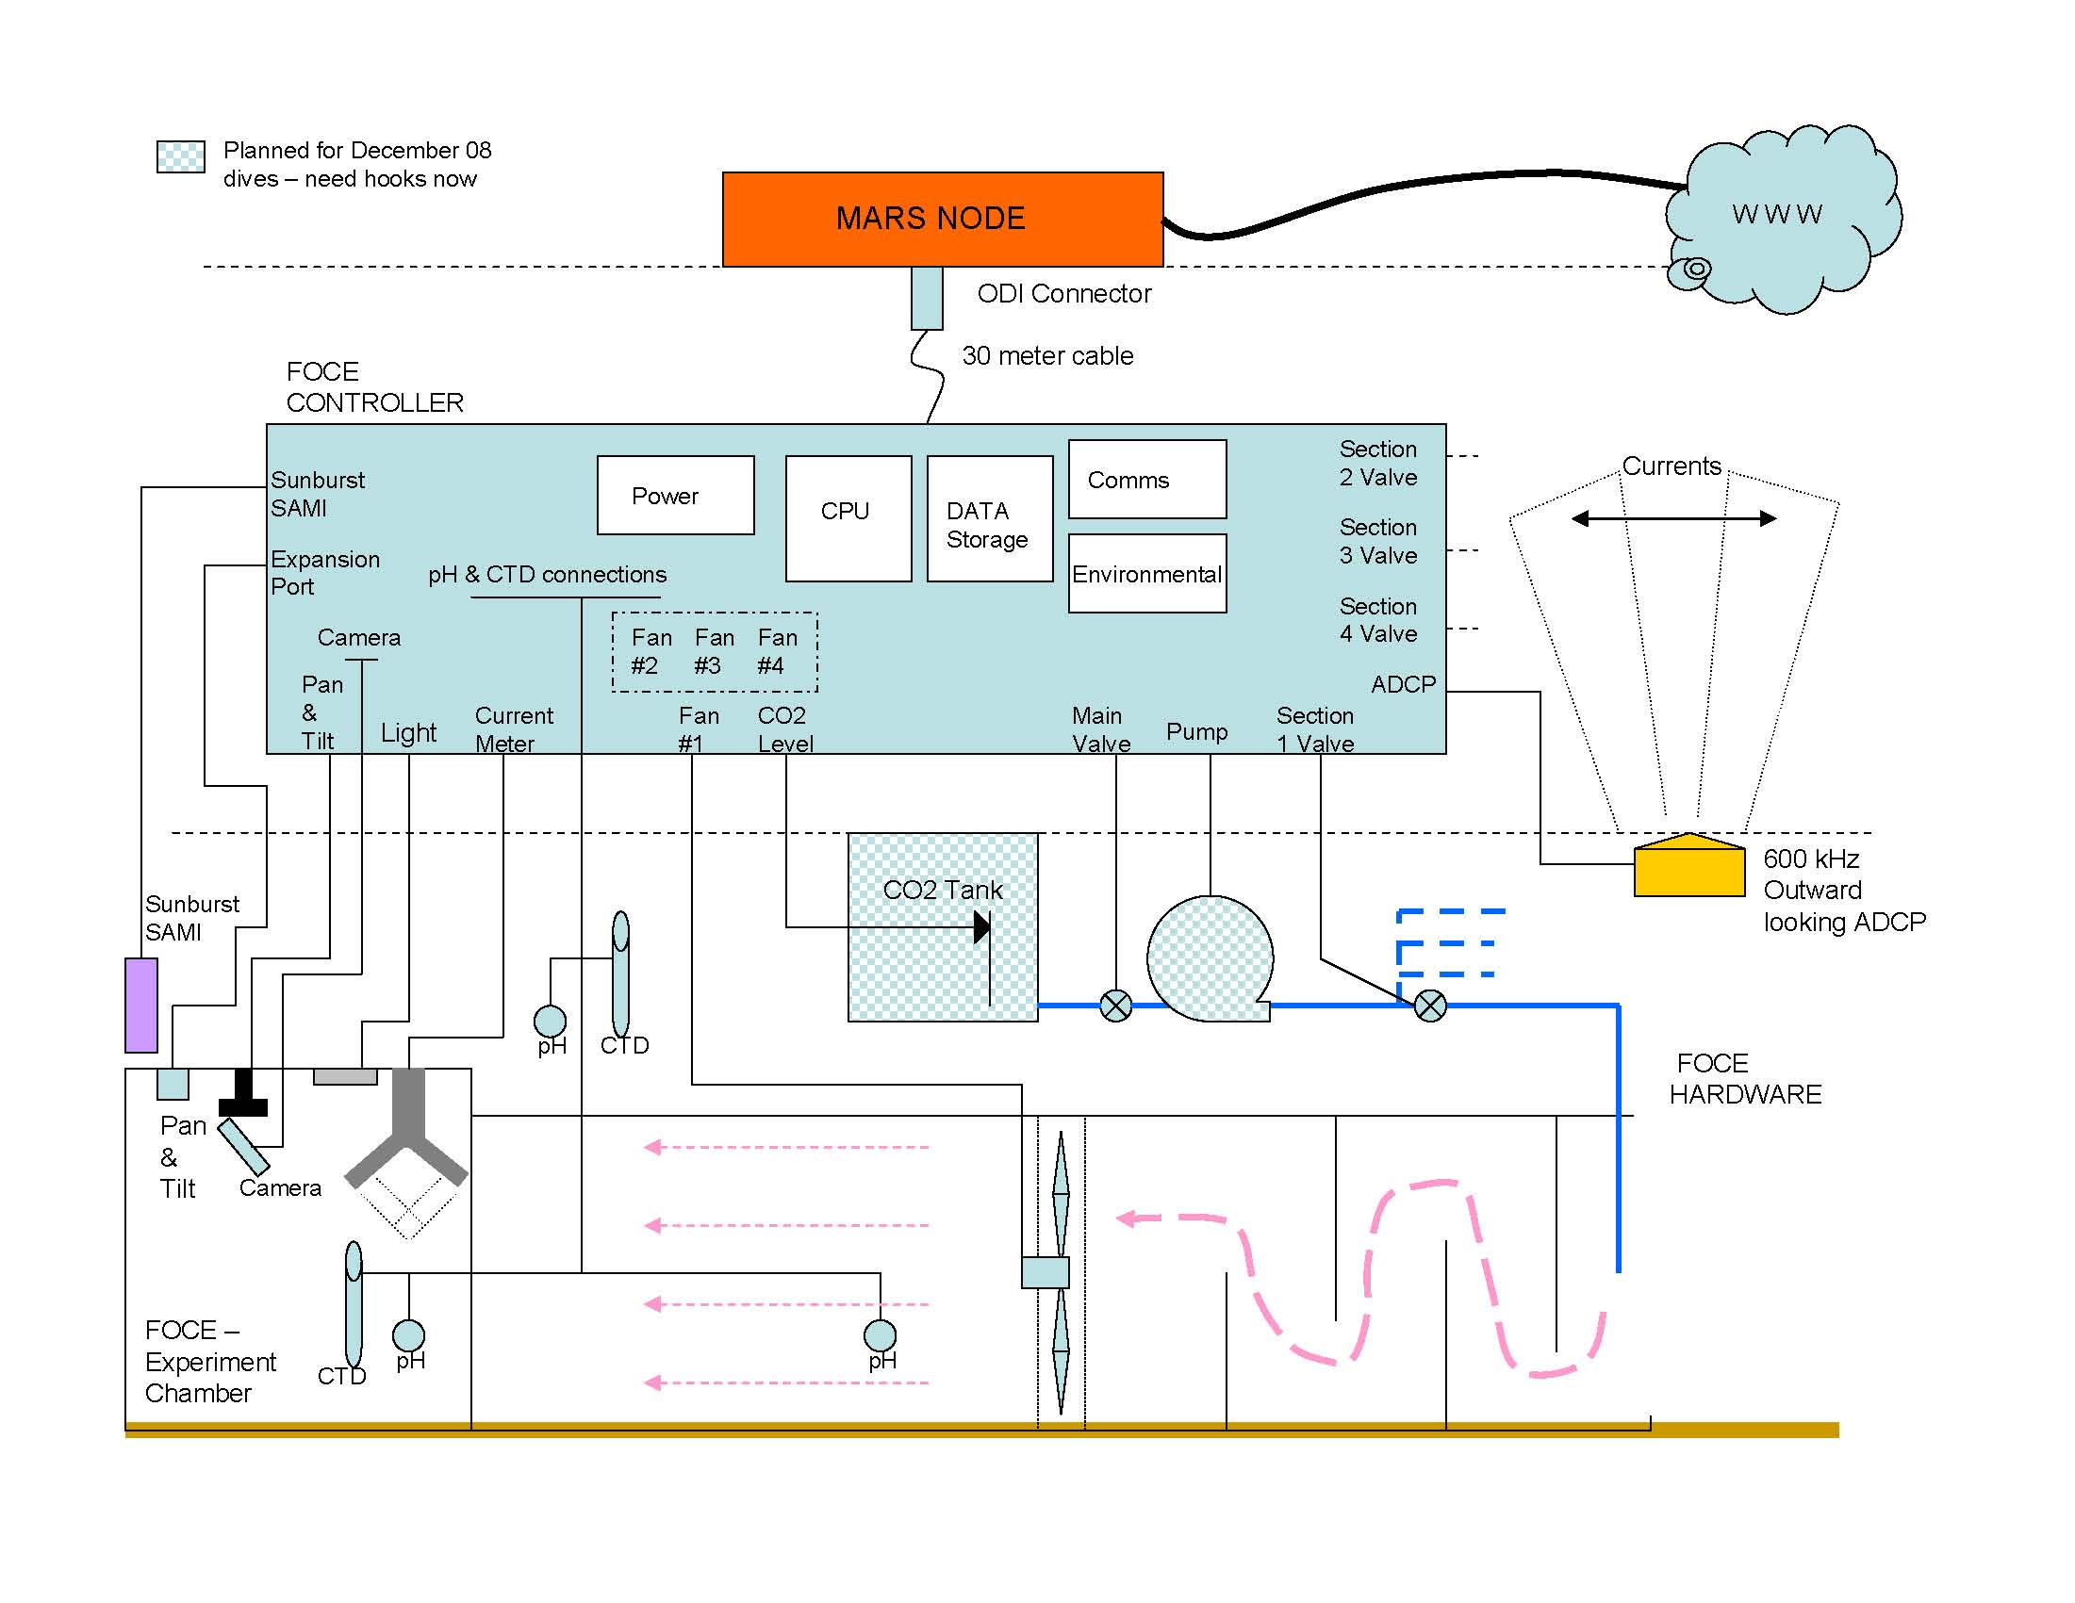
xFOCE Systems concept
What is the minimum requirement of elements for xFOCE?

Slide 21

xFOCE Subsystems and Interfaces
ESW
Data
Power
Communications/Telemetry
(optional)
CO2
ESW
Data Archive
Generation
Physical
Local
SW
ESW Distributor
Data Acquisition
Storage
Protocols
Remote
(optional)
Data
Distribution
Distribution/Protection
Observation Expansion (optional)
Chamber
System Management
User Interface
ESW effector(s)
Instruments
Console
Configuration & Control
Camera(s)
Flow effector(s)
Control
System
GUI
Sensors(s)
Monitoring/
Health/Status

Slide 22
Trade Elements
Mechanical
Chamber size, shape, materials, anchor, mounts
ESW generation, storage, distributor, effectors
Flow effectors

Slide 23
Trade Elements
Software
UI console, GUI, data access SW
Data acquisition, distribution SW
  HW requirements: IO, memory
  Language(s), tools, OS/none, 3rd Party
Communications protocols SW
Control system software

Slide 24
Trade Elements
Electrical
Power generation, storage, distribution
Load/Bus switching, GF detection, isolation, monitoring
Environmental monitoring HW
Data acquisition, archive HW
Communications backbone HW

Slide 25
swFOCE Systems concept
Divide sub-systems out, major blocks and define what will traded starting with xFOCE base.
Define system / sub-system interfaces
Assign each trade to a

Slide 26
swFOCE Systems concept

Slide 27
swFOCE Systems concept
What is required to make an swFOCE?

Slide 28
Mechanical
Basic xFOCE Structure
swFOCE if anything is modified
Anchoring (environmental data)
Flow control
Light management
Bio-fouling

Slide 29
Electrical
Power
Budgets
Management
Communications
Ground Fault ??
Control Circuits

Slide 30
Software
Basic Architectural Structure
xFOCE (minimum needs)
swFOCE (extensible elements as needed)
Open Source
Controller / algorithm development
Science/User interfaces
most basic
options
Realtime vs. ??

Slide 31
Data
Collection
Storage
Processing (??)
Quality
How does design handle modularity of xFOCE

