Slide 2
Response to Concept #1865
(sensor node)
Principles of #1865 concept are sound
  Provide a pattern that is easy for people to duplicate or adapt
  Simplest possible code, hardware; clean system interfaces
  Use COTS hardware
  Save power where possible
Agree that software stack should be kept lean, but think that trades don’t favor embedding instrument drivers
I think it can be even simpler:
  Simplify the hardware: run drivers on one gateway
    One type of development hardware
    Less hardware to configure, maintain
    Fewer parts, simpler system
    Reduce number of housings, connectors
  Simplify the software stack (even more)
    Minimize (eliminate) embedded development (especially for users)
    One software development platform
    Use good SW architecture to design minimal software components
    Emphasize well-designed software interfaces
    C++, maybe Java, but not SIAM
    OSDT? A lot of leverage, but some issues
      performance on small platforms,
      Requires Java

Slide 3
Sensor Node vs Drivers on Gateway
 | Sensor Node | Drivers on Gateway
Power Consumption | Smaller processors do most of the work, larger processor mostly sleeps 3 small processors ≅ 1 larger processor (when running), and still uses the larger processor sometimes – net power savings not clear Could use serial-only interface to gateway Eth-serial converters would simplify software updates and data transfer, but would consume more power | One larger processor about the same as 3-4 small processors – net power use not clear. Could use serial-only interface to instruments Eth-serial converters would eliminate need for custom serial IO expansion, but consume more power
Manufacturing | More hardware to build and test More housings, cables, penetrations More complicated spares inventory | Less to build and test Fewer housings, cables, penetrations Fewer spares to manage Lower system parts count (and cost?)
Custom Hardware | Easy to find COTS HW w/ 4 serial ports (may still want to user Eth-serial converters) 2 custom load switching/iso solutions (SN,GW) | Requires custom serial IO expansion (or Ethernet-serial converters) 1 custom load switching/iso solution (GW)

Slide 4
Sensor Node vs Drivers on Gateway
 | Sensor Node | Drivers on Gateway
Custom Software | Instrument drivers Gateway Node power switching drivers Logging, UI Control system Data exchange protocol SensorNode power switching drivers Bootloader and update manager | Instrument drivers Gateway Node power switching drivers Logging, UI Control system Data exchange protocol Uses FTP, wget, etc. for driver updates
Maintenance | Once drivers are stable, the SensorNode doesn’t need to change Two different code platforms to maintain Software skills span embedded, application and sys admin More hardware to configure More difficult to troubleshoot across distributed platforms Debugging one instrument affects others on shared sensor node Multi-step delivery for software updates | One platform for development, maintenance and debugging Software skills lean to application and sys admin Simpler mechanism for updating drivers OS provides high quality tools for development and troubleshooting Broader community for software and OS support

Slide 5
Sensor Node vs Drivers on Gateway
 | Sensor Node | Drivers on Gateway
Extensibility | Some platforms (Arduino) are very easy to work with More complicated system pattern to follow when making substitutions or extensions 2 HW platforms, 2 software development tool chains Less headroom (RAM, codespace, etc.) | Simpler system pattern to follow when making substitutions or extensions 1 HW platform, 1 tool chain
Reliability | SensorNode drivers are lean, simple, reliable More physical points of failure | Gateway drivers are lean, simple, reliable Fewer physical points of failure

Slide 6
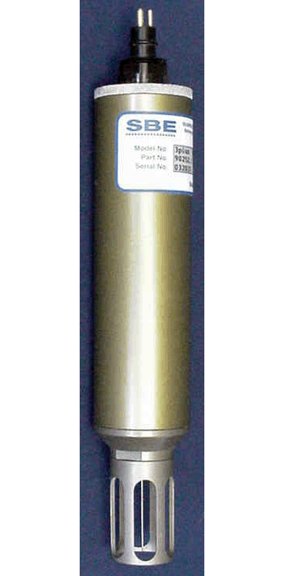
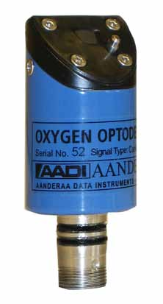
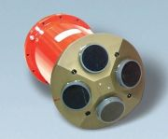
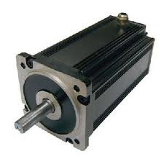
power
Gateway Node (GW)
Power
Switch
rs232
ethernet
SensorNode
(SN)
SN
SN
Sensor Node
System Concept
Components shown are for
One FOCE chamber
~8 basic instruments
M
M

Slide 7
GW
Power
Switch
power
rs232
Config
Data
Archive
Power Ctrl
ethernet
Switching
Isolation
Env Mon
Data
Distribution
Experiment
Control
SN_0
SN_1
SN_2
Data
Acq
Sensor Node Functions
Sensor Nodes collect data
Gateway sleeps, gets data, controls
actuators
M
M

Slide 8
power
rs232
GW
Power
Switch
HTTP
Config
ethernet
Other IO
SN_0.HEX
SN Load
Data
Ctrl
Power Ctrl
SN_1.HEX
GF
SN_2.HEX
SD
Iso
Bootloaders:
TFTP
USB
RS232
Boot
Loader
SN_3.HEX
ESW Ctrl
Flow
Ctrl
Mon
ETH
SN_1
SN_2
SN_0
Software Updates
Sensor Nodes can change software
using custom boot loader
TFTP requires ethernet (more power)
Serial options are more complicated
ILoad
GF
ISO

Slide 9
8
3
2
power
Switch
rs232
ethernet
GW
Power
Switch
other IO
43
8
2
8
2
8
2
SN_0
SN_1
SN_2
30
Housings and Connections
2 UARTS in gateway
4 UARTS per sensor node
6 housings
173 connections
DGS-2205 5-Port Switch: 5W
Digi TS-4: 6W
M
5
M
12
8
12
8
12
8

Slide 10
8
40
25
Switch
3
2
32
power
rs232
ethernet
8
GW
Power
Switch
other IO
8
2
2
8
2
2
8
2
Housings and Connections
Separate housing
for Ethernet switch
2 UARTS in gateway
4 UARTS per sensor node
DGS-2205 5-Port Switch: 5W
Digi TS-4: 6W
7 Housings
195 connections
SN_0
SN_1
SN_2
30
M
5
M
12
8
12
8
12
8

Slide 11
What if the drivers run on the Gateway node?
  Less hardware, housings, connections
    Easier to build
    More reliable
  Simpler software
    One platform
    Easier deployment and configuration management

Slide 12
3
2
2
2
2
51
28
GW
8
Config
Data
Archive
Power
Switch
Data
Distribution
Experiment
Control
power
Power Ctrl
Switching
GF
Isolation
Env Mon
rs232
Drivers
ethernet
Drivers
Drivers
Drivers
36
24
5
M
Drivers on Gateway
Direct serial
Less hardware
Lower power
4 housings
89 connections
12 UARTS on gateway
(custom serial IO expansion?)
M

Slide 13
3
2
2
2
2
46
25
GW
Config
Data
Archive
Power
Switch
8
Data
Distribution
Experiment
Control
power
Power Ctrl
Switching
GF
Isolation
Env Mon
rs232
Drivers
ethernet
Drivers
Drivers
Drivers
6
30
8
2
Eth/Ser 4
Eth/Ser 4
Eth/Ser 4
Housings and Connectors
Drivers on gateway
Ethernet-serial
Less hardware
2 UARTS in gateway
7 housings (or bigger housing)
201 connections
DGS-2205 5-Port Switch: 5W
Digi TS-4 : 6W
20
5
M
M

Slide 14
End

Slide 15
Why should the drivers run on a separate processor, in a bottle?
  To reduce power?
    Arduino Nano 55 mA @ 7 V (0.38 W)
      (1 USB serial, 1 SPI serial)
      GPS + tilt meter driver
    Beagle Bone 0.3-2.3 W

