Slide 1
xFOCE / swFOCE
Review

Slide 2
FOCE and OA Research

Slide 3


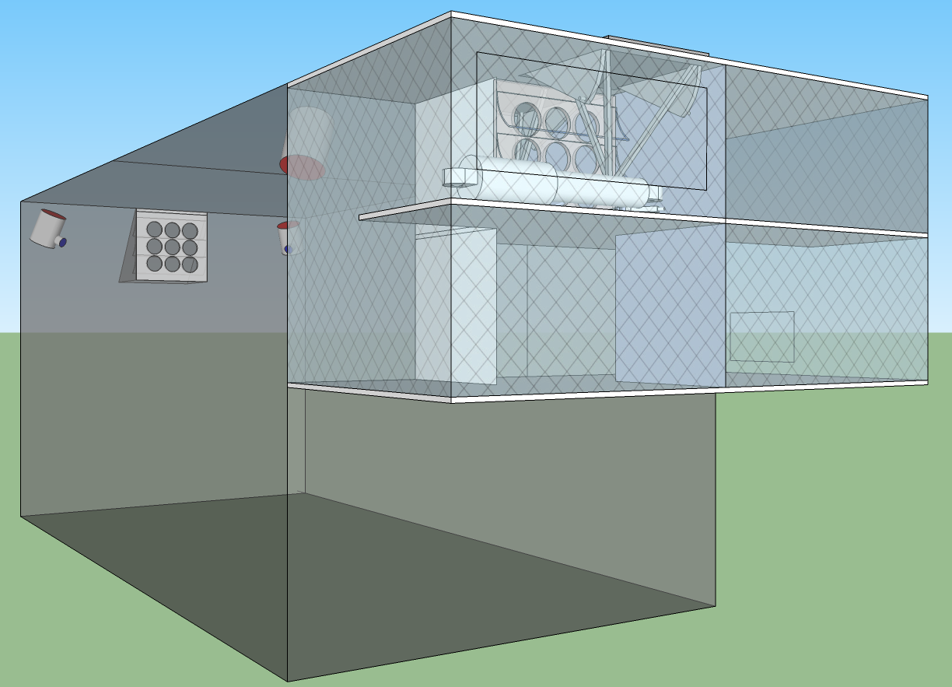





xFOCE
Deep FOCE (dpFOCE) is the original FOCE built for multi-science users on a cabled observatory.
Coral Prototype FOCE (cpFOCE) is the first tech transfer of FOCE built for multi-science users on the Great Barrier Reef. Solar and wind powered except for the creation of the enriched CO₂ water.
European FOCE (eFOCE) is currently under construction and scheduled for deployment in May 2012. This system uses a cable but the CO2 is delivered in bottles to a surface expression.
Antarctic FOCE (antFOCE) proposal submitted and partially funded. Proposal for other 50% of funding underway.

Slide 4



Why xFOCE?
The problem is some folks are reading our papers and starting out on their own. That is fine but they are calling systems FOCE that are 1) not actually doing the functions of FOCE but more over 2) the chemistry is incorrect and publications using the FOCE acronym pull other work into question.
MBARI was contacted and we gave feedback about how to use the existing hardware and reconfigure it to become a functional FOCE.
The scientist did some of it but still didn’t grasp what FOCE is an how to properly set up a system to get meaningful science results.
For the good of the OA research community and MBARI’s reputation we needed to create a way of preventing these errors!

Slide 5
xFOCE
xFOCE shall support 6 test chambers (3 active and 3 control)
xFOCE shall maintain a desired pH offset from ambient within +/- .2 pH
xFOCE shall be capable of pH offsets of between .2 and .8 pH units
xFOCE shall hold a selected pH offset for a minimum of 2 weeks
xFOCE shall be capable of deployments greater than 6 months in duration
xFOCE shall be fully functional in external currents of 50 cm/sec
xFOCE shall mimic surge to the extent possible based on chamber scale
xFOCE shall maximize the allowance of full spectrum natural light
xFOCE shall include pH, CTD, O2, flow rate or calculated flow using velocity with data reported at currently accepted standards for science publication

Slide 6
xFOCE
xFOCE shall provide internal environmental data for all instruments on the required list from each active chamber
xFOCE shall provide internal environmental data for
xFOCE shall be diver maintainable
xFOCE shall not use materials that are toxic to the marine environment
xFOCE shall not be dangerous to maintenance divers
xFOCE shall minimized impacts on local marine life
xFOCE shall be capable of being fully recovered and leave no components behind
xFOCE shall be capable of being built, installed and maintained by a typical university oceanographic research lab with a minimum of 1 scientist and 2 graduate students

Slide 7
xFOCE
xFOCE shall maximize use of commercially “off-the-shelf” or readily available technology to the fullest extent possible
xFOCE shall be capable of working in waters anyplace in the ocean or other alkaline waters where the water velocity does not exceed 75 cm/sec.

Slide 8
xFOCE
xFOCE may support more than 6 total chambers
xFOCE may control pH to tighter than +/- .2 pH units
xFOCE may operate continuously
xFOCE may include photosynthetic active radiation (PAR) sensing
xFOCE may allow alternative maintenance
xFOCE may allow use of any ship of opportunity
xFOCE may modify flow rates internally to maximize CO2 use
xFOCE may operate in waters in any water velocities up to 150 cm/sec

Slide 9
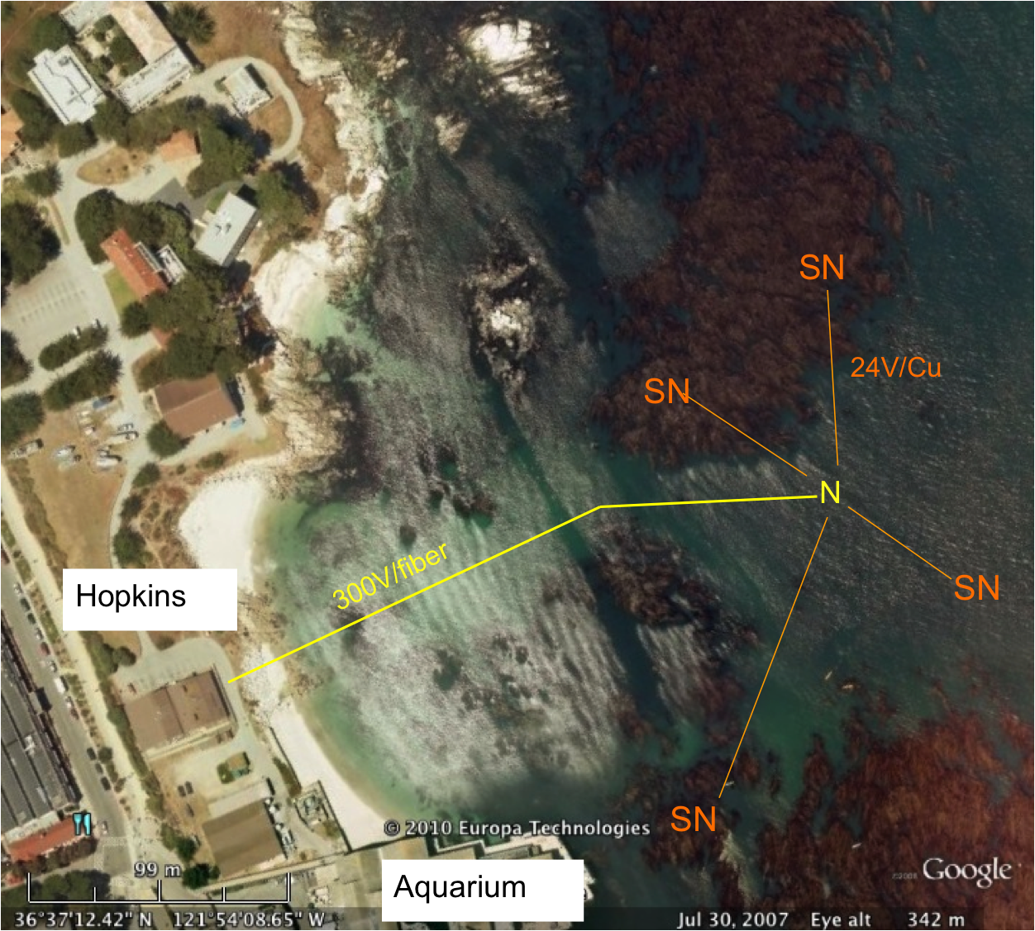
swFOCE
swFOCE shall meet all xFOCE requirements
swFOCE shall not require a support ship greater than 50’ for deployment and recovery
swFOCE shall include a camera system capable of variable time lapse digital data collection suitable for publication, the camera (and light source if included) shall also be adjustable within the swFOCE structure
swFOCE shall use the Stanford Hopkins
Marine Station’s submarine cable
swFOCE shall provide a separate power and communications links form the planned Hopkins science use and will not interfere with other science operations.

Slide 10
xFOCE Concept of Ops cable
Science interface on shore
CO2 and Enriching process on shore
Air / sea interface managed using buried cable
Capable of supporting 6 to 8 xFOCE units
(4 active pH chg and 4 control)
Depth rating
min - XX
max - XX
Anchored to bottom
Uses ??? to prevent erosion

Slide 11
xFOCE Concept of Ops no cable
Science interface on shore
CO2 and Enriching process off shore
Air / sea interface managed using surface expression (buoy ?)
Capable of supporting 6 xFOCE units (?? Maybe less)
(3 active pH chg and 3 control)
Comms by telemetry
Depth rating
min - XX
max - XX
Anchored to bottom
Uses ??? to prevent erosion

Slide 12

xFOCE/swFOCE Concept of Ops
This still needs modification By Bill
Flow Vel

Slide 13
xFOCE Functional Interfaces
House Power
Internet
Power
Generation
CO2
ESW
Mixer
Comms
Data
Distribution
GUI
Distribution/Protection
SW Pump
Configuration & Control
Data Archive
Control System
Storage
Console
Enriched
Seawater
System
Monitoring/
Health/Status
Data Acquisition
Surface
xFOCE Control
Science / Control System
Subsea
Subsea Electronics
ESW Distributor
ESW injector(s)
Instruments
ESW injector(s)
Flow effector(s)
Camera(s)
Flow effector(s)

Slide 14



xFOCE Mooring Concept
Exhaust used for CO₂
Diesel Fuel
Particle Scrubber
CO₂ Mix Electronics
System Control Electronics

Slide 15

xFOCE Systems concept
What is the minimum requirement of elements for xFOCE?
Proposed minimum instrumentation for an active pH controlled chamber. The blue elements are options and controls would only have CTD and pH. Not shown is the other option of a motor and fan to control flow.

Slide 16
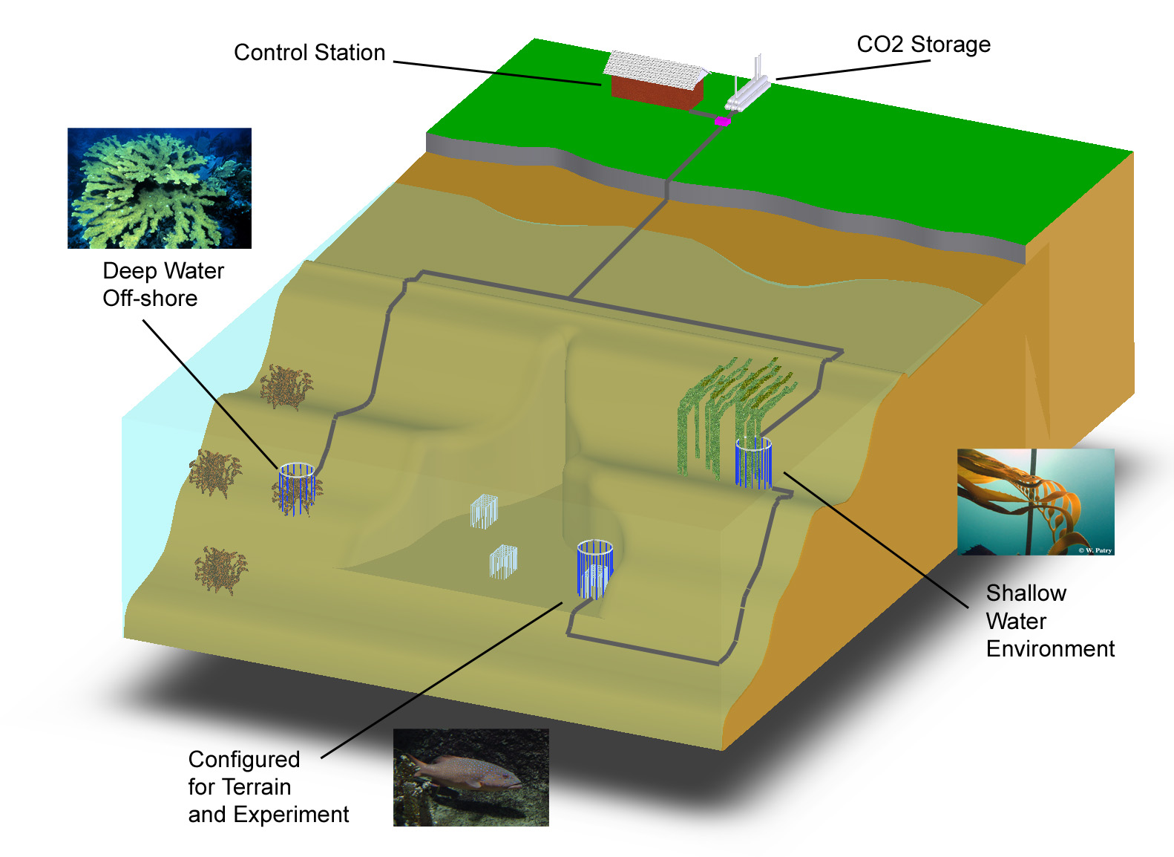
swFOCE Basic Concept
Schematic View of the Hopkins Site
Multi-Site
Multi- Discipline
Multi-Year
Shallow Water
Off-Shore
Shallow Water Corals
Benthic Biology

Slide 17
swFOCE Concept
Bottomside FOCE chamber for swFOCE
pH Sensor
Camera and Light
Ducting
(Time delay)
Flow meter
Animal
Restrictor
CTDO Sensor
Thruster
Anchors
CO₂ Enriched Water
Power and Comm
Cabling
FOCE Controller

Slide 18
xFOCE/swFOCE Cable Concept
Sea Water
Barrier End Cap
Low pH Sea Water
Power and Comms
Existing Drain at
Hopkins
Sea Level
Intake Filter

Slide 19
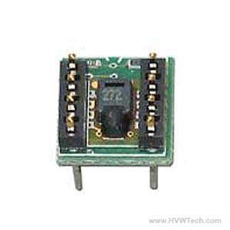
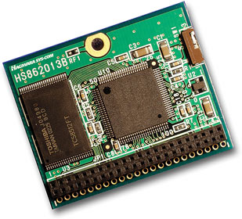
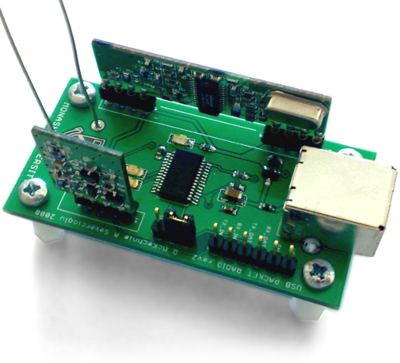
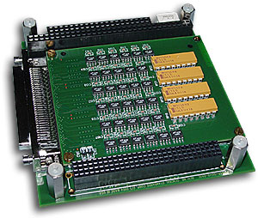
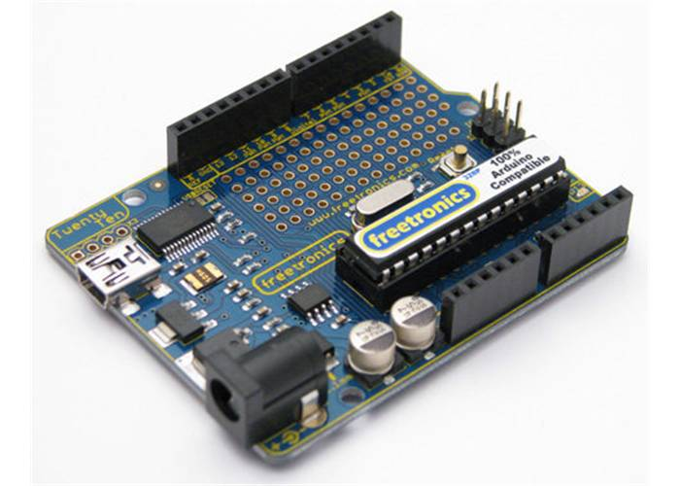
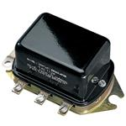
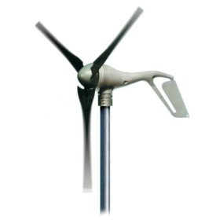
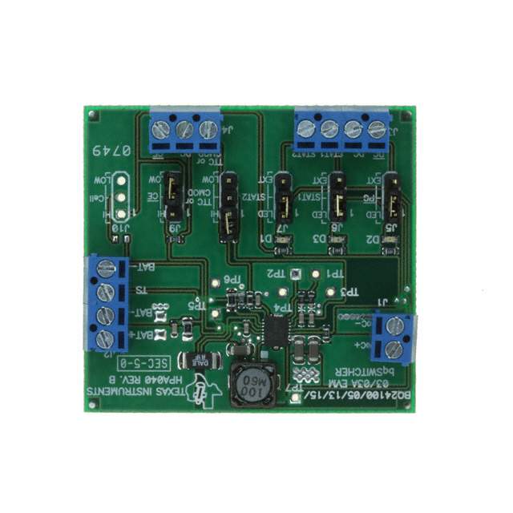
xFOCE /swFOCE Components
Humidity Sensor
Flash Storage
Wireless Comm
Instrument Interface
CPU
Voltage Regulator
Wind ??
Battery Charger
Deep Cycle Batteries

Slide 20
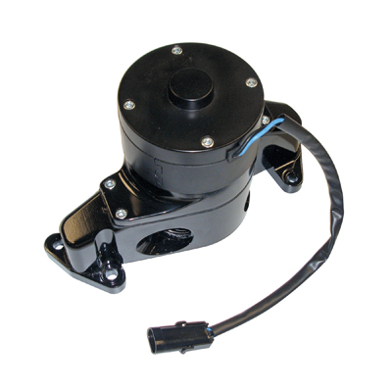
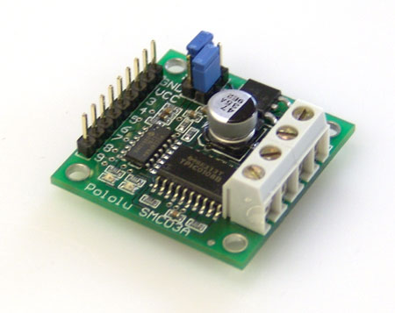
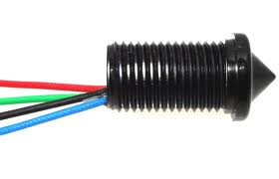
xFOCE /swFOCE Components
Motor Controller
Small Water Pump
Voltage Regulator
Level Sensor
CPU
Deep Cycle Batteries

Slide 21
Trade Elements
Mechanical
Chamber size, shape, materials, anchor, mounts
ESW generation, storage, distributor, effectors
Flow effectors

Slide 22
Trade Elements
Software
UI console, GUI, data access SW
Data acquisition, distribution SW
  HW requirements: IO, memory
  Language(s), tools, OS/none, 3rd Party
Communications protocols SW
Control system software

Slide 23
Trade Elements
Electrical
Power generation, storage, distribution
Load/Bus switching, GF detection, isolation, monitoring
Environmental monitoring HW
Data acquisition, archive HW
Communications backbone HW

Slide 24
swFOCE Systems concept
Divide sub-systems out, major blocks and define what will traded starting with xFOCE base.
Define system / sub-system interfaces
Assign each trade to a

Slide 25
Legal and Permitting

Slide 26
Mechanical
Basic xFOCE Structure
swFOCE if anything is modified
Anchoring (environmental data)
Flow control
Light management
Bio-fouling

Slide 27
Electrical
Power
Budgets
Management
Communications
Ground Fault ??
Control Circuits

Slide 28
Software
Basic Architectural Structure
xFOCE (minimum needs)
swFOCE (extensible elements as needed)
Open Source
Controller / algorithm development
Science/User interfaces
most basic
options
Realtime vs. ??

Slide 29
Data
Collection
Storage
Processing (??)
Quality
How does design handle modularity of xFOCE

Slide 30
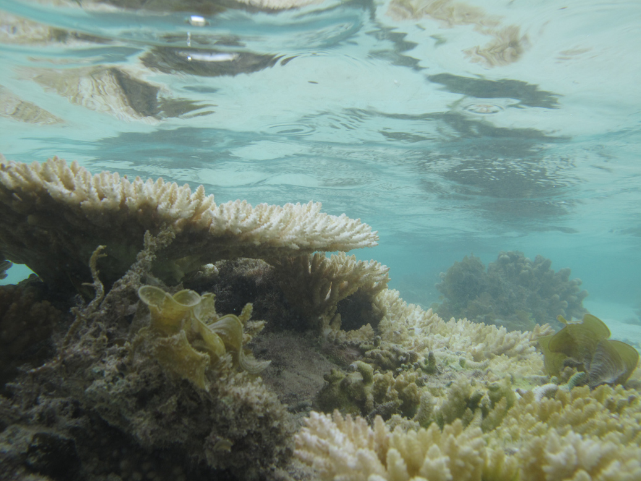
Technology Transfer of FOCE
William J. Kirkwood
Heron Island FOCE Site

