Slide 1
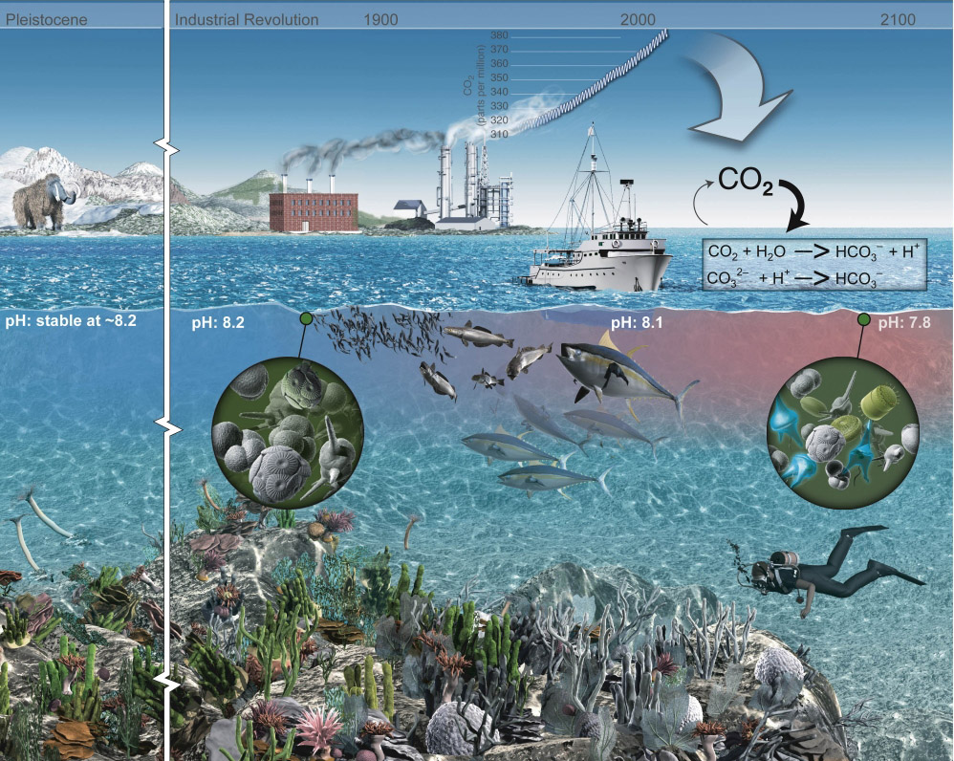
Free Ocean CO₂ Enrichment
An illustration of the atmospheric CO₂ increase and the change in ocean pH

Slide 2
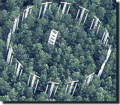

FOCE and OA Research
Free Ocean CO₂ Enrichment experiments are based on an existing base of scientific work that started in the early 1990’s. The Free Air CO₂ Enrichment (FACE) experiments.
Dr. Peter Brewer first proposed this type of experiment to MBARI engineering in 2003 as part of his greenhouse gases research. The drawing to the right is the initial concept from engineering and presented to NOAA’s Dr. Dick Feely later that year.
Concept using the MARS cable in Monterey Bay, later deployed as deep FOCE (dpFOCE)

Slide 3



Why xFOCE?
The problem: Some scientists are misinterpreting our publications and what is required to make a FOCE system work.
MBARI was contacted and we gave feedback about how to use the existing hardware and reconfigure it to become a functional FOCE.
The scientist did some of it but still didn’t grasp what FOCE is an how to properly set up a system to get meaningful science results.
It became apparent that a resource clearly outlining FOCE and how to get started would be useful.

Slide 4


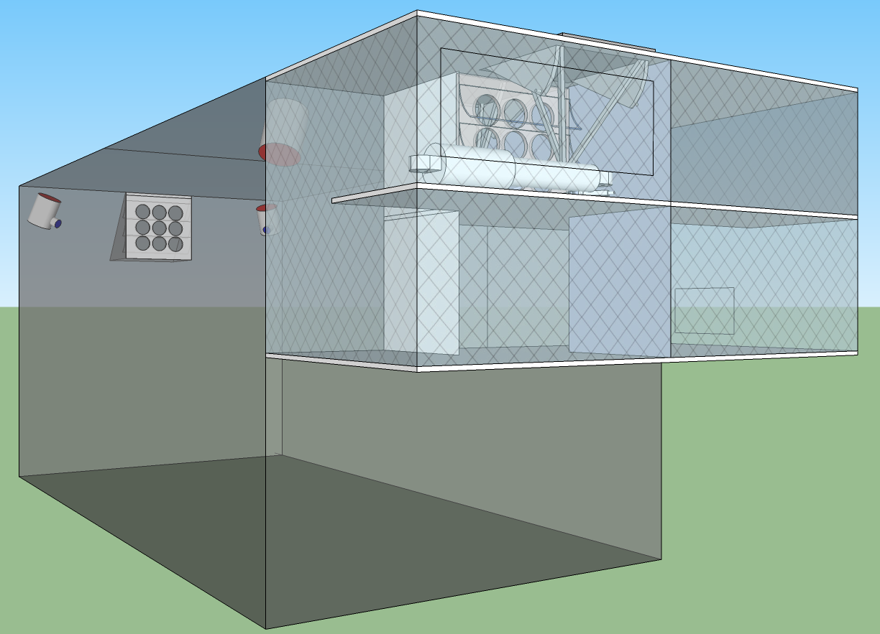





xFOCE
Deep FOCE (dpFOCE) is the original FOCE built for multi-science users on a cabled observatory.
Coral Prototype FOCE (cpFOCE) is the first tech transfer of FOCE built for multi-science users on the Great Barrier Reef. Solar and wind powered except for the creation of the enriched CO₂ water.
European FOCE (eFOCE) is currently under construction and scheduled for deployment in May 2012. This system uses a cable but the CO2 is delivered in bottles to a surface expression.
Antarctic FOCE (antFOCE) proposal submitted and partially funded. Proposal for other 50% of funding submitted April 24th, 2012.

Slide 5
xFOCE
xFOCE shall support 2 test chambers (1 active and 1 control minimum)
xFOCE shall maintain a desired pH offset from ambient within +/- .2 pH
xFOCE shall be capable of pH offsets of between .2 and .8 pH units
xFOCE shall hold a selected pH offset for a minimum of 2 weeks
xFOCE shall be capable of deployments greater than 6 months in duration
xFOCE shall be fully functional in external currents of 50 cm/sec
xFOCE shall mimic surge to the extent possible based on chamber scale
xFOCE shall maximize the allowance of full spectrum natural light
xFOCE shall include pH, CTD, O2, flow rate or calculated flow using velocity

Slide 6
xFOCE
xFOCE shall provide internal environmental data for all instruments on the required list from each active chamber
xFOCE shall provide internal environmental data for
xFOCE shall be diver maintainable
xFOCE shall not use materials that are toxic to the marine environment
xFOCE shall not be dangerous to maintenance divers
xFOCE shall minimized impacts on local marine life
xFOCE shall be capable of being fully recovered and leave no components behind
xFOCE shall be capable of being built, installed and maintained by a typical university oceanographic research lab with a minimum of 1 scientist and 2 graduate students

Slide 7
xFOCE
xFOCE shall maximize use of commercially “off-the-shelf” or readily available technology to the fullest extent possible
xFOCE shall be capable of working in ocean waters where the velocity does not exceed 75 cm/sec.

Slide 8
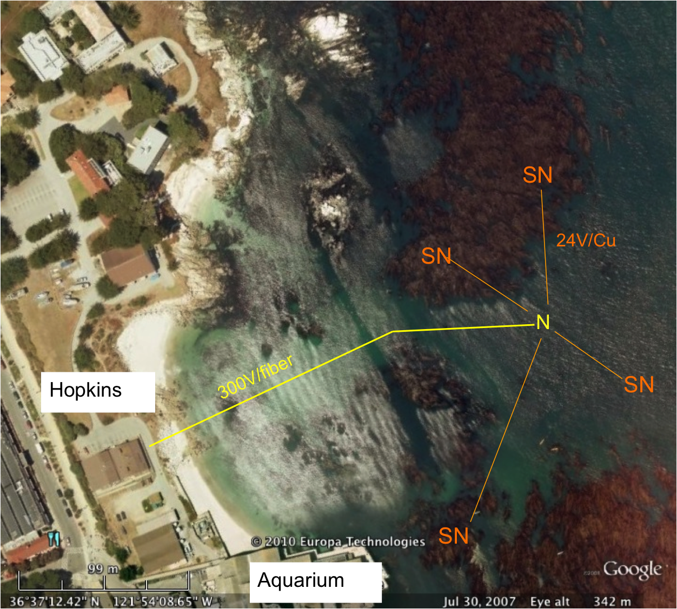
swFOCE
swFOCE shall meet all xFOCE requirements
swFOCE shall not require a support ship greater than 50’ for deployment and recovery
swFOCE shall include a camera system capable of variable time lapse digital data collection suitable for publication, the camera (and light source if included) shall also be adjustable within the swFOCE structure
swFOCE shall use the Stanford Hopkins
Marine Station’s submarine cable
swFOCE shall provide a separate power and communications links form the planned Hopkins science use and will not interfere with other science operations.

Slide 9
xFOCE Concept of Ops cable
Science interface on shore
CO2 and Enriching process on shore
Air / sea interface managed using buried cable
Capable of supporting 6 to 8 xFOCE units
(4 active pH chg and 4 control)
Depth rating
min - XX
max - XX
Anchored to bottom
Uses ??? to prevent erosion

Slide 10
xFOCE Concept of Ops no cable
Science interface on shore
CO2 and Enriching process off shore
Air / sea interface managed using surface expression
Capable of supporting 2 xFOCE units minimum
1 active pH chg and 1 control, 3 active and 3 control desired
Buoy or Platform
Comms by telemetry
Depth rating
max – 40m
Anchored to bottom

Slide 11
xFOCE Functional Requirements
Max depth: 40m (130 ft)
pH Range: 0.0 to -0.6 continuous based on CO₂ available. Brief excursions to -0.8 or -1.0 offset potentially
pH resolution: resolution: 0.05 pH units, 0.1 unit may be OK (prefer best resolution possible)
Temp range: -2 to 30 degrees C
Max ext. velocity: 50 cm/sec
Max int. velocity: 10 cm/sec
Full spectrum light: Max transmission of sunlight at depth
Number of Units: System support for 1 active and 1 control chamber

Slide 12
swFOCE Additional Requirements
Surge: Imitate surge to extent possible
Number of Units: System support for 3 active and 3 control chamber

Slide 13

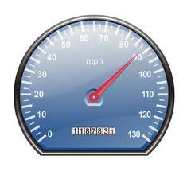
xFOCE/swFOCE Concept of Ops
Flow Vel
Science selected velocity

Slide 14
xFOCE Functional Interfaces
House Power
Internet
Power
Generation
CO2
ESW
Mixer
Comms
Data
Distribution
GUI
Distribution/Protection
SW Pump
Configuration & Control
Data Archive
Control System
Storage
Console
Enriched
Seawater
System
Monitoring/
Health/Status
Data Acquisition
Surface
xFOCE Control
Science / Control System
Subsea
Subsea Electronics
ESW Distributor
ESW injector(s)
Instruments
ESW injector(s)
Flow effector(s)
Camera(s)
Flow effector(s)

Slide 15

xFOCE Systems concept
Blue circles are included for swFOCE
Proposed minimum instrumentation for an active pH controlled chamber. The blue elements are options and controls would only have CTD and pH. Not shown is the other option of a motor and fan to control flow.

Slide 16
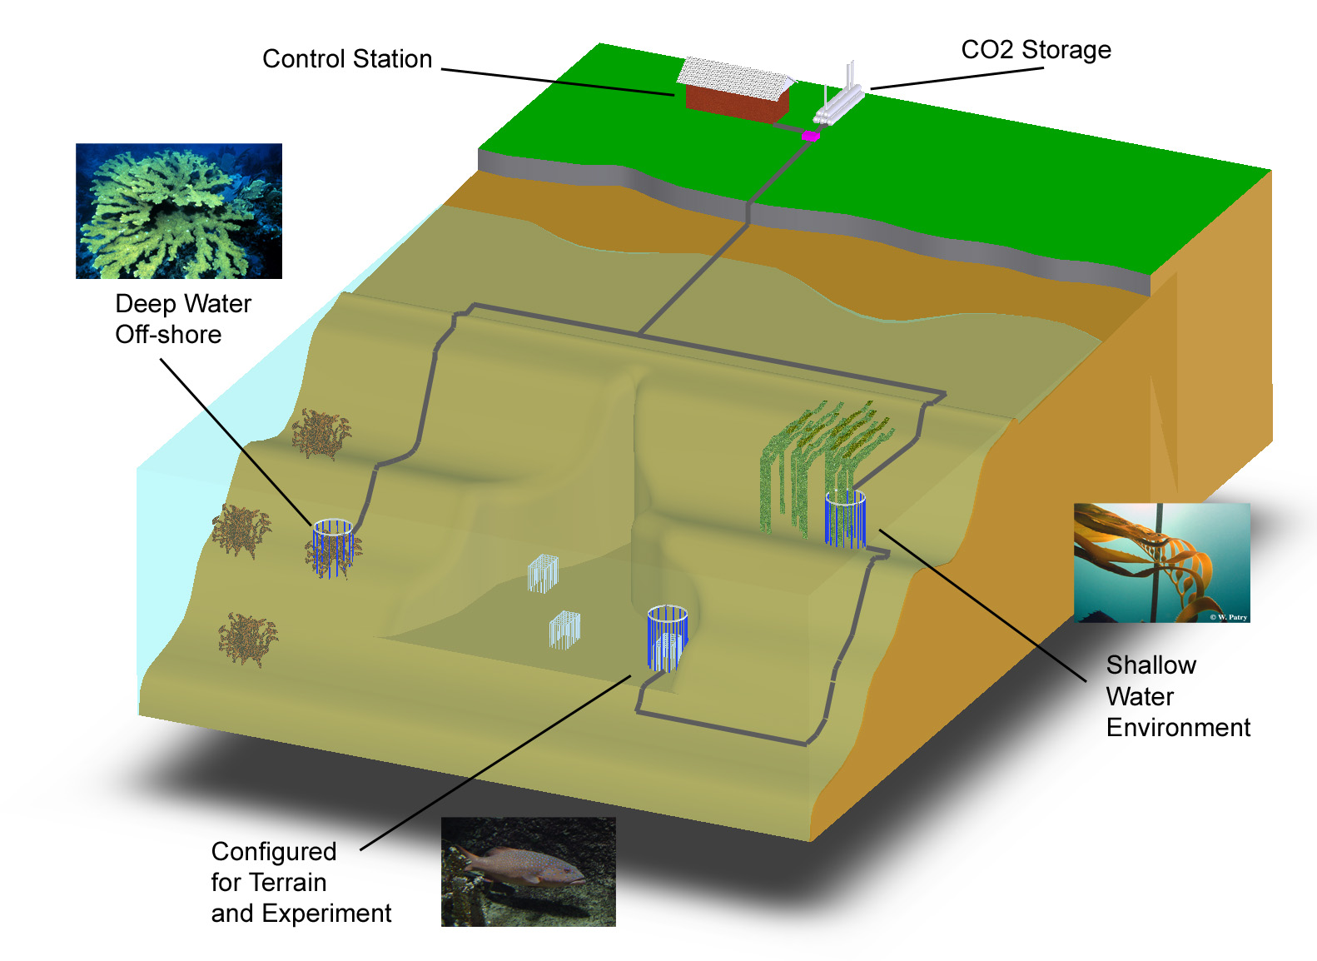
swFOCE Basic Concept
Schematic View of the Hopkins Site
Multi-Site
Multi- Discipline
Multi-Year
Shallow Water
Off-Shore
Shallow Water Corals
Benthic Biology

Slide 17
swFOCE Concept
Bottomside FOCE chamber for swFOCE
pH Sensor
Camera and Light
Ducting
(Time delay)
Flow meter
Animal
Restrictor
CTDO Sensor
Thruster
Anchors
CO₂ Enriched Water
Power and Comm
Cabling
FOCE Controller

Slide 18
swFOCE Cable Concept
Sea Water
Barrier End Cap
Low pH Sea Water
Power and Comms
Existing Drain at
Hopkins
Sea Level
Intake Filter

Slide 19
xFOCE /swFOCE Data Reqs.
Health and Status: Ability to query system status from web page (data dependent on sensors included)
Timing Accuracy: Internet time stamping to 1 second absolute accuracy
Sample Rates: System will support up to 2 Hz standard operation
Basic Data Format: Comma delimited string, time stamped
swFOCE: Compatible with the current dpFOCE data streams and SSDS (Shore Side Data System*)
Autonomously chapters meta-data for instruments
Near real time ground fault monitoring
*SSDS – Open source from MBARI

Slide 20
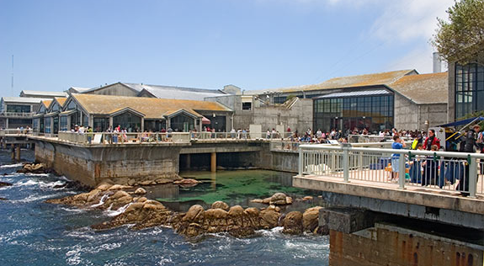
FOCE: A tool to understand local impacts of Ocean Acidification
Funding Provided by The David and Lucile Packard Foundation

Slide 21



xFOCE CO₂ Concept
Exhaust used for CO₂
Diesel Fuel
CO₂ Mix Electronics
Particle Scrubber
System Control Electronics
Supplemental

Slide 22


xFOCE Engineering Trades
Color Frequency Wavelength
violet 668–789 THz 380–450 nm
blue 631–668 THz 450–475 nm
cyan 606–630 THz 476–495 nm
green 526–606 THz 495–570 nm
yellow 508–526 THz 570–590 nm
orange 484–508 THz 590–620 nm
red 400–484 THz 620–750 nm
infrared longer than 750 nm
Since these wavelengths penetrate water easier but most plastic materials respond poorly to high freq light the materials selections will focus on this end of the spectrum
The selection of materials will likely transmit this end of the spectrum fairly well but in selection, if required, we would trade attenuation here to maximize shorter frequencies.
Acrylic (vs Polycarbonate) has less attenuation overall and carries much further into the ultraviolet when comparing the blue lines.

Slide 23
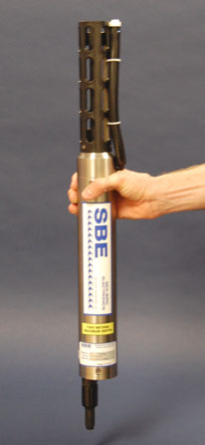
xFOCE Core Instrument Suite
pH : +/- .01 pH unit or better and suitable for
control loop applications
CTD: Comparable to current units at MBARI, unit is
FastCAT SBE49 (oxygen can be included)
Flow sensor: TBD, likely electromagnetic to get smooth
flow numbers and volumetric data. From dpFOCE acoustic velocity sensors are not suitable.
Suggested architecture allows for expansion of additional instrumentation
PAR* - Photosynthetically Active Radiation

Slide 24
swFOCE Core Instrument Suite
pH : +/- .01 pH unit or better and suitable for control loop applications
CTD: Comparable to current units at MBARI, baseline unit is FastCAT SBE49 (oxygen can be included)
Flow sensor: TBD, likely electromagnetic to get smooth
flow numbers and volumetric data. From dpFOCE acoustic velocity sensors are not suitable.
PAR* Sensor: 400 – 700 nm / calibrated t0 0 – 5000 μmol photons•m ⁻² •s ⁻¹
Camera/Lights: 1080p - 16:9 ratio format – light source either natural and/or color balanced LED
PAR* - Photosynthetically Active Radiation

Slide 25
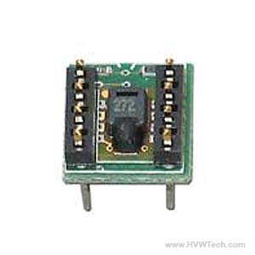
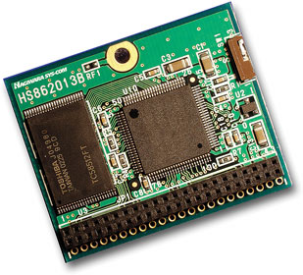
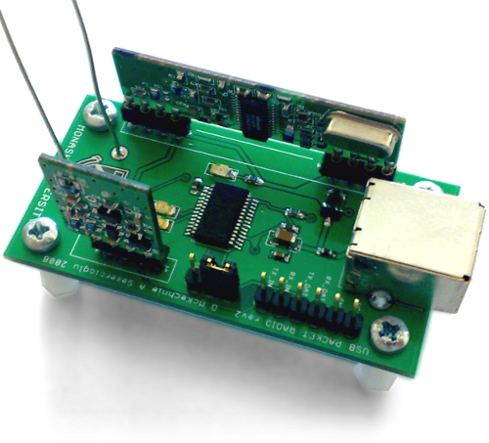
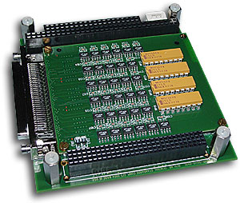
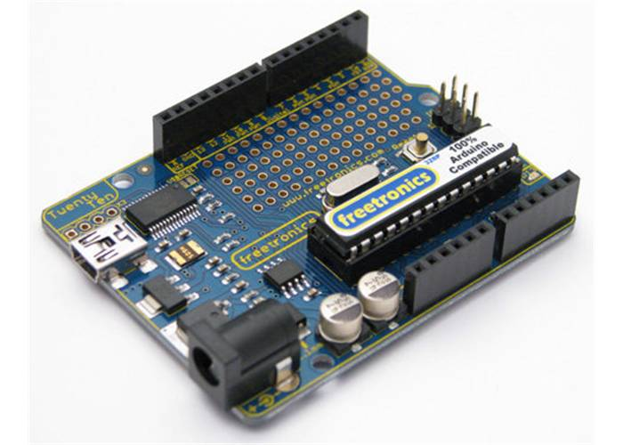
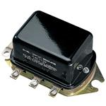
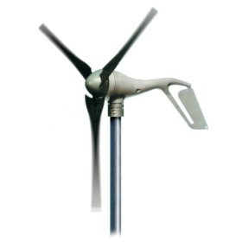
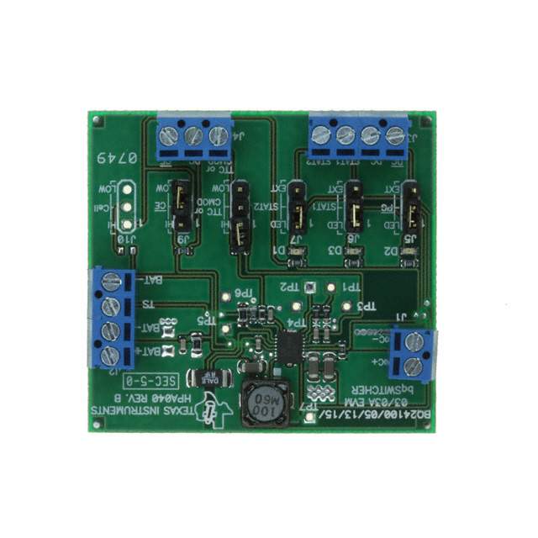
xFOCE /swFOCE Components
Humidity Sensor
Flash Storage
Wireless Comm
Instrument Interface
CPU
Voltage Regulator
Wind ??
Battery Charger
Deep Cycle Batteries

Slide 26
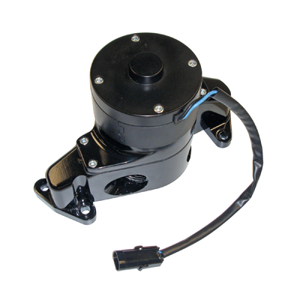
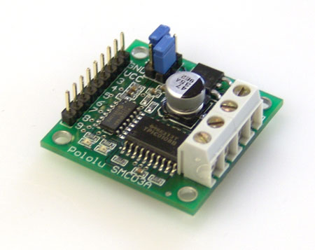
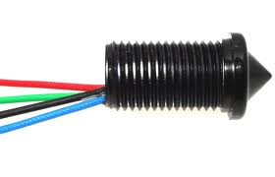
xFOCE /swFOCE Components
Motor Controller
Small Water Pump
Voltage Regulator
Level Sensor
CPU
Deep Cycle Batteries

