Slide 1
xFOCE design idea
From a processor and comms perspective
Thom Maughan
2 Apr 2012

Slide 2
xFOCE Design Idea - #1865
Idea: Gateway Node aggregating inputs from multiple Sensor Nodes that are connected to instruments and motors.
Sensor Node:
  Microprocessor with on-chip peripherals,, low cost, easy to use, commercially available (broadly), ‘friendly’ programming environment,
    4 hardware serial ports + optional 1 software serial port
    Low power
    Real time clock
    Reasonable memory for buffering instrument data
    Standardized extension bus
    Software: on-chip peripheral drivers
  Custom ‘add on’ board sold at adafruit, sparkfun, etc.:
    RS232 level shifters for instrument interface (isolated MAX3250). 3 hardware uarts for instruments, perhaps bit bang to get a 4th or 5th serial port for low data rate instruments
    Hardware serial port for gateway connection. Non-isolated RS232 gateway interface.
    Motor control interface (PWM outputs) with position/rotation feedback inputs
    Isolated Power and on/off management along with current (mA) status for instruments. Ground fault for chassis to ground and chassis to power rail.
    Gateway interface RS232 non-isolated
Gateway Node:
  Microprocessor with ethernet, low cost, easy to use, commercially available (broadly), ‘friendly’ programming environment
    5 hardware serial ports + console port, Ethernet, SD/uSD card, USB host and client
  Custom add-on board sold at adafruit, sparkfun, etc:
    Real Time Clock
    Sensor Node Interface connections
      RS232 level shifters
      Power management and power status for self and for sensor nodes.
    Optional Camera (timelapse or video) control interface
  Gateway node has filesystem , USB, and network (IP) capability.
    Gateway to Gateway for bottom to top on Buoy system.
    Gateway to shore on cabled system

Slide 3
Evaluation Criteria
 | Weight for #1865
Ease of use for SciTech programming | 10
Low cost | 8
Low power | 7
At least 4 hardware uarts | 10
Buffer Memory | 9
Broad user base | 9
‘Accurate’ Real Time Clock 30ppm | 7
Able to meet the functional requirements | 10
Has Ethernet (relevant to gateway node, not sensor node)
Industrial grade hardware, connection, pkg | 4

Slide 4
Presentation notes
Dates: April 27 – dry run, May 14 (Monday AM)
Large audience: Maybe we should do a webex style to enable text chat style feedback to engage users input/feedback
What to tell my mom: CO2 is being absorbed by the ocean, in the future the ocean will be more acidic. FOCE is a time machine that allows biologists to study the acidic ocean of the future by providing a continuously controlled amount of C02 enriched seawater. FOCE looks like a big long aquarium upside down full of seawater on the seafloor .
  Open to the benthic (bottom)
  CO2 enriched sea water controlled in the chamber (by measuring pH)
  Other sensors provide context about the living environment
  Camera for animal behaviour

Slide 5
User Requirements
Targeted Customer: Technically capable, non-engineering Science Tech / Grad Student able to build and test a FOCE from the xFOCE reference guide.
Able to make changes like:
  Substitute a different manufacturers instrument (ex. RBR CTD for a Seabird CTD)
  Add a new instrument (constrained by available power and serial interface)
  Tweak the control parameters for C02 enrichment

Slide 6
Implied requirements
Lowest cost to get the job done reliably – not ‘spare no expense’
  Low power design principles to help reduce cost
Software ‘ease of use’.
  Readable documentation and available getting started and users guides.
  Wide user base with discussion groups for support
Provide examples and ‘starter ware’ validated by Science Tech / Grad students
  Vmware to create pre-installed images to capture complex installation procedures is acceptable.

Slide 7
Evaluation criteria
Sensor Node
Gateway Note
Science Tech can make a ‘delta’ feature modification
Available commercially, ideally with second source
Modular with module replace-ability
Lowest power to handle 4 (5?) serial ports and motor control (as well as data reduction and buffer)
Able to sleep when idle
Low cost pressure tolerant housing – not intended for repair (pvc with silicone potting)
Science Tech can make a ‘delta’ feature modification
Able to drive a long cable with reasonably high speed network connection (ethernet)
Simplest software to do the job
Compute power to implement the pH control loop by controlling sensor nodes
Low power (lowest power to do the job)
Able to sleep (low power) when inactive

Slide 8
Sensor and Control requirements
Core: C02 enriched seawater mixture control inside experimental chamber
  Measure pH and Control CO2 enriched seawater pump
Sensors
  pH (inside and outside), CTD, DO2, PAR, Flow (velocity, volume)
    Read, timestamp, store
  Sensor nodes have the instrument driver
  Sensor nodes running ‘firmware’, but firmware can be updated from gateway node in the case of driver update.
  Camera: need to provision for an ethernet switch and some means for camera control.
    View image/video from shore or store local
Scalable modular design
  xFOCE is the union of the hardware required to accomplish the three FOCE configurations (buoy, buoy-shore, cable-shore)
Philosophy – keep the complexity top side or on shore.
  Just what’s needed an no more to do the job on the wet side

Slide 9
Maintainability considerations (insurance)
Diver safety
  Diver safety switch - Fans off
  Power off?
  Illuminators and Annunciators
Instrument replacement
  Fault
  Calibration

Slide 10
FOCE configurations considered:
1) Buoy, 2) Buoy Connected, 3) Cabled
CO2 ESW
CO2 + PWR
SHORE
CO2 + PWR
SHORE
CO2 ESW
FOCE
FOCE
Gateway node
Buoy FOCE
Cabled FOCE
Sensor node

Slide 11
Hardware Layout and Connections
instruments
motor
Sensor node
Serial? USB? tbd
gateway node
Shore pc
Ethernet switch
gateway node
camera
Ethernet / rf
Advantages:
Modular, expandable
Serial connected – easier wiring than ethernet
Separate housings (lots of small housings)
Low cost, reliable
Dis-Advantages:
Extra interconnect wire vs One Big housing
Sensorless BLDC Motor Control may not be easy as hoped

Slide 12
Node Functionality
Sensor Node software
  ‘Firmware’ – intended to be changed infrequently.
  Mature on-chip peripheral drivers available
  Software: Simple, capable, effective
    Easy to read book for setting up the software environment to make a change
    Type of changes: add a new instrument, likely similar to an existing instrument supported by the reference design
  App model: One application configured (compile or runtime) to tailor for a specific sensor node
  Monitor, bootloader for serial firmware update via gateway node (not requiring JTAG or specialized interface)
  Customized for instruments attached (voltage, power, baud, protocol)
  Instrument On/Off, protocol to read instrument, parsing
  Power management, fault detection and management
  Timestamp, buffer, log, protocol to send to gateway when requested.
Sensor Node hardware
  4 hardware serial ports
  Memory
  PWM for Motor control
  Power management / status / ground fault
  Pressure Tolerant (for potting)
Gateway Node software
  Network stack and cable interface (ethernet)
  File system
  Operating System optional, embedded linux
  Wakes up, reads sensor nodes, stores data, responds to ‘upstream’ requests for data
  reads system status, handles fault management
  Diagnostics and health check
  Gateway Application update from shore
  VMWare image built by MBARI to hide the details of dev env setup
  Simple, proprietary extensible serial protocol to sensor nodes
Gateway Node Hardware
  Ethernet for cable driver
  5 serial ports:
    console + 4 for sensor node interface
    VNC can substitute for console
  USB storage and/or SD card storage
  Optional RF or cellular modem interface
  Power management for Sensor nodes

Slide 13
Sensor Node Processor selection Criteria
Some Processor Options
  Arduino Mega 2560
  PIC24 (used on mbari brs)
  MSP430F5438 or similar
  Stellaris ARM
  Pinguino (arduino-like PIC32)
  Energy Micro Cortex M3 (32bit) – good onchip peripheral driver support, low power, uClinux available, 4 serial ports (not clear)
4 ‘real’ uarts
PWM for Motor control
GPIO bits for on/off ‘load switching’ control, status lights
ADC for power measurement (monitoring voltage and current)
Ultra Low Power capable
‘SciTech’ compatible software (firmware) support (onchip peripheral library support, examples, low/free ide, debbugger, monitor/bootloader)
Good community support and reasonable mature software ecosystem
Market upside for custom board or custom add-on board.
Second source board availability

Slide 14
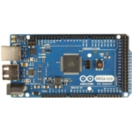
Sensor Node:
Arduino Mega 2560 R3
$65
Input voltage 7 to 12 (max 20)
14 PWM outputs
16 analog inputs
4 UARTs (hardware serial ports)
16 MHz crystal oscillator
USB connection (for programming)
256KBytes of In-System Self-Programmable Flash
4Kbytes EEPROM
8Kbytes Internal SRAM
Write/Erase Cycles:10,000 Flash/100,000 EEPROM
Optional Boot Code Section with Independent Lock Bits
RTC
SPI,
GPIO, bit bang i2c, 40 mA/pin

Slide 15
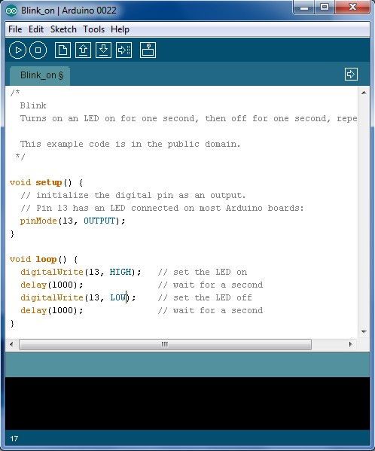
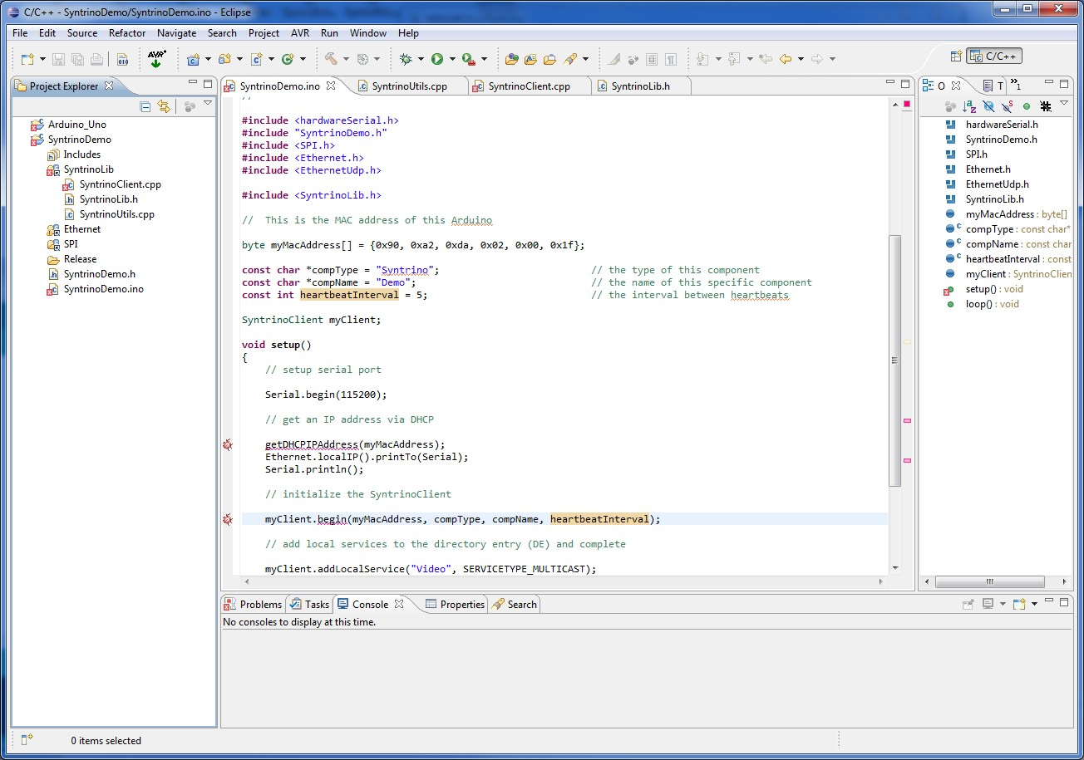
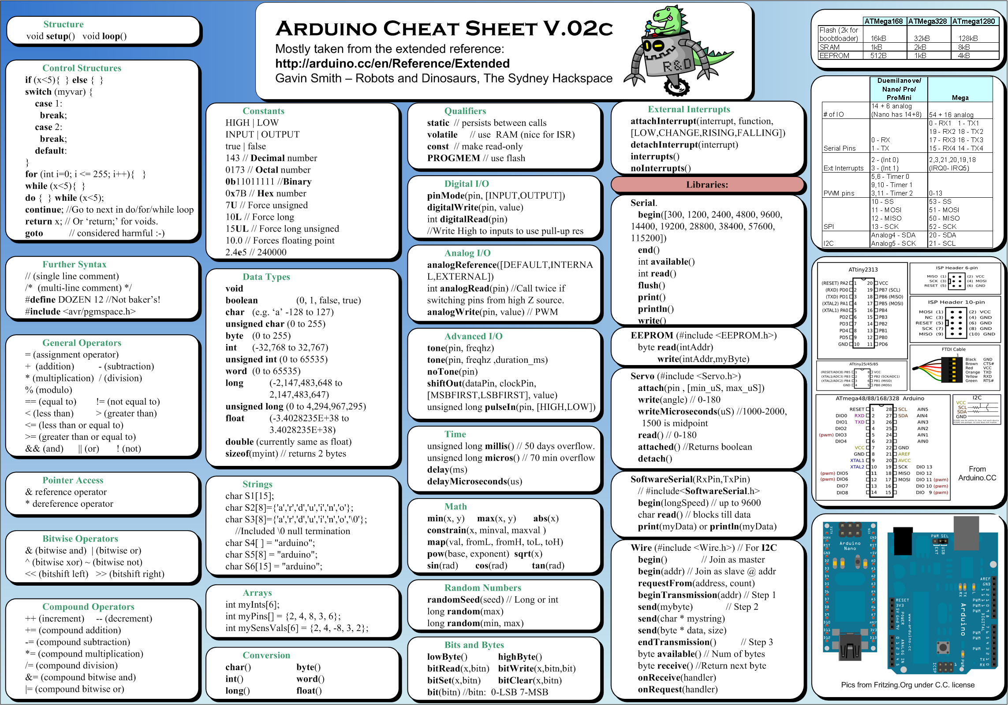
Sensor Node
Software Environment
Arduino Dev
Eclipse+Arduino Dev
Processing/Wiring + c/cpp
One ‘big’ app with all instrument specific drivers in it, compile switches or global variables to configure code
Most instruments are request/response
Serial protocol and data structure definition for talking to the gateway node. New additional instruments are added to the data structure. Protocol is flexible with bytecnt and shared header file

Slide 16
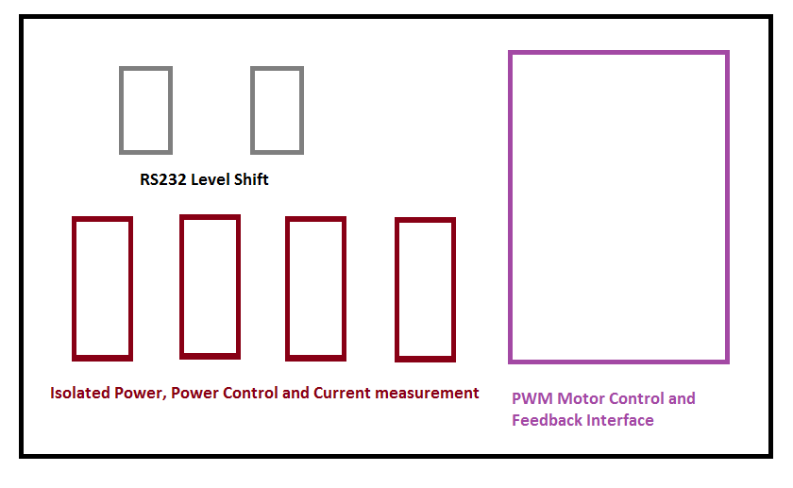
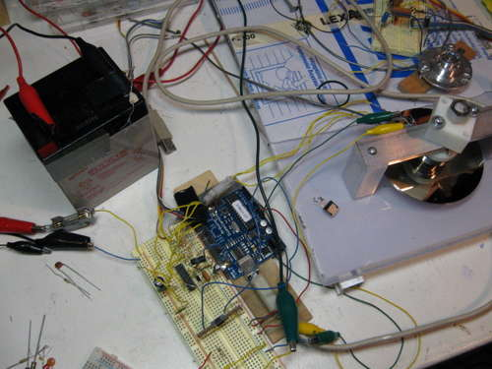
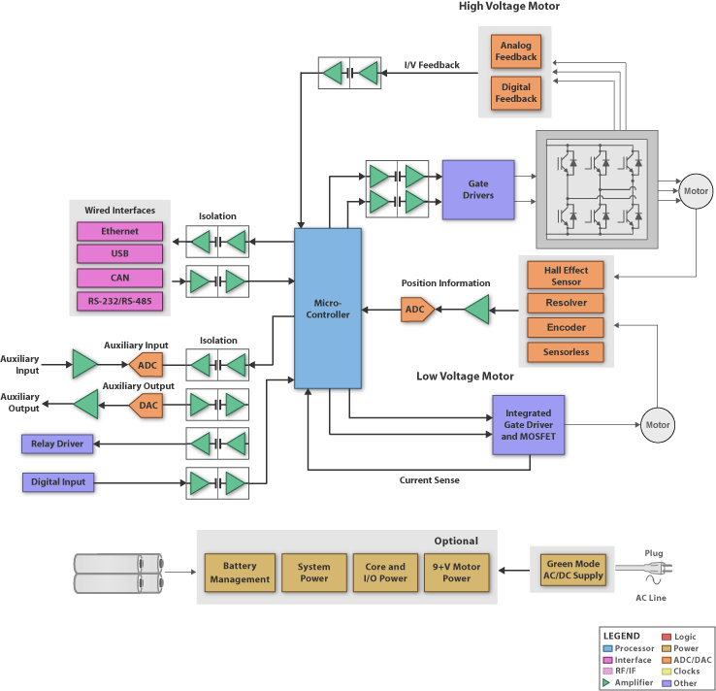
Sensor Node
Custom Shield
Isolated power and ground.
Isolated RS232 level shifters and connectors
instrument power control and status. ground fault chassis to ground, chassis to power, isolation used. (module could be added, but lobbying for measure during test)
Motor control using PWM outputs and rotation feedback input
  Opto isolated PWM from mega
  Motor likely runs from conditioned system power (48v) that is isolated from Sensor and Gateway nodes
Motor type is tbd. BLDC is preferred
  BLDC? 120Watts? 48v, 3A
  Brushed?
  48v? What about 12v or 24v system bus?
  12vdc trolling motor?
  Hugely expensive ROV thruster?
  Custom built thruster / fan setup?
  Many appnotes: Using the PIC18F2431 for Sensorless BLDC Motor Control
http://www.instructables.com/id/BLDC-Motor-Control-with-Arduino-salvaged-HD-motor/
Notes:
Below is the entire program that I wrote for the Ardjuino, with comments included:
/*
* BLDC_congroller 3.1.1
* by David Glaser
*
* The 3.x series of programs is for the ST L6234 3-Phase Motor Driver IC
*
* Runs a disk drive motor clockwise
* With regenerative braking
* Motor speed and braking is controlled by a single potentiometer
* Motor position is determined with three Hall-Effect sensors
* The Arduino receives outputs from 3 hall sensors (pins 2,3,4)
* and converts their combination to 6 different commutation steps
* PWM outputs on pins 9,10,11, at 32 kHz (corresponding to EN 1,2,3 respectively
* 3 DO on pins 5,6,7 (IN 1,2,3)
* Analog in 0 is connected to a potentiometer to change the PWM duty and change
* between motoring and regenerative braking.
* 0-499: braking
* 500-523: coasting
* 524-1023: motoring
* There are many lines commented out that were used for debugging by
* printing various values to the serial connection.
*/
int HallState1; //Variables for the three hall sensors (3,2,1)
int HallState2;
int HallState3;
int HallVal = 1; //binary value of all 3 hall sensors
int mSpeed = 0; //speed level of the motor
int bSpeed = 0; //braking level
int throttle = 0; //this variable is used with analog in to measure the position of the throttle potentiometer
void setup() {
pinMode(2,INPUT); // Hall 1
pinMode(3,INPUT); // Hall 2
pinMode(4,INPUT); // Hall 3
// Outputs for the L6234 Motor Driver
pinMode(5,OUTPUT); // IN 1
pinMode(6,OUTPUT); // IN 2
pinMode(7,OUTPUT); // IN 3
pinMode(9,OUTPUT); // EN 1
pinMode(10,OUTPUT); // EN 2
pinMode(11,OUTPUT); // EN 3
//Serial.begin(9600); //uncomment this line if you will use the serial connection
// also uncomment Serial.flush command at end of program.
/* Set PWM frequency on pins 9,10, and 11
// this bit of code comes from
http://usethearduino.blogspot.com/2008/11/changing-pwm-frequency-on-arduino.html
*/
// Set PWM for pins 9,10 to 32 kHz
//First clear all three prescaler bits:
int prescalerVal = 0x07; //create a variable called prescalerVal and set it equal to the binary number "00000111" number "00000111" number "00000111"
TCCR1B &= ~prescalerVal; //AND the value in TCCR0B with binary number "11111000"
//Now set the appropriate prescaler bits:
int prescalerVal2 = 1; //set prescalerVal equal to binary number "00000001"
TCCR1B |= prescalerVal2; //OR the value in TCCR0B with binary number "00000001"
// Set PWM for pins 3,11 to 32 kHz (Only pin 11 is used in this program)
//First clear all three prescaler bits:
TCCR2B &= ~prescalerVal; //AND the value in TCCR0B with binary number "11111000"
//Now set the appropriate prescaler bits:
TCCR2B |= prescalerVal2; //OR the value in TCCR0B with binary number "00000001"//First clear all three prescaler bits:
}
//MAIN LOOP OF THE PRGROM
void loop(){
//time = millis();
//prints time since program started
//Serial.println(time);
//Serial.print("\n");
throttle = analogRead(0); //value of the throttle potentiometer
mSpeed = map(throttle, 512, 1023, 0, 255); //motoring is mapped to the top half of potentiometer
bSpeed = map(throttle, 0, 511, 255, 0); // regenerative braking on bottom half of pot
//mSpeed = 100; //used for debugging
HallState1 = digitalRead(2); // read input value from Hall 1
HallState2 = digitalRead(3); // read input value from Hall 2
HallState3 = digitalRead(4); // read input value from Hall 3
//digitalWrite(8, HallState1); // LEDs turned on when corresponding sensor is high - originally used for debugging
//digitalWrite(9, HallState2);
//digitalWrite(10, HallState3);
HallVal = (HallState1) + (2*HallState2) + (4*HallState3); //Computes the binary value of the 3 Hall sensors
/*Serial.print("H 1: "); // used for debugging
Serial.println(HallState1);
Serial.print("H 2: ");
Serial.println(HallState2);
Serial.print("H 3: ");
Serial.println(HallState3);
Serial.println(" ");
*/
//Serial.println(mSpeed);
//Serial.println(HallVal);
//Serial.print("\n");
// Monitor transistor outputs
//delay(1000);
/*T1 = digitalRead(2);
//T1 = ~T1;
T2 = digitalRead(4);
//T2 = ~T2;
T3 = digitalRead(5);
//T3 = ~T3;
Serial.print(T1);
Serial.print("\t");
Serial.print(T2);
Serial.print("\t");
Serial.print(T3);
Serial.print("\n");
Serial.print("\n");
Serial.print(digitalRead(3));
Serial.print("\t");
Serial.print(digitalRead(9));
Serial.print("\t");
Serial.println(digitalRead(10));
Serial.print("\n");
Serial.print("\n");
//delay(500);
*/
// Commutation for Motoring
// Each binary number has a case that corresponds to different transistors being turned on
// Bit Math is used to change the values of the output
// For tutorial on bitmath with the Arduino: http://www.arduino.cc/playground/Code/BitMath
// PORTD contains the outputs for the IN pins on the L6234 driver
// that determine whether the upper or lower transistor of each phase is used
// The outputs for the EN pins are controlled by the Arduino command analogWrite, which
// sets the duty of the PWM (0 = OFF, 255 = ON or throttle value that is controlled by the potentiometer).
if (throttle > 511){
switch (HallVal)
{
case 3:
//PORTD = B011xxx00; // Desired Output for pins 0-7 xxx refers to the Hall inputs, which should not be changed
PORTD &= B00011111;
PORTD |= B01100000; //
analogWrite(9,mSpeed); // PWM on Phase A (High side transistor)
analogWrite(10,0); // Phase B off (duty = 0)
analogWrite(11,255); // Phase C on - duty = 100% (Low side transistor)
break;
case 1:
//PORTD = B001xxx00; // Desired Output for pins 0-7
PORTD &= B00011111; //
PORTD |= B00100000; //
analogWrite(9,mSpeed); // PWM on Phase A (High side transistor)
analogWrite(10,255); //Phase B on (Low side transistor)
analogWrite(11,0); //Phase B off (duty = 0)
break;
case 5:
//PORTD = B101xxx00; // Desired Output for pins 0-7
PORTD &= B00011111; //
PORTD |= B10100000;
analogWrite(9,0);
analogWrite(10,255);
analogWrite(11,mSpeed);
break;
case 4:
//PORTD = B100xxx00; // Desired Output for pins 0-7
PORTD &= B00011111;
PORTD |= B10000000; //
analogWrite(9,255);
analogWrite(10,0);
analogWrite(11,mSpeed);
break;
case 6:
//PORTD = B110xxx00; // Desired Output for pins 0-7
PORTD &= B00011111;
PORTD = B11000000; //
analogWrite(9,255);
analogWrite(10,mSpeed);
analogWrite(11,0);
break;
case 2:
//PORTD = B010xxx00; // Desired Output for pins 0-7
PORTD &= B00011111;
PORTD |= B01000000; //
analogWrite(9,0);
analogWrite(10,mSpeed);
analogWrite(11,255);
break;
}
}
// Commutation for Regenerative Braking
// PORTD (Outputs for IN pins on L6234) pins are always low so only the
// lower transistors on each phase are used
// upper transistors are always off during regen. braking.
else{
//PORTD = B000xxx00; // Desired Output for pins 0-7
PORTD &= B00011111;
PORTD |= B00000000; //
switch (HallVal)
{
case 3:
analogWrite(9,bSpeed);
//analogWrite(9,0);
analogWrite(10,0);
analogWrite(11,0);
break;
case 1:
analogWrite(9,bSpeed);
analogWrite(10,0);
analogWrite(11,0);
break;
case 5:
analogWrite(9,0);
analogWrite(10,0);
analogWrite(11,bSpeed);
break;
case 4:
analogWrite(9,0);
analogWrite(10,0);
analogWrite(11,bSpeed);
break;
case 6:
analogWrite(9,0);
analogWrite(10,bSpeed);
analogWrite(11,0);
break;
case 2:
analogWrite(9,0);
analogWrite(10,bSpeed);
analogWrite(11,0);
break;
}
}
//time = millis();
//prints time since program started
//Serial.println(time);
//Serial.print("\n");
//Serial.flush(); //uncomment this if you will use serial port for debugging
}

Slide 17
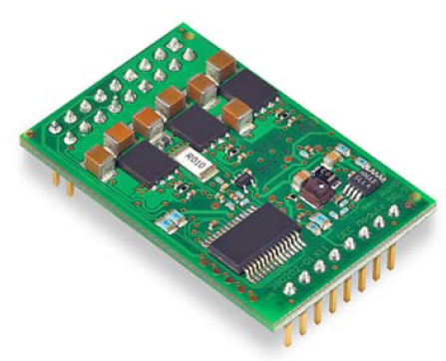
BLDC Controller
The DEC Module 50/5 (Digital EC Controller) is a small 1-quadrant digital controller for the control of brushless DC motors up to 250 W (needs Hall)
http://aquaticus.info/bldc_controller
http://open-bldc.org/wiki/Open-BLDC
s
Ideal is sensorless to minimize penetrations
Maxon DEC is small and can do the job, but has Hall
Atmel, Microchip, TI, IRF, Zilog make reference designs for sensorless
Ideal is to integrate on Arduino shield and use Arduino to run the algorithms and drive the PWM.

Slide 18
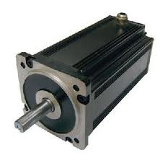
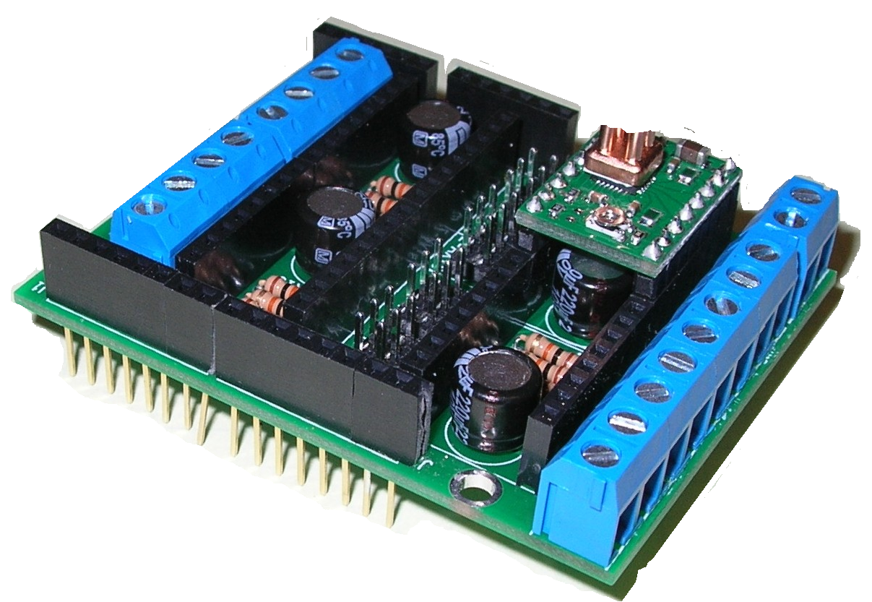
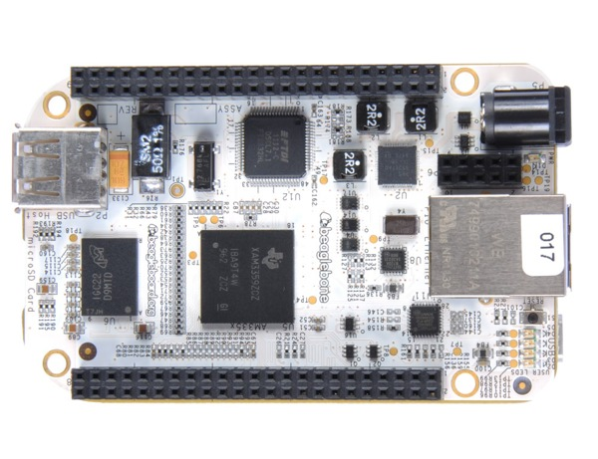
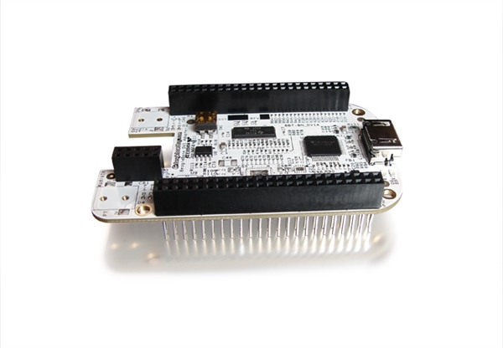

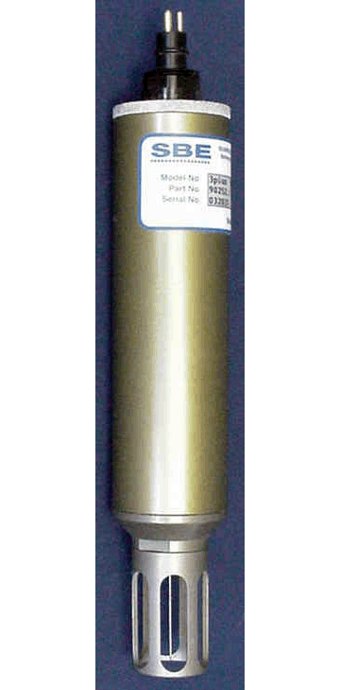
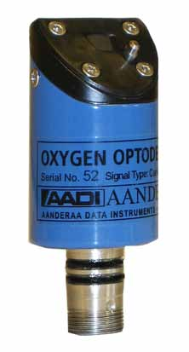
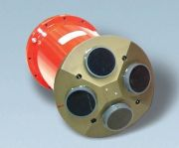
FOCE Chamber
Architecture ™
Gateway node connected to sensor nodes
– sensor nodes aggregate up to three (maybe four or five) instruments
- gateway node handles storage and communications
Arduino Mega 2560 R3 for sensor node and motor control
Custom ‘shield’ for rs232 level shift, instrument power management and status, PWM motor control outputs and motor movement feedback
Beaglebone for gateway CPU – linux, scripting, android, python, goodness gracious, file system, USB, ethernet.
Custom ‘cape’ for providing serial interface to sensor nodes

Slide 19
Motor Control Notes
Motors and options (tbd)
  Motorguide 966080035 Varimax V75 HB Freshwater BM Trolling Motor $623
12v, 24v, 48v ??? 48v is not UL
Electric trolling motor
BLDC
Looking at what’s been done with hobby electric cars and airplanes and can it be scaled up to 100 to 500 Watts
Sensor vs Sensorless control
IS NOT: precise motor control
IS: reliable, current limited, startup, stable low speed, designed to have headroom on back emf at full speed
Semiconductor reference designs for BLDC control
TI Picollo
TI Stellaris
Microchip
Renasas
International Rectifier iMotion

Slide 20
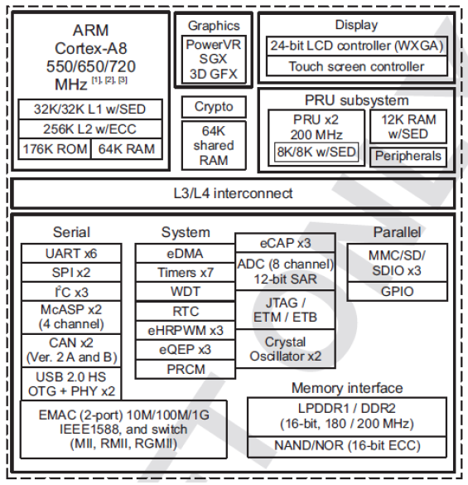
Gateway Node:
BeagleBone
$90
Altoid tin size
AM3359 – Cortex A8, upto 720Mhz
PMIC – power managed linux
Ethernet
USB Host and Client
256MB DDR2, 32 KB EEPROM for config
microSD
SPI, I2C, Console plus up to 5 available serial ports
LCD
GPIO
CANbus
A/D: Seven 100Ksamp/s A to D converters
Indicators: Power, four user LED
McASP0
PWM – up to 6
RTC
Interface bus, pin muxing
Power is 5v
BeagleBone Power Consumption(mA@5V)
MODE USB DC DC+USB
Reset 180 60 190
UBoot 363 230 340
Kernel Booting(Peak) 502 350 470

Slide 21
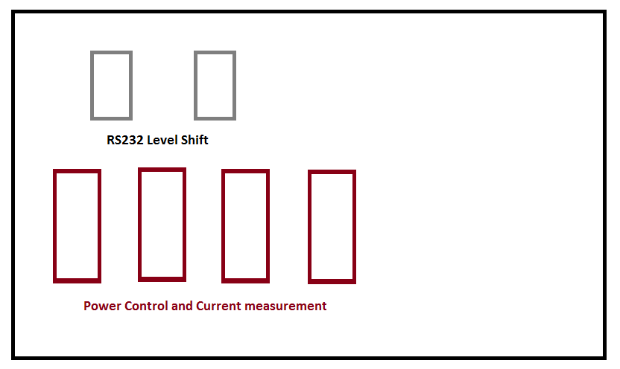
Gateway Node
Custom ‘Cape’
RS232 level shifters
connectors
Sensor node power control and status

Slide 22
BeagleBone software dev
Note to Thom: put in pictures of eclipse
Pitch the idea of using VMWare to dodge having the SciTech/Gradstud install linux – provide a pre-installed linux with beaglebone dev pre-installed
Eclipse
Android
Android solution on BeagleBone can be used as an Open Accessory Kit for connecting to other Android Devices
http://processors.wiki.ti.com/index.php/BeagleBone-Android-DevKit_Guide
Ease of use: prebuilts
$ tar -xzvf BeagleBone.tar.gz $ cd BeagleBone $ sudo ./mkmmc-android.sh /dev/sd<device>
VNC connection from the Host to the BeagleBone to provide a graphical user interface via ethernet

Slide 23
Camera Module
Timelapse
  Home brew?
TBD – identify camera options
Ethernet for shore connected
Ethernet to topside storage for buoy
Camera control from Gateway Node
Standalone camera – just turn on power and it records
What about pan and tilt?
Much more research needs to be done here…

Slide 24
xFOCE Design Idea #1865, Specifics
Sensor Node:
  Arduino Mega 2560 R3 ($65) with custom ‘shield’
    4 hardware serial ports + optional 1 software serial port
  Custom Shield sold at adafruit, sparkfun, etc.:
    RS232 level shifters for instrument interface (isolated MAX3250). 3 hardware uarts for instruments, perhaps bit bang to get a 4th or 5th serial port for low data rate instruments
    Hardware serial port for gateway connection. Non-isolated gateway.
    Motor control interface (using Arduino PWM outputs) with position/rotation feedback inputs
    Isolated Power and on/off management along with current (mA) status for instruments
    Gateway interface RS232 non-isolated
Gateway Node:
  Beaglebone ($90) with custom ‘cape’
    5 hardware serial ports + console port, Ethernet, USB host and client, uSD card
  Custom cape sold at adafruit, sparkfun, etc:
    RS232 level shifters
    Power management and power status for self and for sensor nodes
    Sensor Node Interface connections
  Gateway node has filesystem , USB, and network (IP) capability. Gateway to Gateway for bottom to top on Buoy system.
  ‘Diver Safety Switch’ to disable motors, etc. ‘Diver Sys OK’ status check annunciator
Grounding
  Chassis ground to connect metal housings. Separated from signal and power ground

Slide 25
Gateway Node Notes
Interface to shore-side “data management system” or to topside gateway node which interfaces to shore.
  130 foot cable might push ethernet limits
Custom circuitry to adapt for interfacing would be provided as a product for sale to SparkFun, AdaFruit, or other of the many ‘hobby’ companies
Modular
Low Power
Product lifecycle of 5 to 7 years
Processor options considered
  Digi 16 serial to one ethernet – this is good for the shore-side case. A bit power hungry for the buoy case but could be done for bottomside instrument interface with a top side embedded linux box.
  Lantronix or Digi, xport. Ethernet and some serial. xPort, xPort Pro, xPort Pico. ‘Evolution-OS or with Linux-OS’. DevKit is $285 for xPort Pro. Devices are $60. 16MB SDRAM/16MB Flash. 150 mA.
    32bit Processor speed is likely low (below 100 Mhz). Limited number of serial ports (2?)
  OMAP BeagleBone <<<<< ‘ease of use’ linux, good peripheral mix, low cost, reasonably low power (1.5W) broad open source support.
  OMAP Gumstix - connectors
  Rasberry Pi
  Arduino Mega 2560 R3
  PIC32
  Stellaris ARM processors with ethernet and usb

Slide 26
Backup (don’t read the junk beyond here)
Slides by Thom Maughan, #1865
2 Apr 2012

Slide 27
Housings (Packaging)
Minimize penetrations
Electrical isolation to avoid ground faulting
Pressure tolerant with low cost ‘Home Depot’ housing PVC with Silicone as a potting compound
Distributed and modular: 5 or more housings rather than one big housing

Slide 28
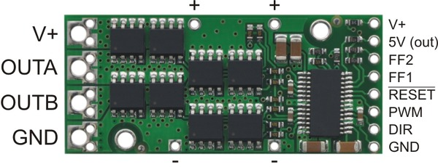
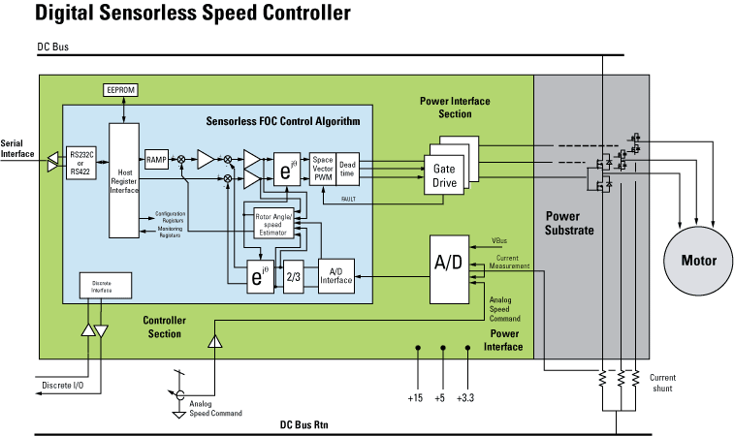
Motor Control
Polulu brushed motor controller 50v 6A
http://www.kellycontroller.com/ksl4810024v-48v100asensorless-bldc-controller-p-660.html

Slide 29
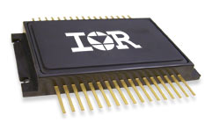
International Rectifier
Product Applications
 | Motion Control Engine (MCE) eliminates software programming
 | Algorithm development reduced to simple menu selections
 | Robust algorithm, tolerant of parameter variation - supports a variety of PMAC/BLDC motors
 | No motor voltage feedback required – minimizes additional hardware
 | Fast control loop execution – controls low inductance, high speed motors
 | Advanced Space Vector Modulator – low loss, low EMI features
 | Accurate speed regulation with integrated start and ramp functions
 | Digital (RS232/422) or analog speed control
 | Discrete I/O includes START/STOP,FAULT,FLTCLR
 | Light weight plastic frame on IMS substrate
 | Operating temp –40 º C to +85 º C
 | 15Arms current, up to 48V DC bus
Might not be available yet

Slide 30
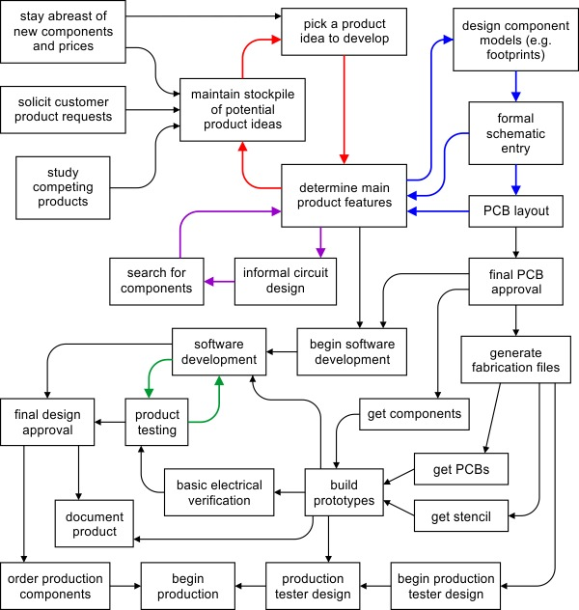
Idea to Product (Polulu)

Slide 31
Notes
Android Update
What is the BeagleBone?
The BeagleBone is the low-cost, high-expansion hardware-hacker focused BeagleBoard. It is a bare-bones BeagleBoard that acts as a USB or Ethernet connected expansion companion for your current BeagleBoard and BeagleBoard-xM or works stand-alone. The BeagleBone is small even by BeagleBoard standards and with the high-performance ARM capabilities you expect from a BeagleBoard, the BeagleBone brings full-featured Linux to places it has never gone before.
Notes:
The industry generally supports phones up to 18 months. If you own a phone that's older than 18 months, you're likely stuck with the current OS.
Q: What are the upgrade plans of the three largest Android phone manufacturers — Samsung, HTC and Motorola?
A: A small lineup of devices, including the Samsung Galaxy Nexus smartphone and Motorola Xoom tablet, already run on ICS.
Motorola says several devices now on Gingerbread will be upgraded throughout the year including Droid Razr, Motorola Razr, Droid 4, Droid Bionic, Atrix 2 and the Photon 4G smartphones and Droid Xyboard 10.1 and 8.2 tablets.
HTC says the following U.S. smartphone models will upgrade to ICS: Sensation 4G; Vivid; Amaze 4G; EVO 3D; EVO Design 4G; Rhyme; Thunderbolt; Droid Incredible 2; and HTC Rezound.
Samsung didn't reveal details.
Q: How do I upgrade to 4.0?
A: If your phone is eligible, you'll get an alert on your phone.
Once you agree to user terms, the new software will be installed automatically over the air.

Slide 32
BeagleBone Notes
What is the BeagleBone capable of doing?
At over 1.5 billion Dhrystone operations per second and vector floating point arithmetic operations, the BeagleBone is capable of not just interfacing to all of your robotics motor drivers, location or pressure sensors and 2D or 3D cameras, but also running OpenCV, OpenNI and other image collection and analysis software to recognize the objects around your robot and the gestures you might make to control it. Through HDMI, VGA or LCD expansion boards, it is capable of decoding and displaying mutliple video formats utilizing a completely open source software stack and synchronizing playback over Ethernet or USB with other BeagleBoards to create massive video walls. If what you are into is building 3D printers, then the BeagleBone has the extensive PWM capabilities, the on-chip Ethernet and the 3D rendering and manipulation capabilities all help you eliminate both your underpowered microcontroller-based controller board as well as that PC from your basement.

Slide 33
BLDC Controller options
Freescale
Microchip
Texas Instruments
International Rectifier
Atmel
Zilog Z8FMC1600
Cheap Junk From China for eBikes
  http://www.leafmotor.com/
  http://www.chinaripu.com/key-electric%20bike%20kits-9/
Reliable
24v / 48v (72v capable)
150W / 10A capable
Notes:
Freescale's BLDC (brushless dc motor) control board for industrial and appliance applications is a system for controlling a 3-phase BLDC motors with three Hall-effect position sensors. This Reference Design is based on the MC68HC908MR8 8-bit microcontroller unit (MCU). The reference design consists of:
Hardware design of the PCBs
Development of the motor control algorithms and user interface
There are two board versions available, one for operating at 110-127 VAC and the other for operating at 220-240 VAC. The 3-phase inverter of the 110-127 VAC board operates at a nominal voltage of 180 VDC and 8 A RMS with 11 A peak. The inverter of the 220-240 VAC board operates at a nominal voltage of 320 VDC driving the same current.
View Product Image
View Block Diagram
Features
Target Devices/Platforms:MC68HC908MR8
M68HC08 Family
Application Features:Single PCB for power and logic stages
Discrete three-phase inverter
Sensing circuitry for current, voltage and temperature
User interface: 16 x 2 character display and two push buttons
Optoisolated RS-232 interface for external microcontroller communication and for in-application programming
The example software consists of the following, but may be easily modified to perform other process cycles:
PI speed controller for closed loop control
Six-step BLDC commutation control based on three Hall-effect position sensors
User interface control
Two washing machine process implementations: wash process and spin process:
Wash process consists of generating a sine wave of speed references, including positive and negative reference speeds
Spin process consists of generating a start up curve of reference speeds and maintaining a fixed reference speed for a certain time. The PI speed controller operates in the 200 rpm up to 4000 rpm range
Application Usage:Home/Industrial Applications
Hardware:
A bill of materials, schematic diagrams and gerber files are provided within the design reference manual, DRM007, to allow easy self-assembly of the boards.
Reference Design:
The BLDC Motor Control Board for Industrial and Appliance applications Reference Design was created in Mexico Applications Lab.
The E-BIKE-based 78F0712 brushless DC motor controller design
2012-01-06 by seoer1
This paper introduces the special chip μPD78F0712 motor control as the core of E-BIKE with brushless DC motor controller design, focuses primarily on the PWM control circuit and power switching devices of choice, drive circuit, protection circuit and software design.
Keywords: μPD78F0712; brushless DC motor; controller; electric bicycle
Introduction
Electric bicycle is a safe, economical and clean, green transport, not only in energy, the environment has its unique advantages and competitiveness, and can more easily control the use of modern technology to achieve its goal of mechatronics, which has broad prospects for development.
Speed ​​accuracy is not required in many of the applications, brushless DC Utility Vehicle Manufacturer (BLDC), mainly through the open-loop speed control mode PWM modulation to achieve. Turn-on logic signal applied to the PWM signal given by external PWM duty cycle to achieve the speed of change, the hardware implementation easier, lower cost. The current speed of electric bicycles on the market they use this approach.
To improve the E-BIKE (bike) with a brushless DC motor control performance, this paper presents a dedicated motor using NEC's core control chip μPD78F0712 control program, and the motor speed and current closed-loop control, purpose is to improve the dynamic and static characteristics, to optimize the control performance.
μPD78F0712
μPD78F0712 for the NEC's 8-bit motor control dedicated driver chip, which is characterized as follows: Minimum instruction execution time of up to 0.1ms; external clock frequency of 20MHz; high-speed on-chip crystal oscillator (8MHz); 32 8-bit general purpose registers; on-chip multiplication / division device; 16K ROM, 768 Bytes RAM; self-programming function; on-chip watchdog timer; 10 inverter control circuit; 4-channel 10-bit A / D conversion; No. 15 IO ports; real-time output port.
Brushless DC motor control system
ΜPD78F0712 brushless DC motor based on the control system block diagram shown in Figure 1.
Figure 1 Block diagram of control system
Diagram of the role of each function block is as follows: speed bicycle handle a given analog circuit has been given speed; drive circuit to the MCU power MOSFET drive signal into the drive signal to control the conduction state of the power tubes; DC power circuit to exchange transformation, control of the motor current; current feedback is used to detect the motor current; position feedback is used to detect the rotor position; no sensor circuit according to the motor back-EMF to determine the rotor position. The following describes the various parts of the specific circuits and functions.
Position detection circuit
Brushless DC motor using three spatial difference of 120o of the Hall device for position detection. The output waveform shown in Figure 2.
Figure 2 Hall device output signal
The three filtered signals processed by the MCU external interrupt input pin of the three processing, get the correct rotor position information. Determined by the MCU according to the commutation control logic for motor commutation, obtain a continuous output torque, allowing the motor to the correct continuous operation. Under this three-way signals at the same time the location information can be obtained through the differential calculation of the actual motor speed, in order to ensure system stability, response speed filtering. Location of the sampling circuit shown in Figure 3.
Location of the sampling circuit in Figure 3
Voltage detection circuit
The role of the voltage detection circuit is real-time detection of the output voltage of the battery to prevent battery during operation due to over-discharge damage. The output voltage through the resistor divider and the control chip A / D converter circuit to convert the program to achieve the control voltage protection.
Current detection circuit
Current detection circuit for detecting the operation process of the flow through the mobility scooter windings and the power circuit of the current instantaneous value and the current sampling for the current closed-loop control systems, and overcurrent protection. To reduce system cost, brushless DC motor according to the pairwise power control method works in the next three-phase drive circuit and systems to bridge between the string into a 5-ohm power resistors, the two terminal voltage after amplification for current sampling.
Power circuit
Power circuit shown in Figure 4, the DC supply voltage of 48V, three-phase bridge inverter circuit, work is twenty-two power, that is, in each work cycle for every 60 degrees relative to a power tube, each power MOSFET is 120 degrees, the same bridge arm do not need to add two MOSFET dead time.
Figure 4 power circuits
Drive circuit
Driver circuit generally includes two forms: the use of special driver chip or discrete devices constitute a drive circuit. The system used in the latter program, you can ensure the reliability of the premise of reducing system cost. By the discrete components of one phase leg of the driver circuit shown in Figure 5.
Figure 5 drive circuit
Software control strategy
The system uses the speed and current double closed loop digital control, which is a debugging feature is convenient, easy to control the policy change. The speed loop PI control strategy using the traditional, current loop with a back-EMF compensation using PI control scheme. Software design is modular control scheme, given the speed and position from the sampling rate, the closed-loop regulation and other functions are controlled by the MCU software. System software flow shown in Figure 6.
Figure 6 Control block diagram
The control of motor speed by software based on the actual closed-loop voltage and current is calculated to change the PWM output pulse duty cycle. PWM drive pulse frequency 20KHz, the maximum reduction of the system of electromagnetic noise. Which the calculation of the current loop cycle is 100ms, the speed loop calculation period 500ms. The control principle structure shown in Figure 7.
Figure 7 Control Principle structure
Prototype testing and analysis
According to system requirements, new day as a test prototype elegance No. 6, the use of brushless DC motor of the indicators are as follows:
Rated voltage: 48V; rated power: 240W;
Rated torque: 6N.m; Rated speed: 300rpm;
Motor efficiency: ≥ 80%; rated current: 7A.
Other system control circuit to ensure the circumstances remain unchanged after the replacement control board prototype shown in Figure 8.
Figure 8 test prototype
According to the performance of electric bicycles are required to complete the functional tests, system performance has also been greatly improved.
· 120o/60o motor switching
By changing the commutation logic controller to complete the switch for both motor control.
· Brake power.
· Electric auxiliary brake and reverse charging
Software can control the braking force by the size and anti-charge current.
· Cruise control.
· Speed ​​and current closed loop
Closed-loop control to improve tracking accuracy and speed the process of reducing the torque ripple operation.
· Stall protection
In the case of stall protective role of the power circuit.
· Undervoltage protection
Battery to prevent over-discharge protection.
· Other auxiliary functions.
After the system test proved that with the current market, E-BIKE, this system has achieved all the basic control functions, and on this basis, an increase of speed and current closed-loop control to improve the system's dynamic response.
keywords:mini electric scooter

Slide 34
BLDC motor options
Trolling (fishing) motor and prop
  Typically 12v Bldc
Maxon with gear head
  24v motor with 48v at controller for proper back emf comp at high speed
No motor – use some kind of controllable mechanism that ‘gates’ wave/ surge to pump the chamber. Linear actuators, motors or solenoids likely
Notes:
The E-BIKE-based 78F0712 brushless DC motor controller design
2012-01-06 by seoer1
This paper introduces the special chip μPD78F0712 motor control as the core of E-BIKE with brushless DC motor controller design, focuses primarily on the PWM control circuit and power switching devices of choice, drive circuit, protection circuit and software design.
Keywords: μPD78F0712; brushless DC motor; controller; electric bicycle
Introduction
Electric bicycle is a safe, economical and clean, green transport, not only in energy, the environment has its unique advantages and competitiveness, and can more easily control the use of modern technology to achieve its goal of mechatronics, which has broad prospects for development.
Speed ​​accuracy is not required in many of the applications, brushless DC Utility Vehicle Manufacturer (BLDC), mainly through the open-loop speed control mode PWM modulation to achieve. Turn-on logic signal applied to the PWM signal given by external PWM duty cycle to achieve the speed of change, the hardware implementation easier, lower cost. The current speed of electric bicycles on the market they use this approach.
To improve the E-BIKE (bike) with a brushless DC motor control performance, this paper presents a dedicated motor using NEC's core control chip μPD78F0712 control program, and the motor speed and current closed-loop control, purpose is to improve the dynamic and static characteristics, to optimize the control performance.
μPD78F0712
μPD78F0712 for the NEC's 8-bit motor control dedicated driver chip, which is characterized as follows: Minimum instruction execution time of up to 0.1ms; external clock frequency of 20MHz; high-speed on-chip crystal oscillator (8MHz); 32 8-bit general purpose registers; on-chip multiplication / division device; 16K ROM, 768 Bytes RAM; self-programming function; on-chip watchdog timer; 10 inverter control circuit; 4-channel 10-bit A / D conversion; No. 15 IO ports; real-time output port.
Brushless DC motor control system
ΜPD78F0712 brushless DC motor based on the control system block diagram shown in Figure 1.
Figure 1 Block diagram of control system
Diagram of the role of each function block is as follows: speed bicycle handle a given analog circuit has been given speed; drive circuit to the MCU power MOSFET drive signal into the drive signal to control the conduction state of the power tubes; DC power circuit to exchange transformation, control of the motor current; current feedback is used to detect the motor current; position feedback is used to detect the rotor position; no sensor circuit according to the motor back-EMF to determine the rotor position. The following describes the various parts of the specific circuits and functions.
Position detection circuit
Brushless DC motor using three spatial difference of 120o of the Hall device for position detection. The output waveform shown in Figure 2.
Figure 2 Hall device output signal
The three filtered signals processed by the MCU external interrupt input pin of the three processing, get the correct rotor position information. Determined by the MCU according to the commutation control logic for motor commutation, obtain a continuous output torque, allowing the motor to the correct continuous operation. Under this three-way signals at the same time the location information can be obtained through the differential calculation of the actual motor speed, in order to ensure system stability, response speed filtering. Location of the sampling circuit shown in Figure 3.
Location of the sampling circuit in Figure 3
Voltage detection circuit
The role of the voltage detection circuit is real-time detection of the output voltage of the battery to prevent battery during operation due to over-discharge damage. The output voltage through the resistor divider and the control chip A / D converter circuit to convert the program to achieve the control voltage protection.
Current detection circuit
Current detection circuit for detecting the operation process of the flow through the mobility scooter windings and the power circuit of the current instantaneous value and the current sampling for the current closed-loop control systems, and overcurrent protection. To reduce system cost, brushless DC motor according to the pairwise power control method works in the next three-phase drive circuit and systems to bridge between the string into a 5-ohm power resistors, the two terminal voltage after amplification for current sampling.
Power circuit
Power circuit shown in Figure 4, the DC supply voltage of 48V, three-phase bridge inverter circuit, work is twenty-two power, that is, in each work cycle for every 60 degrees relative to a power tube, each power MOSFET is 120 degrees, the same bridge arm do not need to add two MOSFET dead time.
Figure 4 power circuits
Drive circuit
Driver circuit generally includes two forms: the use of special driver chip or discrete devices constitute a drive circuit. The system used in the latter program, you can ensure the reliability of the premise of reducing system cost. By the discrete components of one phase leg of the driver circuit shown in Figure 5.
Figure 5 drive circuit
Software control strategy
The system uses the speed and current double closed loop digital control, which is a debugging feature is convenient, easy to control the policy change. The speed loop PI control strategy using the traditional, current loop with a back-EMF compensation using PI control scheme. Software design is modular control scheme, given the speed and position from the sampling rate, the closed-loop regulation and other functions are controlled by the MCU software. System software flow shown in Figure 6.
Figure 6 Control block diagram
The control of motor speed by software based on the actual closed-loop voltage and current is calculated to change the PWM output pulse duty cycle. PWM drive pulse frequency 20KHz, the maximum reduction of the system of electromagnetic noise. Which the calculation of the current loop cycle is 100ms, the speed loop calculation period 500ms. The control principle structure shown in Figure 7.
Figure 7 Control Principle structure
Prototype testing and analysis
According to system requirements, new day as a test prototype elegance No. 6, the use of brushless DC motor of the indicators are as follows:
Rated voltage: 48V; rated power: 240W;
Rated torque: 6N.m; Rated speed: 300rpm;
Motor efficiency: ≥ 80%; rated current: 7A.
Other system control circuit to ensure the circumstances remain unchanged after the replacement control board prototype shown in Figure 8.
Figure 8 test prototype
According to the performance of electric bicycles are required to complete the functional tests, system performance has also been greatly improved.
· 120o/60o motor switching
By changing the commutation logic controller to complete the switch for both motor control.
· Brake power.
· Electric auxiliary brake and reverse charging
Software can control the braking force by the size and anti-charge current.
· Cruise control.
· Speed ​​and current closed loop
Closed-loop control to improve tracking accuracy and speed the process of reducing the torque ripple operation.
· Stall protection
In the case of stall protective role of the power circuit.
· Undervoltage protection
Battery to prevent over-discharge protection.
· Other auxiliary functions.
After the system test proved that with the current market, E-BIKE, this system has achieved all the basic control functions, and on this basis, an increase of speed and current closed-loop control to improve the system's dynamic response.
keywords:mini electric scooter

Slide 35
Gateway Node processor options
Rasberry Pi
  Not enough serial ports (need to confirm)
BeagleBone
  Requires custom ‘cape’
  DVI Cape for BeagleBone from Maker Shed
Digi / LanTronix
  Not enough serial ports
  Ethernet to sensor node unnecessarily complicates the wiring (cat5 vs rs232) and is prone to booboo’s – foce can

Slide 36
Packaging and Cabling
Home Depot – PVC
  Potted with Silicon
‘Real’ Ocean connectors are OK – ex. Teledyne impulse
Provide clear directions to xFOCE customer on tap of connector hole, connector wiring, etc.
‘Special’ Ethernet wiring procedure
All electronics aside from camera are potted in silicone or other cheap/accessible potting compound. Conformal coating plus cement?

