Slide 1
xFOCE/swFOCE Data System

Slide 2
xFOCE Data
Clients
Archive
Configuration
& Control
Basic requirements
  Sample rates, Timestamp accuracy (1 s)
  Time-stamped archive of experiment data
  Flexible data archive format (time-stamped CSV)
  Health and status monitoring
Users will prefer different ways to access data
  MATLAB, Excel, LabView, custom utilities…
Well defined (and standard) interfaces are key
  Configuration and control interfaces
  Data access interfaces:
    Services, clients, applications
    Simple, efficient, support low-bandwidth links
  Data archive formats
Metadata
  Science and system contextual data
    Changes to instruments, sampling, calibrations
    Ground faults, leaks and other system faults
  Enables understanding of what is (or did) happen
  Provides insight into anomalies, troubleshooting
Transformation
Presentation
Query
Links
Archive
Distribution
Distribution
Distribution
Controller
Controller
Controller
Driver
Driver
Device
Device

Slide 3
swFOCE Data
Added requirements
  Remote access
    Multi-user
    Separate administrative access
  Metadata management
  Compatibility w/ dpFOCE data
  Ground fault monitoring
  Still/video image data

Slide 4

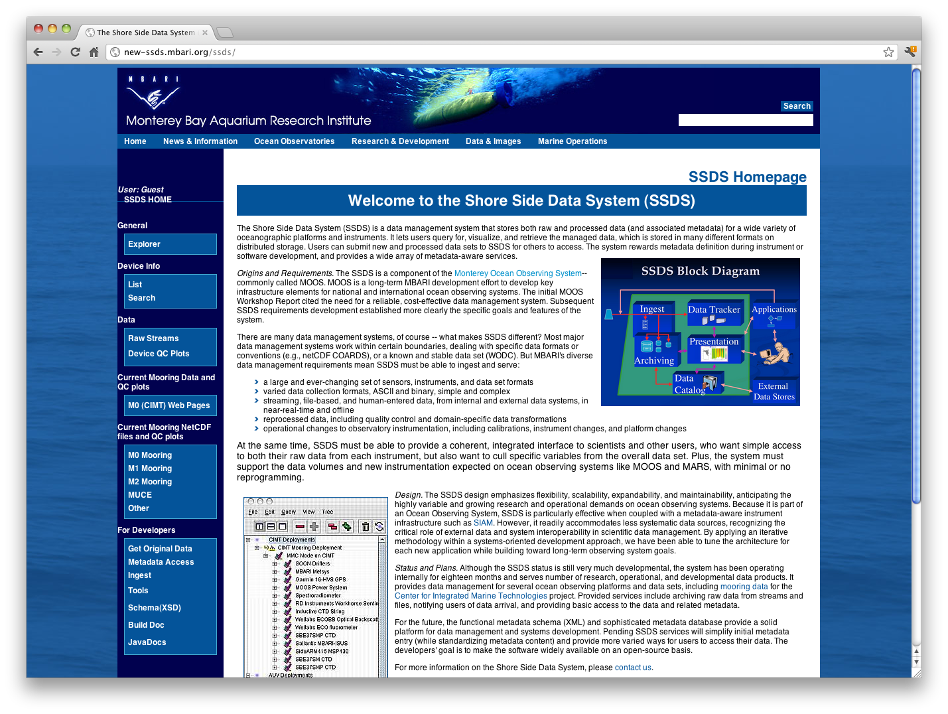

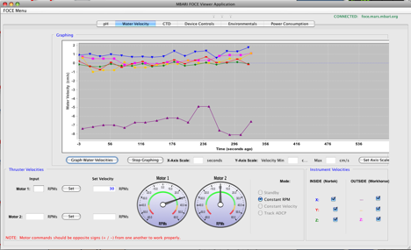
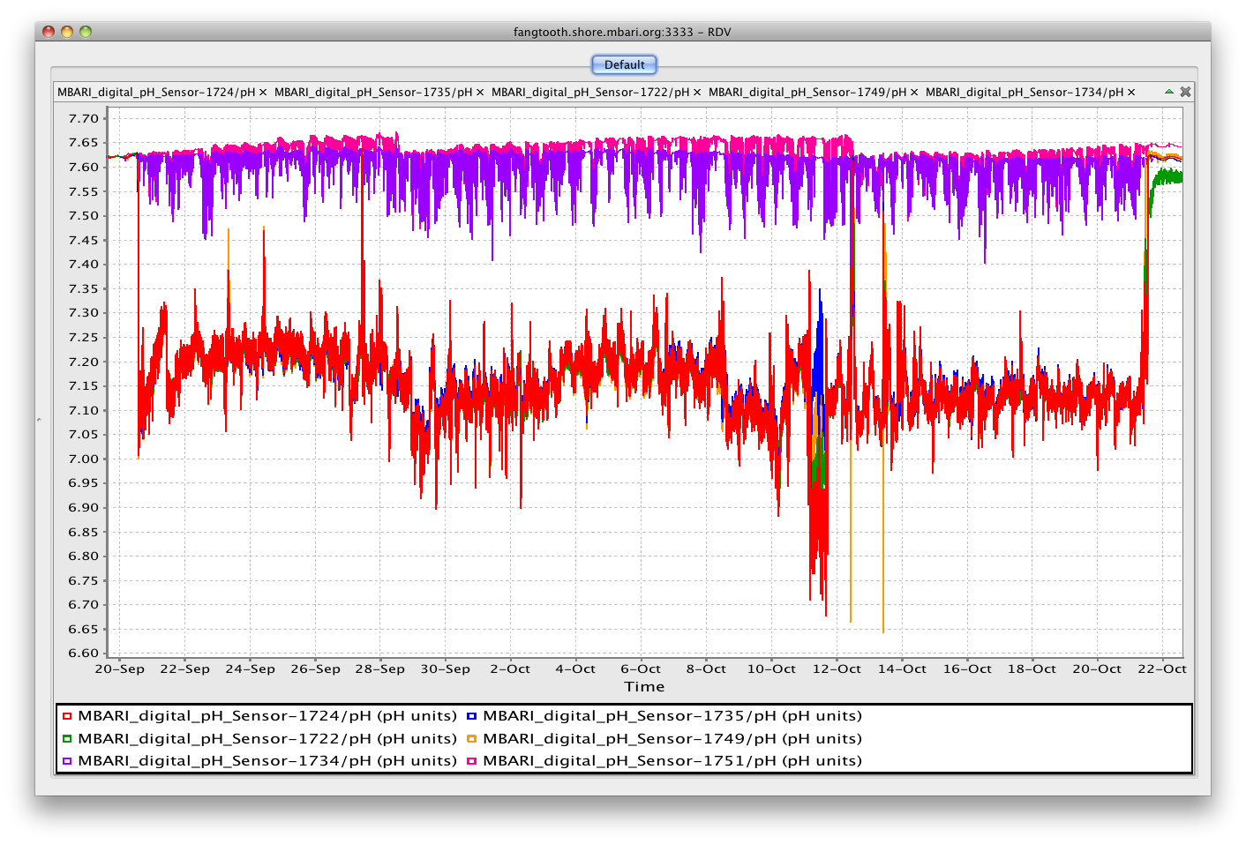

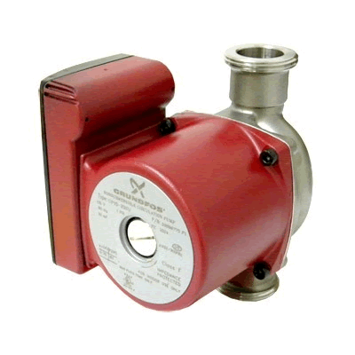
swFOCE Data
Seafloor
Hopkins
Remote
Shore Side Data System (SSDS)
Primary data archive
MBARI internal standard
SSDS Server
Controller
TCP, UDP
HTTPS
Java RMI
Controller
SSDS Data
Archive
Controller
User
Tools
Instrument Data
Archive
HTTPS
Instrument Data
Archive
Local Data
Archive
SSDS
Controller Software
Access
Server
Control Service
Access
Service
Data ACQ
Services
FOCE GUI
Control, monitor
Data ACQ
Services
OSDT?
Data ACQ
Services
OSDT Server
TCP, UDP
OSDT Data
Archive
Data
ACQ
•••
Data
ACQ
Real-time Data Viewer (RDV) OSDT client
Live, post-experiment
data playback
Open Source
DataTurbine
Flow
ESW
CTD
pH
DO
Flow

Slide 5
UI
Help users to understand and simplify key choices
What UI choices will the user make related to UI
  Network, interfaces, security
How do those choices affect concerns (performance, flexibility, ease, cost)
What are pros/cons of various choices
  Cost, power, bandwidth, software skill, processing capability, software/system dependencies
Modularity
  Interfaces that support flexibility in UI choices
  Expansion path: what’s needed up front to start simply and build capability
Sketch out a couple of concepts at either end of the spectrum
Specific choice/detail more important for SWFOCE

Slide 6
UI System Requirements
Network Connectivity (Ethernet, Serial, Wireless)
Health and Status (heartbeat on connection)
Control Application Programming Interfaces (APIs) – System and Instruments
Data Collection APIs
Security:
  User Authentication/Authorization
  Enforce Maintenance or Lockout of System (unless mechanical)
Node/Instrument List (registry)
Metadata access / management
Data Format and Parsing (or pick data format)
System Change Notification (push notification for low bandwidth)
Scaling and Extensibility (all the above for additional instruments)
Data repository for historical data

Slide 7
REQUIREMENTS | xFOCE | SWFOCE
1. Network Connectivity | ■ | ■
2. Health and Status | ■ | ■
3. Control APIs for both System & Instruments | ■ | ■
4. Data Collection APIs | ■ | ■
5. Security | ■ | ■
6. Node/Instrument List (Registry) | ■ | ■
7. Metadata Access Management | ■ | ■
8. Data format and parsing | ■ | ■
9. System Change Notification | ■ | ■
10. Scaling and Extensibility | ■ | ■
11. Data repository | ■ | ■

Slide 8
UI Functions

Slide 9
One end of the spectrum

Slide 10
The other end (swFOCE)

Slide 11
The other end (swFOCE)
COMMS

Slide 12
The other end (swFOCE)
Comms
Transport

Slide 13
The other end (swFOCE)
Comms
Transport
Security

Slide 14
The other end (swFOCE)
Comms
Transport
Security

Slide 15
The take home
Take a controlled, layered approach architecture
Define options for comms
Design transport for system concerns and comms
  RPC
  Messaging
  ?
Design security/safety
Explicit, well document and controlled interfaces/APIs
These core system APIs can be used by any type of client
  Command line
  Direct client application
  Remote Client

