Slide 1
Mechanical Components
Comprising
xFOCE / swFOCE
Farley F. Shane

Slide 2
xFOCE Mechanical
Sub-Systems
        Seafloor System
          Experiment Chamber
          Ancillary Support Equipment
        Surface Support Systems
          Seawater Enrichment System
            Generation
            Delivery
          Power

Slide 3
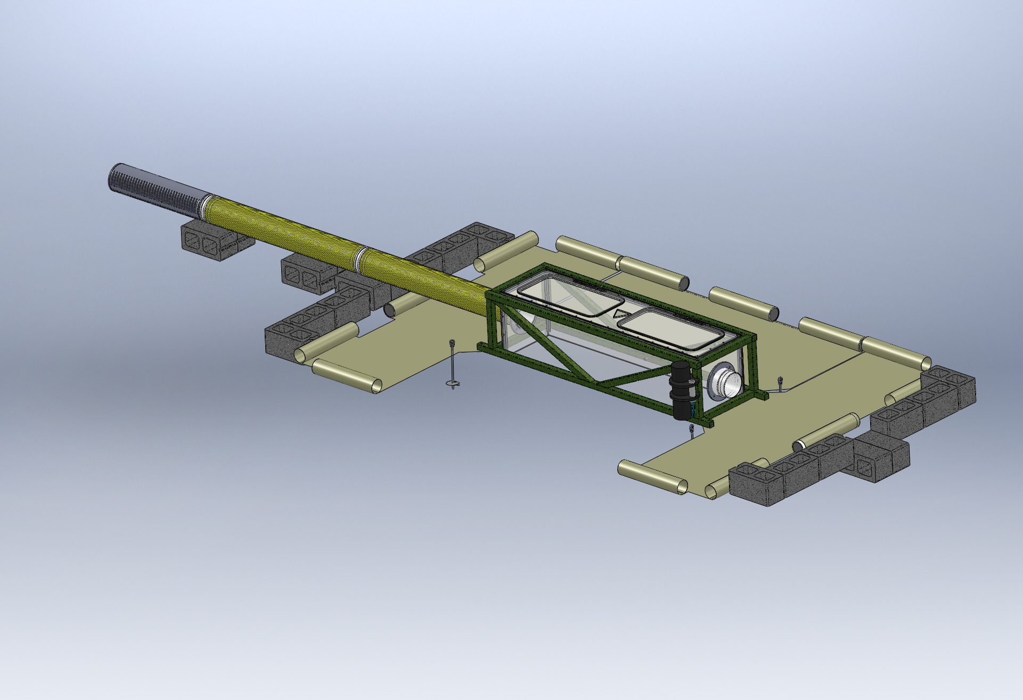
Typical Seafloor System Comprising an xFOCE
As needed
Enriched Seawater Delivery
From Surface
Enriched Seawater
Experiment Chamber
(Both Ends)
Perimeter Weights
Seawater Inlet
Valve Manifold
(Both Ends)
Fan Module
Location
(Both Ends)
Delay Path Section
(Both Ends)
(Conformal Sealing Mat
Removed for Clarity)
Conformal Sealing Mat(s)
Chamber Anchors (at corners)
Shear Skirt
(Bottom Perimeter
Scour Protection Elements

Slide 4

Sample Experiment Chambers
Fans to
Control Current
Buoyancy Blocks
Access Hatches
Control System in
Pressure Housing
Exo-Frame
Fitting for Time
Delay Section
Delay Path
Experiment Chamber
Conformal Seal
Subsea CO2 Reservoir
Enriched SW
Delay Path
Anchors
MBARI Deep FOCE
SWFOCE Prototype
Surge Translation Paddle
Surface Available for Instrumentation
Fan
Fan
Handle
Side Access Opening
(Hatch Not Shown)
Modular Fan Section
Perimeter Shear Skirt
Hemi- Cylindrical
Trapezoidal

Slide 5
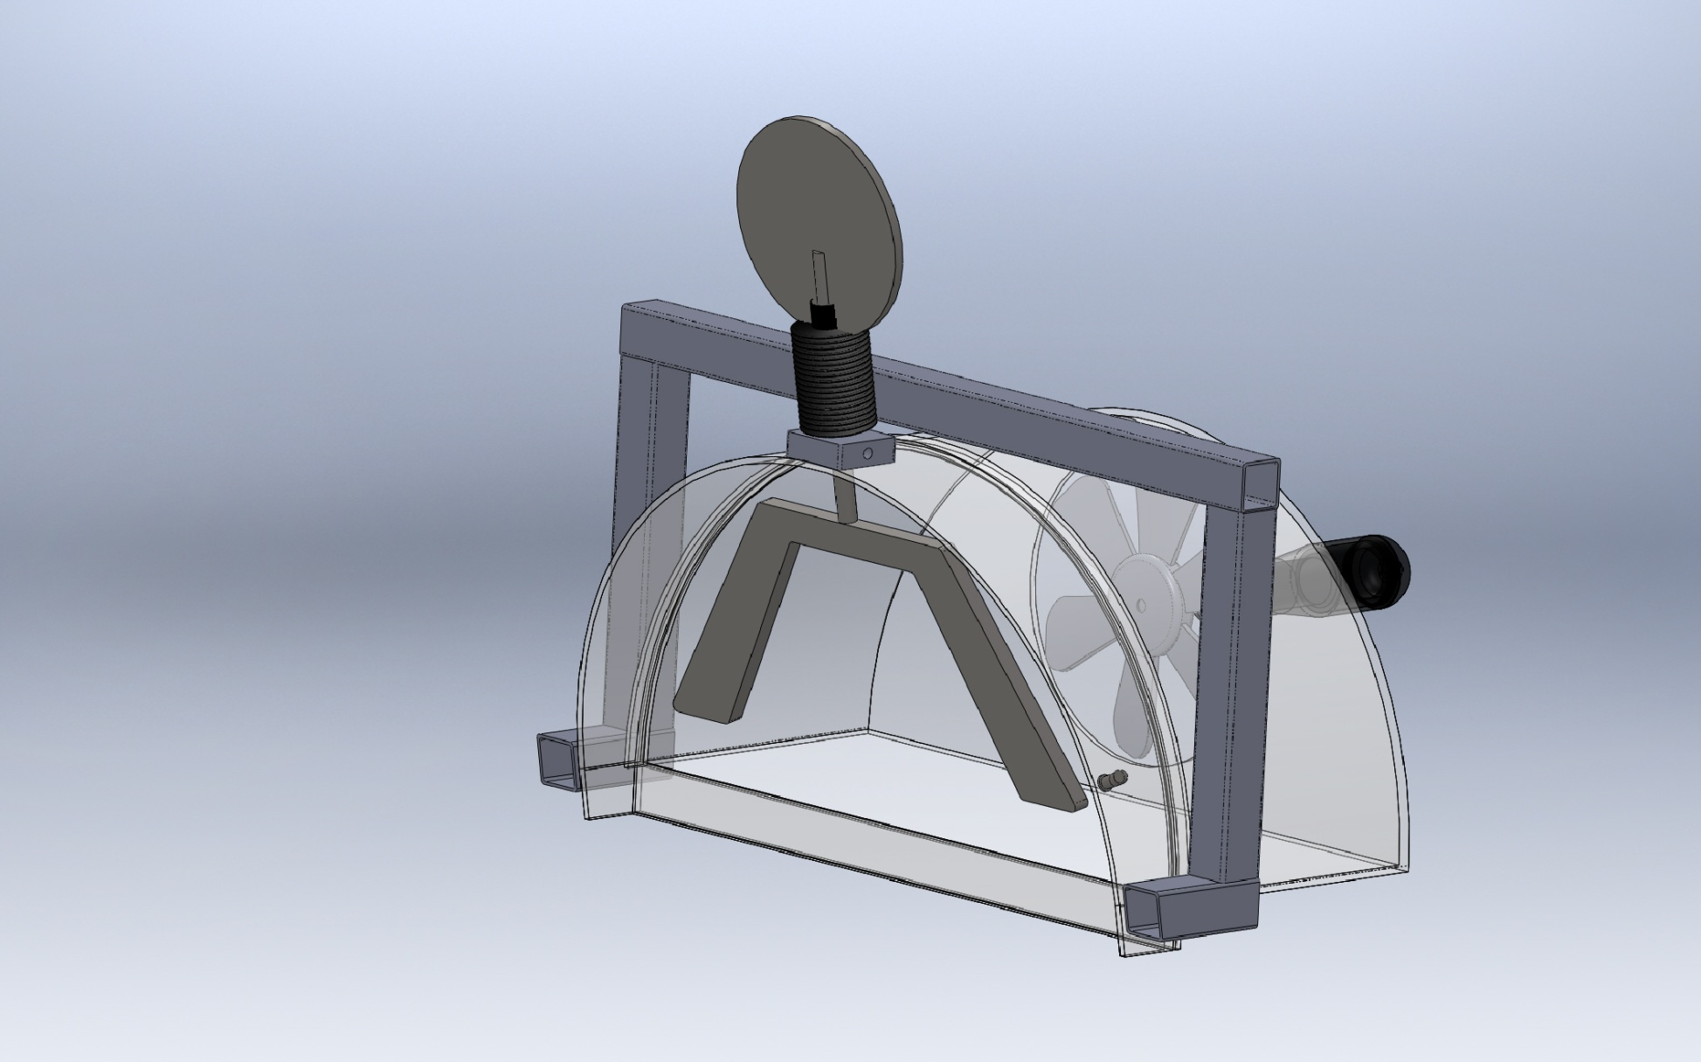
Longitudinal Surge Translation Mechanism
Pivot
Paddles
Section View

Slide 6
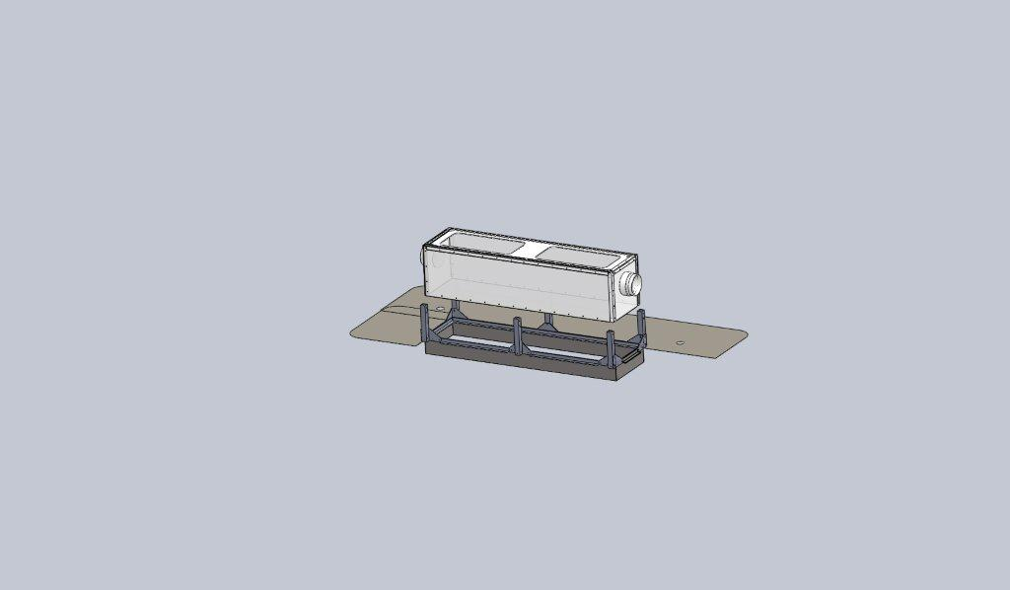
Chamber Dock w/Shear Skirt and Interface Seal
Experiment Chamber
Chamber Dock
Interface Seal
Rigid Perimeter Shear Skirt

Slide 7


Time Delay Mixing Section
Offset pH = -0.7
Bkgrd pH ~ 8.1
Offset pH = -0.5
Offset pH = -0.3
(34.9 deg. F)
Flexible Duct
(39.2 deg. F)
(50 deg. F)
Length
  Calculated using 2 Tau time delay and desired maximum current speed.
  Provides the time necessary for the CO2 and seawater to chemically react and establish stabilized pH.
Cross-sectional area and current speed
(volume/time) will approximate the rate of change
of the enriched seawater in the Experiment Chamber.
(77 deg. F)
Tau = 67.8 secs
*
*
Tau = 51.3 secs
*
Tau = 31.1 secs
*
Curves from the Zeebe-Wolf Gladrow CO2 kinetic model
showing e-folding time at various temperatures as a function
of pH.

Slide 8



Simulating Current
Type
Pro
Con
  Compatible with shallow depths
  Easy maintenance/replacement
  Compatible with available power (AC/DC, etc.)
  Controllable according to requirements
  Capable of reasonable volume/rate delivery
  Low Cost --$50-$200
Requires modification to fit shroud
Not designed for long term running
Requires close monitoring of shaft seals
Trolling Motor
Technadyne Model 520 Brushless DC
  Multiple voltages
  Analog or digital control
  Magnetically coupled prop
CrustCrawler 400 HFL
  0-50VDC 400watts
  300 ft Depth
  Low Cost --$600
High Cost --$3700
Lip seals
Commercial Thruster
  Compatible with shallow depths
  Large range of flow rates
  Large range of DC voltages
  Readily available/replaceable
  Very inexpensive-- $20-$50
  Not designed to run continuously
  May need replacing more often
Submersible Bilge Pump
Brand Names: Rule, Attwood, Lovett, Johnson, Jabsco,…

Slide 9










Anchoring
Semi, Consolidated, and Unconsolidated
Sand, Silt, and Clay
  Deadweight
    Concrete Block
  Direct Embedment
    Helix
    Keyed Plate
  Drag Embedment (Primarily for buoy moorings)
    Danforth, CQR, Delta, Bruce, etc.
  Self –Burying (Better for loose sand, silt)
    Dor-Mor
    Mushroom
Rock and Coral
  Deadweight
    Concrete Block
  Direct Embedment
    Powder Actuated Stud Gun (down to
    46 meter (150’) depth)
    Epoxied Stud (Drilled hole)
    Expansion Bolt (Drilled hole)
Drag
Embedment
Block
Stud
Gun
Self-Burying
Helix
Epoxied Stud

Slide 10
Enriched Seawater Generation and Delivery
(Cont.)
Needs Revision
(SWFOCE shown)

Slide 11
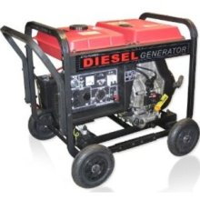


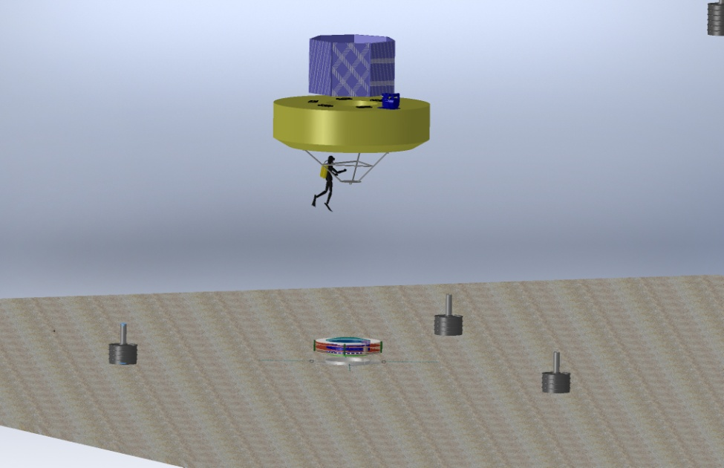
Power for XFOCE
Diesel Generator
3500 Watt Output
0.3 Gallon per Hr.
Onshore Power
  Power supply Unit
  UPS
Remote Location Power
Onshore or Offshore
  Diesel Generator
    Batteries
    Bonus of CO2 generation
  Wind Powered Generator
    Batteries
  Solar Cells
    Batteries
Offshore
  Moored Buoy
Wind Generator
400 Watt Output
240 Watt Panel
Buoy
xFOCE
Anchor
  Moored Buoy

Slide 12


Supporting Information
Extracting CO2 from Exhaust
Carbon Dioxide Emissions from 1 gallon of fuel
Source: U.S. Environmental Protection Agency, "Emission Facts: Average Carbon Dioxide Emissions Resulting from Gasoline and Diesel Fuel," February 2009.

Slide 13
Low Cost Shallow Water Pressure Housing
PVC - Polyvinyl Chloride
strong and rigid
resistant to a variety of acids and bases
maximum usable temperature 140ºF (60ºC)
PVC Pipe
Nominal Pipe Size (inches) | Schedule 40 | Schedule 80
1/2 | 358 | 509
3/4 | 289 | 413
1 | 270 | 378
1 1/4 | 221 | 312
1 1/2 | 198 | 282
2 | 166 | 243
2 1/2 | 182 | 255
3 | 158 | 225
4 |  | 194
5 |  | 173
6 |  | 167
8 |  | 148
(psi)
(psi)
Operating Temp (°F) | De-Rating Factor
73 | 1.00
80 | 0.88
90 | 0.75
100 | 0.62
110 | 0.51
120 | 0.40
130 | 0.31
140 | 0.22
Needs Revision
Design Parameters
Operating Depth = 40 Meters (~131 ft.)
Maximum Pressure = .444 x Depth (ft.) +14.7 psi → 73 psi
Factor of Safety = 2 Therefore 2 x 73 psi = ~146 psi max.

Slide 14
Mechanical Components
Comprising
xFOCE / swFOCE
Farley F. Shane

Slide 15
Typical Seafloor System Comprising an xFOCE
As needed
Enriched Seawater Delivery
From Surface
Enriched Seawater
Experiment Chamber
(Both Ends)
Perimeter Weights
Seawater Inlet
Valve Manifold
(Both Ends)
Fan Module
Location
(Both Ends)
Delay Path Section
(Both Ends)
(Conformal Sealing Mat
Removed for Clarity)
Conformal Sealing Mat(s)
Chamber Anchors (at corners)
Shear Skirt
(Bottom Perimeter
Scour Protection Elements
Notes:
Bricks optional

Slide 16
Sample Experiment Chambers
Fans to
Control Current
Buoyancy Blocks
Access Hatches
Control System in
Pressure Housing
Exo-Frame
Fitting for Time
Delay Section
Delay Path
Experiment Chamber
Conformal Seal
Subsea CO2 Reservoir
Enriched SW
Delay Path
Anchors
MBARI Deep FOCE
swFOCE Prototype
Surge Translation Paddle
Surface Available for Instrumentation
Fan
Fan
Handle
Side Access Opening
(Hatch Not Shown)
Modular Fan Section
Perimeter Shear Skirt
Hemi- Cylindrical
Trapezoidal

Slide 17
swFOCE Assembly w/Shear Skirt and Interface Seal
Experiment Chamber
Chamber Dock
Interface Seal
Rigid Perimeter Shear Skirt
Notes:
Make image bigger
Add “concept” notation
Add real picture of test unit (in situ)

Slide 18
Surge Translation Mechanism
Pivot
Paddles
Section View

Slide 19
Time Delay Mixing Section
Offset pH = -0.7
Bkgrd pH ~ 8.1
Offset pH = -0.5
Offset pH = -0.3
(34.9 deg. F)
Flexible Duct
(39.2 deg. F)
(50 deg. F)
Length
  Calculated using 2 Tau time delay and desired maximum current speed.
  Provides the time necessary for the CO2 and seawater to chemically react and establish stabilized pH.
Cross-sectional area and current speed
(volume/time) will approximate the rate of change
of the enriched seawater in the Experiment Chamber.
(77 deg. F)
Tau = 67.8 secs
*
*
Tau = 51.3 secs
*
Tau = 31.1 secs
*
Curves from the Zeebe-Wolf Gladrow CO2 kinetic model
showing e-folding time at various temperatures as a function
of pH.
Notes:
Add time delay comments at front of talk

Slide 20
Simulating Current
Type
Pro
Con
  Compatible with shallow depths
  Easy maintenance/replacement
  Compatible with available power (AC/DC, etc.)
  Controllable according to requirements
  Capable of reasonable volume/rate delivery
  Low Cost --$50-$200
Requires modification to fit shroud
Not designed for long term running
Requires close monitoring of shaft seals
Trolling Motor
Technadyne Model 520 Brushless DC
  Multiple voltages
  Analog or digital control
  Magnetically coupled prop
CrustCrawler 400 HFL
  0-50VDC 400watts
  300 ft Depth
  Low Cost --$600
High Cost --$3700
Lip seals
Commercial Thruster
  Compatible with shallow depths
  Large range of flow rates
  Large range of DC voltages
  Readily available/replaceable
  Very inexpensive-- $20-$50
  Not designed to run continuously
  May need replacing more often
Submersible Bilge Pump
Brand Names: Rule, Attwood, Lovett, Johnson, Jabsco,…

Slide 21

Anchoring
Semi, Consolidated, and
Unconsolidated Sand, Silt, and Clay
Deadweight
  Concrete Block
Direct Embedment
  Helix
  Keyed Plate
Drag Embedment (Primarily for buoy moorings)
  Danforth, CQR, Delta, Bruce, etc.
Self –Burying (Better for loose sand, silt)
  Dor-Mor
  Mushroom
Rock and Coral
Deadweight
  Concrete Block
Direct Embedment
  Powder Actuated Stud Gun (down to
  46 meter (150’) depth)
  Epoxied Stud (Drilled hole)
  Expansion Bolt (Drilled hole)
Drag
Embedment
Block
Stud
Gun
Self-Burying
Expansion Bolt
Epoxied Stud
Helix

Slide 22
Power Options for xFOCE
Diesel Generator
3500 Watt Output
0.3 Gallon per Hr.
Onshore Power
  Power supply Unit
  UPS
Remote Location Power
Onshore or Offshore
  Diesel Generator
    Batteries
    Bonus of CO2 generation
  Wind Powered Generator
    Batteries
  Solar Cells
    Batteries
Offshore
  Moored Buoy
Wind Generator
400 Watt Output
240 Watt Panel
Buoy
xFOCE
Anchor
  Moored Buoy
Notes:
Check power consumption for half power (2 kW for 0.3 Gal/h)

Slide 23

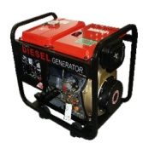


Supporting Information
Exhaust used for CO₂
Diesel Fuel
Option for Extracting CO₂ from Exhaust
CO₂ Mix Electronics
Particle Scrubber
Supplemental
System Control Electronics
Carbon Dioxide Emissions from 1 gallon of fuel
Source: U.S. Environmental Protection Agency, "Emission Facts: Average Carbon Dioxide Emissions Resulting from Gasoline and Diesel Fuel," February 2009.
Notes:
Option for xFOCE (should be explicit for

Slide 24
Low Cost Shallow Water Pressure Housing
PVC - Polyvinyl Chloride
strong and rigid
resistant to a variety of acids and bases
maximum usable temperature 140ºF (60ºC)
PVC Pipe
Nominal Pipe Size (inches) | Schedule 40 | Schedule 80
1/2 | 358 | 509
3/4 | 289 | 413
1 | 270 | 378
1 1/4 | 221 | 312
1 1/2 | 198 | 282
2 | 166 | 243
2 1/2 | 182 | 255
3 | 158 | 225
4 |  | 194
5 |  | 173
6 |  | 167
8 |  | 148
(psi)
(psi)
Operating Temp (°F) | De-Rating Factor
73 | 1.00
80 | 0.88
90 | 0.75
100 | 0.62
110 | 0.51
120 | 0.40
130 | 0.31
140 | 0.22
Needs Revision
Design Parameters
Operating Depth = 40 Meters (~131 ft.)
Maximum Pressure = .444 x Depth (ft.) +14.7 psi → 73 psi
Factor of Safety = 2 Therefore 2 x 73 psi = ~146 psi max.

Slide 25


xFOCE Engineering Trades
Since these wavelengths penetrate water easier but most plastic materials respond poorly to high freq light the materials selections will focus on this end of the spectrum
Color Frequency Wavelength
violet 668–789 THz 380–450 nm
blue 631–668 THz 450–475 nm
cyan 606–630 THz 476–495 nm
green 526–606 THz 495–570 nm
yellow 508–526 THz 570–590 nm
orange 484–508 THz 590–620 nm
red 400–484 THz 620–750 nm
infrared longer than 750 nm
The selection of materials will likely transmit this end of the spectrum fairly well but in selection, if required, we would trade attenuation here to maximize shorter frequencies.
Acrylic (vs Polycarbonate) has less attenuation overall and carries much further into the ultraviolet when comparing the blue lines.

Slide 26
