Slide 1
Mechanical Components
Comprising
xFOCE / swFOCE
Farley F. Shane

Slide 2
xFOCE Mechanical
Sub-Systems
        Seafloor System
          Experiment Chamber
          Ancillary Support Equipment
        Surface Support Systems
          Seawater Enrichment System
            Generation
            Delivery
          Power

Slide 3
Typical Seafloor System Comprising an xFOCE
Enriched Seawater Delivery Line
As needed
From Surface
Scour Protection Elements
Experiment Chamber
Perimeter Weights
Seawater Inlet
Delay Path Section
Scour Protection Elements
Fan
Chamber Anchors (at 4 corners)
Seawater Inlet
Fan
Conformal Sealing Mat(s)
Delay Path Section

Slide 4
Experiment Chamber
Requirements
  Diver Accessible
    40 meters or less
  Design focus on modularity
    Addition, Removal, or maintenance of equipment and instrumentation
  Sized for desired site and area of experimentation.
  Capable of accommodating all required instrumentation and ancillary equipment.
  At least one seawater entrance and one exit.
    Permits local current access.
    Permits active simulation of local current.
      Fan or Pump
  Access Hatch(es)
    Internal observation subject access.
    Access for maintenance of chamber, internal instrumentation, and ancillary equipment.
  Delay Path Connections
    Inlet to the Chamber for the mixed Enriched Seawater.
    Permits attachment of the duct
    Inlet for nutrients
  Anchoring points
  Site Interface Seal
    Mitigate enriched seawater leakage/ intrusion.
    Inhibit undesired local critter incursion.
  Optional
    Local surge internally translated by mechanical or other method.
    Detachable baseplate for securing to the site for ease of replacing/cleaning chamber.

Slide 5

Sample Experiment Chambers
Fans to
Control Current
Buoyancy Blocks
Access Hatches
Control System in
Pressure Housing
Exo-Frame
Fitting for Time
Delay Section
Delay Path
Experiment Chamber
Conformal Seal
Subsea CO2 Reservoir
Enriched SW
Delay Path
Anchors
MBARI Deep FOCE
SWFOCE Prototype
Surge Translation Paddle
Surface Available for Instrumentation
Fan
Fan
Handle
Side Access Opening
(Hatch Not Shown)
Modular Fan Section
Perimeter Shear Skirt
Hemi- Cylindrical
Trapezoidal

Slide 6
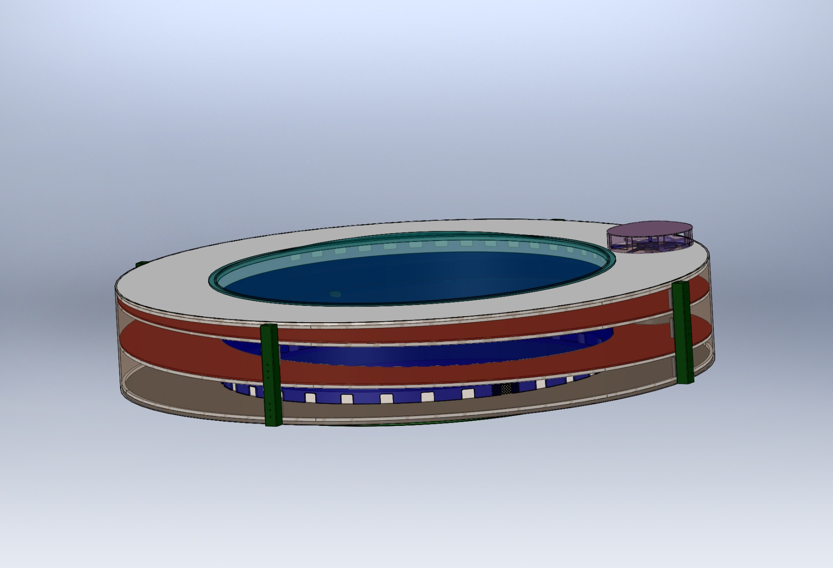
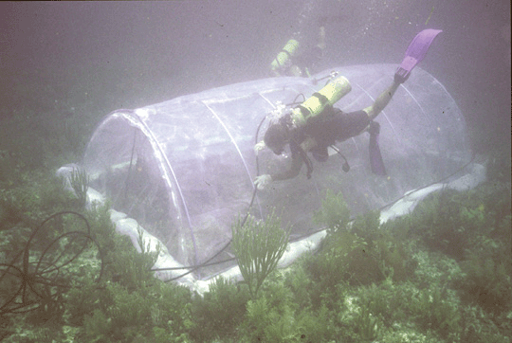
Sample Experiment Chambers
(Cont.)
Experiment Chamber
Transparent Cover
Exhaust Vents
Exhaust
Fan
Enriched SW
Inlet
Integral Delay Path
Inlet vents
Guggenheim Museum/Stadium Concept
Compliant Chamber
(Not a FOCE as shown)
Submersible Habitat for Analyzing Reef Quality (SHARQ)
Polyethylene film
Frame made of plastic or metal tubing.
Requires a fairly benign environment.
Translates surge.
Isolates waterborne nutrients.
Requires creative instrument attachment.

Slide 7
Chamber Shear Skirt and Interface Seal
Chamber Shear Skirt
  Extend into the seafloor 8-10 cm.
    Resists lateral movement
    Seals perimeter of chamber at seafloor
    Assists in preventing critter intrusion
Chamber Interface Seal
  Extend 30 – 40 cm on seafloor surface from perimeter of Chamber
  Assists in sealing chamber at uneven seafloor surface
  Can assist in scour prevention and erosion from currents
  Variety of applicable materials
    Canvas
    Reinforced Plastic Sheet
    Rubber/Nitrile/ sheet
  Should be weighted
    Lead
    Concrete blocks
    Grout Bags

Slide 8


Time Delay Mixing Section
Duct that provides the necessary time for the CO2
and seawater to chemically react and establish
a stabilized pH.
Reference the Zeebe-Wolf Gladrow CO2 Kinetic
Model to determine Tau (shown previously and
here).
Duct length is determined by using a 2 Tau time delay and the desired maximum current speed.
The cross-sectional area and the current speed
(volume/time) will approximate the rate of change
of the enriched seawater in the Experiment Chamber.
Offset pH = -0.7
Bkgrd pH ~ 8.1
Offset pH = -0.5
Offset pH = -0.3
Tau = 67.8 secs
*
*
Flexible Duct
Tau = 51.3 secs
*
Tau = 31.1 secs
*
Commonly used for air handling
Integrated coil to maintain flow (use plastic instead of metals)
Use all plastic.
2 “ - 12” diameter commonly available
Low cost
Curves from the Zeebe-Wolf Gladrow CO2 kinetic model
showing e-folding time at various temperatures as a function of pH.

Slide 9



Components to Simulate Current
Trolling Motors
  Compatible with shallow depths
  Reasonably predictable reliability (MTBF)
  Easy maintenance/replacement
  Compatible with available power (AC/DC, etc.)
  Controllable according to requirements
  Capable of reasonable volume/rate delivery
Commercial Thrusters
  Technadyne Model 520 DC Brushless - $3700, 520 Watts, various voltages available, analog or digital control, magnetically coupled prop
  CrustCrawler 400 HFL - $600, 0-50 VDC, 400 watts, lip seals, 300 ft
Submersible Bilge Pumps
  Compatible with shallow depths
  Large range of flow rates
  Large range of DC voltages
  Readily available/replaceable
  Very inexpensive
  Brand Names: Rule, Attwood, Lovett, Johnson, Jabsco,…
  May need replacing more often
  Not designed to run continuously
Trolling Motor
Commercial Thruster
Submersible Bilge Pump

Slide 10
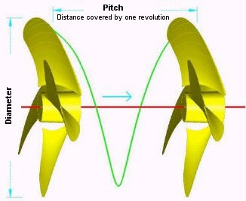
Components to Simulate Current
(Cont.)
Custom Thruster using Propellor and Motor
Disk Theory for Moving Water
Ppropellor x RPM x Areapropellor / 100 = Volumewater / minute
Where:
* Ppropellor = Propellor Pitch (cm.)
RPM = Revolutions per minute
Areapropellor = Area of the diameter projected by rotated propellor (cm. sq.)
Volumewater = volume of water moved by propellor (liters)
Equation for motor H.P. Requirement
HP = (psi x GPM) / (1714 x efficiencyMotor)
*NOTE: Pitch is defined as "the distance a propellor would move in one revolution
if it were moving through a soft solid, like a screw through wood." For example,
a 21-pitch propellor would move forward 21 inches (53.3 cm) in one revolution.

Slide 11
Anchoring
Anchors
  Related to type of seafloor, longevity, access, etc.
    Semi, Consolidated, and Unconsolidated Sand, Silt, and Clay
      Deadweight
        Concrete Block
        Other
      Direct Embedment
        Helix
        Keyed Plate
      Drag Embedment (Primarily for buoy moorings)
        Danforth, CQR, Delta, Bruce, etc.
      Self –Burying (Better for loose sand, silt)
        Dor-Mor
        Mushroom
    Rock and Coral
      Deadweight
        Concrete Block
        Other
      Direct Embedment
        Powder Actuated Stud Gun (down to 46 meter (150’) depth)
        Epoxied Stud (Drilled hole)
        Expansion Bolt (Drilled hole)

Slide 12











Examples of Anchors
CQR
Epoxied Anchor Pins in Coral
Installation of
Anchor Pins
Claw or Bruce
Danforth
Drag Embedment Anchors for Mooring Buoy
Powder Actuated Stud Gun
Self Embedment Anchors
Deadweight Block
Single or
Multiple Helix
Dor-Mor
Helix Anchor

Slide 13
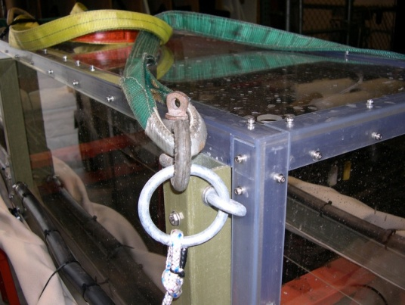
Anchor Notes
Helix type easy to install by diver
  Screw-It Beach anchor, removable handle, Corrosion resistant - $70
  Ironwood Pacific – 21”, 4” helix, powder coated steel, $40 each
  MilSpec Anchors -- set of 4 for $23
Keyed Plate type requires digging out for retrieval
  Triangular earth anchors with galvanized cables, set of 4. ~$40
Drag embedment anchors require setting by boat.
Installation of anchor pins require drilling holes in coral or rock.
SWFOCE method of securing anchor to frame

Slide 14
Enriched Seawater Generation and Delivery
  This system mixes CO2 with seawater and delivers the enriched seawater to each Seafloor Experiment System.
  The Delivery System is comprised of at least the following components:
    Mixing Tank
      Contains CO2 and seawater at 2 atmospheres.
      Designed for the creation and buffered storage of
      enriched seawater.
      Adequate volume to supply the requirements for all Experiment Systems
      Vaporizing Nozzle(s) to create enriched seawater
      Instrumentation to assure adequate monitoring and mixing of enriched seawater.
    Pump and Motor
      Provides recirculating seawater to mixing tank
      Provides enriched seawater to experiment systems
    Seawater Delivery Source
    CO2 Delivery Source
    Ancillary equipment and instrumentation
      Valves
      Gauges
      Filters
      Sensors

Slide 15
Enriched Seawater Generation and Delivery
(Cont.)
(SWFOCE shown)

Slide 16


Supporting Information
Optional CO2 Use from Exhaust
Carbon Dioxide Emissions from 1 gallon of fuel
Source: U.S. Environmental Protection Agency, "Emission Facts: Average Carbon Dioxide Emissions Resulting from Gasoline and Diesel Fuel," February 2009.

Slide 17



Power for XFOCE
Onshore Power
  Power supply Unit
  UPS
Diesel Generator
3500 Watt Output
0.3 Gallon per Hr.
Remote Location Power
Onshore or Offshore
  Diesel Generator
    Bonus of CO2 generation
  Wind Powered Generator
    Batteries
  Solar Cells
    Batteries
Wind Generator
400 Watt Output
240 Watt Panel

Slide 18
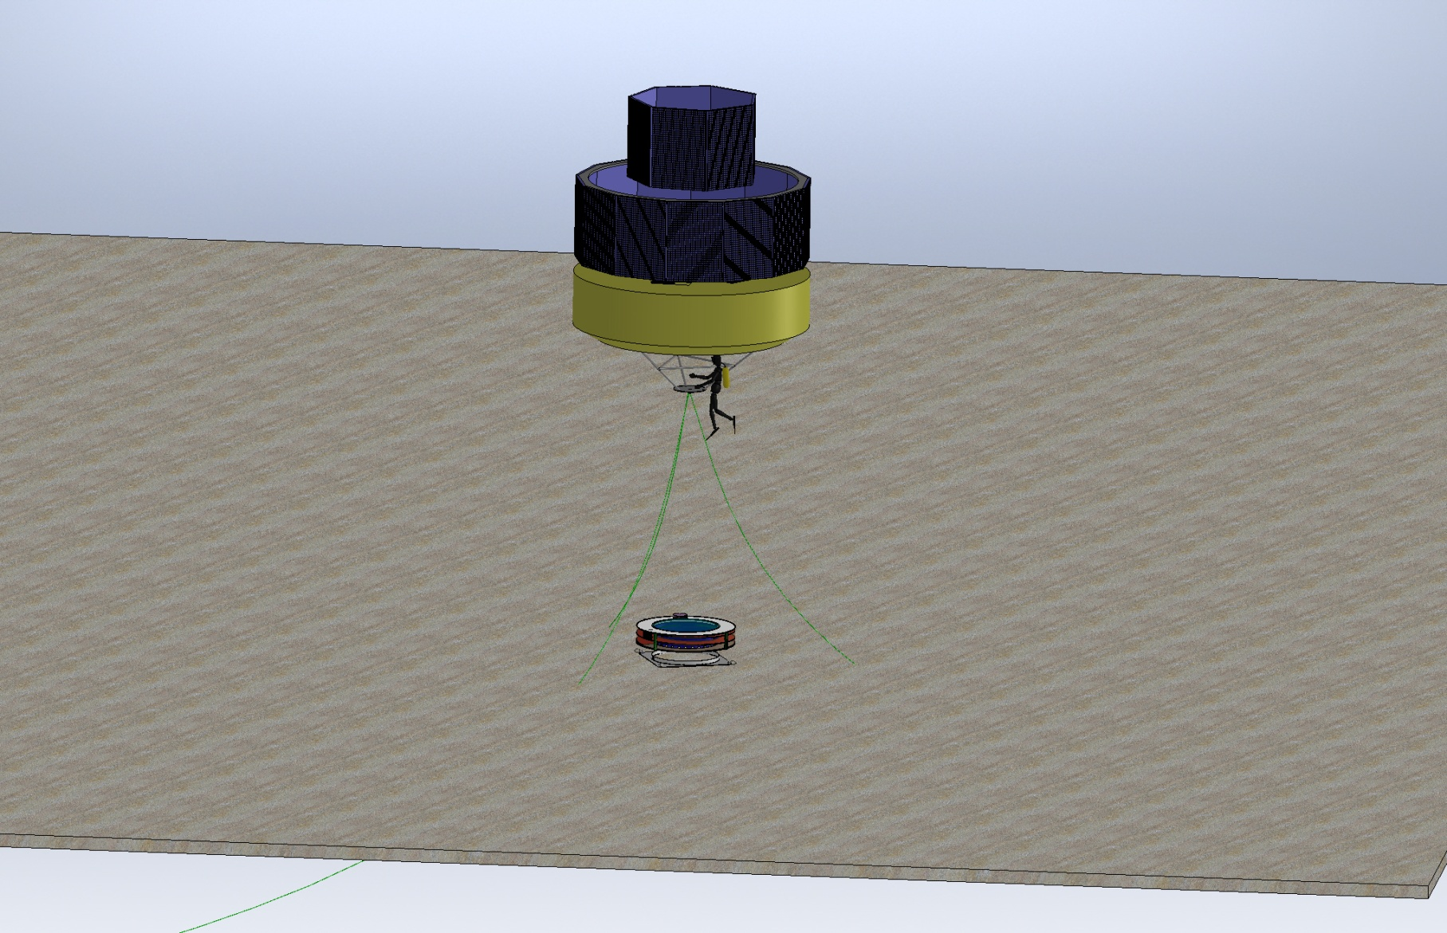
Option for Power to Remote xFoce
Power from Solar Cells on Buoy

Slide 19
XFOCE Website Reference Material
Spreadsheet
Estimation of Shallow-FOCE CO₂ enriched seawater release rate:
Assumptions:
 | 1. Shallow FOCE is smaller than FOCE at MARS by 1/2: 0.5m X 0.5m.
 | 2. Water velocity thru flume set as "on average" a 1 cm/s flow through chamber.
 |  | - residence time for a 1 meter length chamber is 100 secs.
 |  | - internal cyclic flow indiced by a paddle.
 |  | cm/sec | ht (m) | w (m)
 |  | 10 | 0.5 | 0.5 | 25 | L/s
 | 3. Concentration of CO2-ESW: |  |  | 40 | mM | pH: | 4.75
 | 4. FOCE uses different amounts of CO2 depending upon pH offset:
 |  |  |  |  | Vol CO2-ESW |  |  |  | Amt CO2
 |  | pH offset | +TCO2 | Amt CO2 | mL/s | L/min | L/day |  | kg/day | lb/day
 |  |  | μmol/kg | µmole/s
 |  | 0.2 | 74.5 | 1862.5 | 46.563 | 2.794 | 4023 |  | 7.082 | 15.61
 |  | 0.4 | 136.1 | 3402.5 | 85.062 | 5.104 | 7349 |  | 12.938 | 28.52
 |  | 0.8 | 257.3 | 6432.5 | 160.813 | 9.649 | 13894 |  | 24.459 | 53.92
 |  | 1.5 | 767.7 | 19192.5 | 479.813 | 28.789 | 41456 |  | 72.978 | 160.89

Slide 20
XFOCE Website Reference Material
Spreadsheet
 |  | FOCE Delay Section Lengths and Flow(Q)
Assumption for this version - pH delta of - 0.3, 10 deg. C, so 2 Tau ~ 135 seconds |  |  |  |  |  |  |  |  | 4/2/2012
 |  | -Ambient pH ~8.1
 |  | -Mixing Section is Round tubing or pipe
 |  | -Flow thru Test Section is the bulk (average) flow
INPUTS | 47.0 | cm, Height of Test Section |  |  |  | Note: swFOCE dim's Ht, W, L
 |  |  |  |  |  |  | 47cm,49cm, 2m
 | 49.0 | cm, Width of Test Section
 | 2.0 | meters, Length of Test Section
 | 2 | cm/second, Flow velocity in Test Section
 | 30.5 | cm, Diameter of Mixing Section tubing |  |  |  | 12.0 | inches
RESULTS | 2303.0 | cm sqd, Cross Sectional Area of Test Section
 | 730.2 | cm sqd, Cross Sectional Area of Mixing Section
 | 6.3 | cm/sec, Flow vel in mixing section
 | 8.5 | meters, Length of mixing section req'd for 2 Tau
 | 4.6 | Liters/sec, Quantity of S.W. req'd
 | 16582 | Liters/hr
 | 4381 | Gallons/hr
 | 100 | seconds, Residence Time in Test Section

Slide 21
Flow Rate of Stabilized Enriched Seawater Relative to Chamber Cross-Section and Internal Current Speed
XFOCE Website Reference Material
*Liters/minute (Gallons/minute)
Current Speed
Cross Section of Experiment Chamber | 2 cm/sec | 4 cm/sec | 6 cm /sec | 8 cm/sec | 10 cm/sec
.5 m x .5 m | 602 (159) | 1200 (317) | 1802 (476) | 2400 (634) | 3001 (793)
.25 m x .25 m | 299 (79) | 450 (119) | 901 (238) | 1200 (317) | 1503 (397)
.13 m x .13 m | 151 (40) | 299 (79) | 450 (119) | 598 (158) | 749 (198)
*3.785 liters = 1 gallon
NOTE: The relative cross-sectional areas of the time delay mixing section (provides
delivery of stabilized enriched seawater) and the experiment chamber must
be considered when desiring to minimize the time for stabilizing pH in the
chamber.

Slide 22
XFOCE Website Reference Material
Potential Polymer Materials for Large Panels
Polycarbonate-colored or clear
Nearly unbreakable
Scratch resistant
Relatively easy to fabricate
Excellent corrosion resistance
High notch sensitivity (crack propagation)
Difficult to saw
Visible light transmission good ~86%
Yellows when exposed to UV
Acrylic- colored or clear
Fair impact resistance
Excellent corrosion resistance
High notch sensitivity (crack propagation)
Difficult to work with
Requires non-solvent based cutting fluid during fabrication
Visible light transmission is very good, 92%
UV transmission falls off rapidly at ~350 nm
  G UVT formulation available with 275 nm cut-off
Less yellowing from UV
Easily bonded with methyl chloride, or Weld-On #16
PVC – pale blue or clear
Fair impact resistance
Fair notch sensitivity (crack propagation)
Good UV resistance
  Thicker materials retain resistance longer
  Starts to yellow over long term > 20 months
Good chemical resistance
Excellent corrosion resistance

Slide 23
Potential Materials and Components
p.2
XFOCE Website Reference Material
(Cont.)
If using an External Frame to support Panels:
FRP-fiber reinforced plastic (fiberglass)
  Easy to work with
  Available in many structural shapes
  Excellent for long term immersion
  Can dull cutting/boring tools quickly
  Does not hold threads well
  Sheet metal screws can be used in >.25“ thick materials.
6061 Aluminum
  Easy to work with
  Available in many structural shapes
  Corrosion issues when in contact with SS fasteners
    Insulating washers may be used
  Excellent for long term immersion
    Cathodic protection may be used
PVC - polyvinyl chloride
  Easy to work with
    Drilled and tapped easily
    Bonds well with adhesives
  Available in many structural shapes
  Clear version is UV resistant
    Angles used for reinforcing edges allow good passage of light
UHMW- ultra-high molecular weight polyethylene
  Easy to work with
  Common shapes are sheets, bars, rods
  Lower specific gravity than seawater
  Black formulation precludes light but is UV resistant
COMPONENTS
LATCHES
  Must be sturdy
  Corrosion resistant
  Easily operated by diver with gloves on
  Commercially available
    Cabinet type, SS
    Block and pin, plastic or SS
  Custom Design
    Cam lock, single or paired
    Other
HINGES
Must be sturdy, corrosion resistant
-piano type, SS
-solid rubber, 1/8-1/4” thick, screwed in with facing plate
FASTENERS
Use stainless steel
  316 is preferable, 18-8 is acceptable

Slide 24
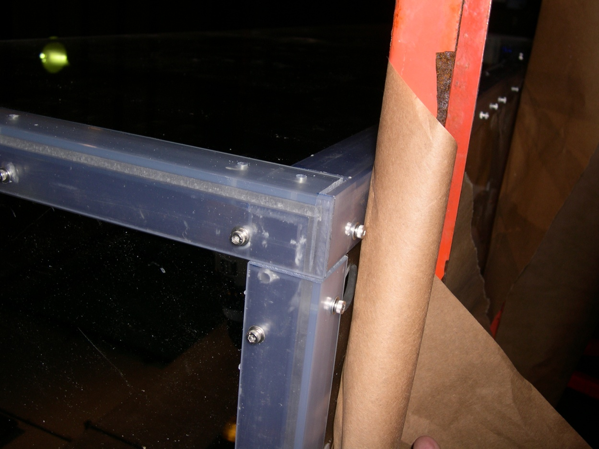
Proven Fabrication Methods
XFOCE Website Reference Material
Outer Angle
Inner Angle
Wall
Clearance
Outer Angle
Wall
Threaded
Inner Angle
Fastening Angles for Stiffness
Use of appropriate materials will maximize light
transmission into the test chamber.
-1/4” Clear Acrylic Panels
-3/16” x 1.5” x 1.5” clear PVC angle used as outside support structure.
-3/16” x1.25” x1.25” clear PVC used inside.
-8-32 x 5/8” screws tapped into inner PVC pieces, 6” Center to Center.
FABRICATION Note: Drilling holes in plastics, polycarbonate and especially acrylic can be difficult because the drill tends to grab and “dig” into the material. Modify the cutting edge of the drill’s flutes by filing or sanding the cutting edge to a more vertical “scraping” edge (i.e. perpendicular to the surface being cut). Keep it sharp and a very nice hole without breakout on the back surface will result.

Slide 25
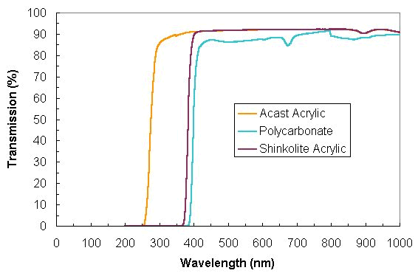
XFOCE Website Reference Material
Light Transmission through
Polycarbonate and Acrylic

Slide 26
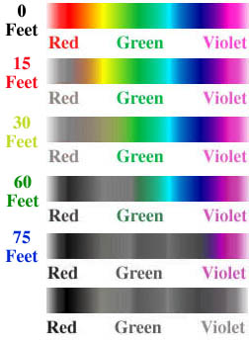
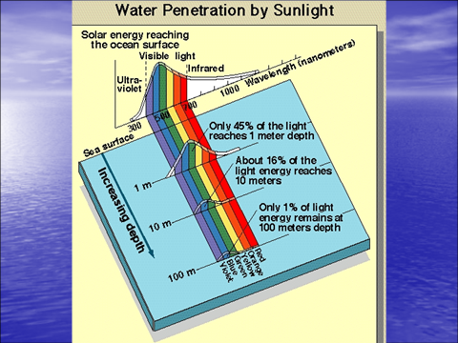
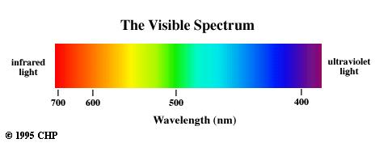
400nm through 700 nm
XFOCE Website Reference Material
Photosynthetically Active Radiation (PAR)
(0 Meters)
(4.6 Meters)
(9.1 Meters)
(18.3 Meters)
(22.9 Meters)

Slide 27
XFOCE Website Reference Material
Low Cost Shallow Water Pressure Housing Case Fabrication
PVC - Polyvinyl Chloride
strong and rigid
resistant to a variety of acids and bases
maximum usable temperature 140ºF (60ºC)
PVC
Nominal Pipe Size (inches) | Schedule 40 | Schedule 80
1/2 | 358 | 509
3/4 | 289 | 413
1 | 270 | 378
1 1/4 | 221 | 312
1 1/2 | 198 | 282
2 | 166 | 243
2 1/2 | 182 | 255
3 | 158 | 225
4 | 133 | 194
5 | 117 | 173
6 | 106 | 167
8 | 93 | 148
10 | 84 | 140
12 | 79 | 137
Operating Temp (°F) | De-Rating Factor
73 | 1.00
80 | 0.88
90 | 0.75
100 | 0.62
110 | 0.51
120 | 0.40
130 | 0.31
140 | 0.22
Operating Depth = 40 Meters (~131 ft.)
Maximum Pressure = .444 x Depth (ft.) +14.7 psi → 73 psi
Factor of Safety = 2 Therefore 2 x 73 psi = ~146 psi

