Slide 1
Supporting Information
Notes:
Option for xFOCE (should be explicit for

Slide 2
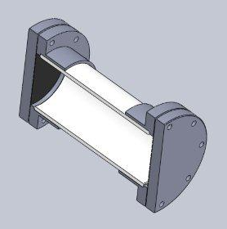
Low-cost Shallow Water Pressure Housing
Van-Stone / Socket Flange
PVC - Polyvinyl Chloride
strong and rigid
resistant to a variety of acids and bases
maximum usable temperature 140ºF (60ºC)
Cap
PVC Pipe
Nominal Pipe Size (inches) | Schedule 40 | Schedule 80
1/2 | 358 | 509
3/4 | 289 | 413
1 | 270 | 378
1 1/4 | 221 | 312
1 1/2 | 198 | 282
2 | 166 | 243
2 1/2 | 182 | 255
3 | 158 | 225
4 |  | 194
5 |  | 173
6 |  | 167
8 |  | 148
(psi)
(psi)
Operating Temp (°F) | De-Rating Factor
73 | 1.00
80 | 0.88
90 | 0.75
100 | 0.62
110 | 0.51
120 | 0.40
130 | 0.31
140 | 0.22
PVC Pipe
Gasket
Design Parameters
Operating Depth = 40 Meters (~131 ft.)
Maximum Pressure = .444 x Depth (ft.) +14.7 psi → 73 psi
Factor of Safety = 2 Therefore 2 x 73 psi = ~146 psi max.
Notes:
This is a generic Sch80 PVC, COTS pressure housing good to diver depths.
Flanges glued on with PVC cement, Butyl or Neoprene 1/8" rubber discs for
seals, caps bolted on.

