Slide 1
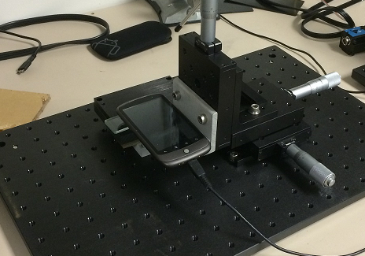
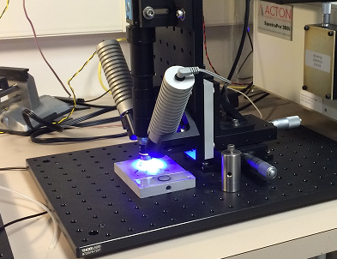
Desktop testbed: goals
Gain familiarity with object and methods
  Fluidics
  Optics
Find out what is possible
  Scale performance to deployable prototype
  Design optimization
Test some ideas
  Pressure gradients
  Bulk vs. hydro focusing

Slide 2
Key criteria
Adaptability to autonomous platform
Science “performance”
Maintenance stability
Actionable data
Size, power
Population diversity
Maintenance
Trigger sampling
Shock
Throughput
Alignment
Telemetry
Tilt
Temporal, spatial resolution
Biofouling
Screening/sorting
Limiting use on many platforms
Length of deployment
Population statistics in real time is challenging
Configurability
Unattended operation

Slide 3
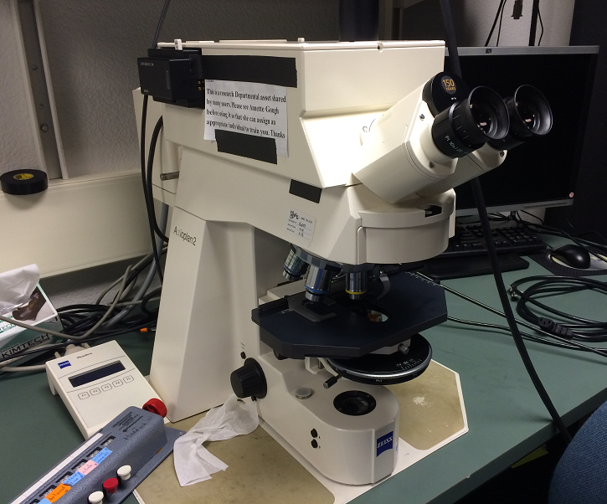
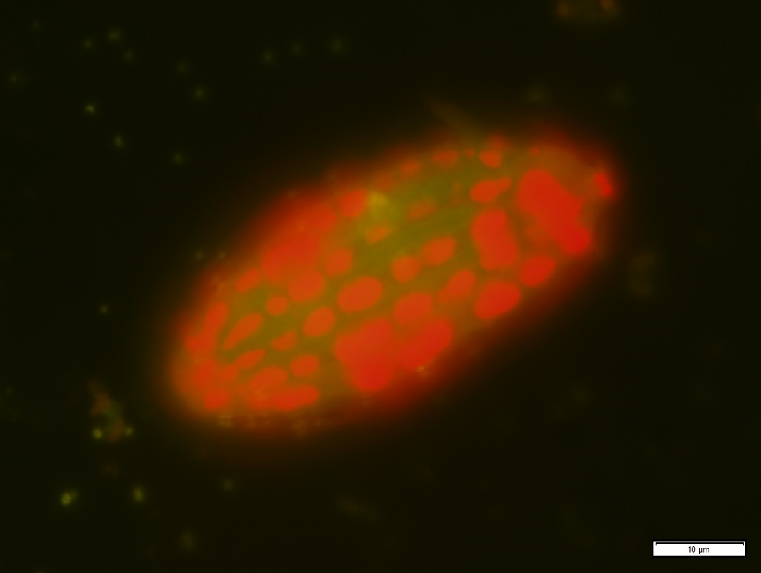
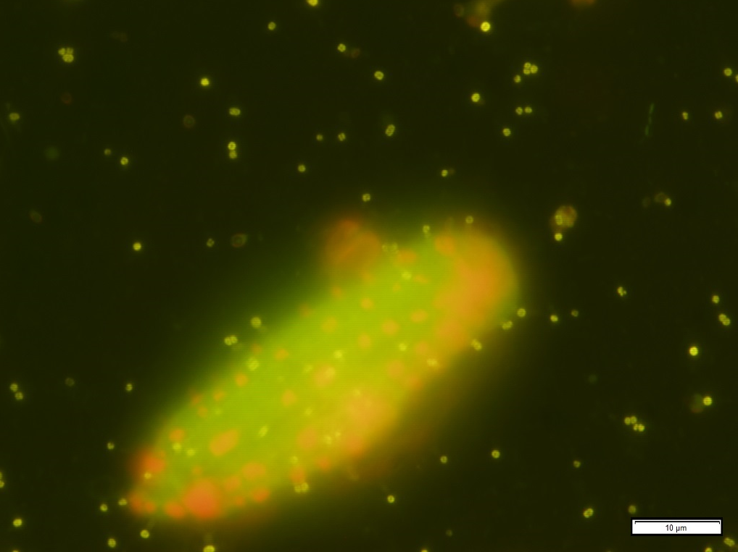
Benchmark: fluorescent imaging
Zeiss Axioplan fluorescence microscope
Courtesy of Lisa Ziccarelli
Red: chlorophyll
Ciliate with sequestered chloroplasts at 100x
Different physiological state?

Slide 4
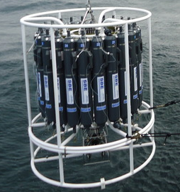
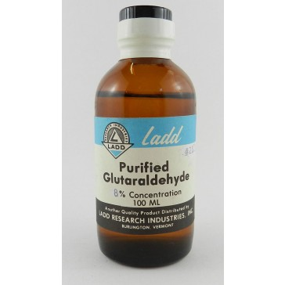
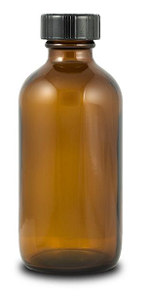
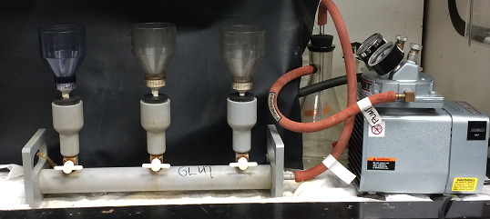
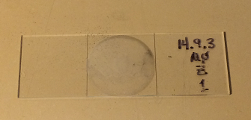
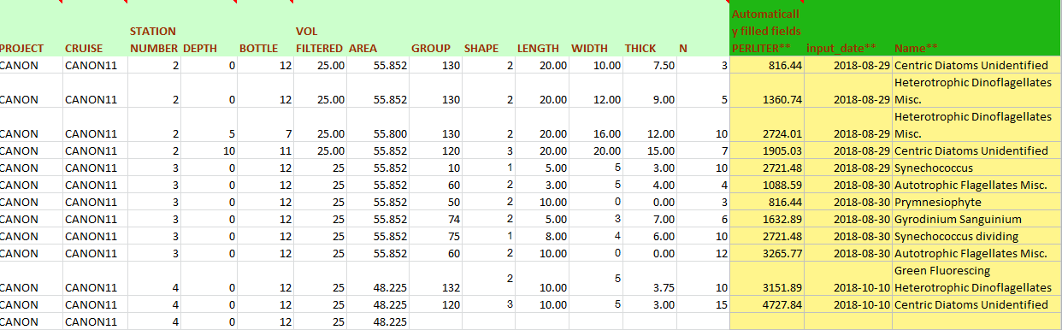
Benchmark: fluorescent imaging
Sampling, 125 ml
Fixing with Glutaraldehyde
Filtering 25 ml on 0.2um black polycarbonate filter
Visual identification, counting
Translating stage
Change objective: 10x, 40x, 100x
Entering spreadsheet
Notes:
Multiple steps, manual, lab equipment. Can we automate?

Slide 5
Benchmark: fluorescent imaging
Traditional method, time series
Laboratory equipment, manual
Hours per slide
Can we emulate?
  Simplified version
  Autonomous, unattended operation
Testing with slides
How you do it?
Notes:
Multiple steps, manual, lab equipment. Can we automate?

Slide 6
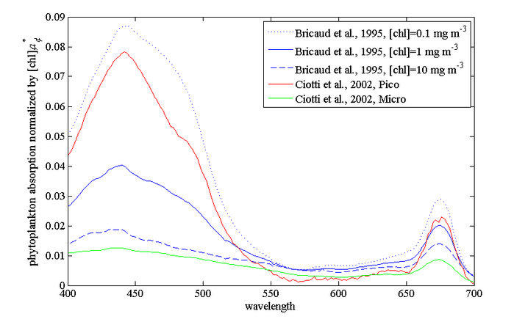
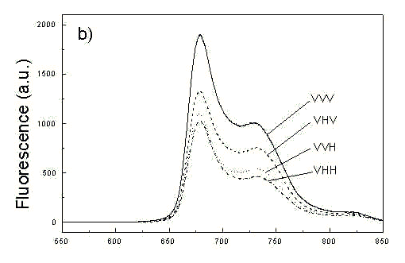
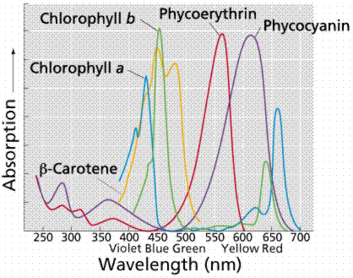
Pigment fluorescence: how you do it?
Chlorophyll absorption (1)
Chlorophyll (auto) fluorescence (3)
Pigments absorption (2)
bandpass
Light source + excitation filter
Detector + emission filter
long wave pass
(1) http://www.oceanopticsbook.info/view/optical_constituents_of_the_ocean/_phytoplankton
(2) http://mhl.nsw.gov.au/projects/berowra/chloro.php
(3) http://www.photobiology.com/photobiology99/contrib/danuta/
Notes:
Useful technique – how you do it? Auto fluorescence of native pigment

Slide 7
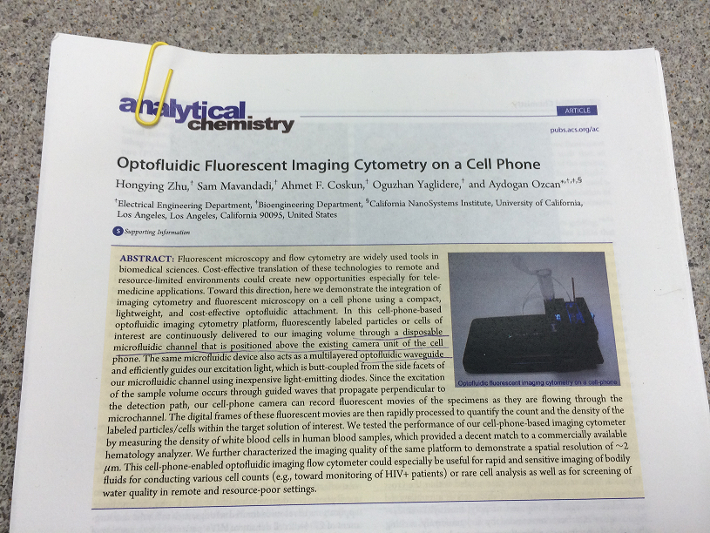
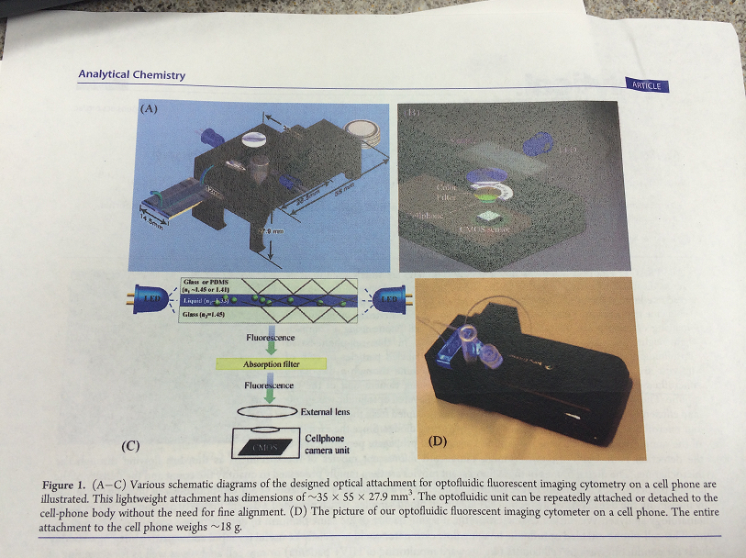
Cell phone cytometer?
Courtesy of Ken Johnson
Fluorescent Imaging cytometry on a cell phone
Inexpensive components
Biomedical applications

Slide 8
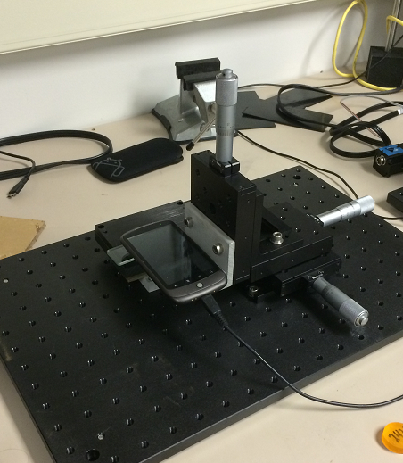
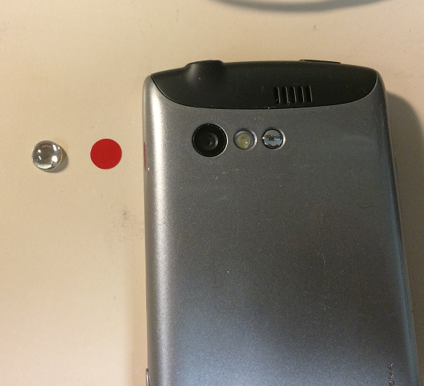
Cell phone test stand
Optical filter film (for fluorescence)
Micro lens
X-Y-Z stage
Cell phone
Sample on a slide
Optical base plate

Slide 9
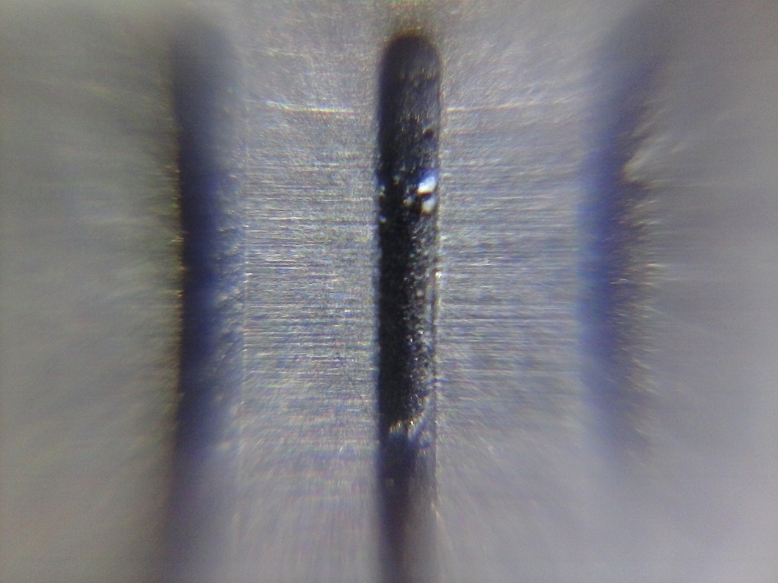
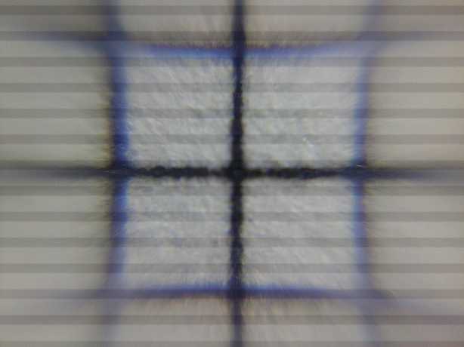
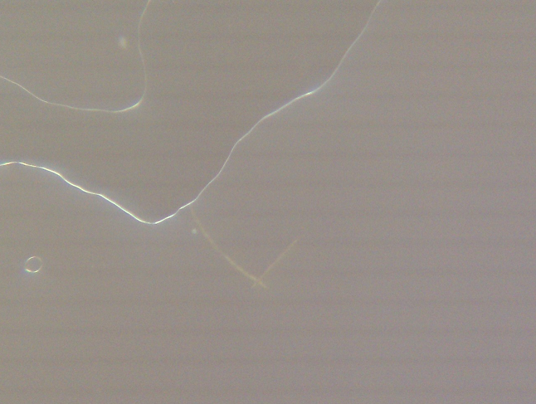
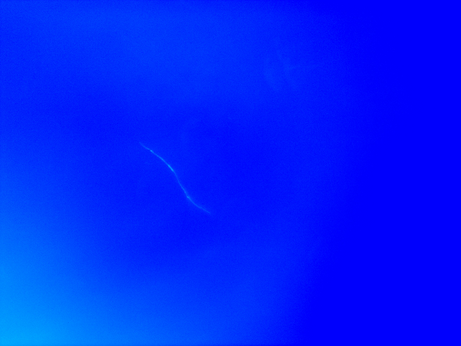
Cell phone microscope
Kyocera C5155 2048x1536 1.6um/pixel
1 mm grid
85 um line
6-10 um texture
HTC Nexus One 2592x1944 1.3um/pixel
With red film filter Cross-talk!!!
Stained pseudo -nitzschia

Slide 10
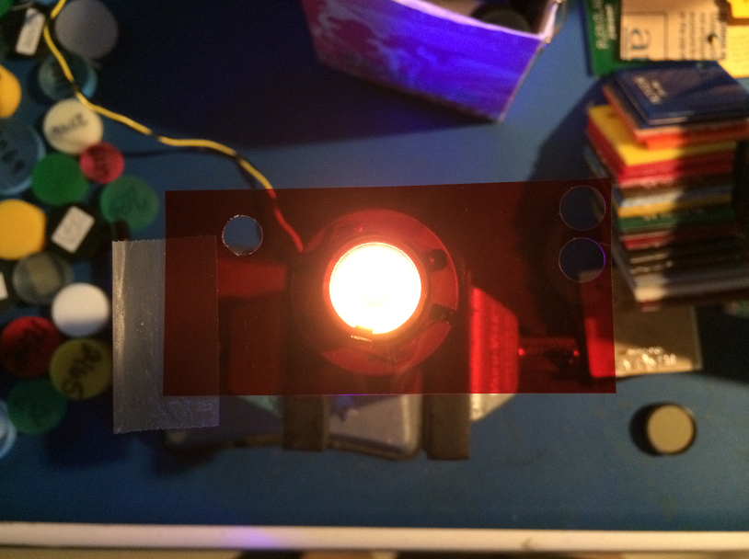
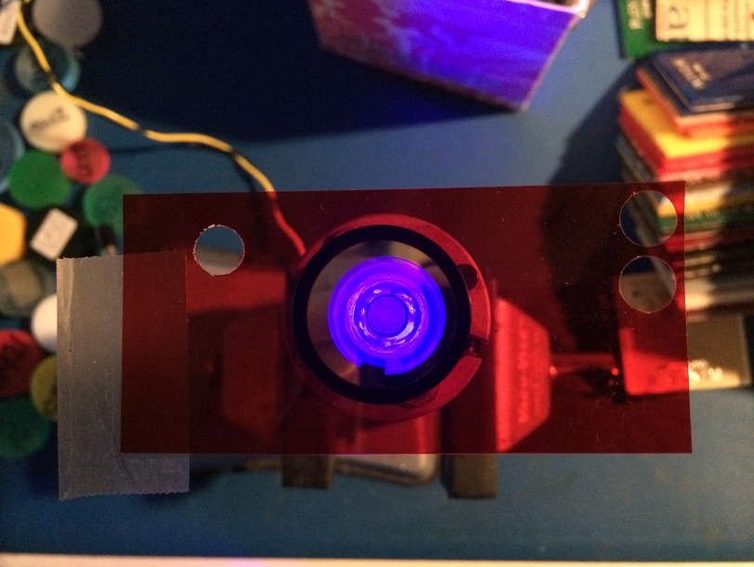
Optics: chasing cross-talk
LED Luxeon Royal Blue 455 nm
+
Red filter (Roscolux #19)
Pink light is visible:
Long tail of blue LED
LED Luxeon Royal Blue 455 nm
+
Blue filter (Intor 450-40)
+
Red filter (Roscolux #19)
Blue is still visible
Red filter OD not enough

Slide 11
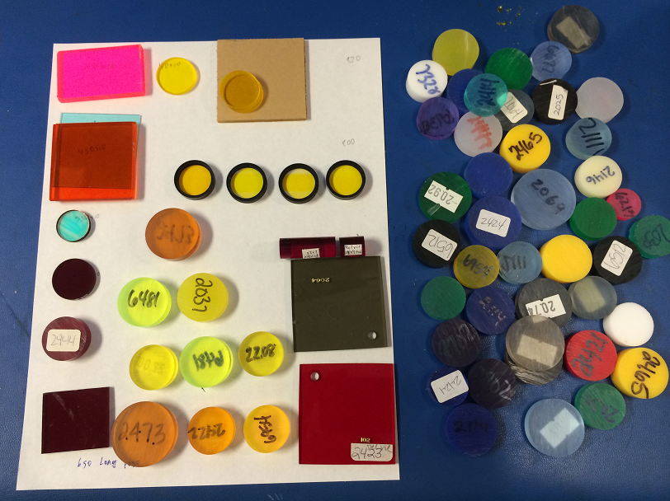
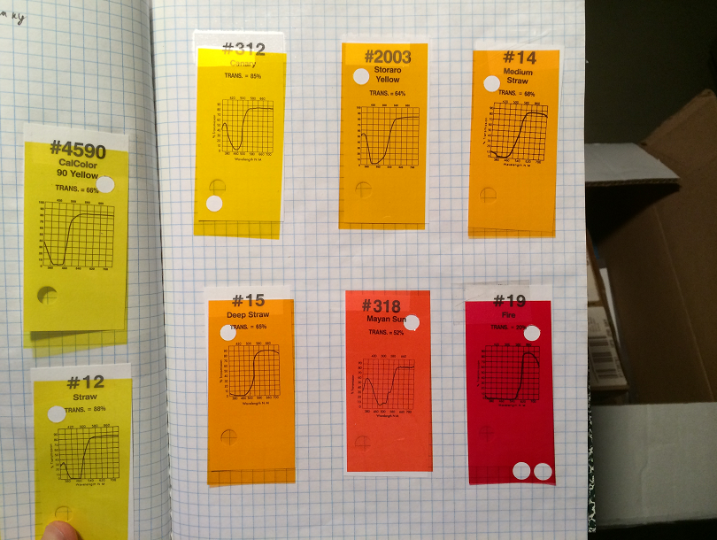
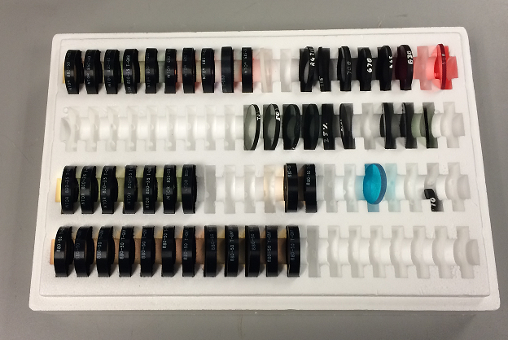
Optics: Filters
Solid plastic
Color film
Interference filters

Slide 12
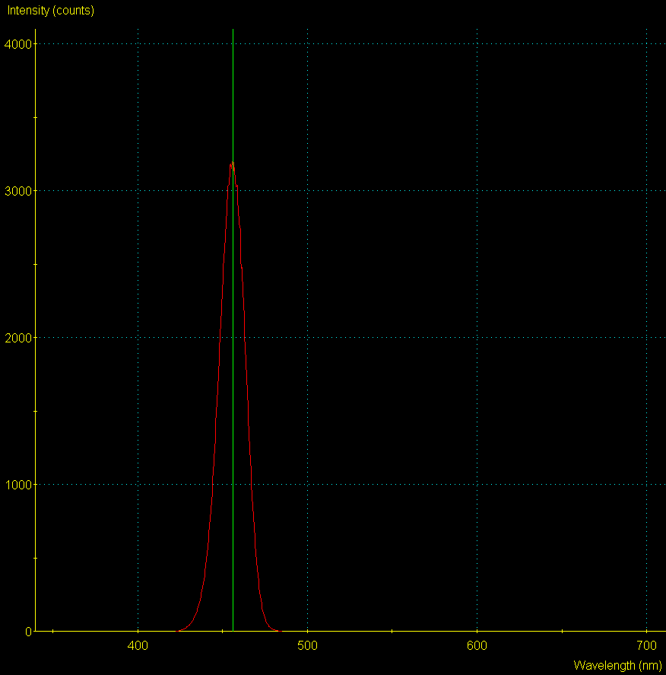
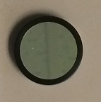
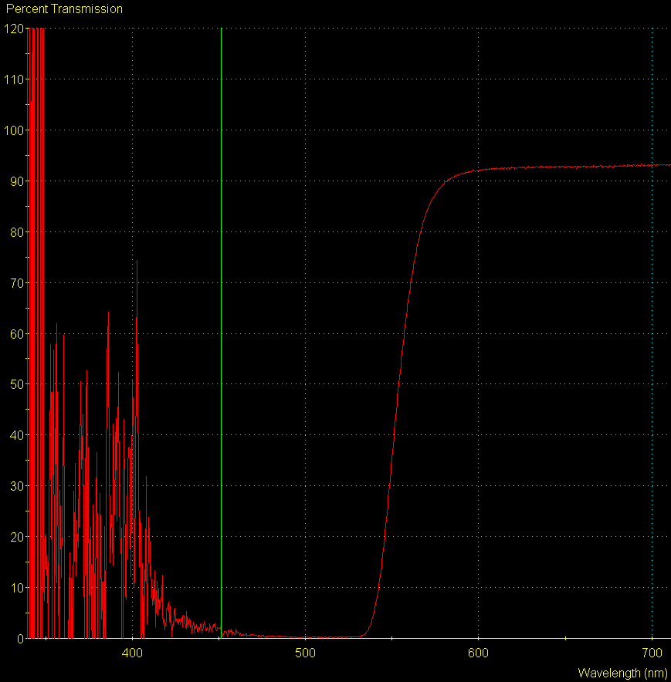
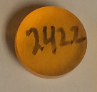
Optics: Filters
Intensity, counts
LED Luxeon Royal Blue 455 nm
+
Intor 450-40 filter
Transmission, %
Delvie 2422 plastic filter
Isolation region Cross-talk removed But filter is thick!

Slide 13
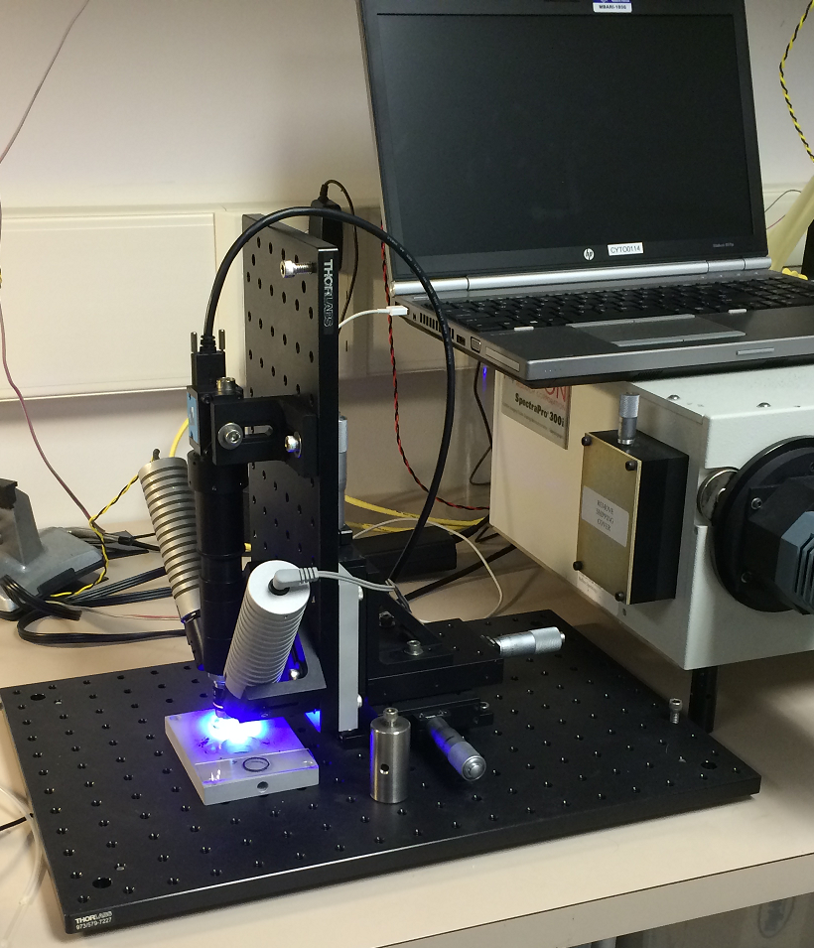
Testbed
Blue LED
Imaging Source cameras:
BW and Color 1600x1200
Lens tube
White LED
X-Y-Z stage
Base plate
Microscope objective

Slide 14
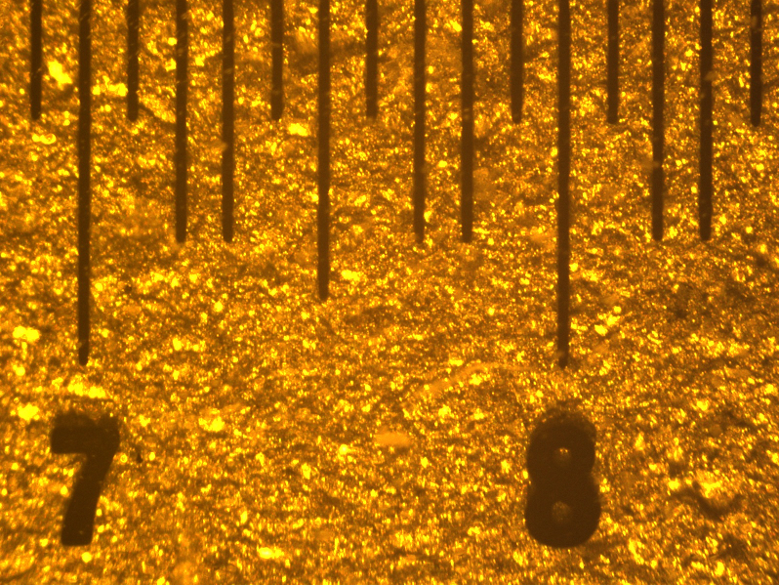
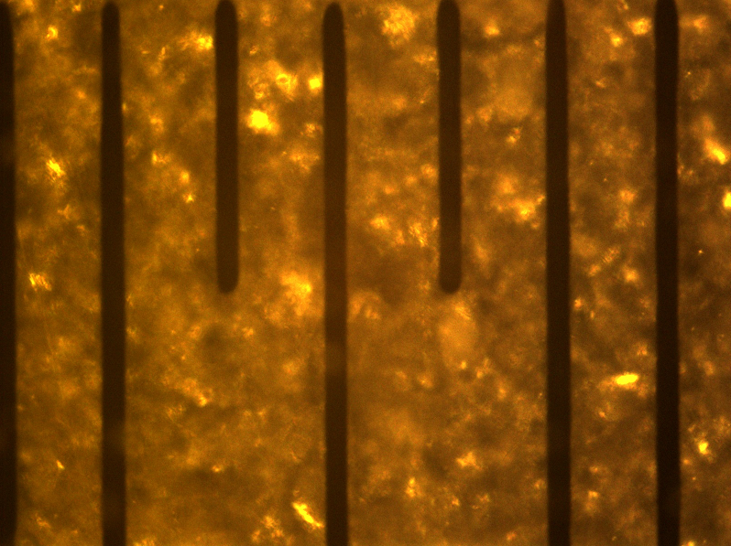
Testbed: imaging scale
4x objective
1600x1200 pixel
1600 um wide = > 1 um / pixel
10x objective
1600x1200 pixel
650um wide = > 0.4 um / pixel
100 um optical glass target

Slide 15
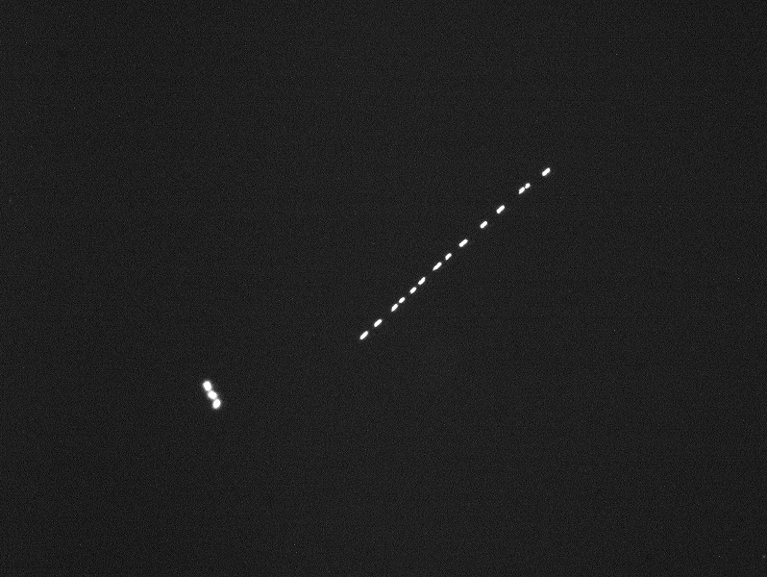
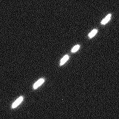
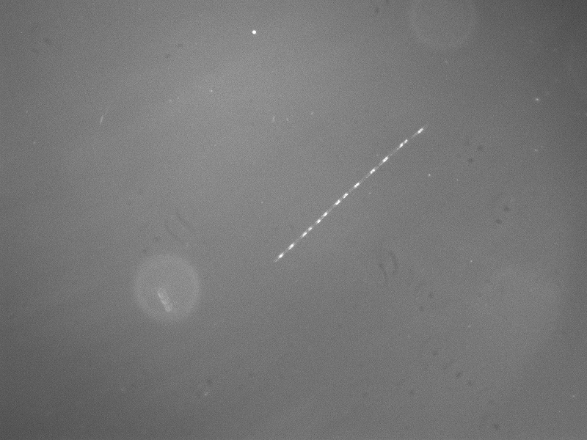
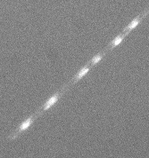
Testbed: BW imaging, slide
Fluorescence
Samples courtesy of Holly Bowers
160 x 160 um region
4x objective
1600x1200 pixel, 1 um / pixel
RG630 filter
BW camera: all pigments – one color
160 x 160 um region
“White” light

Slide 16
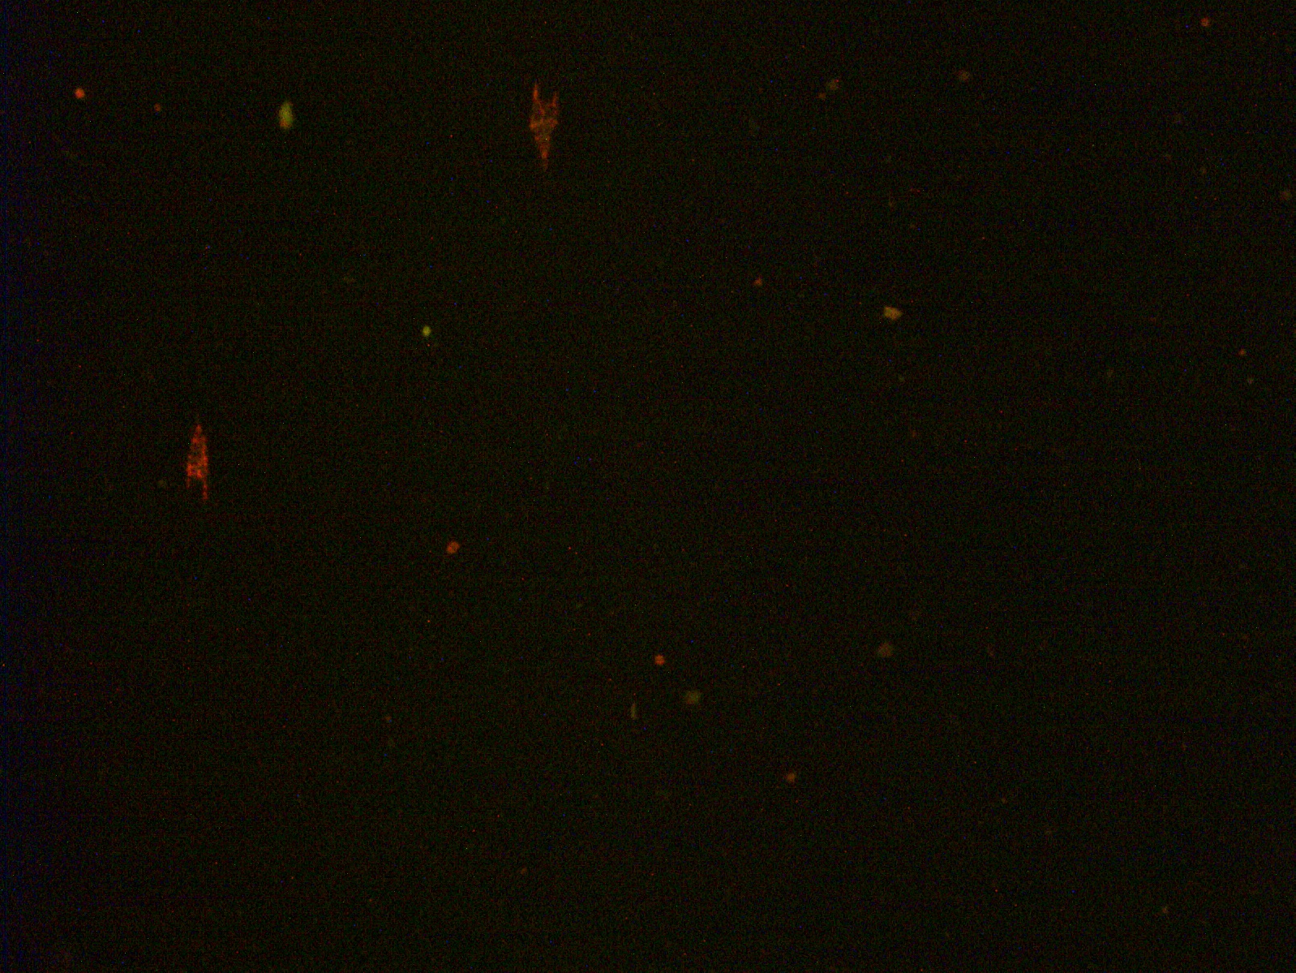
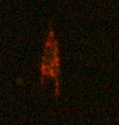
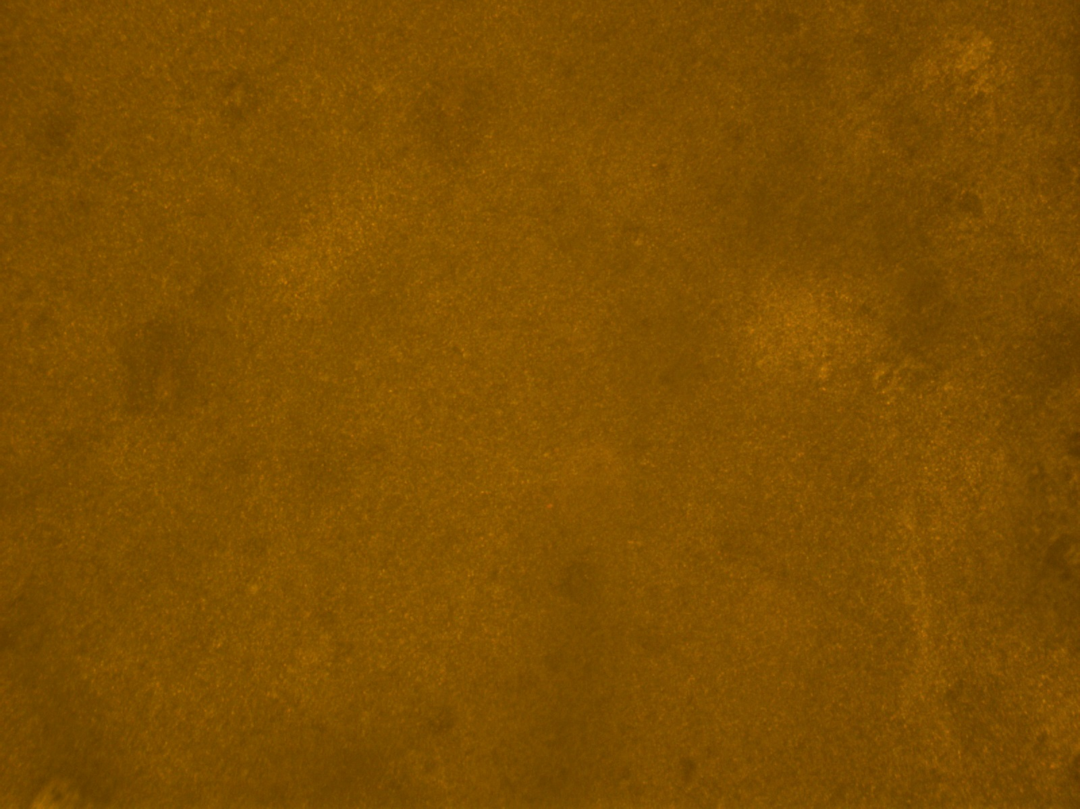
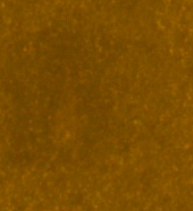
Testbed: color, fixed sample
Fluorescence
Samples courtesy of Lisa Ziccarelly
65 x 65 um region
10x objective
1600x1200 pixel, 0.4 um / pixel
Delvie 2422 filter
Color camera: ID pigment group
65 x 65 um region
“White” light

Slide 17
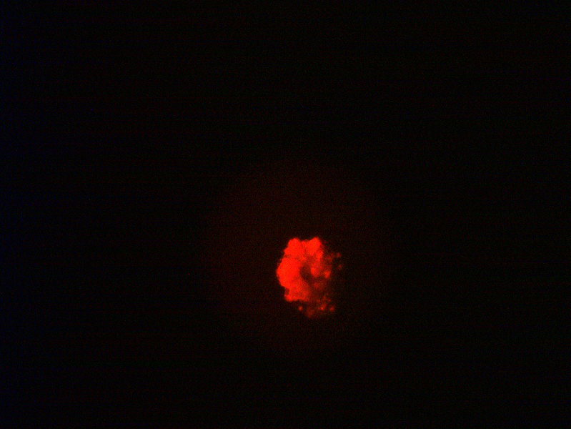
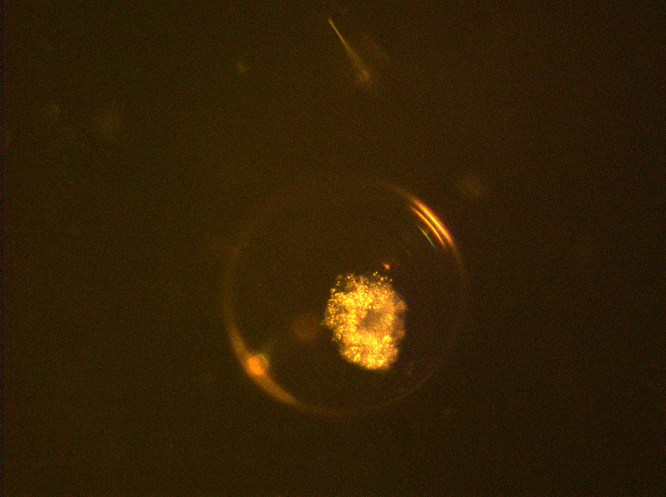
Testbed: color, net tow sample
Fluorescence
Samples courtesy of Julio Harvey
10x objective
1600x1200 pixel, 0.4 um / pixel
Delvie 2422 filter
Color camera: ID pigment group
Multiple cells per slide, each in its own bubble!
White light

Slide 18
Comparison
microscope components
Includes processing platform
Better camera control
Compact, low power
Access to image trigger signals
Single camera?
Multi-camera architecture
Limited control of camera
Use of microscope objectives
Cell phone obsolescence
Need processor board
“Cell phone level”
Entry level
High end

Slide 19
Learned
organic vs. inorganic
2 channels:
Synchronous acquisition seems to be valuable
Fluorescence signal is weak
  Longer exposure
  Higher excitation power
  Fluorescence of materials
Depth of field is quite short at high resolution
“Cell phone microscope”: not bad!
Images of same object
High dynamic range of detection
Flow cell configuration

Slide 20
Next steps
Have some idea
Energy: sensitivity, power, exposure
Architecture
  Software: image processing
  Flow cell design
  Processing platform
Capability ⬄ requirements
  Search for middle ground
  Multidisciplinary team
Running out of time this year
Very important

