Slide 1
Desktop testbed: goals
Gain familiarity with object and methods
  Fluidics
  Optics
Find out what is possible
  Scaling of performance to deployable prototype
  Direction to design optimization
Test ideas
  Cell phone Cytometer
  Automated fluorescent microscope

Slide 2
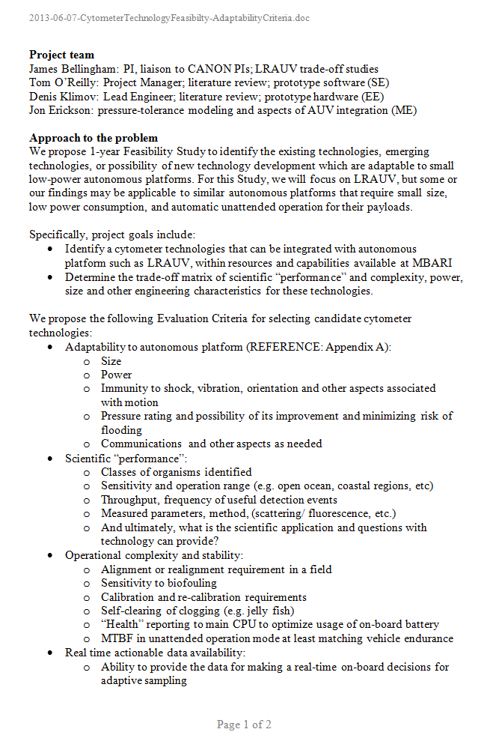
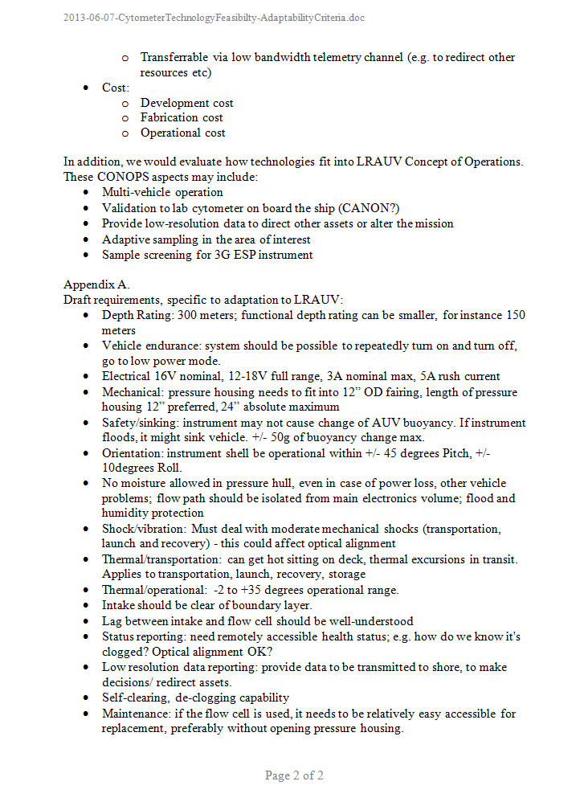
Approach – what do we need?
Technology evaluation criteria
Draft adaptation requirements (LRAUV)

Slide 3
Key criteria
Adaptability to autonomous platform
Science “performance”
Maintenance stability
Actionable data
Size, power
Population diversity
Maintenance
Trigger sampling
Shock
Throughput
Alignment
Telemetry
Tilt
Temporal spatial resolution
Biofouling
Screening/sorting

Slide 4
Key criteria
Adaptability to autonomous platform
Science “performance”
Maintenance stability
Actionable data
Size, power
Population diversity
Maintenance
Trigger sampling
Shock
Throughput
Alignment
Telemetry
Tilt
Temporal spatial resolution
Biofouling
Screening/sorting
Limiting use on many platforms
Length of deployment
Population statistics in real time is challenging
Configurability
Unattended operation

Slide 5
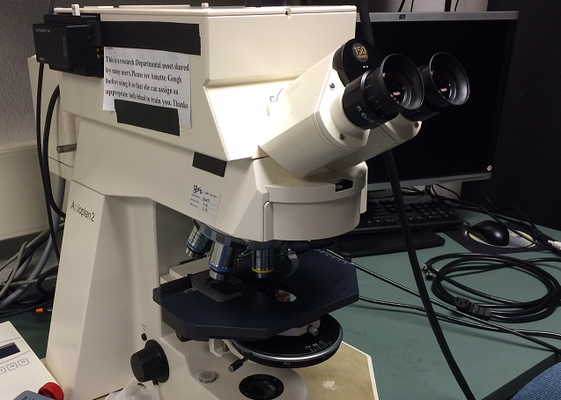
Fluorescent imaging
Sampling
Rosette photo
Fixing
Filtering photo
Filtering 25mm 0.2um
Counting
Translating stage
Change objective
Spreadsheet sample?
Entering spreadsheet

Slide 6
Optics: excitation and fluorescence

Slide 7
Optics: filtes

Slide 8
Imaging: scale and depth of field

Slide 9
Imaging: exposure vs. throughtput

Slide 10
Optics: optimization

Slide 11
Methods comparison
Optical methods of detection
Proxy to population composition
  Size
  Pigment
Fluorescence can be used with most methods by adding appropriate channel
Trade-off method advantages/drawbacks for applications

Slide 12
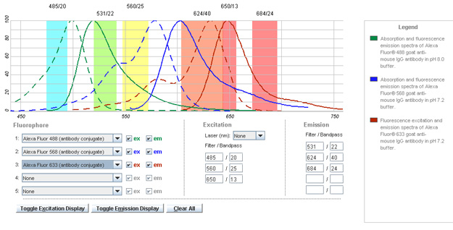
Bulk scattering
High–res detector
Signature decomposition
Min ~10E3- 10E4 cells / scatter scan for repeatability
High throughput at relatively low processing cost
Harder to interpret larger / complex morphology cells
Sensitive to cell (random) orientation

Slide 13
Flow cytometry
Light
Detection volume
Flow
Resolution
Optimization
Concentration
Narrow range of parameters
Statistics
Signal on detector
Limited dynamic range vs. wide natural range population composition
If detection volume is set to be able to resolve pulses from small particles, then statistics on larger cells with low concentration is becoming unacceptably slow
Hard to interpret data for larger / complex morphology organisms

Slide 14
Imaging cytometry
Flow
Detection volumes
Detection volumes
Resolution of morphology
Wider range of parameters
Space domain
Wider dynamic range on cell size vs. statistics
Works better for larger/ complex morphology organisms
Does not work well for smaller (< 5um) organisms

Slide 15
Scale comparison
0.1 um
1 um
10 um
100 um
1000 um
particle size
Flow cytometry
Imaging
Bulk scattering
Different detection methods have different optimum size range
There is certain overlap
Combination methods help overcome limitations and expand application range

Slide 16
Hardware
Imaging cytometer, 2 channels:
  Imaging and fluorescence imaging
  Synchronous or asynchronous acquisition?
Ability to package into compact instrument
Maintenance/ longevity
Camera and imaging vs. processing platform
organic vs. inorganic
Same image or different images?
Flow cell configuration
Could decouple for larger system
Or integrated (cell phone?)

Slide 17
Hardware
Size, complexity
Attractive, but problem of contrast
Could orientation be tracked at the cost or resolution?
Optics:
  1 or 2 cameras?
  Tunable filter?
  Still images vs. video?
Light source:
  Triggering, optical resolution

Slide 18
Hardware
Pressure, velocity gradient
Acoustics
Electric field?
Recirculation helps keep clean = > longevity
Larger cells sizes possible
Orientation seems to be common theme
  Can it be controlled?
Bulk vs. hydro focusing

Slide 19
Software
Simplified imaging processing algorithm
  Particle length and width
  Fluorescent vs non-fluorescent
  Area, integral signal => proxy to biomass
Triggered image logging, other actions
Prototype runs on laptop, should be embedded in the future
Explore hardware acceleration, e.g. with FPGA or GPU

Slide 20
Example processing chain, implemented in GPU/FPGA
From “A hardware accelerated approach for imaging flow cytometry”, Lee, Meng et al (2013)

Slide 21
Some open questions, issues
How best to compare AUV integration candidates?
  So far have compared “marketing” specifications
  What are current top candidates?
Deployment duration, particle size range? (affects design significantly)
Need close science engagement during prototype development

