Slide 1
Desktop testbed: goals
Gain familiarity with object and methods
  Fluidics
  Optics
Find out what is possible
  Scaling of performance to deployable prototype
  Direction to design optimization
Test ideas
  Cell phone cytometer
  Automated fluorescent microscope

Slide 2
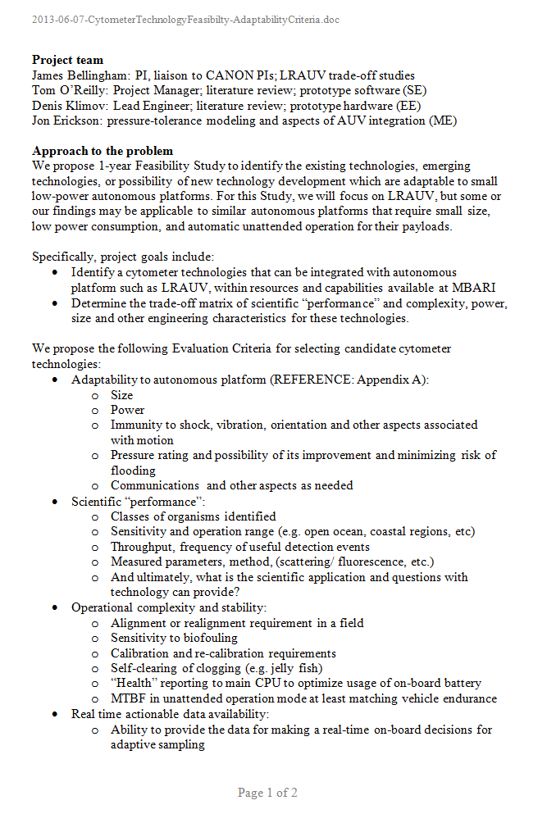
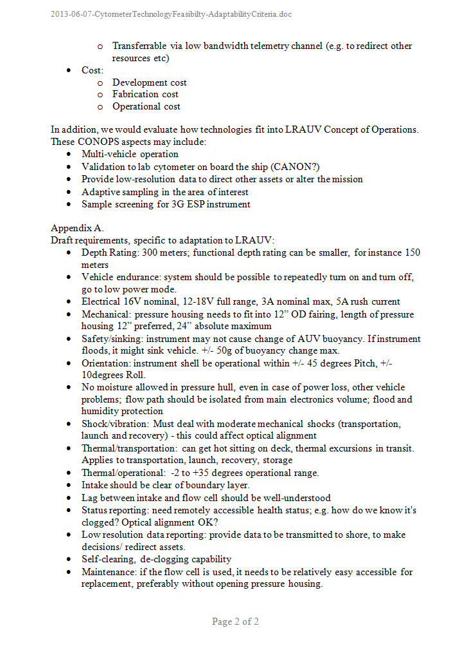
Approach – what do we need?
Technology evaluation criteria
Draft adaptation requirements (LRAUV)

Slide 3
Key criteria
Adaptability to autonomous platform
Science “performance”
Maintenance stability
Actionable data
Size, power
Population diversity
Maintenance
Trigger sampling
Shock
Throughput
Alignment
Telemetry
Tilt
Temporal spatial resolution
Biofouling
Screening/sorting

Slide 4
Key criteria
Adaptability to autonomous platform
Science “performance”
Maintenance stability
Actionable data
Size, power
Population diversity
Maintenance
Trigger sampling
Shock
Throughput
Alignment
Telemetry
Tilt
Temporal spatial resolution
Biofouling
Screening/sorting
Limiting use on many platforms
Length of deployment
Population statistics in real time is challenging
Configurability
Unattended operation

Slide 5
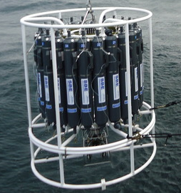
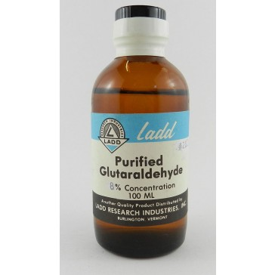
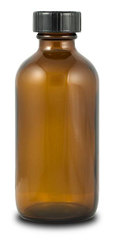
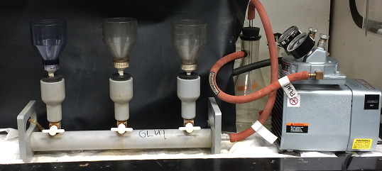
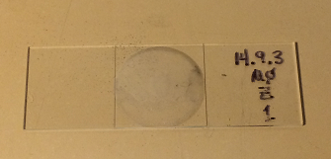
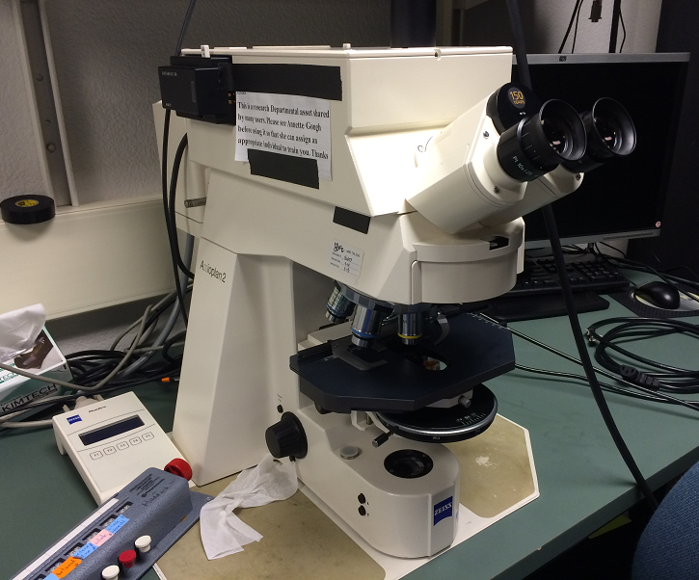
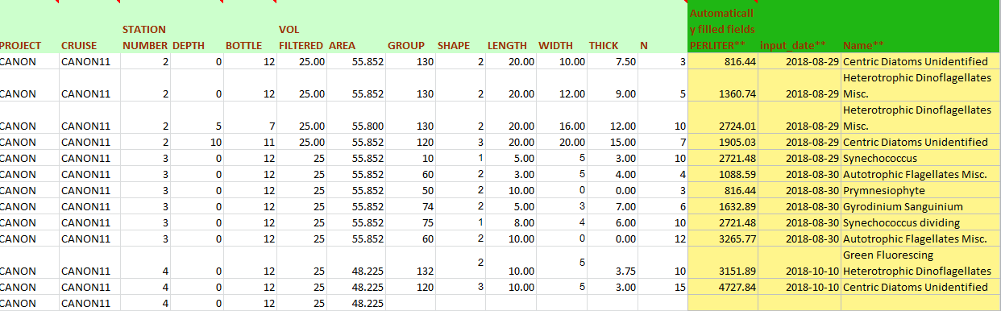
Benchmark: fluorescent imaging
Sampling, 125 ml
Fixing with Glutaraldehyde
Filtering 25 ml on 0.2um black polycarbonate filter
Visual identification, counting
Translating stage
Change objective: 10x, 40x, 100x
Entering spreadsheet

Slide 6
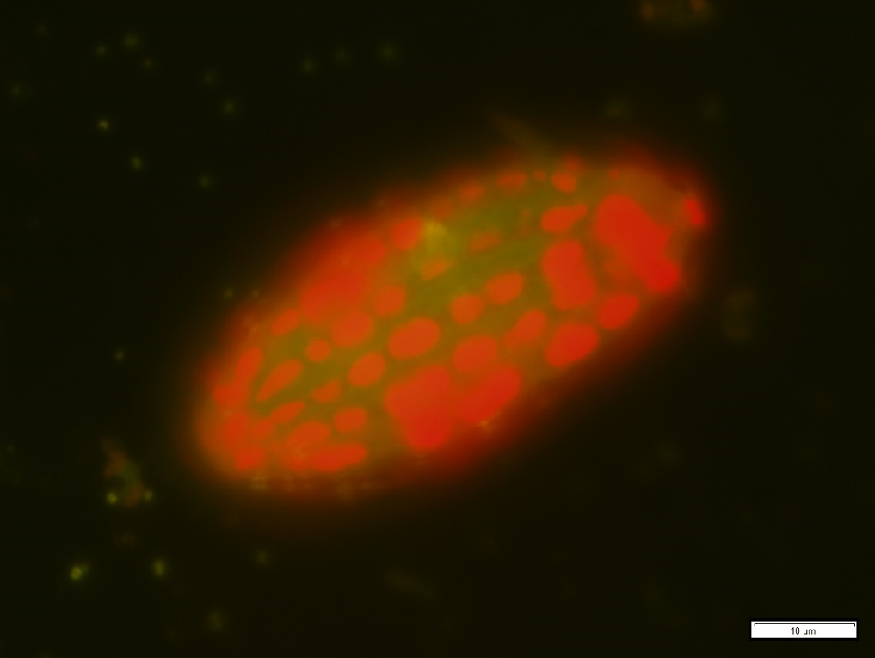
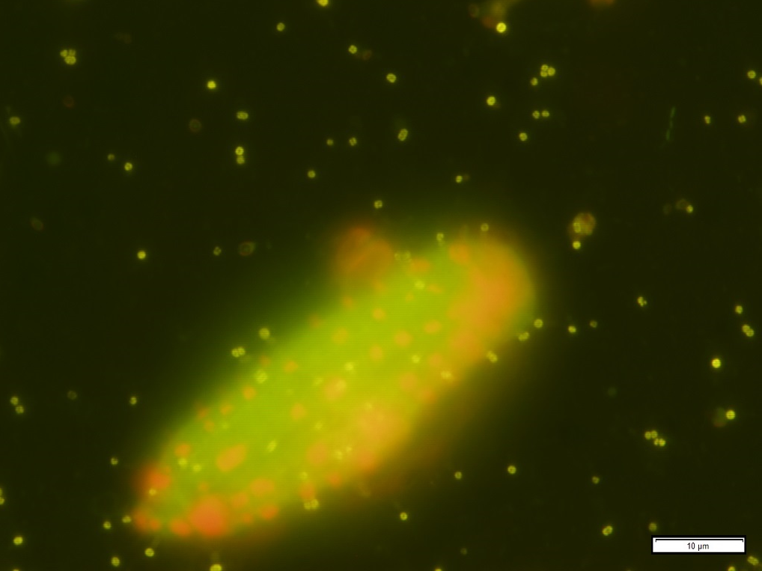
Benchmark: fluorescent imaging
Zeiss Axioplan fluorescence microscope
Courtesy of Lisa Ziccarelli
Ciliate with sequestered chloroplasts, at 100x

Slide 7
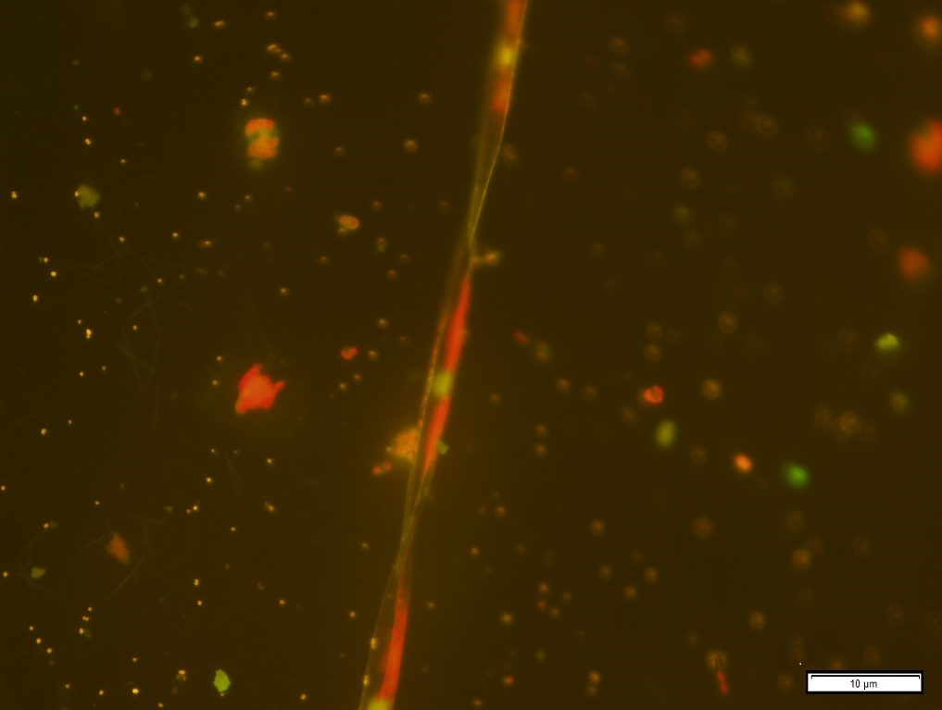
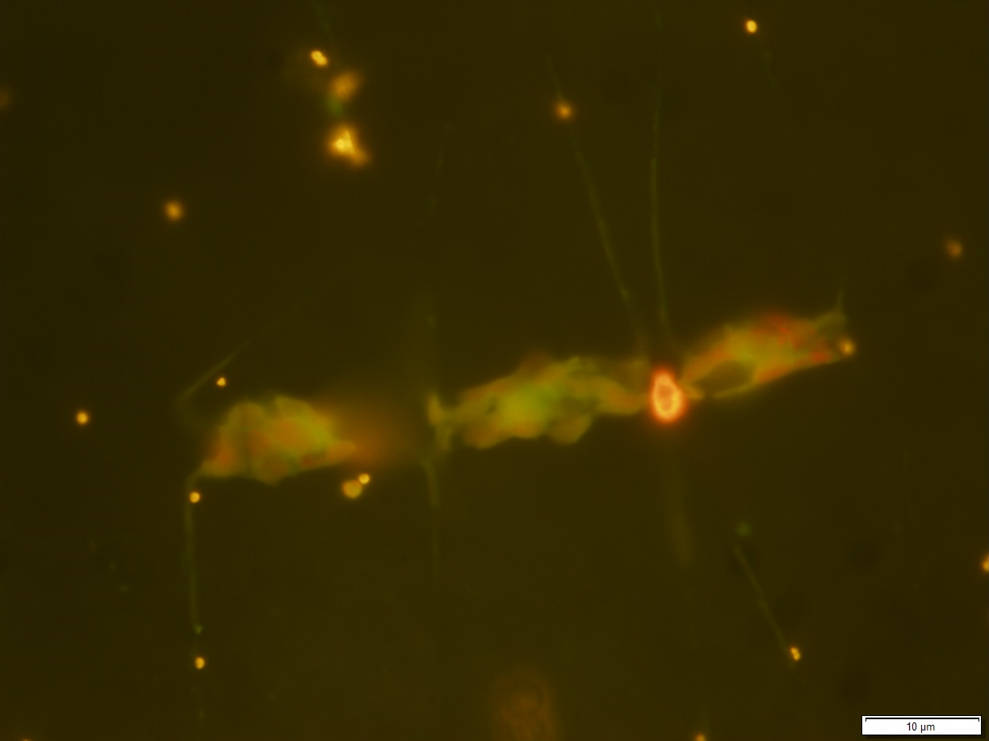
Benchmark: fluorescent imaging
Zeiss Axioplan fluorescence microscope
Courtesy of Lisa Ziccarelli
Pseudo-nitzschia, at 100x
Chaetoceros, at 100x

Slide 8
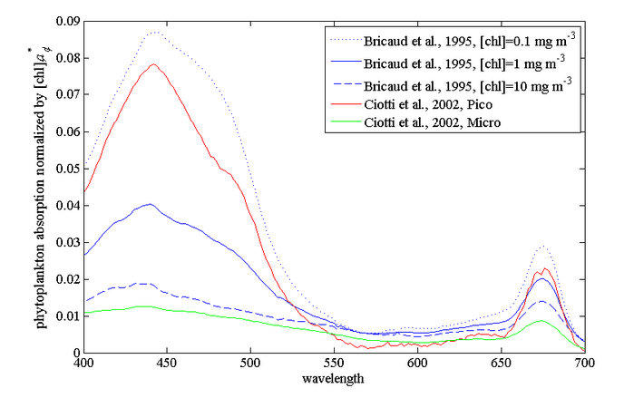
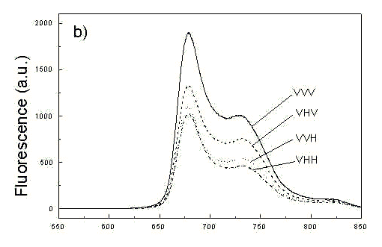
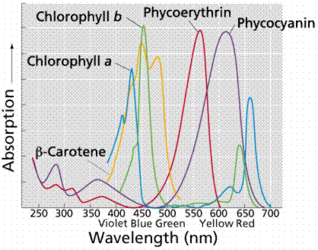
Optics: excitation and fluorescence
Chlorophyll absorption (1)
Chlorophyll fluorescence (3)
Pigments absorption (2)
Light source + excitation filter
Detector + emission filter
(1) http://www.oceanopticsbook.info/view/optical_constituents_of_the_ocean/_phytoplankton
(2) http://mhl.nsw.gov.au/projects/berowra/chloro.php
(3) http://www.photobiology.com/photobiology99/contrib/danuta/

Slide 9
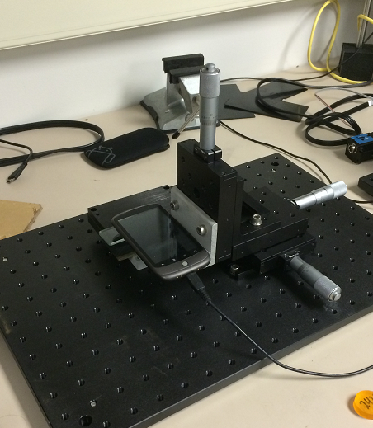
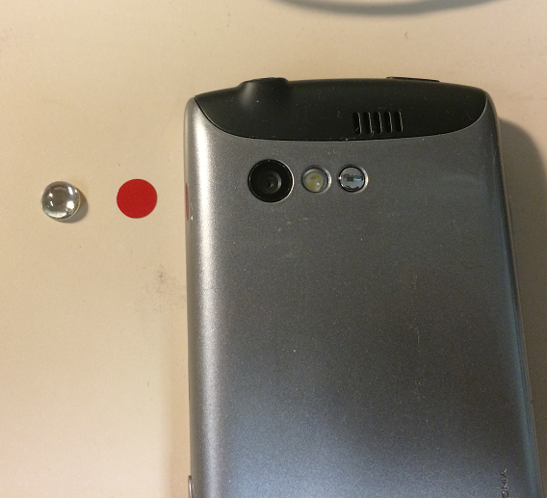
Cell phone test stand
Optical filter film (for fluorescence)
Micro lens
X-Y-Z stage
Cell phone
Sample on a slide
Optical base plate

Slide 10
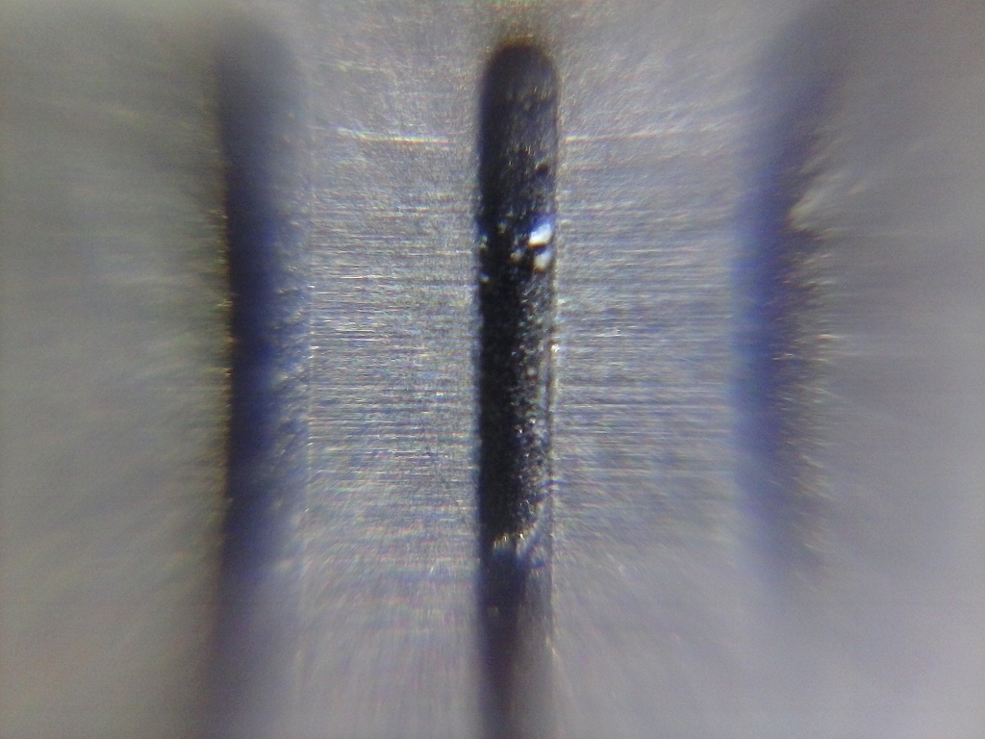
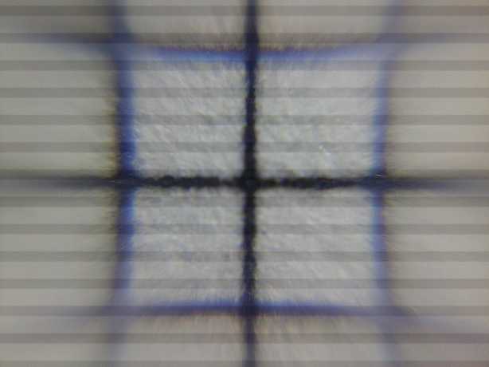

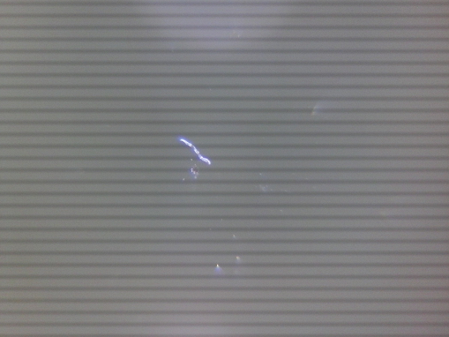
Cell phone: Kyocera C5155
2048x1536
1.6 um / pixel
1 mm grid
85 um line
45 um, 27 pixel

Slide 11
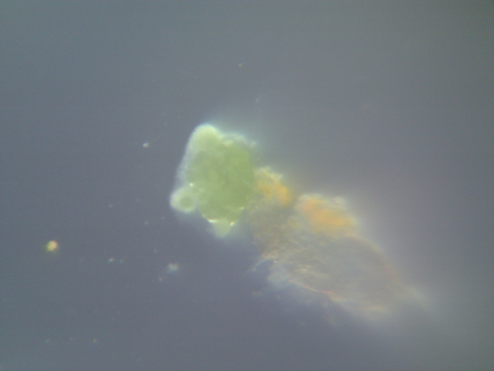
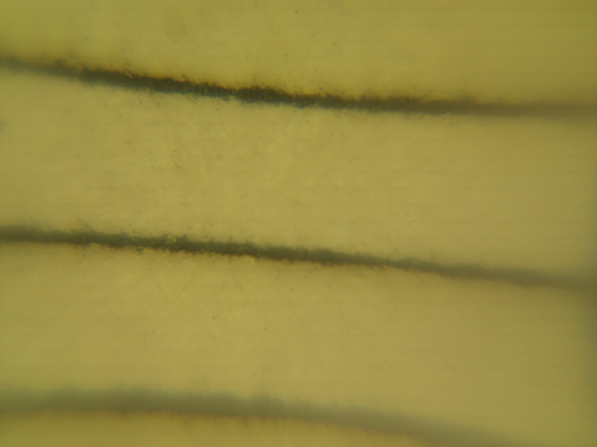
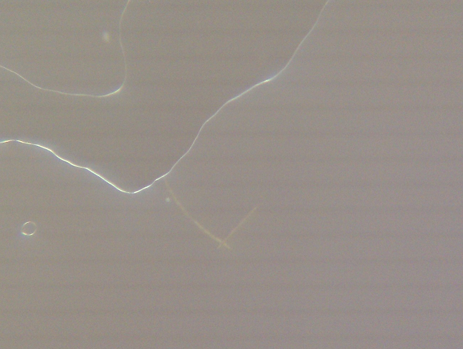
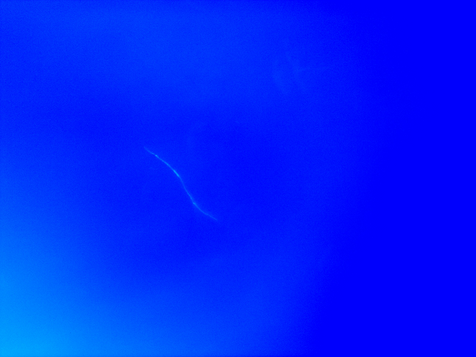
Cell phone: HTC Nexus One
2592x1944
1.3 um / pixel
1 mm grid
85 um line
With red film filter
Cross-talk!!!

Slide 12
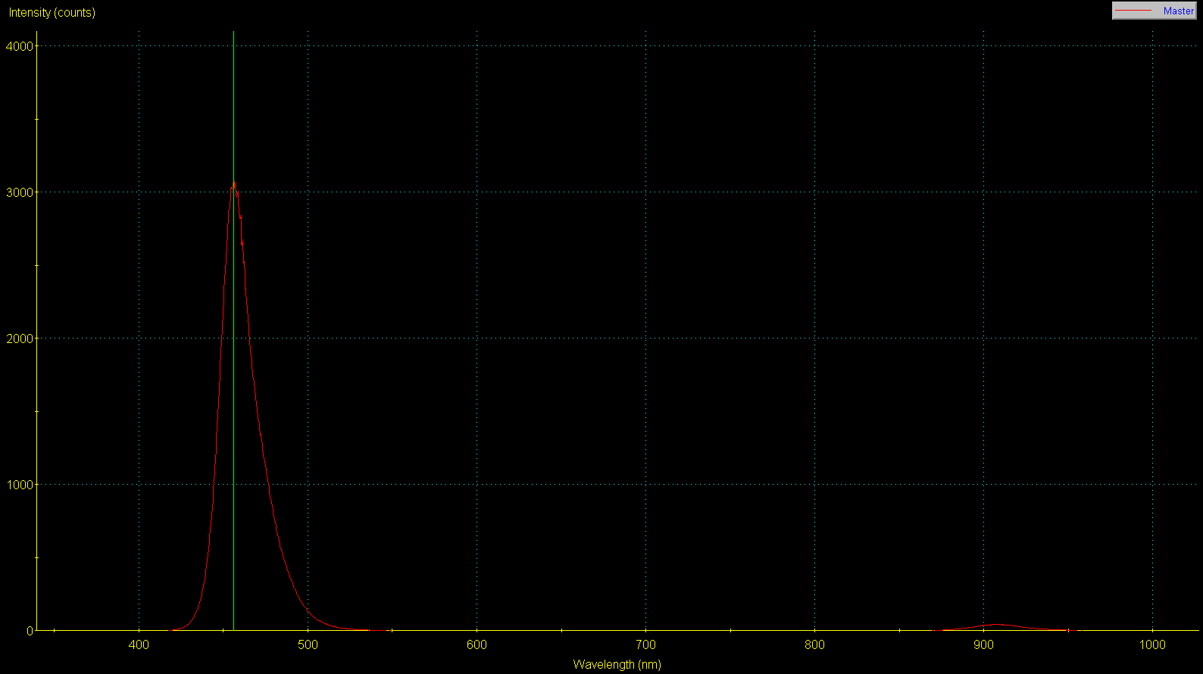
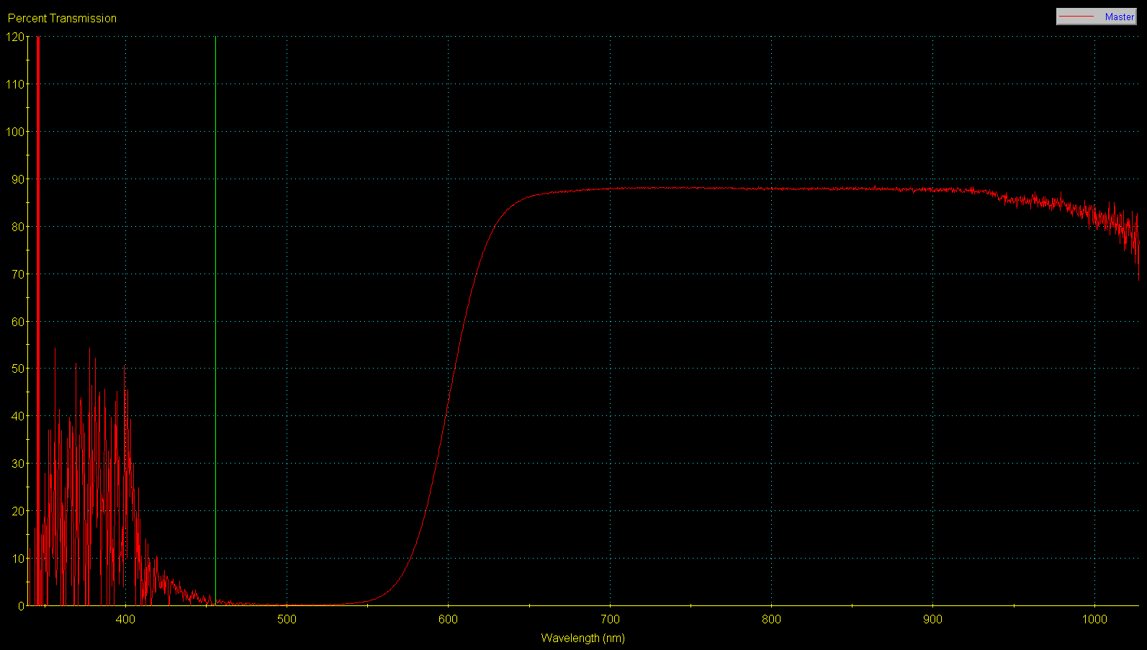
Optics: Filters
LED Luxeon Royal Blue 455 nm
Roscolux #19 red film
Cross-talk regions
Problem!!!

Slide 13
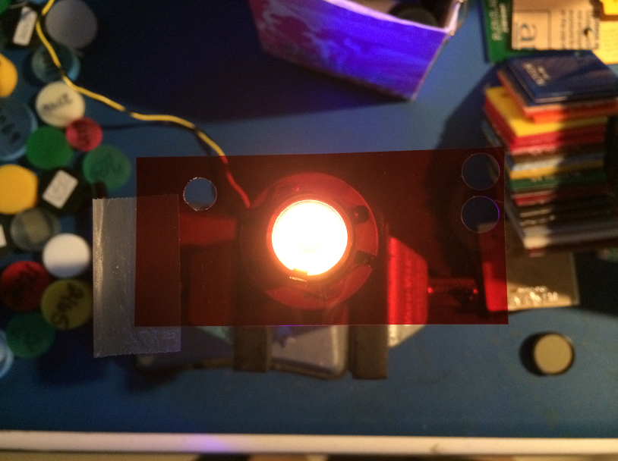
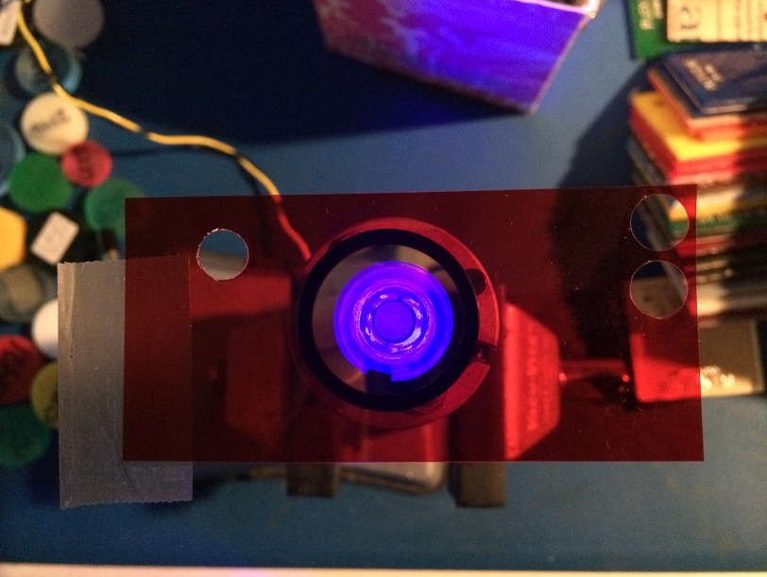
Optics: Filters
LED Luxeon Royal Blue 455 nm
+
Roscolux #19
LED Luxeon Royal Blue 455 nm
+
Blue filter (Intor 450-40)
+
Red filter (Roscolux #19)
Blue is still visible
Problem!!!

Slide 14
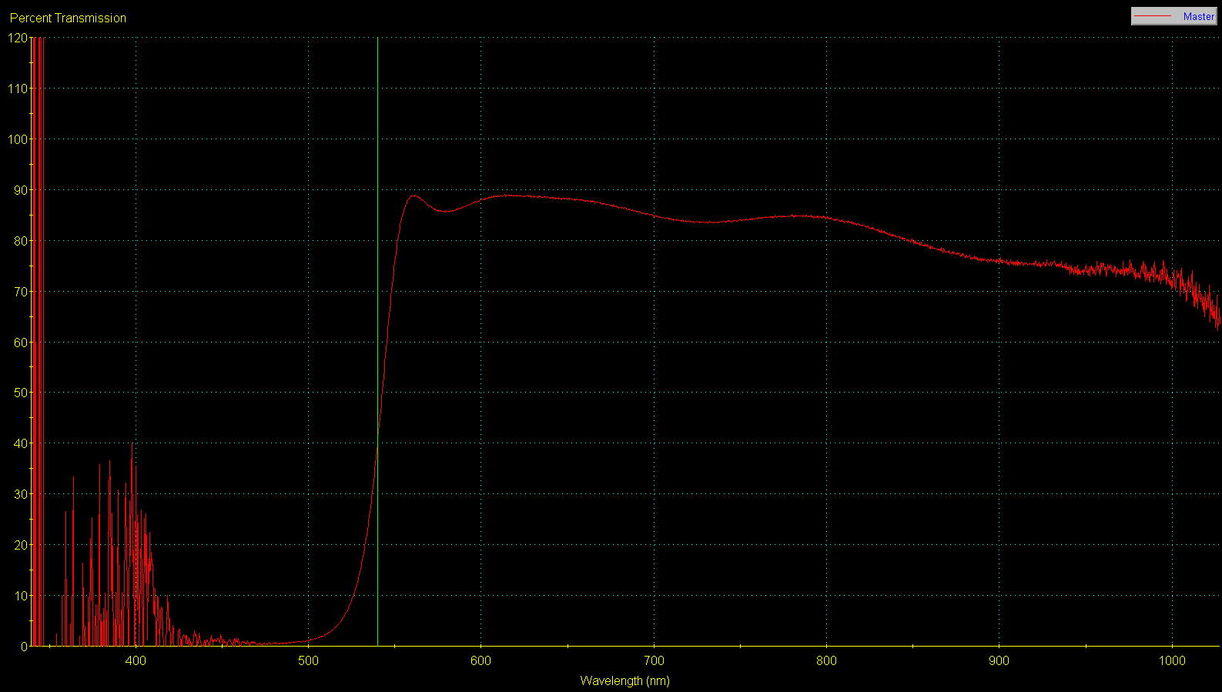
Optics: Filters
LED Luxeon Royal Blue 455 nm
540 Long Pass Filter (Intor)
Cross-talk region
Problem!!!

Slide 15
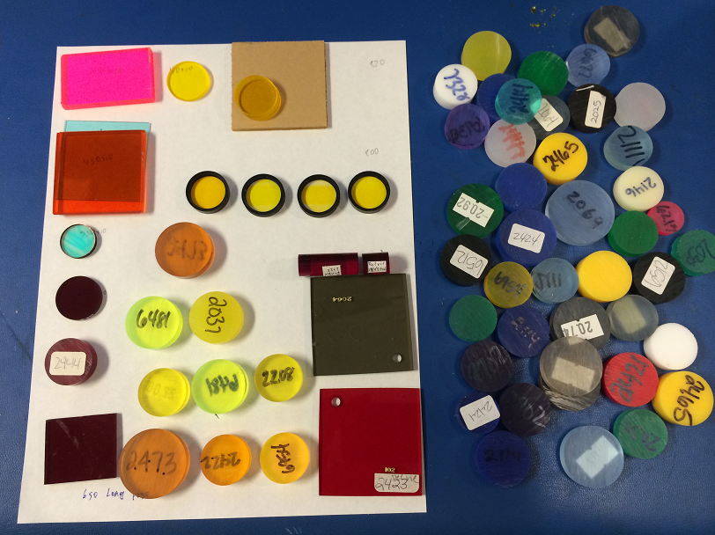
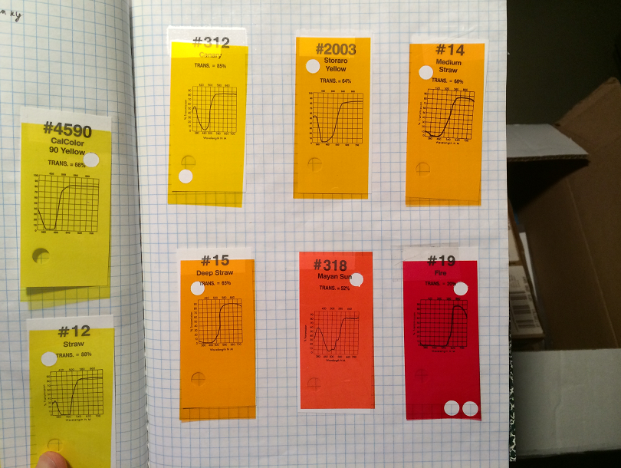
Optics: Filters
Filter search
Film
Plastic
Interference filters

Slide 16
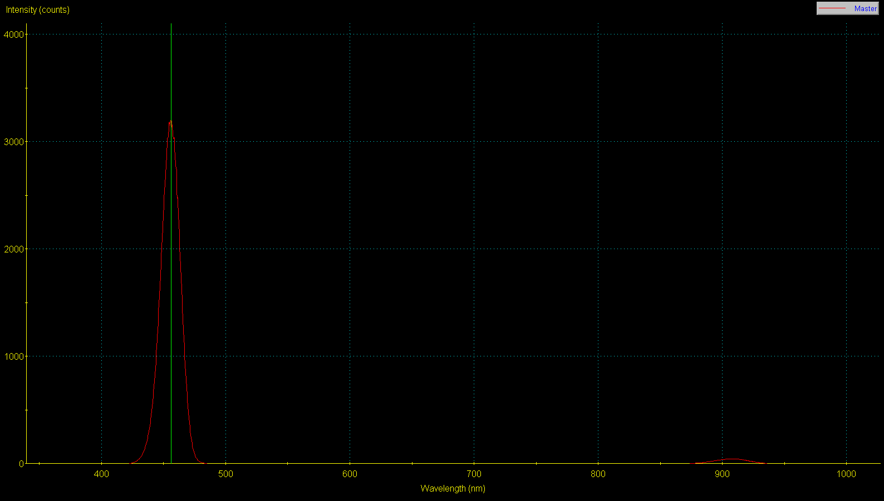
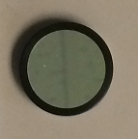
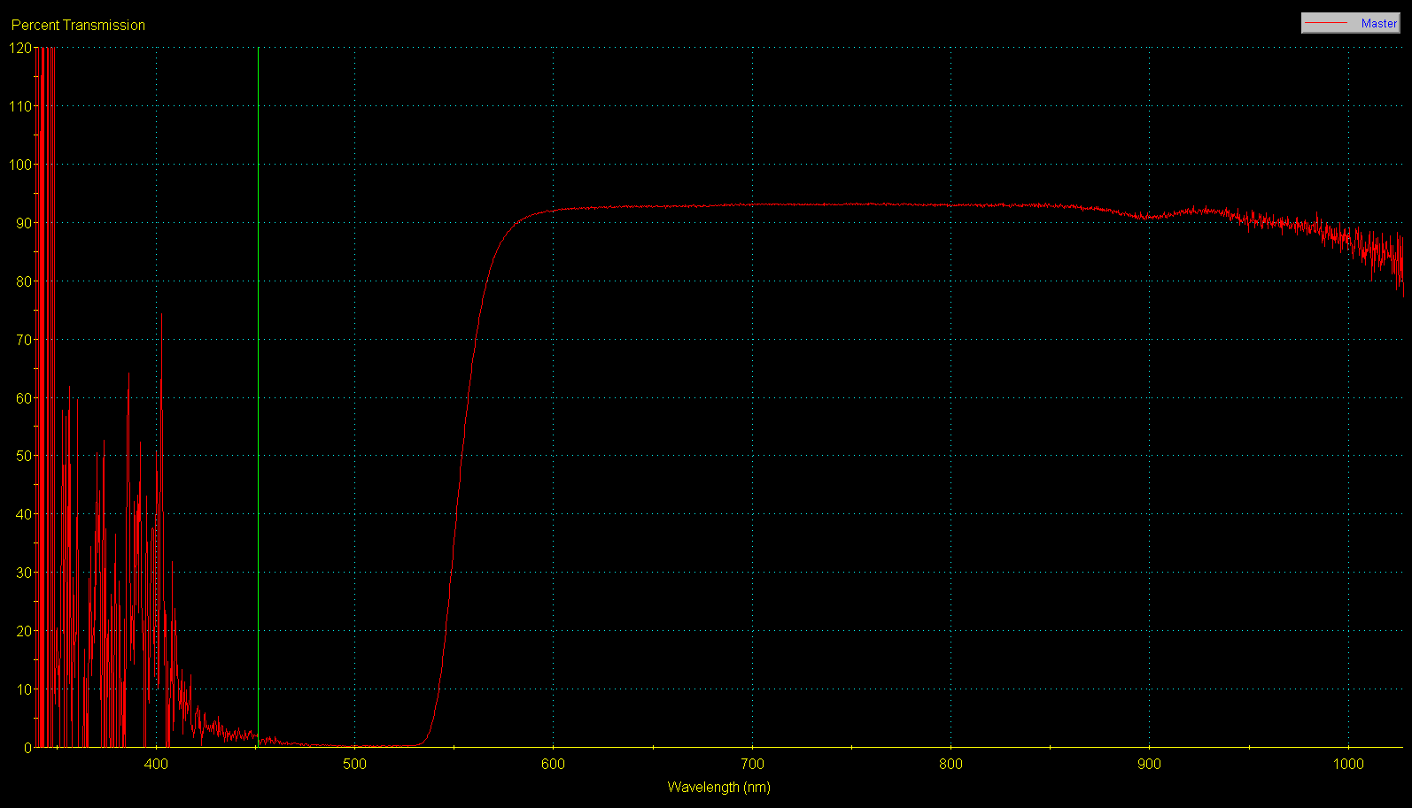
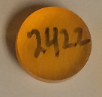
Optics: Filters
LED Luxeon Royal Blue 455 nm
+
Intor 450-40 filter
Delvie 2422 plastic filter
Isolation region
Cross-talk removed!

Slide 17
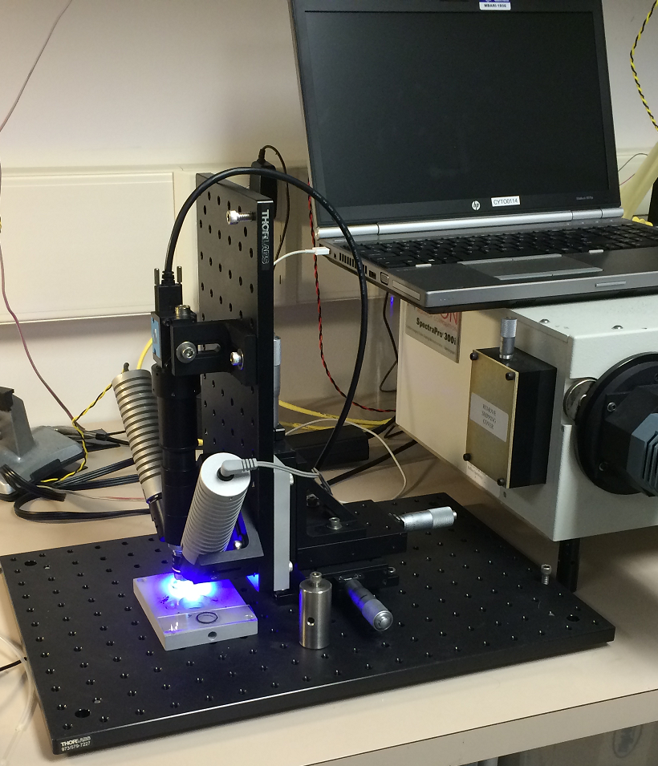
Testbed
Blue LED
Imaging Source camera
Lens tube
White LED
X-Y-Z stage
Base plate
Microscope objective

Slide 18
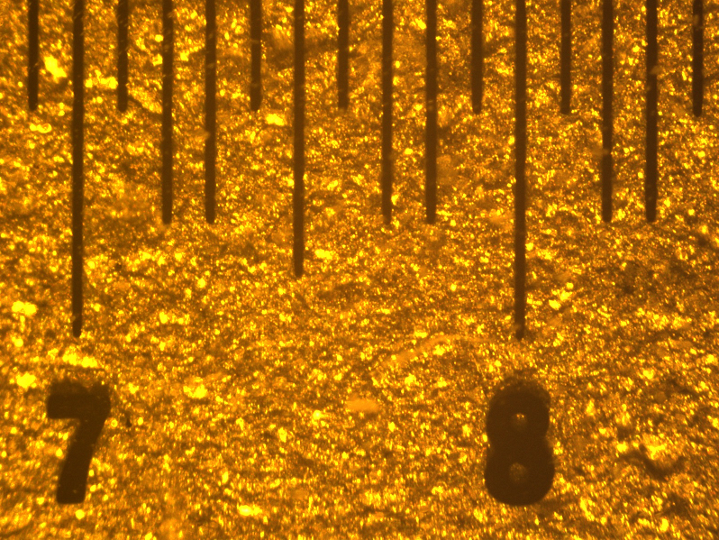
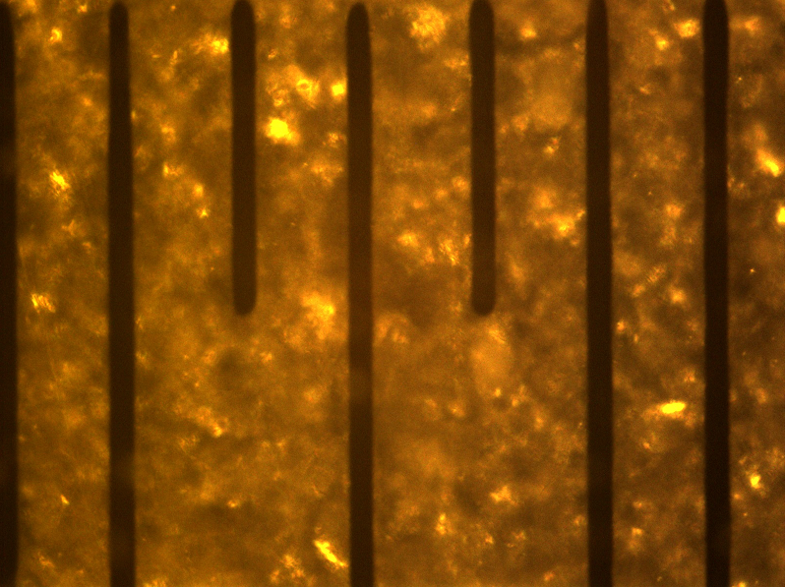
Testbed: imaging scale
4x objective
1600x1200 pixel
1600 um wide = > 1 um / pixel
10x objective
1600x1200 pixel
650um wide = > 0.4 um / pixel
100 um optical glass target

Slide 19
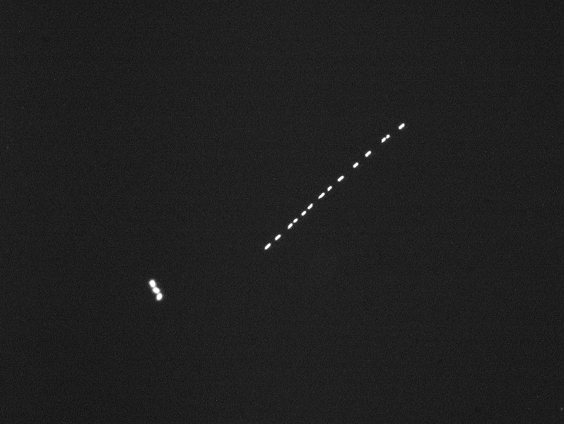
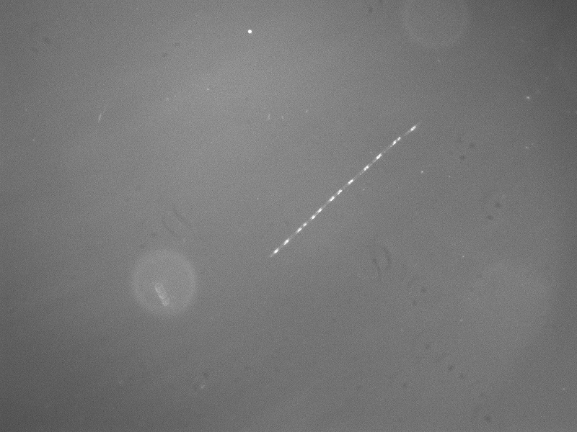
Testbed: imaging scale
Fluorescence
4x objective
1600x1200 pixel, 1 um / pixel
RG630 filter
BW camera
White light

Slide 20
Optics: optimization

Slide 21
Some open questions, issues
How best to compare AUV integration candidates?
  So far have compared “marketing” specifications
  What are current top candidates?
Deployment duration, particle size range? (affects design significantly)
Need close science engagement during prototype development

