Slide 1
Cytometer technology for autonomous platforms: a feasibility study
Tom O’Reilly
Denis Klimov
Francisco Chavez
Andy Hamilton
11/17/2014

Slide 2
Contributors and collaborators
Methods and applications
Samples and analysis
Jim Bellingham
Francisco Chavez
Alex Worden
John Ryan
Magda Gutowska
Steve Haddock
Ken Johnson
Peter Lopez (NYU)
Holly Bowers
Reiko Michisaki
Camille Poirier
Lisa Ziccarelli
Tim Pennington
Julio Harvey
April Woods
Jason Smith
Gernot Friederich
Instruments and training
Heidi Sosik (WHOI)
Rob Johnson (WHOI)
Jarred Swalwell (UW)
Harry Nelson, Kevin Stewart (Fluid Imaging)
Stephen Jones, John Samson (Resolution Optics)

Slide 3
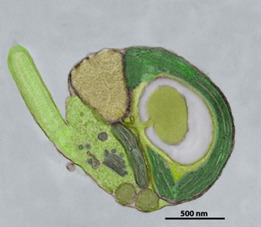
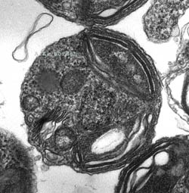
Key CANON questions about single-celled organisms
What organisms are present?
How are the organisms distributed spatially and temporally?
How do organisms and ecosystems respond to climatic/oceanographic changes?
Population dynamics, harmful algal blooms...

Slide 4
Cytometer (Gk kytos + metron)
Automatically measures individual cell characteristics; size, shape, morphology, taxonomy, physiologic state...
Takes many measurements (e.g. >1000s per second)
Several technical approaches, more kinds of “cytometer” today
Notes:
Contrast with ‘bulk’ techniques, e.g. transmissometer, nephelometer...

Slide 5
Project goals and activities
Look at available and emerging cytometers, potentially compatible with AUV, WG
Evaluate instruments in lab, at sea
Develop bench-top test bed
Formulate implementation path
  Science use cases
  Buy-vs-build

Slide 6
Flow Cytometry
Infer cell type from whole cell scatter, fluorescence
Best for simple cell morphologies, ~0.5 – 10 microns. Complex morphologies more problematic
pmt
sample core
sheath fluid
Fwd scatter filter
lens
field stop
laser light
pmt
objective
fluor filter

Slide 7
Flow cytometry - cytogram
Swalwell et al, 2011
Notes:
Cytogram, aka “dot plot” shows correlation between two parameters. Populations are identified through multi-variate training sets which define discriminant functions for different cell types.

Slide 8
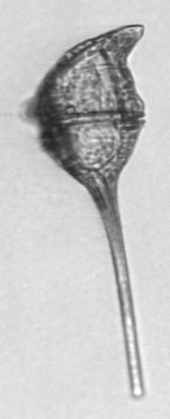
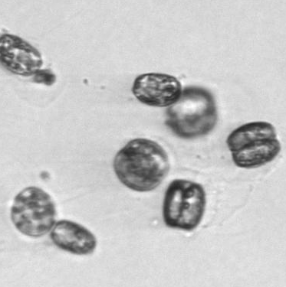
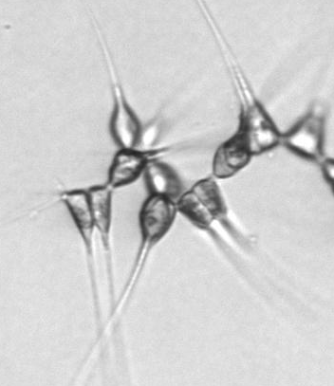
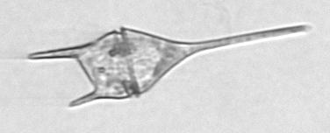

Imaging cytometers
Add camera to detectors
Image analysis for cell size, shape, internal structure, taxonomy...
Handles morphologically complex cells
Lower size-limit ~2 microns (diffraction limit)
Imaging Flow Cytobot

Slide 9
Light sheet imaging cytometer
Cells flow through blue laser light-sheet, generate chl-a images
No motion blur
1 ml/min
0.75 um resolution, identify species > 5 um
Can generate Z-stacks, 3D images
Wu and Chan, 2013
Notes:
Light sheet 5.4 um thick
Image acq speed: ~30 ms/particle

Slide 10
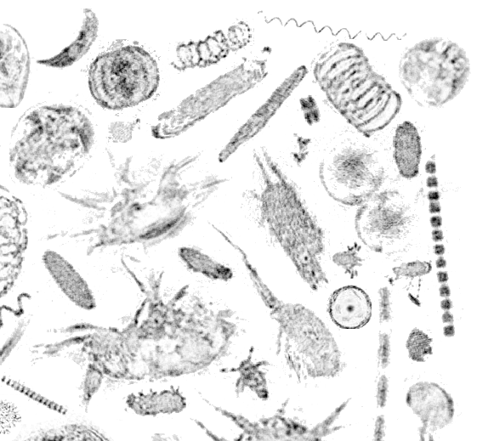
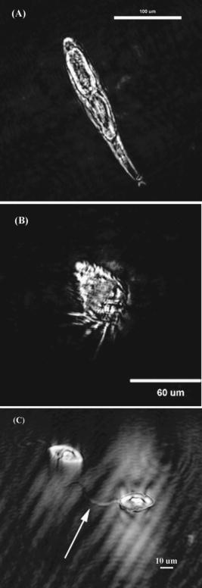
Holographic microscopy
No objective lens, object info captured from large volume, post-acquisition focusing
LISST Holo (courtesy J. Ryan)
Submersible Microscope
Notes:
Holo: 4.5 microns/pixel, ~1 minute to acq image.
SM: 16-50 fps, lateral resolution ~1 um, 5W

Slide 11
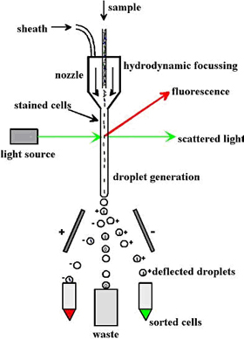
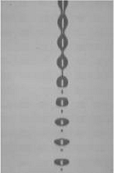
Additional cytometer techniques; sorting
Sort cells based on scatter/fluorescence; purifies rare subpopulations for further analysis
Courtesy of P. Lopez

Slide 12
Target organism size
In general, more small cells than large cells
Abundance (A)
V_{N}
A∝D^{b}
(-1.3 < b < -0.6)
V_{N}: volumetric rate required to detect N cells per unit time
0.1 um
10 um
1 mm
10 cm
10 m
Size (D)
Courtesy J Bellingham

Slide 13
Application scale
0.1 um
1 um
10 um
100 um
1000 um
particle size
Flow cytometry
Imaging
Worden
Scholin, Ryan
Vrijenhoek, Haddock
Different methods have different optimal size range
‘Hybrid’ methods help overcome limitations, expand application scale
Chavez

Slide 14
Some potential MBARI applications
Application | Target cells | Investigator
Oligotrophic population dynamics | prochlorococcus; 0.5-0.8 um, 10^4-10^5 cell/ml syncechococcus; 0.8-1.5 um, 10^3-10^4 cell/ml eukaryotic ultraphytoplankton; 2-20 um, 10^3-10^4 cell/ml heterotrophic bacteria; <5 um, 10^5-10^6 cells/ml; | Worden
Coastal population dynamics | cells > 2 um (Chavez) ~10^5 phytoplankton cell/ml | Chavez, Smith, Ryan
HAB survey | Pseudo-nitzschia; Width = 2-8um, Length = 40-175um Washington coast 1998 Pseudo-nitzschia bloom, 18000 cell/ml Washington coast 1997 Pseudo-nitzschia bloom, 13000 cell/ml Gulf of Mexico Karenia bloom: 20-40 um, ~700 cell/ml Gulf of Mexico Dinophysis bloom: 20-40 um, ~300 cell/ml Gulf of Maine Alexandrium bloom: 40-50 um, ~5 cell/ml | Scholin

Slide 15
Some throughput limits
core
sheath
Assume ρ = 10,000 cells/ml, N = 1000 cells (CV = 3%): “Typical” flow cytometer f = 1 ml/hr; must measure for 359 sec
Core flow rate – small cells not resolvable at high flow rates
‘Dead time’ increases with event rate, can miss rare cells
  Reduce detector gain to decrease event rate
Optimize setup for target cells
laser
slow flow
fast flow

Slide 16
Mobile autonomous cytometer applications
Three-dimensional surveys
Pinpoint regions of interest for intensive ship sampling
Draw on 3G ESP, LRAUV-Dorado experience

Slide 17
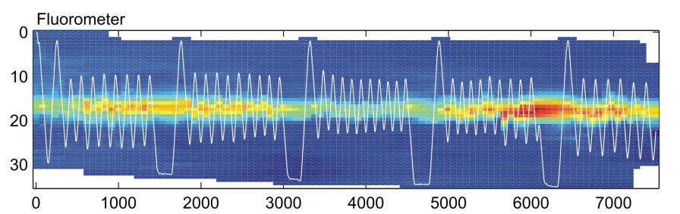

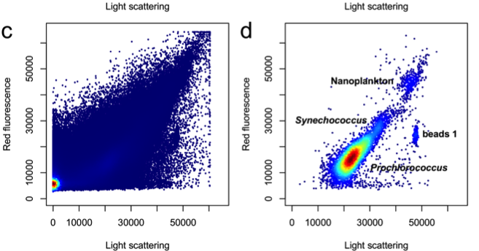

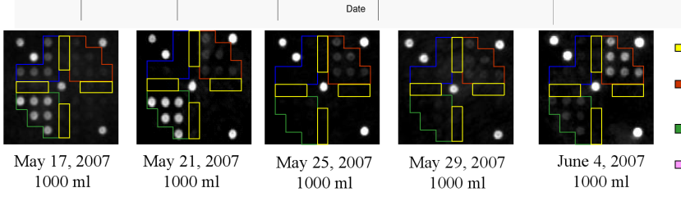
Aug
Collaborative surveys
Notes:
This is the present MBARI CANON paradigm – integrated use of diverse robotic platforms equipped with chemical and biological sensors, shore based assets, satellite systems, and modeling. For the near term (and perhaps mid term) we anticipate requiring a ship which would carry researchers conducting laboratory analysis on samples collected by the ship and the robotic systems.
CANON uses multiple mobile platforms to track individual aggregations of organisms to better observe how they respond to and interact with their surrounding environment.
New platforms and sensors required. Sensors such as the ISUS nitrate sensor, dissolved oxygen, various types of fluorometers, particle size, and ability to identify individual microbial species (e.g. using ESP) are necessary, along with water sampling for later laboratory analysis. Deployment time requirements are set by the duration of biological events - for example a coastal bloom might last about a month. This drives a need for a platform that can last about a month (much longer than Dorado) and carry a more complex sensor suite than a glider, motivating the Tethys Long Range AUV (which is now in testing).

Slide 18
Autonomous vehicle challenges
Sampling – moving vs stationary, ‘gulp’ vs continuous
Power, size
Telemetry
Thermal, orientation, shock

Slide 19
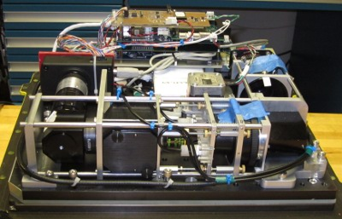
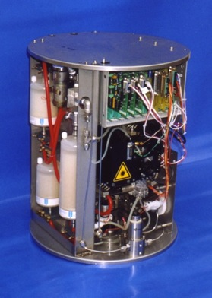
Existing autonomous mobile cytometer platforms
Wave Glider (in progress)
  Jupiter Research Foundation mobile microscope
  WG Imaging Flow Cytobot (WHOI)
AUV
  CytoSub prototype on AutoSub (2002)
JRF microscope payload

Slide 20
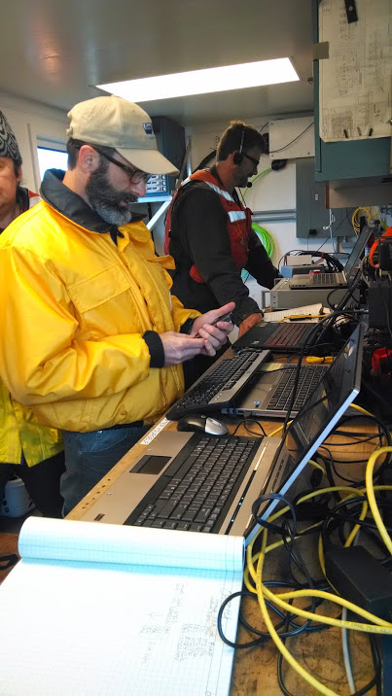
Instrument comparisons
Imaging Flow Cytobot - flow cytometer with camera (O’Reilly)
FlowCam – laminar flow cell with chl PMT and camera (Hamilton)
LISST Holo – holographic microscope (Ryan)
Submersible Microscope – holographic microscope (Klimov)
LISST-100X – bulk scattering (Ryan)
Lab fluorescent microscope - Zeiss Axioplan2 (Ziccarelli, Michisaki)
BD Influx – “Gold standard” lab cytometer (Poirier)
SeaFlow cytometer (Swalwell)
Notes:
Goals: gain experience with flow cytometry, compare instrument capabilities and nuances.

Slide 21
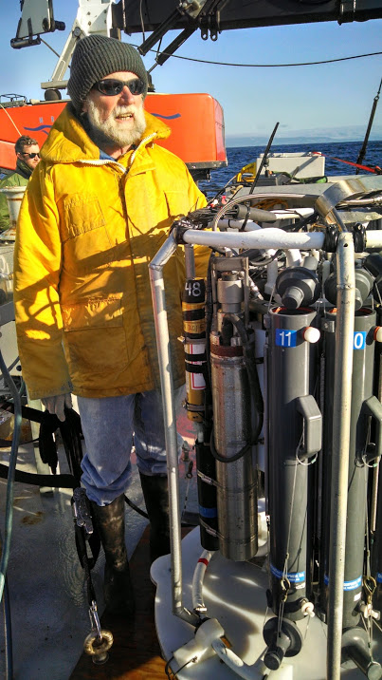
Instrument comparisons
Particle size distributions
Particle concentrations
Images
Sampling methods
Tests
  Culture samples in the lab
  At sea on Rachel Carson, pumped rosette sampling

Slide 22
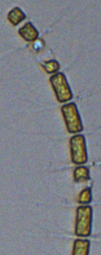
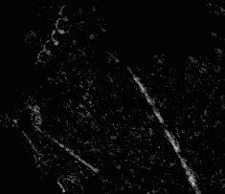
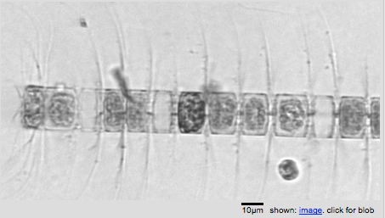
Image comparisons
Flowcam: 0.55 micron/pixel
LISST Holo: 4.4 micron/pixel
IFCB: 0.32 micron/pixel

Slide 23
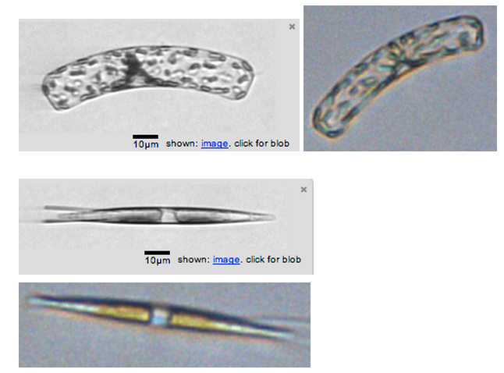
IFCB and FlowCam
IFCB
FlowCam
IFCB
FlowCam

Slide 24

Particle size distributions
IFCB, FlowCam measure equivalent circular diameter (ECD)
LISST-100X derives particle dimensions from ‘bulk’ forward scatter
Reinecker et al, 2008

Slide 25
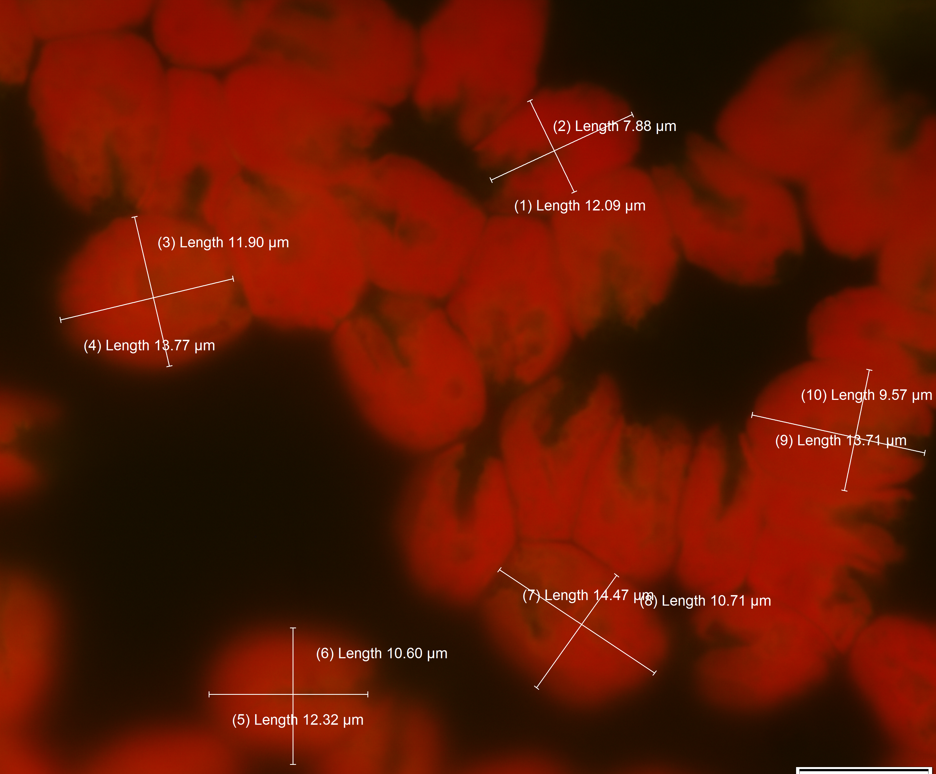
Particle size distributions
Also measured size with Zeiss Axioplan-2

Slide 26
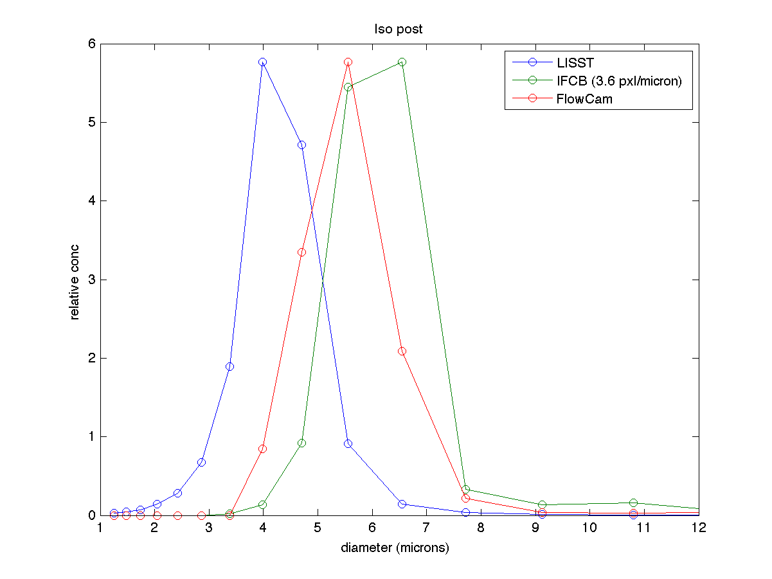

Particle size distribution
Isochrysis
LISST100X
Zeiss

Slide 27
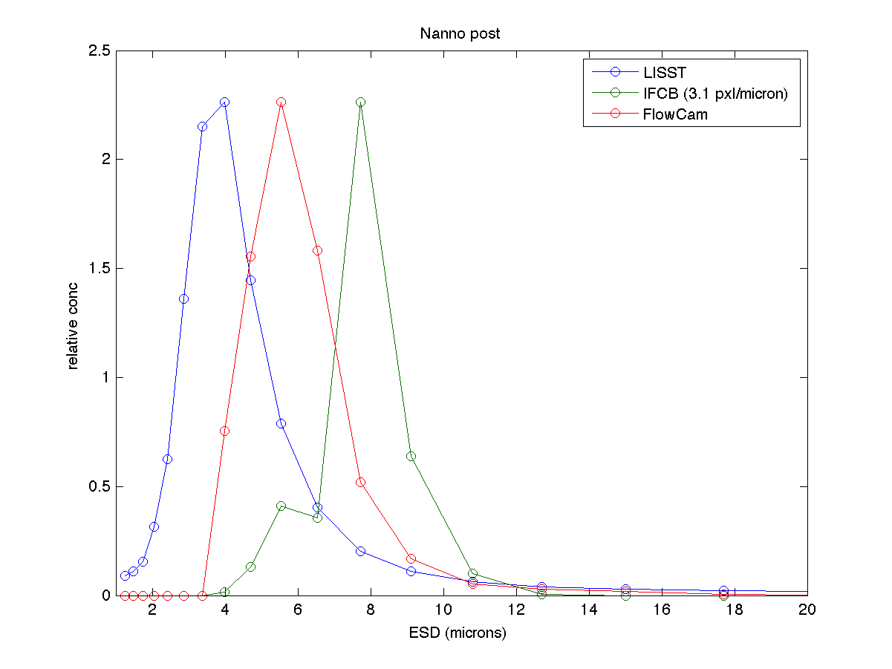
Particle size differences
FlowCam, IFCB: particle boundary, size (ECD) determined by image processing
IFCB Nannochloropsis
3.1 pixel/micron

Slide 28

Particle size differences: calibration
LISST-100X – no calibration method provided
IFCB and FlowCam – calibrate with beads
Carefully calibrated IFCB
  Note fuzzy bead edge
FlowCam – no reliable bead data collected
IFCB: 9 micron bead, 3.5 pixels/micron

Slide 29
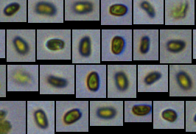
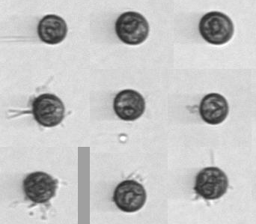
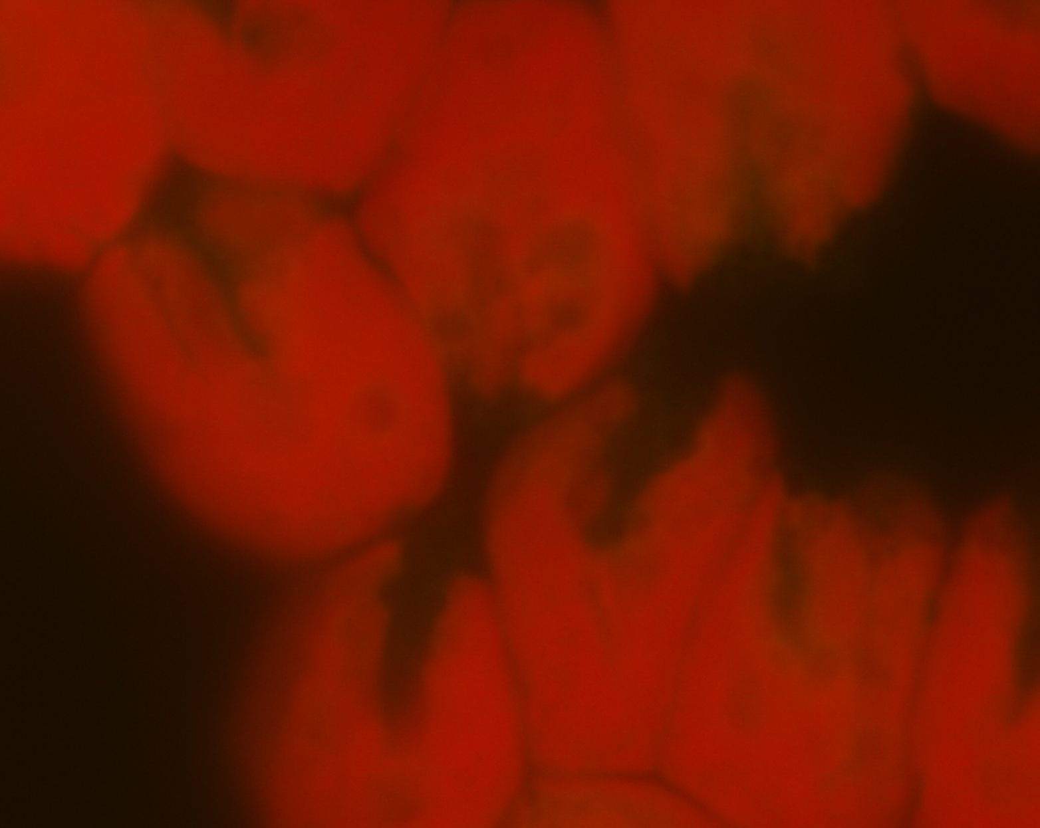
Particle size differences: physiologic state
FlowCam
Zeiss Axioplan-2
IFCB – round???
Dunaliela (~10 microns)

Slide 30
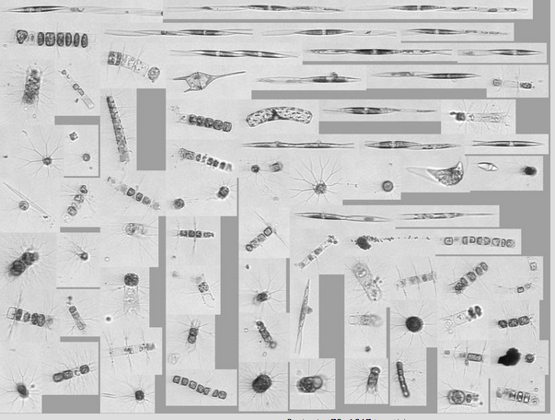
Paragon sample
IFCB

Slide 31
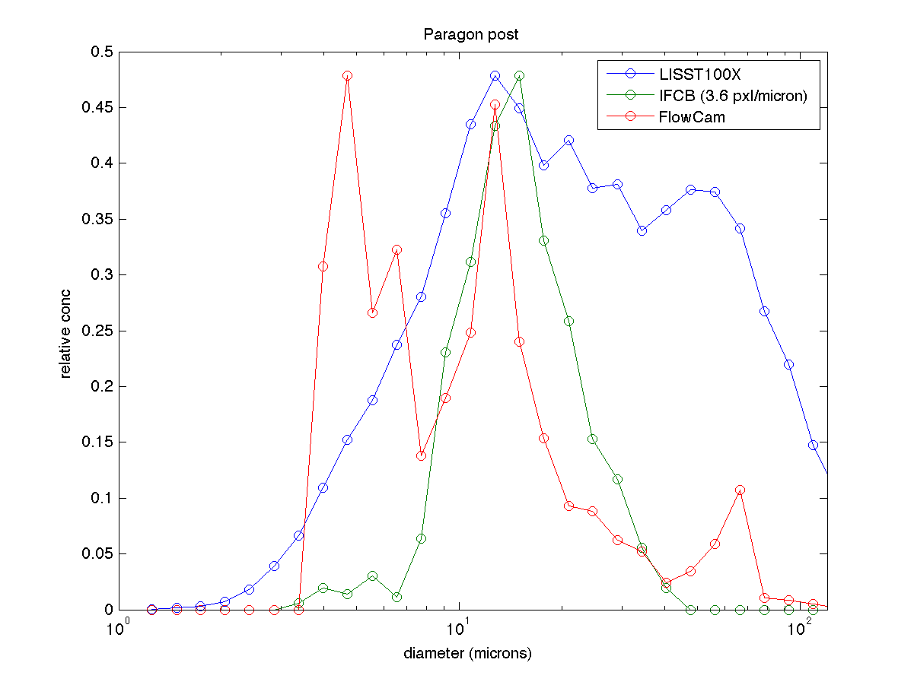
Particle size distribution
Paragon
LISST100X peaks for each shape axis
IFCB PMT gain set for larger cells
IFCB 150 um Nitex mesh
FlowCam 100 um flow cell

Slide 32
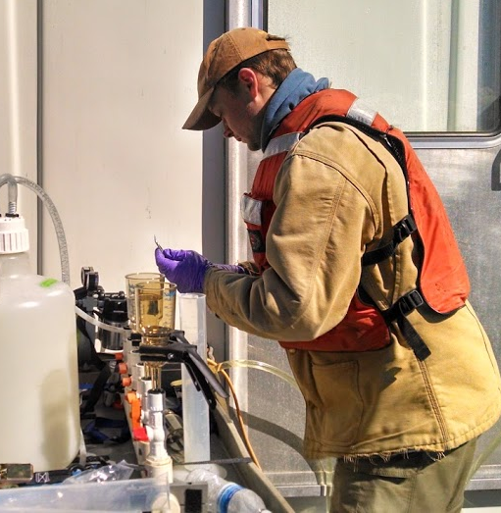
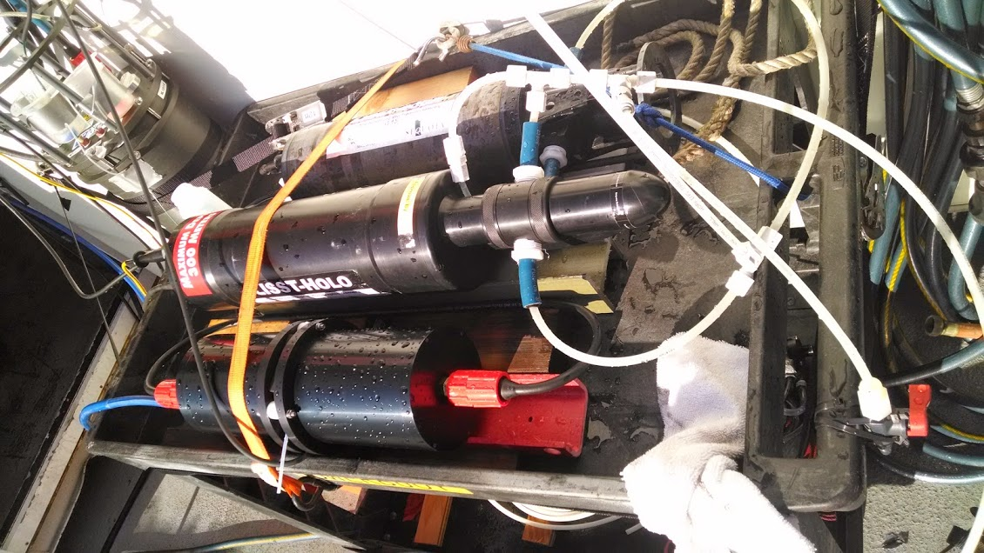
Evaluation: more to do...
Evaluate particle concentration results
Compare IFCB, FlowCam, SeaFlow pumped rosette profiles to InFlux lab cytometer (with J. Smith, Swalwell, Poirier)
Revisit Submersible Microscope -Try latest software release

Slide 33
Lessons from evaluations
Calibration against common standard
Instrument settings influence which cells are analyzed
Software settings influence results (e.g. where is the cell “edge”?)
Sampling: continuous vs discrete
Notes:
We note ‘quirks’, pros and cons of each instrument – but this slide shows some general observations.
Statistics and sample draw are especially relevant for moving platform. IFCB not designed for fine scale spatial resolution (e.g. on profiler)

Slide 34
Klimov: Bench top test-bed

Slide 35
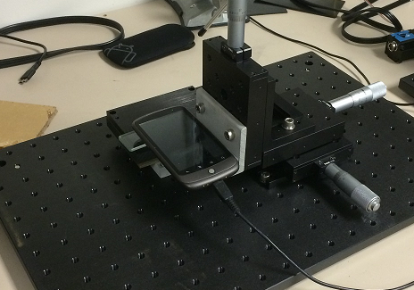
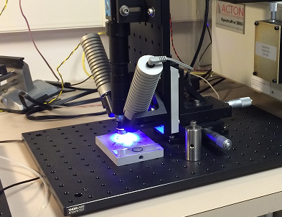
Desktop testbed: goals
Gain familiarity with object and methods
  Fluidics
  Optics
Find out what is possible
  Scale performance to deployable prototype
  Design optimization
Test some ideas
  Pressure gradients
  Bulk vs. hydro focusing

Slide 36
Key criteria
Adaptability to autonomous platform
Science “performance”
Maintenance stability
Actionable data
Size, power
Population diversity
Maintenance
Trigger sampling
Shock
Throughput
Alignment
Telemetry
Tilt
Temporal, spatial resolution
Biofouling
Screening/sorting
Limiting use on many platforms
Length of deployment
Population statistics in real time is challenging
Configurability
Unattended operation

Slide 37
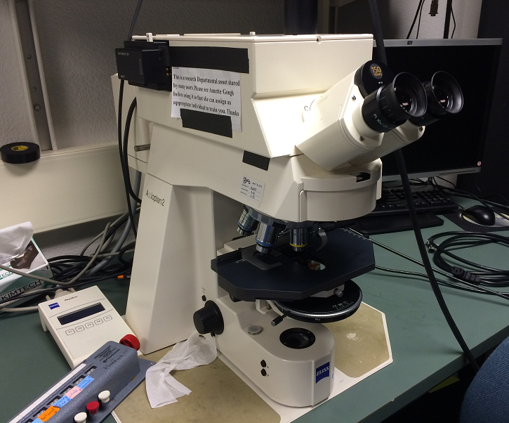
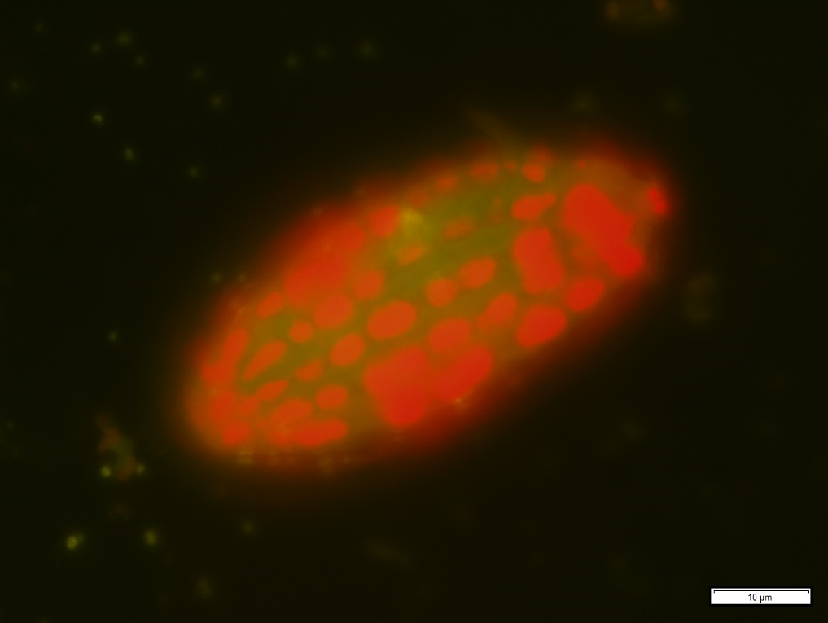
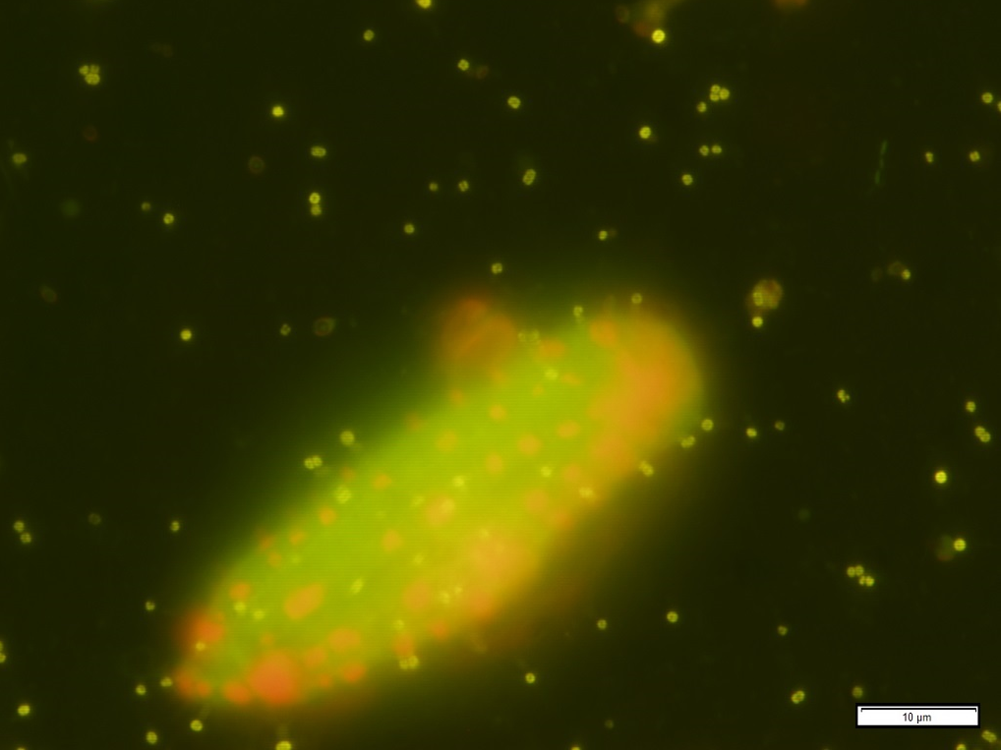
Benchmark: fluorescent imaging
Zeiss Axioplan fluorescence microscope
Courtesy of Lisa Ziccarelli
Red: chlorophyll
Ciliate with sequestered chloroplasts at 100x
Different physiological state?

Slide 38
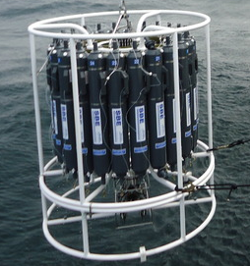
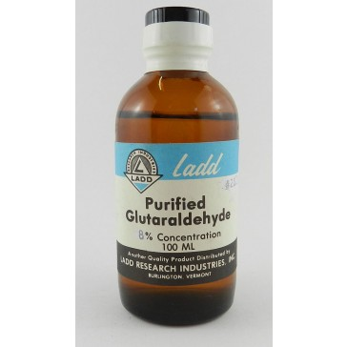
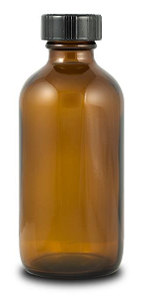
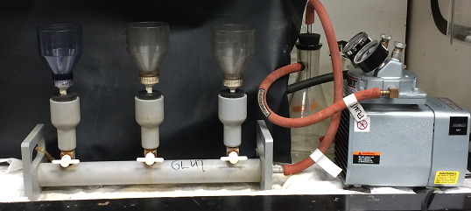
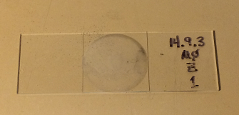
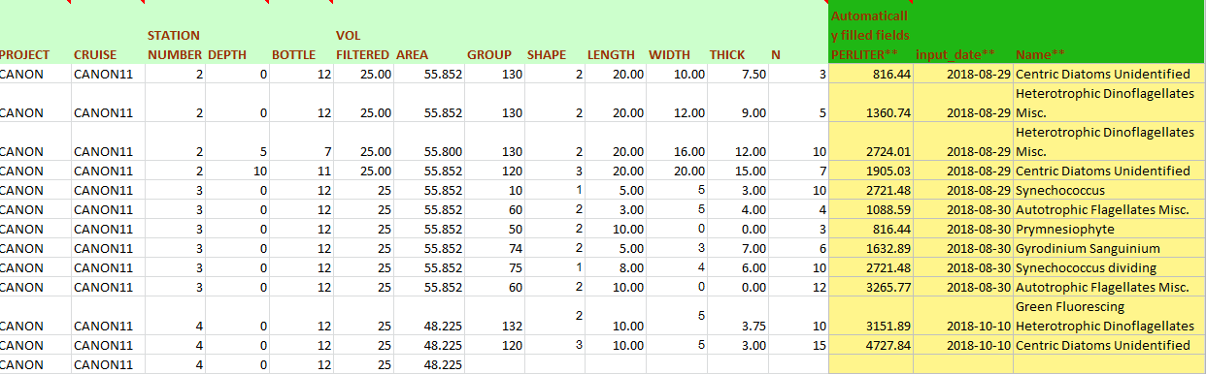
Benchmark: fluorescent imaging
Sampling, 125 ml
Fixing with Glutaraldehyde
Filtering 25 ml on 0.2um black polycarbonate filter
Visual identification, counting
Translating stage
Change objective: 10x, 40x, 100x
Entering spreadsheet
Notes:
Multiple steps, manual, lab equipment. Can we automate?

Slide 39
Benchmark: fluorescent imaging
Traditional method, time series
Laboratory equipment, manual
Hours per slide
Can we emulate?
  Simplified version
  Autonomous, unattended operation
Testing with slides
How you do it?
Notes:
Multiple steps, manual, lab equipment. Can we automate?

Slide 40
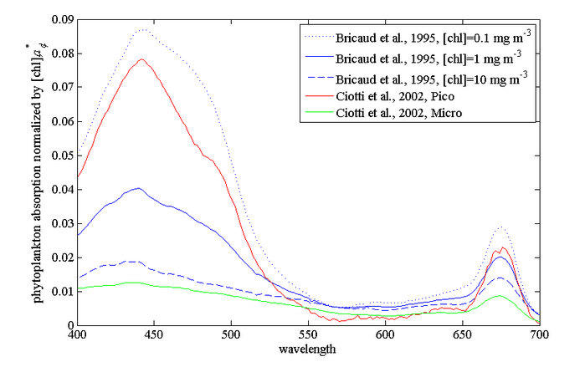
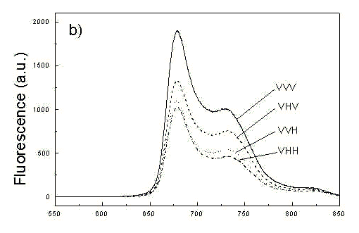
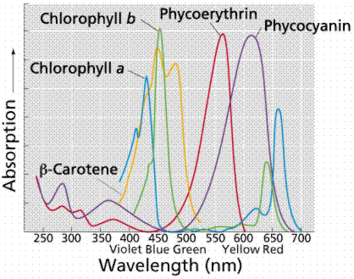
Pigment fluorescence: how you do it?
Chlorophyll absorption (1)
Chlorophyll (auto) fluorescence (3)
Pigments absorption (2)
bandpass
Light source + excitation filter
Detector + emission filter
long wave pass
(1) http://www.oceanopticsbook.info/view/optical_constituents_of_the_ocean/_phytoplankton
(2) http://mhl.nsw.gov.au/projects/berowra/chloro.php
(3) http://www.photobiology.com/photobiology99/contrib/danuta/
Notes:
Useful technique – how you do it? Auto fluorescence of native pigment

Slide 41
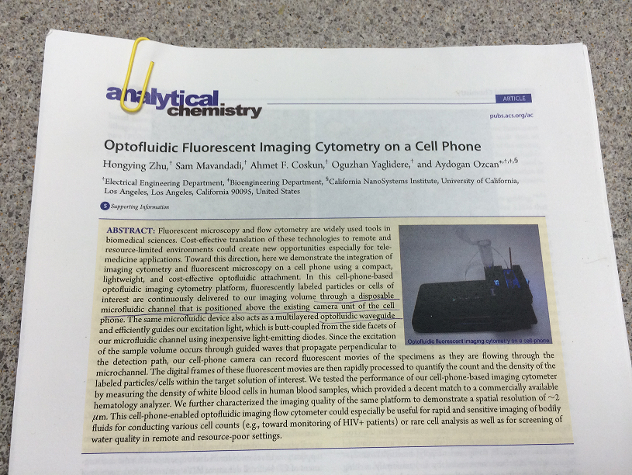
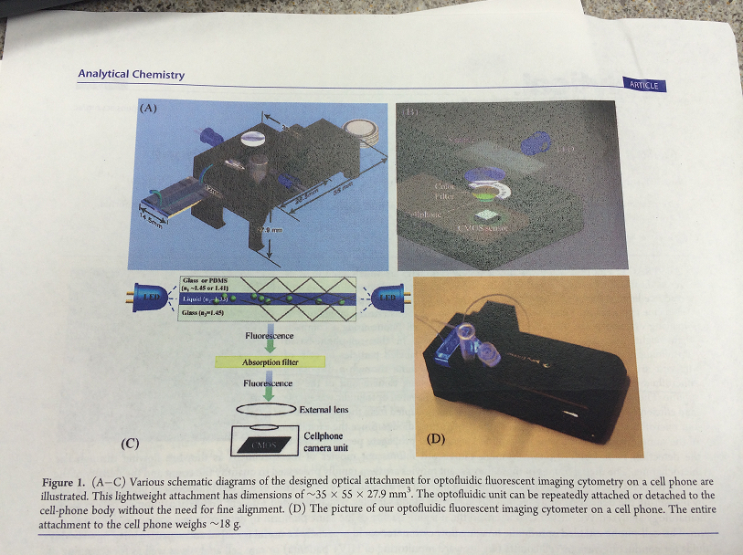
Cell phone cytometer?
Courtesy of Ken Johnson
Fluorescent Imaging cytometry on a cell phone
Inexpensive components
Biomedical applications

Slide 42
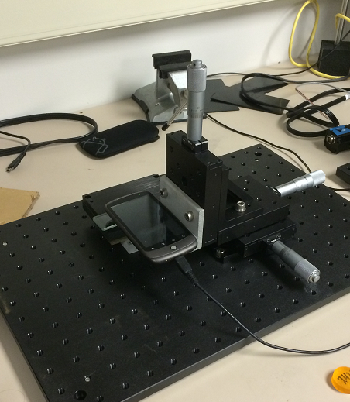
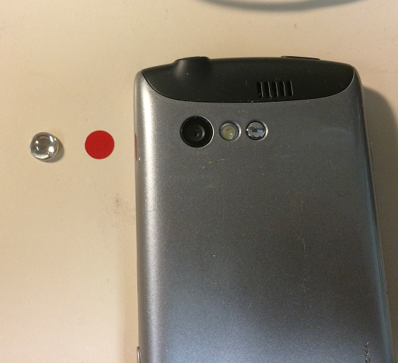
Cell phone test stand
Optical filter film (for fluorescence)
Micro lens
X-Y-Z stage
Cell phone
Sample on a slide
Optical base plate

Slide 43
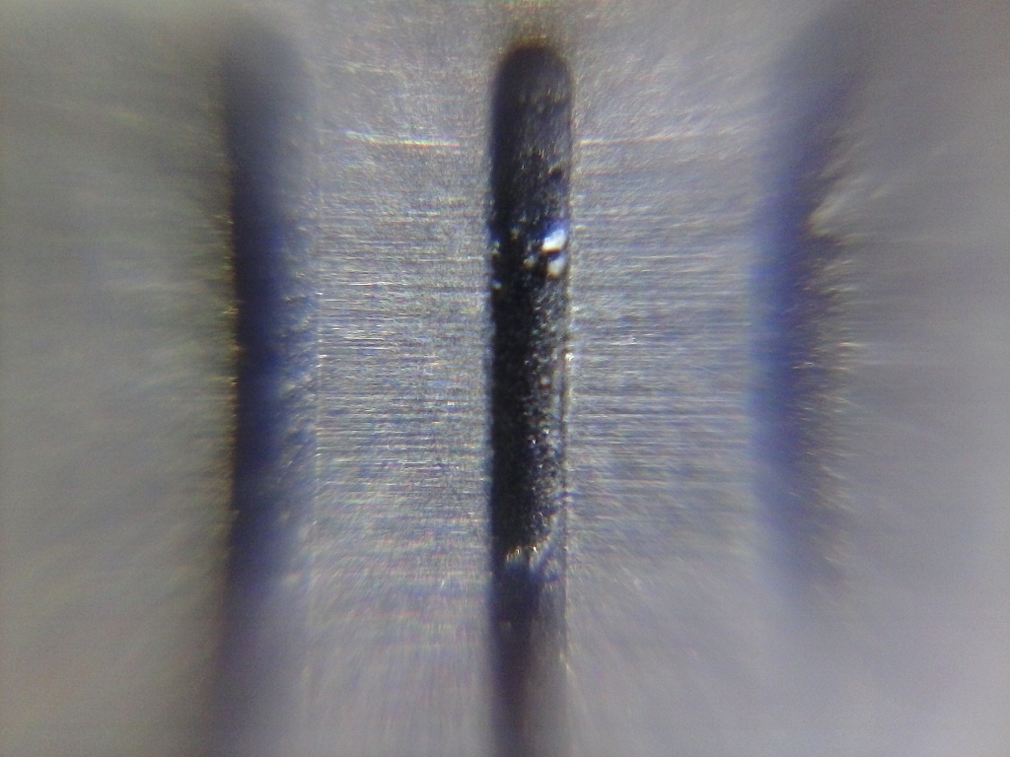



Cell phone microscope
Kyocera C5155 2048x1536 1.6um/pixel
1 mm grid
85 um line
6-10 um texture
HTC Nexus One 2592x1944 1.3um/pixel
With red film filter Cross-talk!!!
Stained pseudo -nitzschia

Slide 44


Optics: chasing cross-talk
LED Luxeon Royal Blue 455 nm
+
Red filter (Roscolux #19)
Pink light is visible:
Long tail of blue LED
LED Luxeon Royal Blue 455 nm
+
Blue filter (Intor 450-40)
+
Red filter (Roscolux #19)
Blue is still visible
Red filter OD not enough

Slide 45



Optics: Filters
Solid plastic
Color film
Interference filters

Slide 46




Optics: Filters
Intensity, counts
LED Luxeon Royal Blue 455 nm
+
Intor 450-40 filter
Transmission, %
Delvie 2422 plastic filter
Isolation region Cross-talk removed But filter is thick!

Slide 47

Testbed
Blue LED
Imaging Source cameras:
BW and Color 1600x1200
Lens tube
White LED
X-Y-Z stage
Base plate
Microscope objective

Slide 48


Testbed: imaging scale
4x objective
1600x1200 pixel
1600 um wide = > 1 um / pixel
10x objective
1600x1200 pixel
650um wide = > 0.4 um / pixel
100 um optical glass target

Slide 49




Testbed: BW imaging, slide
Fluorescence
Samples courtesy of Holly Bowers
160 x 160 um region
4x objective
1600x1200 pixel, 1 um / pixel
RG630 filter
BW camera: all pigments – one color
160 x 160 um region
“White” light

Slide 50




Testbed: color, fixed sample
Fluorescence
Samples courtesy of Lisa Ziccarelly
65 x 65 um region
10x objective
1600x1200 pixel, 0.4 um / pixel
Delvie 2422 filter
Color camera: ID pigment group
65 x 65 um region
“White” light

Slide 51


Testbed: color, net tow sample
Fluorescence
Samples courtesy of Julio Harvey
10x objective
1600x1200 pixel, 0.4 um / pixel
Delvie 2422 filter
Color camera: ID pigment group
Multiple cells per slide, each in its own bubble!
White light

Slide 52
Comparison
microscope components
Includes processing platform
Better camera control
Compact, low power
Access to image trigger signals
Single camera?
Multi-camera architecture
Limited control of camera
Use of microscope objectives
Cell phone obsolescence
Need processor board
“Cell phone level”
Entry level
High end

Slide 53
Learned
organic vs. inorganic
2 channels:
Synchronous acquisition seems to be valuable
Fluorescence signal is weak
  Longer exposure
  Higher excitation power
  Fluorescence of materials
Depth of field is quite short at high resolution
“Cell phone microscope”: not bad!
Images of same object
High dynamic range of detection
Flow cell configuration

Slide 54
Next steps
Have some idea
Energy: sensitivity, power, exposure
Architecture
  Software: image processing
  Flow cell design
  Processing platform
Capability ⬄ requirements
  Search for middle ground
  Multidisciplinary team
Running out of time this year
Very important

Slide 55
Future project directions
Continue investigation into latest tech
Refine test-bed, test against science use cases
Investigate automated cell identification (e.g. as used by IFCB, Flowcam)
Trade-offs; Build vs buy, science vs cost
Continue collaborator engagement (JRF, Sosik, Swalwell, Garren...)
Implementation project in 2016

Slide 56
Questions?

