Slide 1
Cytometer technology for autonomous platforms
2014 Kickoff
Tom O’Reilly and Denis Klimov
Jim Bellingham
Francisco Chavez
Alex Worden

Slide 2
Project focus
Cytometry (fr. Greek “cell measurement”): General name for methods that measure parameters of individual cells
  Flow cytometers
  Microscopes (including fluorescent microscopes)
  Coulter counters

Slide 3
Project goals
Investigate cytometers that could be integrated with LRAUV or Dorado
Build lab test-bed to study approaches (hardware and software)
Evaluate available cytometers
Facilitate collaboration with external cytometer developers (commercial, academic)

Slide 4
Project allocation and budget
O’Reilly (project manager) – 23 days
Klimov - 40 days
Budget: $6,800 (travel, test-bed components)

Slide 5
Schedule and milestones
Discuss SeaFlow during Swalwell visit to MBARI | 2/5
Demonstrate fluorescent microscope test-bed, version 1 | 6/1
Evaluate loaner instrument in fall CANON (e.g. Submersible Microscope) | 9/15
Annual project report, including test-bed results | 12/15

Slide 6
Flow vs imaging vs “bulk” instruments (DENIS)
Cell morphology effects
Size ranges addressed
MBARI science application interests

Slide 7
Single-volume detection
Light
Detection volume
Flow
Resolution
Optimization
Concentration
Narrow range of parameters
Statistics
Signal on detector
Limited dynamic range vs. wide natural range population composition
If detection volume is set to be able to resolve pulses from small particles, then statistics on larger cells with low concentration is becoming unacceptably slow
Hard to interpret data for larger / complex morphology organisms

Slide 8
Imaging methods
Flow
Detection volumes
Detection volumes
Resolution of morphology
Wider range of parameters
Space domain
Wider dynamic range on cell size vs. statistics
Works better for larger/ complex morphology organisms
Does not work well for smaller (< 5um) organisms

Slide 9
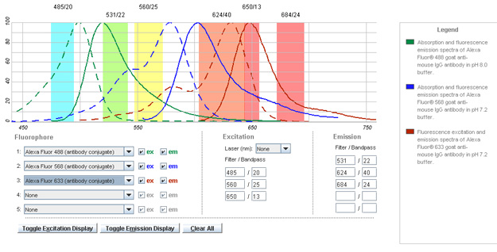
Bulk scattering
High–res detector
Signature decomposition
High throughput al low processing lost
Harder to interpret larger / complex morphology cells
Sensitive to cell orientation

Slide 10
Scale comparison
0.1 um
1 um
10 um
100 um
1000 um
particle size
Flow cytometry
Imaging
Bulk scattering
Different detection methods have different optimum size range
There is certain overlap
Combination methods help overcome limitations and expand application range

Slide 11
Test bed hardware details
Denis

Slide 12
Test bed software details
Particle detection
Classification
  Fluorescent vs non-fluorescent
  Size
  Shape
Prototype runs on laptop, should be embedded in the future
FPGA or GPU hardware acceleration

Slide 13
Example processing chain, implemented in GPU/FPGA
From “A hardware accelerated approach for imaging flow cytometry”, Lee, Meng et al (2013)

