Slide 1
901303
Cytometer technology for autonomous platforms
Tom O’Reilly
Denis Klimov
Francisco Chavez

Slide 2
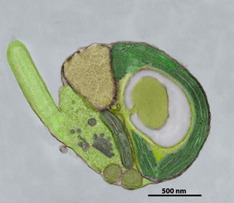
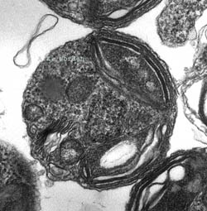
Project goals and activities
Look at available and emerging cytometers, microscopes potentially compatible with AUV, ASV
Evaluate instruments in lab, at sea
Develop bench-top test bed
Formulate implementation path
  Science use cases
  Buy-vs-build

Slide 3
Project team
Denis Klimov: Electrical/optical engineering
Francisco Chavez: Science applications
Tom O’Reilly: Project manager, software
Worden, Scholin, Chavez labs

Slide 4
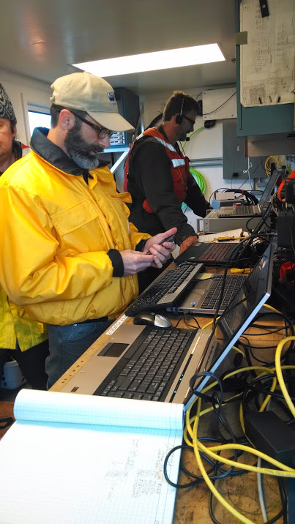
2014
Evaluated, compared multiple instruments onboard Rachel Carson, in the lab
Bench-top cell phone, fluorescent microscope test-beds
Presented results at project update, 11/2014
Cytometer/microscope evaluations aboard the Carson

Slide 5
2015
Collaboration with Jupiter Research Foundation, Wave Glider microscope
Publication with Dr Peter Lopez (NYU)
Complete analysis of 2014 instrument comparisons (in progress)
Evaluate improved 4Deep Submersible Microscope (in progress)
IFCB: pseudo nitzschia
Notes:
Instrument comparisons - Improved Seaflow calibration, new Submersible Microscope hardware/software

Slide 6
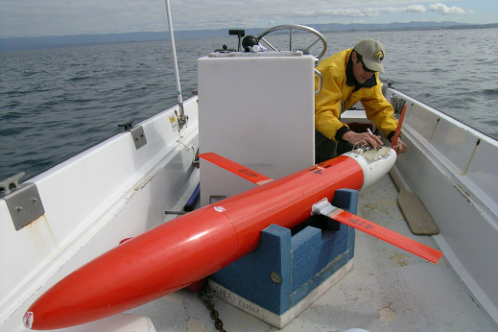
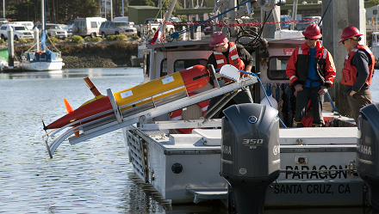
MTS Journal article (TechSurge issue)
Invited by Peter Lopez (Flow Cytometry and Cell Sorting Center, NYU School of Medicine)
  Lopez, O’Reilly, Klimov (2015), “Cytometers set sail with sea-going mobile robots”, Marine Technology Society Journal, volume 49, no 3
Unplanned, opportunistic activity
  Some 2015 deliverables likely not delivered this year
Notes:
Lopez participated in MTS Ocean Sensors TechSurge workshop 2014 with Bellingham. Lopez was invited MBARI seminar speaker in 2014.

Slide 7
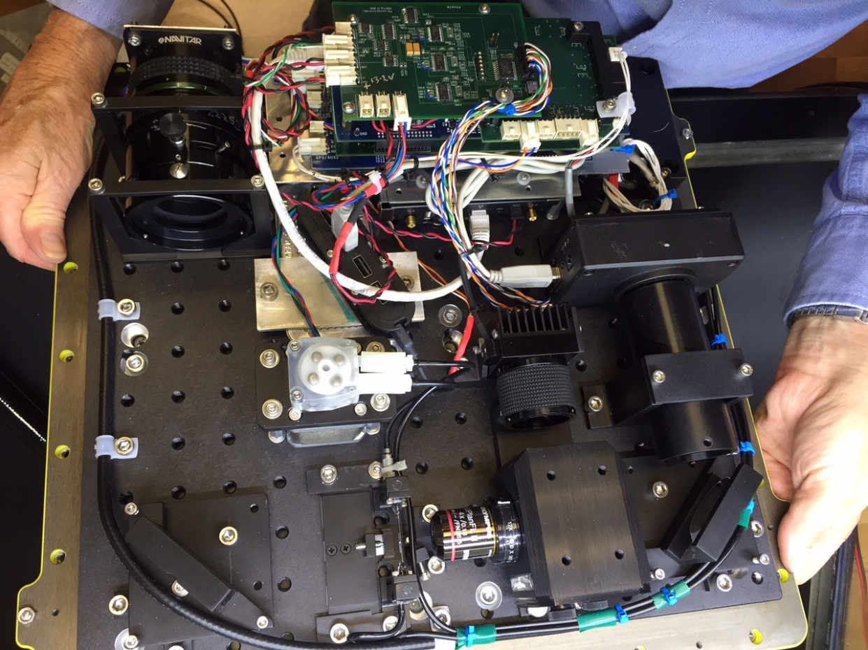
JRF WG microscope collaboration
Technical advice to JRF
  Fluorescence imaging, optics
  Sample preparation, etc.
Science application advice
  Discussions with Scholin,
  Chavez labs (Ryan, Bowers,
  et al...)
  Sampling at depth, statistics, image analysis, etc.
Plans for 2016 collaboration

Slide 8
Application scales
0.1 um
1 um
10 um
100 um
1000 um
particle size
Worden
Scholin, Ryan
Vrijenhoek, Haddock
Chavez
PipeCyte - funded
Mobile IFCB - funded
Emerging AUV/ASV cytometer/microscopes
PSI-FI
WG microscope
Submersible microscope
Notes:
PipeCyte has 3-year NSF funding
PSI-FI apparently being commercialized in China

Slide 9
MBARI 2016 mobile cytometer/microscope workshop
Instrument and vehicle experts discuss latest developments
  Instrument designs
  Science applications
  Adaptive sampling with AUV
  Instrument demos?
Sosik and Swalwell are enthusiastic about this
~2-3 days, 20 participants

Slide 10
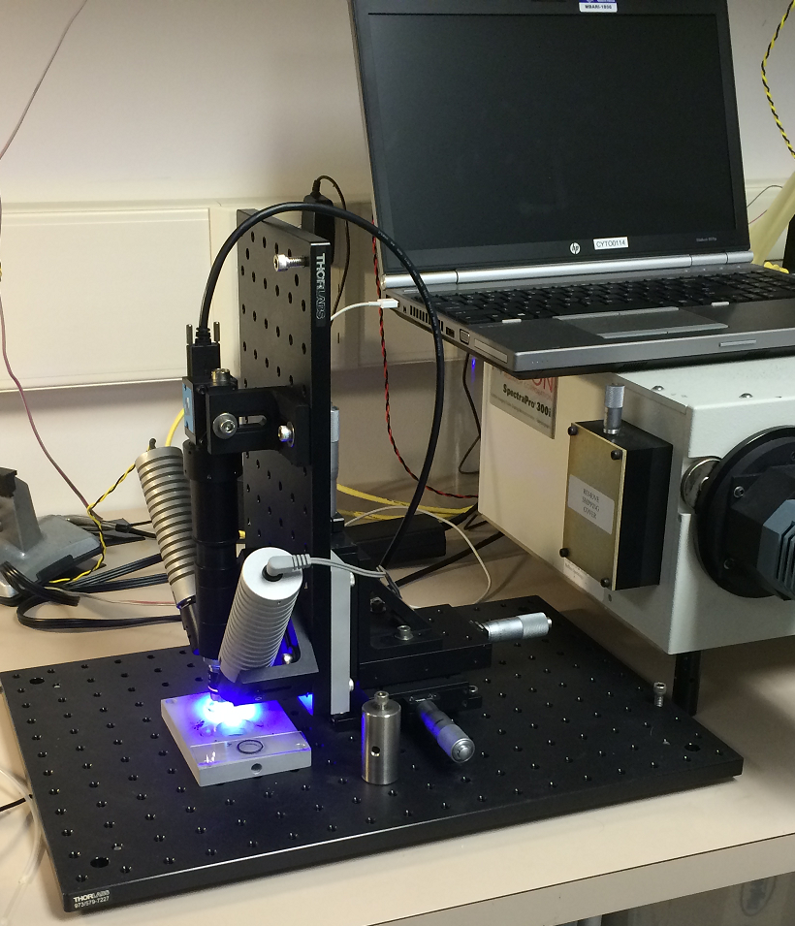
Proposed 2016 plan
Host mobile cytometer workshop at MBARI
Survey cell image identification software (e.g. IFCB)
Refine functional prototype
  Cell phone fluorescent microscope
  (low cost, size, power)
  Sample flow design, lighting, software
Monitor developments, possible collaborations
Some activity might be subsumed by
JRF collaboration project
Bench-top fluorescent microscope prototype
Notes:
Functional prototype – not ready for deployment (no pressure vessel, vehicle interfaces).
E.g. some of Klimov’s time could be spent studying feasibility of submersible WG microscope

Slide 11
Questions?

Slide 12
Synergy with JRF collaboration project

Slide 13
Some emerging mobile instruments
PipeCyte flow cytometer (Swalwell/UW)
  NSF proposal
Psi-Fi light-sheet imaging cytometer
  Commercial venture underway?
Mobile Imaging Flow Cytobot (Sosik/WHOI)
  Integration with Wave Glider, other mobile platforms
Wave Glider Microscope (JRF)
  MBARI/JRF collaboration project in 2016?

