Slide 1
Cytometry for Autonomous Platforms (feasibility study)
Sample
Flow
Assessment of population composition based on parameterization and statistics of individual particles
Lab cytometers: large, complex, labor intensive
Need: compact cytometer capable of unattended operation in situ
AUV integration would allow adaptive sampling strategies and triggering other assets
nozzle
Scattering
laser
camera
fluorescence
Swalwell et al, 2011
Notes:
Diversity and interactions among microbial populations are key to the geochemical cycles that maintain Earth’s biosphere.
Cytometers discriminate between microbial species in situ. Measure population variations in space and time, changes due to natural and human forcing.

Slide 2
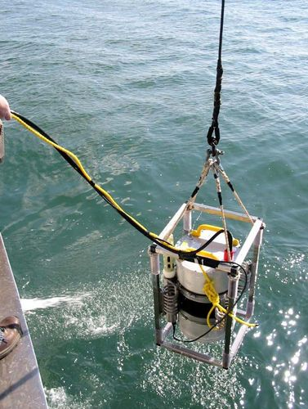
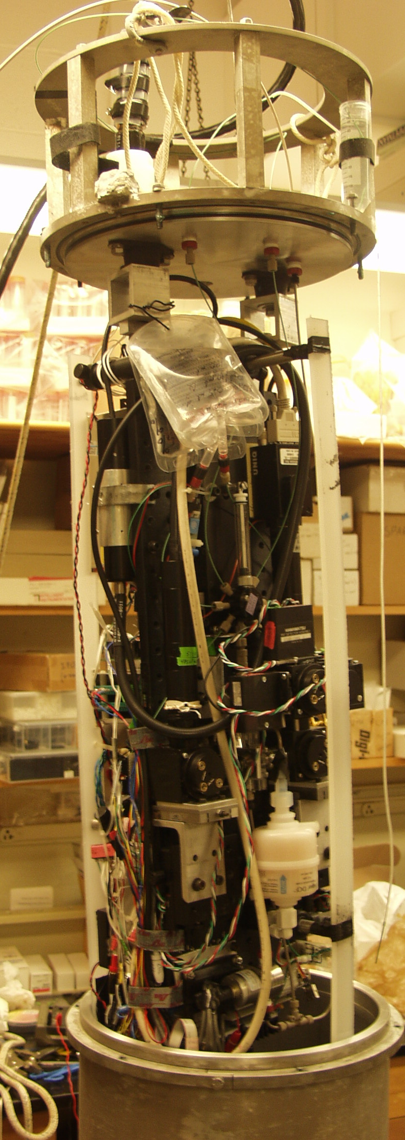
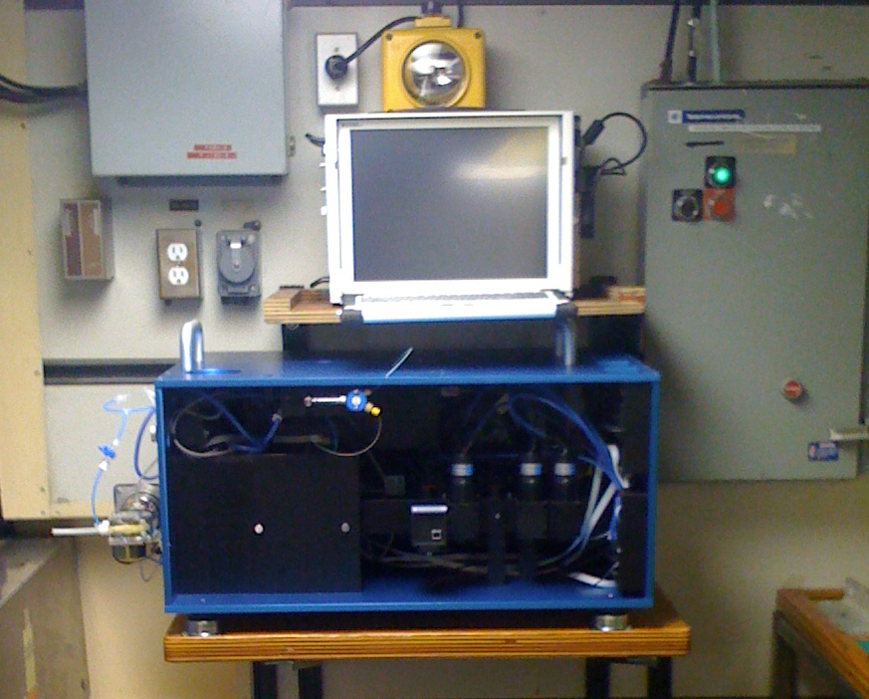
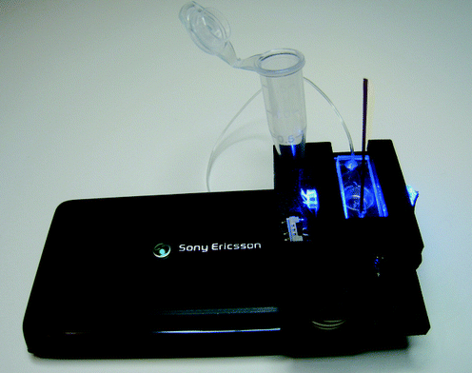
Some candidate cytometers for AUV integration
CytoSub (CytoBuoy BV)
Seaflow
(University of Washington)
Imaging Flow Cytobot (WHOI)
Cell-phone cytometer
(Holomic LLC)
Notes:
Developers/users of existing instruments invited to MBARI to present, run their instruments aboard our ships. Planning benchtop imaging cytometer in 2014.

