Slide 1
Cytometry for Autonomous Platforms (feasibility study)
cells
nozzle
Measure microbial composition and distribution
Lab cytometers - large, complex devices
Investigate small/low-power cytometers for integration with autonomous mobile platforms
Engineering-CANON partnership
side scatter
laser
fwd scatter
camera
fluorescence
Swalwell et al, 2011
Notes:
Diversity and interactions among microbial populations are key to the geochemical cycles that maintain Earth’s biosphere.
Cytometers discriminate between microbial species in situ. Measure population variations in space and time, changes due to natural and human forcing.

Slide 2
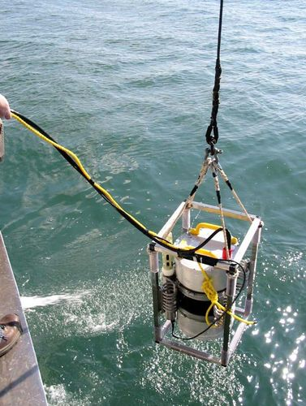
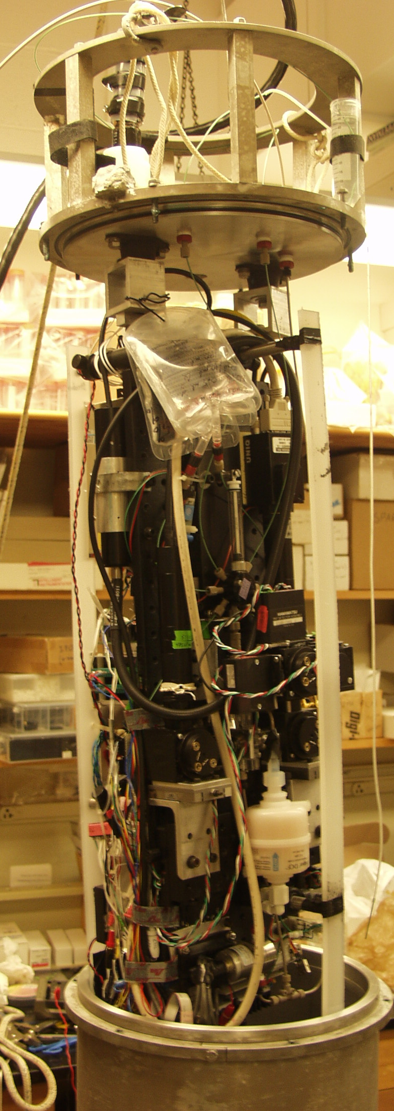
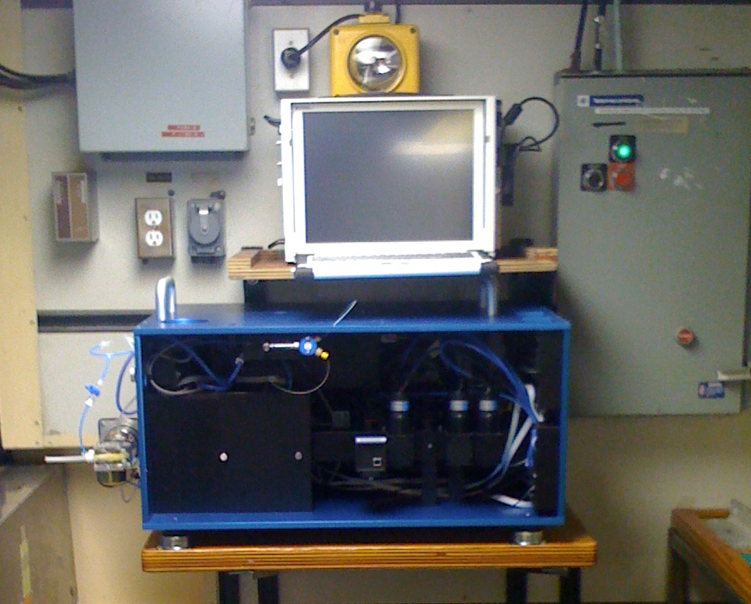
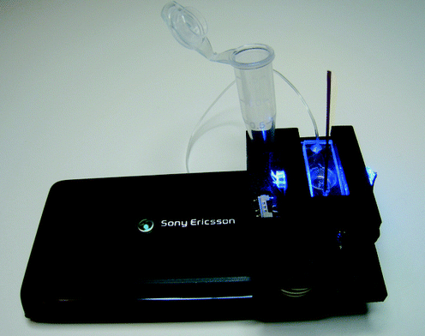
Some candidate cytometers for AUV integration
CytoSub (CytoBuoy BV)
Seaflow
(University of Washington)
Imaging Flow Cytobot (WHOI)
Cell-phone cytometer
(Holomic LLC)
Notes:
Developers/users of existing instruments invited to MBARI to present, run their instruments aboard our ships. Planning benchtop imaging cytometer in 2014.

