Slide 1
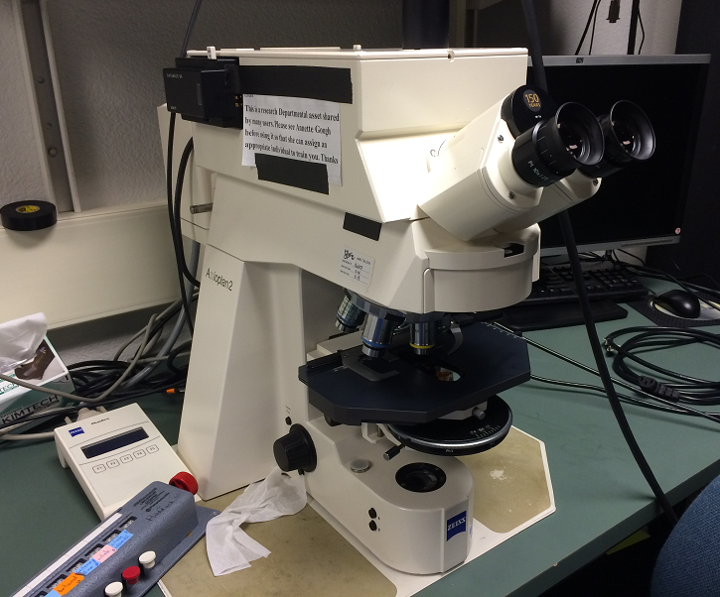
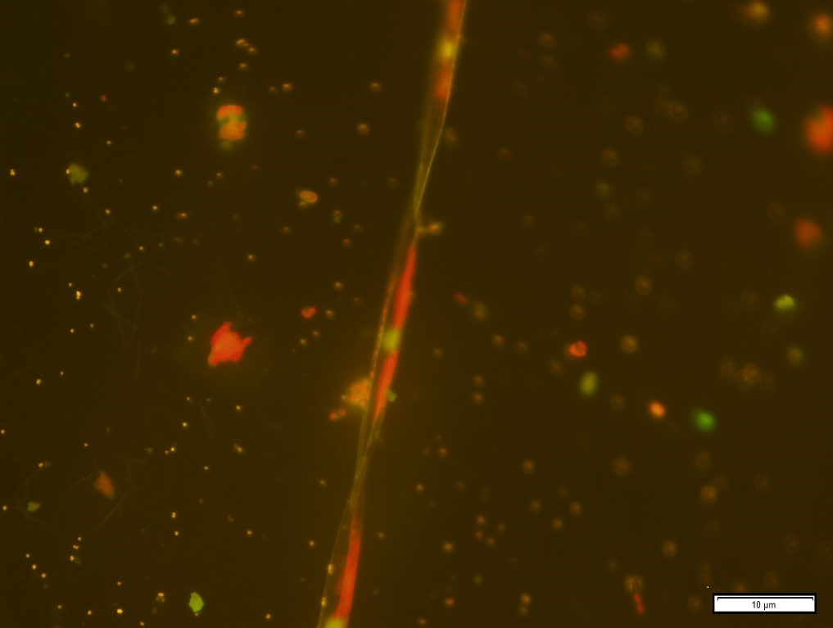
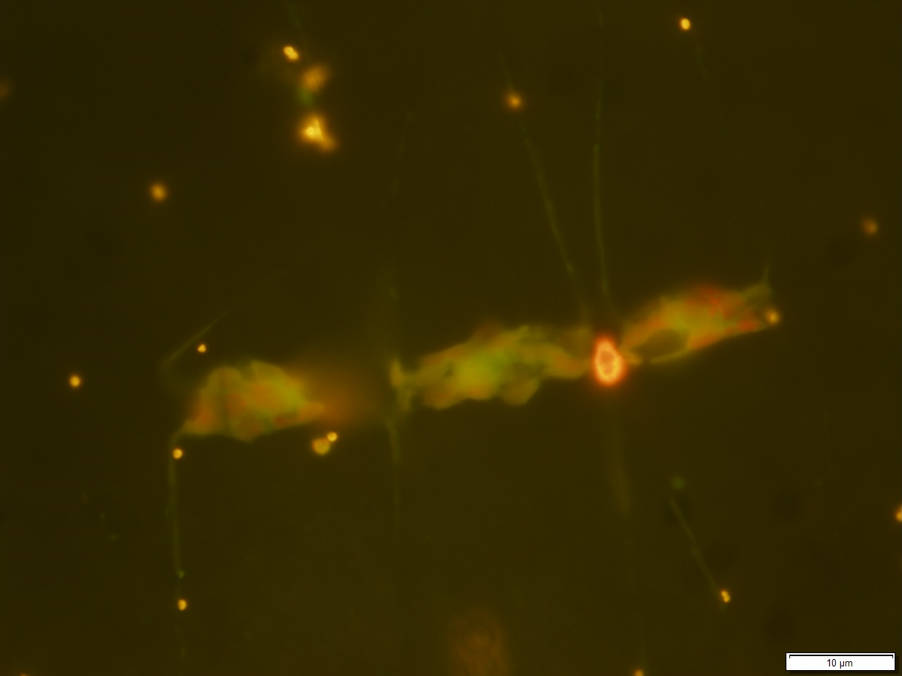
Benchmark: fluorescent imaging
Zeiss Axioplan fluorescence microscope
Courtesy of Lisa Ziccarelli
Pseudo-nitzschia, at 100x
Chaetoceros, at 100x

Slide 2
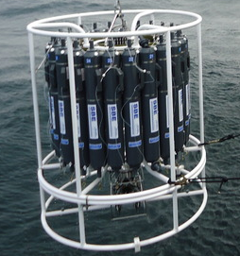
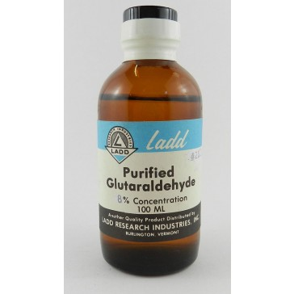
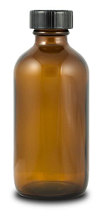
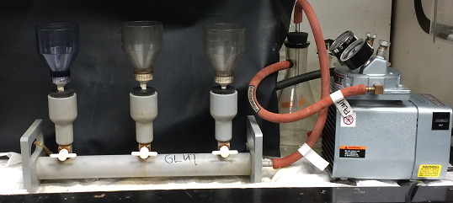
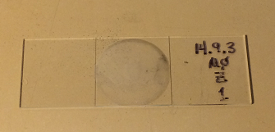
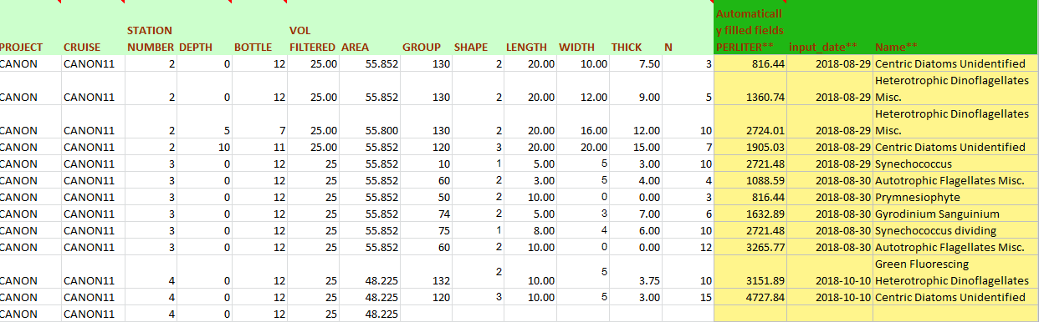
Benchmark: fluorescent imaging
Sampling, 125 ml
Fixing with Glutaraldehyde
Filtering 25 ml on 0.2um black polycarbonate filter
Visual identification, counting
Courtesy of Lisa Ziccarelli
Translating stage
Change objective: 10x, 40x, 100x
Entering spreadsheet
Notes:
Multiple steps, manual, lab equipment. Can we automate?

Slide 3
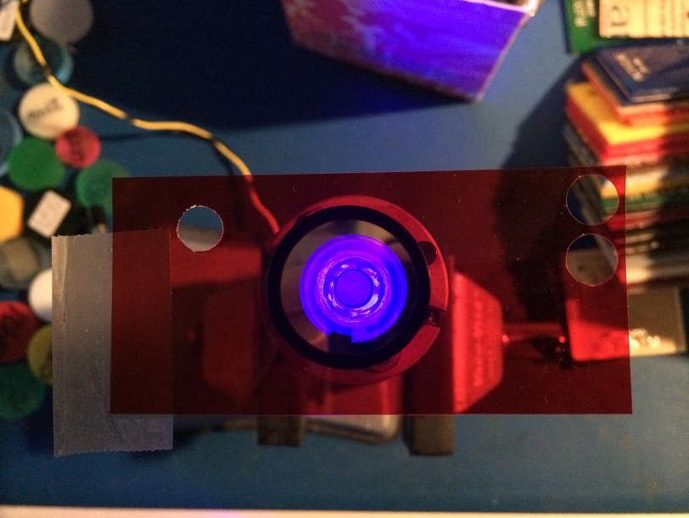
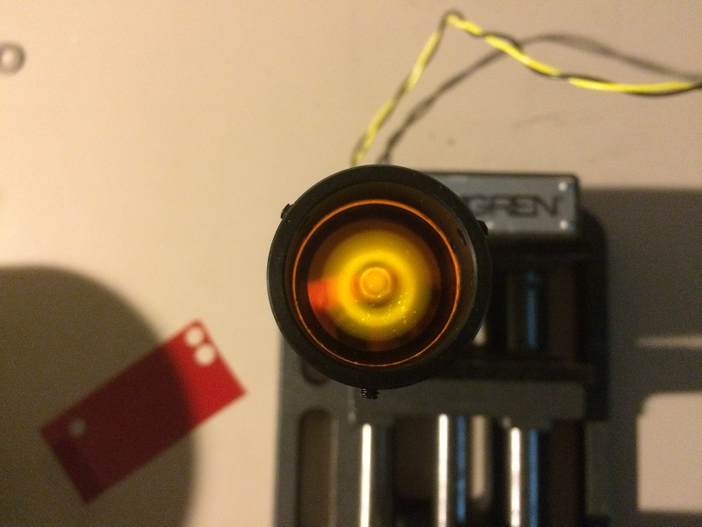
Optics: chasing cross-talk
LED Luxeon Royal Blue 455 nm
+
Blue filter (Intor 450-40)
+
Red filter (Roscolux #19)
Blue is still visible
Red filter OD not enough
LED Luxeon Royal Blue 455 nm
+
Blue filter (Intor 450-40)
+
Delvie 2422
Yellow light slightly visible – may upgrade blue filter

