Slide 1
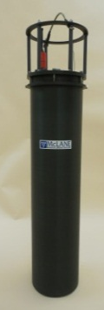

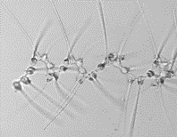


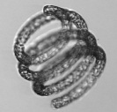

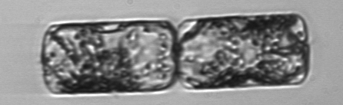
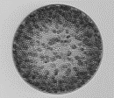


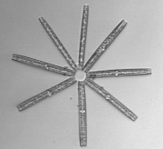
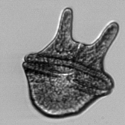

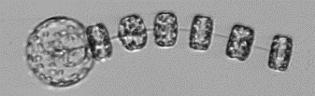




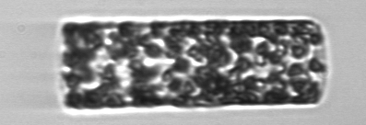

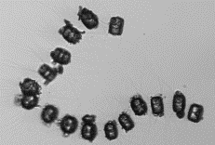
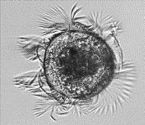



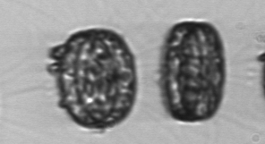
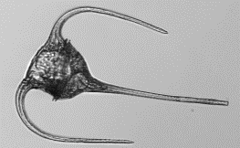
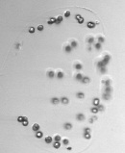


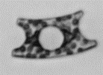


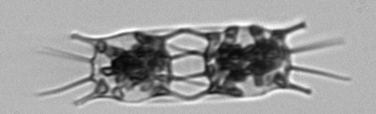





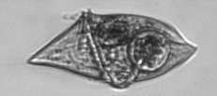



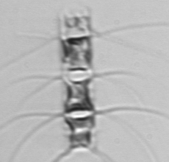

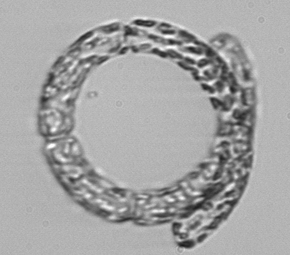
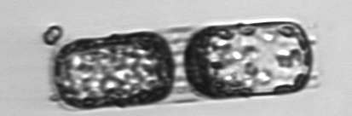

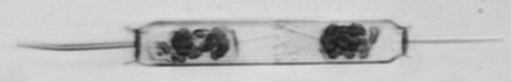
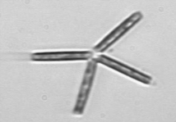


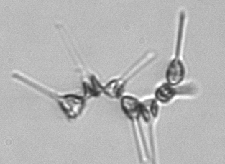



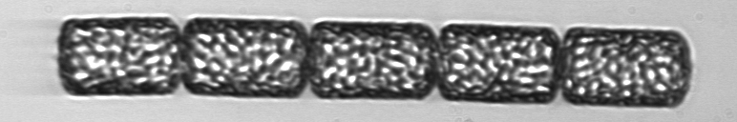


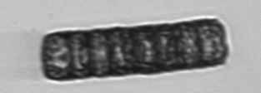



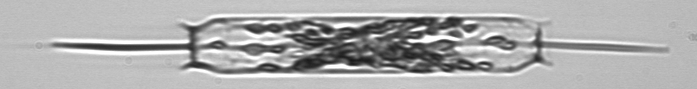

Imaging FlowCytobot – WHOI (development team); McLane (commercial production)
Imaging-in-flow cytometer
Concurrent high resolution images (~1 μm) and laser scattering and fluorescence for cell identification and characterization
Precise timing / sample volume for cell concentration
Precise flow / focus control for reliable image quality
Real time onboard ROI extraction
Optimized for microplankton
http://ifcb-data.whoi.edu/
Features for extended deployment
Automated biofouling control
Automated standard analysis (beads)
Real time humidity sensing & alerts
Redundancy for critical mechanical components
Remote focus control & flow maintenance actions (debubble, backflush, etc.)
MBARI automated cytometer/microscope workshop, 1-2 Jun 2016 Sosik, WHOI, IFCB lightning talk

Slide 2
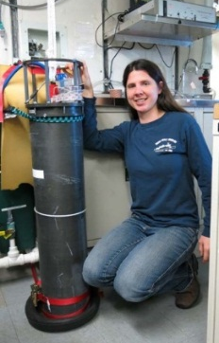
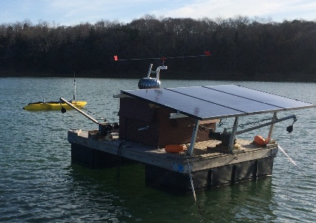
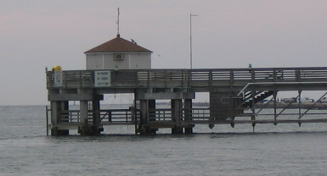
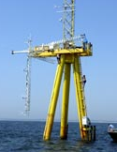
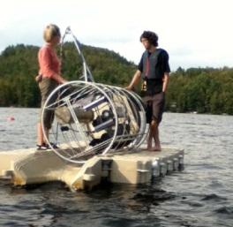
Imaging FlowCytobot – WHOI (development team); McLane (commercial production)
Proven deployment capabilities
Observatory sites
  Time series, 6 mo or longer deployments common
  Vertical profiling
  Cabled, solar, generator power
Underway continuous on ships worldwide
  N. Atlantic, G. of ME, G. of MX, Arctic, S. Ocean...
Wide in situ temperature range, -2-28 °C
Freshwater and seawater environments
Discoveries & novel studies
Seasonality, multi-year patterns & trends
New species
HAB early warning
Life cycle links to bloom dynamics
In situ species-specific growth rates
Phytoplankton-parasite interactions
Grazing interactions…
Ship’s lab
Sosik
Coastal pier in Texas
Campbell
Solar powered raft in marsh
Brosnahan and Anderson
Some limitations / challenges for science use cases
Standard flow cell (860x180 μm) precludes v. large cells/chains
Not sensitive enough for picoplankton
~15 ml h⁻¹ sample rate too low for some needs
Currrent depth rating (40 m) too narrow for some needs
Relatively large instrument size and power demand
Martha’s Vineyard Coastal Observatory
Sosik and Olson
Profiler in Canadian lake
Huot
MBARI automated cytometer/microscope workshop, 1-2 Jun 2016 Sosik, WHOI, IFCB lightning talk

Slide 3
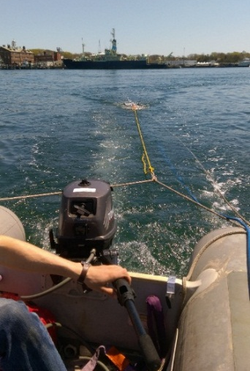
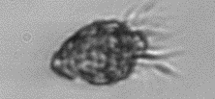
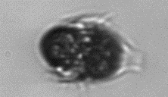
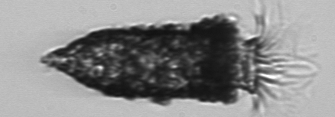
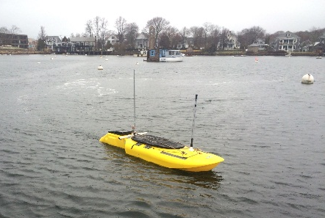
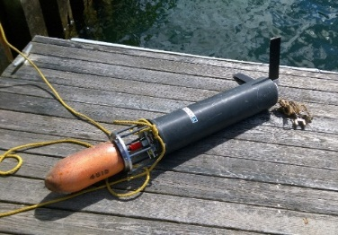
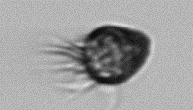
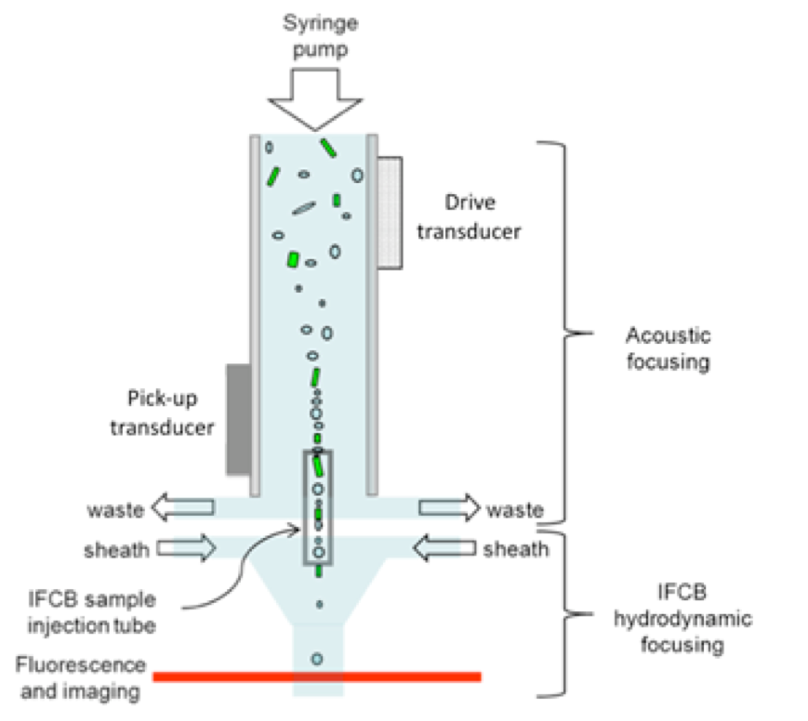
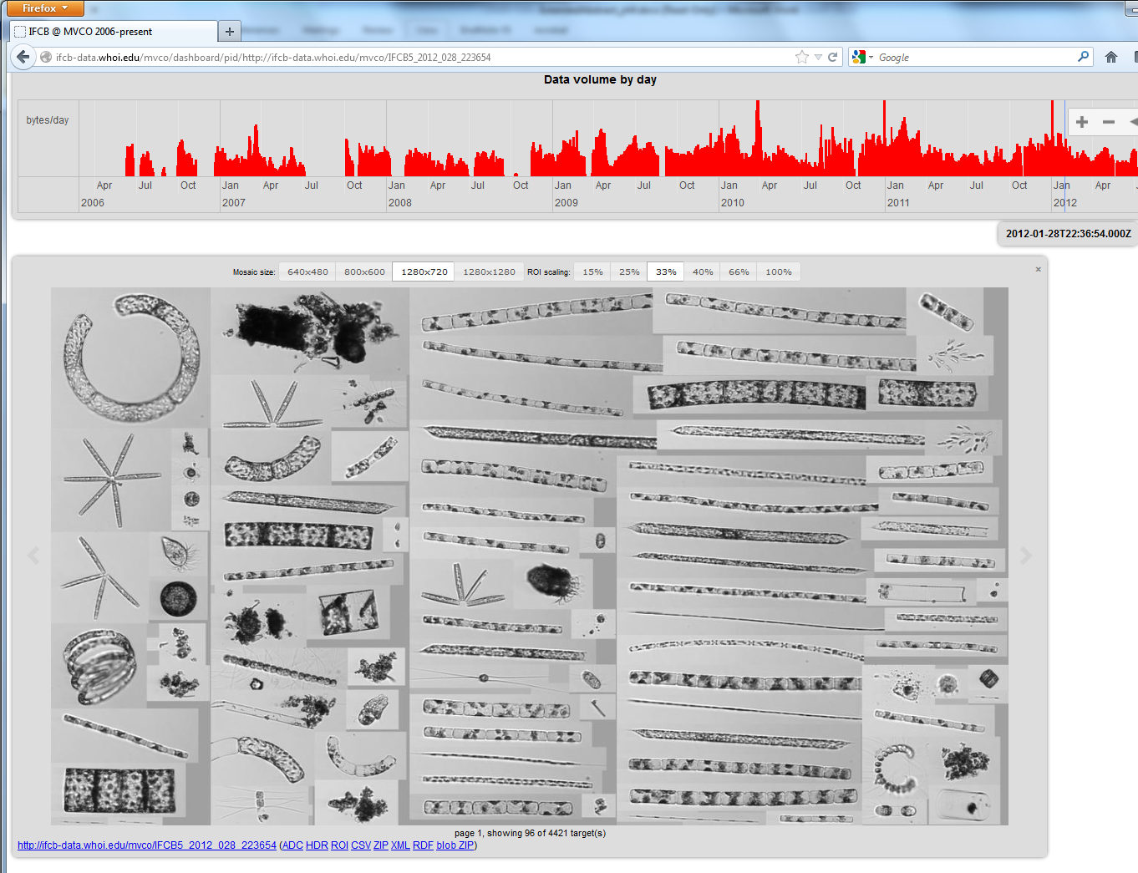
Imaging FlowCytobot – New developments underway at WHOI
IFCB-S (Staining)
Enhanced detection of protozoan taxa
Automated live cell staining, targeting micrograzers
Microinjector for concentrated FDA into mixing chamber
IFCB-AV for Autonomous Vehicles
Enable spatial sampling
Horizontal operation on surface vehicles
Targeting flexible modes (towed, interior payload, exterior payload)
IFCB-HT (High Throughput)
Enhanced sampling statistics (volume analyzed)
Acoustic focusing to gently pre-concentrate
cells above flow cell
IFCB Dashboard and processing workflow
Web service based access for raw data & products
Automated image analysis and classification pipelines
End-to-end provenance
Standard formats
Open source code
User Group, Wiki pages, etc.
http://ifcb-data.whoi.edu/
MBARI automated cytometer/microscope workshop, 1-2 Jun 2016 Sosik, WHOI, IFCB lightning talk

