Slide 1
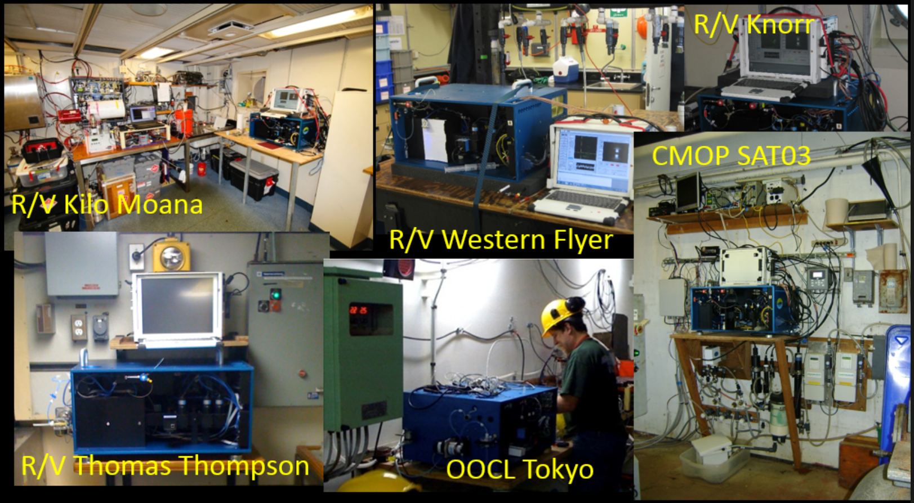
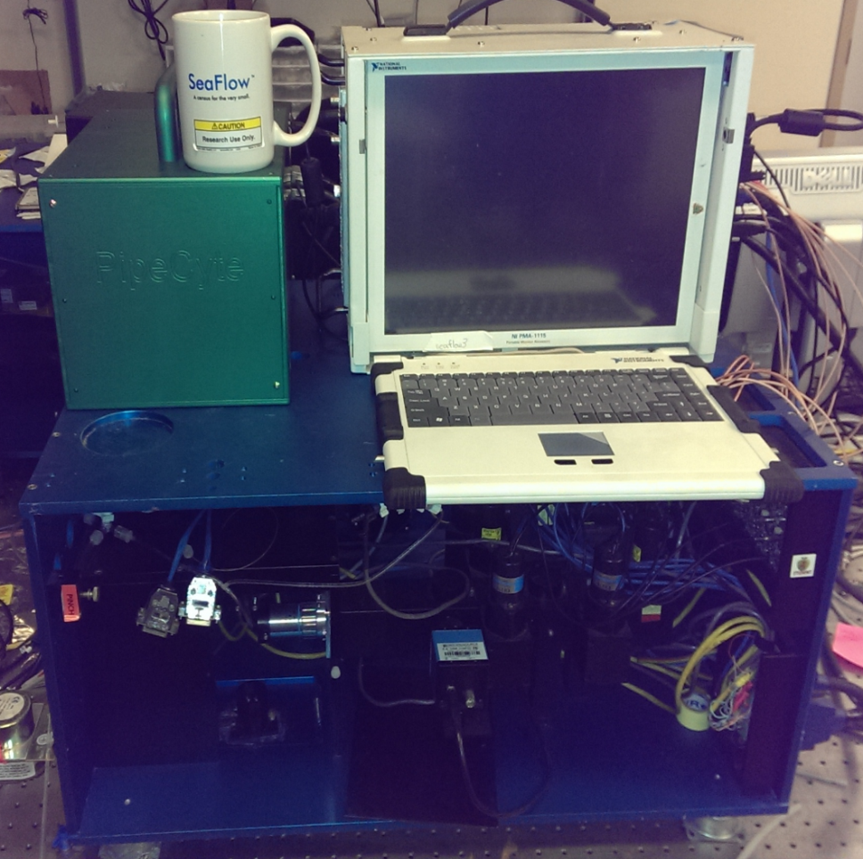
SeaFlow & PipeCyte
Notes:
Would take about 2 years of 8 hour days to analyze the dataset manually
Probably largest fcm dataset available
Maybe combine this into spec sheet and use previous slide to motivate flowphyto

Slide 2
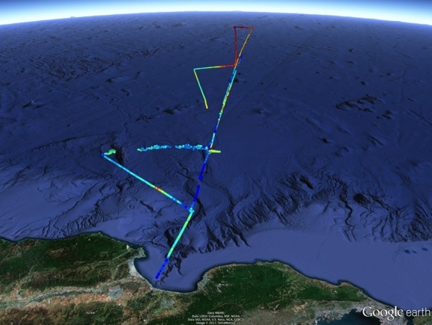
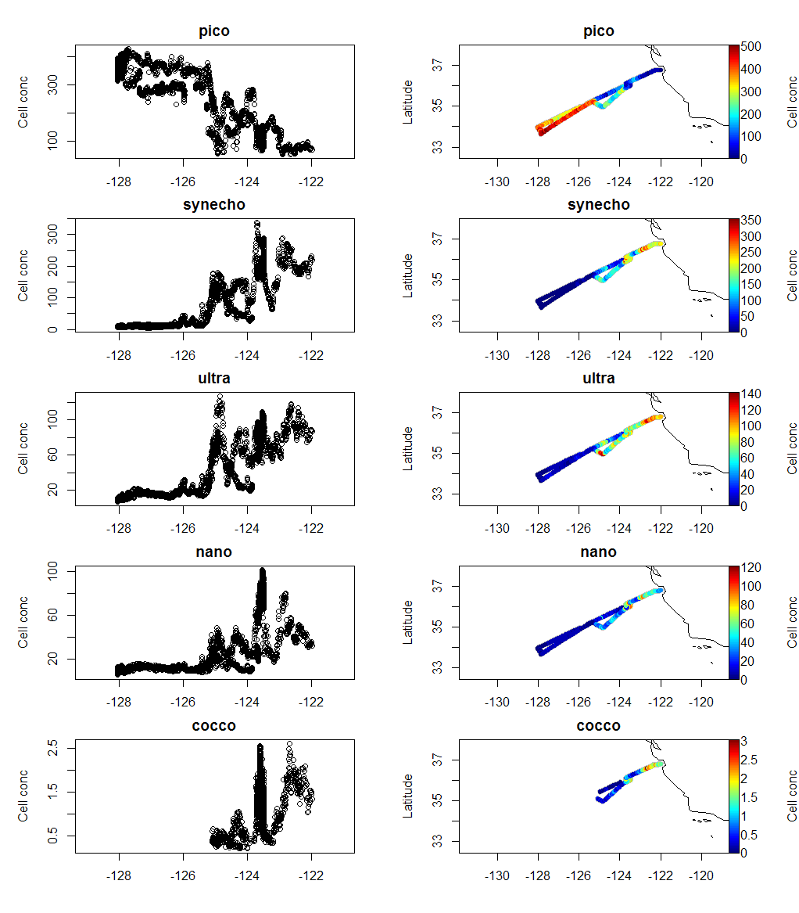
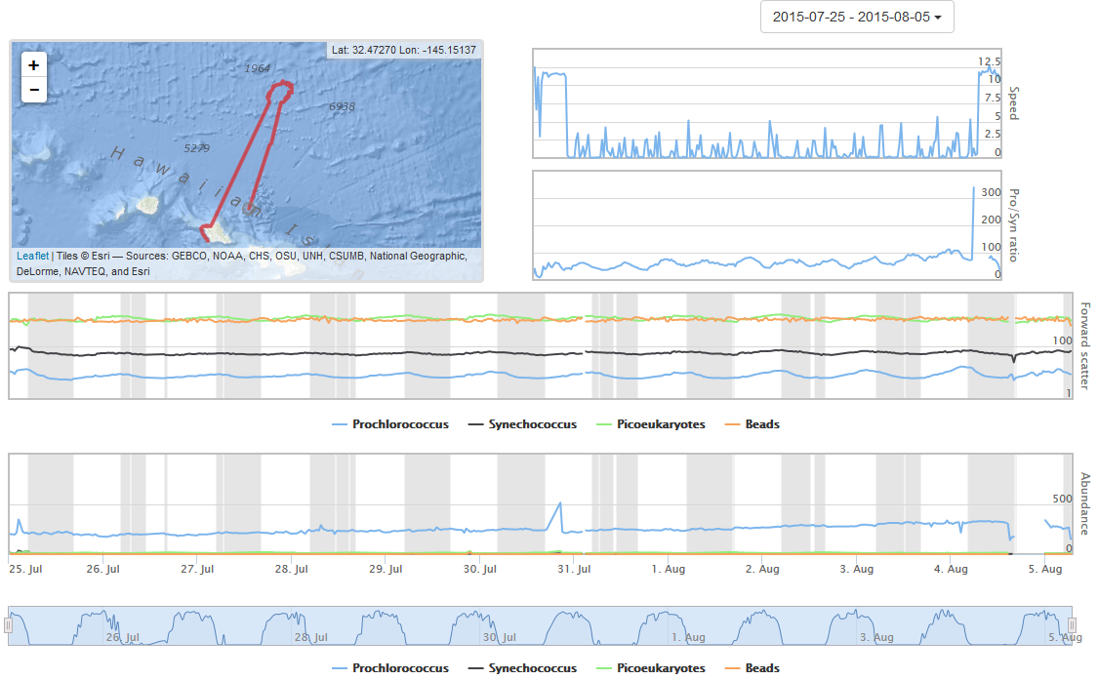
Notes:
Would take about 2 years of 8 hour days to analyze the dataset manually
Probably largest fcm dataset available
Maybe combine this into spec sheet and use previous slide to motivate flowphyto

Slide 3
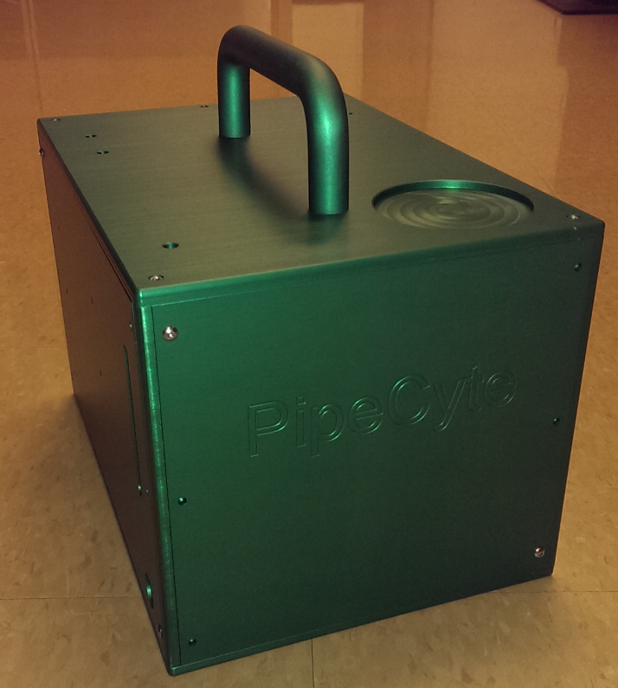
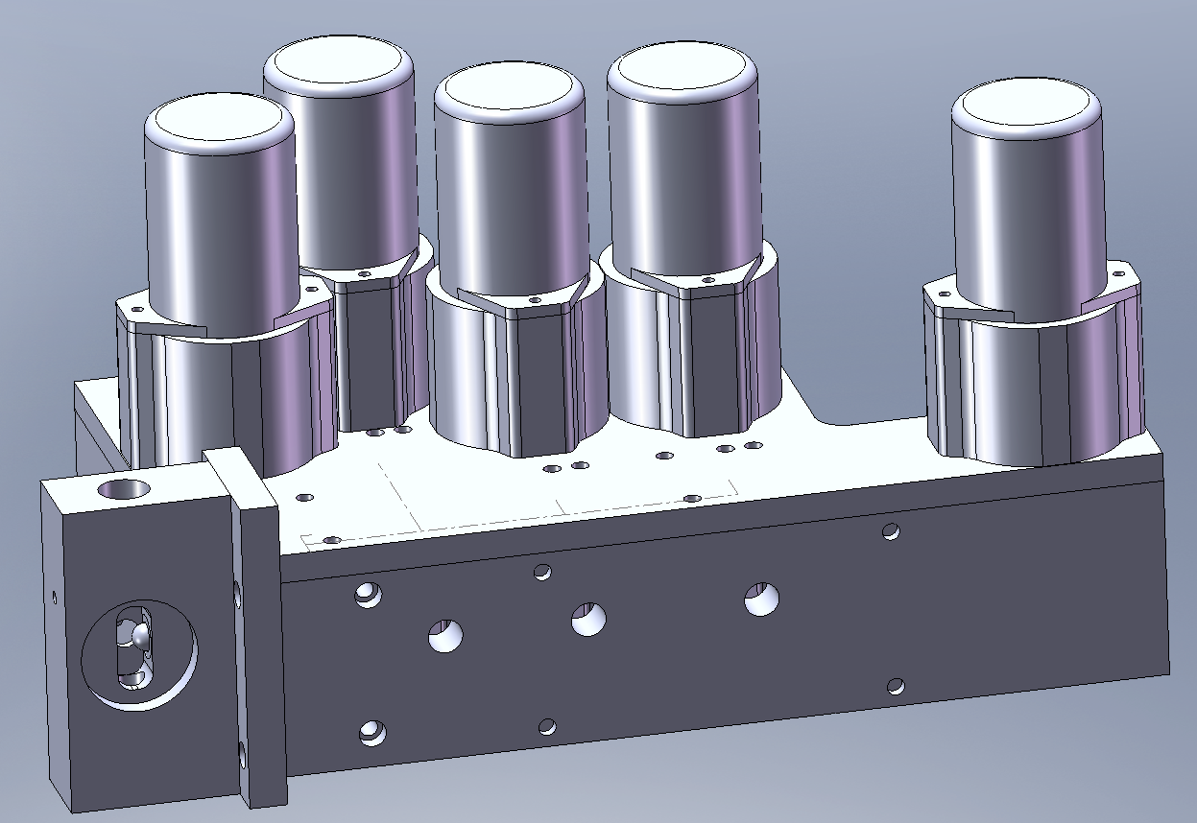
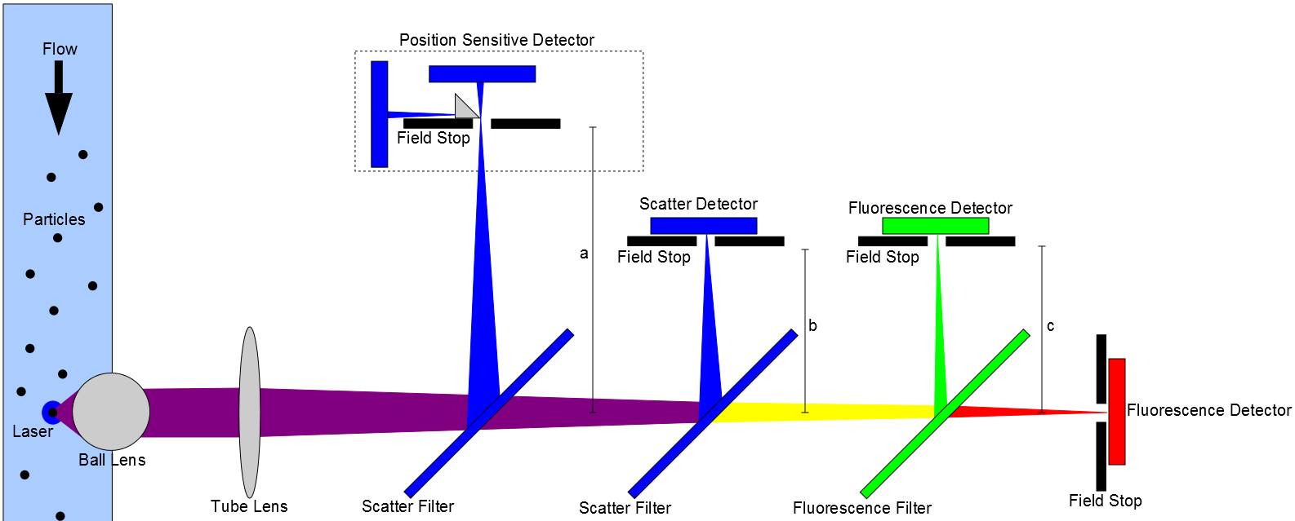
Advantages:
Small
Requires only seawater
Sub 40 watt (current)
Sub 20 watt (target)
~0.5-10 micron detection
Simple onboard processing
Counts AND growth rates
No micro-fluidics!!!

