Slide 1
2016-06-01\\MBARI \lightning talk
CytoBuoy
Flow cytometry solutions

Slide 2
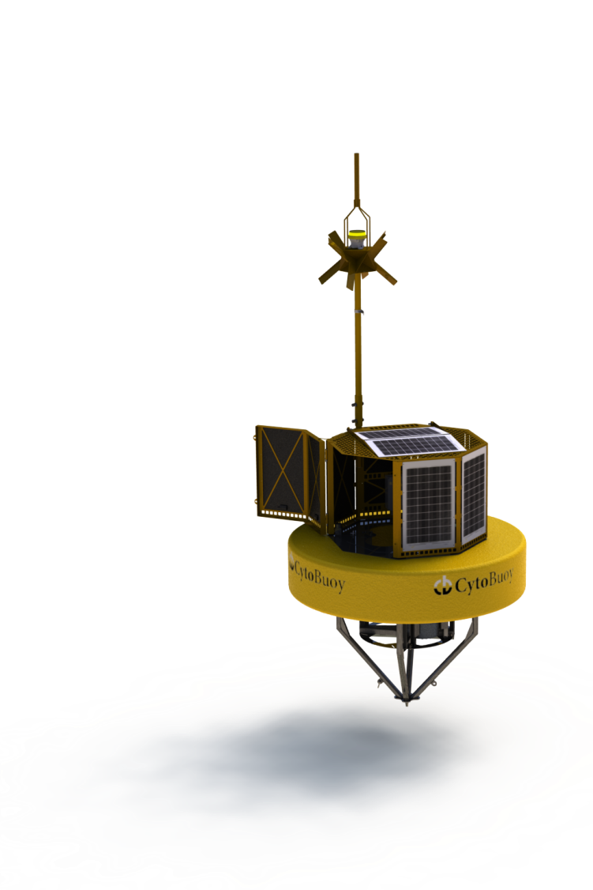
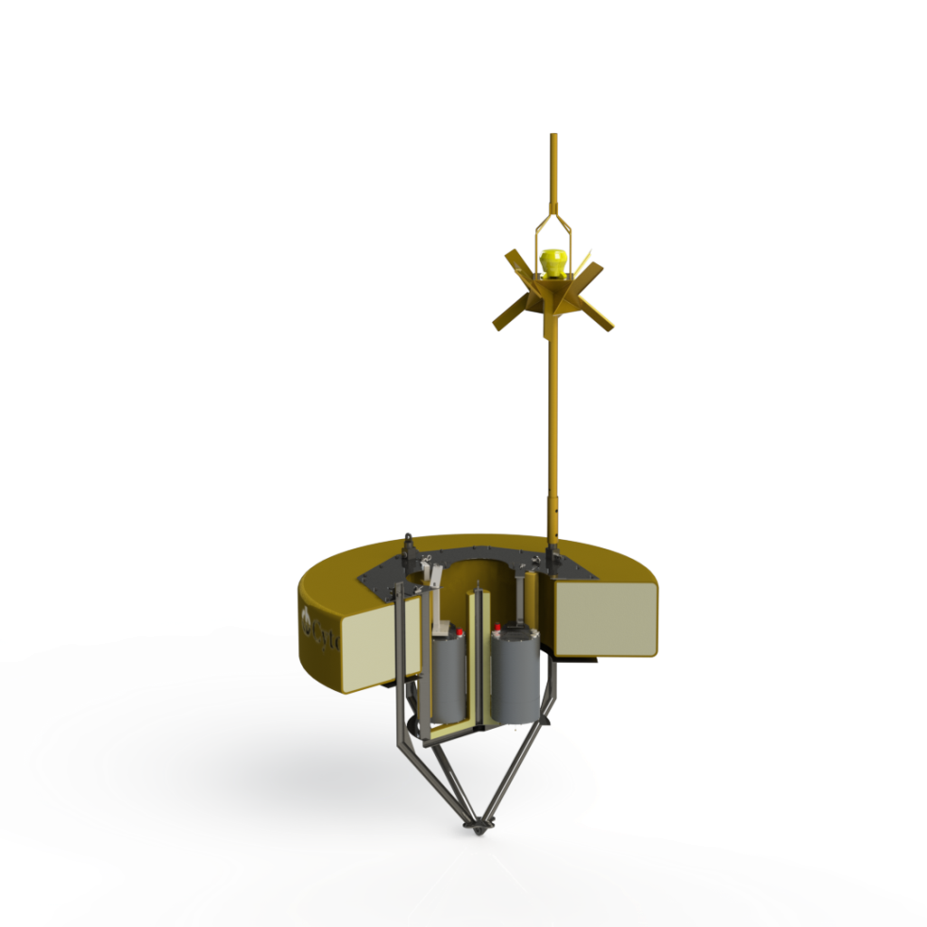
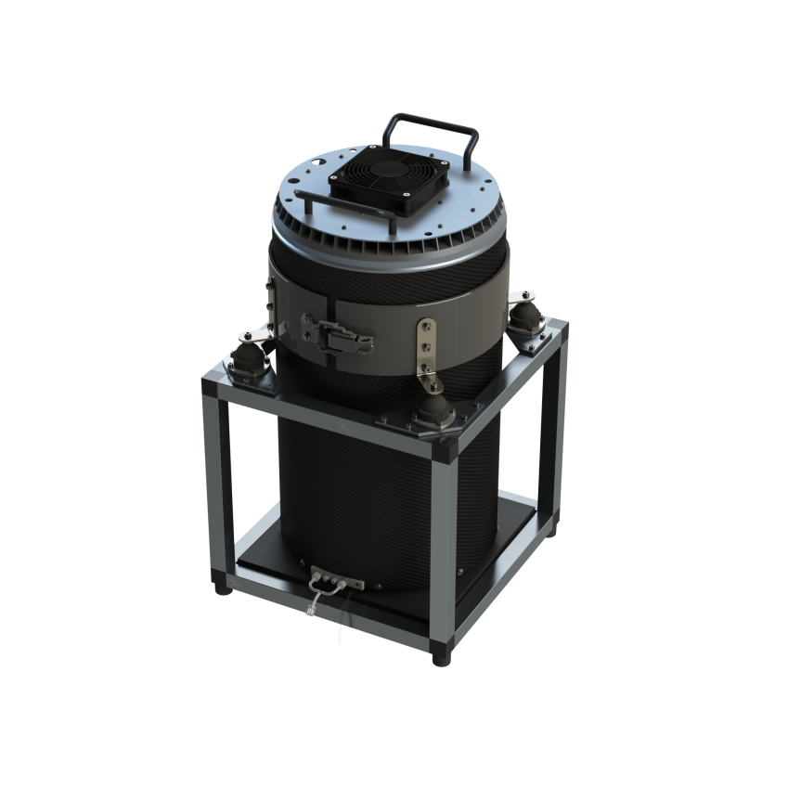
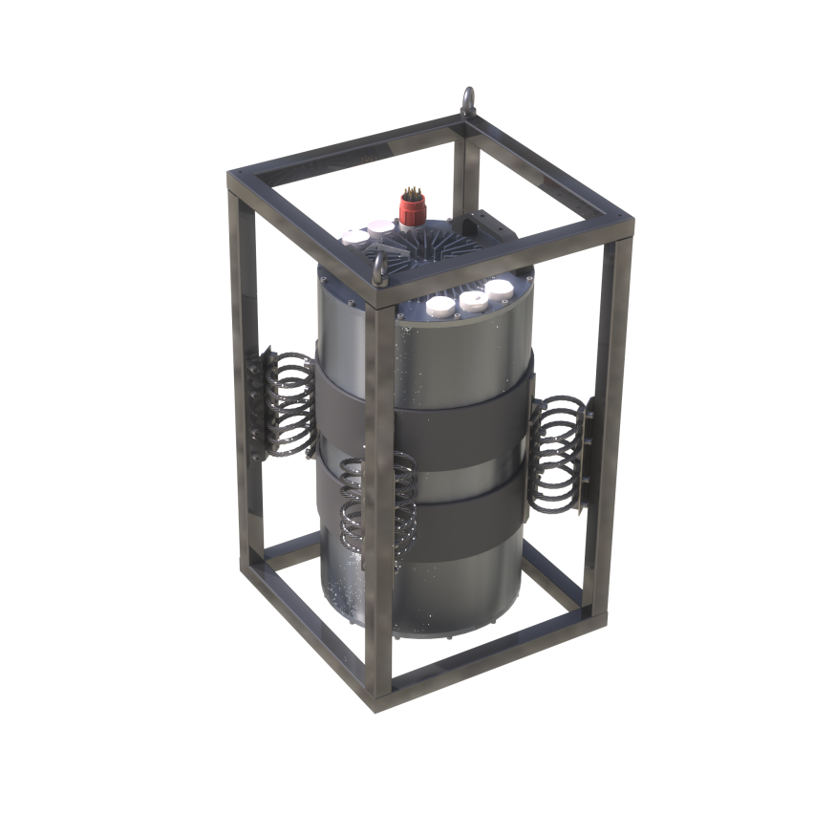
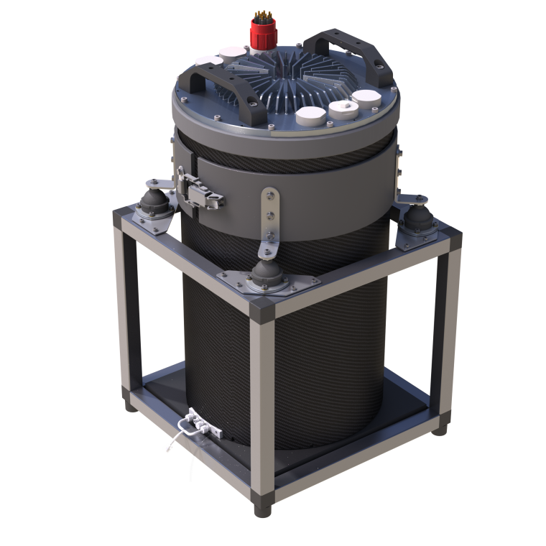
CytoSense, research grade flowcytometer suitable for lab, mobile and shipboard use
Up to 2 lasers, 6 detectors
Imaging in flow
Carbon lab hull
Shock absorbers
Easy access
CytoSub, SytoSense in a waterproof hull. Fo lab, mobile, shipboard, submerged and buoy use
CytoBuoy, Buoy platform optimized for CytoSub. Room for 4 instrument packages.

Slide 3
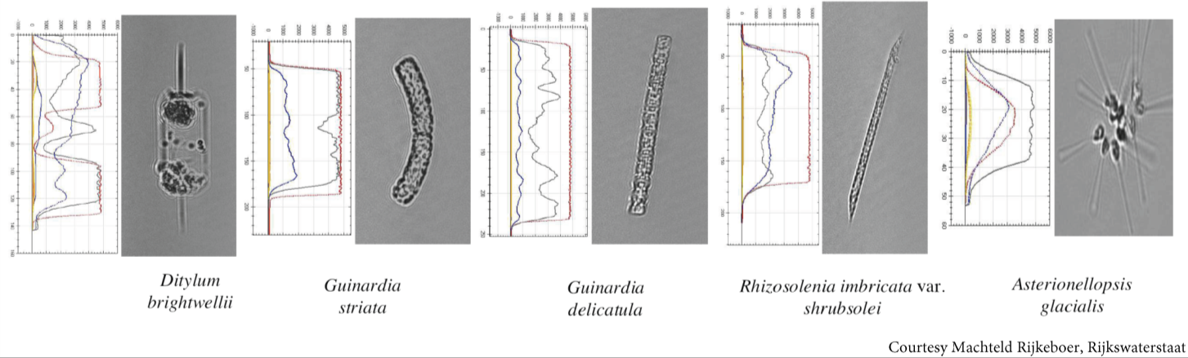
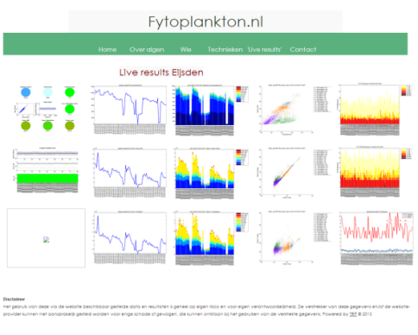
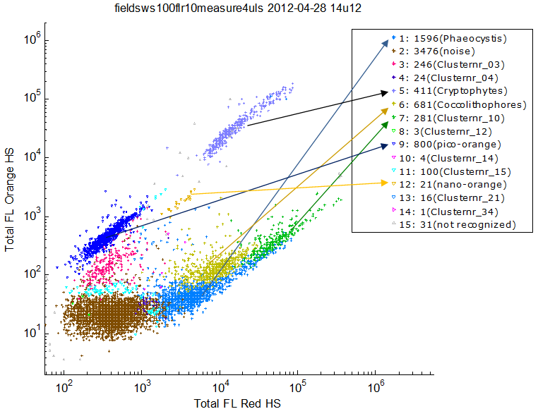
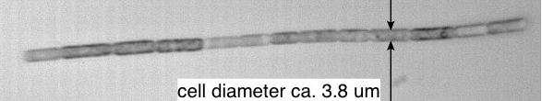
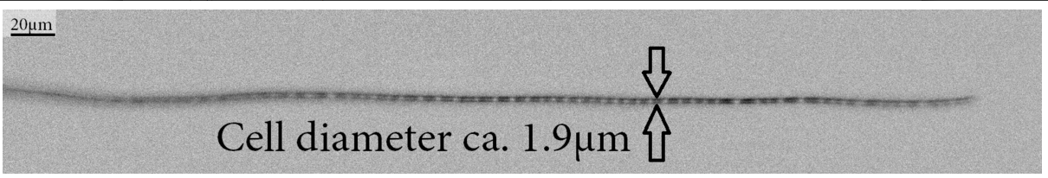
The CytoSense. A scanning Flowcytometer.
1 Using particle pulse profiles for unsupervised clustering to discriminate different particle types.
2 Create pulse profile cluster database to follow clusters in time.
3 Use targeted and untargted imaging to identify pulse profile clusters

Slide 4
Especially suitable for analysis of chainforming particles. Pulseprofiles allow for accurate filament length estimation and cell count within single filament. (max size 800um diameter 3-4mm length*)
In line fluorescent staining of samples to discriminate bacterial population from sediment particles. (Currently only for CytoSense. CytoSub integration under development)
Using ferry’s and other ships of opportunity for fytoplankton monitoring.
Biovolume estimation based on pulse profile data and imaging data.
(Dutch ministry of infrastructure and environment)
High frequency in situ HAB monitoring of microcystis sp.
Q. Zhou, W. Chen, H. Zhang et al.
A Flow Cytometer Based Protocol for Quantitative Analysis of Bloom-forming Cyanobacteria (Microcystis) in Lake Sediments
Journal of Environmental Sciences 2012, 24(9) 1709–1716

