Slide 1
μPeek:
A bluetooth connected cellphone microscope
Scrona AG, Zurich, Switzerland

Slide 2
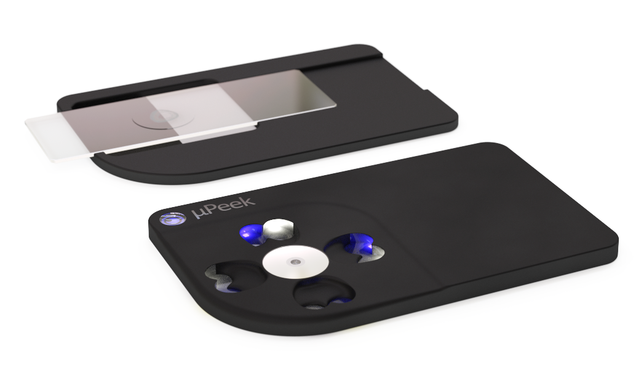
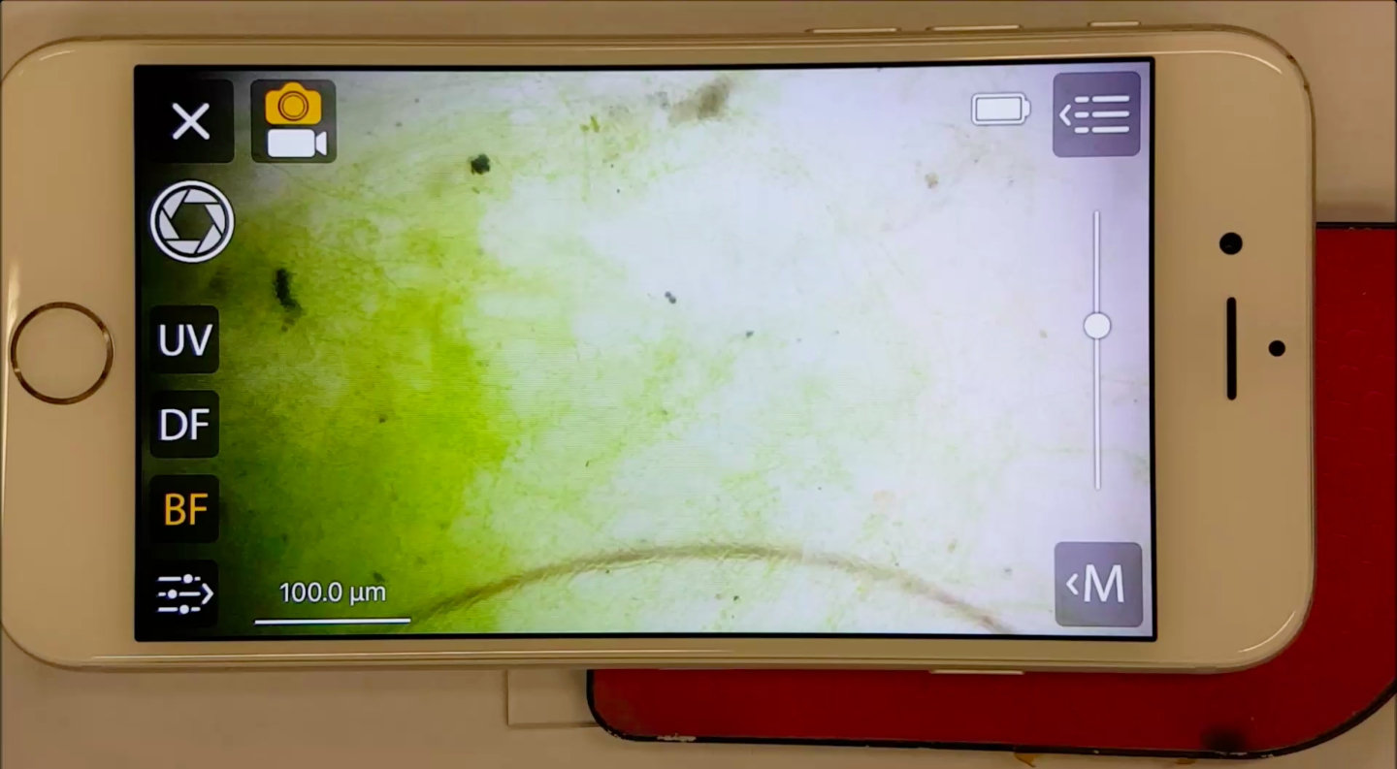
Perceived Advantages
Compact
Low power
Software controlled
Illumination options
Phone-based camera
and/or video capture
communications
Opportunity to influence
  Optics
  Illumination
  Software API
Low cost

Slide 3
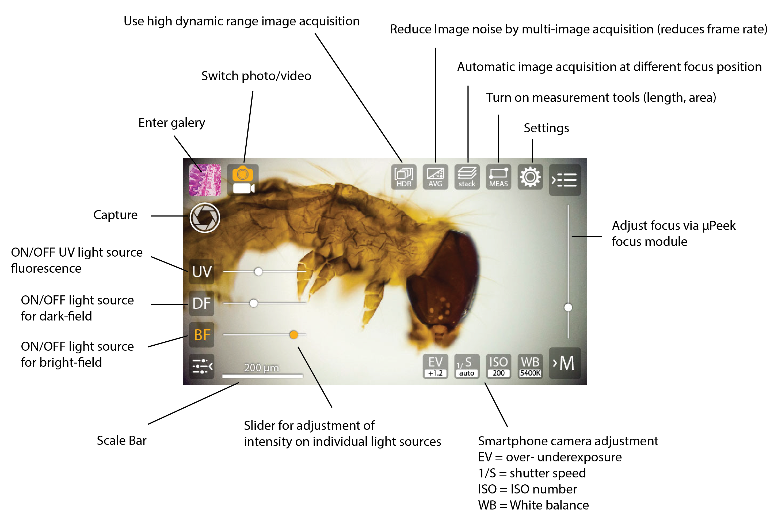
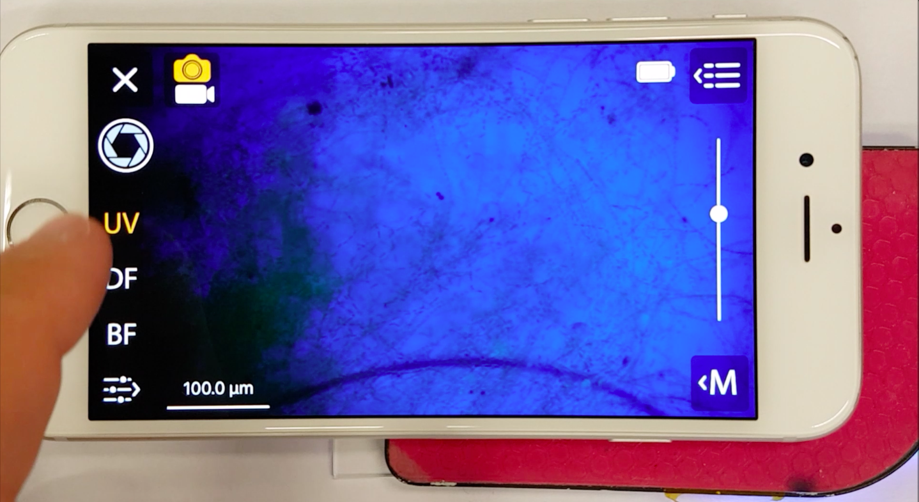
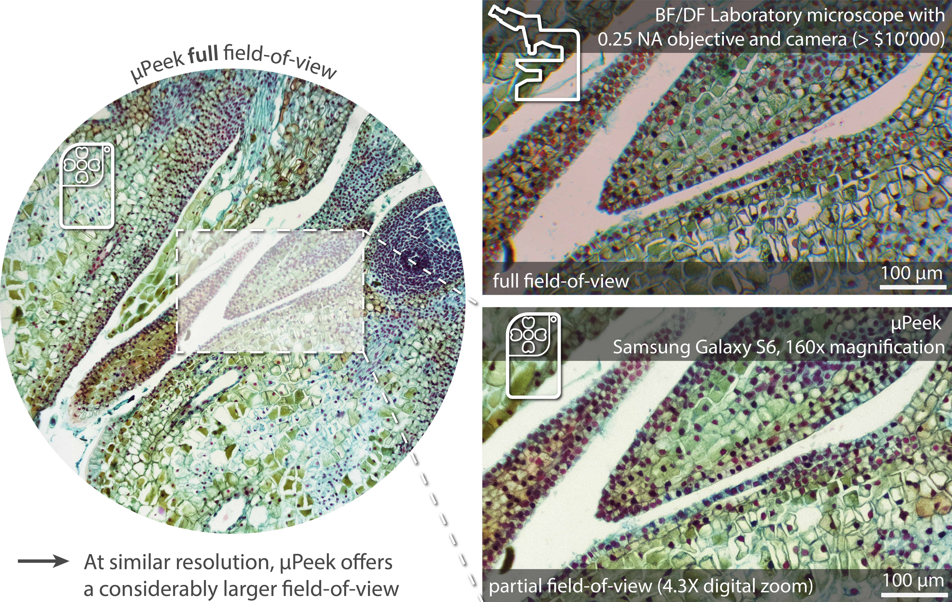
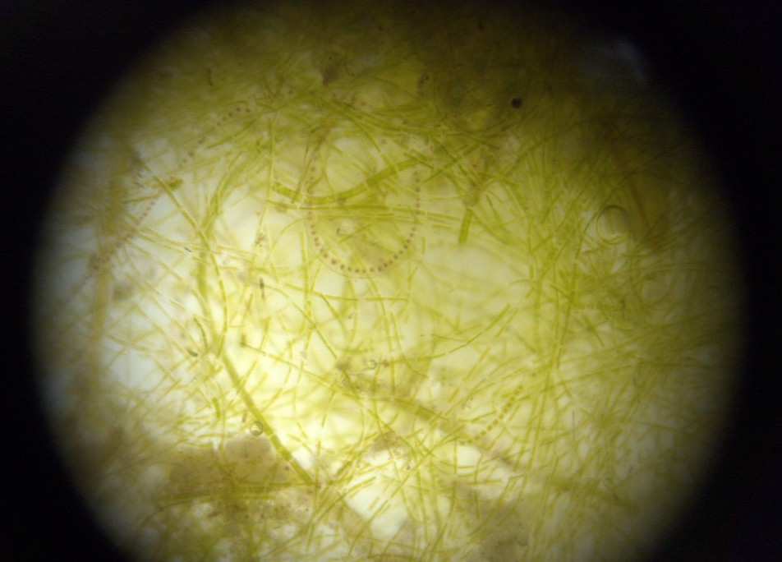
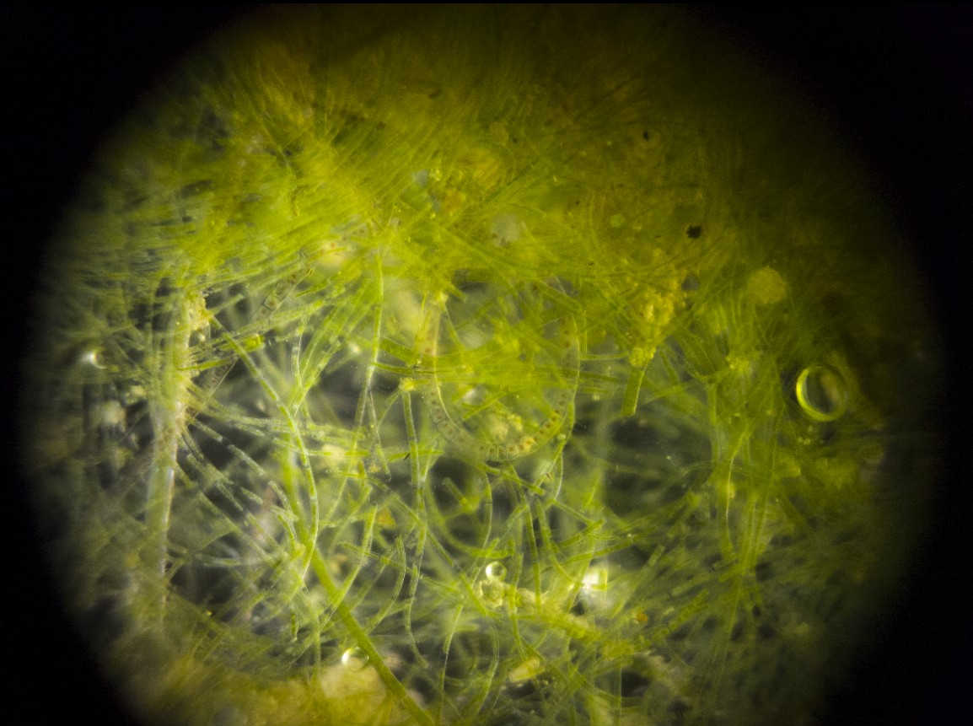

Slide 4
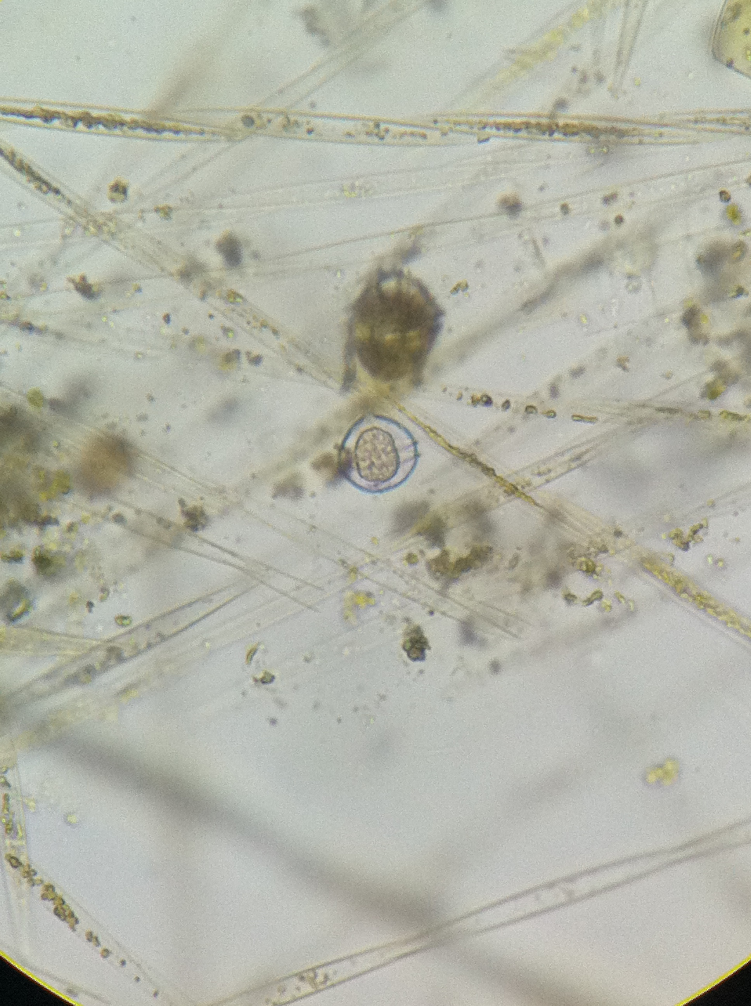
Perceived Limitations
New product (not yet in production ~60-90 days out)
Designed with a different market in mind (how adaptable?)
No automated sample handling
in current design

