Slide 1
Underwater
Atomic Force Microscope
Shuhei Nishida and Teruo Fujii
IIS, Univ. of Tokyo

Slide 2
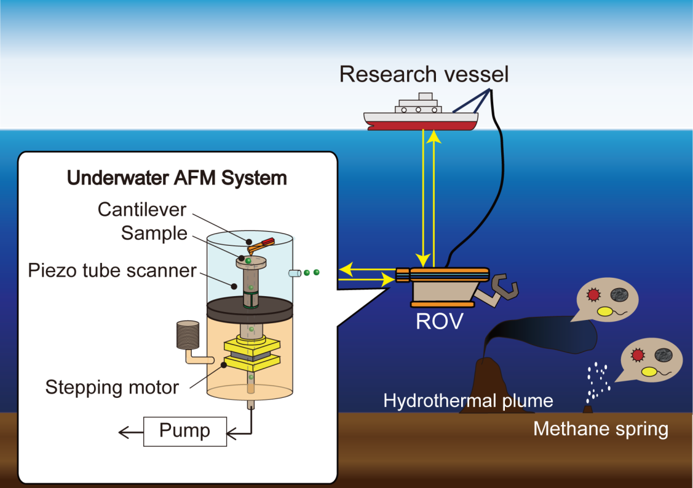
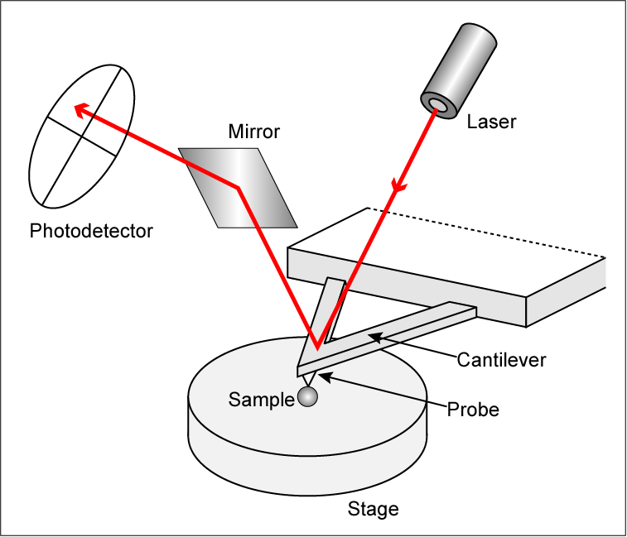
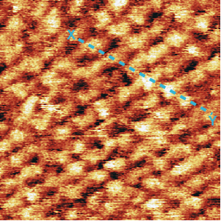
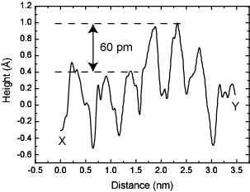
AFM to UAFM

Slide 3
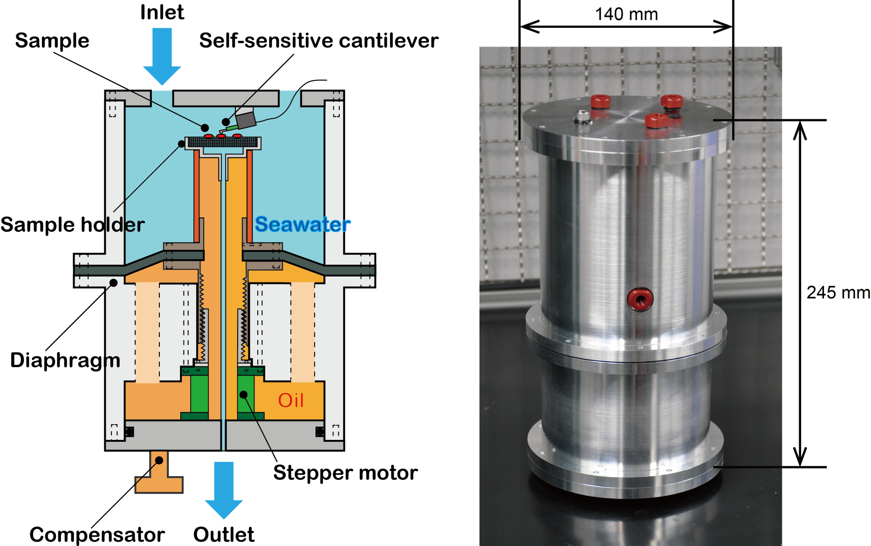
Design

Slide 4
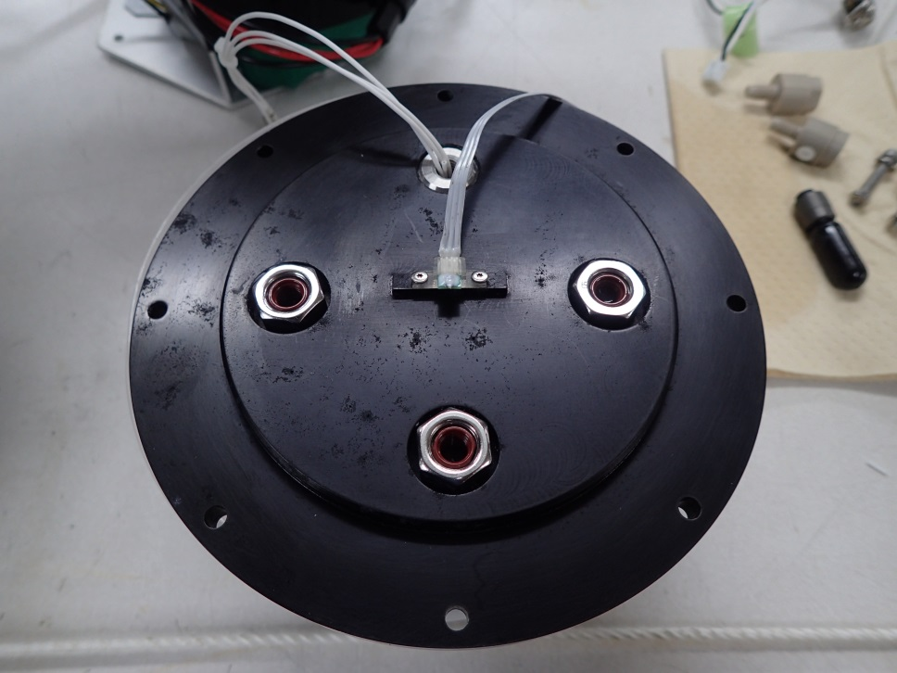
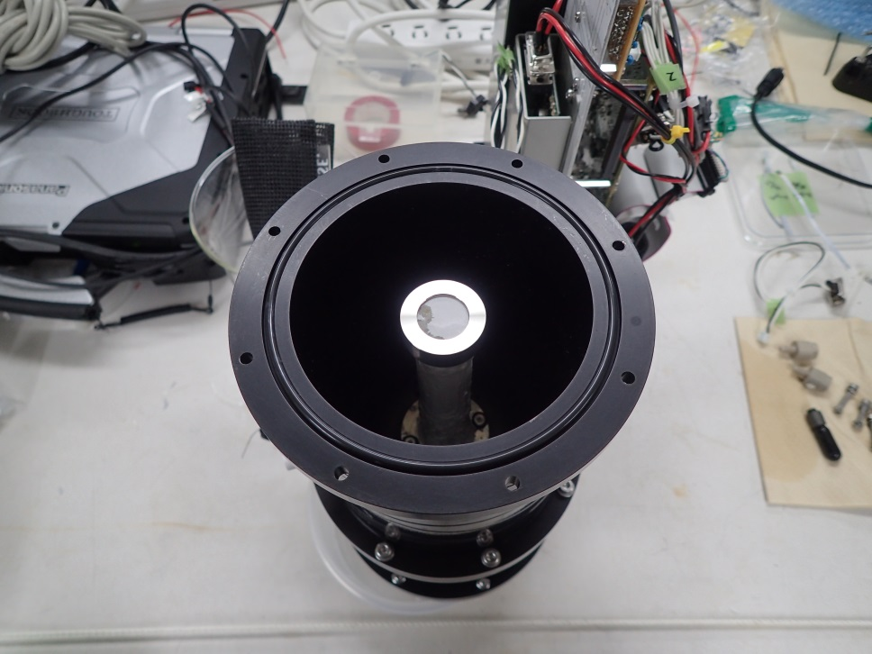
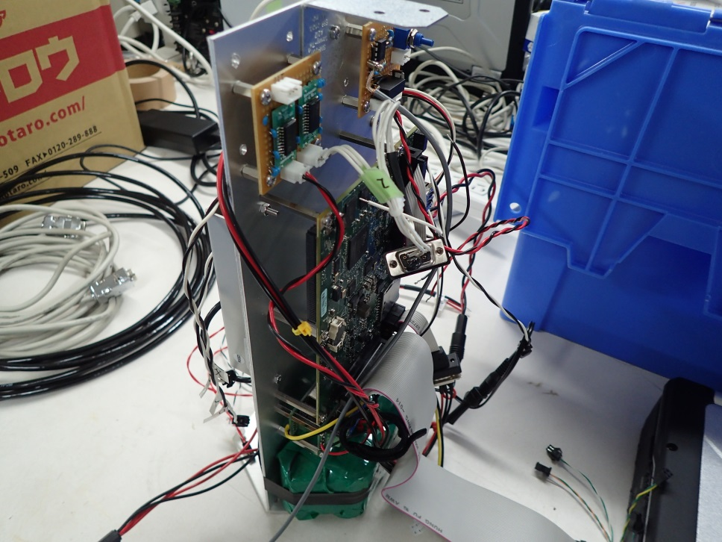
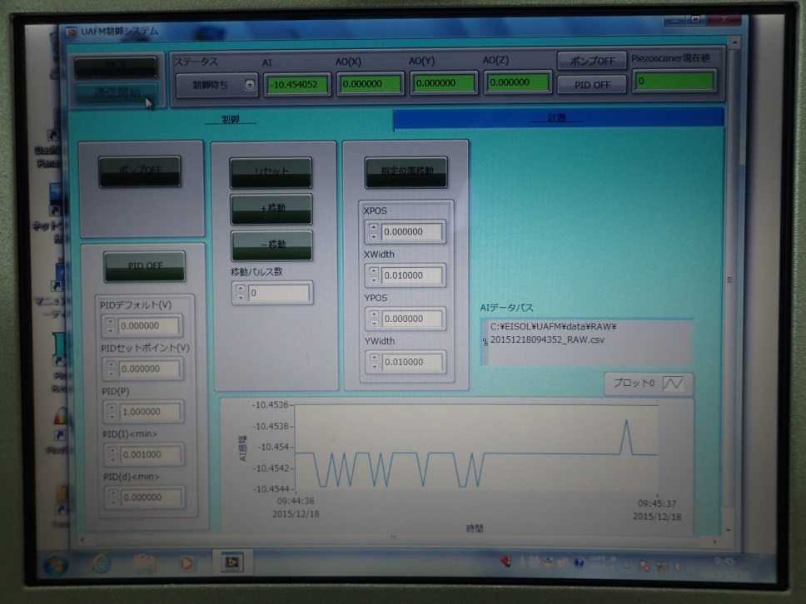
Membrane Filter
Self-sensitive Cantilever
Tube Scanner
AFM Head (Top Cover)
AFM Head (Inside)
AFM Controller
Software

Slide 5
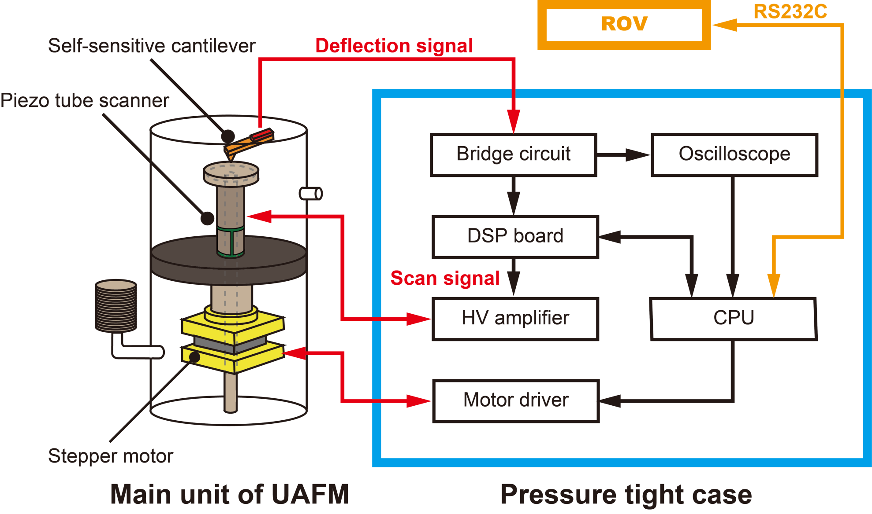
Operation System

Slide 6
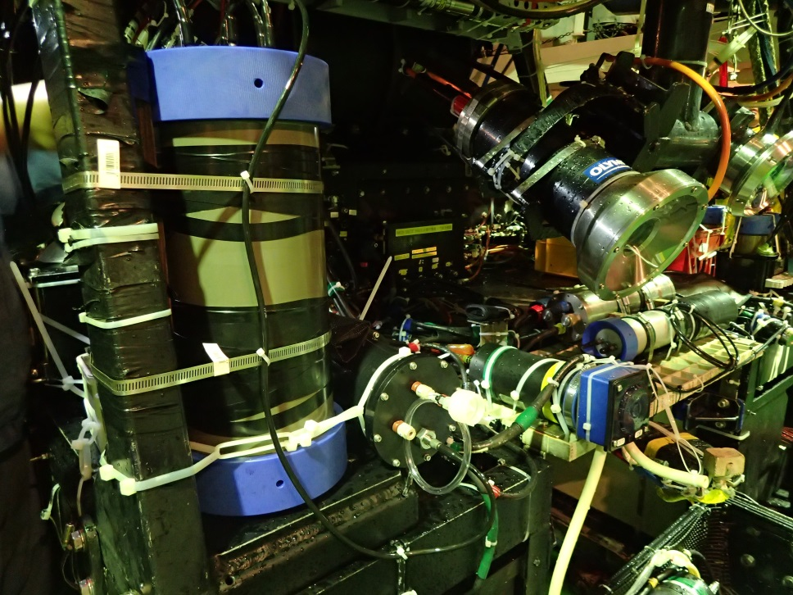
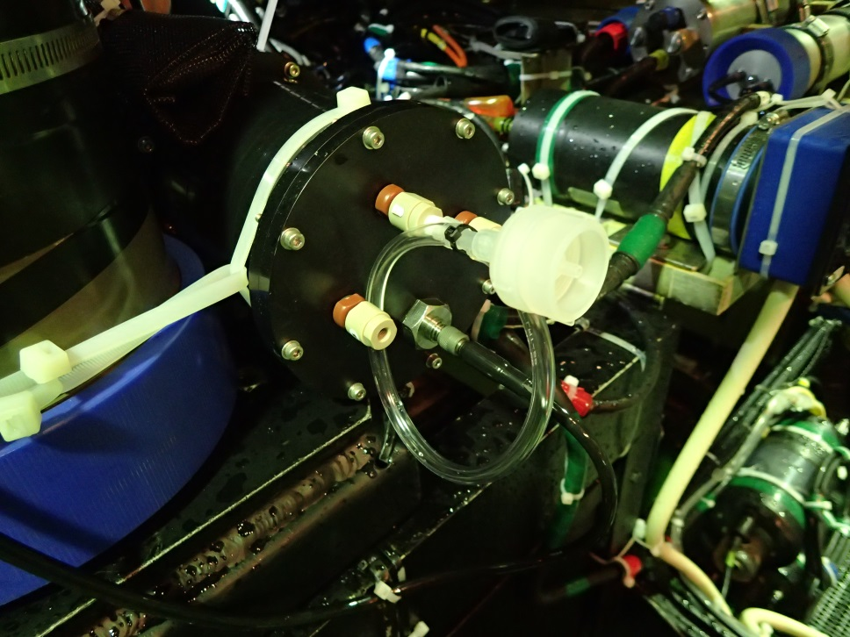
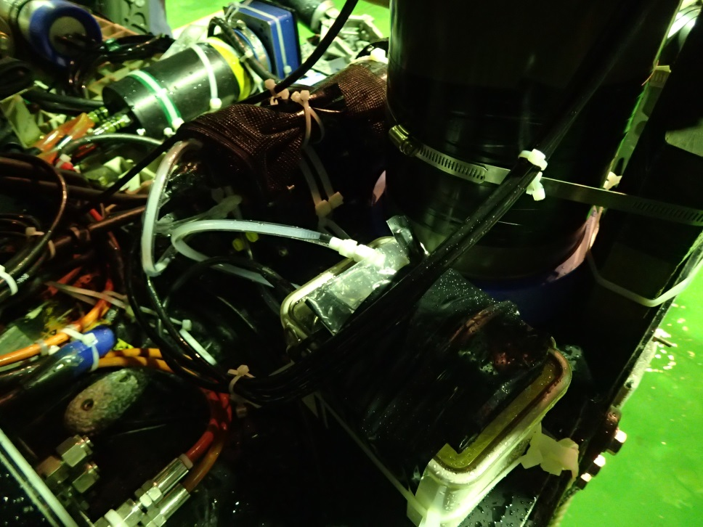
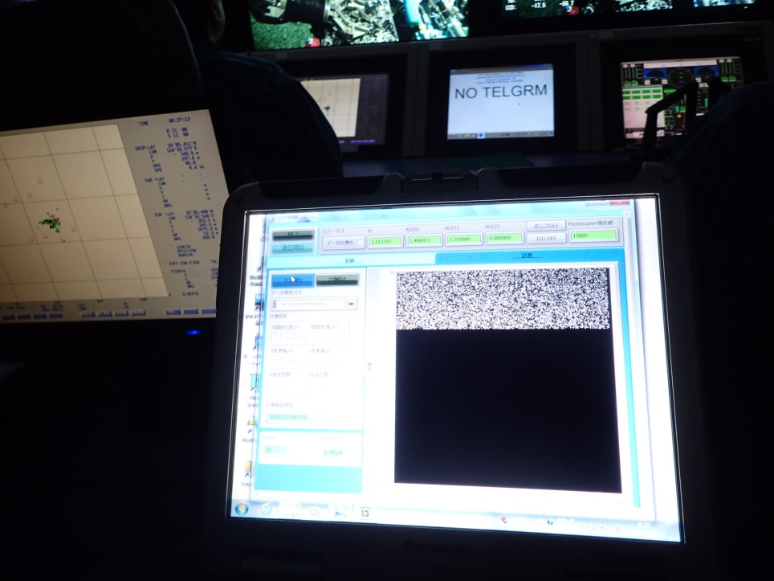
10um Prefilter
Pump
Operation Room

Slide 7
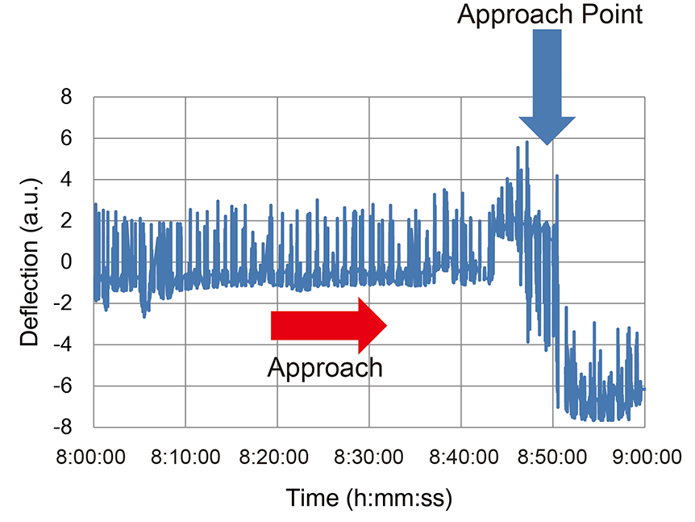
Approach and Imaging in deep-sea
1600m at Okinawa Trough

Slide 9
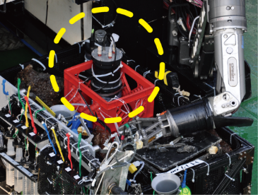
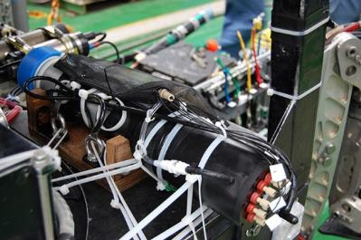
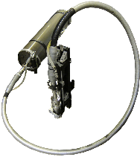
Scope
Biological
Micro Nano Sensor
Complexity
Chemical
Photonics
Physical
Acoustics
Scale
μm
mm
m
km
1000km

