Slide 1
In situ ATP measurement using microfluidic devices –IISA-ATP-
Tatsuhiro Fukuba
Japan Agency for Marine-Earth Science and Technology (JAMSTEC)

Slide 2

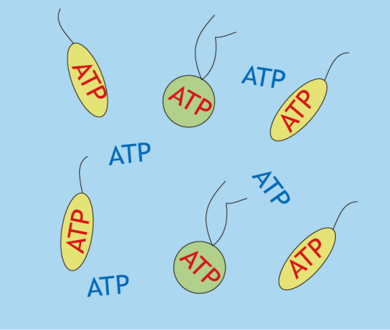
ATP as a proxy of microbial biomass
●ATP（adenosine triphosphate)
-One of the essencial biomolecule for energy conversion and storage in life system
●ATP quanrtification using L-L assay
-Firefly luciferin-luciferase bioluminescence assay
-Detection limit :10⁻¹²〜10⁻¹³ M without preconcentration
-Symple protocol (Just mix sample and reagents)
Extracelluler（dissolved）ATP
Intracelluler（particurate） ATP
For accurate biomass estimation
Total ATP
Easy to measure (no separation)
For rough estimation of microbial biomass
Microbial biomass anormary detection
In situ analyzer for ATP quantification

Slide 3
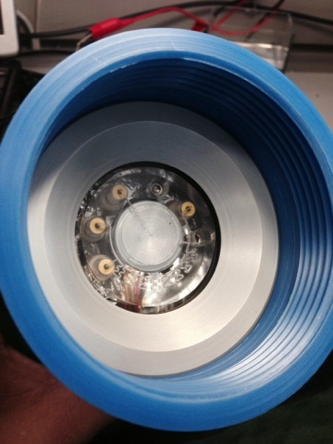
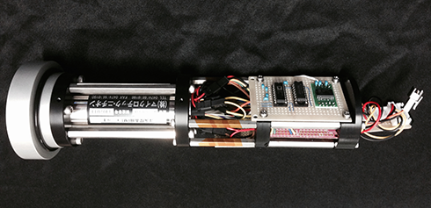
IISA（Integrated in situ Analyzer) -ATP2
Plastic bags (chemicals & waste)
Microfluidic unit
Microfluidic device
Oil-filled
RS232
24VDC
Pumps
&
Valves
&
Electronics
Power management
PMT control
Data logging
Sample
inlet
PMT
Pressure tight housing
Power line for microfluidic unit
PMT
Electronics/Data logger
Nearly commercial phase

Slide 4
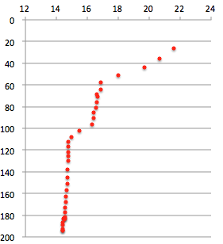
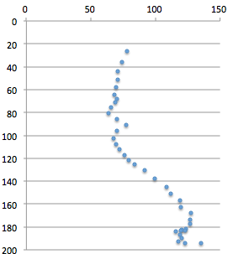
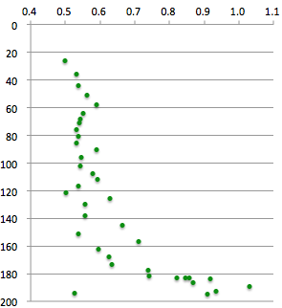
In situ ATP analysis result（vertical profile）
Temperature (℃)
ATP (pM)
Depth （m）
Depth （m）
ATP increase
=high biomass in
Ohmuro hole
Stable temperature
in Ohmuro hole
0
Turbidity (FTU)
Depth （m）
100
Depth （m）
200
Hydrothermal site
Ohmuro hole
Turbidity increase
NT14-16 HPD#1699 Ohmuro hole

