Slide 1
Conventional Optics –
Resolution or Volume, but not Both!
Mitutoyo Telecentric Objectives, 2/3“ sensor:
Magnification | Resolving power (μm) | Depth of Focus (μm) | Imaged Volume (μl)
10x | 1.31 | 6.2 | 0.0036
5x | 2.12 | 16.3 | 0.038
3x | 3.06 | 34 | 0.22
Flow Channels – Limited Size Range
Narrow
Wide
Clogs
Requires prefiltering
Objects out of focus

Slide 2
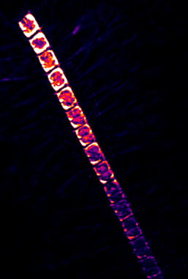
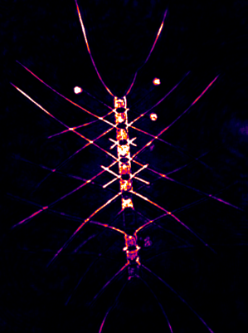
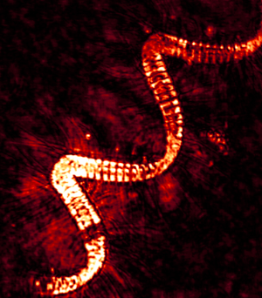
Holographic Optics –
Resolution AND Volume…
Laser
35 μl
Camera
15 mm
0.25x0.25 mm
1.2 μm
2.5x2.5 mm
3 μm
… and Speed
Up to 16 frames per second (2048x2048)
Up to 2 m/s tow speed (1 μs laser pulse)
Refocus digitally after capture
No pumps, no moving parts, open design
Low power, low weight, down to to 5500m deployments – ideal for ROVs and AUVs
Autonomous Unit – 5.5h autonomous recording

Slide 3
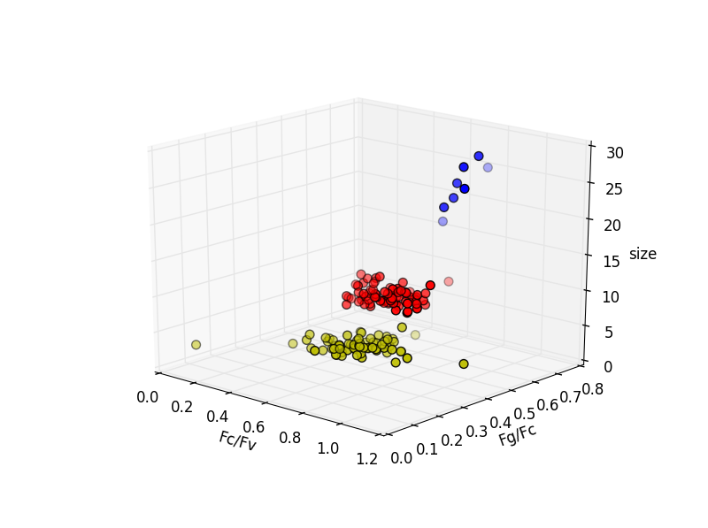
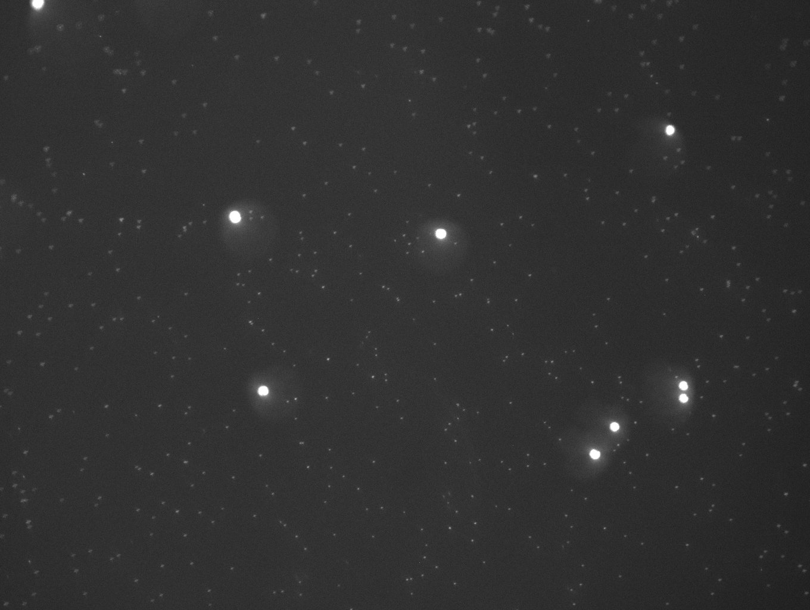
Fluorescence?
3-colour fluorescence microscope in development
Designed for early HAB detection
Detection limit as low as 10 cells/ml
Alexandrium detected in the mixed algae culture
Fluorescence fingerprint + cell size information
Preview in October (Ocean Optics), available in December
Isochrysis galbana and Alexandrium tamarense fluorescence at 405nm
Alexandrium tamarense, Thalassiosira weissflogii and Isochrysis galbana

