Slide 1




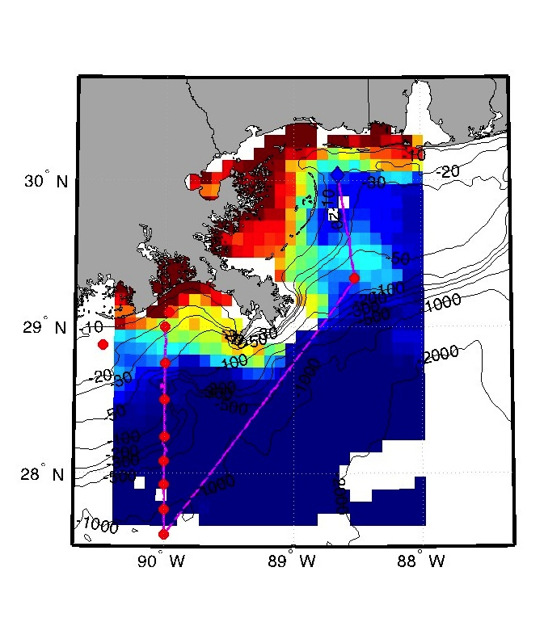
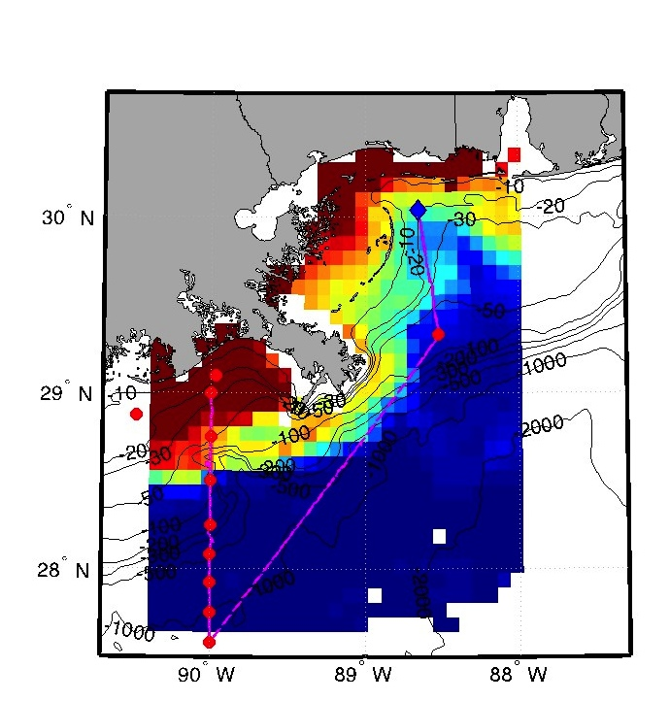
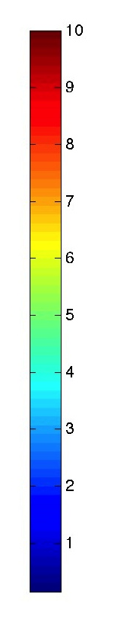
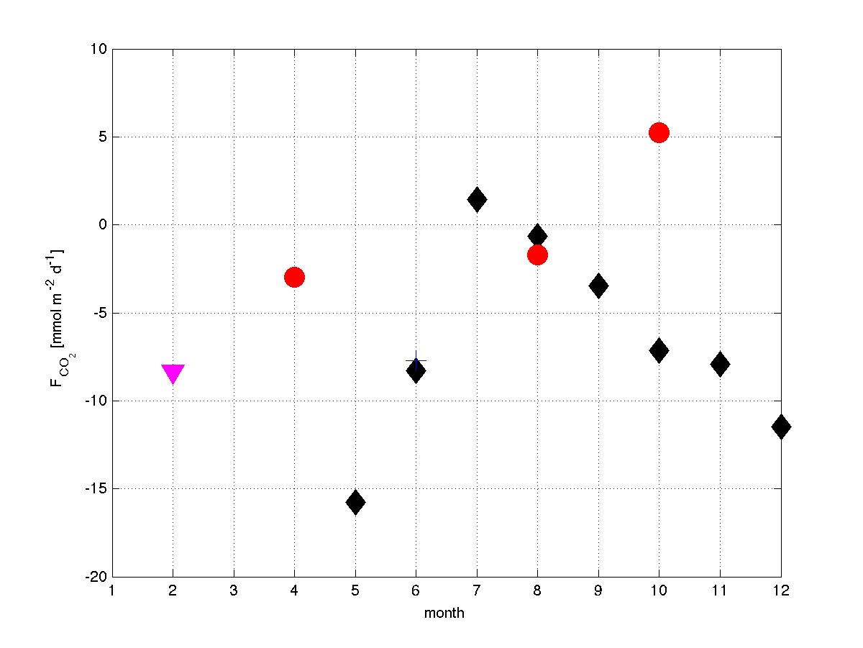

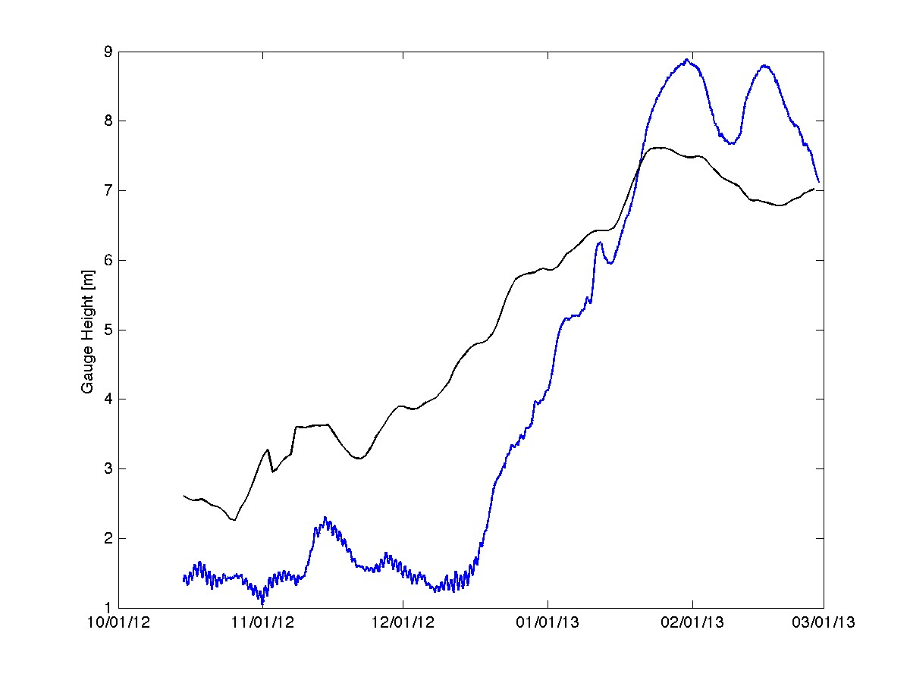
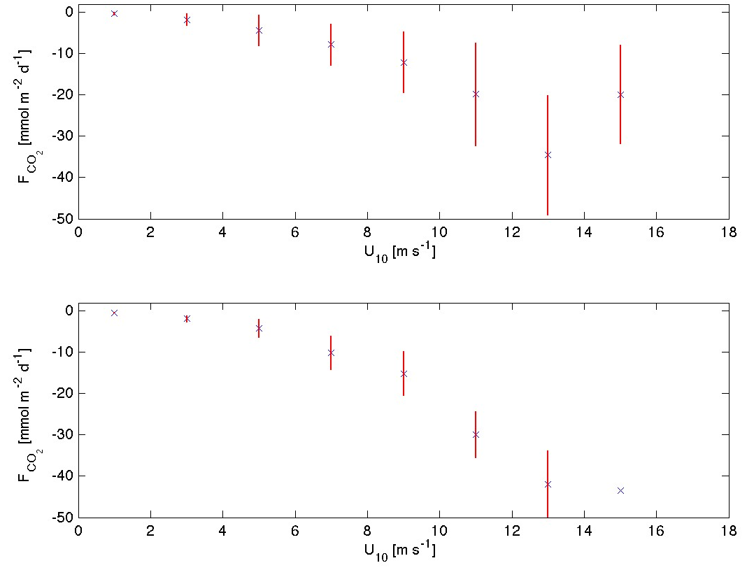
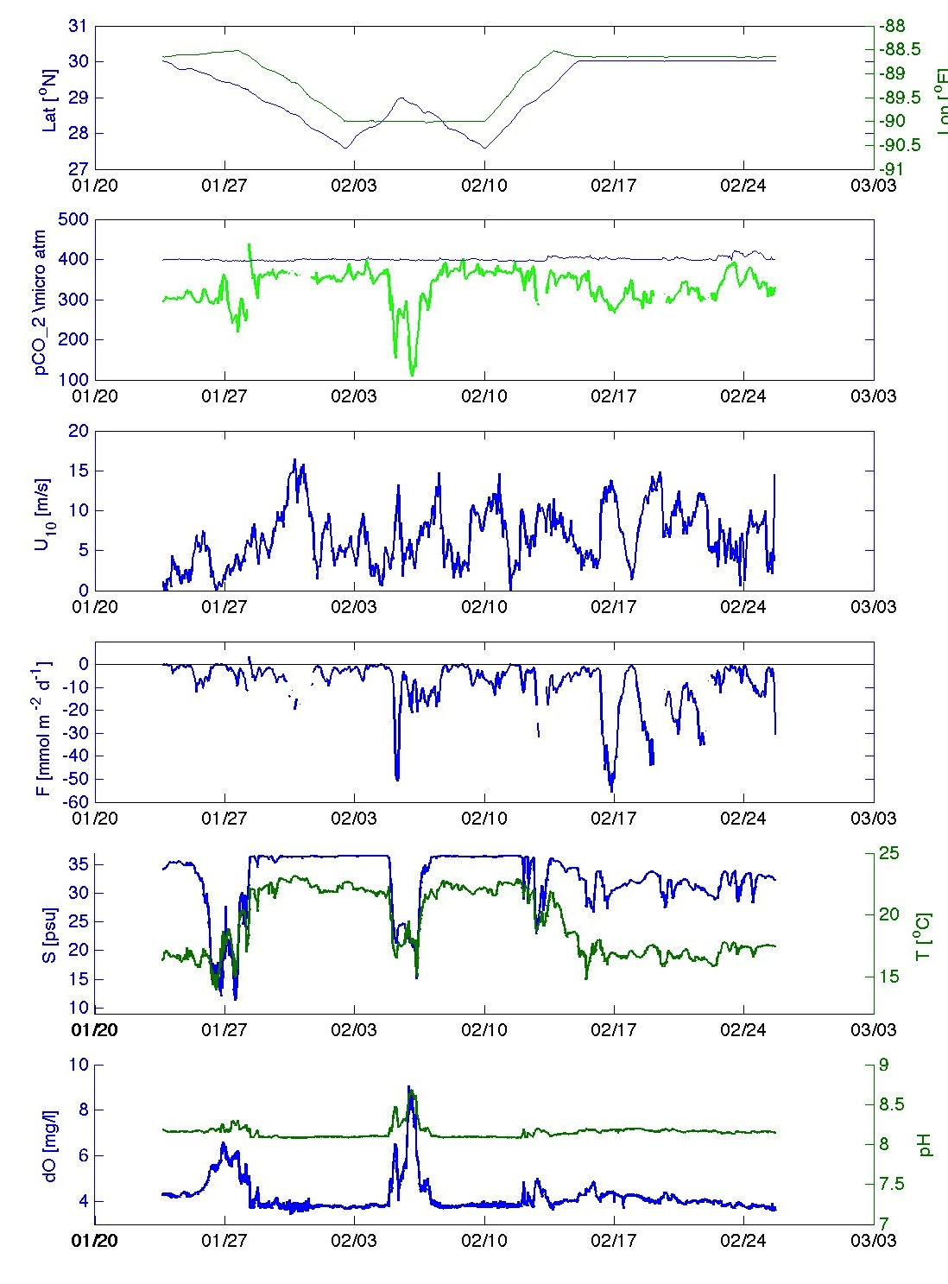
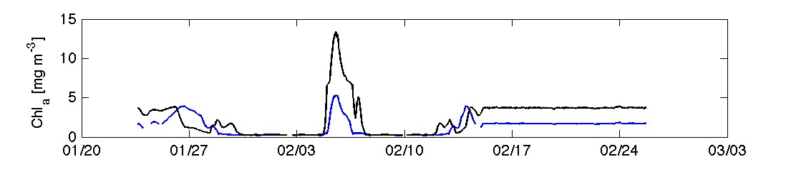


A Pilot Project for Autonomous Ocean Acidification Surveys in the Northern Gulf with the Liquid Robotics Wave Glider. #033
Stephan Howden¹, Jamie Griffin², Rik Wanninkhof³, Gernot Friederich⁴, Kjell Gundersen⁵ and Kevin Martin¹
¹University of Southern Mississippi, ²Liquid Robotics, ³NOAA/AOML, ⁴MBARI,⁵Institute for Marine Research (Havforskningsinstituttet) Bergen, Norway.
Wave Glider Instruments
Deployment 01/23/2013-02/27/2013
Average CO2 Flux
Airmar PB200 Weather Station | Airmar CS4500 Water Speed Sensor
Seabird GPTCTD 90688 CTD w/high speed pump | Seabird SBE43F DO
Honeywell Durafet pH | Li-cor 820 pCO2
MODIS Image January 23, 2013
Deployment and Recovery Location
MODIS Image February 17, 2013
Drought conditions
Mississippi River Outflow
USGS Mississippi River Gauge at Baton Rouge, Louisiana
River was below the 5 year average from October 2012 through most of January 2013 but at or above average for most of the Jan-Feb deployment
<2005-2009>
Chlorophyll a [mg m⁻³]
actual
This study
Lohrenz et al., 2010
Braatz, 2011
Lohrenz and Cai 2006
Wave Glider track
+
Stations for the GOMECC cruises
Means and Standard Deviations of Data Binned in 2 m/s Winds
Methods
CenGOOS Buoy and Wave Glider launch and recovery site
All data Binned into 2 m/s wind speed bins. Fluxes change due to both temporal and sparial variations
Wave Glider back at buoy station
Wind speeds (10 m) from NDBC buoy 42040 used when anemometer on Wave Glider failed.
pH₂O computed from temperature and salinity following Weiss and Price (1980)
pCO₂ is the computed water-saturated partial pressure from measured xCO₂ and, barometric pressure and pH₂O following Sabine et al.,(2000);
Flux of CO₂ to atmosphere (F) computed via
  The piston velocity k (Wanninkhof, 1992)
  where Sc is the Schmidt # computed via a temperature dependence following Wanninkhof (1992) using empirical relationships determined by , Jähne et al., (1987)
  s is the solubility of CO₂ as a function of temperature and salinity (Weiss, 1974)
  The
Chlorophyll a concentrations from MODIS on the Aqua satellite were obtained from the OceanColor website of NASA/GSFC (http://oceancolor.gsfc.nasa.gov/cgi/l3) at 4 km resolution.
Latitude
Longitude
Lon
pCO₂ air
pCO2 seawater
Only data collected while Wave Glider was at CenGOOS buoy location. Flux changes driven mostly by time variation of winds
NDBC Buoy 42040
U10 [m/s]
Summary
CO₂ Flux to atmosphere
The CO₂ flux over the course of the mission varied between -55.72 and 3.56 μmol m⁻² d⁻¹ with an average of -8.33.
Dividing the mission into prior and after the glider sat in a watch circle around CenGOOS buoy the average fluxes were -5.63 and -14.33 μmol m⁻² d⁻¹ , respectively.
Waveglider could adaptively sample regions where uncertainty in remote retrievals of pCO2 is high
In this application the Wave Glider with the MBARI OA package has been shown to be useful in monitoring a spatially and temporally heterogeneous region for air-sea carbon flux and seawater pH. These platforms will help achieve the goal of developing the monitoring capacity to quantify and track ocean acidification, called for in the NOAA Ocean and Great Lakes Acidification Research Implementation Plan.
Real-time Data
S [psu]
T seawater [ºC]
dO [mg/l]
pH
In collaboration with the Gulf of Mexico Coastal Ocean Observing Center (GCOOS) the data were served in real-time on its Products website with an ESRI server application.
MODIS Chl_a 01/23
MODIS Cha_a 02/17
Acknowledgements
References
This project was funded by a NOAA grant, through the Northern Gulf Institute, to member institution the University of Southern Mississippi, and from a NOAA grant to the Gulf of Mexico Coastal Ocean Observing System to Liquid Robotics. Wai-jun Cai of UGA provided analysis of TA and DIC from wet samples. The Liquid Robotics deployment, recovery, and operations teams were essential to the project.
Braatz, A. (2011) M.S. Thesis, The University of Southern Mississippi, Hattiesburg, MS, pp86.
Jähne, B., K. O. Münnich, R. Bösinger, A. Dutzi, W. Huber and P. Libner (1987), On the parameters influencing air-water gas exchange, J. Geo.phys. Res., 92, 1937-1949
Lohrenz, S. E. and W.-J. Cai (2006), Satellite ocean color assessment of air-sea fluxes of CO2 in a river-dominated coastal margin, G. Res. Let. 33, L01601, doi:10.1029/2005GL023942.
Lohrenz, S. E., W.-J. Cai, F. Chen, X. Chen, and M. Tuel (2010) , Seasonal variability in air-sea fluxes of CO2 in a river-influenced coastal margin, J. Geophys. Res. 115, doi:10.1029/2009JC005608.
Wanninkhof, R. (1992), Relationship between wind speed and gas exchange over the ocean, J. Geophys. Res. 97, 7373-7382.
Weiss, R. F. (1974). Carbon dioxide in water and seawater: The solubility of a non-ideal gas, Mar. Chem. 2, 203-215.
Weiss, R. F. and B. A. Price (1980), Nitrous Oxide solubility in water and seawater, Mar. Chem., 8, 347-359.

