Slide 1
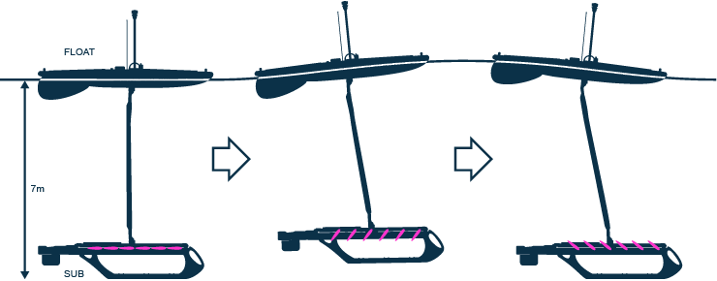
Fully Autonomous Control for the WaveGlider
Philip Cooksey

Slide 2
Outline
Background Information
The WaveGlider
Problem Statement
Controlling the WaveGlider
  Serial Protocols
  Commands
  C++ Code
Future Teleo-Reactive Executive (T-REX) Integration

Slide 3
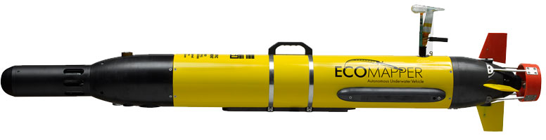
Background Information
Senior at California State University Monterey Bay
Worked with the Autonomous Group for a few years
  Developed web command interface for T-REX
  Increased plan execution performance in T-REX
  Combined ROS and T-REX to run together on the EcoMapper.

Slide 4
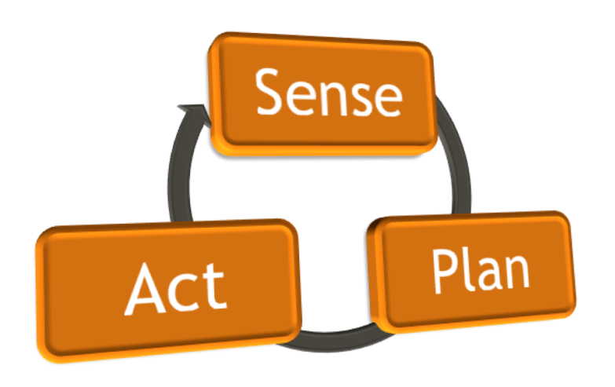
Capstone
Develop autonomous control on the WaveGlider
  Interface with WaveGlider
  Read environment/vehicle data
  Send commands
  Incorporate autonomous planner

Slide 5
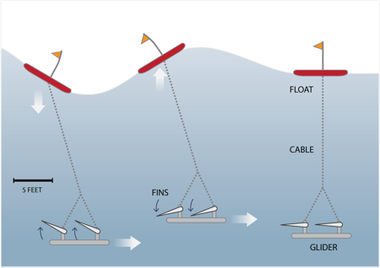
WaveGlider
Created by Liquid Robotics
Wave and solar powered
Command controlled
  Wave Glider Management System(WGMS) online system
Environmental Monitoring
Site Assessment
Global Weather

Slide 6
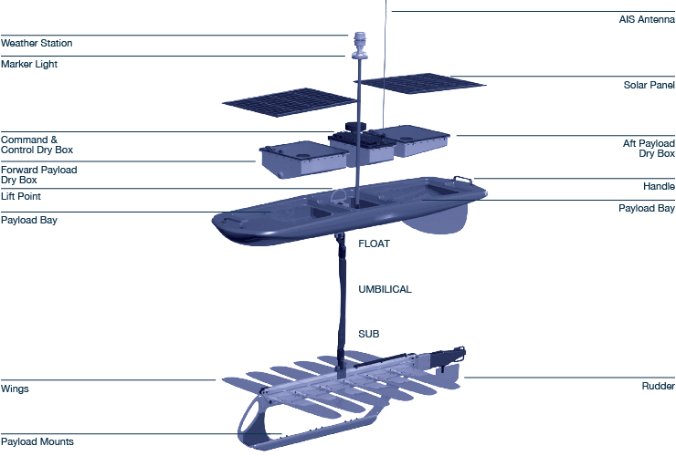
WaveGlider

Slide 7
WaveGlider
Pros
  Highly functional
  Enormous potential for ocean research
  Missions lasting months
Cons
  Closed online control system
  Expensive to operate (~ $60,000 per year)
  Lack of open source code

Slide 8
Problem Statement
A critical problem for the vehicle has been its lack of open source autonomy; currently every WaveGlider is controlled by an online management system and is piloted by human operators from the control center of Liquid Robotics.

Slide 9
Capstone Proposal
Build an open source autonomous control system
Run onboard the WaveGlider
Use T-REX framework for adaptability and future extensions
Pros
  Embedded control system
  Onboard autonomy can reduce cost of piloting, which can be up to $60,000 per year
  Open source code: https://github.com/pcooksey/TREX-WaveGlider

Slide 10
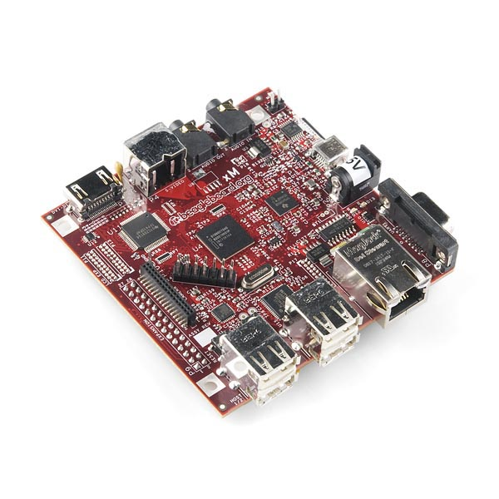
Controlling the WaveGlider
Onboard BeagleBoard-XM
  Cost $149
  ARM Cortex-A8
  1 GHz
  Ubuntu OS
USB-to-Serial port connection to Command & Control

Slide 11
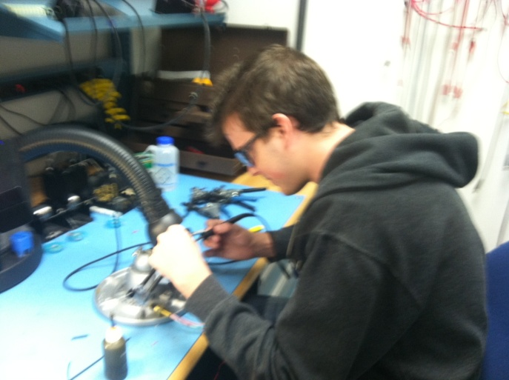
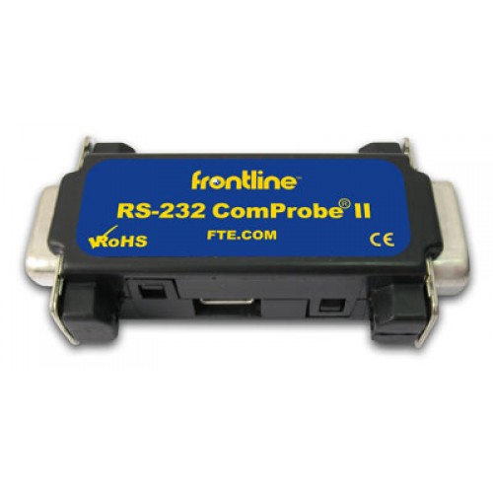
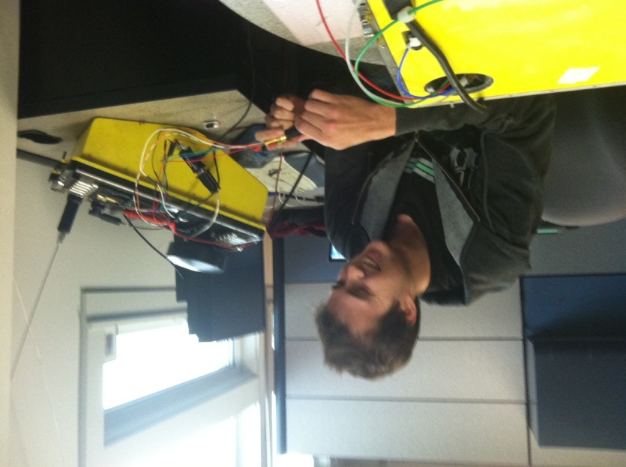
Starting the Communication
WaveGlider documentation
Lack of actual serial data
Reverse engineer the process

Slide 12
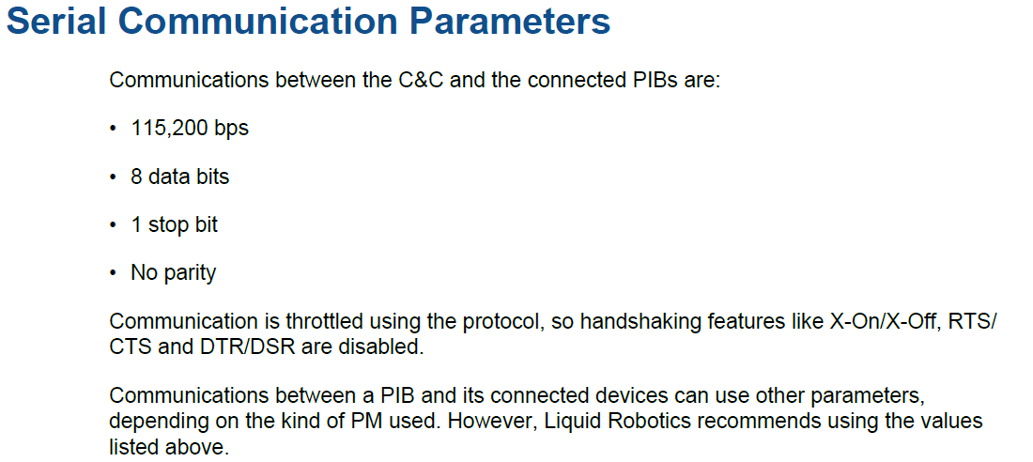
WaveGlider Serial Parameters

Slide 13
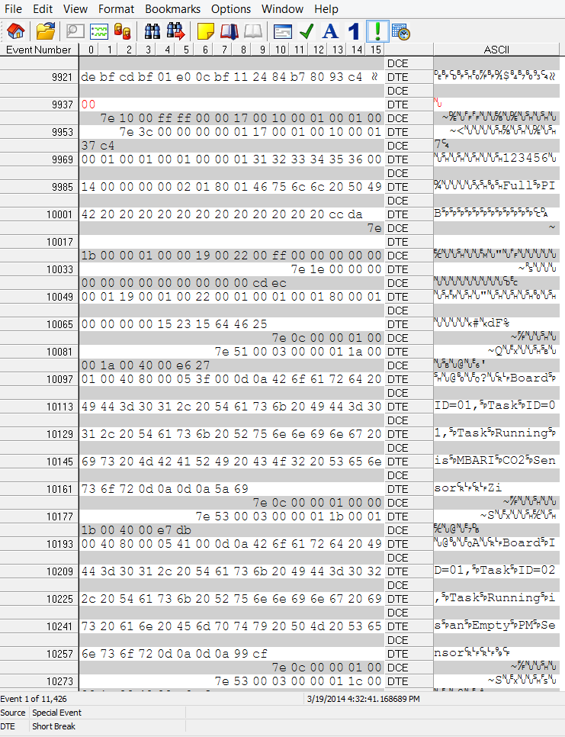
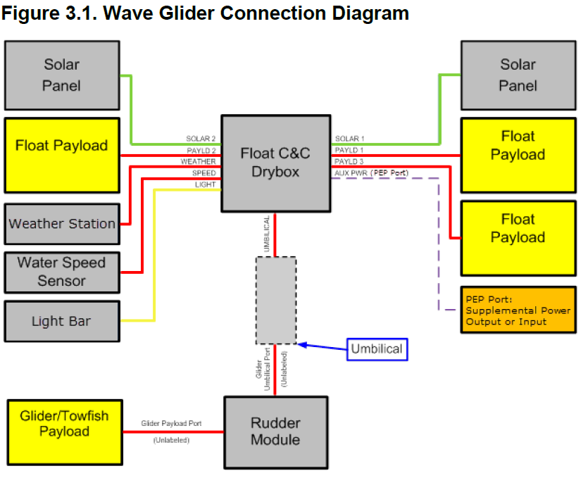
Raw Serial Data

Slide 14
Processing the Data
Review the WaveGlider documentation
Determine Packet Format
Decode the collected serial data
Analyze the structure
Reverse engineer the process
Communicate with the WaveGlider

Slide 15
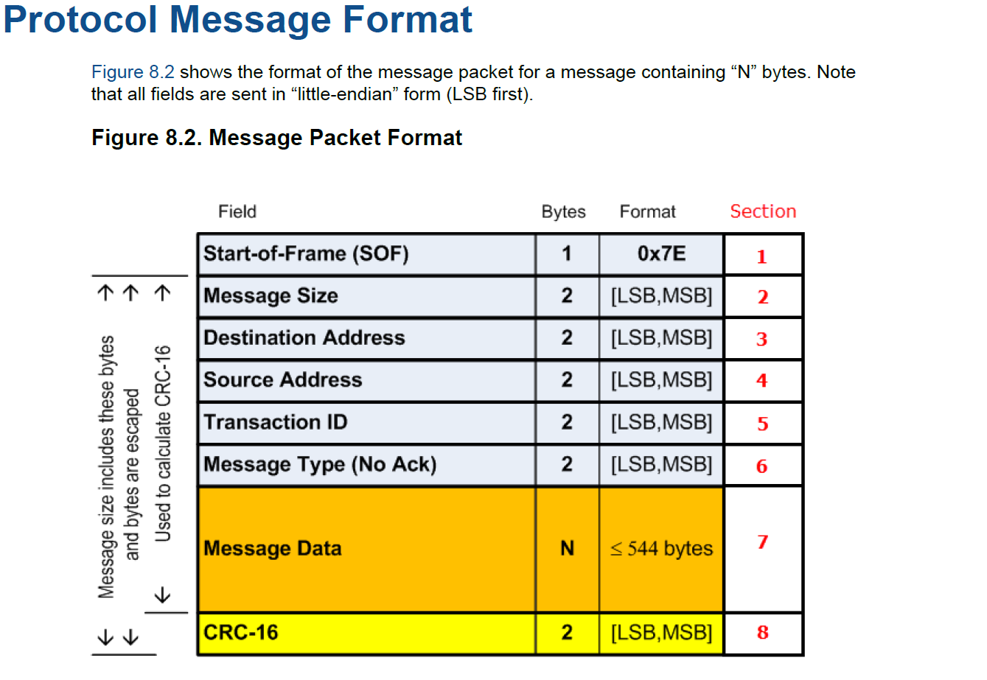
Payload Packet

Slide 16
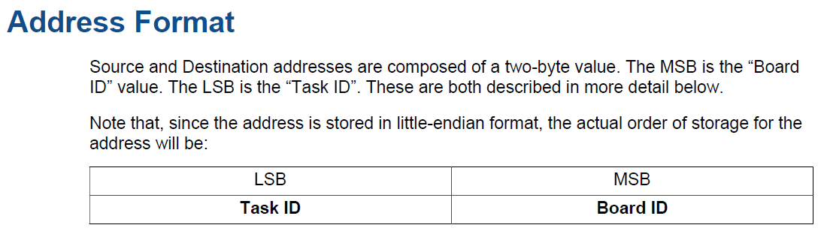
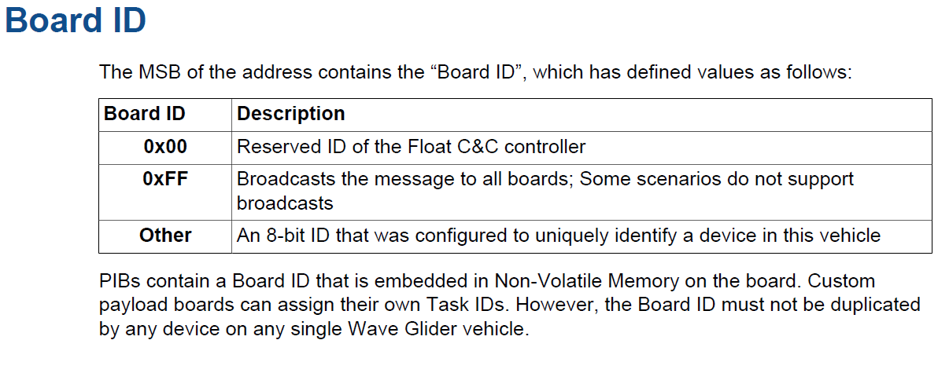

Slide 17
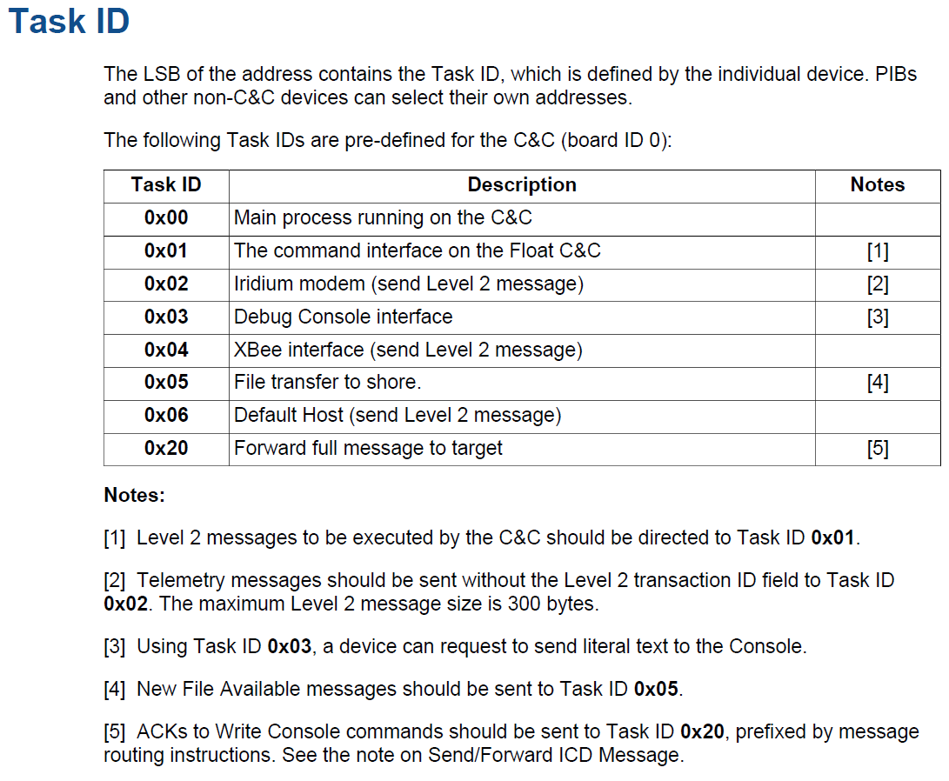

Slide 18
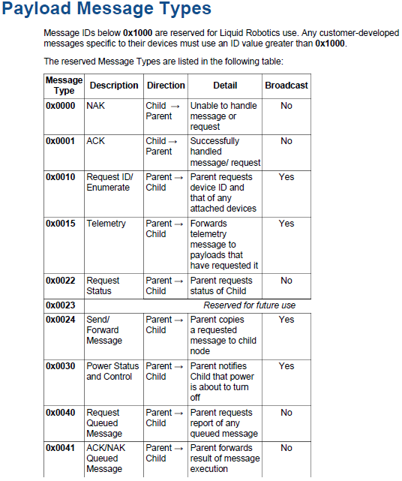

Slide 19
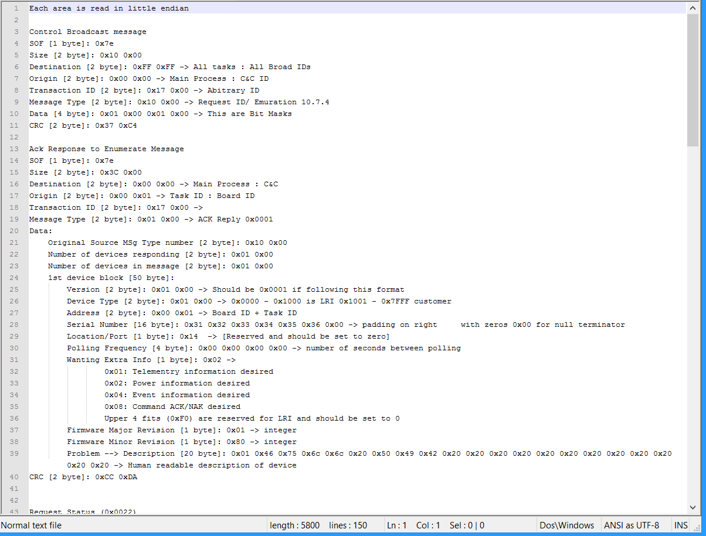
Processing the Serial Data
Enumeration Process

Slide 20
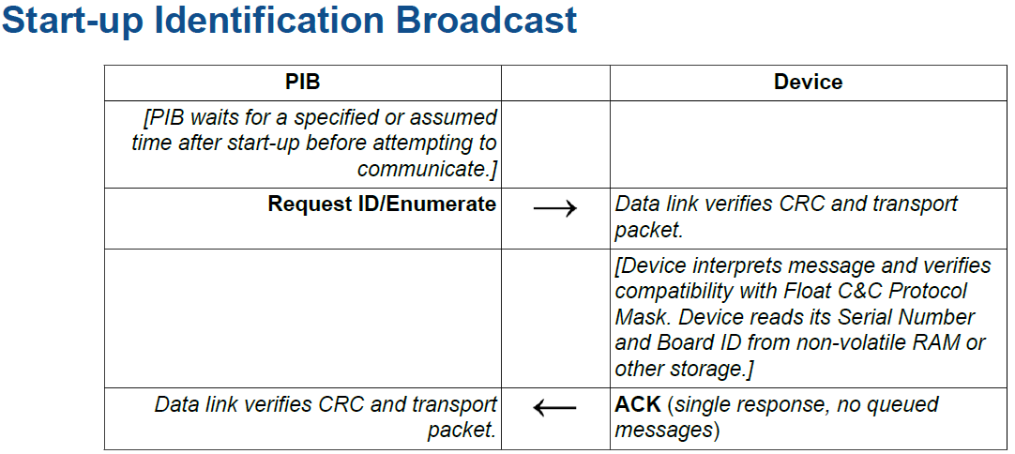
Request ID/Enumerate (0x0010)

Slide 21
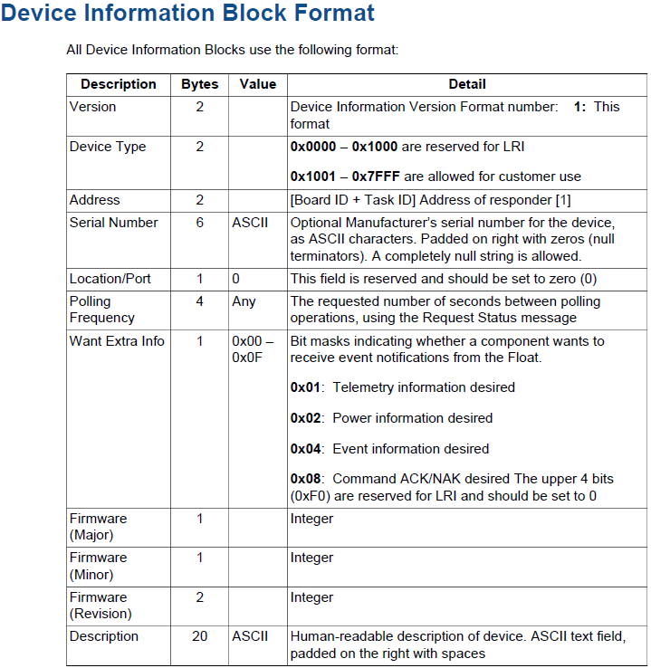
Enumerate Reply

Slide 22
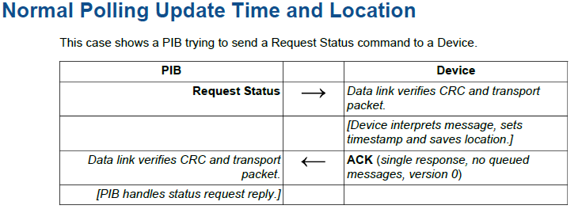
Request Status (0x0022)

Slide 23
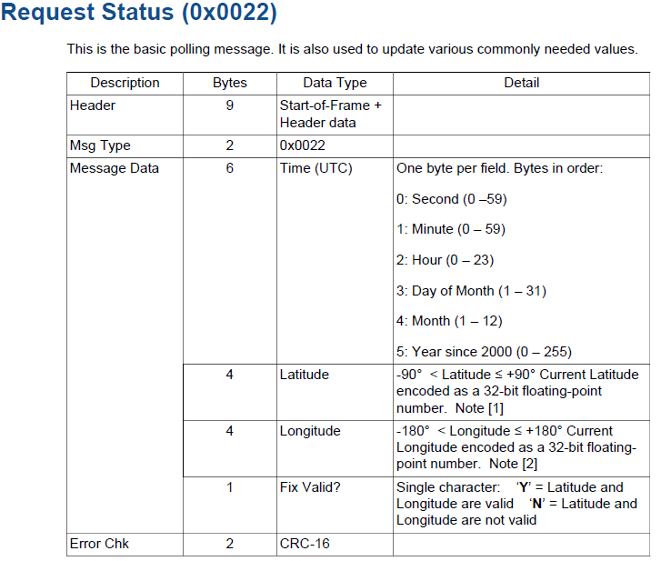
Request Status (0x0022)

Slide 24
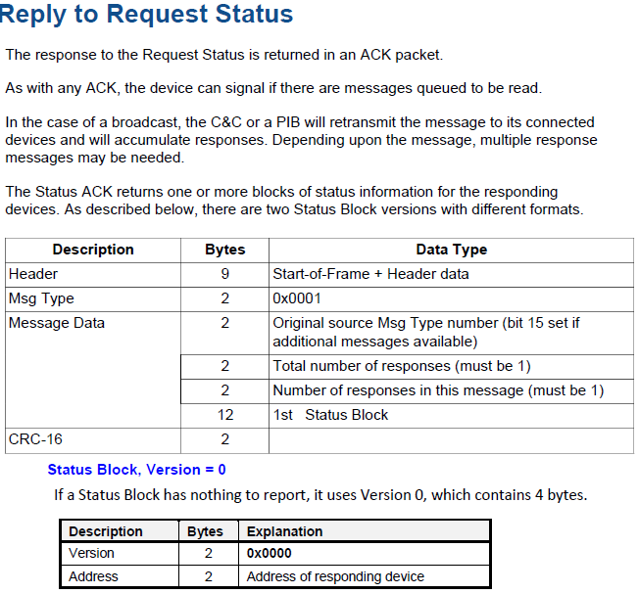
ACK Reply Status (0x0001)
Message Available (Commands)
0x0000
0x8000

Slide 25
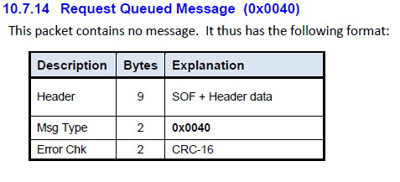
Queued Message (0x0040)

Slide 26
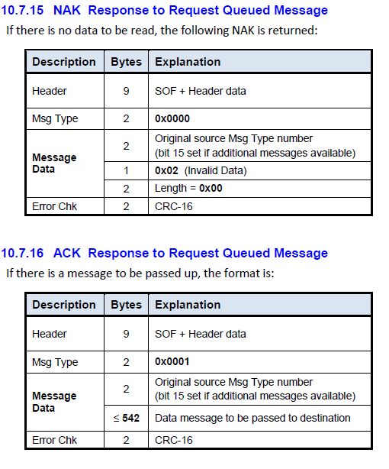
ACK Reply Message (0x0001)
(0x0001) format type
Commands

Slide 27
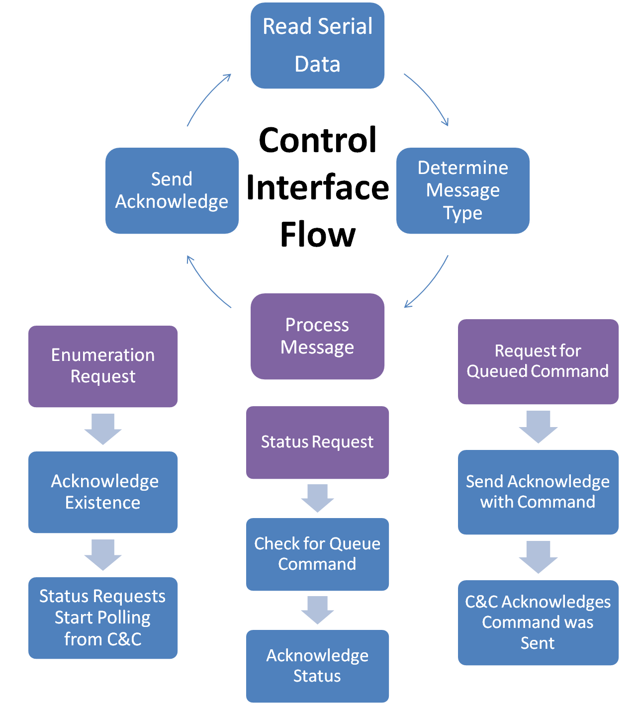
Serial Port Message Loop

Slide 28
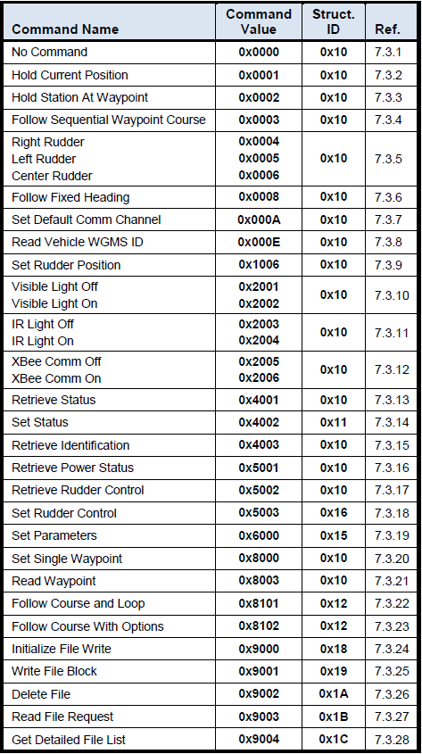
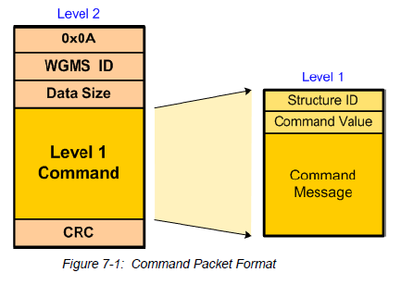
Commands

Slide 29
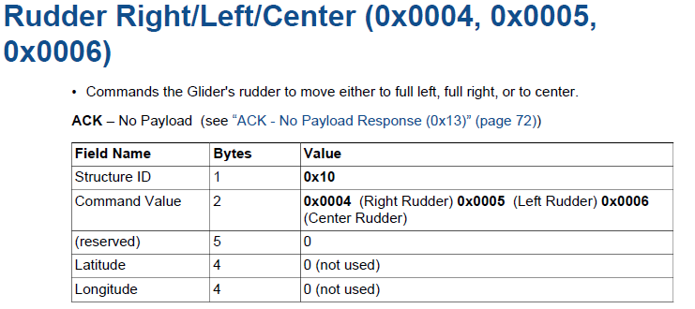
Example Rudder Command

Slide 30
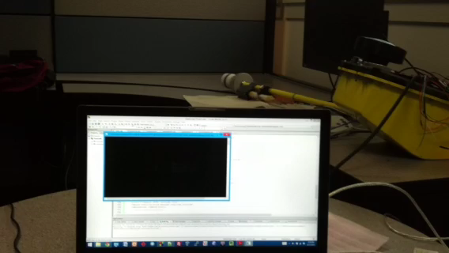
Turn Light On

Slide 31
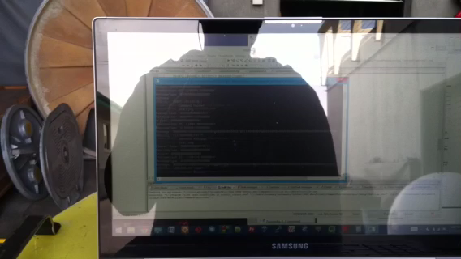
Hold Station at Waypoint

Slide 32
Waypoint Control
Generate waypoints
Set waypoints command to Command & Controller
  Stored in array
Different commands for using waypoint
  Hold station at waypoint
  Follow sequential waypoint course
  Follow course and loop
  Follow course with option

Slide 33
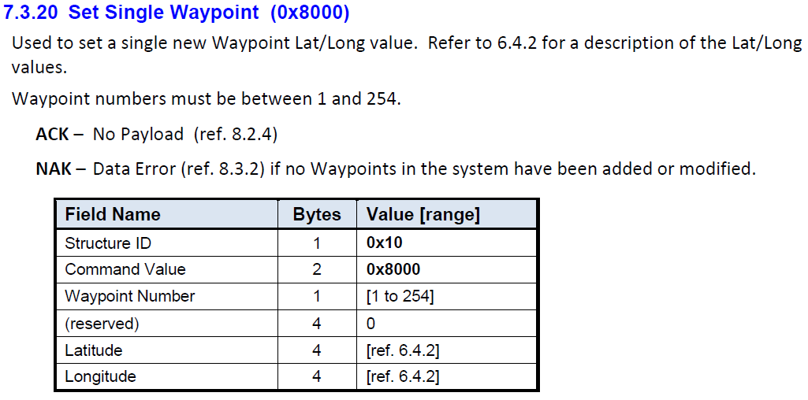
Waypoint encoded (32bit) example:
0x150F085 or 22081669 divided by 600,000 gives 36.802781667 latitude
0xFBA4FF1A or 4221894426 (subtract 2^32 since the high order bit is set, so −73072870) divided by 600,000 gives −121.788116667 latitude.

Slide 34
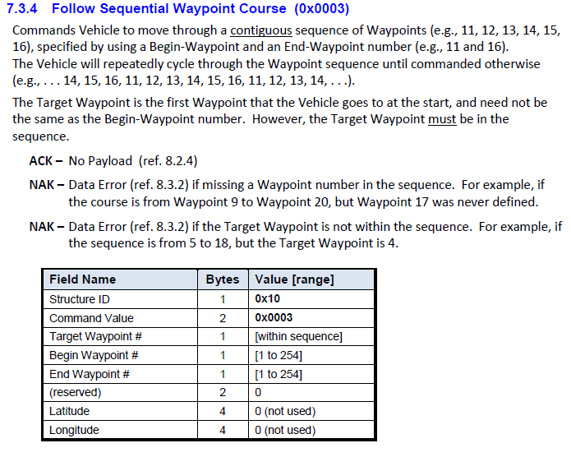

Slide 35
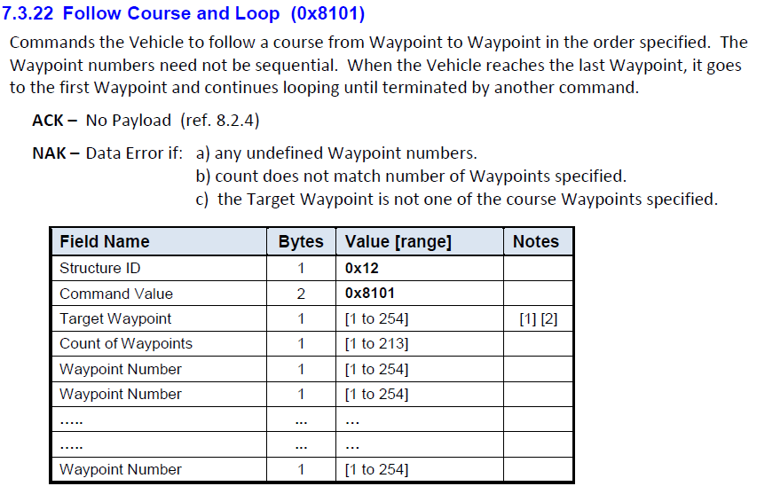

Slide 36
Code Details
C++ Boost Asio Library
  Serial port
Open source serial code
Basic data storage
  boost::dynamic_bitset<>
  std::bitset<>

Slide 37
Command Class
public:
static const int BYTE = 8;
Command(bitset<1*BYTE> ID, bitset<2*BYTE> value, bitset<5*BYTE> message,
bitset<4*BYTE> longitude, bitset<4*BYTE> latitude);
virtual ~Command();
bitset<1*BYTE> ID;
bitset<2*BYTE> value;
bitset<5*BYTE> message;
bitset<4*BYTE> longitude;
bitset<4*BYTE> latitude;
int dataSize() const;
bitset<16*BYTE> fullCommand() const;
string fullCommand();
private:
int size;

Slide 38
Command Packet
public:
CommandPacket(const Command &command);
virtual ~CommandPacket();
const std::vector<int8_t> packet();
boost::dynamic_bitset<> dynamicPacket();
string stringPacket();
private:
int16_t createCRC();
bitset<1*Command::BYTE> header;
bitset<4*Command::BYTE> ID;
bitset<2*Command::BYTE> dataSize;
const Command &command;
bitset<2*Command::BYTE> CRC;

Slide 39
Payload Packet
public:
enum Data{ Size, Destination, Origin, TransactionID, MessageType };
PayloadPacket(): SOF(start) {};
PayloadPacket(bitset<byte(2)> destination, bitset<byte(2)> origin, bitset<byte(2)> transactionID,
bitset<byte(2)> messageType, boost::dynamic_bitset<> message);
virtual ~PayloadPacket();
bool read(TimeoutSerial &serial);
void write(TimeoutSerial &serial);
boost::dynamic_bitset<> getMessage() { return message; }
bitset<byte(2)> getData(Data value);
private:
int16_t generateCRC();
template<size_t N>
void readIn(bitset<N>& binary, vector<char>& values, int first, int last);
bitset<byte(1)> SOF;
bitset<byte(2)> packetSize;
bitset<byte(2)> destination;
bitset<byte(2)> origin;
bitset<byte(2)> transactionID;
bitset<byte(2)> messageType;
boost::dynamic_bitset<> message;
bitset<byte(2)> CRC;

Slide 40
Send Simple Command
void sendCommand(TimeoutSerial &serial, PayloadPacket &payload, Commands commandValue)
bitset<2*Command::BYTE> destination (0x0100);
bitset<2*Command::BYTE> origin(0x0001);
bitset<2*Command::BYTE> transactionID = payload.getData(PayloadPacket::TransactionID);
bitset<2*Command::BYTE> messageType(0x0100);
bitset<4*Command::BYTE> originalMesgType(0x40000100);
// Creating a simple command
bitset<1*Command::BYTE> ID (0x10);
bitset<2*Command::BYTE> value (commandValue);
bitset<5*Command::BYTE> message (0x00);
bitset<4*Command::BYTE> longitude (0x0);
bitset<4*Command::BYTE> latitude (0x0);
Command level1(ID, value, message, longitude, latitude);
CommandPacket command(level1);
// End of creating command
string temp = originalMesgType.to_string()+command.stringPacket();
boost::dynamic_bitset<> fullMessage(temp);
// Create payload packet
PayloadPacket packet(destination, origin, transactionID, messageType, fullMessage);
packet.write(serial);

Slide 41
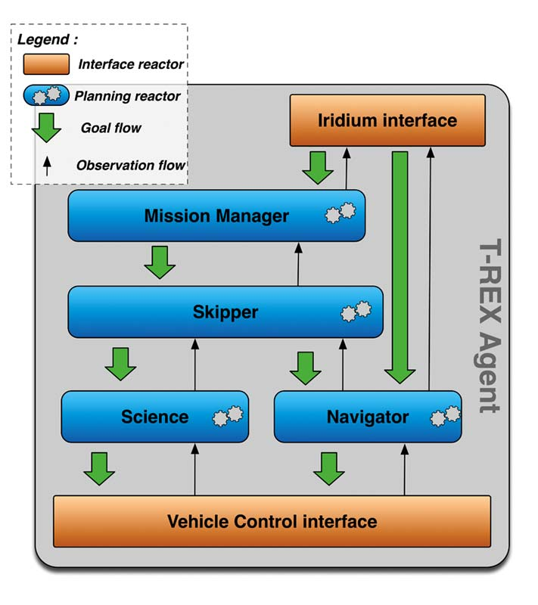
T-REX Integration

Slide 42
Future T-REX Integration
Planning Reactor already created within T-REX
Navigator
Planning models
  Controls
  Environment

Slide 43


Thanks
David and Lucile Packard Foundation and MBARI
  Kanna Rajan
  Thom Maughan
Chavez Lab for the loan of the WaveGlider C&C
Undergraduate Research Opportunity Center (UROC)
Capstone advisor: Kate Lockwood
Liquid Robotics
  Mike Cookson

Slide 44
Thank you

