Slide 1
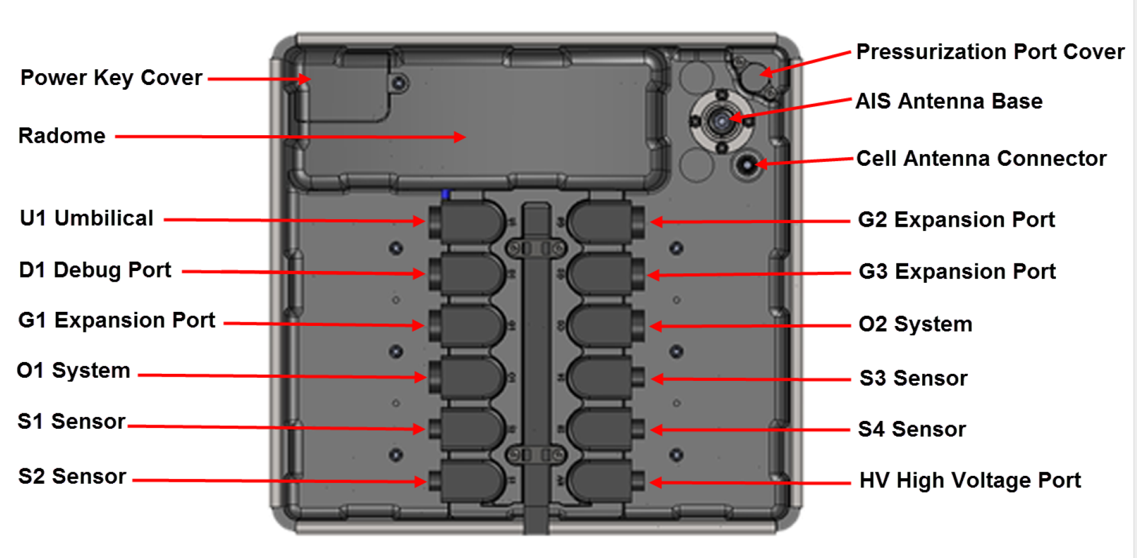

Slide 2
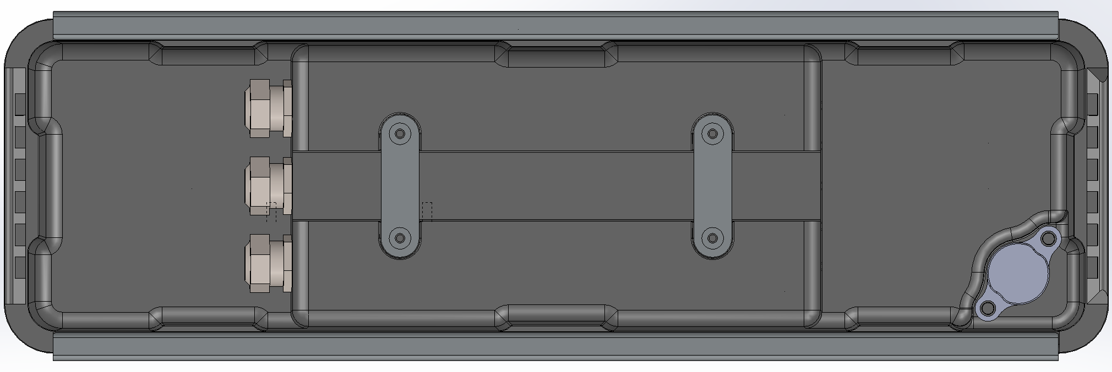

Slide 3
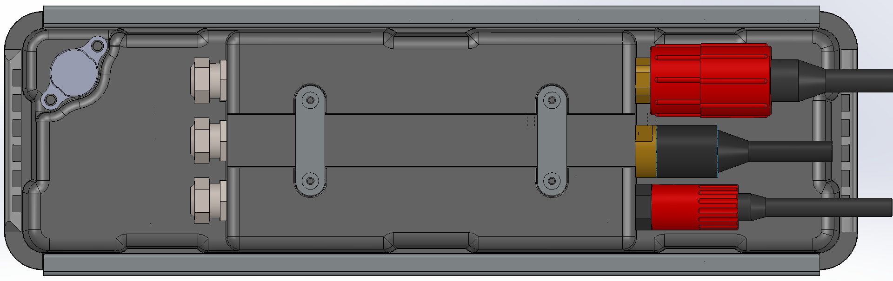

Slide 4
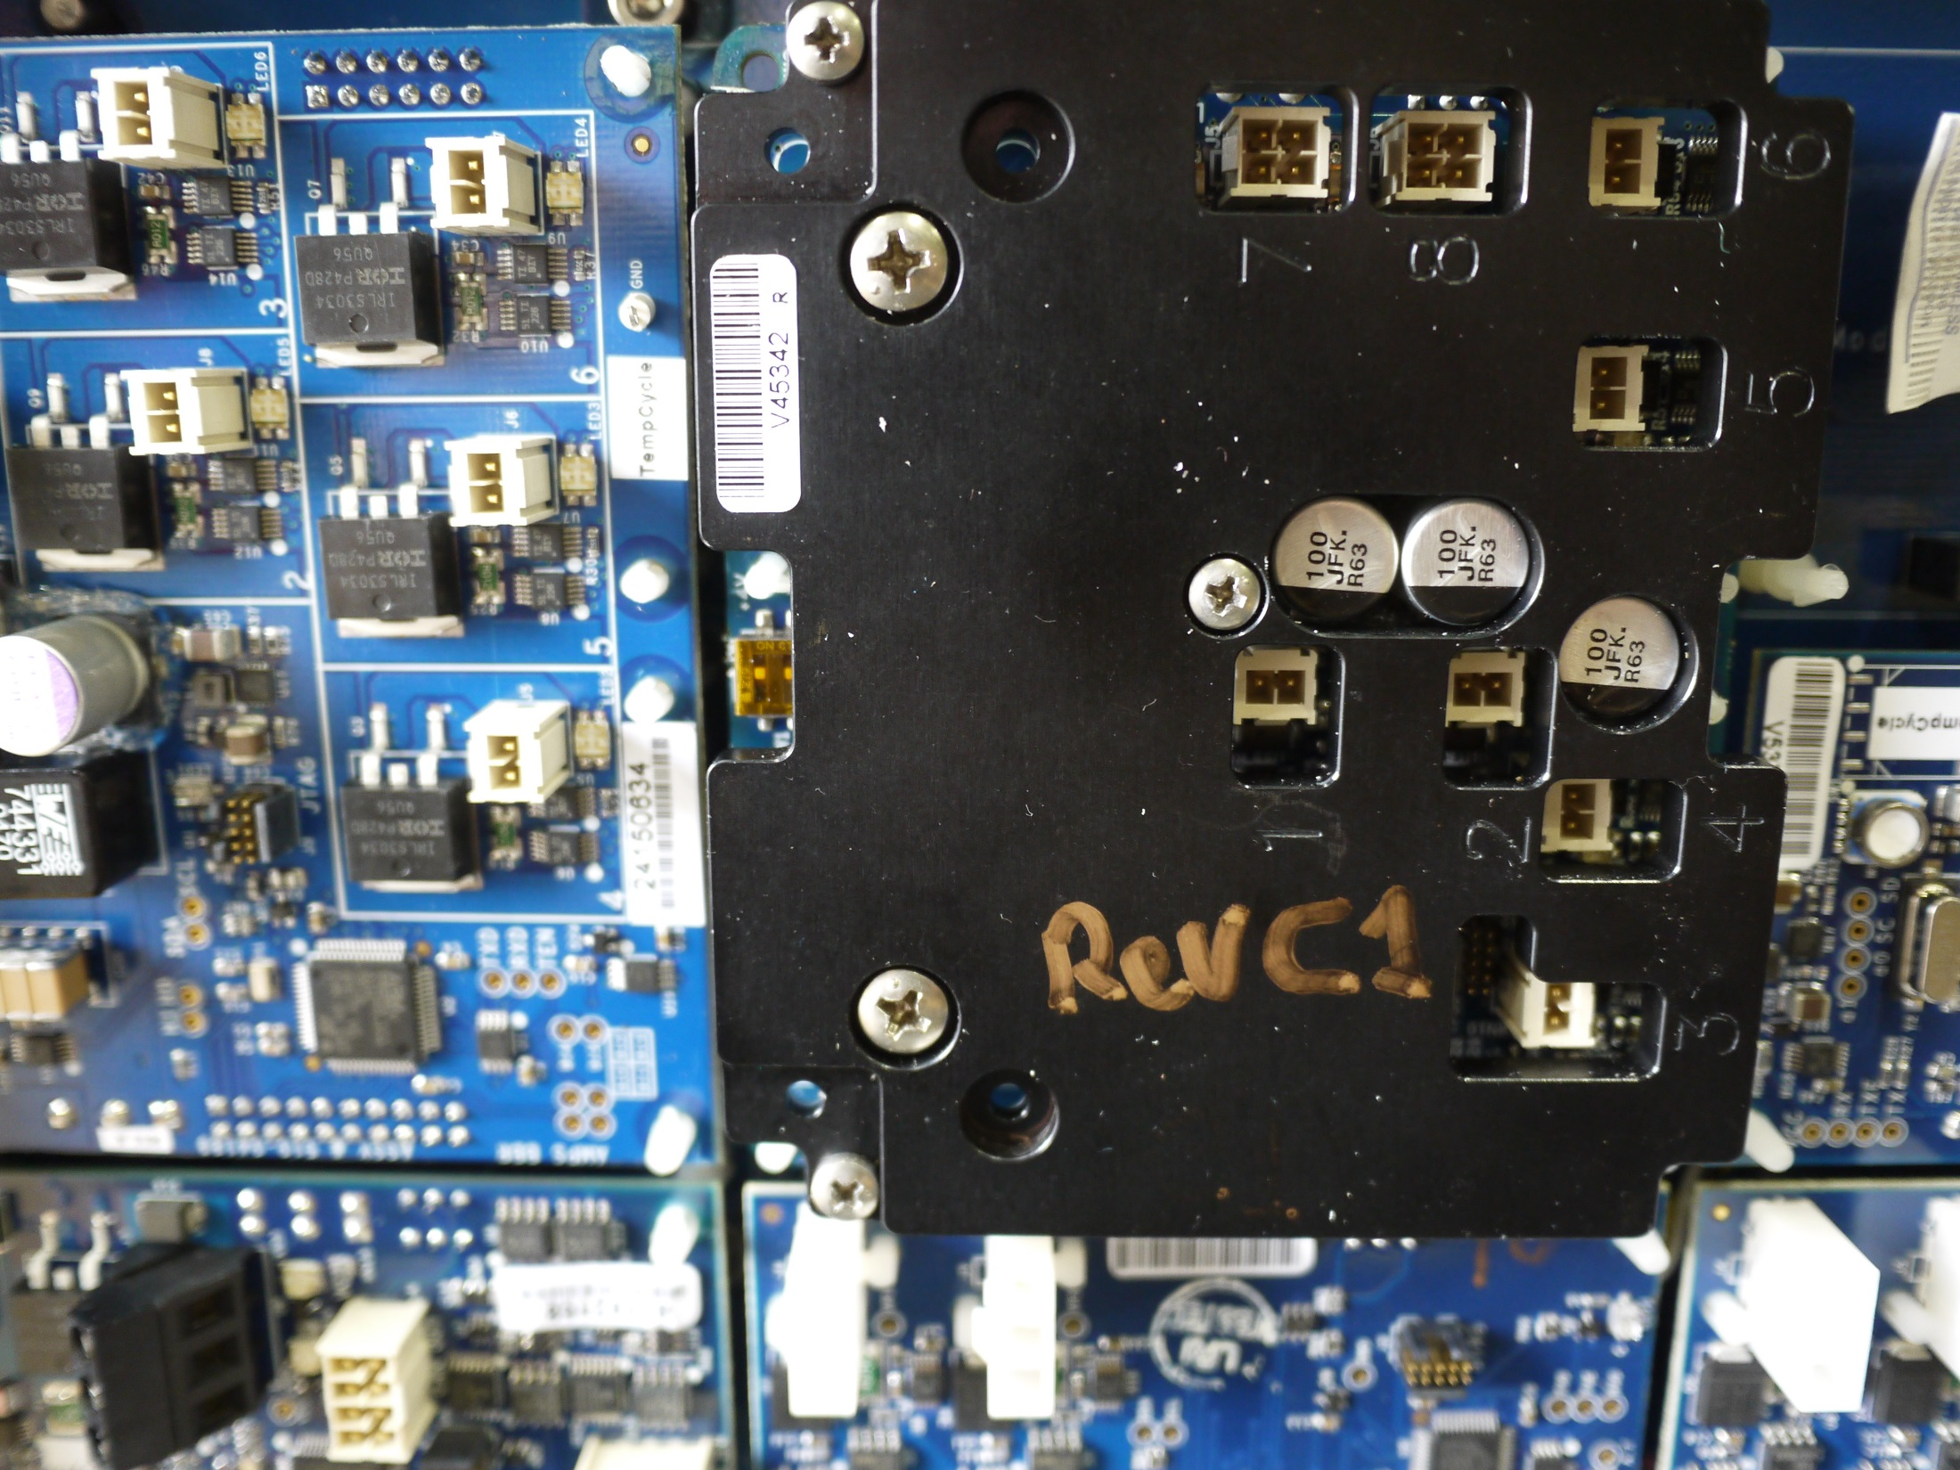
SET DIP SWITCH FOR 28 V OUTPUT ON HV PORT
SW1 (+4) = ON
SW2 (+20) = OFF

