Slide 1
2014 Spring EcoHAB Wave Glider Navigation Tutorial
Collected by MRC 4/11/14
Rev. B 14APR14

Slide 2
Operating Instructions - Navigation
Liquid Robotics Operational Desk: 408 636-4205
Drive WG back and forth between ESP circles to rendezvous with the LRAUV Daphne.
The Approach waypoints (114, 115, 116, 117) are to provide a clear path to next circle.
Use the Follow Sequential Course Command and enter the following:
1. Target Waypoint: First approach waypoint to have a clear exit from current circle position.
2. From Waypoint: Same as Target Waypoint.
3. To Waypoint: Approach waypoint for the next circle (note, without a new course the WG will cycle between the from and to Waypoints).
When the WG is on it’s way and can approach the new circle without any obstruction, then issue a new Follow Sequential Course Command :
1. Target Waypoint: First waypoint in the new circle that can be reached from the current position without obstruction.
2. From Waypoint: Lowest number Waypoint in the circle.
3. To Waypoint: Highest number Waypoint for the circle.
The WG will enter the circle at the Target Waypoint and advance sequentially through the Waypoint sequence and repeat.
  E.G. to enter the NE (MACK) circle:
  Target Waypoint: TBD
  From Waypoint: 12
  To Waypoint: 19
  E.G. to enter the SW (BRUCE) circle:
  Target Waypoint: TBD
  From Waypoint: 104
  To Waypoint: 111

Slide 3
AUV Location
Use tethys dashboard - http://aosn.mbari.org/TethysDash/?vehicle=daphne and click on the latest data log file.
Drag or copy the shore.kmz file into Google Earth to see where the LRAUV is.
  Note: Green is track starting location and Red is end.
Vector the WG to the appropriate side of the circle (see navigation above).

Slide 4
Payload (from Tom)
If we need to save power, then turn off the Freewave when LRAUV is not in range; ssh into hotspot3g and issue "sudo fwOff". But leave SMC and CDMA on to allow synching with shore, and interactive sessions with the SMC.
If we need to conserve more power, then turn off the Hotspot SMC; ssh into hotspot3g and issue a "sudo halt“. Then turn off SMC power through WGMS. This means no synch'ing with shore or AUV. It doesn't make much sense to turn off both the Freewave and the CDMA, but leave the SMC running.
ssh hotspot@hotspot3g.mbari.org
Login: hotspot
Password: **ynner
>sudo halt
When we need the Freewave for LRAUV rendezvous:
a) If SMC is on and CDMA is on, then ssh into hotspot3g and issue "sudo fwOn"
b) If SMC is on but CDMA is off (unlikely), then power-cycle the SMC through WGMS
b) If SMC is off, turn on SMC through WGMS. Both the CDMA and the Freewave radios are powered ON automatically when the Hotspot SMC is first turned on.
Whenever the SMC is on, I think it best to have the CDMA on as well if we can afford the power. During last month's sea trials the LR "runshell" mechanism proved a very unreliable way of controlling the Hotspot radios, and I have heard nothing from LR regarding a fix for this.

Slide 5
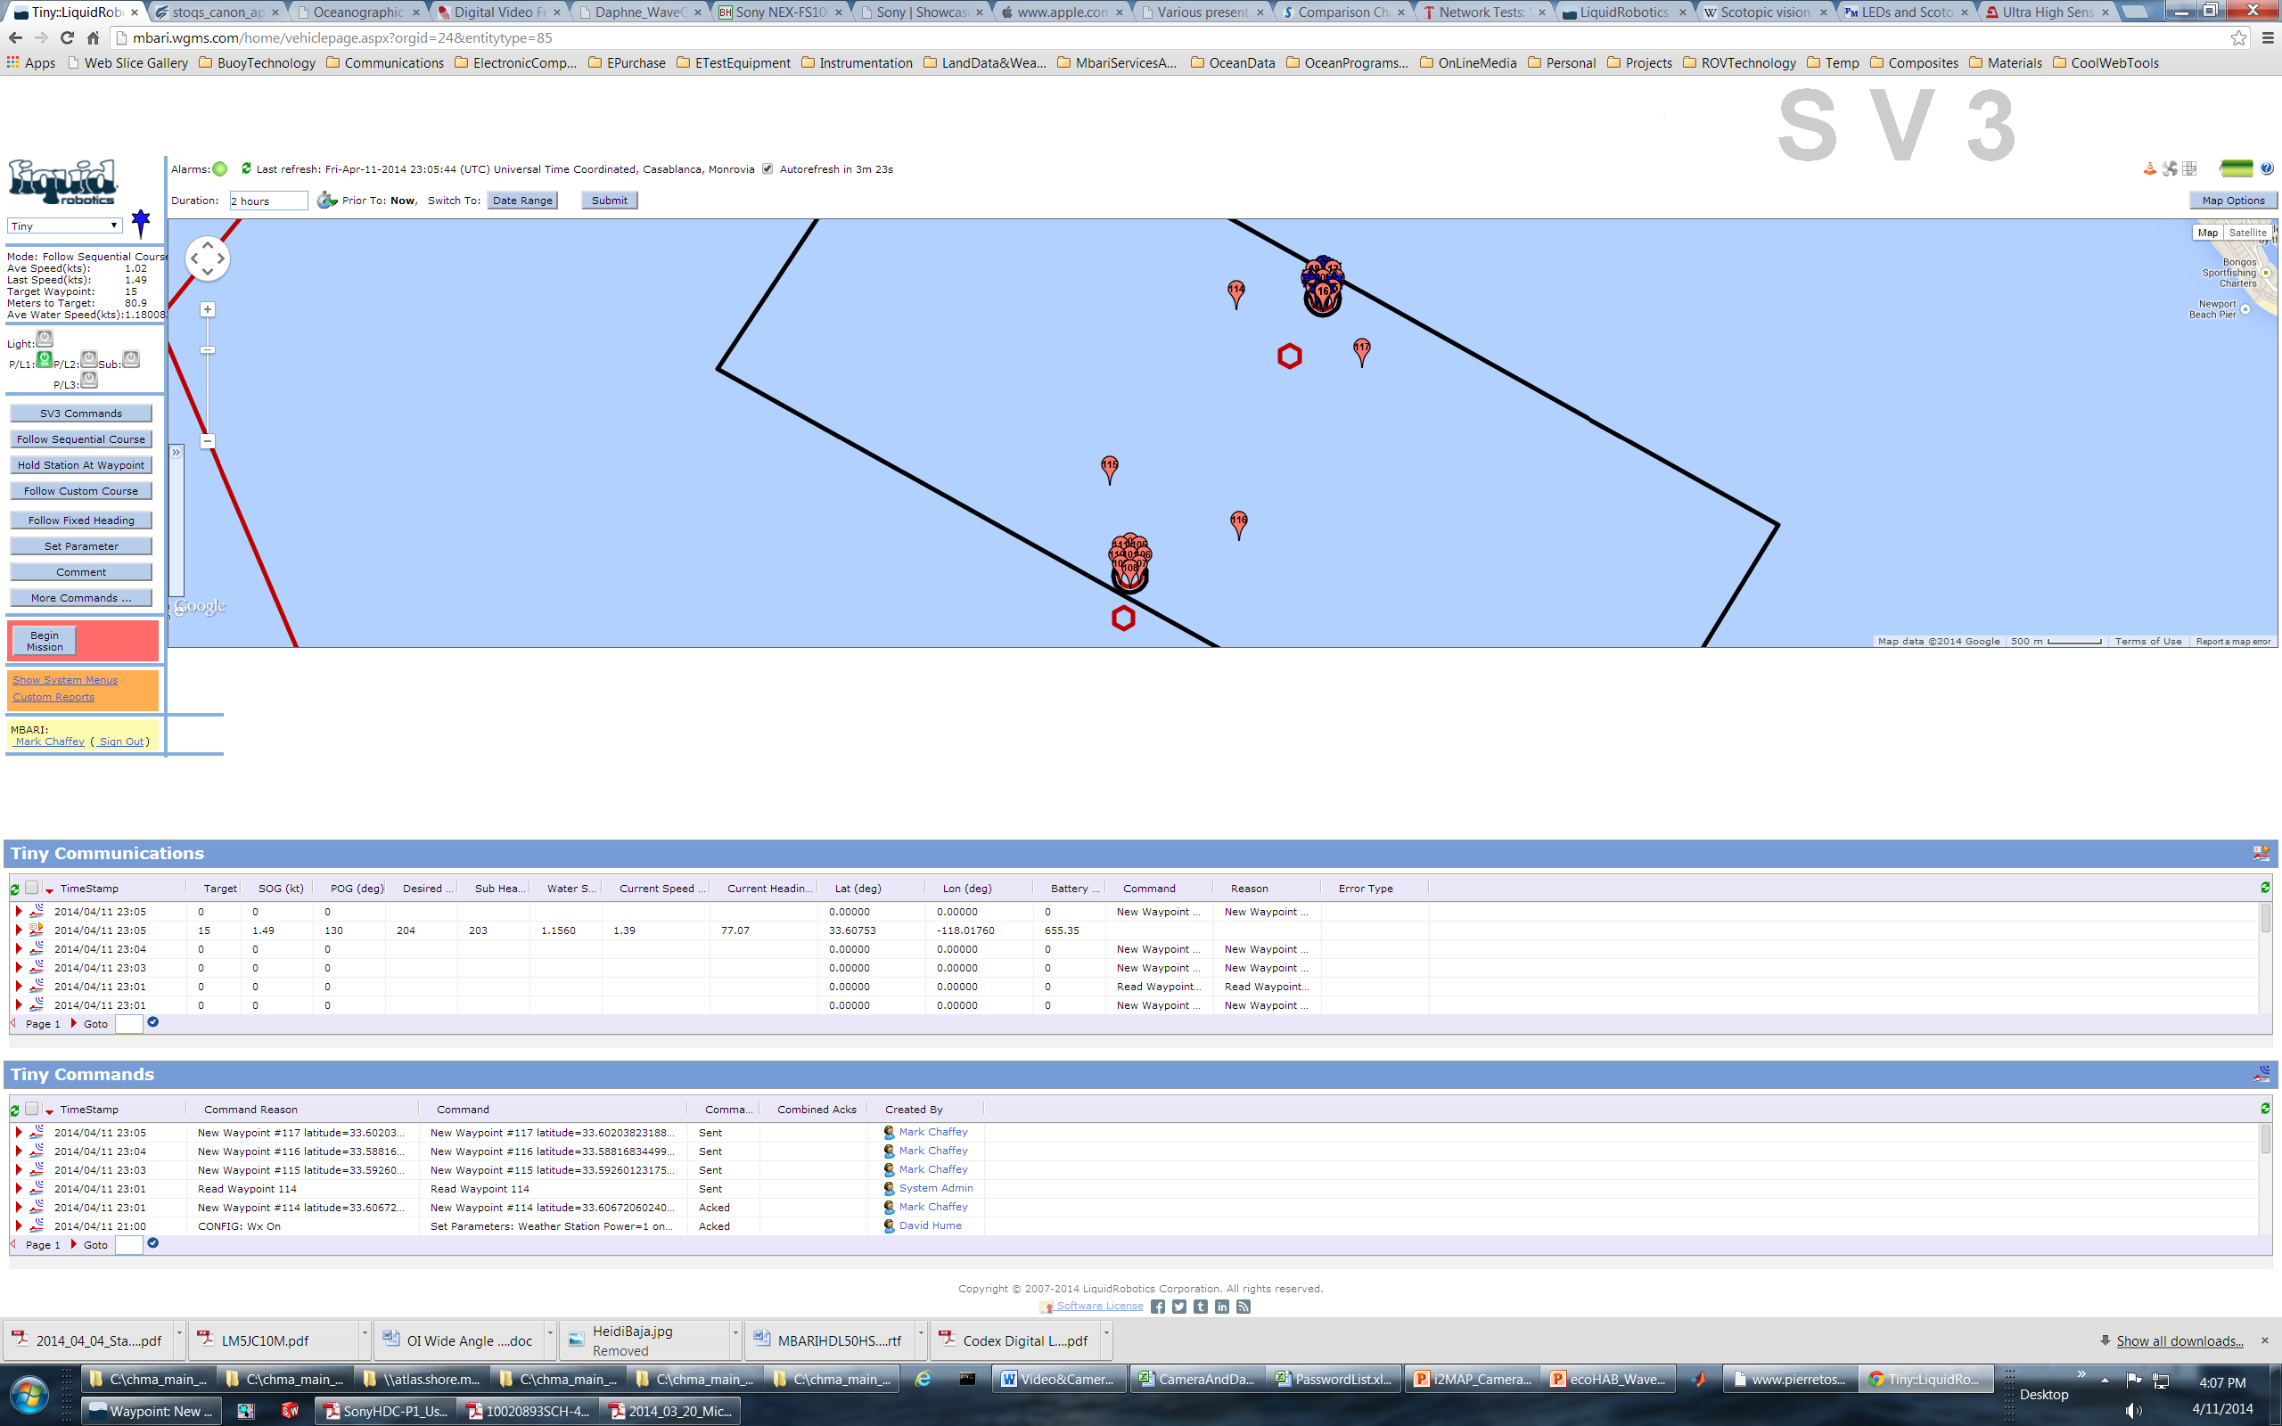
Overall Map
ESP MACK
APPROACH WAYPOINTS
KEEP OUT AREA (MOORING)
ESP BRUCE

Slide 6
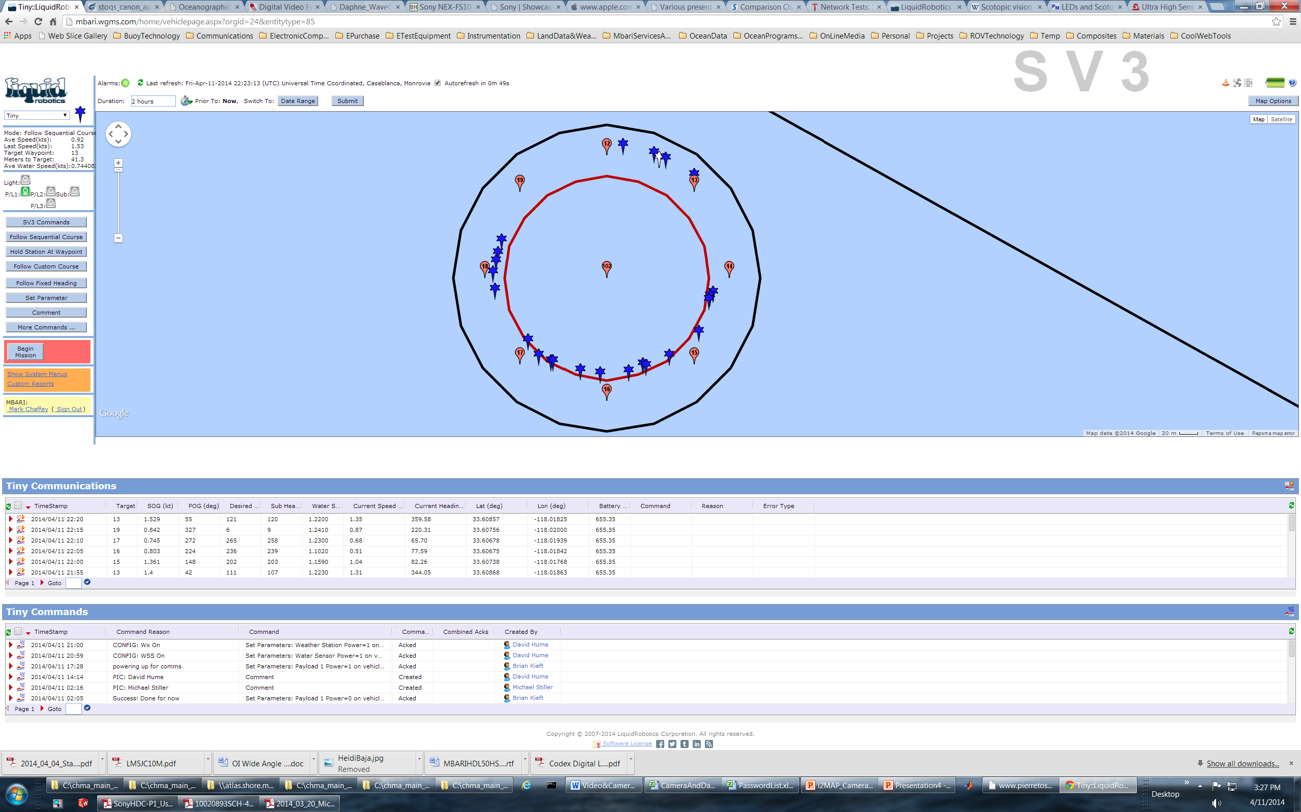
NE Circle
ESP MACK

Slide 7
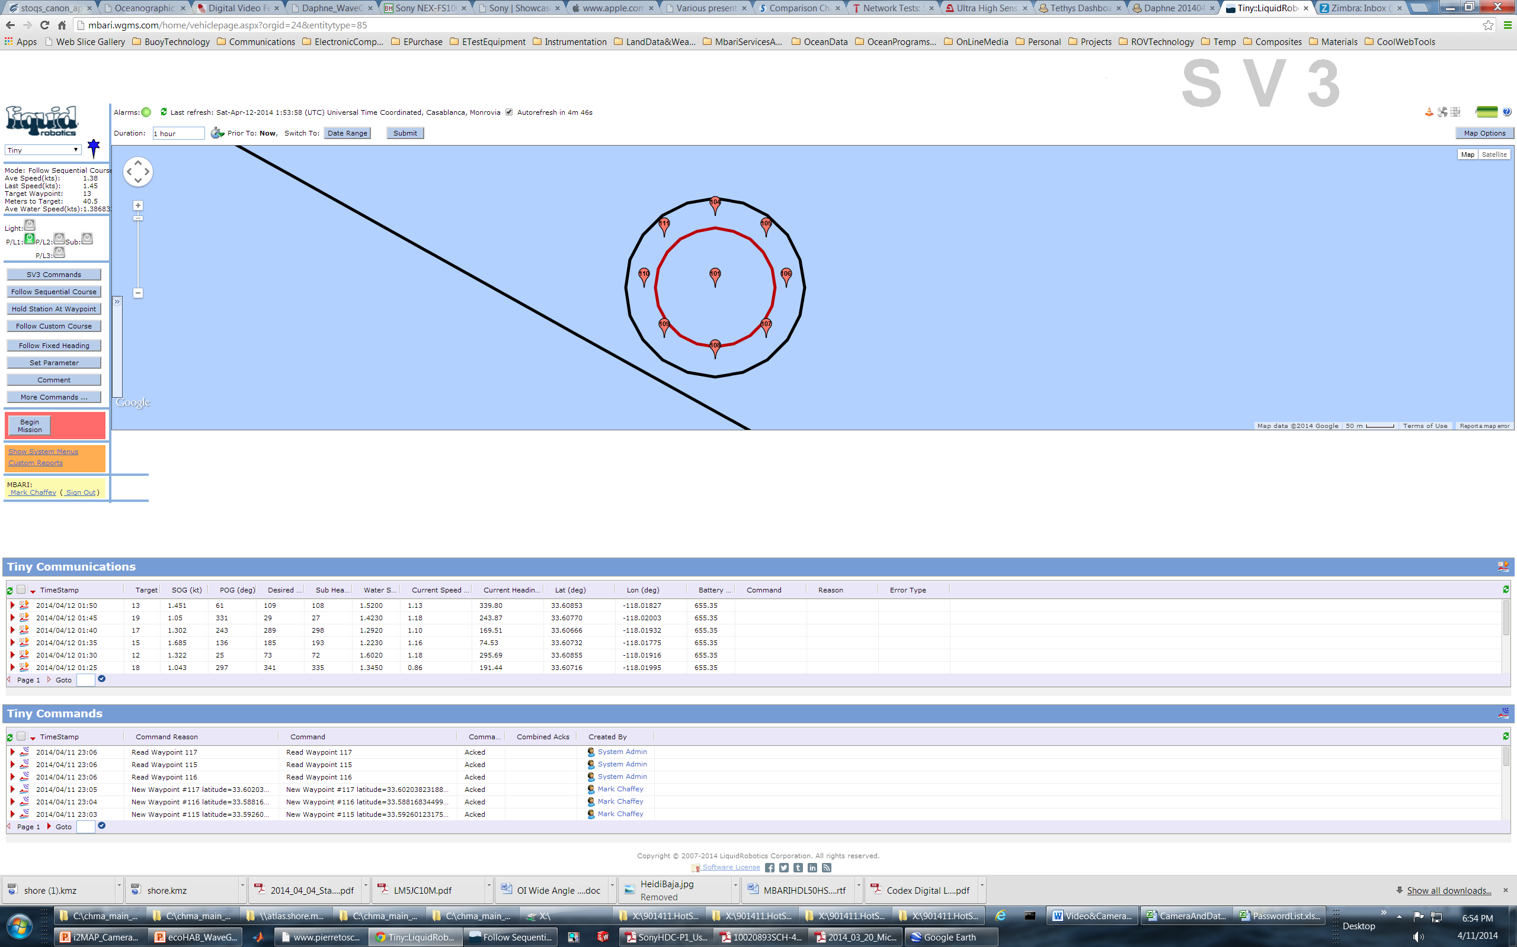
SW Circle
ESP BRUCE

Slide 8
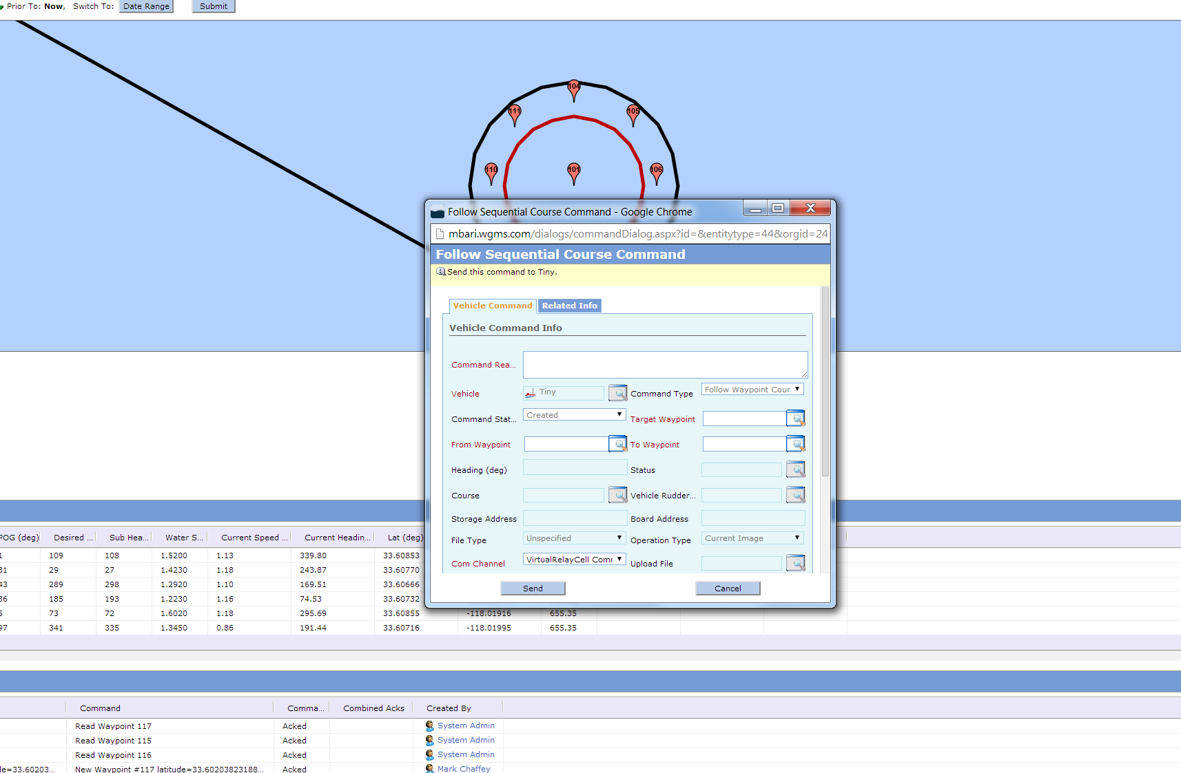
Follow Sequential Course Command

