Slide 1
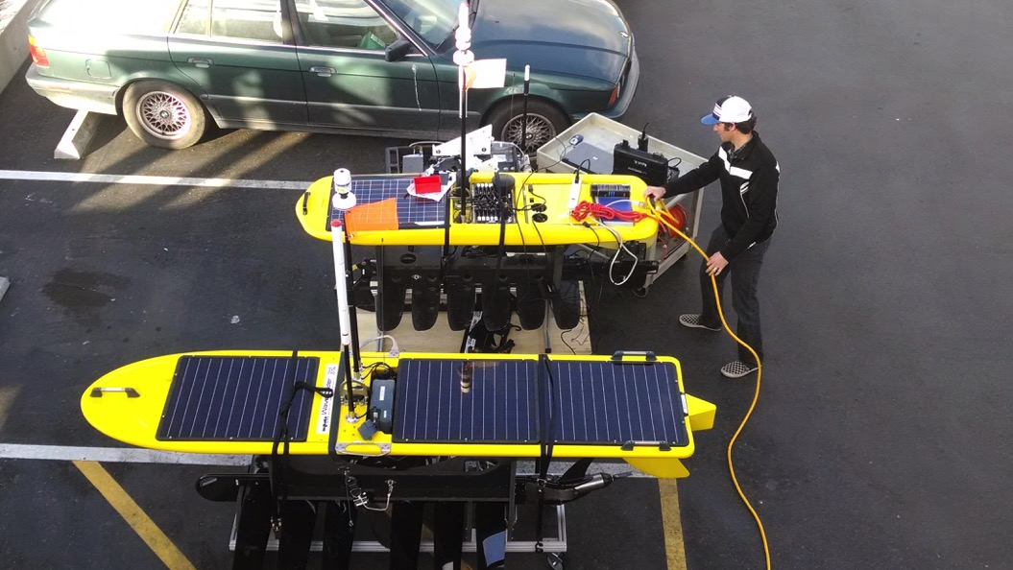
MBARI Wave Glider “Hot Spot” applications
Tom O’Reilly and Brian Kieft

Slide 2
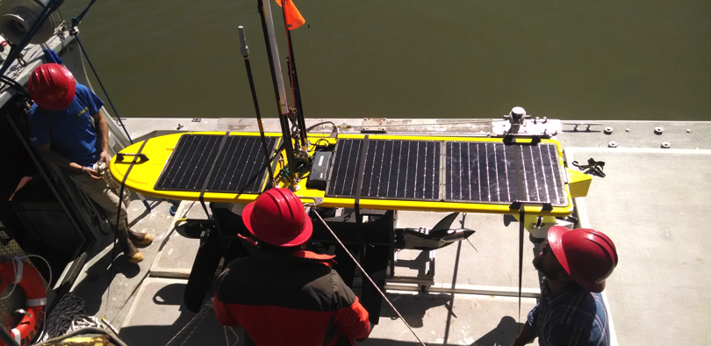
Hot Spot payload
Relay data between autonomous sensor platforms, shore; geolocate/track assets, features
Acoustic modem, directional acoustic transponder
Cellular, satellite, WiFi, 900 MHz, antennas – distinct from Wave Glider “core” radios
Application software on SMC
Inspired by work of Rajan, Borges de Sousa, Pinto, Martins et al (University of Porto LSTS)

Slide 3
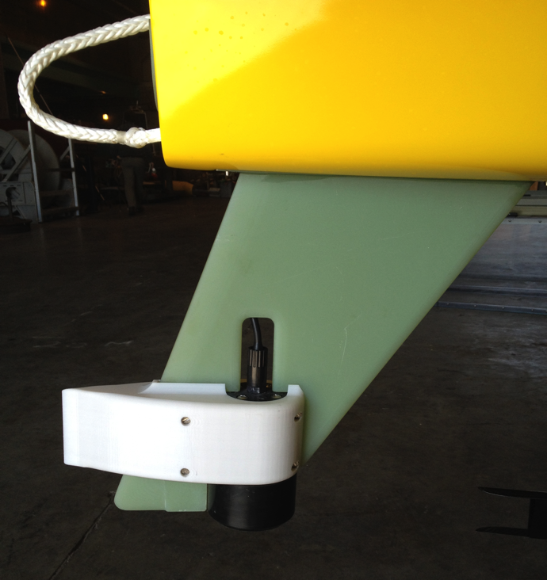
Hot Spot Acoustics
Acoustic modem – range, data exchange
Directional Acoustic Transponder (DAT) – bearing/range/elev
Target (e.g. AUV) carries acoustic modem or DAT

Slide 4
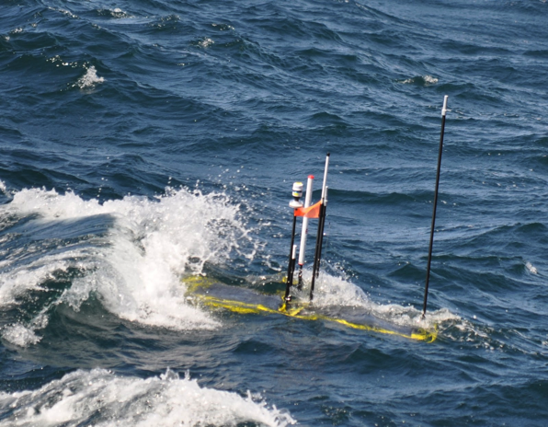
Hot Spot radios
Line-of-sight to AUV
  802.11 Wifi (Ubiquiti)
  900 MHz (Freewave)
Link to shore
  Cell modem (coastal regions)
  Globalstar satellite (coastal, some open ocean)
  Iridium satellite (world-wide)
Notes:
Console capaibilty; through ssh (cell, Globalstar) or Iridium console

Slide 5
Cell signal strength at Hot Spot

Slide 6
Hot Spot applications
Gateway console applications
  User ssh/dial-in to Hot Spot via satellite or cell, then connect to asset via RF or acoustic
  Data retrieval, trouble-shooting, reconfiguration...
Autonomous applications
  Acoustic geolocation
  AUV navigation, target tracking/stalking
  AUV command/telemetry relay

Slide 7

Hot Spot gateway console
AUV on surface
AUV, benthic instruments
Notes:
User logs into Hot Spot via cell or satellite, then accesses onboard RF or acoustic interfaces to connect with vehicles/instruments, get status, other data. Real-time interaction with assets anywhere on Earth. No ship needed

Slide 8
Autonomous navigation apps
Offboard (from shore)
  Invoke LR wcs script to send WG commands
Onboard (from SMC)
  Send commands to CCU through LR interface
Applications:
  Geolocate, follow vehicles/instruments
  Adaptive sampling, front detection
Notes:
Autonomous navigation apps eliminate need for continuous human control through WGMS. Offboard commanding is subject to WGMS latency.

Slide 9
Autonomous onboard navigation apps
Requires Regulus, Python, Java on SMC
Issue gotoWatch() command to CCU through CORBA interface
  CCU ship avoidance supercedes navigation commands
Issue alarms/events, any other WG command to CCU as appropriate
Commands reflected in wgms ‘commands history’
Notes:
Can issue ANY wave glider command to the CCU

Slide 10
Hot Spot “stalking” algorithm
GPS
GPS loc
Hot Spot SMC
Main vehicle
computer
application
Nav cmd
“Black box”
DAT
rudder
Get target bearing/range/elev from DAT
Compute target lat/lon, depth
If target location is “safe”, command vehicle to circle target
Repeat every n seconds
Notes:
Compute target lat/lon from bearing/range (DAT) and Wave Glider lat/lon (GPS)

Slide 11

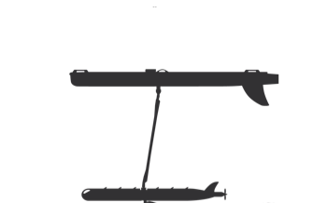
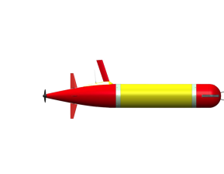
Chase application:
Lagrangian drift sampling
R/V Rachel Carson
Wave Glider
Profiler
Drifter
Notes:
Drifter LRAUV moves with current, servos to thermocline or other depth surface using variable buoyancy system. Wave Glider and profiler LRAUV acoustically determine drifter LRAUV location and circle it. All three vehicles carry science sensors (CTD, fluorescence, backscatter, dissolved oxygen). Crewed ship periodically visits to take water samples for genomic/microscopic/isotopic analysis, uses Wave Glider surface location to easily locate the volume to be sampled.

Slide 12
Lagrangian drift sampling:
October 2014
Wave Glider autonomously chased drifter for 48 hours
drifting AUV at thermocline
WG, following drifting AUV
profiling AUV
1000 m
Notes:
RV Rachel Carson able to easily locate Wave Glider. Acoustic track shows small wiggles which are artifacts – note that we don’t yet account for offsets between DAT, compass, GPS
Autonomous navigation saved operational cost – no need for operator to continually issue commands through WGMS interface
Last Fall navigation commands were issued automatically from on shore following receipt of target location from WG cell; now they issued directly from the Hot Spot payload to the main vehicle computer.

Slide 13
Range-only geolocation
Advantages
  Acoustic modem; relatively cheap, simple gear
Limitations
  Multiple range measurements, energy, time needed
  Best accuracy for stationary/slow targets
Notes:
In collaboration with Ivan Masmitja, Joaquin del Rio at Polytecnic University of Catalunya

Slide 14
Test2
Benthic Rover
Station M, 4000 m depth
Crawl speed: ~3 m/day
Acoustic modem
Test1
Masmitja, Kieft, Gomariz, del Rio, O’Reilly
Session 212
Marriot Santa Barbara room
Tuesday 3:30-5:00 pm
WG Hot Spot application
Navigates WG in specified pattern centered on specified point
Acquires acoustic target range at specified interval
Computes target location (x, y, z)
Notes:
Need to periodically check Rover status, position via acoustic modem link.
Previously used crewed ship – costing several days
Now using Wave Glider Hot Spot

Slide 15
Disruption tolerant ‘data mule’
Hot Spot automatic store-and-forward data between vehicles, shore
rsync file-transfer protocol
  It’s everywhere; very robust implementations
  Very efficient “delta-transfer” algorithm
  Disruption-tolerant; transfer resumes where it left off
  Requires TCP/IP link
Notes:
Rsync is included with most Linux distributions – no need to install

Slide 16
Hot Spot store-and-forward exchange using rsync
SHORE
Cellular
HOT SPOT
incoming
802.11
outgoing
incoming
cache
outgoing
Pull outgoing files from AUV into cache

Slide 17
Hot Spot store-and-forward exchange using rsync
SHORE
Cellular
HOT SPOT
incoming
802.11
outgoing
incoming
cache
outgoing
Pull outgoing files from shore into cache
Push cached files destined for AUV

Slide 18
Hot Spot store-and-forward exchange using rsync
SHORE
Cellular
HOT SPOT
incoming
outgoing
cache
Push cached files destined for shore
Notes:
If RF link breaks mid-transfer, rsync will pick up where it left off on next attempt. If destination link not available, rsync will try later; Hot Spot is store-and-forward/data-mule.
Only differences between source and destination are transferred; so if ‘n’ bytes are added to an N-byte file between retrievals, only ‘n’ bytes are transferred

Slide 19
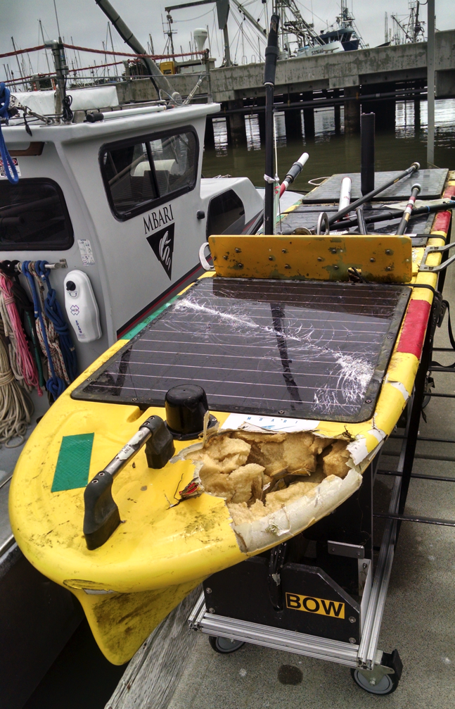
Collision
WG running tests for several days, 3 km from harbor mouth
Light, radar target enhancer on
Ship AIS avoidance enabled
Hit by object not carrying AIS
  15:00 local time – daylight
  Cracked solar panels, broken antennas/masts, float damage

Slide 20
Collision
Smoke from Big Sur fire limited visibility to few hundred meters
Hot Spot onboard autonomous navigation was running, but ship avoidance was enabled, no AIS signal detected
Repairs cost $14K, 33 days – but collision occurred after 380 sea days, 20,000 km
Lessons:
  Spending time near harbor mouth may increase risk
  Significant risk from non-AIS vessels

Slide 21
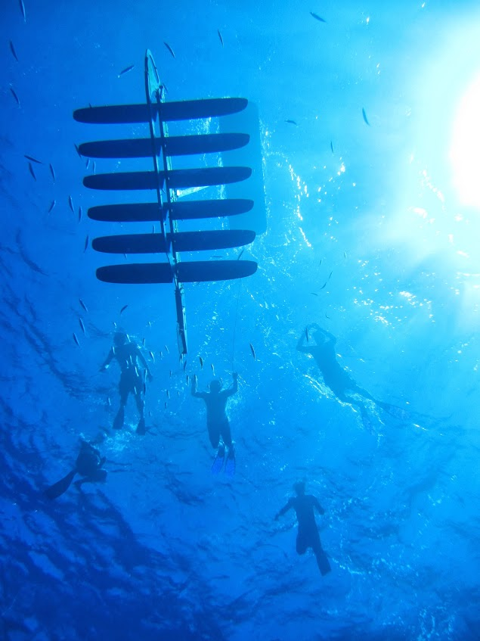
Questions?

