Slide 1
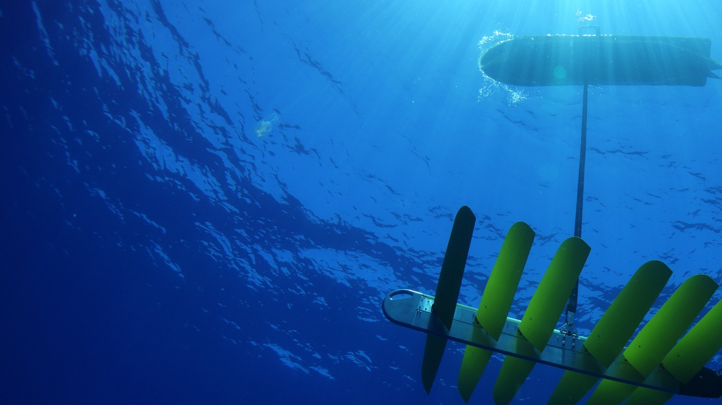
Next Generation Oceanographic Research – Robots Talking to Robots
Date
www.liquid-robotics.com

Slide 2
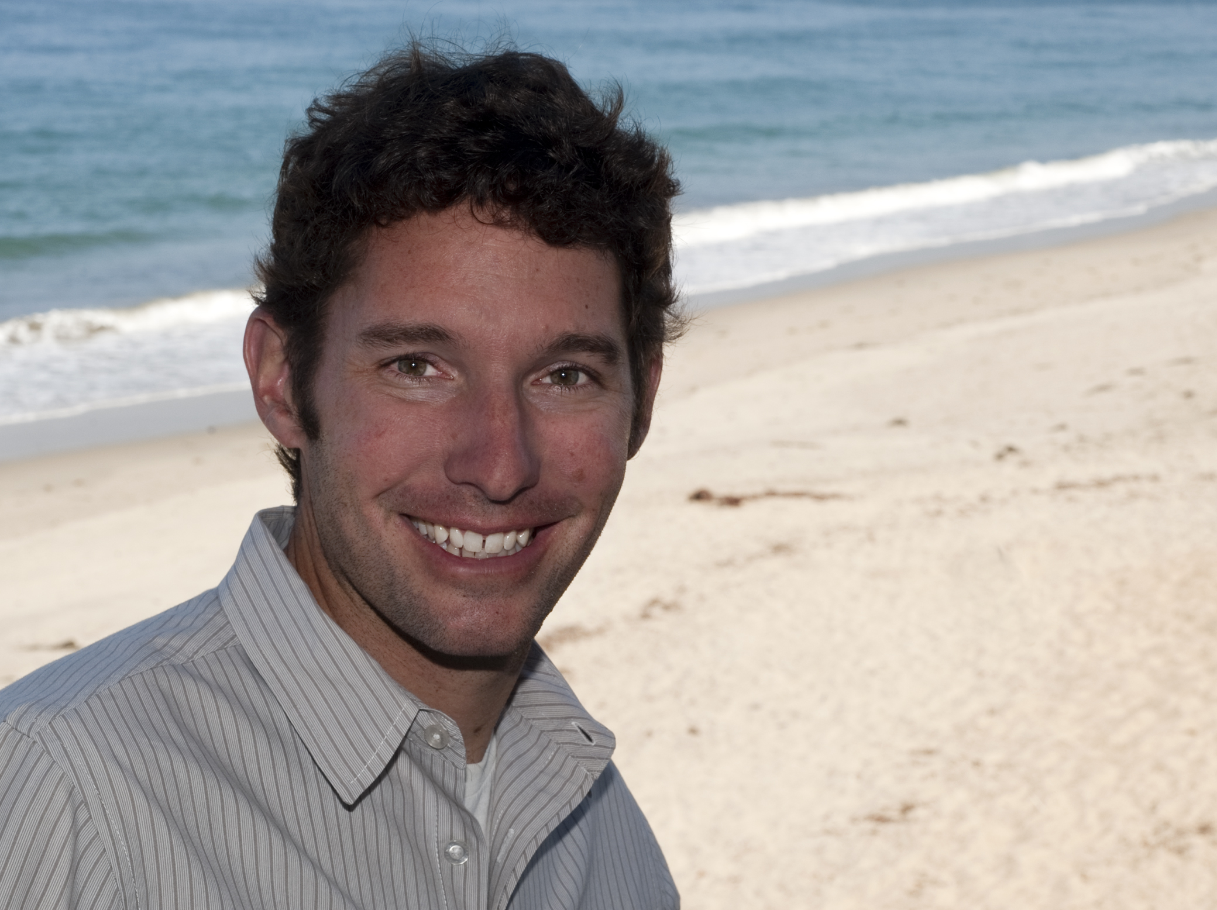
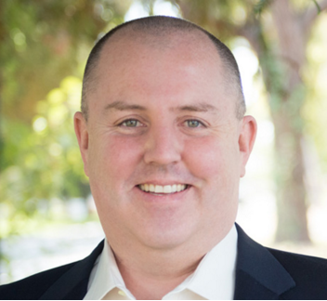
Speakers
Monterey Bay Research Institute (MBARI)
Liquid Robotics
Brian Kieft
Software Engineer
Graham Hine
Co-founder, Sr. Vice President Global Partner Development

Slide 3
Agenda
Wave Glider Background
Monterey Bay Research Institute (MBARI)
Applications for Wave Gliders at MBARI
Robots Talking To Robots
  How It works
  Application Details
What’s Next
Questions & Answers
Notes:
Wave Glider Platform - 1 page
MBARI Use of Wave Glide

Slide 4
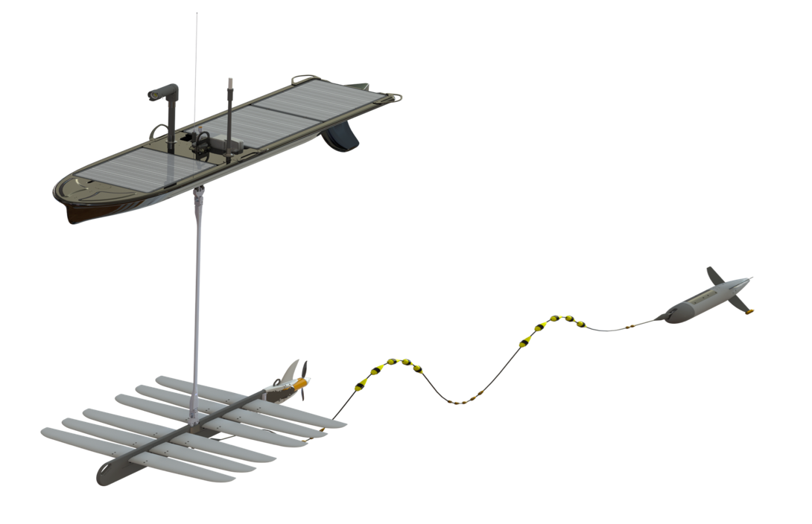
Wave Glider
An Unmanned Surface Vehicle (USV) powered by waves and sun
24x7 Long-Duration Operations
Persistence and mobility
Proven At Sea
Over 1M nautical miles
Real-Time Communications Gateway
From sea floor to space
Lower Risks & Costs
Lower TCO while keeping people out of harm’s way
Open & Extensible
Open architecture for sensor integration
Notes:
24x7 Long Duration Operations - -Station keeping or mobile data collection for up to 12 months with no
fuel, emission, or crew
Proven at Sea - Over 1M nautical miles to date. Successful operations from doldrums to hurricanes/typhones
Real-Time Communications from Sea Floor to Space - Provides immediate situational awareness and accelerated decision making.
Lower Risks and Costs - Do more with less while keeping people out of harm’s way
Open & Extensible ”Open Architecture” – standards based software – no other licensing agreement to integrate sensor
Scale - Integrate and operate with other systems - Add new sensors and software capabilities

Slide 5
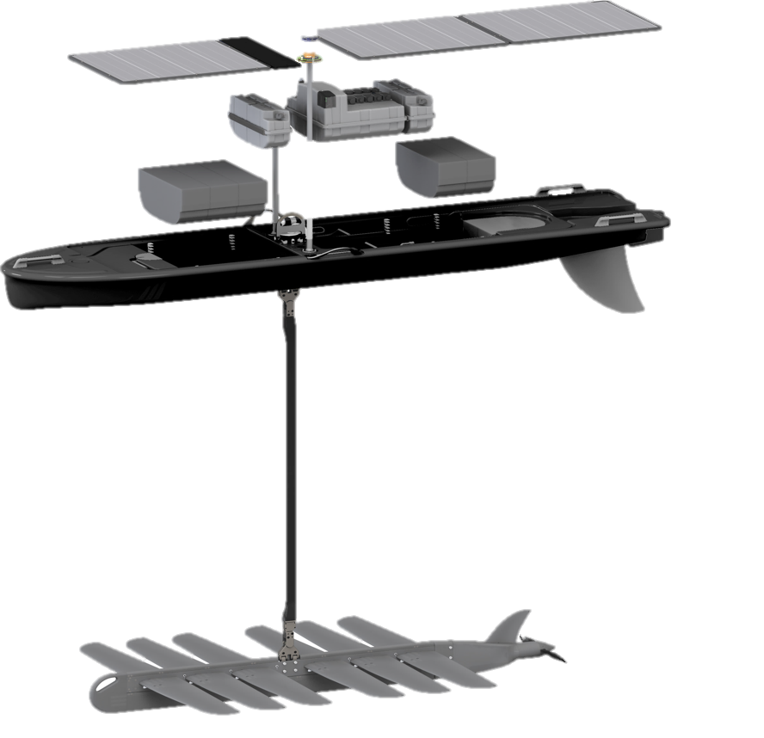
What Is the Wave Glider
Power, Compute, Communications
Float
Umbilical
8M Umbilical (standard)
Sub

Slide 6
A Gateway to New Possibilities
From seafloor to shore, Wave Gliders are the essential link between information systems and decision makers.
Sensor
Platform
Perpetual
Power
Communications
Gateway
Built-in
Intelligence
Notes:
Critical sea-to-space communications gateway
Mobile, self-powered sensor platform can go with others can’t
Built-in intelligence enables autonomous operation, along with new mission possibilities.

Slide 7
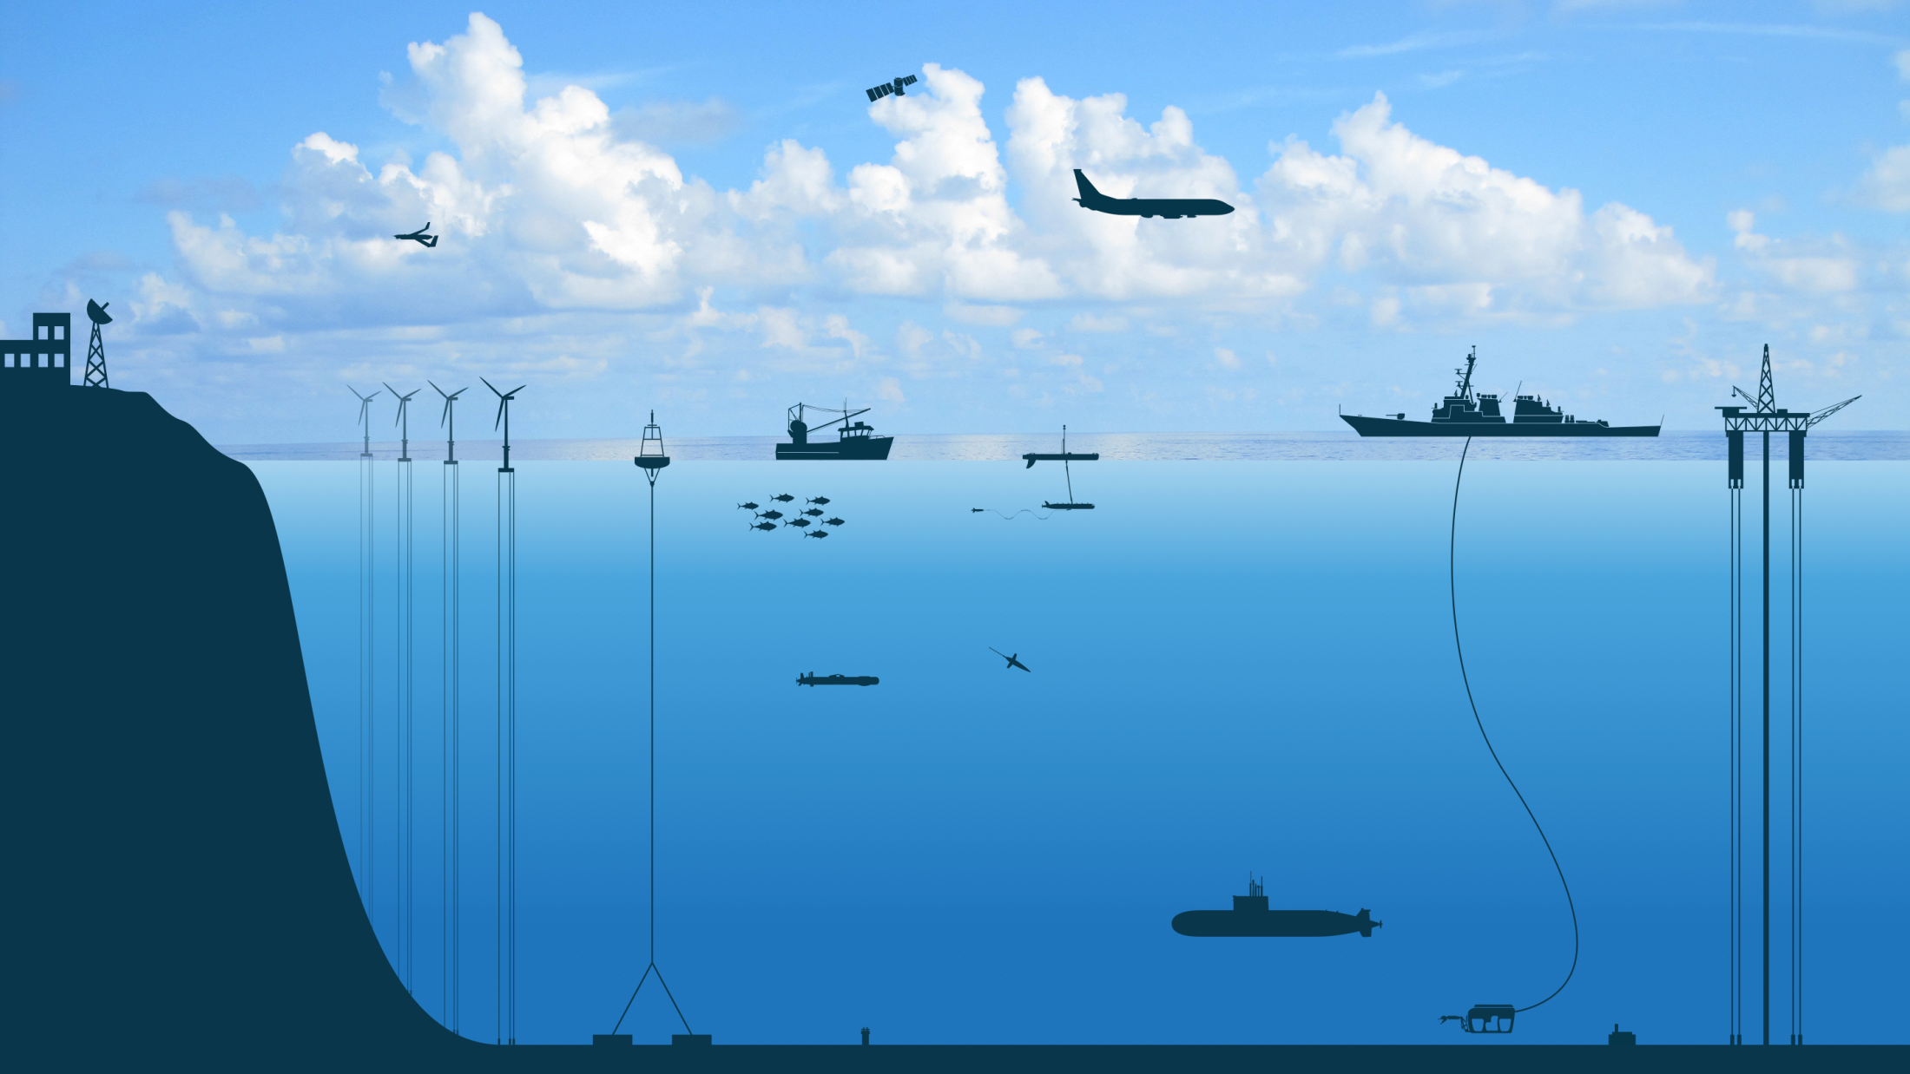
The Digital Ocean:
A System of Systems
Notes:
From the surface to seafloor, a vast array of equipment is being deployed to digitize the ocean’s data
This is transforming industry, defense, and the environment in much the same way that digital technology has done in terrestrial applications
The Digital Ocean is emerging all over the world. But to fully realize its promise, these systems need to be integrated together.
This requires partnership and collaboration among vendors, researchers, government organizations, and industry

Slide 8
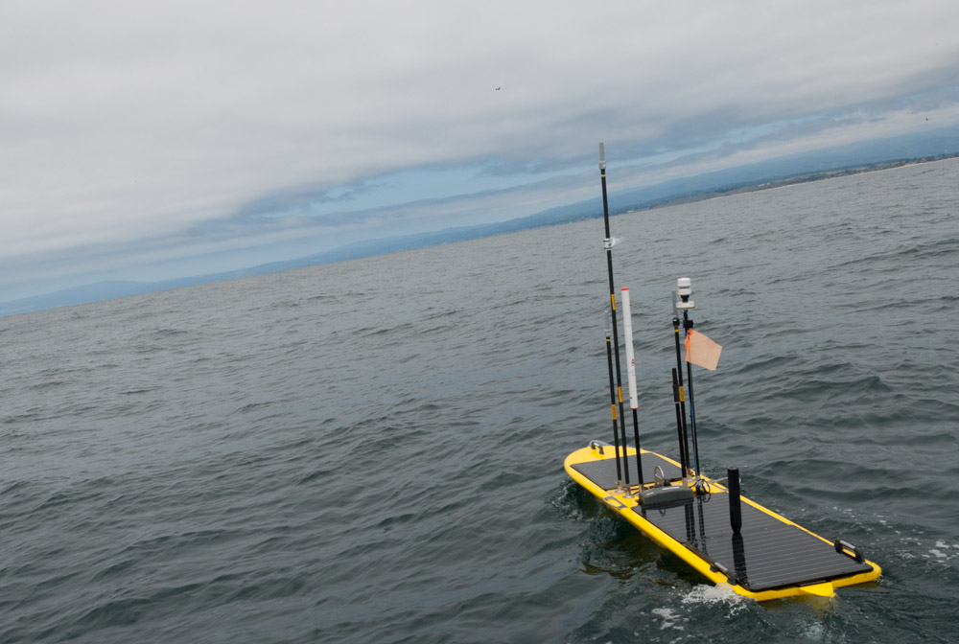

Monterey Bay Aquarium
Research Institute
Wave Glider Applications

Slide 9

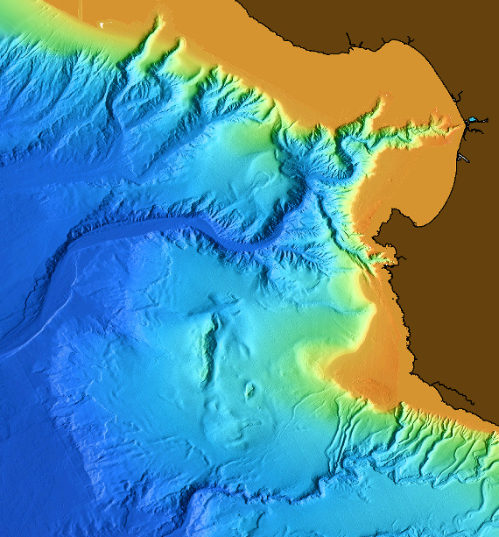
Monterey Bay Research Institute (MBARI) Background
A non-profit oceanographic research center - founded in 1987 by David Packard
A recognized center for advanced research and education in ocean science and technology
  Emphasis on the peer relationship between engineers and scientist as a basic principle of its operations
  Identify areas of marine science where research progress is limited by lack of appropriate technology
Key Research Themes
  Ocean Visualization
  Ecosystem Dynamics
  Ocean Biogeochemistry
  Exploration
Monterey Bay Canyon- plunges to 4000M

Slide 10
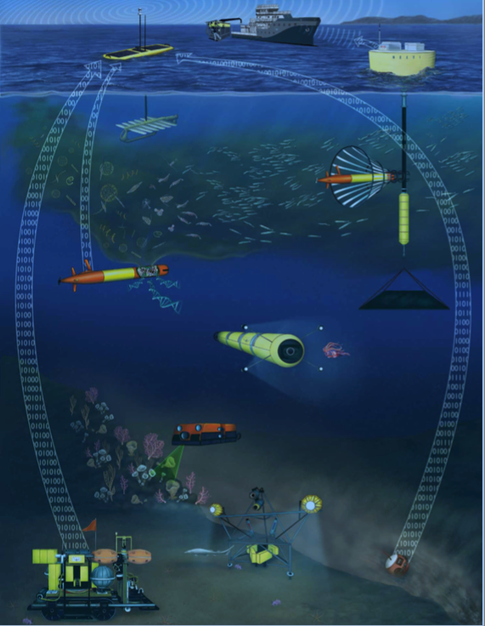
MBARI Uses a Range of Technologies To
Drive Research
Multi-year investment in multiple technologies to differentiate research
Technology investment examples include:
  A – Benthic Rover
  B – Time lapse camera
  C - Benthic event detector
  D – Conceptual AUV with LIDAR
  E – mid-water imaging AUV
  F – 3rd gen. Env. Sampling AUV
  G – Long range AUV
  H – Wave Glider (USV)
  I - Power Buoy
  J – AUV Docking System
H
I
J
F
G
E
D
A
B
C

Slide 11
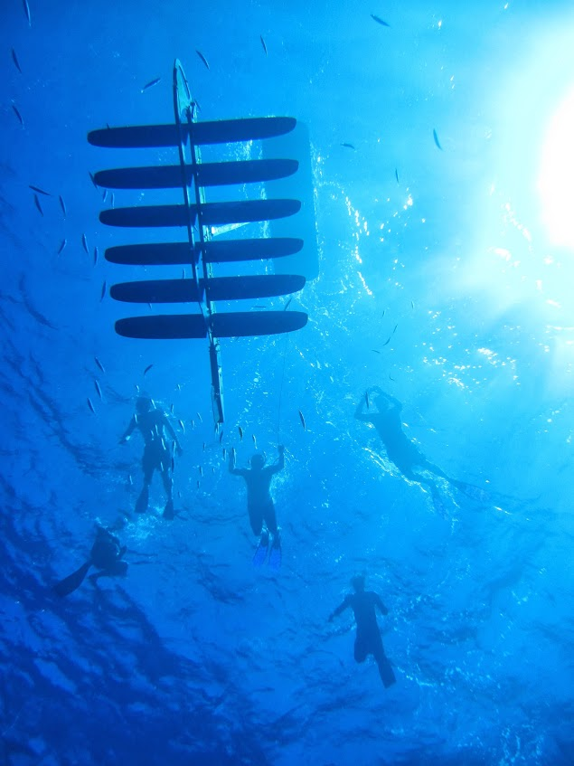
Wave Glider Applications At MBARI
Wave Glider Applications
  Acoustic location/tracking
    Autonomous Underwater Vehicle (AUV) chasing
    BED
    Benthic Rover
  Ocean acidification
  Radio relay
  Homing

Slide 12
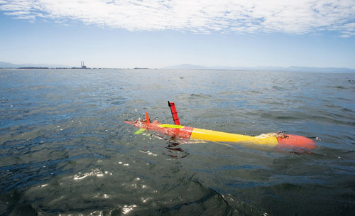
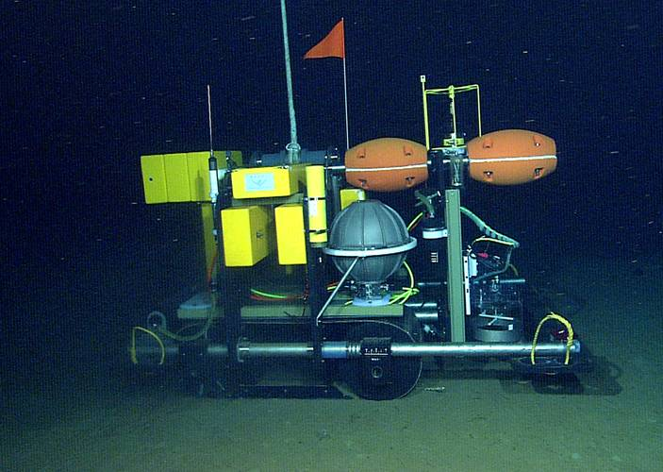
Wave Glider as Acoustic Hot Spot - Applications
WG chases submerged AUV
WG homes on, hovers over stationary target (e.g. benthic rover)
AUV homes on WG (e.g. for data transfer)
Long Range AUV (LRAUV)
Benthic Rover

Slide 13
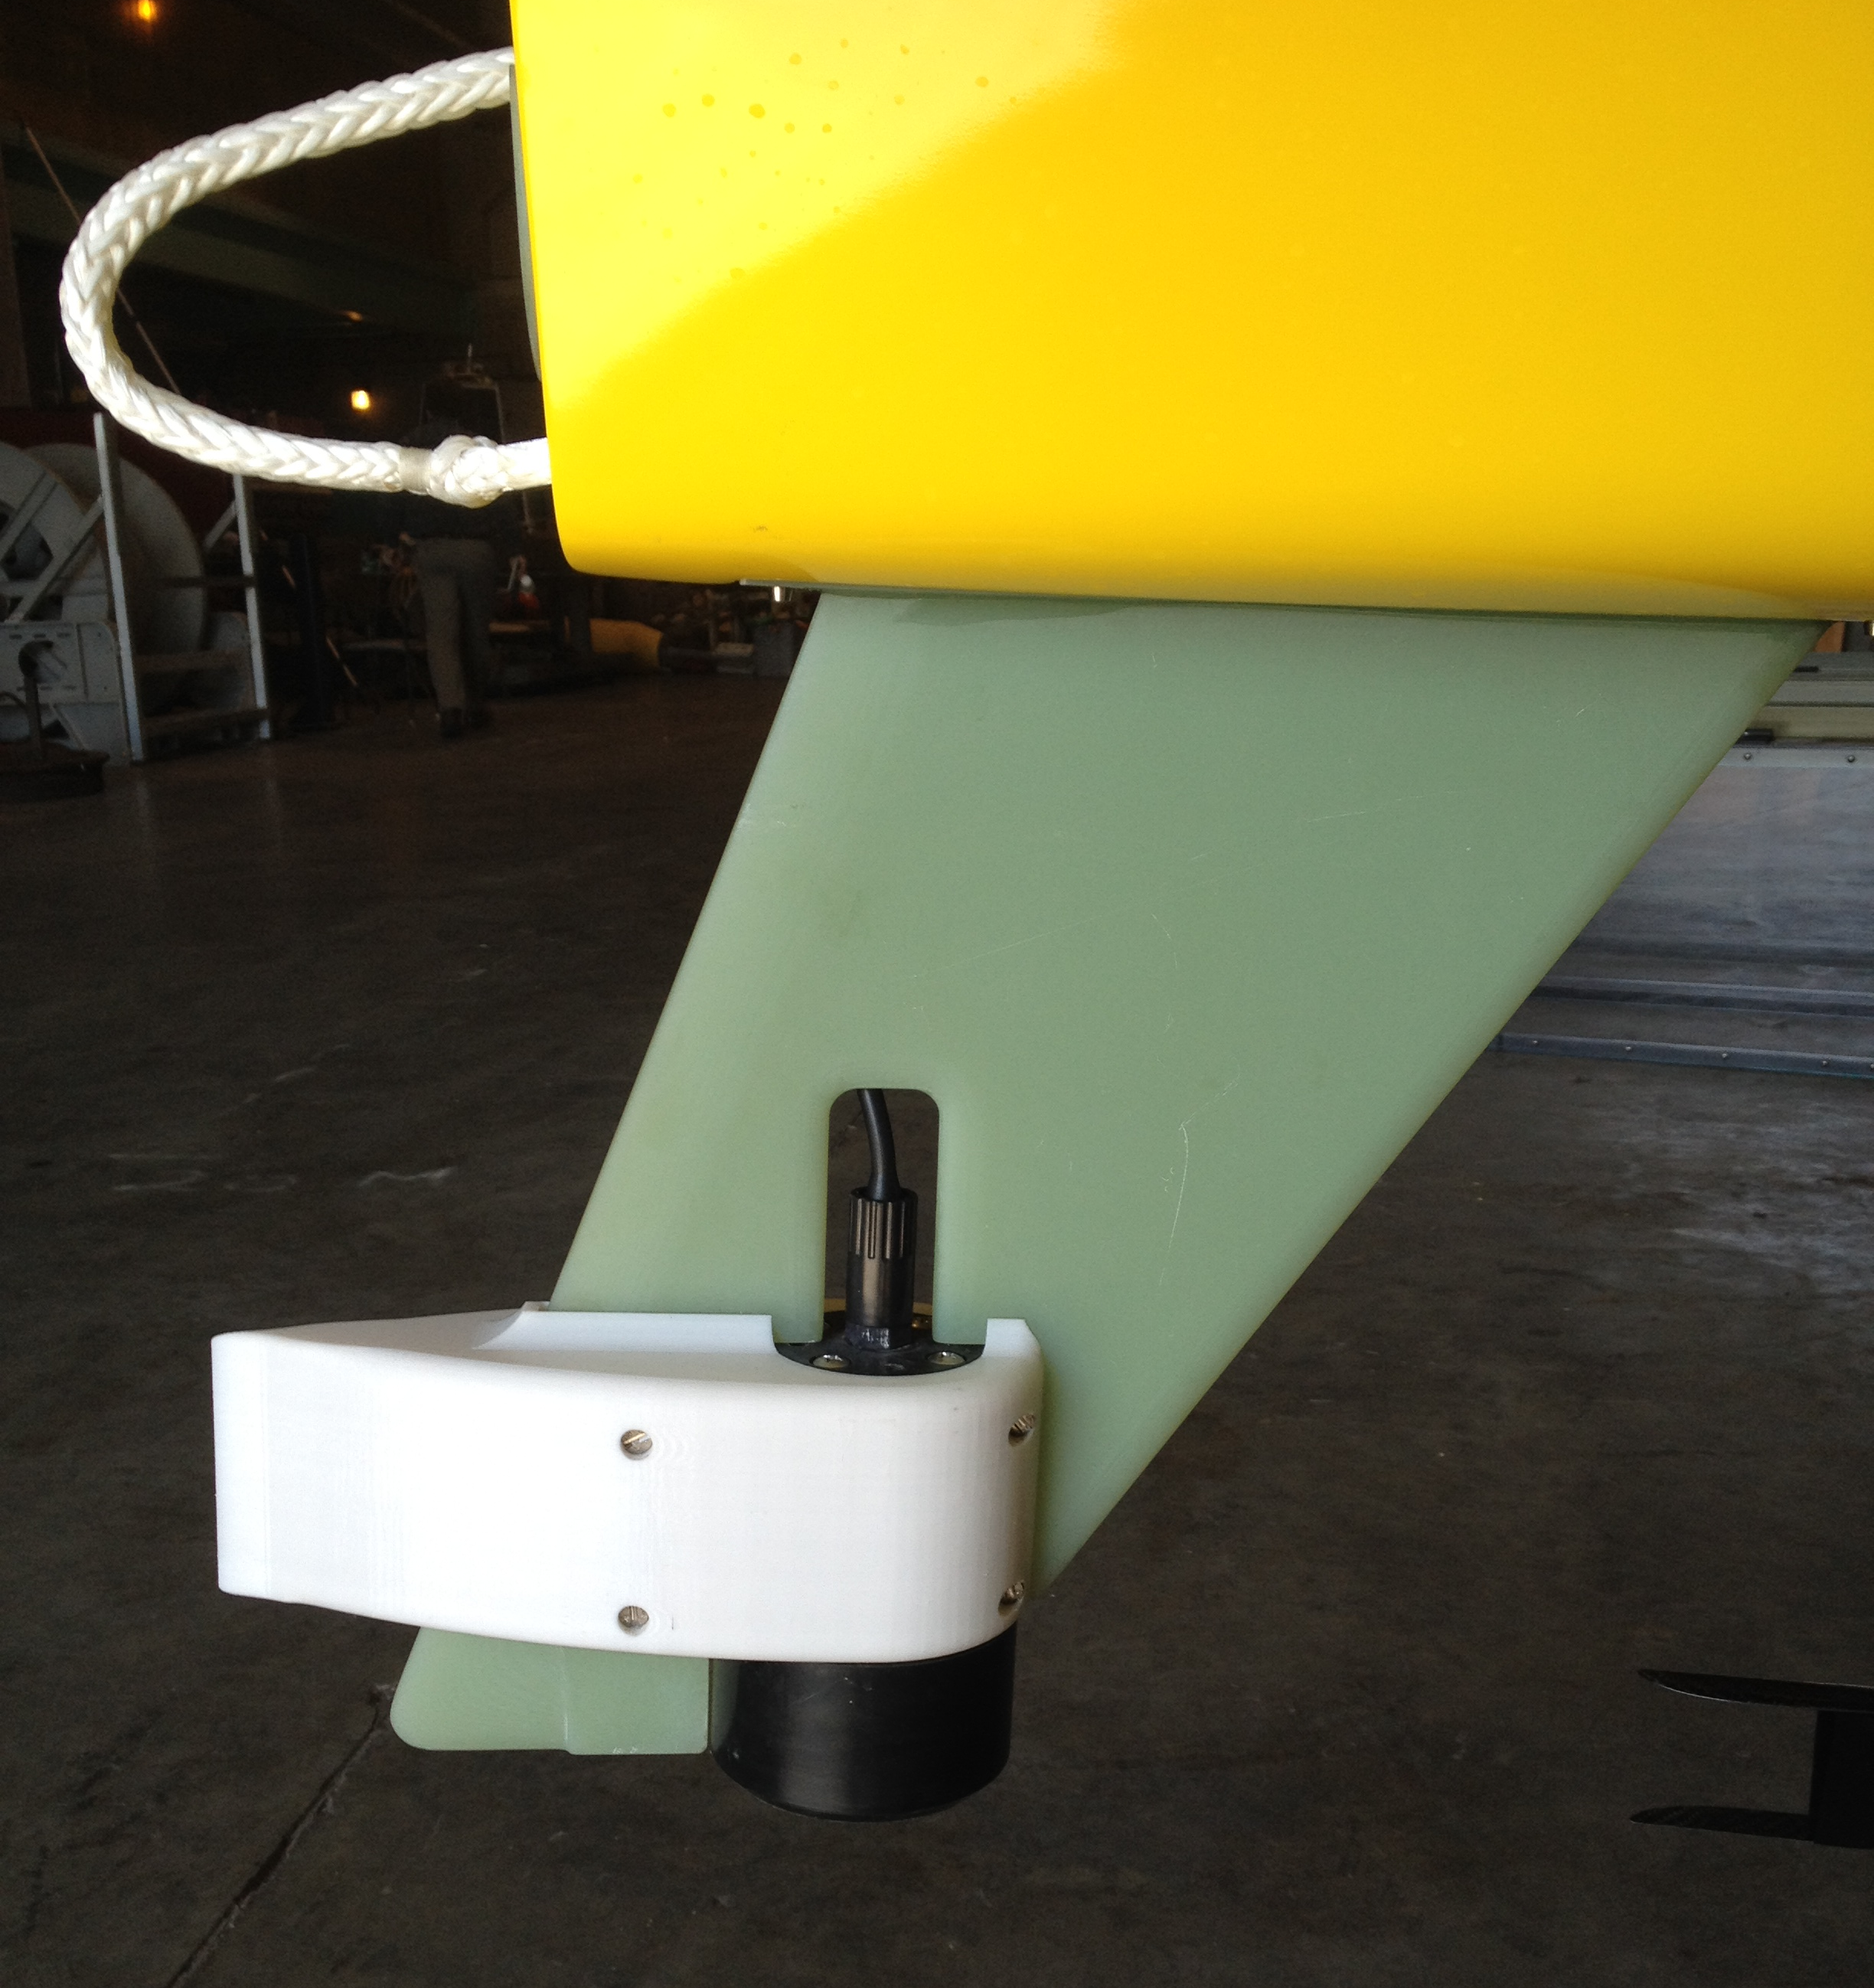
AUV Chasing with Wave Glider
How it works
  Directional Acoustic Transponder (DAT) mounted on Wave Glider skeg (see picture)
    Gives target range, bearing, elevation
  Target (e.g. AUV) carries acoustic modem or DAT
Notes:
Teledyne-Benthos makes the DAT, which is like a combined USBL-modem. We use the Medium Frequency devices (16-29 KHz), compromising range for smaller size (relative to the LF device). We see low acoustic noise levels on the Wave Glider – not an issue so far.
Have not encountered multipath problems yet.

Slide 14
Hot Spot “Chase” Algorithm
GPS
GPS loc
Hot Spot computer
Main vehicle
computer
Nav cmd
“Black box”
Rudder
DAT
Get target bearing/range/elev. from DAT
Compute target latitude/longitude
If target location is “safe”, command vehicle to circle target
Repeat every n seconds
Notes:
Compute target lat/lon from bearing/range (DAT) and Wave Glider lat/lon (GPS)

Slide 15
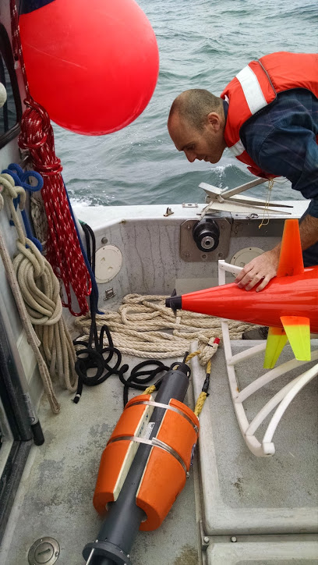
Target Practice
Moored acoustic modem 10m above sea floor, water depth 50m, known latitude / longtitude
Wave Glider Hot Spot “chases” modem,
circle r=100 m
Compare computed target location to actual

Slide 16
Acoustic vs. True Range to Stationary Target
This slide may be excluded
Notes:
WG computes target location for each acoustic response, issues nav command to center a 100 meter watch circle on that location. Gets new target location about once every 75 seconds. Most ranges in 60-153 meter range

Slide 17
Acoustic vs. True Bearing to Stationary Target
This slide may be excluded
50 m
Mean bearing error:26.2 deg
Notes:
Several bearing errors > 40 degrees. When measured from 100 meters; 30 deg bearing error -> 50 meters position error, 40 deg bearing error -> 64 meters position error

Slide 18

Remineralization During Phytoplankton Bloom
Characterize chemistry/biology within drifting water mass, esp. near thermocline
Continuously analyze water mass in situ with sensors on Wave Glider and AUVs
Visit water mass with crewed ship each day, collect water samples for lab analysis
Sample in
Lagrangian frame
Long Range AUV (LRAUV)

Slide 19

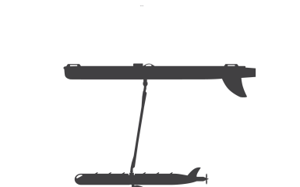
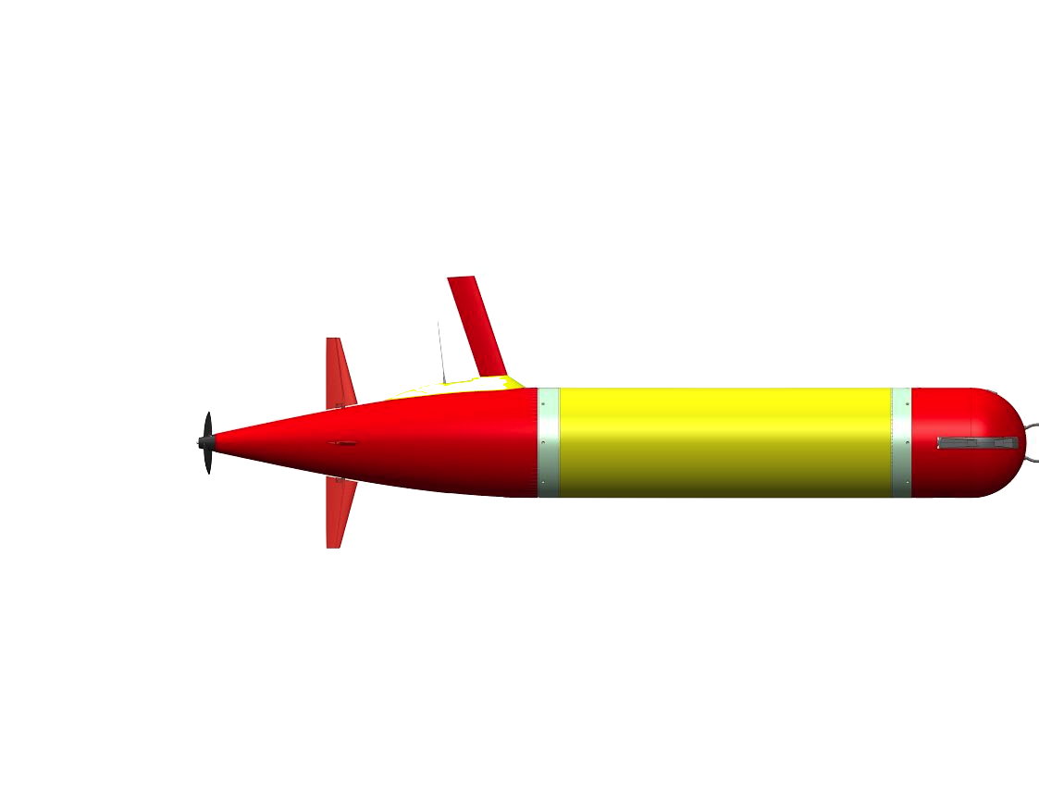
Chase Application: Lagrangian Drift Sampling
R/V Rachel Carson
Wave Glider
Profiler
Drifter
Notes:
Drifter LRAUV moves with current, servos to thermocline or other depth surface using variable buoyancy system. Wave Glider and profiler LRAUV acoustically determine drifter LRAUV location and circle it. All three vehicles carry science sensors (CTD, fluorescence, backscatter, dissolved oxygen). Crewed ship periodically visits to take water samples for genomic/microscopic/isotopic analysis, uses Wave Glider surface location to easily locate the volume to be sampled.

Slide 20
Lagrangian Drift Sampling: October 2014
Wave Glider autonomously chased drifter for 48 hours
Drifting AUV at thermocline
WG, following drifting AUV
Profiling AUV
1000 m
Notes:
RV Rachel Carson able to easily locate Wave Glider. Acoustic track shows small wiggles which are artifacts – note that we don’t yet account for offsets between DAT, compass, GPS
Autonomous navigation saved operational cost – no need for operator to continually issue commands through WGMS interface
Last Fall navigation commands were issued automatically from on shore following receipt of target location from WG cell; now they issued directly from the Hot Spot payload to the main vehicle computer.

Slide 21
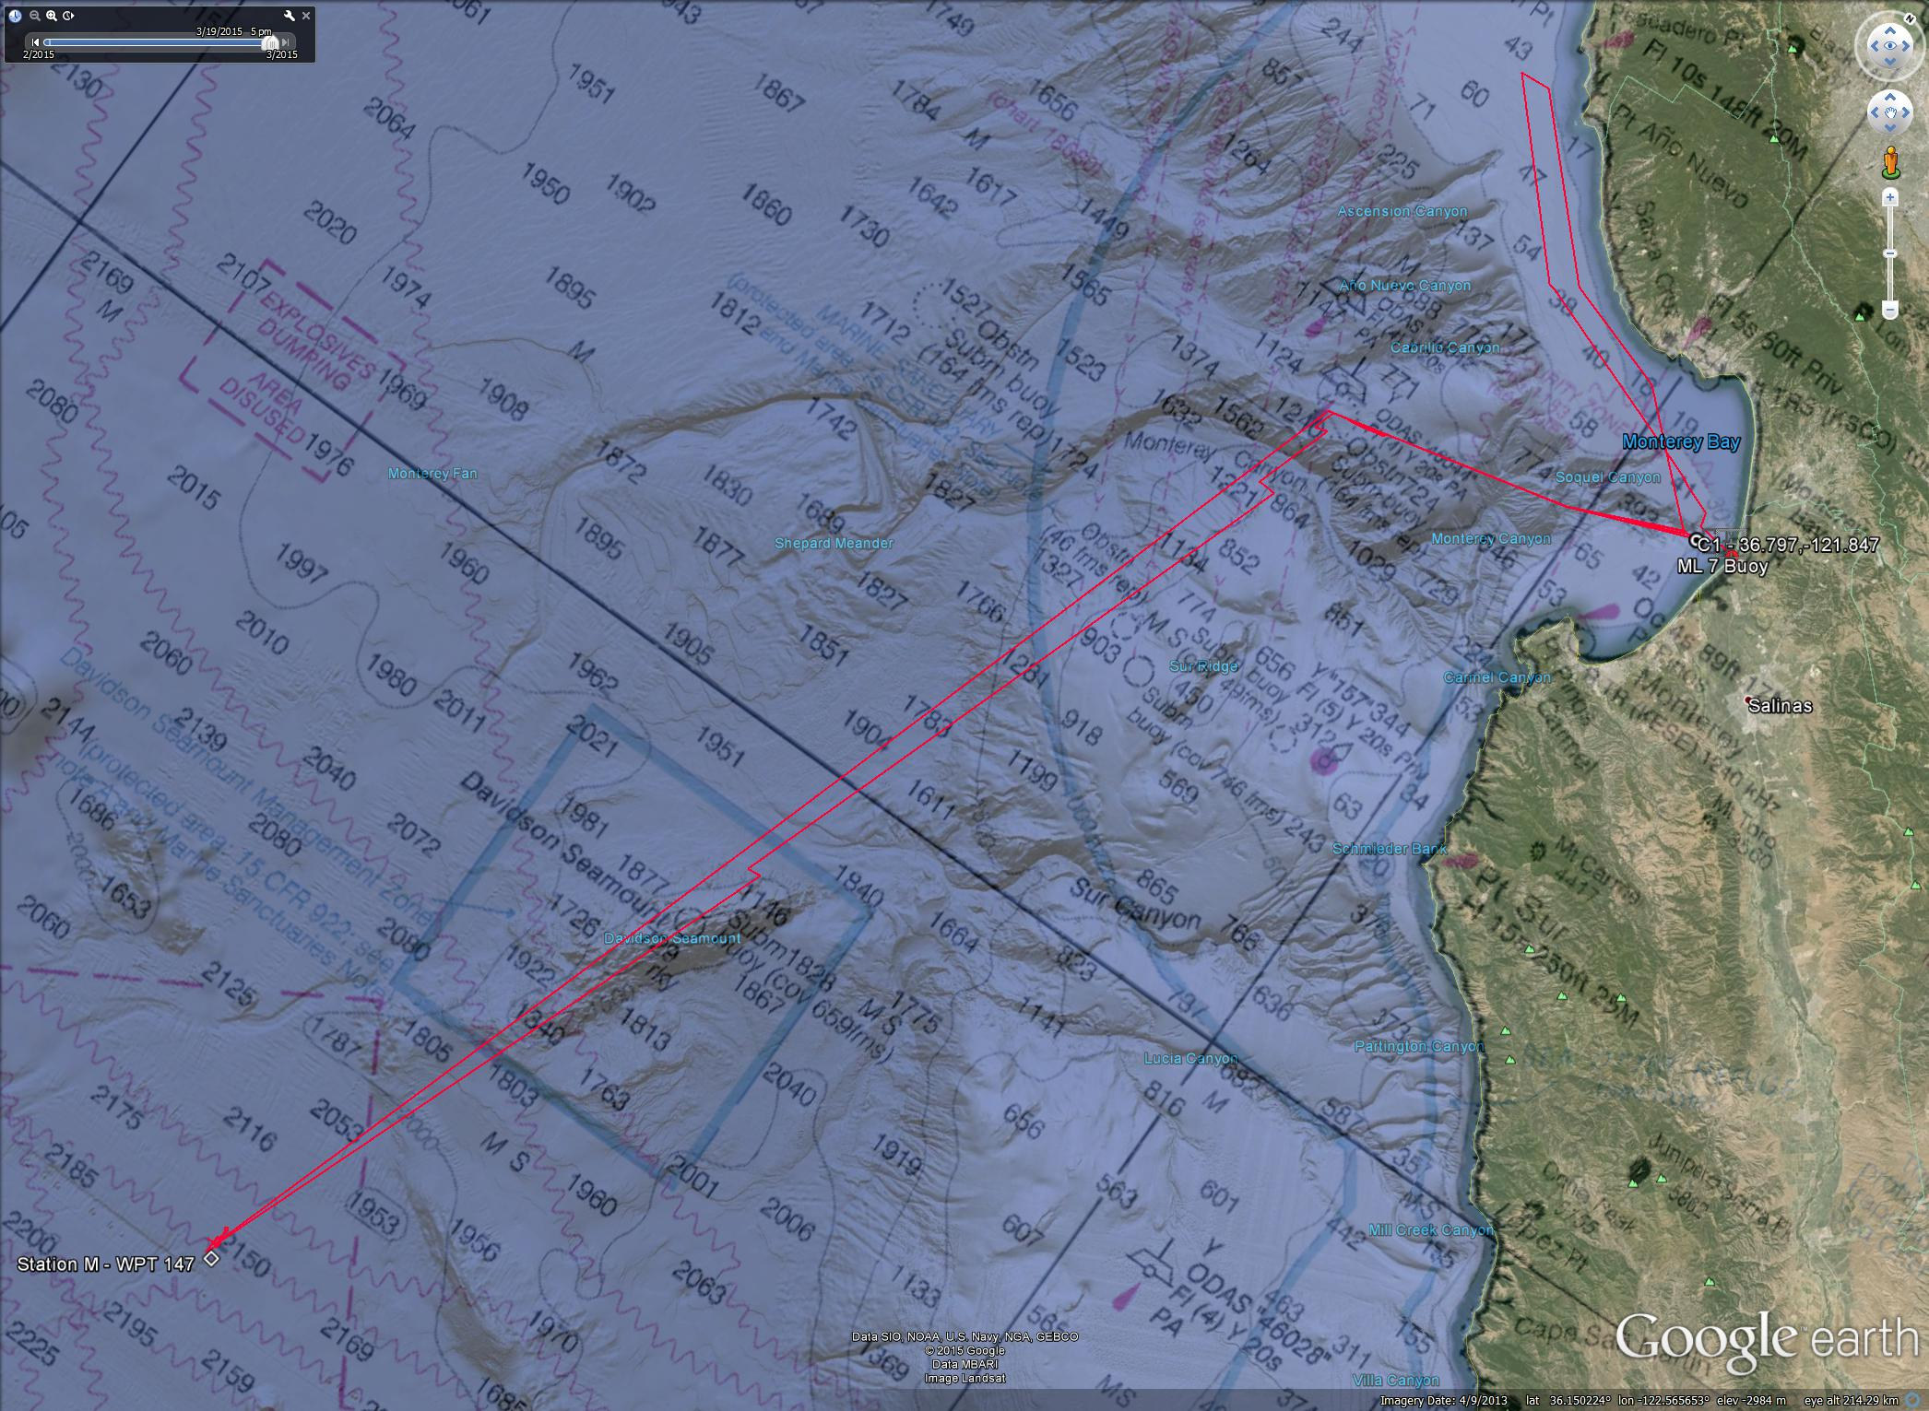
Rover Location at Station M
Business and Scientific Value
  Proof of asset health
How It Works
  No DAT on WG, LF modem
    Slant-ranges
    Least squares fit
Data Transfer
  Limited bandwidth (100s bits/sec)

Slide 22
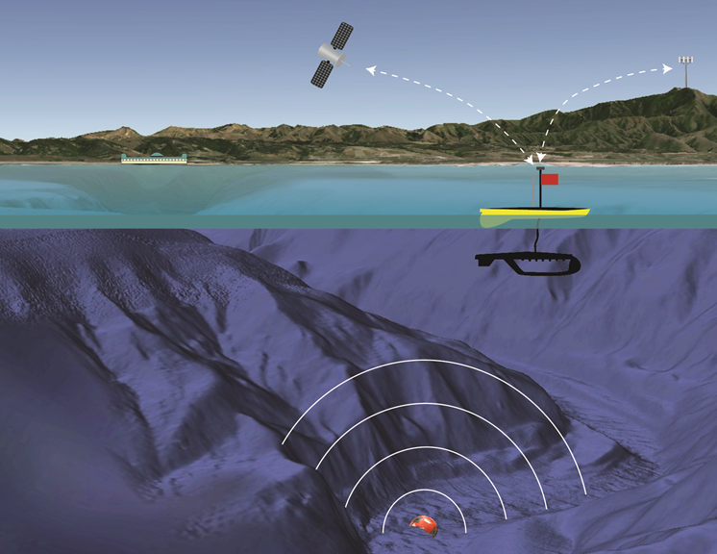
Benthic Event Detector Application
Benthic Event Detector
  Logs sediment debris flows (accelerometer)
  Buried in sea-floor
  Data retrieval via acoustic
Future
  USBL geolocation of BEDs (currently done with small boat)

Slide 23
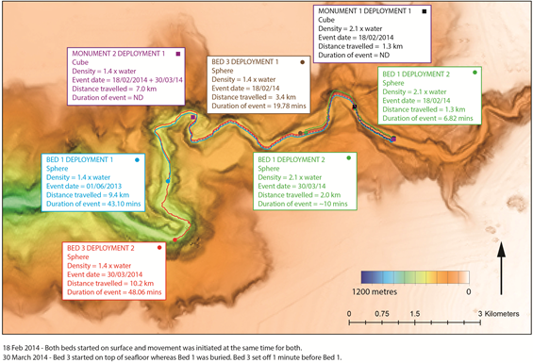
BED Data Relay

Slide 24
What’s Next at MBARI
AUV Docking with Wave Glider
Echo sounder
Fish tag tracking
AUV tow out, event response
Docking
CTD casts

Slide 25



Leading Oceanographic Institutes Use Wave Gliders to Advance Science in New Ways

Slide 26
Benefits of Using Wave Gliders
Connect and coordinate subsea assets – Real-time gateway that enables coordinated robot activity
Lower risk and costs – Proven over 1M miles at sea - across a range of environments
Increase temporal & spatial observations – 24x7 long duration operations
Multi-mission platform – Developer program, global integrators, and a community of customers
Improve boat usage – Replace boat time with unmanned systems
Use either 25 or 26

Slide 27
Benefits of Using Wave Gliders
Use either 25 or 26
Communications
Gateway
Sensor
Platform
Perpetual
Power
Built-in
Intelligence
Enables coordinated robot activity (subsea & surface)
Use existing sensors or customize new payloads
Long duration missions without the need for a boat
Precise navigation, autonomous operations, on-board compute

Slide 28
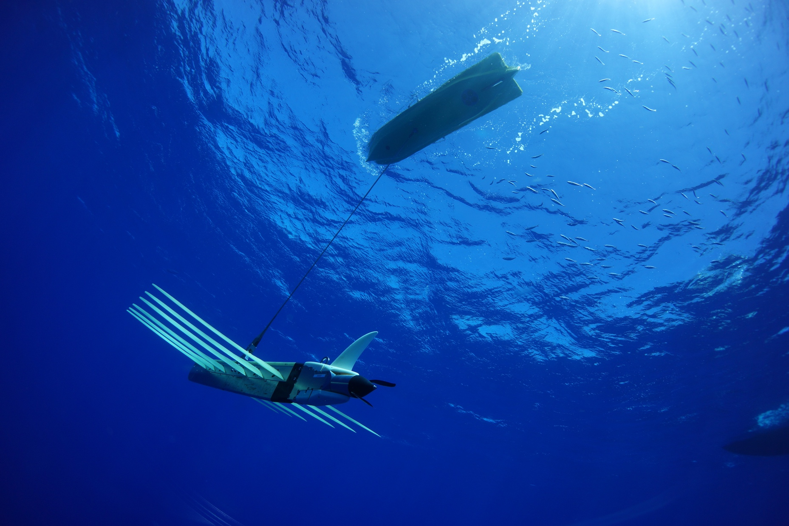
Wave Glider Accomplishments
9
Technology Readiness Level
17
Hurricanes navigated
50+
Sensors integrated
350+
Vehicles manufactured
9,380
Longest single mission (NM)
27,000+
Total days at sea
1,222,634+
Nautical Miles traveled (to-date)
125,500,754
Ocean measurements (to-date)

Slide 29
Questions & Answers
For further questions contact us at:
info@liquid-robotics.com
@LiquidRobotics

Slide 30
Appendix

Slide 31


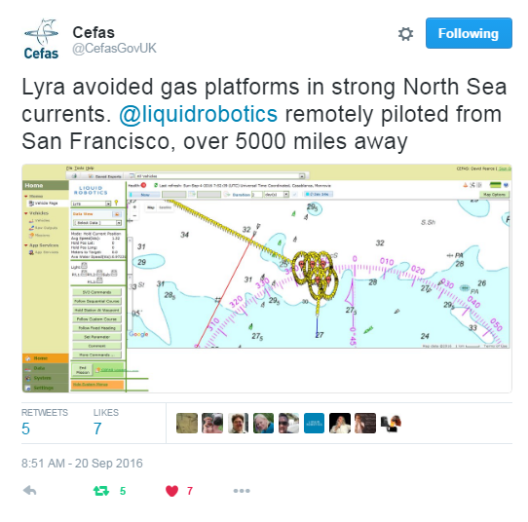
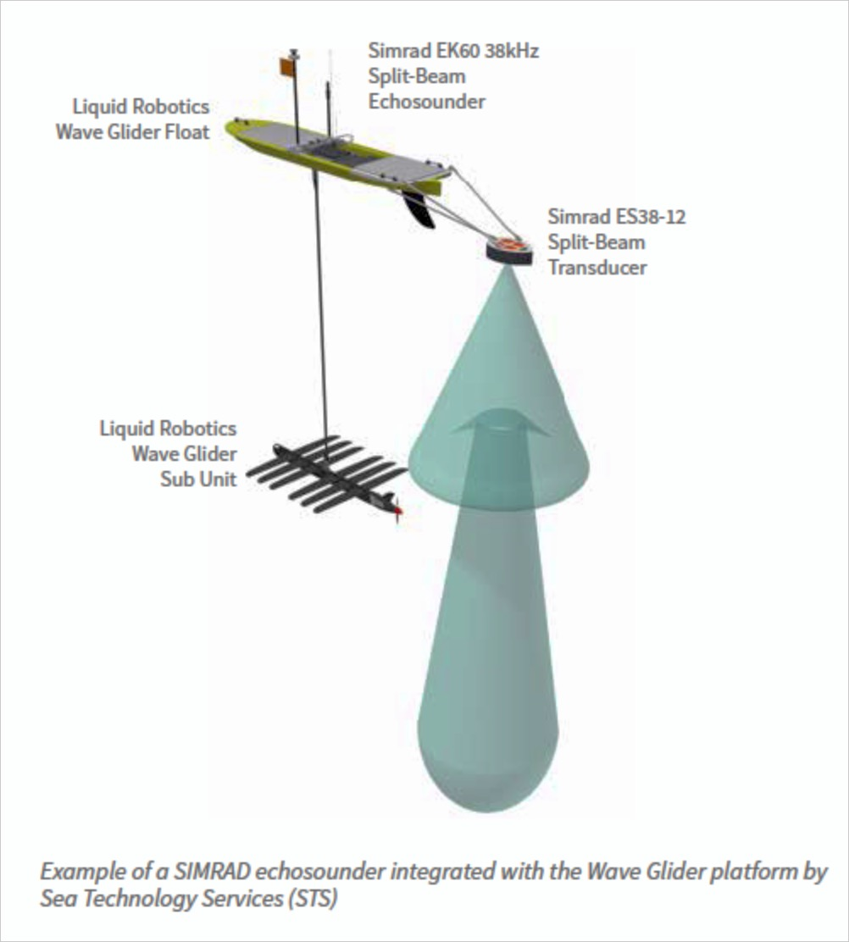
Examples of Missions Across the Globe
CSIR – Improving the cost & frequency of Fish Stock Assessment
SCRIPPS – Real time, deep sea, seismic detection & sensor placement
Cefas - 1st On-demand, long duration water sampling thru harsh Nordic Seas
Notes:
CSIR INFO:
Customer: Council for Scientific and Industrial Research (CSIR)
Locations: S. Africa
Challenges:
Government surveys are expensive $3M USD/ survey
Infrequent surveys 2x / year – impacts economy & science
Solution: Wave Gliders + Weather Sensors + Simrad Echosounder
CEFAS INFO:
1st On-demand, long duration water sampling
Wave Glider deployed in the North Sea, 60 km off Lincolnshire UK coastline
48 Day mission, 2700km, 350 ships detected
Navigated thru southern North Sea gas fields & platforms
SCRIPPS INFO:
Customer: Scripps Institute of Oceanography
Locations: North America
Challenges:
Improve seismic activity monitoring with more seafloor sensors
Difficulty & cost of placing & monitoring deep ocean seafloor seismic sensors
Solution: Wave Glider + weather station + towed acoustic modem

Slide 32
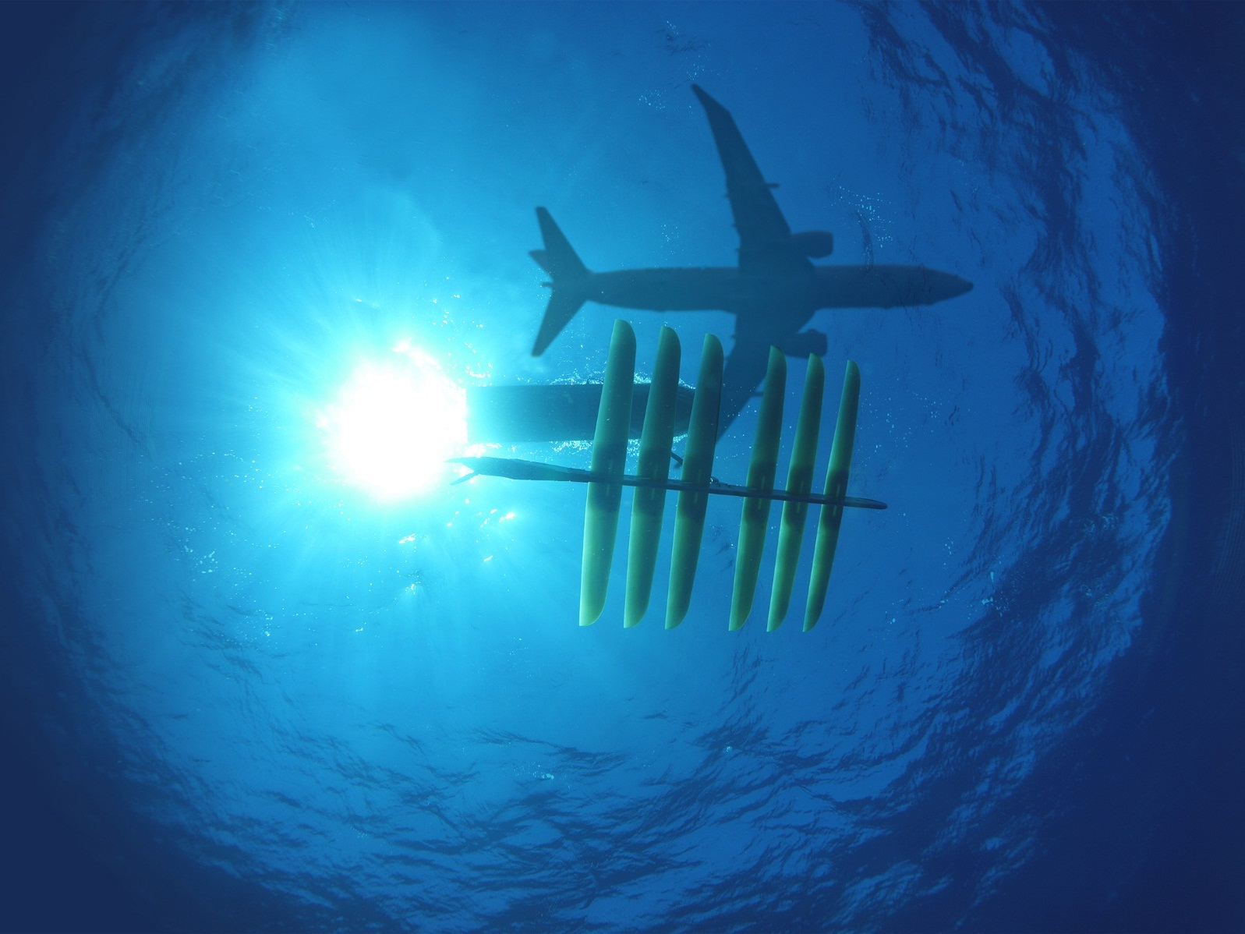
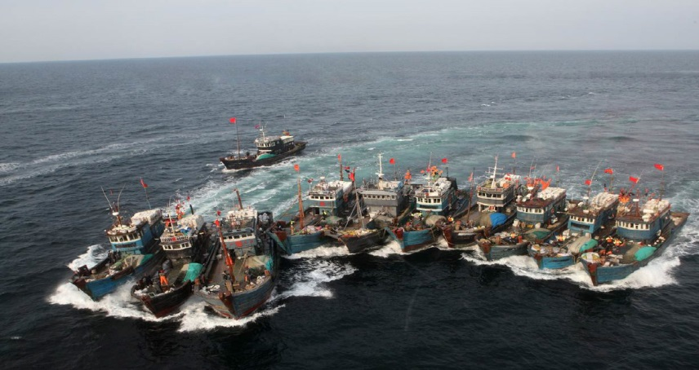
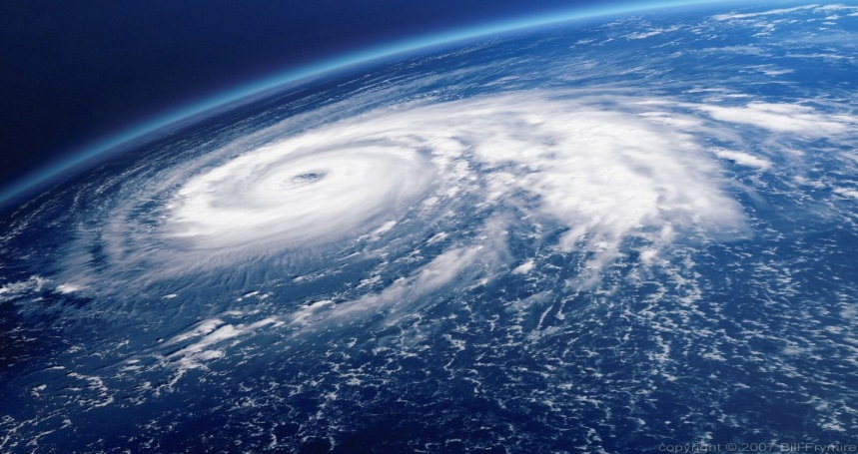
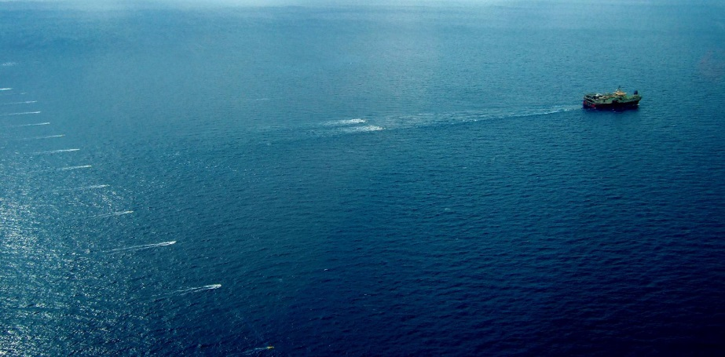
Wave Glider Markets & Applications
Defense
Maritime Domain Awareness
Anti-Submarine Warfare
Gateway Communications
Surface Vessel Detection
Illegal Fishing
Border Protection
Marine Protected Area (MPA)
Environmental Assessment
Oil & Gas
Hydrocarbon Monitoring
Metocean
Seismic Survey
Gateway Communications
METOC
Fish Stock Assess / Tracking
Tsunami & Seismic Monitoring

Slide 33













Key Partners Across Industries Help Us Deliver Solutions
Maritime Domain Awareness
Defense
Oil & Gas
Marine Seismic
Oil & Gas &
Marine Seismic
Environmental Assessment
Notes:
Liquid Robotics works with partners across industries to create customer-ready solutions.
Presenter should highlight a couple of our partners and talk through examples.
Explain the nature of some of the partnerships. What does it mean to be a partner? Technology development, investment, deployment?

