Slide 1
Mobile Hotspot Preliminary* Design Review
Tom O’Reilly / Mark Chaffey
* “The aim of the preliminary design review is that from now on the team is working on a single ‘point’ design…”

Slide 2
Wave Glider (WG) HotSpot Functional Requirements
Support 2013 Autonomy field trials and the 2013 CANON fall experiment.
  Provide data transfer from mobile platforms to MBARI servers with minimum latency.
Provide bidirectional data transfer with:
  Significantly higher resolution than the current capability using AUV based Iridium satellite modems.*
  Minimum platform surface time.
Provide these capabilities anywhere along the California coast where MBARI may conduct field operations.
Simple configuration and operation.
Don’t restrict HotSpot platform to WG.
  Loose coupling to WG infrastructure
Allow future expansion to acoustic communications.
Don’t re-invent existing solutions.
* An AUV generates ~ 10MB of data per hour and the current feasible data return during the mission is several hundreds of bytes per hour.

Slide 3
WG HotSpot Design Requirements
Communicate to mobile platforms via line-of-sight (LOS) radio link.
  For Dorado must use a 900 mHz FGRplus-RE ethernet radio.*
  802.11 WiFi link for Porto group Seacon AUVs.
Communicate to MBARI servers by linking using:
  via public wireless phone network
  via Over-the-Horizon satellite communications link
      Initially Iridium RUDICS
      Future migration to a less expensive, higher bandwidth option.
Use leased WG platform
  Available energy limited by stock capability and other users (~10W).
  Minimal or no customization of WG possible.
* Pending hardware confirmation from Hans T.

Slide 4
WG HotSpot Design Requirements cont…
Minimize shadowing of solar panels.
Minimize antenna weight aloft.
Maximize antenna heights.
Minimize interference with lifting bail.
Do not create RF interference between 900 MHz radios, Iridium and wireless phone modems*.
  Maximize vertical antenna separation.
  Minimum 20cm horizontal antenna separation.
*Also unknown interference potential from radar Racon.

Slide 5
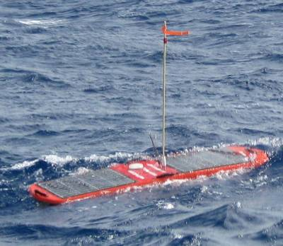
Fall 2013 CANON Near Shore (<10nm) Gateway Relay to MBARI Scenario
Land Based 3G GSM/GPRS/EDG Cellular modem 1000/500kbs downlink/uplink
FreeWave 900 MHz
<1nm range
Dorado AUV
ODSS, etc.
802.11G
Firewall
MBARI intranet
Seacon AUV
Wave Glider
FreeWave 900 MHz
Drifter

Slide 6
Fall 2013 CANON Offshore Gateway Relay to MBARI Scenario
Iridium Rudics – 2.4kbs
Globalstar – 9.6kbs
FreeWave 900 MHz
<1nm range
Dorado AUV
ODSS, etc.
802.11G
IP WAN
Firewall
MBARI intranet
Seacon AUV
Wave Glider
FreeWave 900 MHz
Drifter

Slide 7
Software topics
Proposed approach
DTN compared with rsync
Bent pipe vs store-and-forward
Link management
Rsync-based algorithm
Required interfaces

Slide 8
Proposed HotSpot approach for 2013
Store-and-forward files using rsync
  No DTN
  Bent pipe not supported
  Files only, not “remote procedure calls”
HotSpot acts as TCP/IP gateway in “console” mode
Link management
  Some links always-on
  Scheduled links (e.g. satellite, cellular)
  Auto link select between satellite/cellular

Slide 9
HotSpot stores and forwards files between “endpoints”
tethys endpoint
Freewave
shore endpoint
3g
HotSpot
dorado endpoint
Freewave
802.11
seacon endpoint

Slide 10
DTN compared with rsync
 | DTN | rsync
Bent pipe support | yes | no
Dynamic endpoint | yes | yes
Non-IP support | Integrated CLA interface, some existing CLA drivers | Design/implement non-IP driver interface
Multi-hop routing | yes | no
Tolerant to link disconnect | yes | yes (‘-partial’ option)
Reliability | DTN daemon issues | very reliable
Configuration | Complex, poorly documented | Straightforward; well-documented
Documentation | poorly organized | extensive
Development effort | Debug existing DTN C++ code, develop scripts | Develop rsync scripts, configuration
Wider adoption | Experimental; No known operational applications | Pervasive

Slide 11
Bent pipe vs store-and-forward
Bent pipe
  HS relays each message to destination as it receives it from source
  Source and destination links are simultaneously active
Store and forward
  HS gets messages from source, stores them in a file, later sends file to destination
  One link active at a time
NOTE: Store and forward is REQUIRED, in case a link segment is down!

Slide 12
File transfer airtime
Assume radios on AUV and HS with bit rates R_{fast} and R_{slow}
Assume transfer file of size V_{file} from AUV to HS to shore
File transfer airtime T
  Store and forward: T = V_{file} * (R_{fast} + R_{slow})
  Bent pipe: T = R_{slow}* V_{file}

Slide 13
File transfer airtime
Assuming V_{file} = 500 KB:
 | Freewave + RUDICS | Freewave + 3G | Freewave + Globalstar
R_{fast} | 96 kbit/s | 200 kbit/s | 96 kbit/s
R_{slow} | 2.4 kbit/s | 96 kbit/sec | 7.8 kbit/s
T (bent pipe) | 1667 s | 42 s | 513 s
T (store-fwd) | 1709 s | 62 s | 554 s
The additional store-fwd time is incurred over the faster link
The additional store-fwd cost is 10s of seconds in this example
Store-and-fwd incurs additional latency due to link scheduling

Slide 14
Link management
Always-on link - e.g. Freewave listens for AUV
Scheduled link - e.g. periodically connect satellite modem to shore
  Control radio power when possible
  Adjustable schedule
  But must coordinate with AUV schedules (radio, surfacing)
Auto-selected link – e.g. use either cellular or satellite, depending on signal strength

Slide 15
Link scheduling
On-demand: connect link in response to asynchronous event
  Requires connection “rules”, e.g. “Connect to shore immediately after data received from Dorado”
  Minimizes store-and-fwd latency
  Not required for 2013

Slide 16
HS-AUV link management:
HS radio always on
Endpoint turns on radio, negotiates with HS to establish link
Endpoint turns radio off after n minutes
  Unaware of data retrieval process; no need for “closing handshake”
  Partially-transferred file will be resumed on next comms session (“rsync –partial” option)
  Specify ‘n’ to balance on-surface time against average file size

Slide 17
rsync store-and-fwd
Every endpoint has this structure in its file system:
  /outgoing/endpoint1
  /outgoing/endpoint2
  ...
  /incoming/endpoint1
  /incoming/endpoint2
  ...
  “endpoint1”, “endpoint2”, ... represent mnemonically useful host names, e.g. “dorado-gulper”, “tethys”, etc.
HotSpot file system has this structure:
  /endpoint1/outgoing/endpoint2
  /endpoint2/outgoing/endpoint1
  ...
Destination endpoint specified by subdirectory name
Shore treated like any other endpoint

Slide 18
rsync store-and-fwd algorithm
When connection established with endpoint “eConnected”
# Pull outgoing from eConnected
rsync eConnected:/outgoing to local:/eConnected/outgoing
# Push incoming to eConnected
for each endpoint other than eConnected:
rsync local:/endpoint[i]/outgoing/eConnected
eConnected:/incoming/endpoint[i]
if (success) remove local:/endpoint[i]/outgoing/eConnected
Run periodically for always-on links, or when intermittent link connects
Use rsync “-partial” option to resume file transfer after network disruption – transfers single file over multiple sessions

Slide 19
rsync store-and-fwd algorithm
Endpoint can detect new files with periodic scan of /incoming subdirectories, or via inotify
Interpretation of files is beyond HotSpot scope
  Could use file-naming naming convention, subdirectory structure, etc

Slide 20
rsync store-and-fwd
Endpoint must have TCP/IP stack
Endpoint must run rsync daemon
Endpoint must provide account for HS access
All endpoints must agree on valid endpoint names; each endpoint must provide its name to HotSpot (e.g. via ZeroConf or during ppp link negotiation)

Slide 21
rsyncd
rsyncd
rsyncd
/outgoing
/incoming
/outgoing
/incoming
/outgoing
/incoming
Dorado
Seacon-1
Seacon-2
Free
wave
802.11
802.11
ppp/SLIP
LAN
rsyncd
cell or sat
Free
wave
802.11
/outgoing
/incoming
Internet
HotSpot app
shore
rsync
Endpoint file cache
Fall 2013 CANON scenario
WaveGlider SMC

Slide 22
Non-IP links
Non-IP “bridge” on HS - e.g. acoustic - transfers files between cache and non-IP link
Specify link as “acoustic” in HS configuration file
LAN
cell or sat
Free
wave
802.11
rsync
HotSpot app
Endpoint file cache
Acoustic
bridge
Tethys
WaveGlider SMC
acoustic

Slide 23
Endpoint console function
Set HS as TCP/IP gateway to individual endpoints
E.g. - User can ssh from shore/ship endpoint to AUV endpoint
  RUDICS for shore-to-HS segment
  Freewave for HS-to-AUV segment

Slide 24
How does HotSpot know...
Endpoint addresses?
  Could specify in HS configuration file, but auto-discovery is simpler for users
  Endpoints can advertise themselves via ZeroConf
When endpoint connected and ready for push-pull?
  Some links are scheduled, some are always-on, some may break
  HS could use ZeroConf, ppp ip-up script, and/or ping

Slide 25
Standard endpoint names
Endpoint users must use subdirectory names that HS can map to IP address of another endpoint
  HS logs error when it can’t map directory name

Slide 26
Interfaces accessed by HotSpot
Serial radio ports
Ethernet radio sockets
Radio power switches
Radio signal strength

Slide 27
HotSpot-provided interfaces
Remote interfaces:
  /incoming and /outgoing directories on endpoints
Local interfaces (e.g. on WG SMC):
  List of available links
  Link status (bitrate, connected?, signal strength, etc)
  List of known endpoints
  Event log (e.g. files transferred, latest connection time, errors/warnings, etc)
  FUTURE: Assert connection on specified link
  FUTURE: Link quality index (includes %success rate, waves, etc)

Slide 28
Open questions
How to schedule HS and endpoint radios to maximize connection probability?
  First experiments; HS radio always on? How does U Porto handle this?
Cell radio interface
  IP or serial?
  Need to set up ppp?
Wave Glider issues
  How does WG power management affect HotSpot?
  May want capability to manage HotSpot (e.g. modify radio schedules) via Wave Glider Iridium SBD

Slide 29
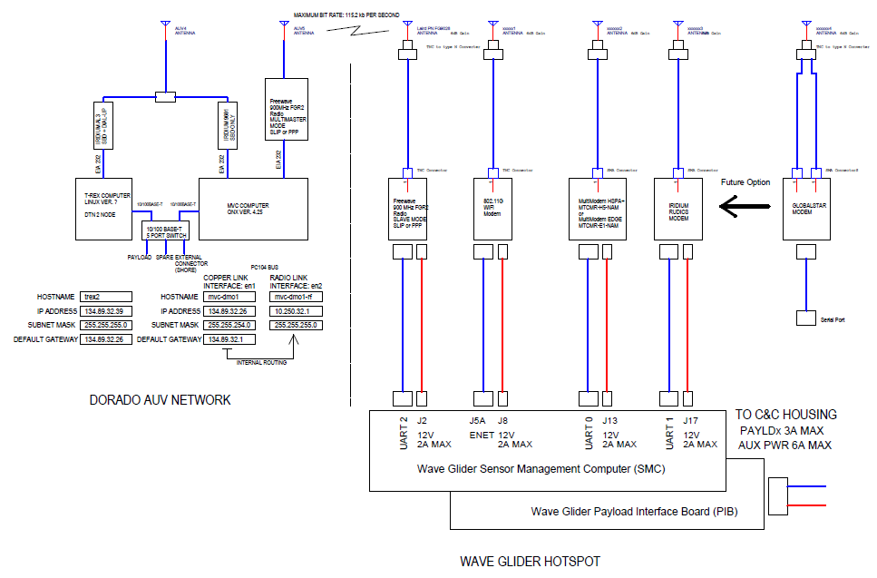
WG HotSpot Electrical Interface A

Slide 30
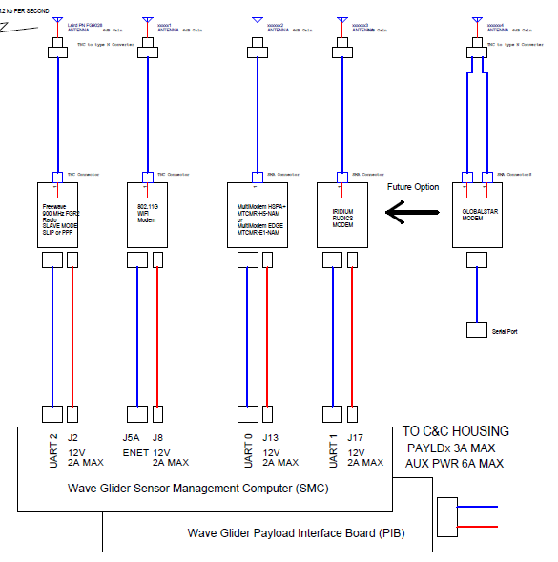
WG HotSpot Detail Interface A

Slide 31

Wave Glider Mechanical Interface

Slide 32
WG Preliminary Power Budget
HotSpot Power Budget
 | Power Use in Watts
Device | Sleep | Standby | Transmit
SMC Overhead* | 0.5 | 0.5 | 0.5
900MHz Modem |  | 0.14 | 4.4
802.11 Modem |  | 4 | 4
Iridium Modem |  | 0.4 | 1.25
Cellular Modem | 0.53 | 1.29 | 2.47
Totals | 1.03 | 6.33 | 12.62
Example 1 | 1.65
Example 2 | 2.25
Example 3 | 3.42
Example 1 = 900MHz modem at 15% and Cellular at 20%
Example 2 = 900MHz, 802.11 modems at 15% and Cellular at 20%
Example 2 = 900MHz, 802.11 modems at 20% and Cellular at 50%
* Estimate

Slide 33
Project Management
Detailed budget TBD.
  Estimate ~$20k
Schedule
  Have tested hardware ready for June Dorado cruises.
  Detailed milestones to June TBD.
    In a reversal, need to negotiate WG test time from Thom.
    Get radios and Wave Glider Sensor Management Computer (SMC) into Tom’s hands ASAP.
Resources remaining.
  Tom has about 320 hours
  Mark has about 294 hours

Slide 34
Open Questions
Cell radio interface
  IP or serial?
  Need to set up PPP?
Wave Glider issues
  How does WG power management affect HotSpot?
  May want capability to manage HotSpot (e.g. modify radio schedules) via Wave Glider Iridium SBD
  Use Front or rear payload bay for electronics?
    Depends on Iridium modem sharing.
    Space considerations.
    Front housing more $.
  Use WG housing or our own?
    Recommend WG housing.
  Details of antenna mounting.

Slide 35

END

Slide 36
Public Cell Service Options
T-MOBILE: GSM 1700/2100 MHz, 1900 MHz (3G) or EDGE 1900 MHz (2G). SIM card system.
AT&T: GSM 850 MHz, 1900 MHz (3G). SIM. LTE 700MHz (4G), SIM.
Verizon: CDMA 850 MHz, 1900 MHz (3G) . No SIM. LTE 700MHz (4G), SIM.

Slide 37
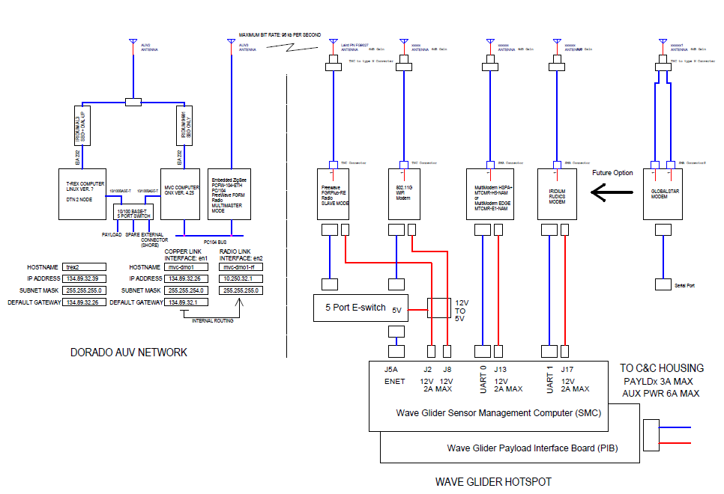
WG HotSpot Electrical Interface B

