Slide 1
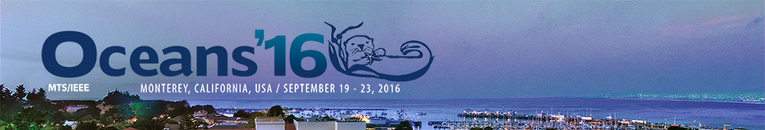
Range-Only Underwater Target Localization: Path Characterization
I. Masmitja, B. Kieft, S. Gomariz, J. Del Rio, T. O’Reilly

Slide 2

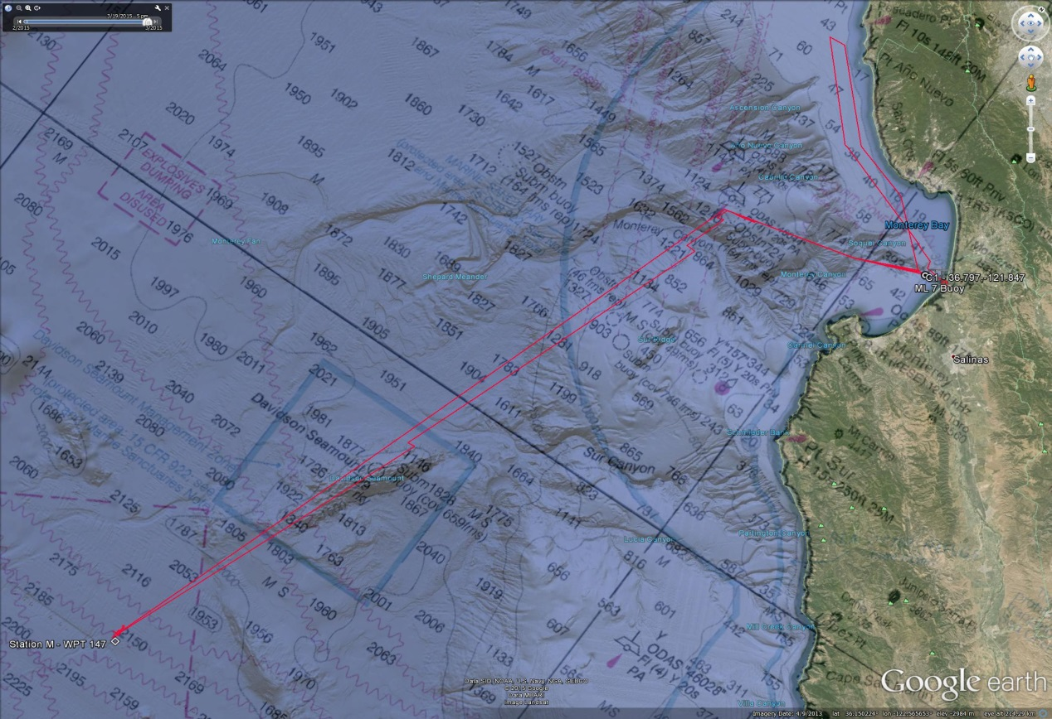
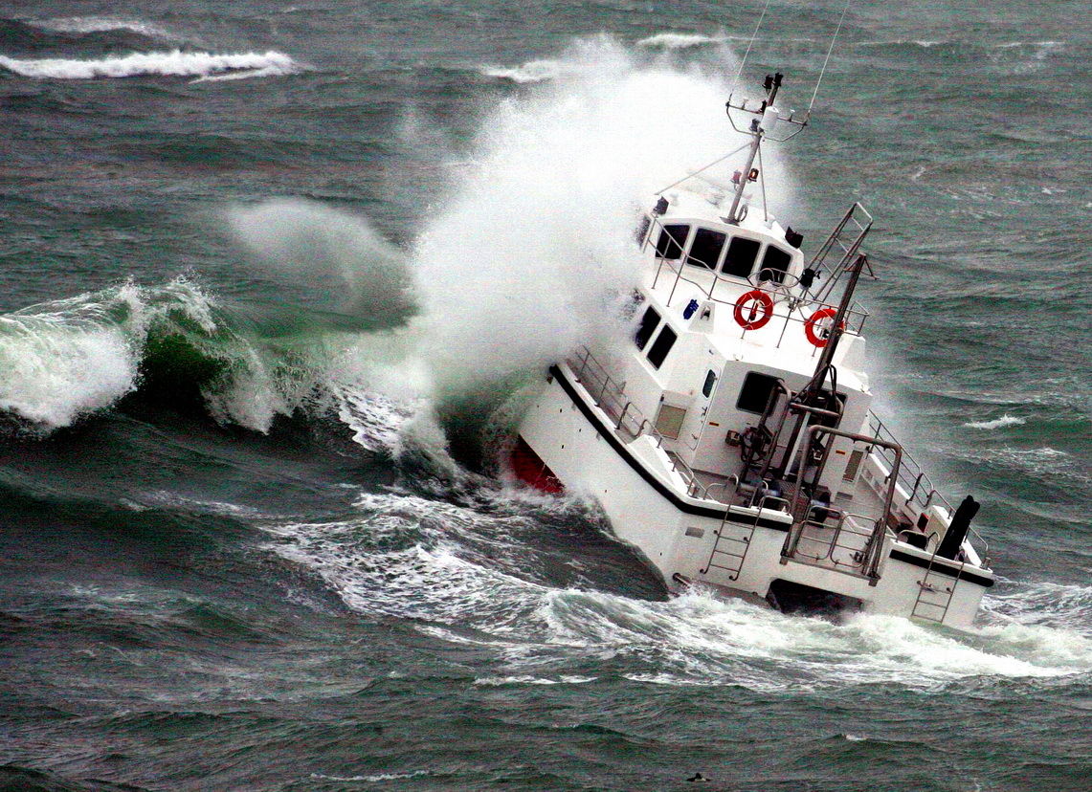
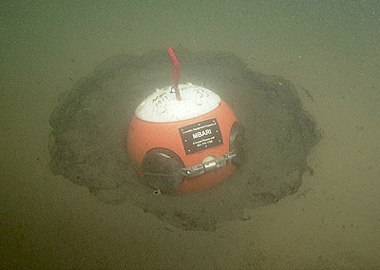
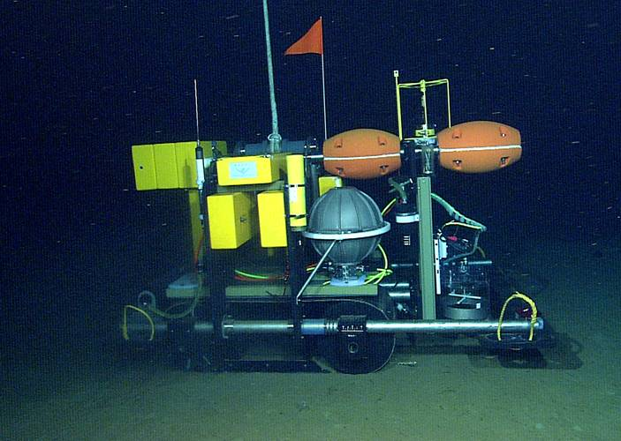
Introduction
In this work we show how to determine the optimal parameters for range-only target localization

Slide 3
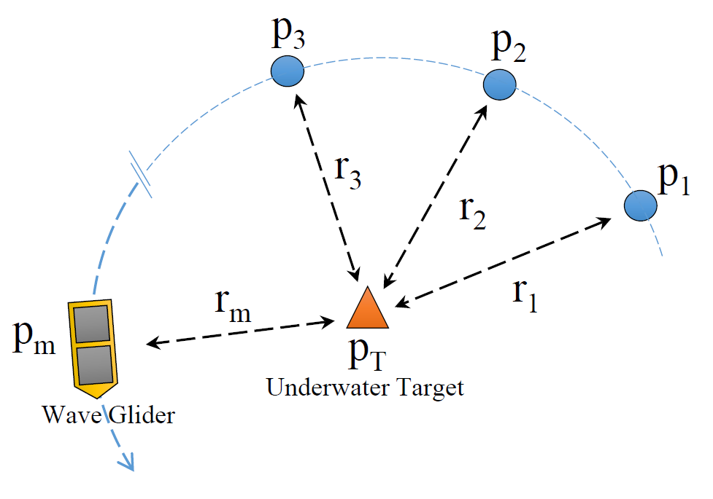

Range-Only target localization
Determine the underwater target position using one mobile vehicle
Closed-form Least Square algorithms (LS)
Iterative minimization algorithms (e.g. MLE)
$${\overline{r}}_{i}=\left\|p_{T}−p_{i}\right\|+ w_{i}$$
Notes:
MLE: Max Likelihood Estimation
LS fit was used on real data due to best computation speed on Waveglider

Slide 4
Simulations
Different simulations were conducted to determine the best parameters to increase the capabilities of the acoustic positioning system:
    Path shape
    Number of points
    Radius around target
    Offset from target
LS and MLE algorithms were compared against the Cramér-Rao Bound (CRB), which specifies the best possible performance with any estimator. Moreover, all the simulations have been obtained through 1000 Monte Carlo iterations.

Slide 5
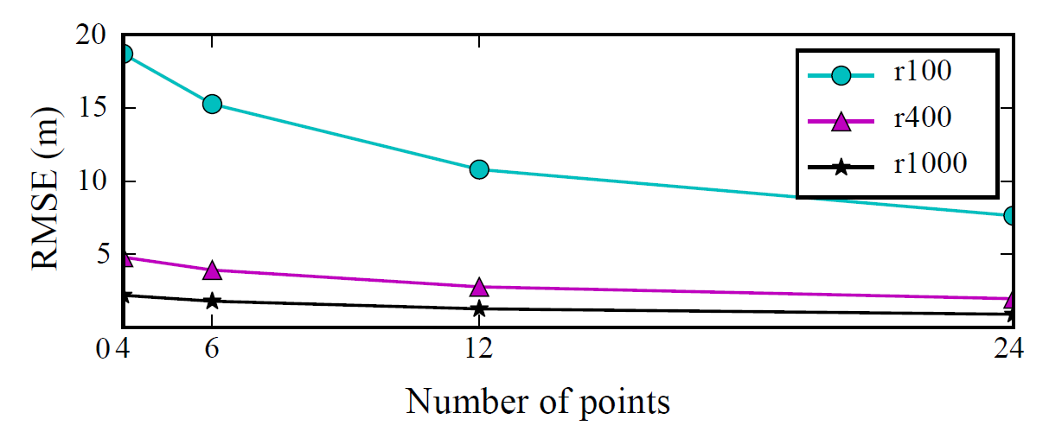
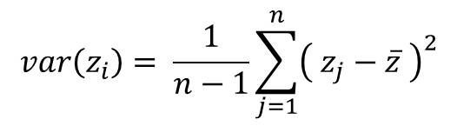
Simulations. Number of points
RMSE evolution as a function of the number of points used to compute the target position, for circles centered over the target with 100 m, 400 m, and 1000 m of radius (r100, r400, and r1000 respectively). With 1800 m target depth
$$var\left(z_{i}\right)= \frac{1}{n−1}\sum_{j=1}^{n}{{\left( z_{j}−\overline{z} \right)}^{2}}$$
Cramér-Rao Bound representation under different scenarios
Notes:
Consistent with standard deviation of a set of measurements with random noise.

Slide 6
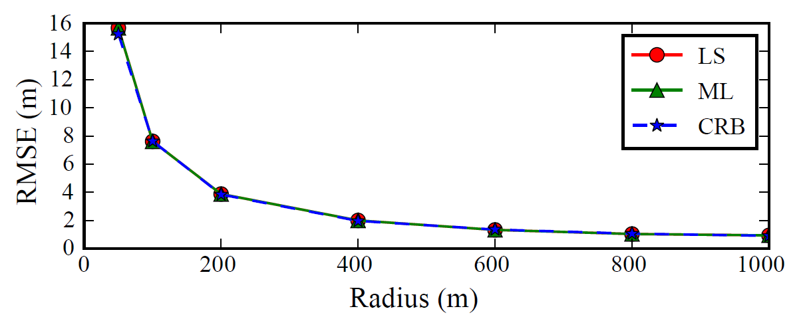
Simulations. Radius around target
RMSE evolution as a function of the circle radius (6 points), for a target at 1800 m of depth. Moreover, a comparison between LS, MLE and CRB algorithms are shown
Cramér-Rao Bound representation under different scenarios

Slide 7
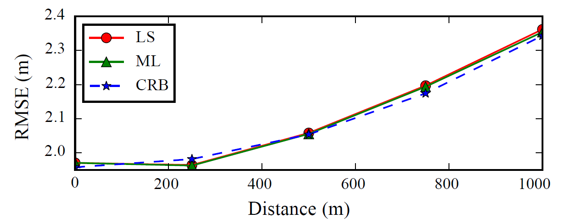
Simulations. Offset from target
RMSE evolution as a function of the offset between circumference center and target, for a target at 1800 m of depth. Radius 400m. Moreover, a comparison between LS, MLE and CRB algorithms are shown
Cramér-Rao Bound representation under different scenarios

Slide 8
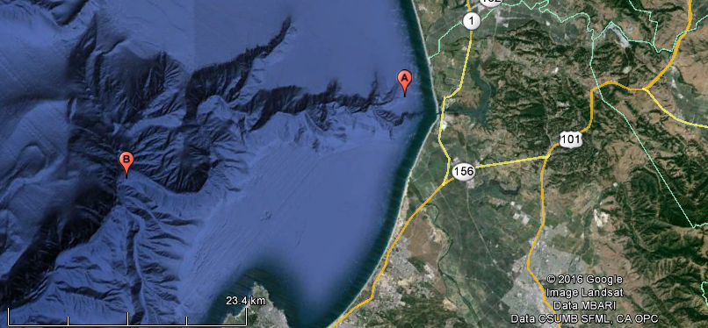
Real Field Tests
Temporary deployment
(Shallow water, 80 m)
BIN Instrument
(Mid water, 1800 m)
MBARI
Two different seabed targets in Monterey Bay, California, have been used to perform the field tests.

Slide 9
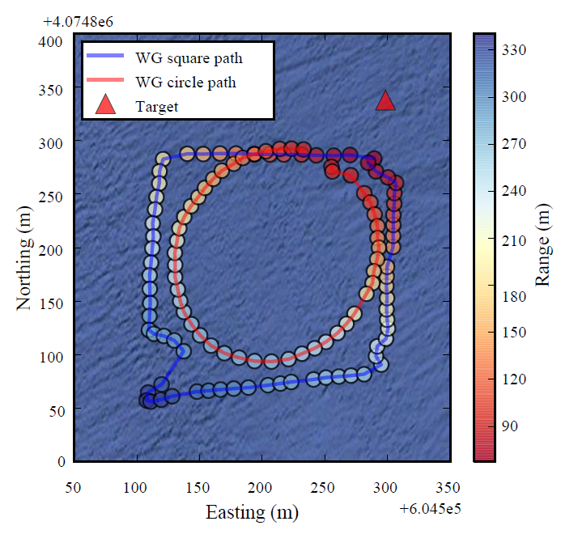
Real Field Tests
MBARI
Square and circle path shape done over a temporary deployment target at 80 m depth. Each dot represents a WG range acquired, where its color is the range value in meters. Triangle is the computed target position.
Notes:
Python script driving WG in shapes
Target moving too much being hung from boat

Slide 10
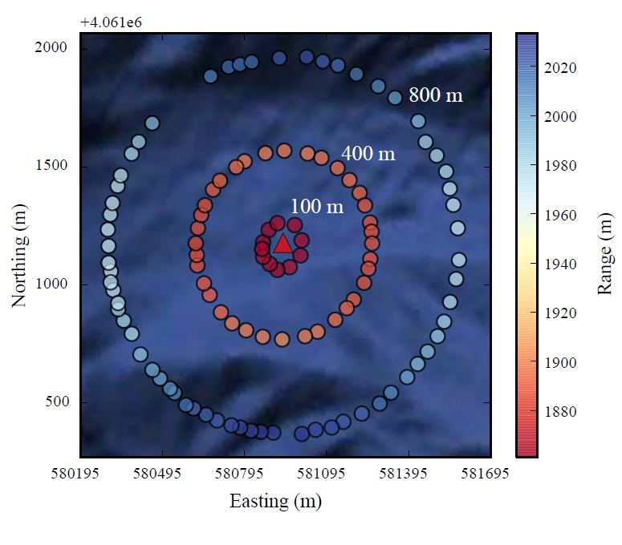
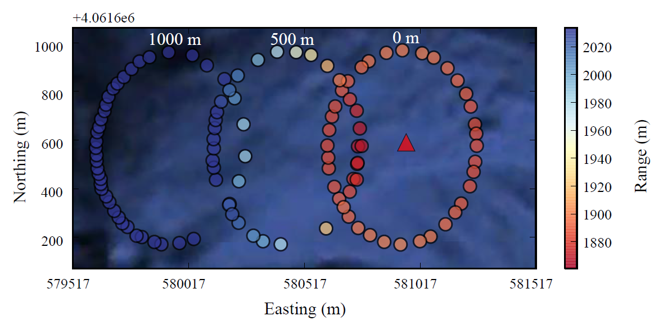
Real Field Tests
WG trajectories realized over BIN target with three different radius, which were 100, 400 and 800 meters
WG trajectories realized over BIN target with three different offsets between target and circle center, which were 0, 500 and 1000 meters. 400 m radius.

Slide 11
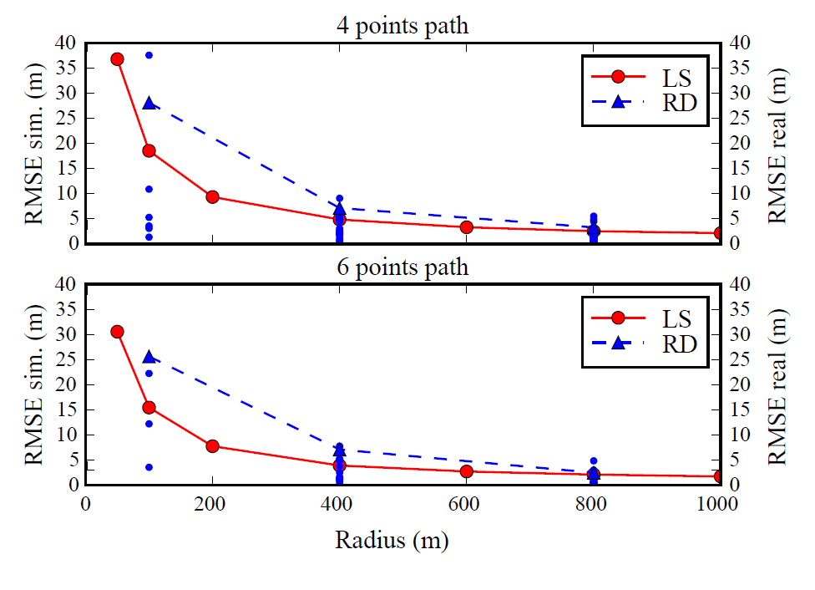
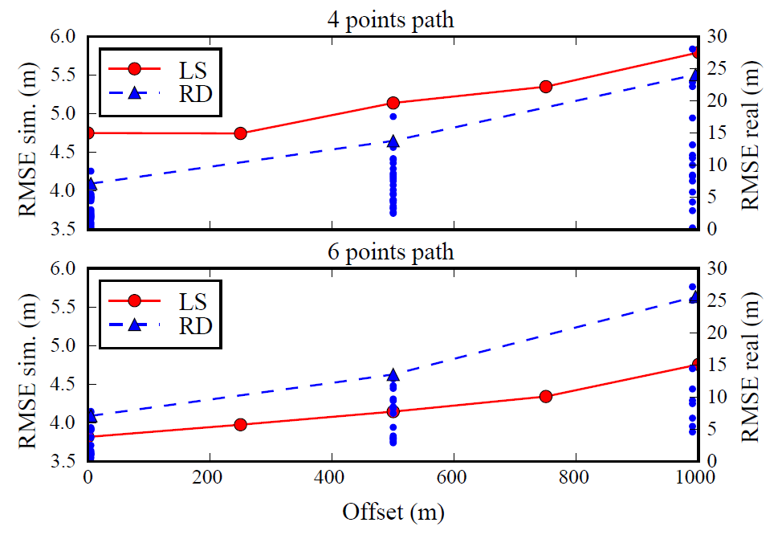
Real Field Tests
Different circles
Different offsets
These graphics show a behavior comparison between simulation (LS) and real data (RD) results for different radius of circle paths centered over the BIN target. Using 4 and 6 equidistant points to compute the target localization
These graphics show a behavior comparison between simulations (LS) and real data (RD) results for different offsets of circle paths cover the BIN target. Using 4 and 6 equidistant points to compute the target localization
Notes:
400m radius for offset chart.

Slide 12
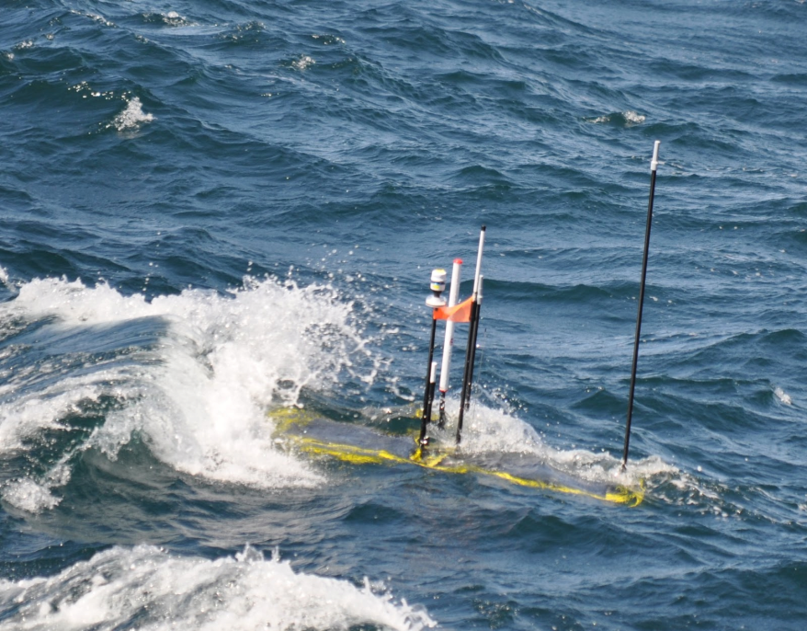
Conclusions
It works!
Accuracy improves with number of points and radius
Error decreases as offset decreases
Highest accuracy when target within pattern
Future work:
  Tune simulations against real data
  Evaluate with other external factors (e.g. weather)
  Tradeoff energy and time cost
  Moving target: How does speed affect error?

Slide 13

Thank you!
ivan.masmitja@upc.edu
bkieft@mbari.org

