Slide 1
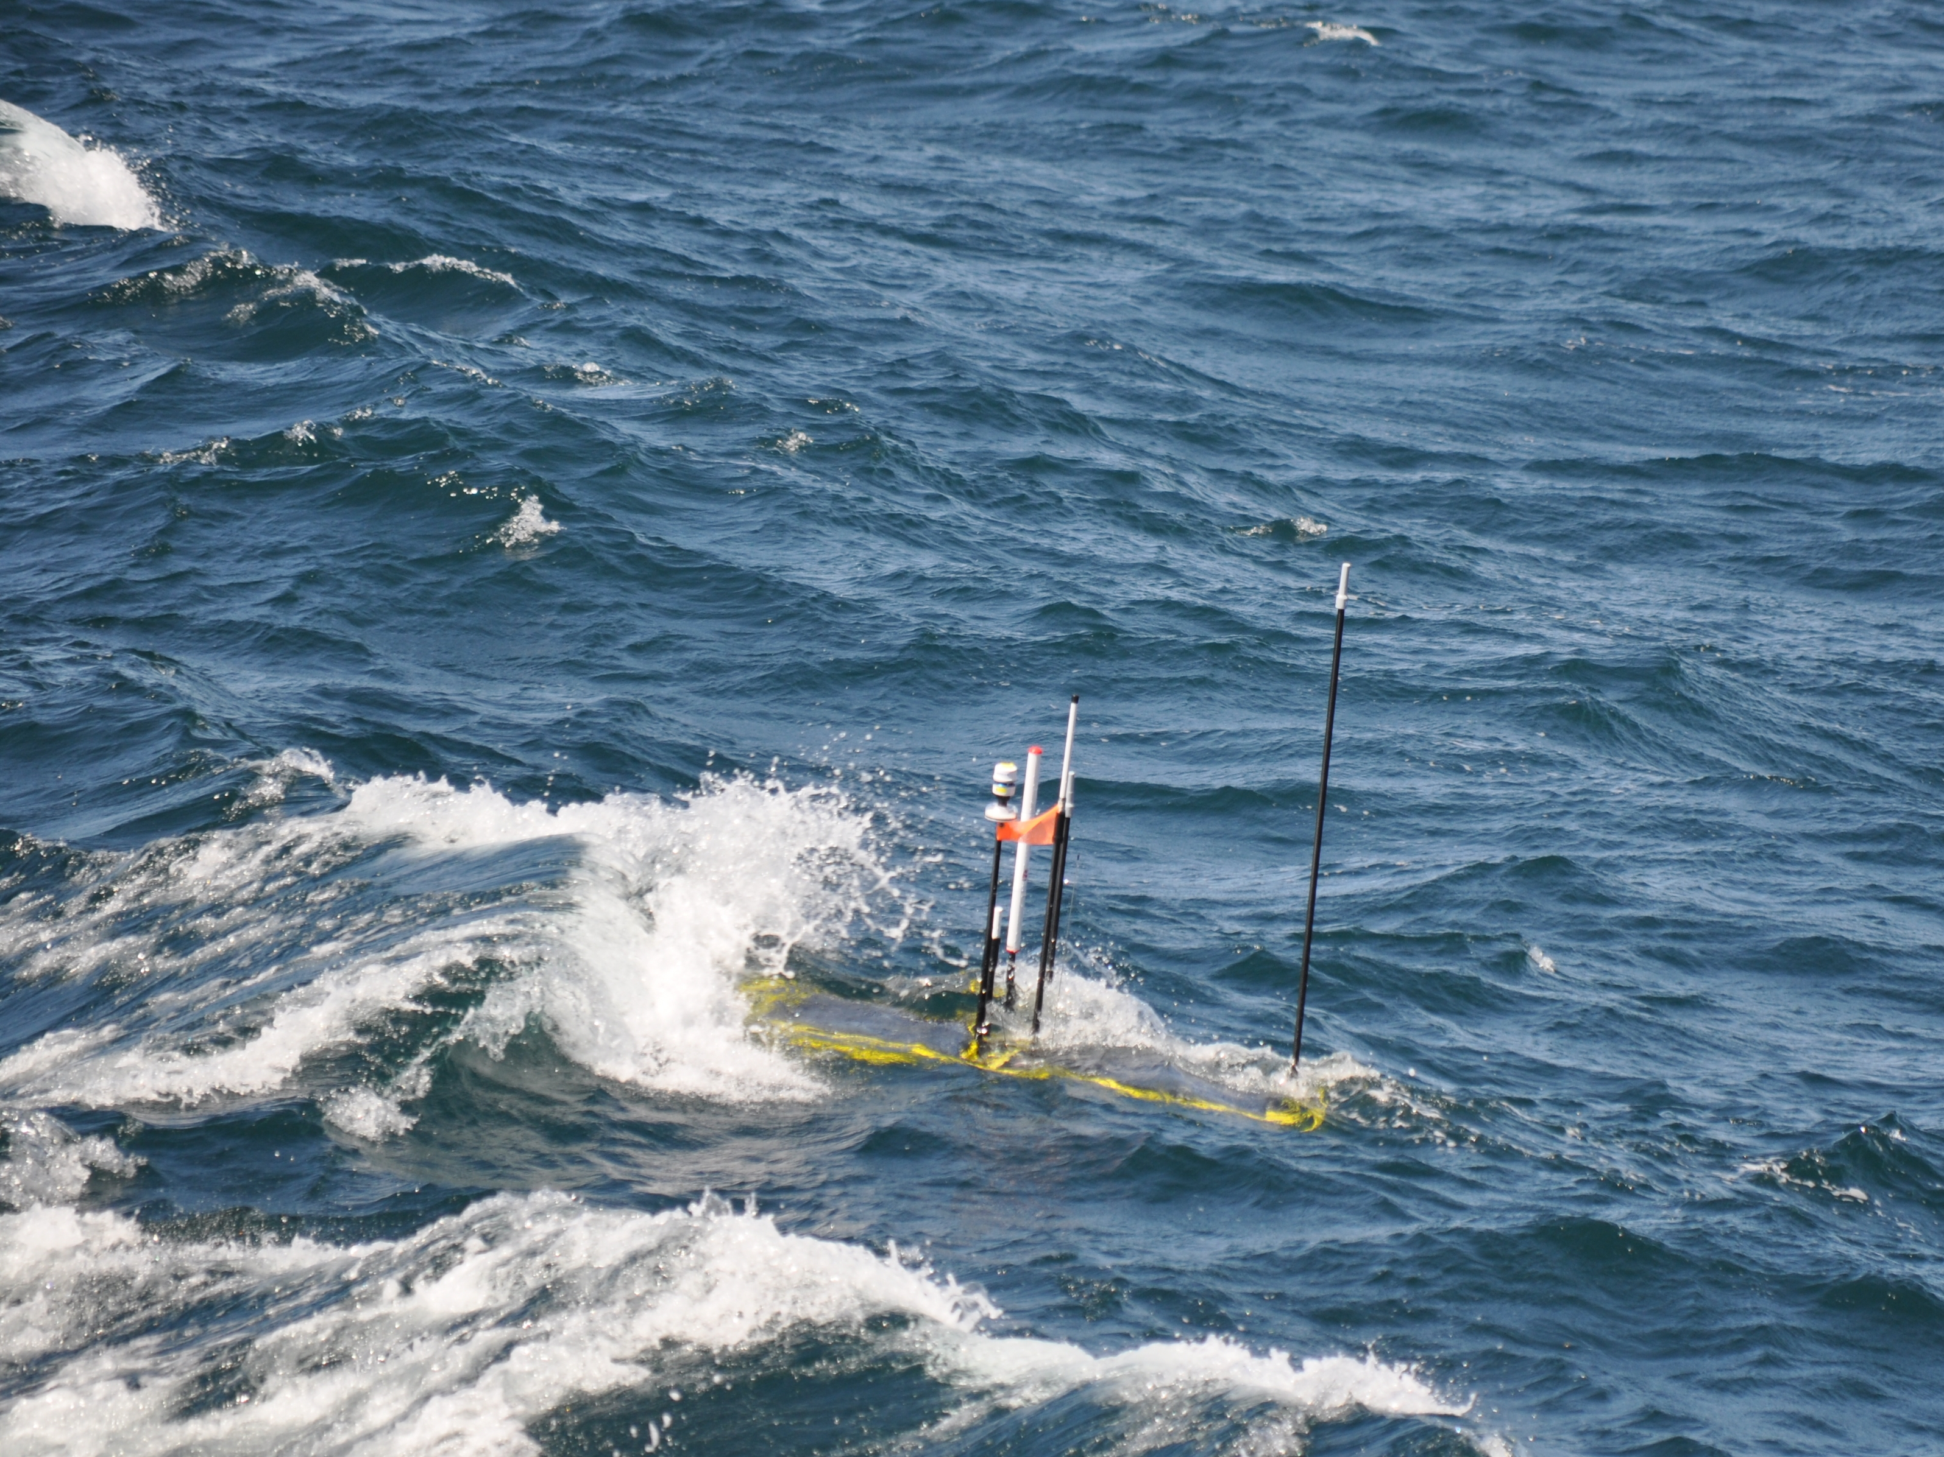
Wave Glider Hot Spot
901411
(formerly 901224 DTN feasibility)

Slide 2
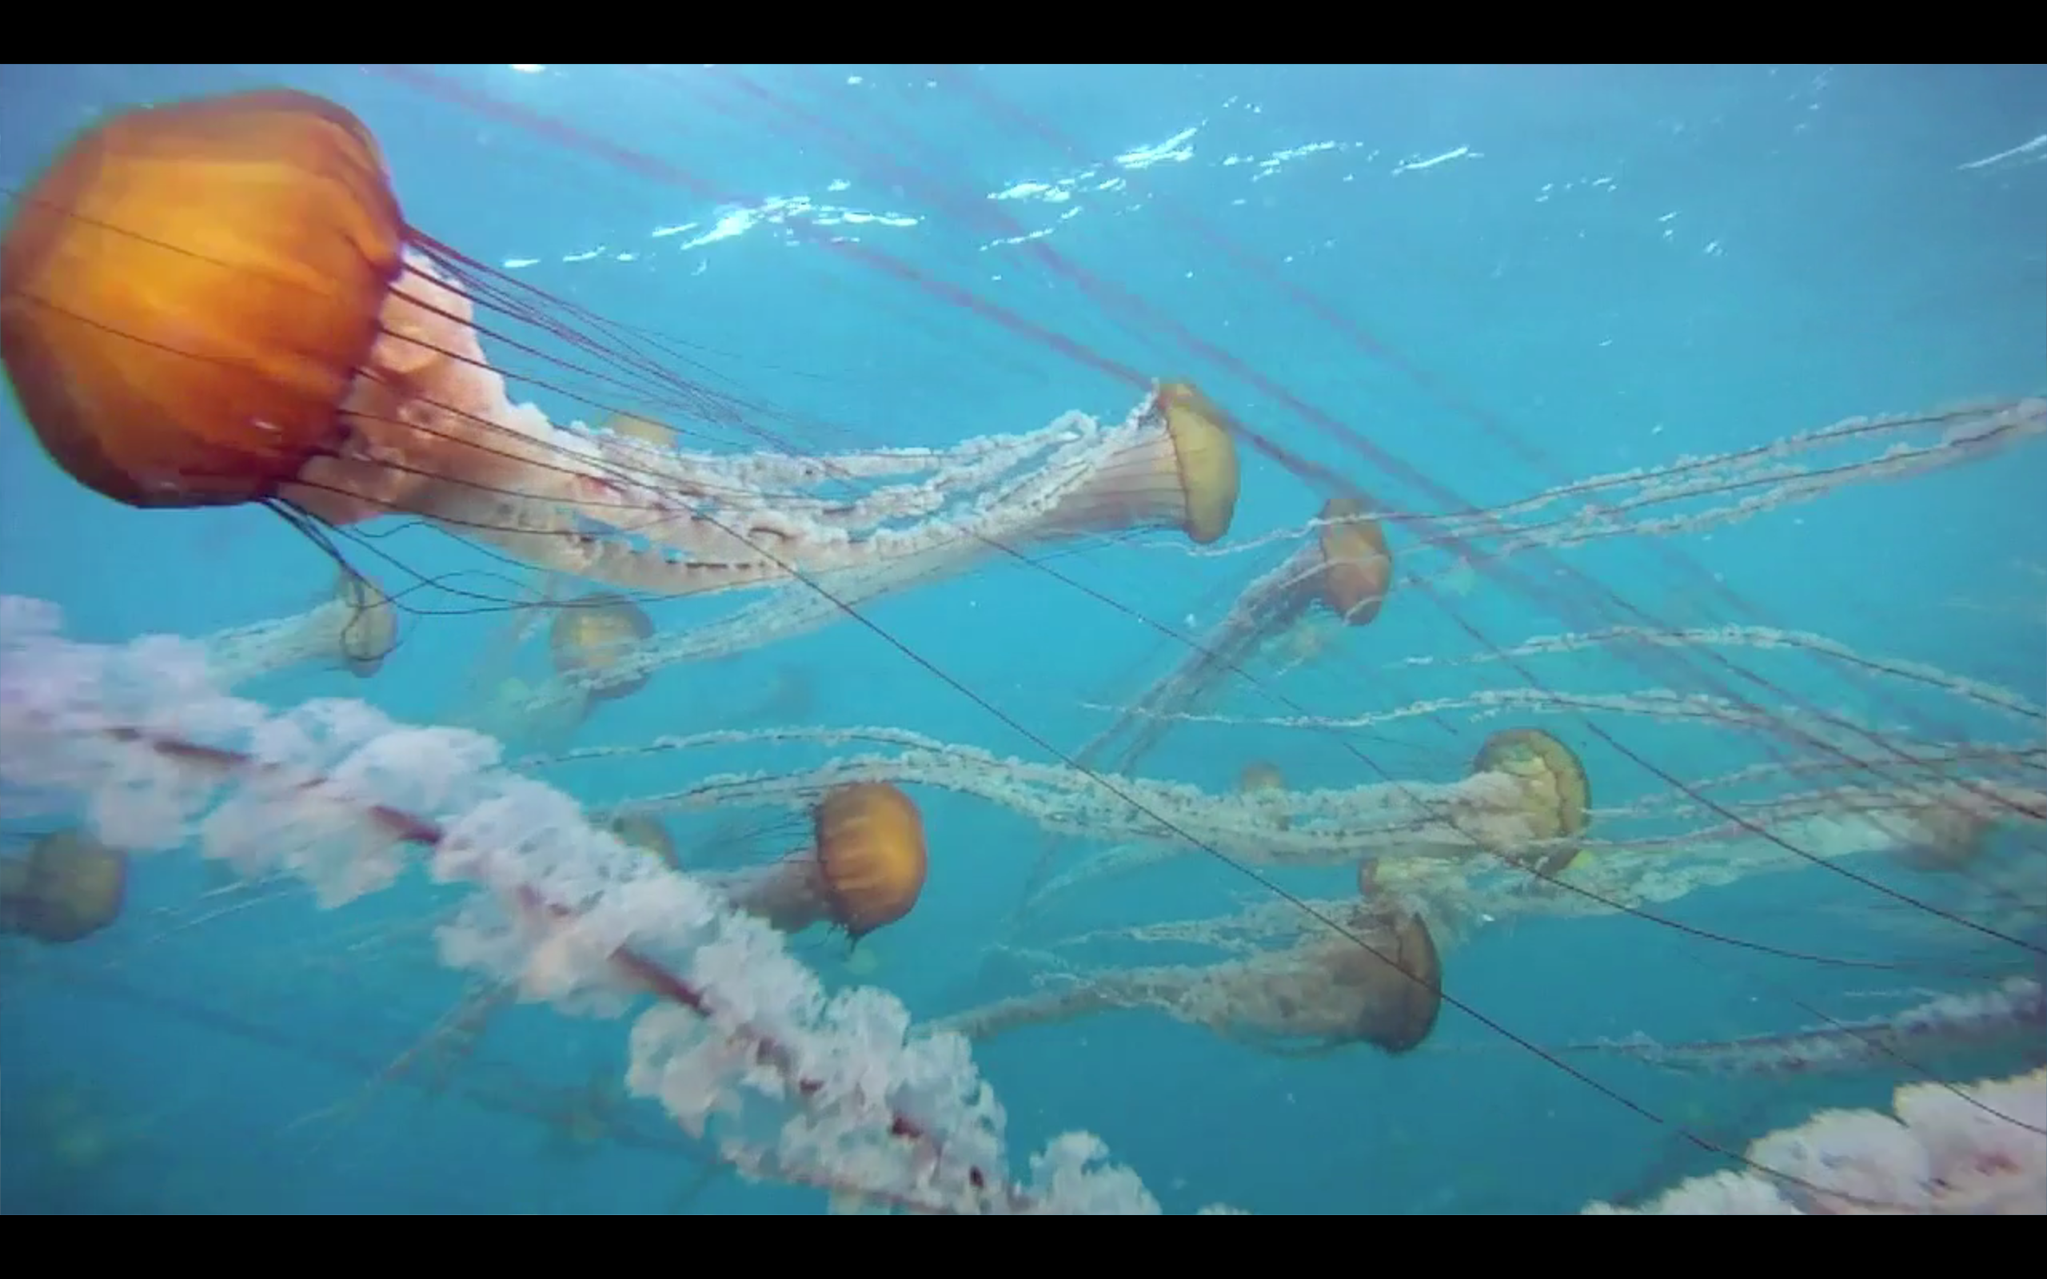
Growing Data
Persistent presence + multiple assets = large datasets
Large data sources (Mb to Gb)
  Imaging
  Genomic
  ADCP
Background image: video taken by Tethys LRAUV, 12/2011

Slide 3
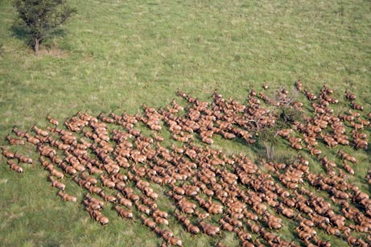
Science Applications
Patch and organism tracking, minimize surface time
Data transfer of large files
Acoustic navigation / localization
Informed decision making (e.g. through ODSS)

Slide 4
Relevance to MBARI Strategic plan
“…adapt innovative technologies…”
  Exploration and discovery
  Ocean visualization
  Ecosystem dynamics
  Ocean biogeochemistry

Slide 5
Specific Applications
Improve effectiveness and coordination of assets
    Distributed Autonomy
      University of Porto SeaCon AUV collaboration fall CANON 2013
    CANON / LRAUV
      LST tracking
      LRAUVs
    Aerostat
    Benthic Event Detectors

Slide 6
The Cost of Data
Financial (ship time, data transfer)
WG: $800/day, Ship: $12K/day
Opportunity cost (add graph of bytes returned as a function of surface time)

Slide 7
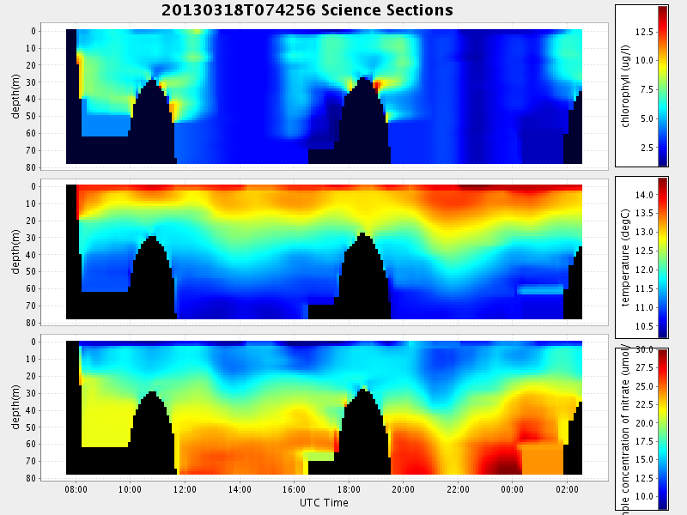
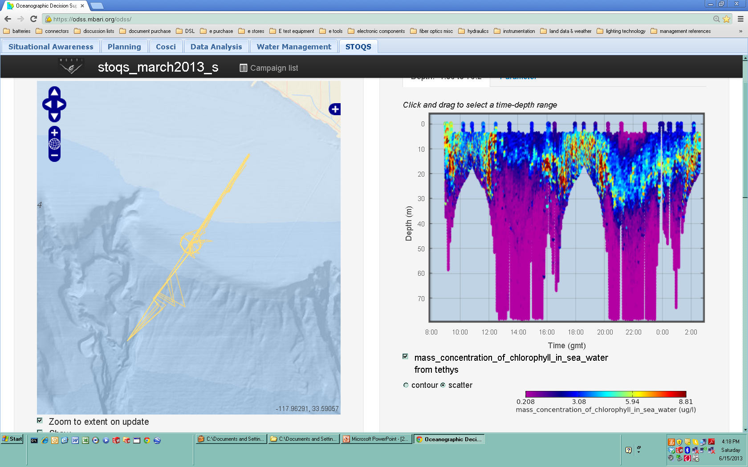
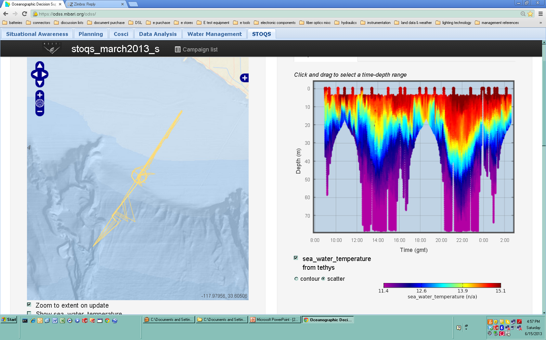
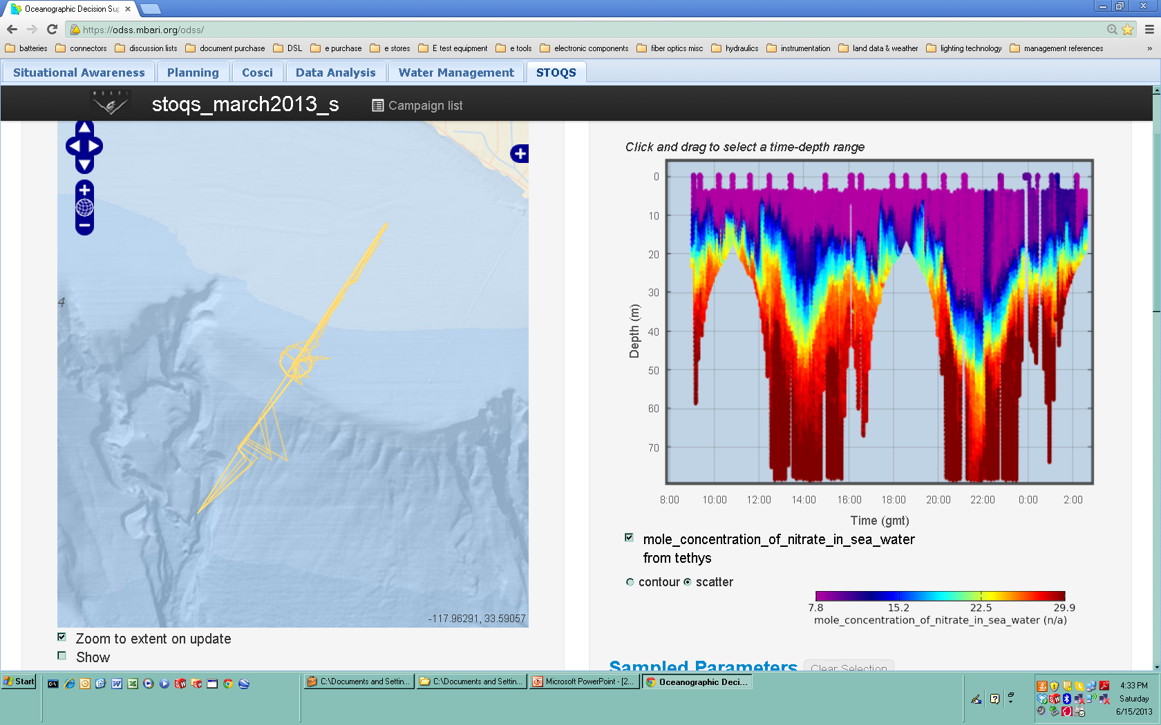
The Cost of Data
Informed Decision Making
  EcoHAB spring 2013: decimated versus complete data

Slide 8
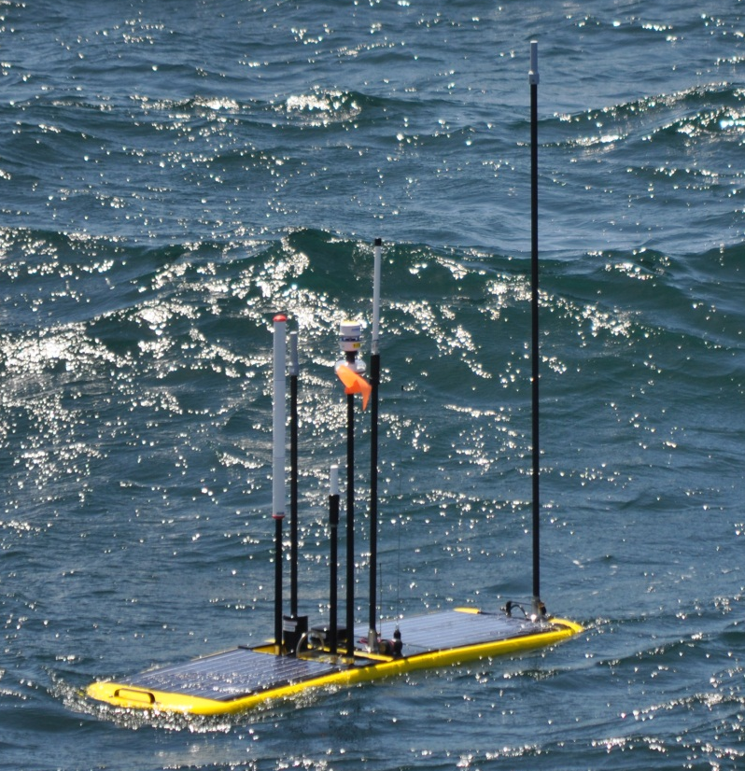
Current Work
Radio and antenna integration
  Freewave (2)
  GSM Modem (Multitech 3G)
Dorado-WG link characterization sea trials
Initial Wave Glider Acoustic Work

Slide 9
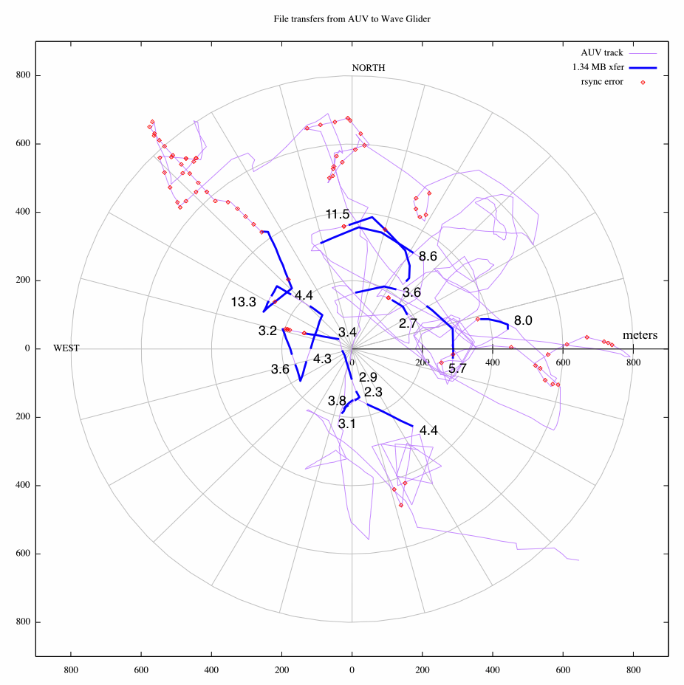
Current Work
1.34 Mbyte file-set:
Mean transfer time: 4.8 minutes
Mean transfer time within 200 meters: 3.6 minutes
Farthest successful transfer range: 450 meters, transferred in 8.0 minutes

Slide 10
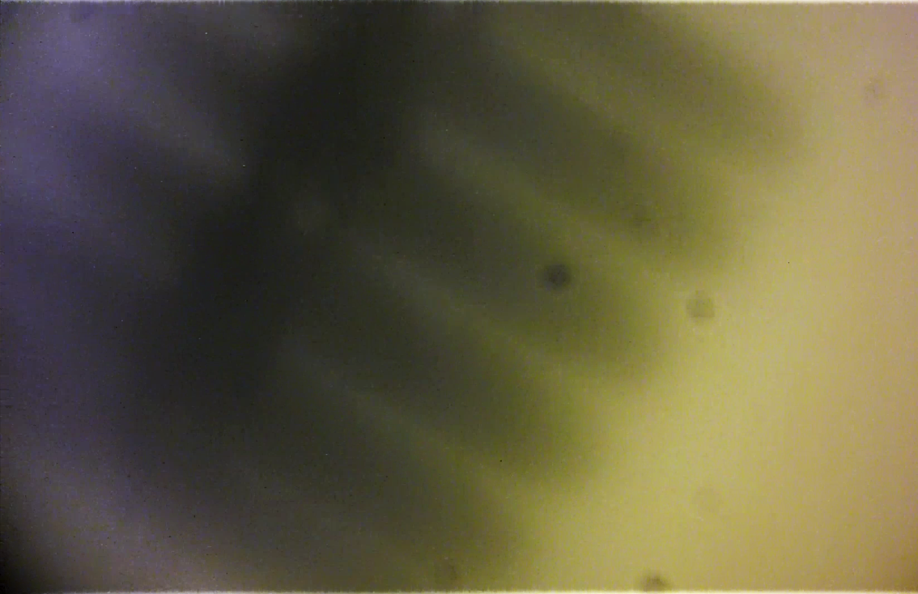
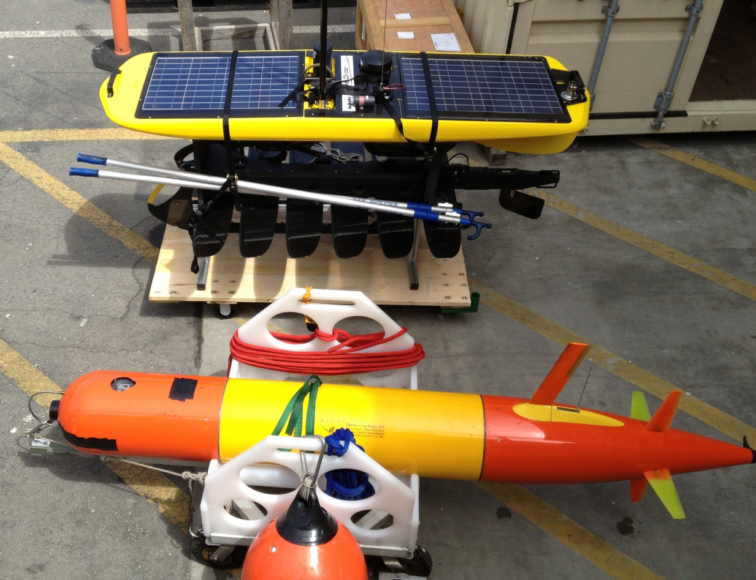
Current Work
Initial acoustic work focused on homing to the Wave Glider.
Modem mounted here
Daphne iUSBL used to home
to Wave Glider

Slide 11
Future Work
Addition of Acoustic modem and interface
  iUSBL add on possibility
Add endpoints
  Refine protocols to demonstrate use with LRAUV, LST, BEDs
Globalstar/Iridium Integration*
802.11 Wifi*
GSM Modem Integration*
Power Management
Aerostat data transfer demonstration
Investigate Georgia Tech Agile Aperture Antenna (http://www.unmannedsystemstechnology.com/2013/06/gtri-agile-aperture-antenna-tested-on-autonomous-ocean-vehicle/)
* Work begins 2013

Slide 12
Equipment
Waveglider
Wave Glider Towbody*
Acoustic modem (LF)*
Acoustic modem (MF)*?
802.11 radio*
Satellite modems*
iUSBL (DAT MF)*?
* Proposing to share inventory from other programs

Slide 14
SV3 Benefits
Extensible power bus
More energy available below the float (including the towbody)
Higher performance computing
Parallel integration/development with LRI (i.e. better support)
More payloads
Back seat driver
Propulsion
L&R from Paragon as usual

